Slide 1
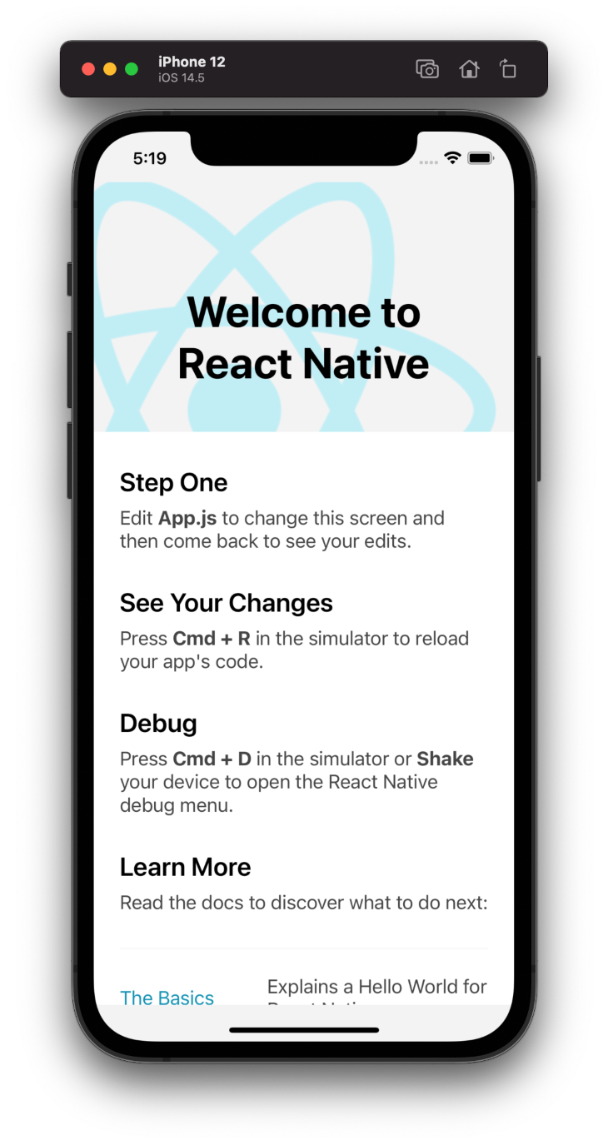
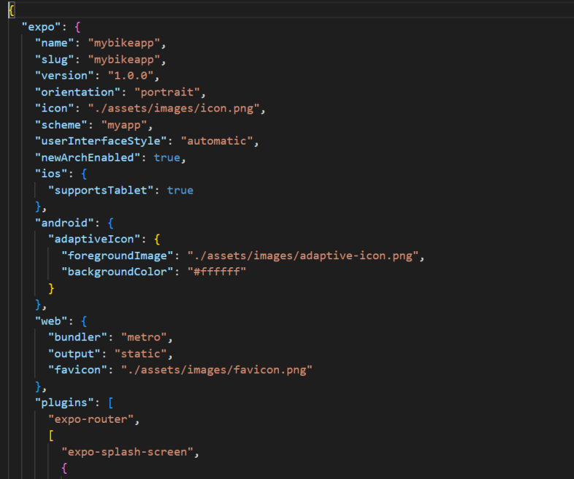
Creation of the app and some of the default code
Non-Cognitive Predictors of Student Success: A Predictive Validity Comparison Between Domestic and International Students
MyBikeTraffic
Cross-platform mobile app
AMMO BAR
Delete this and replace it with your…
DETAILS/CODE SCREENSHOTS:
Screenshot of the webview component along with a description of how it works
Screenshot of push notification related code and description
Extra Graphs
Extra Correlation tables
Extra Figures
Extra nuance that you’re worried about leaving out.
Keep it messy! This section is just for you.
PRESENTER:
Sellers Crum
Mentor:
Brian Toone
ABSTRACT: This project documents the construction of a cross-platform mobile app for accessing and visualizing data from the mybiketraffic.com website. MAYBE ADD ANOTHER SENTENCE?
BACKGROUND: mybiketraffic.com is a research project that documents a variety of vehicles statistics collected from a bicycle equipped with a variety of sensors: radar, LiDAR, forward facing video, and rear-facing video. The data is currently only available on the host website, and is NOT particularly mobile friendly.
ADD PARAGRAPH HERE TALKING ABOUT REACT NATIVE AS A CROSS-PLATFORM DEVELOPMENT FRAMEWORK
IMPLEMENTATION:
Webview approach [implemented]
Push notifications [in progress]
Native redesign that mirrors website functionality closely [future]
Diverging design that focuses on things a mobile user would be interested in seeing [future]
DETAILS/CODE SCREENSHOTS:
Screenshot of the webview component along with a description of how it works
Screenshot of push notification related code and description
REFERENCES
mybiketraffic.com
react.dev
Etc…….
Notes:
Notes:
In Powerpoint, click View > Guides
Keep text within gutter guides.
Author list: Don’t split names onto two lines (e.g., “Jimmy [break] Smith”). If that happens, use a new line, unless you need the space. Bold the first names of anybody who’s presenting in person.
Intro/methods/result: Do not drop below font size 28, but if you have extra space, jack up the font size until the space is full.
Do not use color in the sidebars except in graphs/figures. It’ll pull attention from the center and slow interpretation for passersby.

