Slide 1
Escalation Management Module
Alabado, Matthew Arnold
Alconcel, Alanis Watz
Balubal, Samantha Nicole
Brillantes, Rachel Anne
Burton, Kathrine Danielle
Pamittan, Engel-Jan

Slide 2
OVERVIEW
Introduction
Objectives
Related Systems
Comparison of Existing and Proposed System
Proposed System (Diagrams)
Proposed Systems Overview
Graphical Representation

Slide 3
INTRODUCTION
Client: Taal Vista Hotel
Problems:
Unattended service requests
Limited escalation process
Solutions:
Escalation process
Escalation reports

Slide 4
OBJECTIVES
GENERAL OBJECTIVE:
Develop a solution for Taal Vista Hotel that will produce effective Escalation Reports
Notes:
To develop a solution for the Quality Assurance Department of Taal Vista Hotel that will produce effective Escalation Reports from the gathered complaint and escalation data

Slide 5
OBJECTIVES
SPECIFIC OBJECTIVES
Develop an Escalation Management Module
Gather escalation data
Formulate a forecast from Escalation Reports
Decrease the numbers of escalation
Notes:
To develop a solution for the Quality Assurance Department of Taal Vista Hotel that will produce effective Escalation Reports from the gathered complaint and escalation data

Slide 6
RELATED SYSTEMS
SYSTEM NAME | COMMON FEATURES | UNIQUE FEATURES
KNOWCROSS (KnowGlitch) | Real-Time Communication | Hotel Management Software
MANAGEENGINE SERVICEDESK PLUS | Ticketing System Real-Time Communication Skills-Based Dispatching | Email to Ticket Conversion Manage and Track all incidents
HOTELTAP | Real-Time Communication | Analytic Dashboards Text Messaging Communication Hotel Process Overview for hotel clients

Slide 7
RELATED SYSTEMS
SYSTEM NAME | COMMON FEATURES | UNIQUE FEATURES
FCS COMPUTER SYSTEMS (GUEST SERVICES) | Mobile-Enabled Task Escalation | Smart Escalation Intelligent job assignment
ALICE (CONCIERGE) | Mobile-Enabled Ticketing System Task-Tracking System | Accessibility of To-Do List through mobile devices (for the staff)
BUTLERPAD | Smart Data (Task Escalation) | Cloud-based Effective communication technology
Notes:
Allows the staff to have access to their to-do lists through their mobile devices.

Slide 8
RELATED SYSTEMS
SYSTEM NAME | COMMON FEATURES | UNIQUE FEATURES
GESS (Guest Experience Software System) | Mobile-Enabled Task Escalation | Automatic alert that notifies the employees
HOTELMGR | Mobile-Enabled Skill-Based Dispatching Task-Tracking System | Multilingual Workflow Management Request Prioritization
ORACLE ESCALATION MANAGEMENT | Task-Tracking System | Service Request and Task-Linking Capability Ownership assignment De-escalation & closure Automatic notification (Escalation Progress)

Slide 9
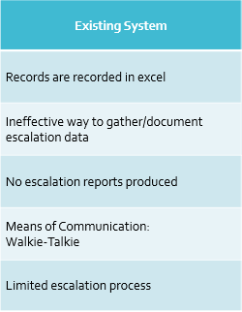
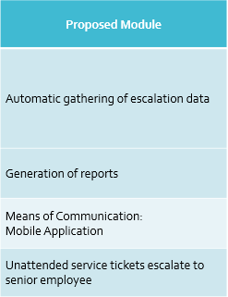
EXISTING SYSTEM vs. PROPOSED SYSTEM
Notes:
Limited escalation process
limited to just directly reporting it to the immediate supervisor with no documentation.
Existing System
Records are recorded in excel
Ineffective way to gather/document escalation data
No escalation reports produced
Means of Communication:
Walkie-Talkie
Limited escalation process
Proposed Module
Automatic gathering of escalation data
Generation of reports
Means of Communication:
Mobile Application
Unattended service tickets escalate to senior employee

Slide 10
DIAGRAMS
Escalation Management Module
Context Flow Diagram
Data Flow Diagram
Use Case Diagram
Package Diagram
Activity Diagram
State Machine Diagram
Sequence Diagram
Communication Diagram
Component Diagram
Deployment Diagram
Entity Relationship Diagram
Class Diagram
Object Diagram
Interaction Overview Diagram

Slide 11
SYSTEMS OVERVIEW
Receive: Unattended service tickets
Hierarchy Levels of Escalation
Level 1 – Supervisor (SUP)
Level 2 – Department Manager (DM)
Level 3 – Resident Manager (RM)
Level 4 – General Manager (GM)
Notes:
Receive: Unattended service tickets
Unattended service tickets from Service Recovery and Reports System Manually escalated tickets from Receptionist
Types of Escalation
Automatic – based on time
Levels of Escalation
Level 1 – Supervisor (SUP)
Level 2 – Department Manager (DM)
Level 3 – Resident Manager (RM)
Level 4 – General Manager (GM)

Slide 12
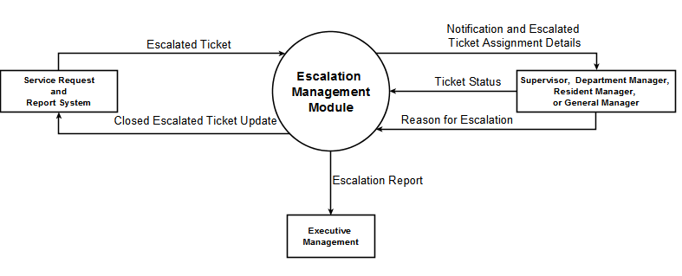
CONTEXT FLOW DIAGRAM

Slide 13
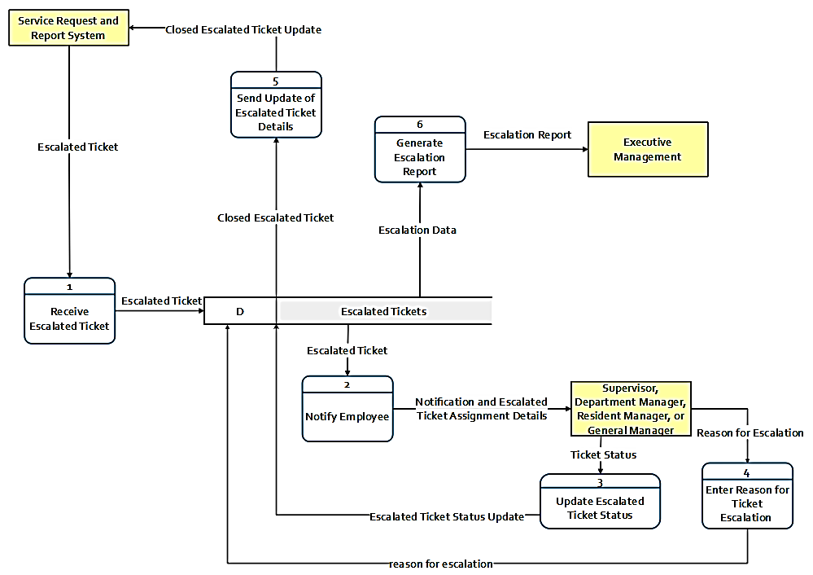
DATA FLOW DIAGRAM
(Level 0)

Slide 14
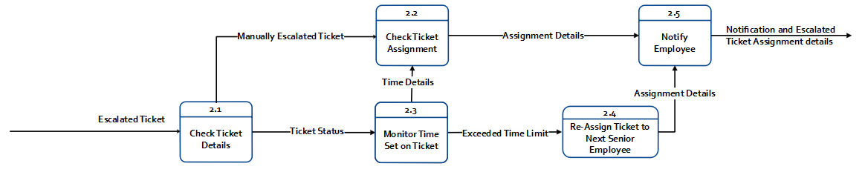
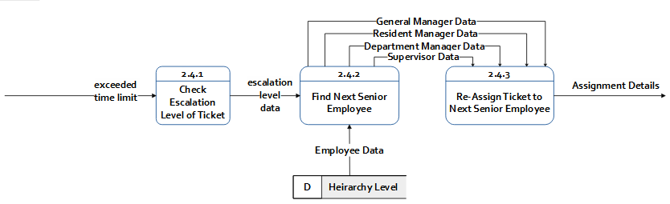
DATA FLOW DIAGRAM (Level 1 – Process 2) (Level 2 – Process 2.4)

Slide 15
DATA FLOW DIAGRAM
(Level 0)

Slide 16
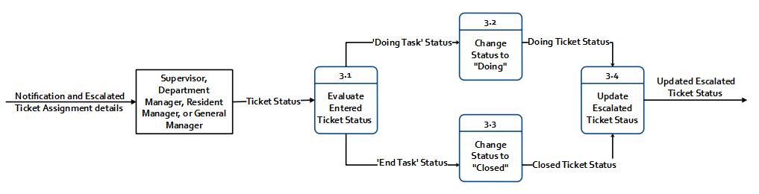
DATA FLOW DIAGRAM
(Level 1 – Process 3)

Slide 17
DATA FLOW DIAGRAM (Level 0)

Slide 18
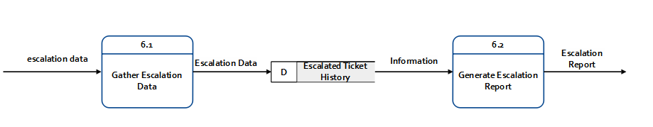
DATA FLOW DIAGRAM (Level 1 – Process 6)

Slide 19
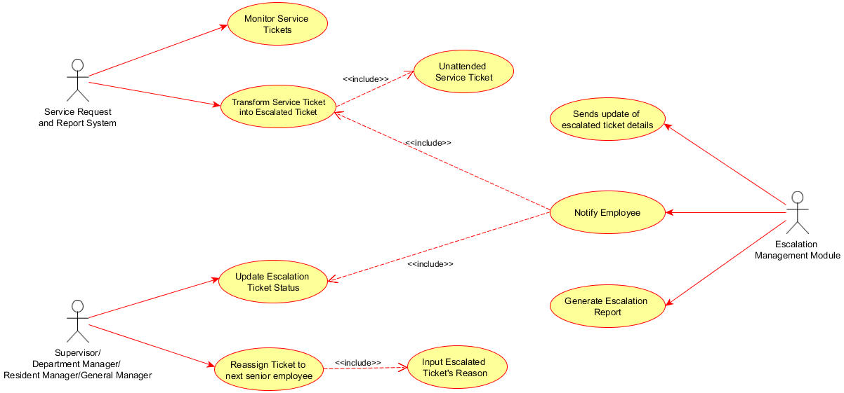
USE CASE DIAGRAM
Notes:
Service Request and Report System use cases are:
Monitor Service Tickets
Transforms service ticket into escalated ticket includes unattended service ticket
The use case of our module “Notify Employee” includes the use case Transform service ticket into escalated ticket because before our module can notify the senior employees an escalated ticket must exist. When the service request and report system transforms the service ticket into escalated ticket, our module will going to receive it and automatically stores to our data store. Afterwards, escalation management module will notify the senior employee.
For the use case of the senior employees:
After receiving the notification, the level 1, 2, 3, or 4 employee is required to update the escalation ticket status to acknowledge the assigned escalated ticket to them. If they fail to do so, the re-assignment of the ticket to the next senior employee includes input escalated ticket’s reason until the escalated ticket has been acknowledge or has been closed.
When the assigned senior employee closed the escalated ticket, the module will send an update of escalated ticket details to the Service Request and Report System and afterwards Generate and Escalation Report.

Slide 20
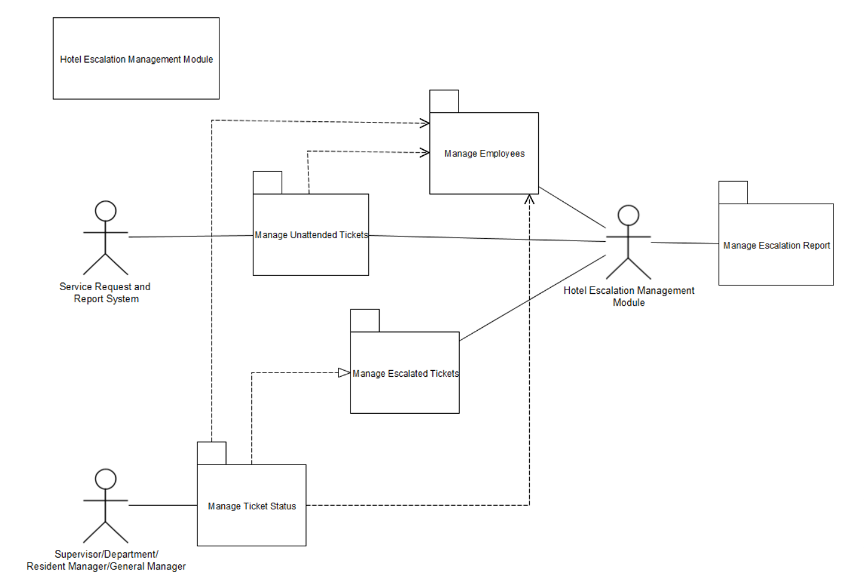
PACKAGE DIAGRAM

Slide 21
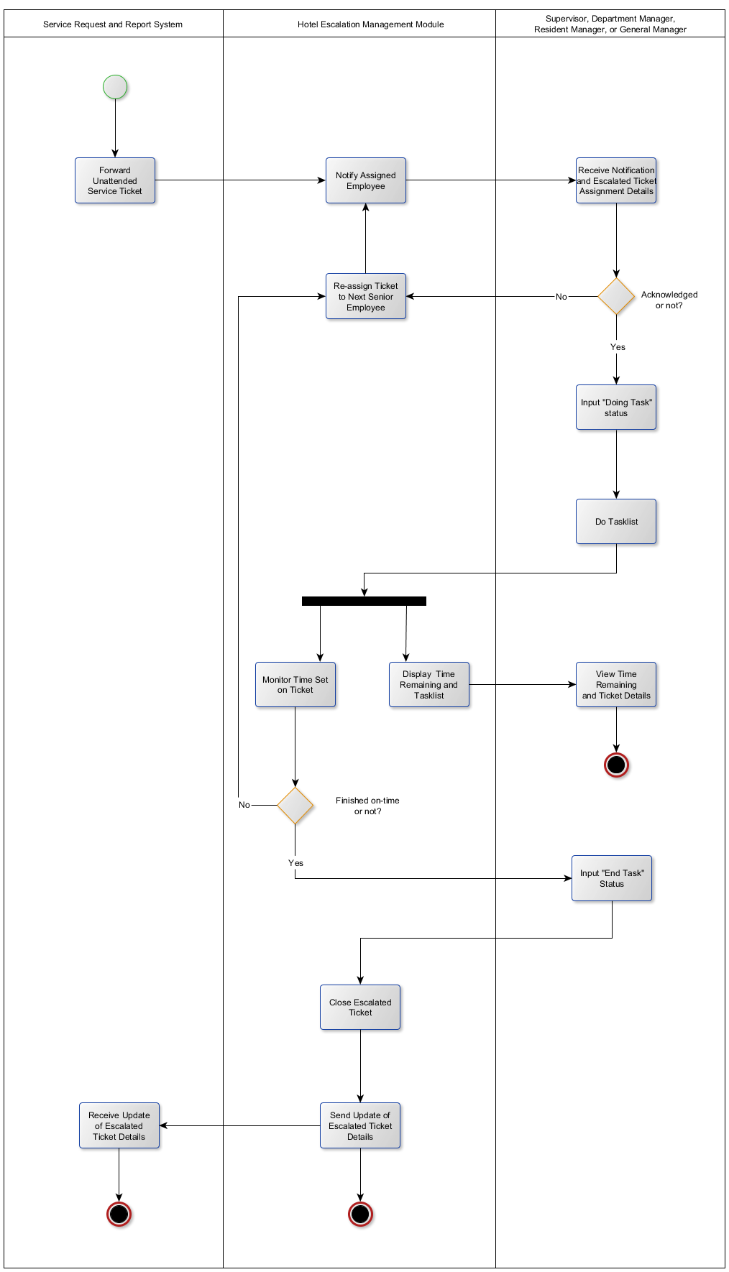
ACTIVITY DIAGRAM (Service Recovery and Report System – Higher level Employee )

Slide 22
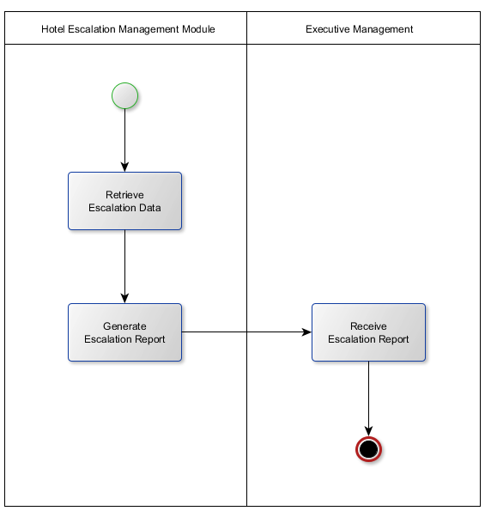
ACTIVITY DIAGRAM (Generation of Escalation Report)

Slide 23
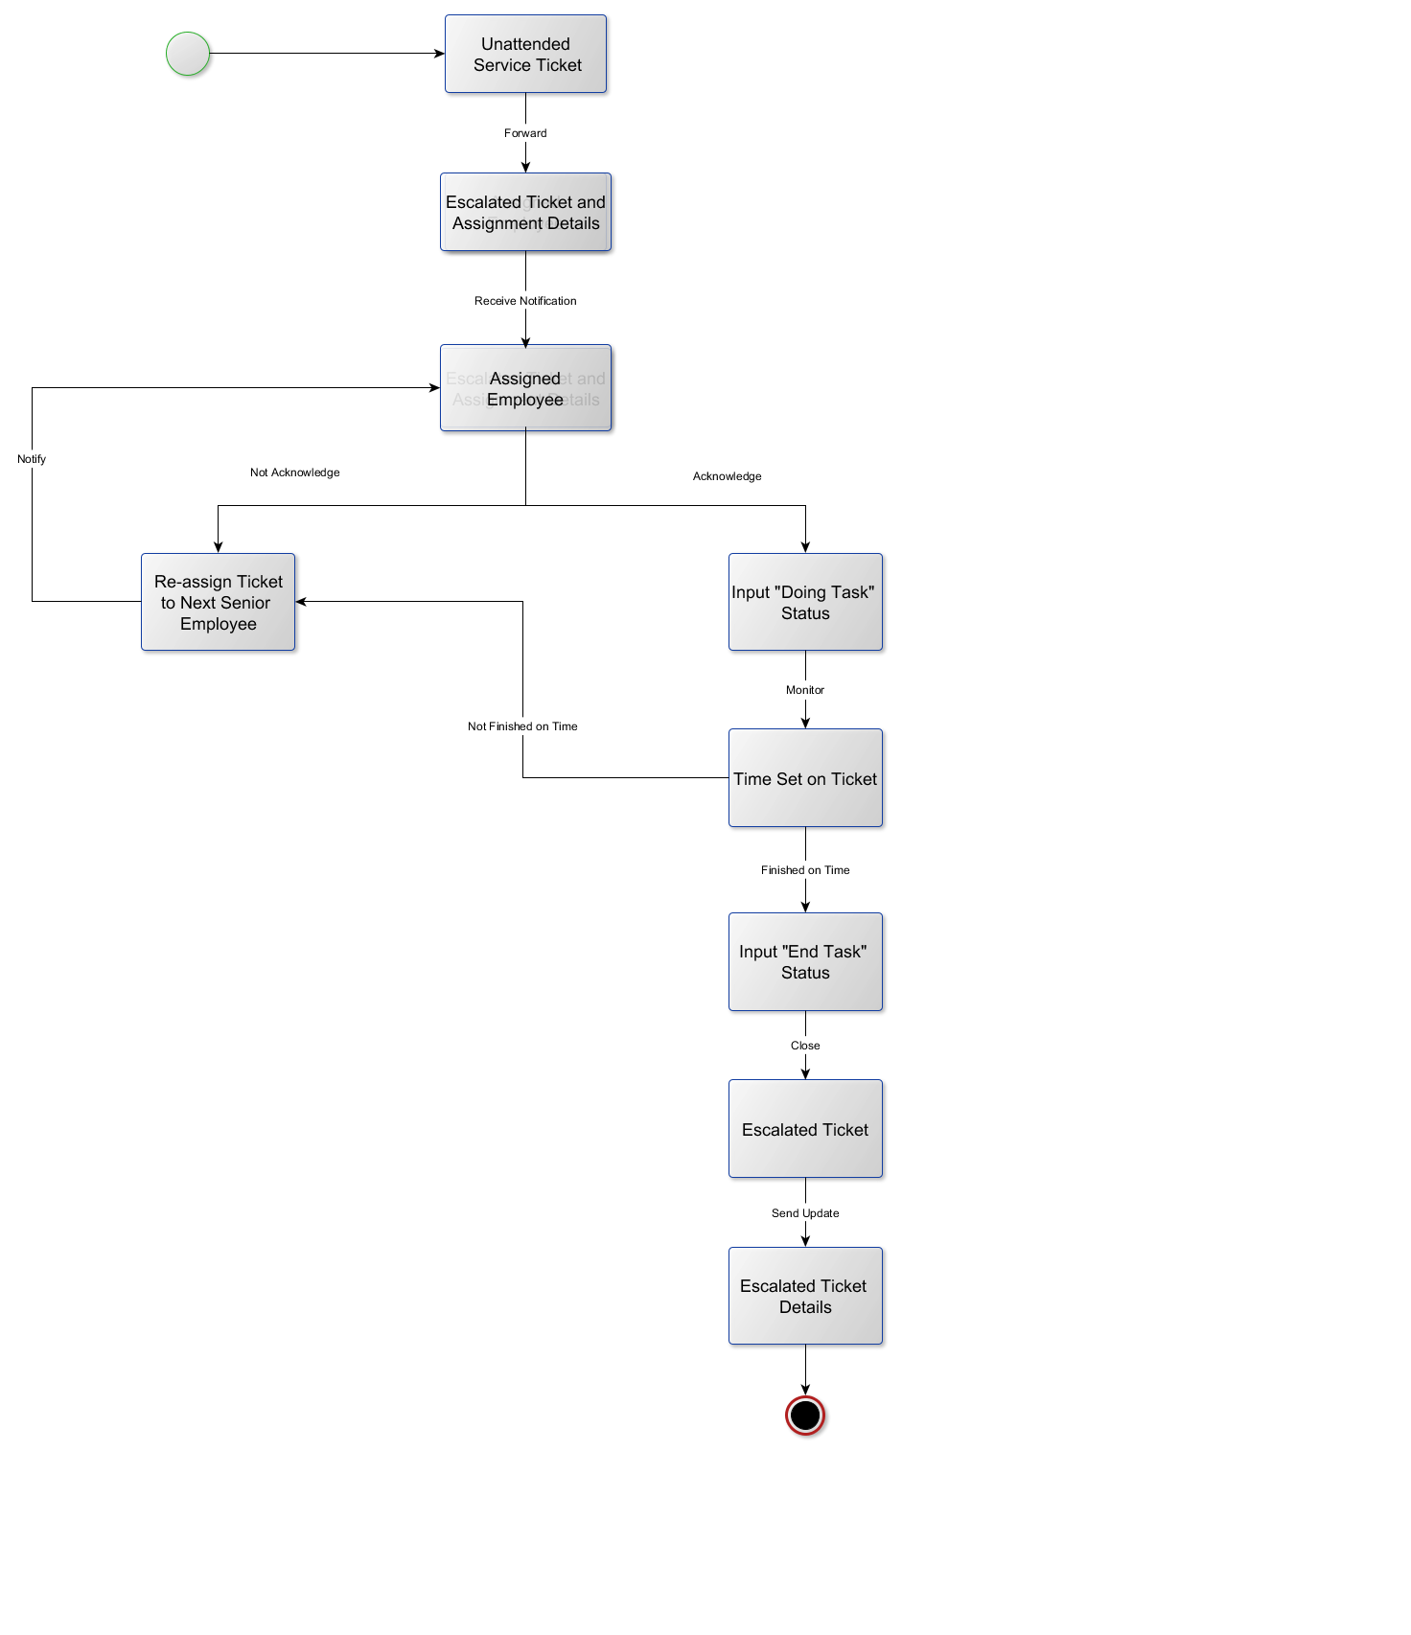
STATE MACHINE DIAGRAM

Slide 24
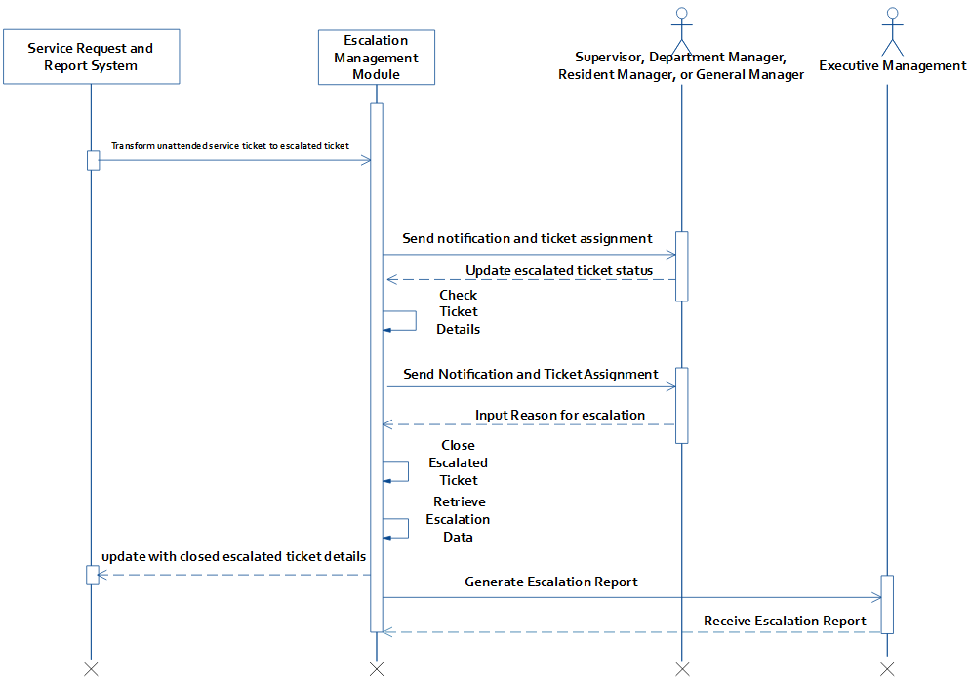
SEQUENCE DIAGRAM

Slide 25
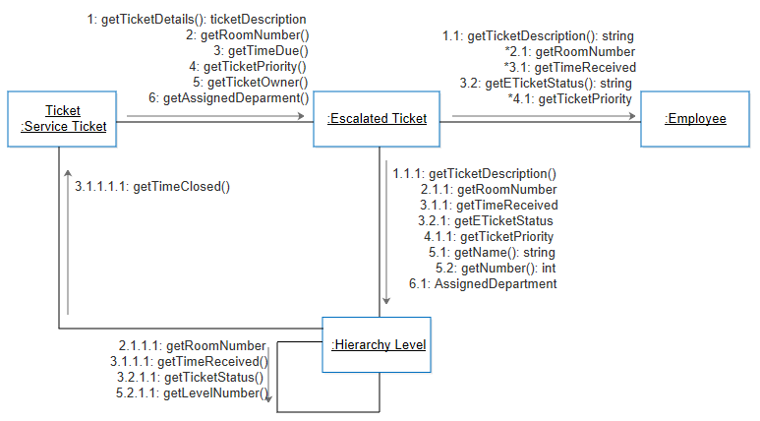
COMMUNICATION DIAGRAM

Slide 26
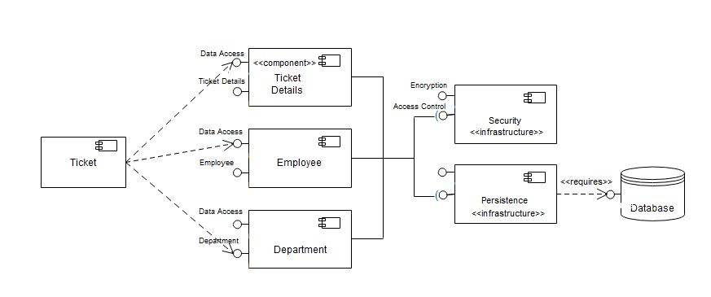
COMPONENT DIAGRAM

Slide 27
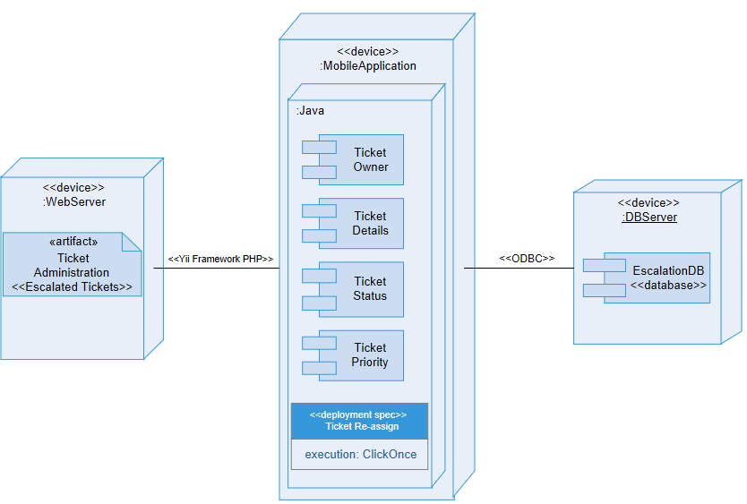
DEPLOYMENT DIAGRAM
Notes:
The webserver shows all the escalated tickets, the team used Yii Framework PHP for developing the interface that is connected to the mobile application.

Slide 28
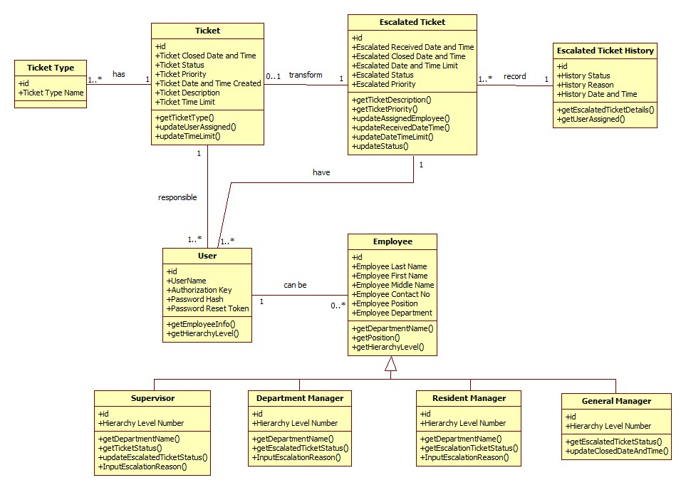
CLASS DIAGRAM

Slide 29
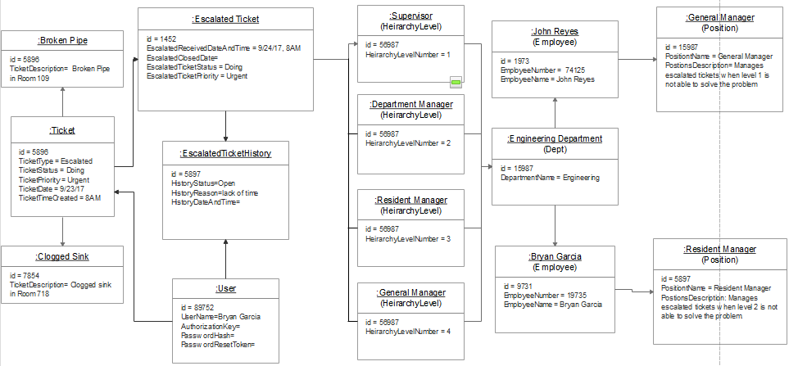
OBJECT DIAGRAM

Slide 30
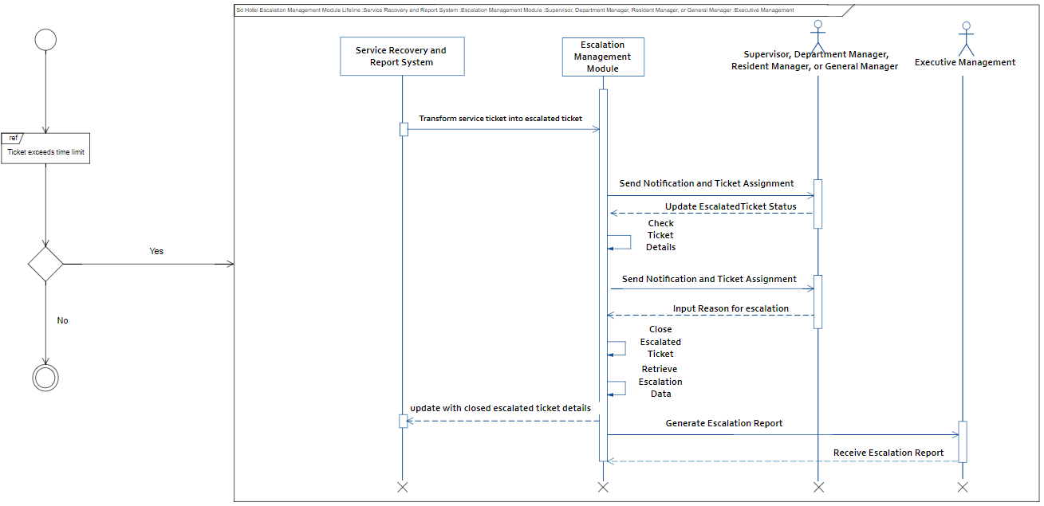
INTERACTION OVERVIEW DIAGRAM

Slide 31
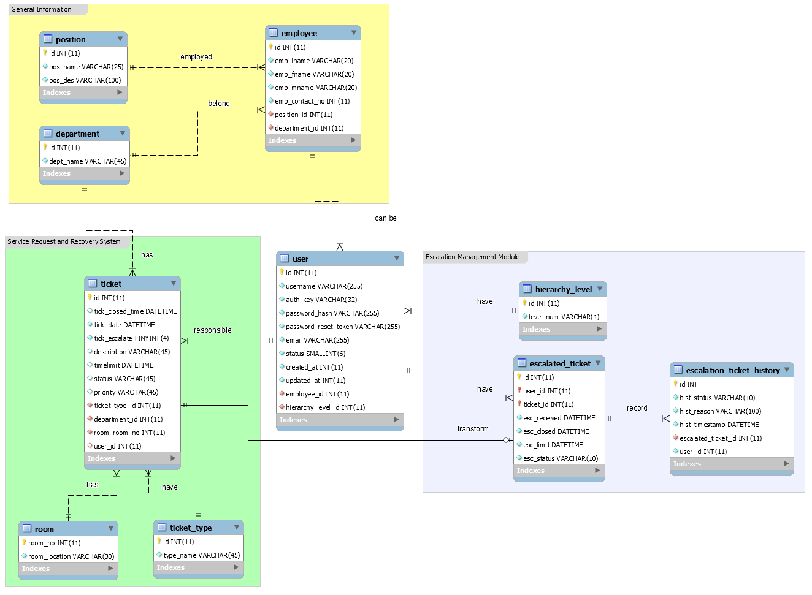
ENTITY RELATIONSHIP DIAGRAM
Notes:
For the ticket, these are the attributes (mention and brief explanation of attributes if possible), when the ticket exceeds the time limit the service request and report system will transform it into an escalated ticket which will be the main focus for our module.
An employee belongs to one department and is given a position. While in every department is employed by many employees and a position can be given to many employee. Now, not all employee of Taal Vista can be a user of our module. The users our module are employees that belongs to the hierarchy level which the team determined awhile ago.
A user can have many assigned escalated ticket but one escalated ticket can only be assigned to one employee at a time. All the updates in an escalated ticket stores/recorded in escalation_ticket_history.

Slide 32
END

Slide 33
Instances for Manual Escalation | Example
Request not part of inventory Requires 3rd party assistance Long Term Engineering Issues | Nebulizer, Wheelchair, Breast Pump Internet, Cable TV, Water Supply, Brownout Broken Pipe, AC Unit Replacement, Broken Furniture

