Slide 1
Customer Part
Request to Quote Form
Customer send to Vendor First Phase
Quantity | 1000
Price | 300
Dispatch Date | Chose from Calendar ( 26/04/2021 )
Submit
Reset
Note :
1. Customer name auto pick from login
2. Vendor name auto pick from selected item
3. Item Code auto pick from selected item
4. Item Name auto pick from selected Item
5. WSP/NET price auto puck from selected item

Slide 2
Customer Part
View History
Date/Time | SKU | Item Name | Quantity | WSP/NET Price | Request Price | Dispatch Date | Request Status | Remark | Action
26/04/21 5:28PM | +D-000001 | Sparky-Men -Jeans | 1000 | 350 | 300 | 26/04/2021 | Pending | Vendor Change Rate | View/Reply
Click on Pulse sign (+)
>>
Show Expanded data with 3-4 times conversation as popups
If Vendor without any changes confirmed status change to confirm otherwise status Rebuild
If status confirm open form details same non-editable mode otherwise
Quantity | 1000
Price | 302
Dispatch Date | Chose from Calendar ( 26/04/2021 )
Please Order
Decline
Rebid
If click on place to order then auto pick item details from JMJXplore with new price and add to cart--- and finally palace to order>>>> Next Slide

Slide 3
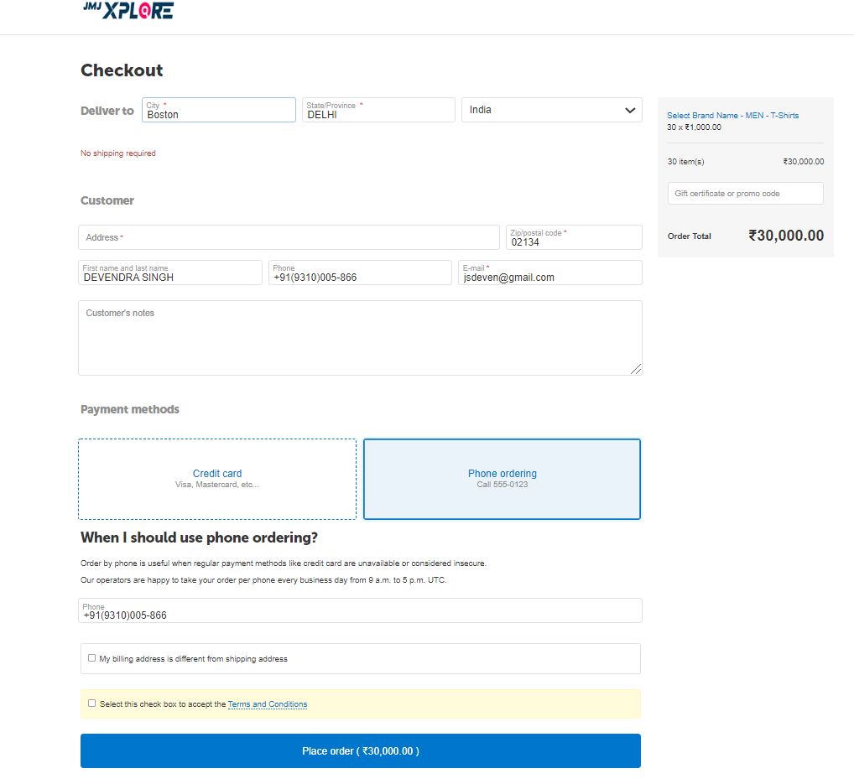
Customer Part
Place to Order
Example : Add to cart with tentative data

Slide 4
Vendor Part
View History
SKU | Item Name | Quantity | WSP/NET Price | Request Price | Dispatch Date | Status | Action
+D-000001 | Sparky-Men -Jeans | 1000 | 350 | 300 | 26/04/2021 | Pending | View/Reply
Click – Open form as popup
Click on Pulse sign (+) >> Show Expanded data with 3-4 times conversation as popups
Quantity | 1000
Price | 300
Dispatch Date | Chose from Calendar ( 26/04/2021 )
Confirm
Rebid
Click – if confirm as same send to customer and change status pending to confirm
Click – if Rebid Edit information and send to customer but existing history save on vendor / customer
Quantity | 1000
Price | 300
Dispatch Date | Chose from Calendar ( 26/04/2021 )
My Price / Rate | 305
Submit
Reset

Slide 5
Point
Request to Quote
Customer Vendor basic information like Customer/Vendor Name auto pick from customer login and vendor name from selected item
Send Request to vendor as per our ppt.
Maintain the history of conversation.
Max 3-4 times exchange the massages.
Conversation direct between customer to vendor
Marketing shows only conversation report and set flag (checked or uncheck (default))
Marketing person check or not show at customer vendor history.

