Slide 1
SORTING ALGORITHMS
MERGESORT

Slide 2
Mergesort
Mergesort is a divide and conquer algorithm that was invented by John von Neumann in 1945
Comparison based algorithm with running time complexity O(N logN)
It is a stable sorting algorithm
Not an in-place algorithm !!!
Although heapsort has the same time bounds as merge sort → heapsort requires only Θ(1) auxiliary space instead of merge sort's Θ(n)
Efficient quicksort implementations generally outperforms mergesort
Mergesort is often the best choice for sorting a linked list: in this situation it is relatively easy to implement a merge sort in such a way that it requires only Θ(1) extra space

Slide 3
 | Quicksort | Mergesort
In place | Yes | No
Stable | No | Yes
Time complexity | Quadratic sometimes | O(N logN)

Slide 4
Mergesort
1.) divide the array into two subarrays recursively
2.) sort these subarrays recursively with mergesort again
3.) if there is only a single item left in the subarray → we consider it
to be sorted by definition
4.) merge the subarrays to get the final sorted array

Slide 5
Mergesort „divide”
32
-12
0
3
1
12
20

Slide 6
Mergesort „divide”
32
-12
0
3
1
12
20
We call the sort method over and over again: mergesort(0,6)
Generate a middle index in order to
partition the array: middleIndex = (low+high) / 2

Slide 7
Mergesort „divide”
32
-12
0
3
1
12
20
We call the sort method over and over again: mergesort(0,6)
Generate a middle index in order to
partition the array: middleIndex = (low+high) / 2

Slide 8
Mergesort „divide”
32
-12
0
3
1
12
20
We call the sort method over and over again: mergesort(0,6)
Generate a middle index in order to
partition the array: middleIndex = (low+high) / 2

Slide 9
Mergesort „divide”
mergesort(0,3) mergesort(4,6)
32
-12
0
3
1
12
20
We call the sort method over and over again: mergesort(0,6)
Generate a middle index in order to
partition the array: middleIndex = (low+high) / 2

Slide 10
Mergesort „divide”
32
-12
0
3
1
12
20
We call the sort method over and over again: mergesort(0,6)
Generate a middle index in order to
partition the array: middleIndex = (low+high) / 2

Slide 11
Mergesort „divide”
mergesort(0,1) mergesort(2,3)
32
-12
0
3
1
12
20
We call the sort method over and over again: mergesort(0,6)
Generate a middle index in order to
partition the array: middleIndex = (low+high) / 2

Slide 12
Mergesort „divide”
32
-12
0
3
1
12
20
We call the sort method over and over again: mergesort(0,6)
Generate a middle index in order to
partition the array: middleIndex = (low+high) / 2

Slide 13
Mergesort „divide”
32
-12
0
3
1
12
20
After several recursive method calls: we end with single items,
we consider them sorted by default
~ so we keep merging these already sorted items

Slide 14
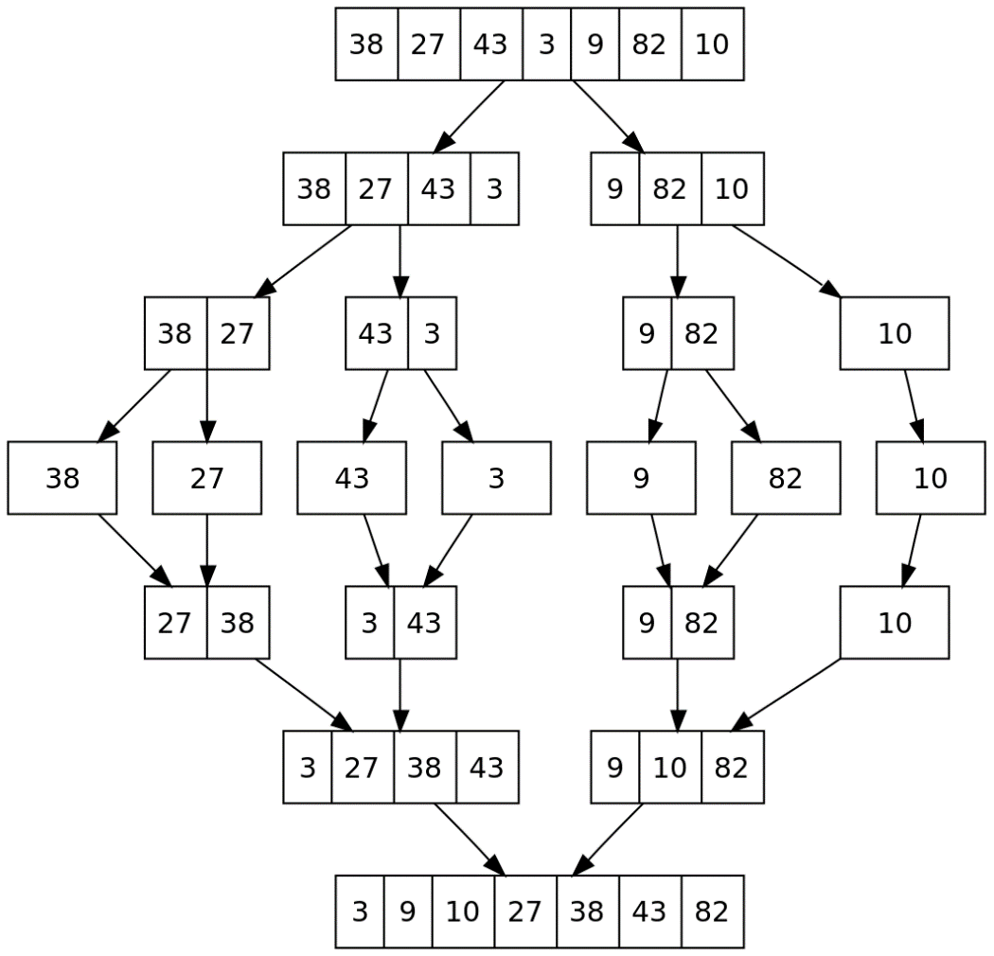

Slide 16
Mergesort „conquer”
3
5
6
10
1
4
8
So after the split operations: we have several distinct arrays that are already
sorted: we have to merge these arrays into a single one

Slide 17
Mergesort „conquer”
3
5
6
10
1
4
8
result array

Slide 18
Mergesort „conquer”
3
5
6
10
1
4
8
result array
We start at the beginning of the subarrays: we keep comparing them, we insert
the smaller into the result array

Slide 19
Mergesort „conquer”
3
5
6
10
1
4
8
result array
We start at the beginning of the subarrays: we keep comparing them, we insert
the smaller into the result array

Slide 20
Mergesort „conquer”
3
5
6
10
1
4
8
1
result array
We start at the beginning of the subarrays: we keep comparing them, we insert
the smaller into the result array

Slide 21
Mergesort „conquer”
3
5
6
10
1
4
8
1
result array
We start at the beginning of the subarrays: we keep comparing them, we insert
the smaller into the result array

Slide 22
Mergesort „conquer”
3
5
6
10
1
4
8
1
result array
We start at the beginning of the subarrays: we keep comparing them, we insert
the smaller into the result array

Slide 23
Mergesort „conquer”
3
5
6
10
1
4
8
1
3
result array
We start at the beginning of the subarrays: we keep comparing them, we insert
the smaller into the result array

Slide 24
Mergesort „conquer”
3
5
6
10
1
4
8
1
3
result array
We start at the beginning of the subarrays: we keep comparing them, we insert
the smaller into the result array

Slide 25
Mergesort „conquer”
3
5
6
10
1
4
8
1
3
result array
We start at the beginning of the subarrays: we keep comparing them, we insert
the smaller into the result array

Slide 26
Mergesort „conquer”
3
5
6
10
1
4
8
1
3
result array
We start at the beginning of the subarrays: we keep comparing them, we insert
the smaller into the result array

Slide 27
Mergesort „conquer”
3
5
6
10
1
4
8
1
3
4
result array
We start at the beginning of the subarrays: we keep comparing them, we insert
the smaller into the result array

Slide 28
Mergesort „conquer”
3
5
6
10
1
4
8
1
3
4
result array
We start at the beginning of the subarrays: we keep comparing them, we insert
the smaller into the result array

Slide 29
Mergesort „conquer”
3
5
6
10
1
4
8
1
3
4
result array
We start at the beginning of the subarrays: we keep comparing them, we insert
the smaller into the result array

Slide 30
Mergesort „conquer”
3
5
6
10
1
4
8
1
3
4
5
result array
We start at the beginning of the subarrays: we keep comparing them, we insert
the smaller into the result array

Slide 31
Mergesort „conquer”
3
5
6
10
1
4
8
1
3
4
5
result array
We start at the beginning of the subarrays: we keep comparing them, we insert
the smaller into the result array

Slide 32
Mergesort „conquer”
3
5
6
10
1
4
8
1
3
4
5
result array
We start at the beginning of the subarrays: we keep comparing them, we insert
the smaller into the result array

Slide 33
Mergesort „conquer”
3
5
6
10
1
4
8
1
3
4
5
6
result array
We start at the beginning of the subarrays: we keep comparing them, we insert
the smaller into the result array

Slide 34
Mergesort „conquer”
3
5
6
10
1
4
8
1
3
4
5
6
result array
We start at the beginning of the subarrays: we keep comparing them, we insert
the smaller into the result array

Slide 35
Mergesort „conquer”
3
5
6
10
1
4
8
1
3
4
5
6
result array
We start at the beginning of the subarrays: we keep comparing them, we insert
the smaller into the result array

Slide 36
Mergesort „conquer”
3
5
6
10
1
4
8
1
3
4
5
6
8
result array
We start at the beginning of the subarrays: we keep comparing them, we insert
the smaller into the result array

Slide 37
Mergesort „conquer”
3
5
6
10
1
4
8
1
3
4
5
6
8
result array
VERY IMPORTANT: we have to iterate through the left and right array if there are
some more items left → in this case the 10 in the left subarray

Slide 38
Mergesort „conquer”
3
5
6
10
1
4
8
1
3
4
5
6
8
10
result array
VERY IMPORTANT: we have to iterate through the left and right array if there are
some more items left → in this case the 10 in the left subarray

Slide 39
Mergesort „conquer”
3
5
6
10
1
4
8
1
3
4
5
6
8
10
result array
VERY IMPORTANT: we have to iterate through the left and right array if there are
some more items left → in this case the 10 in the left subarray

Slide 40
Pseudocode
merge(low, middle, high) {
for i=low to high
tempArray[i] = nums[i];
i = low;
j = middle + 1;
k = low;
while i <= middle && j <= high
if tempArray[i] <= tempArray[j]
nums[k] = tempArray[i]
i++
else
nums[k] = tempArray[j];
j++
k++;
while i <= middle
nums[k] = tempArray[i];
k++;
i++;
while j <= high
nums[k] = tempArray[j];
k++;
j++;
end
mergeSort(low,high)
if (low >= high) return
middle = (low + high) / 2
mergeSort(low, middle)
mergeSort(middle + 1, high)
merge(low, middle, high)
end

Slide 41
Pseudocode
merge(low, middle, high) {
for i=low to high
tempArray[i] = nums[i];
i = low;
j = middle + 1;
k = low;
while i <= middle && j <= high
if tempArray[i] <= tempArray[j]
nums[k] = tempArray[i]
i++
else
nums[k] = tempArray[j];
j++
k++;
while i <= middle
nums[k] = tempArray[i];
k++;
i++;
while j <= high
nums[k] = tempArray[j];
k++;
j++;
end
mergeSort(low,high)
if (low >= high) return
middle = (low + high) / 2
mergeSort(low, middle)
mergeSort(middle + 1, high)
merge(low, middle, high)
end
Base case for recursive method calls,
in this situation the sort is over

Slide 42
Pseudocode
merge(low, middle, high) {
for i=low to high
tempArray[i] = nums[i];
i = low;
j = middle + 1;
k = low;
while i <= middle && j <= high
if tempArray[i] <= tempArray[j]
nums[k] = tempArray[i]
i++
else
nums[k] = tempArray[j];
j++
k++;
while i <= middle
nums[k] = tempArray[i];
k++;
i++;
while j <= high
nums[k] = tempArray[j];
k++;
j++;
end
mergeSort(low,high)
if (low >= high) return
middle = (low + high) / 2
mergeSort(low, middle)
mergeSort(middle + 1, high)
merge(low, middle, high)
end
We look for the middle index to partition
the array into two equal subarrays

Slide 43
Pseudocode
merge(low, middle, high) {
for i=low to high
tempArray[i] = nums[i];
i = low;
j = middle + 1;
k = low;
while i <= middle && j <= high
if tempArray[i] <= tempArray[j]
nums[k] = tempArray[i]
i++
else
nums[k] = tempArray[j];
j++
k++;
while i <= middle
nums[k] = tempArray[i];
k++;
i++;
while j <= high
nums[k] = tempArray[j];
k++;
j++;
end
mergeSort(low,high)
if (low >= high) return
middle = (low + high) / 2
mergeSort(low, middle)
mergeSort(middle + 1, high)
merge(low, middle, high)
end
Call the mergesort method recursively
on the left subarray
IMPORTANT: because of middle, there
will be always more items in the left subarray !!!

Slide 44
Pseudocode
merge(low, middle, high) {
for i=low to high
tempArray[i] = nums[i];
i = low;
j = middle + 1;
k = low;
while i <= middle && j <= high
if tempArray[i] <= tempArray[j]
nums[k] = tempArray[i]
i++
else
nums[k] = tempArray[j];
j++
k++;
while i <= middle
nums[k] = tempArray[i];
k++;
i++;
while j <= high
nums[k] = tempArray[j];
k++;
j++;
end
mergeSort(low,high)
if (low >= high) return
middle = (low + high) / 2
mergeSort(low, middle)
mergeSort(middle + 1, high)
merge(low, middle, high)
end
Call mergesort recursively
on the right subarray
IMPORTANT: because middle+1 there are
at most as many items in the left subarray

Slide 45
Pseudocode
merge(low, middle, high) {
for i=low to high
tempArray[i] = nums[i];
i = low;
j = middle + 1;
k = low;
while i <= middle && j <= high
if tempArray[i] <= tempArray[j]
nums[k] = tempArray[i]
i++
else
nums[k] = tempArray[j];
j++
k++;
while i <= middle
nums[k] = tempArray[i];
k++;
i++;
while j <= high
nums[k] = tempArray[j];
k++;
j++;
end
mergeSort(low,high)
if (low >= high) return
middle = (low + high) / 2
mergeSort(low, middle)
mergeSort(middle + 1, high)
merge(low, middle, high)
end
The conquer part of the algorithm, we keep
merging the subarrays together

Slide 46
Pseudocode
merge(low, middle, high) {
for i=low to high
tempArray[i] = nums[i];
i = low;
j = middle + 1;
k = low;
while i <= middle && j <= high
if tempArray[i] <= tempArray[j]
nums[k] = tempArray[i]
i++
else
nums[k] = tempArray[j];
j++
k++;
while i <= middle
nums[k] = tempArray[i];
k++;
i++;
while j <= high
nums[k] = tempArray[j];
k++;
j++;
end
mergeSort(low,high)
if (low >= high) return
middle = (low + high) / 2
mergeSort(low, middle)
mergeSort(middle + 1, high)
merge(low, middle, high)
end
Create a temporary array: size is equal
to the size of the input
Thats why mergesort has O(N) memory
complexity → we have to use an other array

Slide 47
Pseudocode
merge(low, middle, high) {
for i=low to high
tempArray[i] = nums[i];
i = low;
j = middle + 1;
k = low;
while i <= middle && j <= high
if tempArray[i] <= tempArray[j]
nums[k] = tempArray[i]
i++
else
nums[k] = tempArray[j];
j++
k++;
while i <= middle
nums[k] = tempArray[i];
k++;
i++;
while j <= high
nums[k] = tempArray[j];
k++;
j++;
end
mergeSort(low,high)
if (low >= high) return
middle = (low + high) / 2
mergeSort(low, middle)
mergeSort(middle + 1, high)
merge(low, middle, high)
end
Create the variables to be able to
track the indexes

Slide 48
Pseudocode
merge(low, middle, high) {
for i=low to high
tempArray[i] = nums[i];
i = low;
j = middle + 1;
k = low;
while i <= middle && j <= high
if tempArray[i] <= tempArray[j]
nums[k] = tempArray[i]
i++
else
nums[k] = tempArray[j];
j++
k++;
while i <= middle
nums[k] = tempArray[i];
k++;
i++;
while j <= high
nums[k] = tempArray[j];
k++;
j++;
end
mergeSort(low,high)
if (low >= high) return
middle = (low + high) / 2
mergeSort(low, middle)
mergeSort(middle + 1, high)
merge(low, middle, high)
end
While we have items in the left and right
subarrays

Slide 49
Pseudocode
merge(low, middle, high) {
for i=low to high
tempArray[i] = nums[i];
i = low;
j = middle + 1;
k = low;
while i <= middle && j <= high
if tempArray[i] <= tempArray[j]
nums[k] = tempArray[i]
i++
else
nums[k] = tempArray[j];
j++
k++;
while i <= middle
nums[k] = tempArray[i];
k++;
i++;
while j <= high
nums[k] = tempArray[j];
k++;
j++;
end
mergeSort(low,high)
if (low >= high) return
middle = (low + high) / 2
mergeSort(low, middle)
mergeSort(middle + 1, high)
merge(low, middle, high)
end
The left subarray item is smaller: we put
it to its right / sorted position in the array
Note: we keep merging the items from temp
array to the original nums array

Slide 50
Pseudocode
merge(low, middle, high) {
for i=low to high
tempArray[i] = nums[i];
i = low;
j = middle + 1;
k = low;
while i <= middle && j <= high
if tempArray[i] <= tempArray[j]
nums[k] = tempArray[i]
i++
else
nums[k] = tempArray[j];
j++
k++;
while i <= middle
nums[k] = tempArray[i];
k++;
i++;
while j <= high
nums[k] = tempArray[j];
k++;
j++;
end
mergeSort(low,high)
if (low >= high) return
middle = (low + high) / 2
mergeSort(low, middle)
mergeSort(middle + 1, high)
merge(low, middle, high)
end

Slide 51
Pseudocode
merge(low, middle, high) {
for i=low to high
tempArray[i] = nums[i];
i = low;
j = middle + 1;
k = low;
while i <= middle && j <= high
if tempArray[i] <= tempArray[j]
nums[k] = tempArray[i]
i++
else
nums[k] = tempArray[j];
j++
k++;
while i <= middle
nums[k] = tempArray[i];
k++;
i++;
while j <= high
nums[k] = tempArray[j];
k++;
j++;
end
mergeSort(low,high)
if (low >= high) return
middle = (low + high) / 2
mergeSort(low, middle)
mergeSort(middle + 1, high)
merge(low, middle, high)
end
Sometimes we have items left in the left
subarray: so copy it to the final nums array
~ it is in sorted order so just copy them

Slide 52
Mergesort „conquer”
5
6
7
8
1
2
3
result array

Slide 53
Mergesort „conquer”
5
6
7
8
1
2
3
result array

Slide 54
Mergesort „conquer”
5
6
7
8
1
2
3
1
result array

Slide 55
Mergesort „conquer”
5
6
7
8
1
2
3
1
result array

Slide 56
Mergesort „conquer”
5
6
7
8
1
2
3
1
2
result array

Slide 57
Mergesort „conquer”
5
6
7
8
1
2
3
1
2
result array

Slide 58
Mergesort „conquer”
5
6
7
8
1
2
3
1
2
3
result array

Slide 59
Mergesort „conquer”
5
6
7
8
1
2
3
1
2
3
result array

Slide 60
Mergesort „conquer”
5
6
7
8
1
2
3
1
2
3
result array

Slide 61
Mergesort „conquer”
5
6
7
8
1
2
3
1
2
3
5
6
7
8
result array

Slide 62
Pseudocode
merge(low, middle, high) {
for i=low to high
tempArray[i] = nums[i];
i = low;
j = middle + 1;
k = low;
while i <= middle && j <= high
if tempArray[i] <= tempArray[j]
nums[k] = tempArray[i]
i++
else
nums[k] = tempArray[j];
j++
k++;
while i <= middle
nums[k] = tempArray[i];
k++;
i++;
while j <= high
nums[k] = tempArray[j];
k++;
j++;
end
mergeSort(low,high)
if (low >= high) return
middle = (low + high) / 2
mergeSort(low, middle)
mergeSort(middle + 1, high)
merge(low, middle, high)
end
Sometimes we have items left in the right
subarray: so copy it to the final nums array
~ it is in sorted order so just copy them

Slide 63
Mergesort „conquer”
1
2
3
5
4
7
8
result array

Slide 64
Mergesort „conquer”
1
2
3
5
4
7
8
result array

Slide 65
Mergesort „conquer”
1
2
3
5
4
7
8
1
result array

Slide 66
Mergesort „conquer”
1
2
3
5
4
7
8
1
result array

Slide 67
Mergesort „conquer”
1
2
3
5
4
7
8
1
2
result array

Slide 68
Mergesort „conquer”
1
2
3
5
4
7
8
1
2
result array

Slide 69
Mergesort „conquer”
1
2
3
5
4
7
8
1
2
3
result array

Slide 70
Mergesort „conquer”
1
2
3
5
4
7
8
1
2
3
result array

Slide 71
Mergesort „conquer”
1
2
3
5
4
7
8
1
2
3
4
result array

Slide 72
Mergesort „conquer”
1
2
3
5
4
7
8
1
2
3
4
result array

Slide 73
Mergesort „conquer”
1
2
3
5
4
7
8
1
2
3
4
5
result array

Slide 74
Mergesort „conquer”
1
2
3
5
4
7
8
1
2
3
4
5
result array

Slide 75
Mergesort „conquer”
1
2
3
5
4
7
8
1
2
3
4
5
7
8
result array

