Slide 1






AutoML to support Model Selection in Supervised Traffic Forecasting
Juan S. Angarita Zapata
Supervisors: Antonio D. Masegosa, Isaac Triguero
DeustoTech, Faculty of Engineering, University of Deusto, Spain
Computational Optimisation and Learning Lab, University of Nottingham, UK
November 25, 2020

Slide 2
Outline
Introduction - Preliminaries and Objectives
Contributions
Conclusions and Future Work
1 - Taxonomy of Supervised Traffic Forecasting Problems
2 - Study of general-purpose AutoML in Supervised Traffic Forecasting
3 - AutoEn: a new AutoML method for Supervised Learning problems
Introduction
Contribution 1
Contribution 2
Contribution 3
Conclusions and Future Work

Slide 3
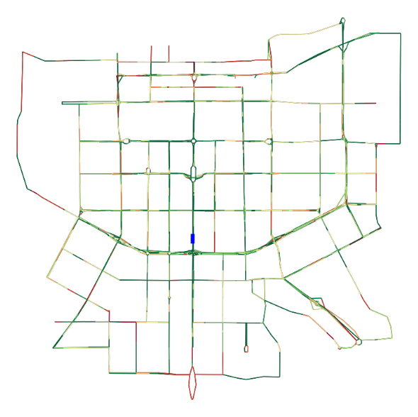
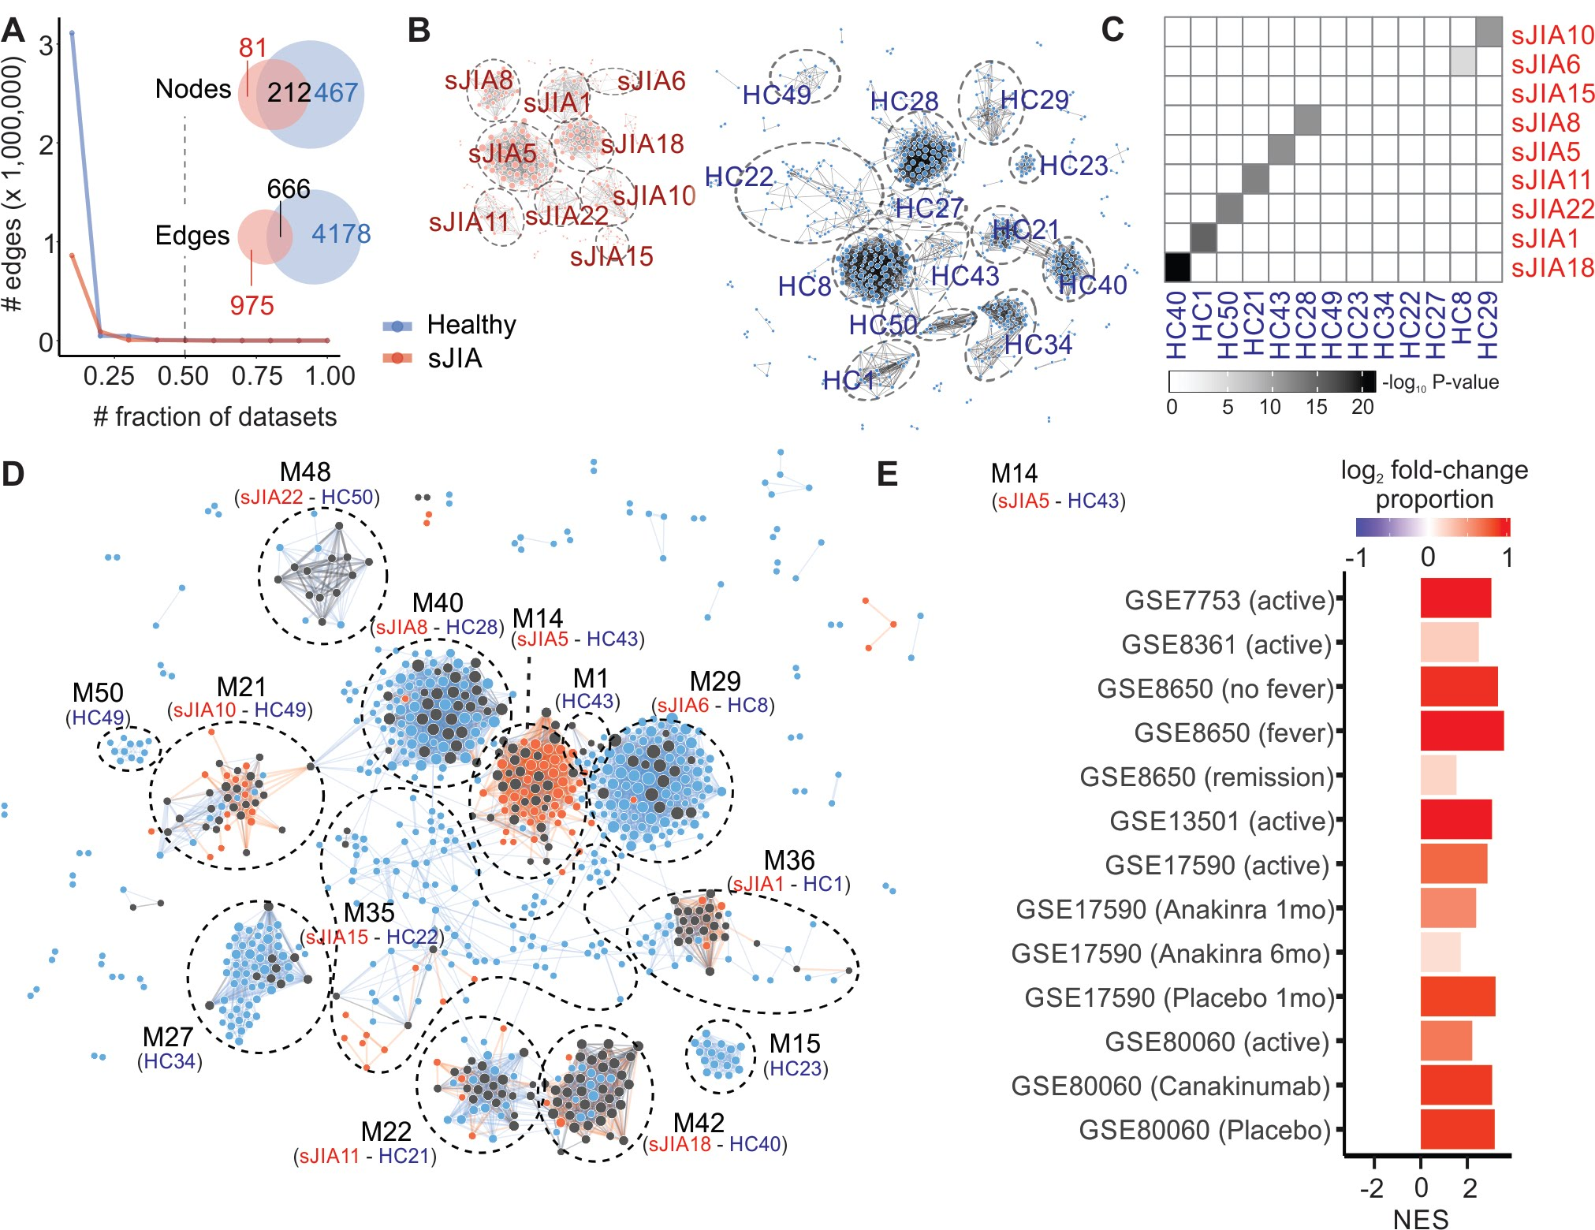

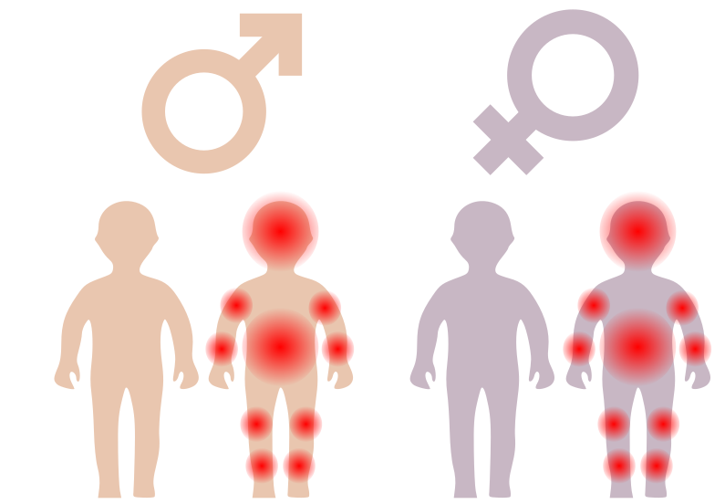

Preliminaries
Vast and complex volumes of data in diverse problem domains
Prada-Medida C, USP, (2019)
$${}^{1}$$
Expert Machine Learning (ML) knowledge is required to analyse and mine this data.
$${}^{1}$$
Hutter et al. (2018 )
Introduction
Contribution 1
Contribution 2
Contribution 3
Conclusions and Future Work

Slide 4
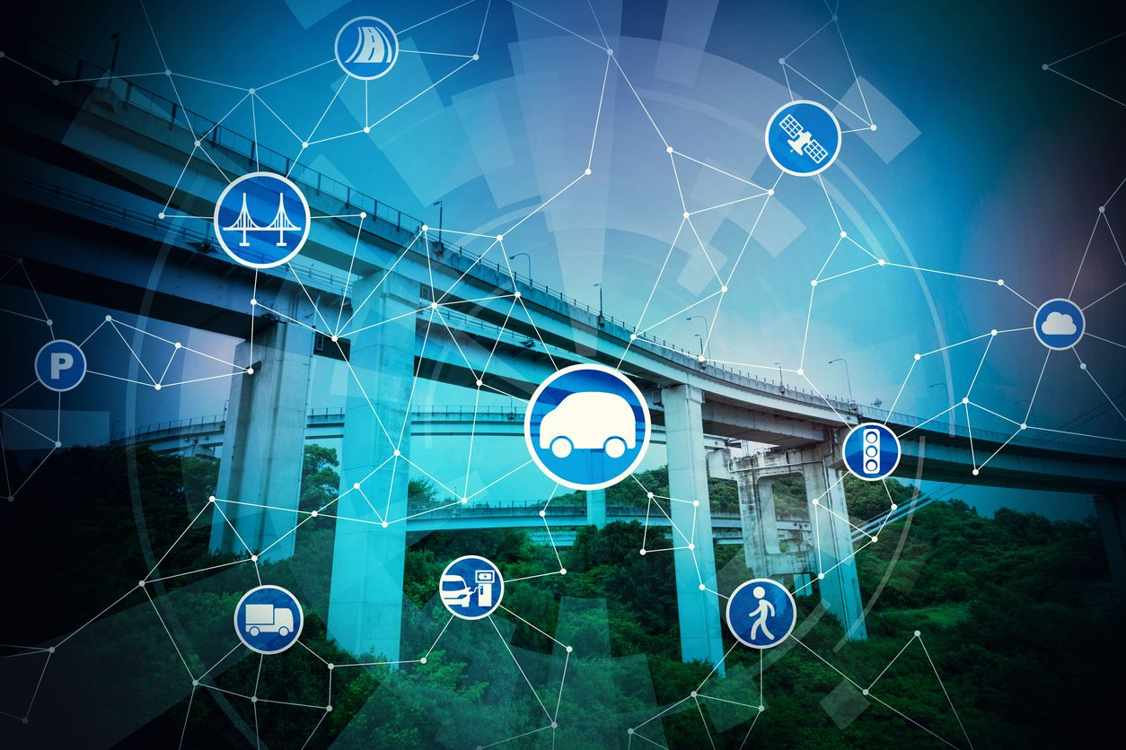
Traffic
Forecasting (TF)
www.viaempresa.cat/es/territorio/barcelona-smart-mobility-congress_2074887_102.html
Intelligent
Transportation Systems

Slide 5
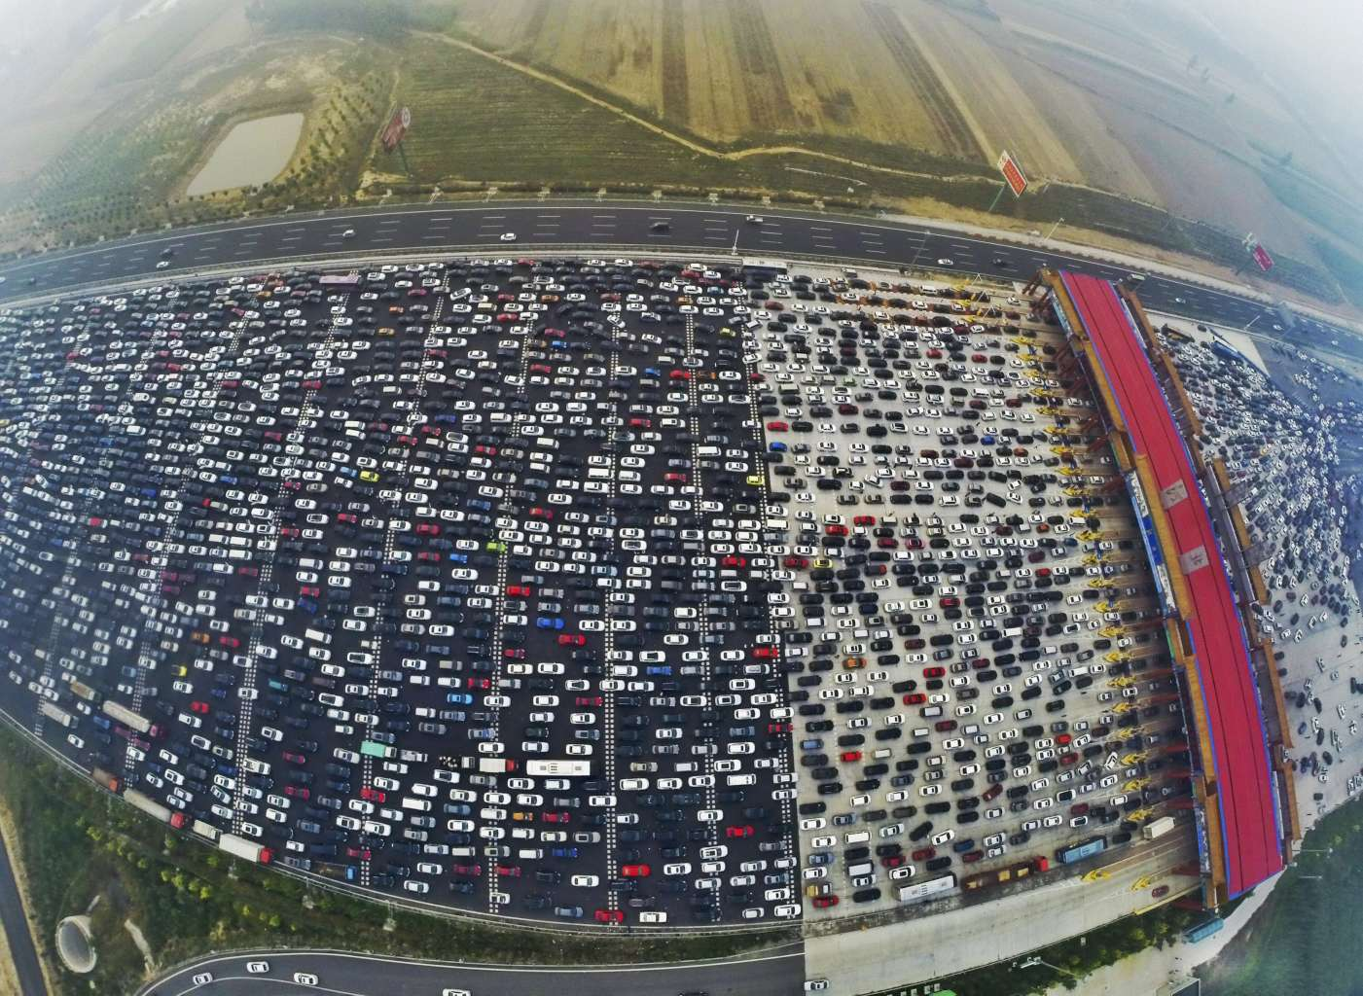
Traffic
Forecasting (TF)
Traffic Congestion
Intelligent
Transportation Systems
www.straitstimes.com/asia/east-asia/massive-traffic-jam-on-beijings-50-lane-expressway-as-golden-week-holiday-ends

Slide 6



Preliminaries
Traffic data, TF, and the influence of ML
19:10h
Step 2
Classical models in TF have difficulties dealing with high volumes of Traffic data.
ML to mine complex traffic data (supervised regression and classification).
Expert ML knowledge can be an asset not always available or affordable.
19:05h
Current moment (19:00h)
Step 1
Target Road Link
$${}^{2}$$
$${}^{2}$$
Laña et al. (2018)
Introduction
Contribution 1
Contribution 2
Contribution 3
Conclusions and Future Work

Slide 7
Thesis aim
Contributing to the development of Automated Methods able to deal with raw-complex data and the scarcity of ML knowledge.
Thus, to satisfy the ML demands of Traffic Forecasting and other data-driven domains.

Slide 8
Objectives
To understand, organise and systematise the existing knowledge about TF problems modelled from a supervised learning perspective - Contribution 1: Taxonomy to classify TF problems.
To characterise the performance of general-purpose AutoML in supervised learning problems using TF as an application area - Contribution 2: Study of current AutoML methods in TF.
To improve the performance of AutoML in supervised learning problems, including TF - Contribution 3: a New AutoML method.
Introduction
Contribution 1
Contribution 2
Contribution 3
Conclusions and Future Work

Slide 9
Outline
Introduction - Preliminaries and Objectives
Contributions
Conclusions and Future Work
1 - Taxonomy of Supervised Traffic Forecasting Problems
2 - Study of general-purpose AutoML in Supervised Traffic Forecasting
3 - AutoEn: a new AutoML method for Supervised Learning problems
Introduction
Contribution 1
Contribution 2
Contribution 3
Conclusions and Future Work

Slide 10


1. Taxonomy of supervised TF problems
Motivation
Supervised learning is the most widely used modelling paradigm in TF.
Transportation literature reports a huge set of supervised ML methods.
Taxonomy of ML methods for TF :
$${}^{3}$$
non-parametric
parametric
$${}^{3}$$
Mori et al, (2015)
Introduction
Contribution 1
Contribution 2
Contribution 3
Conclusions and Future Work

Slide 11

1. Taxonomy of supervised TF problems
Motivation
Categorisation of TF problems and how they can be modelled to be approached by supervised ML methods is an underexplored area.
Hard to formulate guidelines of the most suitable ML methods to deal with diverse TF problems.
Question and Objective
“What types of problems are there in TF and how are they modelled from a supervised learning paradigm?”
To understand, organise and systematise the existing knowledge about TF problems modelled from a supervised learning perspective.
Introduction
Contribution 1
Contribution 2
Contribution 3
Conclusions and Future Work

Slide 12
1. Taxonomy of supervised TF problems
The proposed Taxonomy
TF problems
Traffic specifications
Modelling specifications
A Taxonomy for organising, systematising and classifying supervised TF problems based on transportation and modelling characteristics.
Introduction
Contribution 1
Contribution 2
Contribution 3
Conclusions and Future Work

Slide 13


1. Taxonomy of supervised TF problems
The proposed Taxonomy
TF problems
Traffic specifications
Modelling specifications
1. Data source
2. Scope
3. Problem definition
…
Temporal traffic data
Temporal-Spatial traffic data
Introduction
Contribution 1
Contribution 2
Contribution 3
Conclusions and Future Work

Slide 14
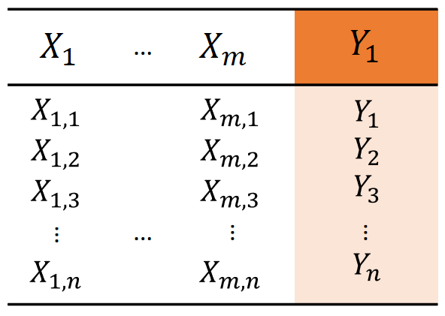
1. Taxonomy of supervised TF problems
The proposed Taxonomy
TF problems
Traffic specifications
Modelling specifications
1. Data source
2. Scope
3. Problem definition
4. Modelling
…
Temporal traffic data
Temporal-Spatial traffic data
ML dataset
Introduction
Contribution 1
Contribution 2
Contribution 3
Conclusions and Future Work

Slide 15
1. Taxonomy of supervised TF problems
Methodology for analysis of literature
Validation of the Taxonomy: Categorisation of TF literature between 2000-2019 (76 papers)
1. Data source | 2.1 Context | 2.2 Spatial coverage | 2.3 Target | 3.1 Input definition | 3.2 Time horizon | 3.3 Time step | 3.4 Output definition | 4.1 Input modelling | 4.2 Output modelling | 4.3 Step prediction | 4.4 Data pre-processing
Pt | Ub | Sg | Mt | T | ST | Md | Fd | Vc | ST | Mt | DP
Hierarchical clustering analysis to extract families of TF problems
Pt - Ub - Sg - Mt- T - ST - Md - Fd - Vc - ST - Mt - DP
Introduction
Contribution 1
Contribution 2
Contribution 3
Conclusions and Future Work

Slide 16


1. Taxonomy of supervised TF problems
Main Results
10 families of TF problems.
Complexity of TF problems changes mainly depending on their type of data sources.
Common ML methods
Decision tree-based
NNs, a few DL
Instance-based
Regression methods
Probabilistic
Moving sensors
Preprocessing
Point sensors
Transportation
User
Imputation of missing values
Normalisation
Interval sensors
Introduction
Contribution 1
Contribution 2
Contribution 3
Conclusions and Future Work

Slide 17
1. Taxonomy of supervised TF problems
Conclusions
A Taxonomy for the categorisation of supervised TF problems.
Lack of guidelines to determine the most suitable ML method to address each problem.
Scarce inclusion of data preprocessing techniques in TF.
Hard to work on the synergies between preprocessing techniques and ML algorithms in TF (the Model Selection Problem).
Introduction
Contribution 1
Contribution 2
Contribution 3
Conclusions and Future Work

Slide 18

1. Taxonomy of supervised TF problems
Publication: Journal paper
Angarita-Zapata JS, Masegosa AD, Triguero I. A Taxonomy of Traffic Forecasting Regression Problems from a Supervised Learning Perspective. IEEE Access 7 (1), 68185 - 68205, 2019.
Status: Published
Impact Factor: 4.098
Quartile: Q1 - JCR
Introduction
Contribution 1
Contribution 2
Contribution 3
Conclusions and Future Work

Slide 19
Outline
Introduction - Preliminaries and Objectives
Contributions
Conclusions and Future Work
1 - Taxonomy of Supervised Traffic Forecasting Problems
2 - Study of general-purpose AutoML in Supervised Traffic Forecasting
3 - AutoEn: a new AutoML method for Supervised Learning problems
Introduction
Contribution 1
Contribution 2
Contribution 3
Conclusions and Future Work

Slide 20
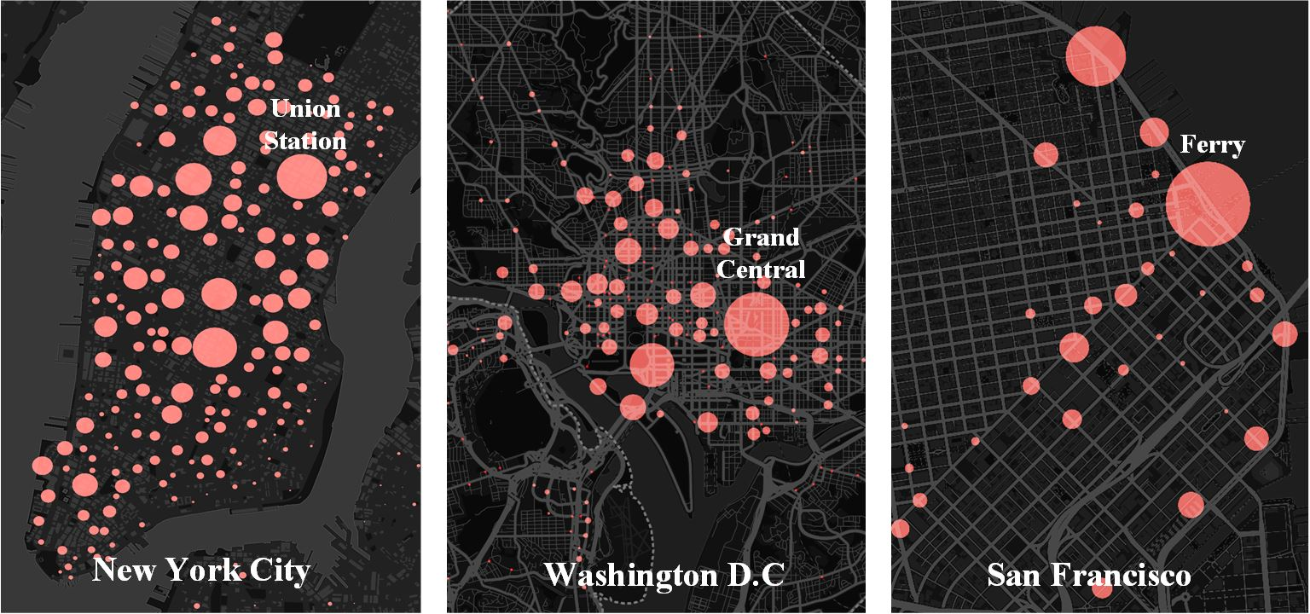
2. Study of AutoML in Supervised Traffic Forecasting
Motivation
Diverse data formats and transportation scenarios.
No free lunch theorem (there is no model that works best for every problem).
https://www.cs.rutgers.edu/~dz220/visualization.html
Model Selection
Transportation user: trial and error approach.
High impact on goals of end-users.
…
Introduction
Contribution 1
Contribution 2
Contribution 3
Conclusions and Future Work

Slide 21
2. Study of AutoML in Supervised Traffic Forecasting
Motivation
ML pipeline
Raw traffic data contains data imperfections need to be preprocessed before using ML methods.
ML pipeline = data preprocessing techniques + ML method.
Preprocessing
Model Selection
…
…
Expert ML knowledge
Time and human effort
High computational capacities
Introduction
Contribution 1
Contribution 2
Contribution 3
Conclusions and Future Work

Slide 22

2. Study of AutoML in Supervised Traffic Forecasting
Motivation
AutoML to automatically (with few or non user intervention) find competitive ML pipelines.
$${}^{1}$$
Reduces human effort and time cost.
Achieves accuracy without being specialised in the problem domain (general-purpose) where the data comes.
Preprocessing
Model Selection
…
…
ML pipeline
$${}^{1}$$
Hutter et al. (2018)
Introduction
Contribution 1
Contribution 2
Contribution 3
Conclusions and Future Work

Slide 23



2. Study of AutoML in Supervised Traffic Forecasting
Motivation: AutoML strategies
Input data
Search Space
AutoML purely based on optimisation
(e.g., AutoWEKA)
Preprocessing
ML methods
…
…
Time budget
,
$${}^{4}$$
Complex search space
The user has to define the time budget
Optimisation of individual pipelines
No consideration of previous learning experience
Yes
Propose
Configuration
Final result
No
Time Budget left?
Train and evaluate
Configuration
$${}^{4}$$
Thornton et al. (2013)
Introduction
Contribution 1
Contribution 2
Contribution 3
Conclusions and Future Work

Slide 24


2. Study of AutoML in Supervised Traffic Forecasting
Motivation: AutoML strategies
Previous Learning Experience (meta-learning)
AutoML based on previous learning experience and optimisation
(e.g., Auto-Sklearn)
,
Optimisation Component
…
…
Search Space
$${}^{5}$$
Preprocessing
ML methods
…
…
,
,
Optimisation of suggested pipelines
Yes
Propose
Configuration
Meta-learning before optimisation
The user has to define the time budget
Optimisation of individual pipelines
Does previous learning experience work in very diverse learning tasks?
Warm-start
(pipeline suggestions)
Time Budget left?
ML algorithm for
Comparison
Train and evaluate
Configuration
No
Final result
Time budget
Input data
$${}^{5}$$
Feurer et al. (2015)
Introduction
Contribution 1
Contribution 2
Contribution 3
Conclusions and Future Work

Slide 25
2. Study of AutoML in Supervised Traffic Forecasting
Motivation
AutoML has been successfully applied in other research areas, but not in TF.
To what extent general-purpose AutoML can be competitive in TF is far from being fully answered.
Can general-purpose AutoML properly work in TF? What are its strengths and weaknesses dealing with supervised learning problems such as TF?
To characterise the performance of AutoML in supervised learning problems using TF as an application area.
Question and Objective
Introduction
Contribution 1
Contribution 2
Contribution 3
Conclusions and Future Work

Slide 26
2. Study of AutoML in Supervised Traffic Forecasting
Experimental framework
Traffic data from
Caltrans System (California State, USA)
Madrid Open Data Portal (Madrid City Council, Spain)
Experimentation | AutoML method | Model assessment | Datasets | Time budget of AutoML | Baseline
Study 1 | AutoWEKA (pure optimisation) | RMSE, Traffic Speed | 18 datasets | 15, 150, 300 minutes | Random Forest, Neural Network, Support Vector Machine kNN
Study 2 | Auto-sklearn (meta-learning, optimisation, ensemble) | Geometric Mean, Traffic Level of Service | Auto-sklearn (optimisation + meta-learning) | 15, 60, 120 minutes | Auto-sklearn’s components
Introduction
Contribution 1
Contribution 2
Contribution 3
Conclusions and Future Work

Slide 27
2. Study of AutoML in Supervised Traffic Forecasting
Results Study 1: AutoWEKA, RMSE (maximisation)
Datasets |  |  | AutoWEKA
 |  |  | 15 mET | 150 mET | 300 mET
Freeway | Temporal Traffic data | 5 min | 2.87 (0.08) | 2.87 (0.08) | 2.91 (0.06)
 |  | 15 min | 5.81 (0.33) | 5.80 (0.28) | 5.82 (0.34)
 |  | 30 min | 7.35 (0.85) | 6.76 (0.41) | 6.99 (0.68)
 |  | 45 min | 8.30 (1.09) | 7.83 (1.12) | 8.53 (0.30)
 |  | 60 min | 9.12 (1.87) | 9.01 (1.67) | 9.61 (1.70)
 | Temporal-Spatial Traffic data | 5 min | 1.19 (0.05) | 1.16 (0.01) | 1.17 (0.03)
 |  | 15 min | 1.92 | 2.00 (0.47) | 2.01 (0.55)
 |  | 30 min | 2.12 (0.37) | 2.37 (0.47) | 1.90 (0.41)
 |  | 45 min | 2.50 (0.48) | 2.33 (0.49) | 2.14 (0.49)
 |  | 60 min | 3.17 (0.63) | 2.82 (0.69) | 2.26 (0.49)
Expected Behavior
“Longer time budgets
lead to better results”
…
Introduction
Contribution 1
Contribution 2
Contribution 3
Conclusions and Future Work

Slide 28
2. Study of AutoML in Supervised Traffic Forecasting
Results Study 1: AutoWEKA, RMSE (maximisation)
Datasets |  |  | AutoWEKA
 |  |  | 15 mET | 150 mET | 300 mET
Freeway | Temporal traffic data | 5 min | 2.87 | 2.87 | 2.91 (0.06)
 |  | 15 min | 5.81 | 5.80 | 5.82 (0.34)
 |  | 30 min | 7.35 | 6.76 | 6.99 (0.68)
 |  | 45 min | 8.30 | 7.83 | 8.53 (0.30)
 |  | 60 min | 9.12 | 9.01 | 9.61 (1.70)
 | Temporal-Spatial traffic data | 5 min | 1.19 | 1.16 | 1.17 (0.03)
 |  | 15 min | 1.92 | 2.00 | 2.01 (0.55)
 |  | 30 min | 2.12 | 2.37 | 1.90 (0.41)
 |  | 45 min | 2.50 | 2.33 | 2.14 (0.49)
 |  | 60 min | 3.17 | 2.82 | 2.26 (0.49)
Expected behavior
Atypical behavior
Expected Behavior
“Longer time budgets
lead to better results”
…
Introduction
Contribution 1
Contribution 2
Contribution 3
Conclusions and Future Work

Slide 29
2. Study of AutoML in Supervised Traffic Forecasting
Results Study 1: AutoWEKA, RMSE (maximisation)
Datasets |  |  | AutoWEKA
 |  |  | 15 mET | 150 mET | 300 mET
Freeway |  | 5 min | 2.87 | 2.87 | 2.91
 |  | 15 min | 5.81 | 5.80 | 5.82
 |  | 30 min | 7.35 | 6.76 | 6.99
 |  | 45 min | 8.30 | 7.83 | 8.53
 |  | 60 min | 9.12 | 9.01 | 9.61
 |  | 5 min | 1.19 | 1.16 | 1.17
 |  | 15 min | 1.92 | 2.00 | 2.01
 |  | 30 min | 2.12 | 2.37 | 1.90
 |  | 45 min | 2.50 | 2.33 | 2.14
 |  | 60 min | 3.17 | 2.82 | 2.26
Expected behavior
Atypical behavior
Expected Behavior
“Longer time budgets
lead to better results”
…
Overfitting
Introduction
Contribution 1
Contribution 2
Contribution 3
Conclusions and Future Work

Slide 30
2. Study of AutoML in Supervised Traffic Forecasting
Results Study 1: AutoWEKA, RMSE (maximisation)
Datasets |  |  | AutoWEKA
 |  |  | 15 mET | 150 mET | 300 mET
Freeway |  | 5 min | 2.87 | 2.87 | 2.91
 |  | 15 min | 5.81 | 5.80 | 5.82
 |  | 30 min | 7.35 | 6.76 | 6.99
 |  | 45 min | 8.30 | 7.83 | 8.53
 |  | 60 min | 9.12 | 9.01 | 9.61
 |  | 5 min | 1.19 | 1.16 | 1.17
 |  | 15 min | 1.92 | 2.00 | 2.01
 |  | 30 min | 2.12 | 2.37 | 1.90
 |  | 45 min | 2.50 | 2.33 | 2.14
 |  | 60 min | 3.17 | 2.82 | 2.26
Expected behavior
Atypical behavior
Expected Behavior
“Longer time budgets
lead to better results”
…
Overfitting
Introduction
Contribution 1
Contribution 2
Contribution 3
Conclusions and Future Work

Slide 31
2. Study of AutoML in Supervised Traffic Forecasting
Results Study 1: AutoWEKA, RMSE (maximisation)
Datasets |  |  | AutoWEKA |  |  | Baseline
 |  |  | 15 mET | 150 mET | 300 mET | kNN | NN | RF | SVM
Freeway |  | 5 min | 2.87 | 2.87 | 2.91 | 4.25 | 2.93 | 2.86 | 2.90
 |  | 15 min | 5.81 | 5.80 | 5.82 | 6.66 | 5.90 | 5.16 | 5.68
 |  | 30 min | 7.35 | 6.76 | 6.99 | 8.30 | 9.05 | 7.06 | 8.19
 |  | 45 min | 8.30 | 7.83 | 8.53 | 8.72 | 10.26 | 7.70 | 9.65
 |  | 60 min | 9.12 | 9.01 | 9.61 | 9.01 | 10.90 | 7.99 | 10.56
 |  | 5 min | 1.19 | 1.16 | 1.17 | 1.46 | 1.44 | 1.13 | 1.11
 |  | 15 min | 1.92 | 2.00 | 2.01 | 1.78 | 2.16 | 1.64 | 1.86
 |  | 30 min | 2.12 | 2.37 | 1.90 | 1.95 | 2.60 | 1.91 | 2.43
 |  | 45 min | 2.50 | 2.33 | 2.14 | 2.05 | 2.92 | 2.06 | 2.82
 |  | 60 min | 3.17 | 2.82 | 2.26 | 2.16 | 2.89 | 2.16 | 3.10
…
Trade-off between human effort and performance
The user has to try different time budgets for AutoWEKA
Introduction
Contribution 1
Contribution 2
Contribution 3
Conclusions and Future Work

Slide 32
2. Study of AutoML in Supervised Traffic Forecasting
Conclusions of Study 1
Test the performance of AutoML, purely based on optimisation, in supervised TF.
With a lower human effort, the transportation user can expect similar or even better results than the best baseline algorithm.
It is difficult to establish a priori the best time budget for the optimisation process.
Overfitting issues with long time budgets.
Introduction
Contribution 1
Contribution 2
Contribution 3
Conclusions and Future Work

Slide 33
2. Study of AutoML in Supervised Traffic Forecasting
Experimental framework
Traffic data from
Caltrans System (California State, USA)
Madrid Open Data Portal (Madrid City Council, Spain)
Experimentation | AutoML method | Model assessment | Datasets | Time budget of AutoML | Baseline
Study 1 | AutoWEKA (pure optimisation) | RMSE, Traffic Speed | 18 datasets | 15, 150, 300 minutes | Random Forest, Neural Network, Support Vector Machine kNN
Study 2 | Auto-sklearn (meta-learning, optimisation, ensemble) | Geometric Mean, Traffic Level of Service | 36 datasets | 15, 60, 120 minutes | Auto-sklearn’s components
Introduction
Contribution 1
Contribution 2
Contribution 3
Conclusions and Future Work

Slide 34
2. Study of AutoML in Supervised Traffic Forecasting
Experimental framework: Study 2
121 pipelines,
25 recommendations
Bayesian
Optimiser
a)
meta-learning
Build
Ensemble
Data
Preprocessing
Feature
Preprocessing
Classifier
25 recommendations -> ensemble
b)
meta-learning
Build
Ensemble
all (121) recommendations -> ensemble
c)
meta-learning
Use the best pipeline from the knowledge base
Training set
Test set
Training set
Validation set
Test set
Introduction
Contribution 1
Contribution 2
Contribution 3
Conclusions and Future Work

Slide 35
2. Study of AutoML in Supervised Traffic Forecasting
Results Study 2: Auto-Sklearn, Geometric mean (minimisation)
Datasets |  |  | Auto-Sklearn_15m | Auto-Sklearn_60m | Auto-Sklearn_120m
Freeway |  | 5 min | 0.87 | 0.88 | 0.88
 |  | 15 min | 0.75 (0.01) | 0.75 (0.01) | 0.76 (0.01)
 |  | 30 min | 0.67 | 0.67 (0.01) | 0.67 (0.01)
 |  | 45 min | 0.60 | 0.61 | 0.61
 |  | 60 min | 0.58 | 0.58 | <0.57
 |  | 5 min | 0.66 (0.01) | 0.65 (0.02) | 0.65 (0.01)
 |  | 15 min | 0.41 (0.03) | 0.42 (0.01) | 0.42 (0.02)
 |  | 30 min | 0.32 (0.02) | 0.32 (0.01) | 0.31 (0.02)
 |  | 45 min | 0.27 (0.01) | 0.28 (0.03) | 0.29 (0.01)
 |  | 60 min | 0.27 (0.02) | 0.25 (0.02) | 0.27 (0.02)
Expected Behavior
“Longer time budgets
lead to better results”
…
Introduction
Contribution 1
Contribution 2
Contribution 3
Conclusions and Future Work

Slide 36
2. Study of AutoML in Supervised Traffic Forecasting
Results Study 2: Auto-Sklearn, Geometric mean (minimisation)
Datasets |  |  | Auto-Sklearn_15m | Auto-Sklearn_60m | Auto-Sklearn_120m
Freeway |  | 5 min | 0.87 | 0.88 | 0.88
 |  | 15 min | 0.75 | 0.75 | 0.76
 |  | 30 min | 0.67 | 0.67 | 0.67
 |  | 45 min | 0.60 | 0.61 | 0.61
 |  | 60 min | 0.58 | 0.58 | 0.57
 |  | 5 min | 0.66 | 0.65 | 0.65
 |  | 15 min | 0.41 | 0.42 | 0.42
 |  | 30 min | 0.32 | 0.32 | 0.31
 |  | 45 min | 0.27 | 0.28 | 0.29
 |  | 60 min | 0.27 | 0.25 | 0.27
Expected behavior
Atypical behavior
Expected Behavior
“Longer time budgets
lead to better results”
…
Overfitting
Introduction
Contribution 1
Contribution 2
Contribution 3
Conclusions and Future Work

Slide 37
2. Study of AutoML in Supervised Traffic Forecasting
Results Study 2: Auto-Sklearn, Geometric mean (minimisation)
Datasets |  |  | Auto-Sklearn_15m | Auto-Sklearn_60m | Auto-Sklearn_120m
Freeway |  | 5 min | 0.87 | 0.88 | 0.88
 |  | 15 min | 0.75 | 0.75 | 0.76
 |  | 30 min | 0.67 | 0.67 | 0.67
 |  | 45 min | 0.60 | 0.61 | 0.61
 |  | 60 min | 0.58 | 0.58 | 0.57
 |  | 5 min | 0.66 | 0.65 | 0.65
 |  | 15 min | 0.41 | 0.42 | 0.42
 |  | 30 min | 0.32 | 0.32 | 0.31
 |  | 45 min | 0.27 | 0.28 | 0.29
 |  | 60 min | 0.27 | 0.25 | 0.27
Expected behavior
Atypical behavior
Expected Behavior
“Longer time budgets
lead to better results”
…
Overfitting
Introduction
Contribution 1
Contribution 2
Contribution 3
Conclusions and Future Work

Slide 38
2. Study of AutoML in Supervised Traffic Forecasting
Results Study 2: Auto-Sklearn, Geometric mean (minimisation)
Datasets |  |  | BestPipeVal | Meta-learning Ensemble_25 | Meta-learning ensemble_25-121 | Auto-Sklearn_15m | Auto-Sklearn_60m | Auto-Sklearn_120m
Freeway |  | 5 min | 0.97 | 0.87 | 0.88 | 0.87 | 0.88 | 0.88
 |  | 15 min | 0.96 | 0.76 | 0.76 | 0.75 | 0.75 | 0.76
 |  | 30 min | 0.94 | 0.66 | 0.66 | 0.67 | 0.67 | 0.67
 |  | 45 min | 0.60 | 0.61 | 0.61 | 0.60 | 0.61 | 0.61
 |  | 60 min | 0.56 | 0.57 | 0.57 | 0.58 | 0.58 | 0.57
 |  | 5 min | 0.91 | 0.65 | 0.66 | 0.66 | 0.65 | 0.65
 |  | 15 min | 0.47 | 0.41 | 0.42 | 0.41 | 0.42 | 0.42
 |  | 30 min | 0.46 | 0.31 | 0.34 | 0.32 | 0.32 | 0.31
 |  | 45 min | 0.44 | 0.25 | 0.39 | 0.27 | 0.28 | 0.29
 |  | 60 min | 0.41 | 0.22 | 0.23 | 0.27 | 0.25 | 0.27
…
Better results with a less complex AutoML strategy
No predefined time budget
Introduction
Contribution 1
Contribution 2
Contribution 3
Conclusions and Future Work

Slide 39
2. Study of AutoML in Supervised Traffic Forecasting
Conclusions of Study 2: AutoML based on previous experience + optimisation
Test the performance of AutoML, based on meta-learning (previous learning experience), optimisation and ensemble learning, in supervised TF.
Long execution times can cause overfitting issues.
Hard to define beforehand a competitive time budget.
A less complex AutoML strategy can have competitive results.
Introduction
Contribution 1
Contribution 2
Contribution 3
Conclusions and Future Work

Slide 40


2. Study of AutoML in Supervised Traffic Forecasting
Publications: Conference papers
Angarita-Zapata JS, Masegosa AD, Triguero I. General-Purpose Automated Machine Learning for Transportation: A Case Study of Auto-sklearn for Traffic Forecasting.
18th International Conference on Information Processing and Management of Uncertainty in Knowledge-Based Systems
Place: Lisbon, Portugal
Year: 2020
Angarita-Zapata JS, Triguero I, Masegosa AD. A preliminary study on automatic algorithm selection for short-term traffic forecasting.
XII International Symposium on Intelligent and Distributed Computing Place: Bilbao, Spain
Year: 2018
Introduction
Contribution 1
Contribution 2
Contribution 3
Conclusions and Future Work

Slide 41

2. Study of AutoML in Supervised Traffic Forecasting
Publications: Book Chapter
Angarita-Zapata JS, Masegosa AD, Triguero I. Evaluating automated machine learning on supervised regression traffic forecasting problems.
Book Title: Studies in Computational Intelligence, vol 872.Springer Cham, 2020
Status: Published
Introduction
Contribution 1
Contribution 2
Contribution 3
Conclusions and Future Work

Slide 42
Outline
Introduction - Preliminaries and Objectives
Contributions
Conclusions and Future Work
1 - Taxonomy of Supervised Traffic Forecasting Problems
2 - Study of general-purpose AutoML in Supervised Traffic Forecasting
3 - AutoEn: a new AutoML method for Supervised Learning problems
Introduction
Contribution 1
Contribution 2
Contribution 3
Conclusions and Future Work

Slide 43
3. AutoEn: AutoML method for supervised problems
Motivation
Is it possible to build a new general-purpose AutoML approach that mitigates current AutoML’s drawbacks and better adapts to specific learning tasks such as TF? To improve the performance of AutoML in supervised learning problems, including
supervised TF.
Question and Objective
Introduction
Contribution 1
Contribution 2
Contribution 3
Conclusions and Future Work

Slide 44
3. AutoEn: AutoML method for supervised problems
AutoEn: general overview
Portfolio of pipelines (~100 pipelines):
No predefined time budget
Ensemble to deal with overfitting
Less complex AutoML strategy
Train and Validate
Pipelines
Decision tree-based
NNs
Instance-based
Regression methods
Probabilistic
Ensembles
Base of pipelines
Ensemble Construction
(stepwise selection)
…
Evaluation
Final Result
(Ensemble of pipelines)
Input data
Introduction
Contribution 1
Contribution 2
Contribution 3
Conclusions and Future Work

Slide 45
3. AutoEn: AutoML method for supervised problems
1.
AutoEn: workflow
Input dataset
Training set
Test set
2.
Training set
Test set
Validation set
No predefined time Budget.
Ensemble less prone to overffiting
Less complex strategy
No optimisation of individual pipelines
3.
Base of pipelines
No
4.
Pipeline
evaluation
…
5.
Ensemble
construction
6.
7.
Train +
Validation sets
Ensemble re-
training
Final
performance
Introduction
Contribution 1
Contribution 2
Contribution 3
Conclusions and Future Work

Slide 46
3. AutoEn: AutoML method for supervised problems
Experimental framework
Data from AutoML open benchmark (Gijsbers et al., 2019)
Experimentation | Datasets | Model assessment | Baseline
General-purpose domain | 16 binary 12 multi-class | ROC_AUC, Log loss | AutoWEKA (1, 4 hours) Auto-Sklearn (1,4 hours) Random Forest, BestV_ML
Traffic Forecasting | 18 multi-class | Log loss 10-CV | Random Forest, BestV_ML
Introduction
Contribution 1
Contribution 2
Contribution 3
Conclusions and Future Work

Slide 47
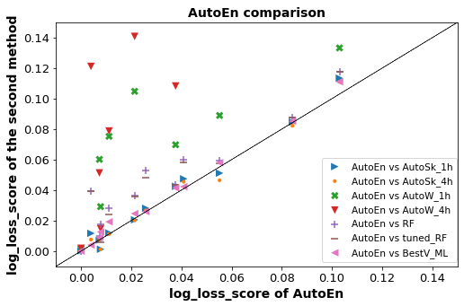
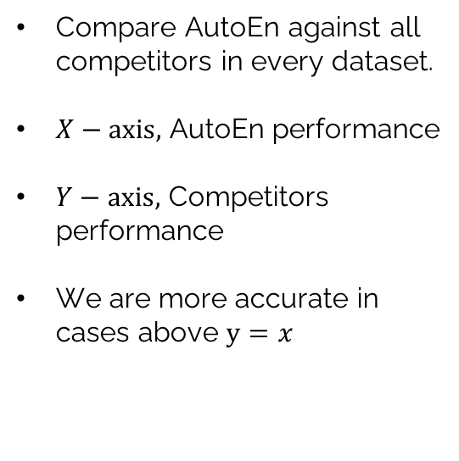
3. AutoEn: AutoML method for supervised problems
Multi-class results: General-purpose domain, Log loss (minimisation)
Compare AutoEn against all competitors in every dataset.
$X−axis,$ AutoEn performance
$Y−axis,$ Competitors performance
We are more accurate in cases above $y=x$
Introduction
Contribution 1
Contribution 2
Contribution 3
Conclusions and Future Work

Slide 48
3. AutoEn: AutoML method for supervised problems
Multi-class results: General-purpose domain, Log loss (minimisation)
Better performance without:
Predefined time Budget
Optimisation of individual pipelines
Less complexity
AutoWEKA (1, 4 hours)
(pure optimisation)
Introduction
Contribution 1
Contribution 2
Contribution 3
Conclusions and Future Work

Slide 49
3. AutoEn: AutoML method for supervised problems
Multi-class results: General-purpose domain, Log loss (minimisation)
Better performance without:
Predefined time Budget
Optimisation of individual pipelines
Less complexity
Auto-Sklearn (1, 4 hours)
(meta-learning,
optimisation, ensemble)
Introduction
Contribution 1
Contribution 2
Contribution 3
Conclusions and Future Work

Slide 50
3. AutoEn: AutoML method for supervised problems
Experimental framework
Traffic data from
Caltrans System (California State, USA)
Madrid Open Data Portal (Madrid City Council, Spain)
Experimentation | Datasets | Model assessment | Baseline
General-purpose domain | 16 binary 12 multi-class | ROC_AUC, Log loss | AutoWEKA (1, 4 hours) Auto-Sklearn (1,4 hours) Random Forest, BestV_ML
Traffic Forecasting | 18 multi-class | Log loss | Auto-Sklearn (15, 60, 150 min) Random Forest, BestV_ML
Introduction
Contribution 1
Contribution 2
Contribution 3
Conclusions and Future Work

Slide 51
3. AutoEn: AutoML method for supervised problems
Results: Traffic Forecasting domain, Log loss (minimisation)
Datasets |  |  | AutoEn | Auto-Sklearn_15m | Auto-Sklearn_60m | Auto-Sklearn_150m | BestV_ML | Random Forest
Freeway |  | 5 min | 0.220 | 0.229 | 0.225 | 0.223 | 0.244 | 0.233
 |  | 15 min | 0.340 | 0.360 | 0.346 | 0.348 | 0.371 | 0.366
 |  | 30 min | 0.381 | 0.398 | 0.389 | 0.391 | 0.417 | 0.442
 |  | 45 min | 0.393 | 0.438 | 0.429 | 0.420 | 0.439 | 0.472
 |  | 60 min | 0.401 | 0.499 | 0.454 | 0.453 | 0.424 | 0.489
 |  | 5 min | 0.128 | 0.117 | 0.114 | 0.116 | 0.142 | 0.133
 |  | 15 min | 0.166 | 0.163 | 0.164 | 0.169 | 0.187 | 0.185
 |  | 30 min | 0.186 | 0.193 | 0.192 | 0.197 | 0.212 | 0.218
 |  | 45 min | 0.180 | 0.195 | 0.182 | 0.182 | 0.199 | 0.217
 |  | 60 min | 0.182 | 0.218 | 0.197 | 0.204 | 0.185 | 0.229
…
Introduction
Contribution 1
Contribution 2
Contribution 3
Conclusions and Future Work

Slide 52
3. AutoEn: AutoML method for supervised problems
Results: Traffic Forecasting domain, Log loss (minimisation)
Datasets |  |  | AutoEn | Auto-Sklearn_15m | Auto-Sklearn_60m | Auto-Sklearn_150m | BestV_ML | Random Forest
Freeway |  | 5 min | 0.220 | 0.229 | 0.225 | 0.223 | 0.244 | 0.233
 |  | 15 min | 0.340 | 0.360 | 0.346 | 0.348 | 0.371 | 0.366
 |  | 30 min | 0.381 | 0.398 | 0.389 | 0.391 | 0.417 | 0.442
 |  | 45 min | 0.393 | 0.438 | 0.429 | 0.420 | 0.439 | 0.472
 |  | 60 min | 0.401 | 0.499 | 0.454 | 0.453 | 0.424 | 0.489
 |  | 5 min | 0.128 | 0.117 | 0.114 | 0.116 | 0.142 | 0.133
 |  | 15 min | 0.166 | 0.163 | 0.164 | 0.169 | 0.187 | 0.185
 |  | 30 min | 0.186 | 0.193 | 0.192 | 0.197 | 0.212 | 0.218
 |  | 45 min | 0.180 | 0.195 | 0.182 | 0.182 | 0.199 | 0.217
 |  | 60 min | 0.182 | 0.218 | 0.197 | 0.204 | 0.185 | 0.229
…
No predefined time Budget
Less overfitting and less complexity
Introduction
Contribution 1
Contribution 2
Contribution 3
Conclusions and Future Work

Slide 53
3. AutoEn: AutoML method for supervised problems
Conclusions
A new AutoML method for supervised learning problems.
AutoML focused on ensembles avoids overfitting and predefined time budgets.
AutoML of multi-classifiers is a strategy less complex that keeps high performance.
AutoEn is better and more competitive than state-of-the-art AutoML approaches in TF problems.
Introduction
Contribution 1
Contribution 2
Contribution 3
Conclusions and Future Work

Slide 54
3. AutoEn: AutoML method for supervised problems
Publication: Journal paper
Angarita-Zapata JS, Masegosa AD, Triguero I. Ensembles are all you need: An AutoML method based on ensembles of predefined machine learning pipelines.
working paper
Status: working paper submitted to first review last May, 2020.
Introduction
Contribution 1
Contribution 2
Contribution 3
Conclusions and Future Work

Slide 55
Outline
Introduction - Preliminaries and Objectives
Contributions
Conclusions and Future Work
1 - Taxonomy of Supervised Traffic Forecasting Problems
2 - Study of general-purpose AutoML in Supervised Traffic Forecasting
3 - AutoEn: a new AutoML method for Supervised Learning problems
Introduction
Contribution 1
Contribution 2
Contribution 3
Conclusions and Future Work

Slide 56
Conclusions and Future Work
Concluding remarks I
Objective 1
To understand, organise and systematise the existing knowledge about TF problems modelled from a supervised learning perspective.
Main Conclusions
The Taxonomy to categorise supervised TF problems.
The lack of guidelines to approach the MSP in TF.
The absence of data prepossessing in the modelling process of TF.
The MSP in transportation: time and human costs.
Introduction
Contribution 1
Contribution 2
Contribution 3
Conclusions and Future Work

Slide 57
Conclusions and Future Work
Concluding remarks II
Objective 2
To characterise the performance of general-purpose AutoML in supervised learning problems using TF as an application area.
Main conclusions
TF is a research area not previously addressed by AutoML.
A comprehensive study of general-purpose AutoML in TF.
Current AutoML strategies suffer from overfitting, low scalability, and previous learning experience does not work properly in TF.
Introduction
Contribution 1
Contribution 2
Contribution 3
Conclusions and Future Work

Slide 58
Conclusions and Future Work
Concluding remarks III
Objective 3
To improve the performance of AutoML in supervised learning problems, including TF.
Main conclusions
AutoEn, a new AutoML method based on ensembles of multiple-classifiers.
AutoEn obtained better or competitive results (in terms of accuracy) with respect to the AutoML state-of-the-art approaches (general-purpose domain and TF).
AutoEn is a straightforward method less prone to overfitting and does not need predefined time budgets.
AutoEn paths the way towards AutoML frameworks purely based on ensemble strategies.
Introduction
Contribution 1
Contribution 2
Contribution 3
Conclusions and Future Work

Slide 59
Conclusions and Future Work
Future Work
Deep learning approaches and new traffic data sources
Bogaerts T, Masegosa AS, Angarita-Zapata JS, Onieva E, Hellinckx P. A graph CNN-LSTM neural network for short and long-term traffic forecasting based on trajectory data. Transportation Research Part C: Emerging Technologies 112, 62-77, 2020
Automated Deep learning to find:
The right architecture (neural architecture search)
The most competitive hyperparameter setting
More autonomous AutoML system to use the best of their inner search strategies
Meta-learning, Optimisation, Ensemble learning (when to use all of them? when to use some of them?)
Introduction
Contribution 1
Contribution 2
Contribution 3
Conclusions and Future Work

Slide 60


Acknowledgements
This work was supported by the European Union Horizon 2020 Research and Innovation Programme under Agreement 769142, and the Marie Sklodoska-Curie under Agreement 665959.

Slide 61
AutoML to support Model Selection in Supervised Traffic Forecasting
Juan S. Angarita Zapata
Supervisors: Antonio D. Masegosa, Isaac Triguero
DeustoTech, Faculty of Engineering, University of Deusto, Spain
Computational Optimisation and Learning Lab, University of Nottingham, UK
November 25, 2020

