Slide 1

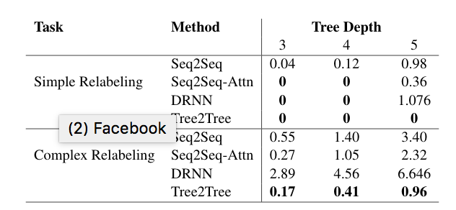
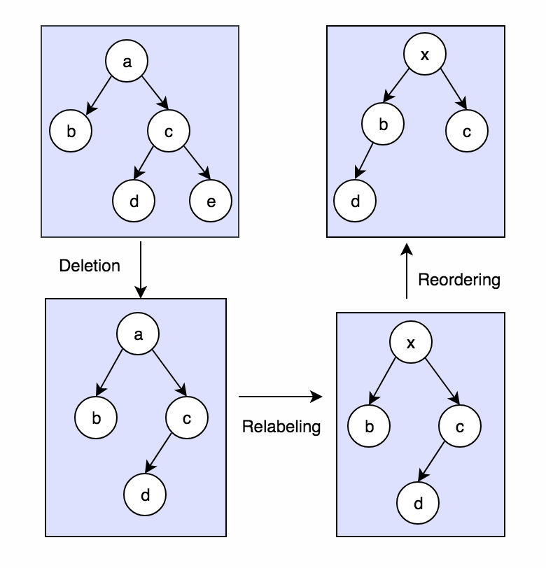
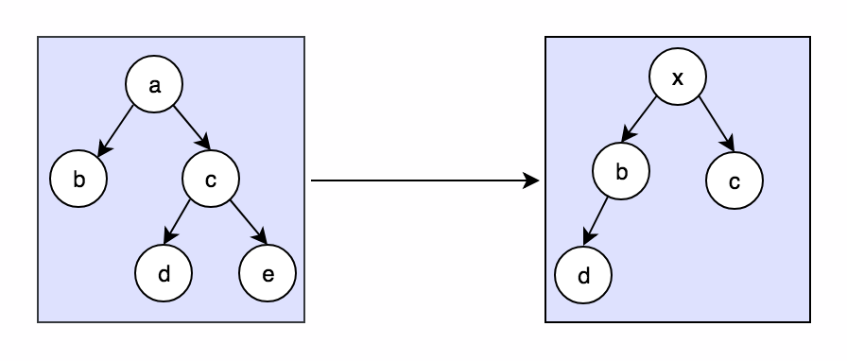
Tree Learning
Yogitha Chilukuri, João Sedoc and Lyle Ungar
Computer & Information Science Department University of Pennsylvania
Motivation
Encoder: Sequential encoder
Decoder: Doubly recurrent Breadth First Search decoder.
Results
Our research focuses on the ability of neural methods to learn how to tranduce one tree structure into another by a sequence of tree operations.
Tree2Tree Model
Not only models the information between parent and child but encodes information of the complete left subtree.
Encoder: TreeLSTM encoder
Decoder: Depth First Search decoder
Tree Transductions
Evaluation
Future Work
Extend our work to NLP tasks such dialogue generation and text simplification.
Experiment with different setting and synthetic tasks to improve training time.
We evaluated the different methods using tree edit distance (TED) between the predicted tree and the actual tree.
TED is the number of insertions, deletions, and modifications to make the two trees equivalent, while aligning the trees.
References
Alvarez-Melis, David, and Tommi S. Jaakkola. "Tree-structured decoding with doubly-recurrent neural networks." (2016).
Decoder: Doubly recurrent Breadth First Search decoder.
Tai, Kuo-Chung. "The tree-to-tree correction problem." Journal of the ACM (JACM) 26.3 (1979): 422-433.
Cowan, Brooke Alissa. A tree-to-tree model for statistical machine translation. Diss. Massachusetts Institute of Technology, 2008
Method
TED = 4
Seq2Tree Model – Doubly Recurrent NN
Separately models the flow of information between parent and child nodes, and between siblings.
Relabel node a to x
Delete node e
Delete node d from right subtree
Delete node d from left subtree

