Slide 1
iHome
Vishal Balasubramanian.
National Public School,Gopalapuram, Chennai

Slide 2
What is iHome?
These days IOT and Smart Home are some of the buzzwords in the computer science field. Smart home devices are like a special kind of devices which can connect to the internet so that you can control them using your Phone,Amazon Echo, Google Home etc.
However, we have many un-smart devices in our homes. These devices may include light bulbs, Fans DVD Players etc. These devices cannot connect to the internet. My project iHome lets you control these ‘un-smart’ devices using the Amazon Echo ☺

Slide 3


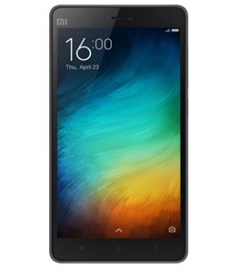


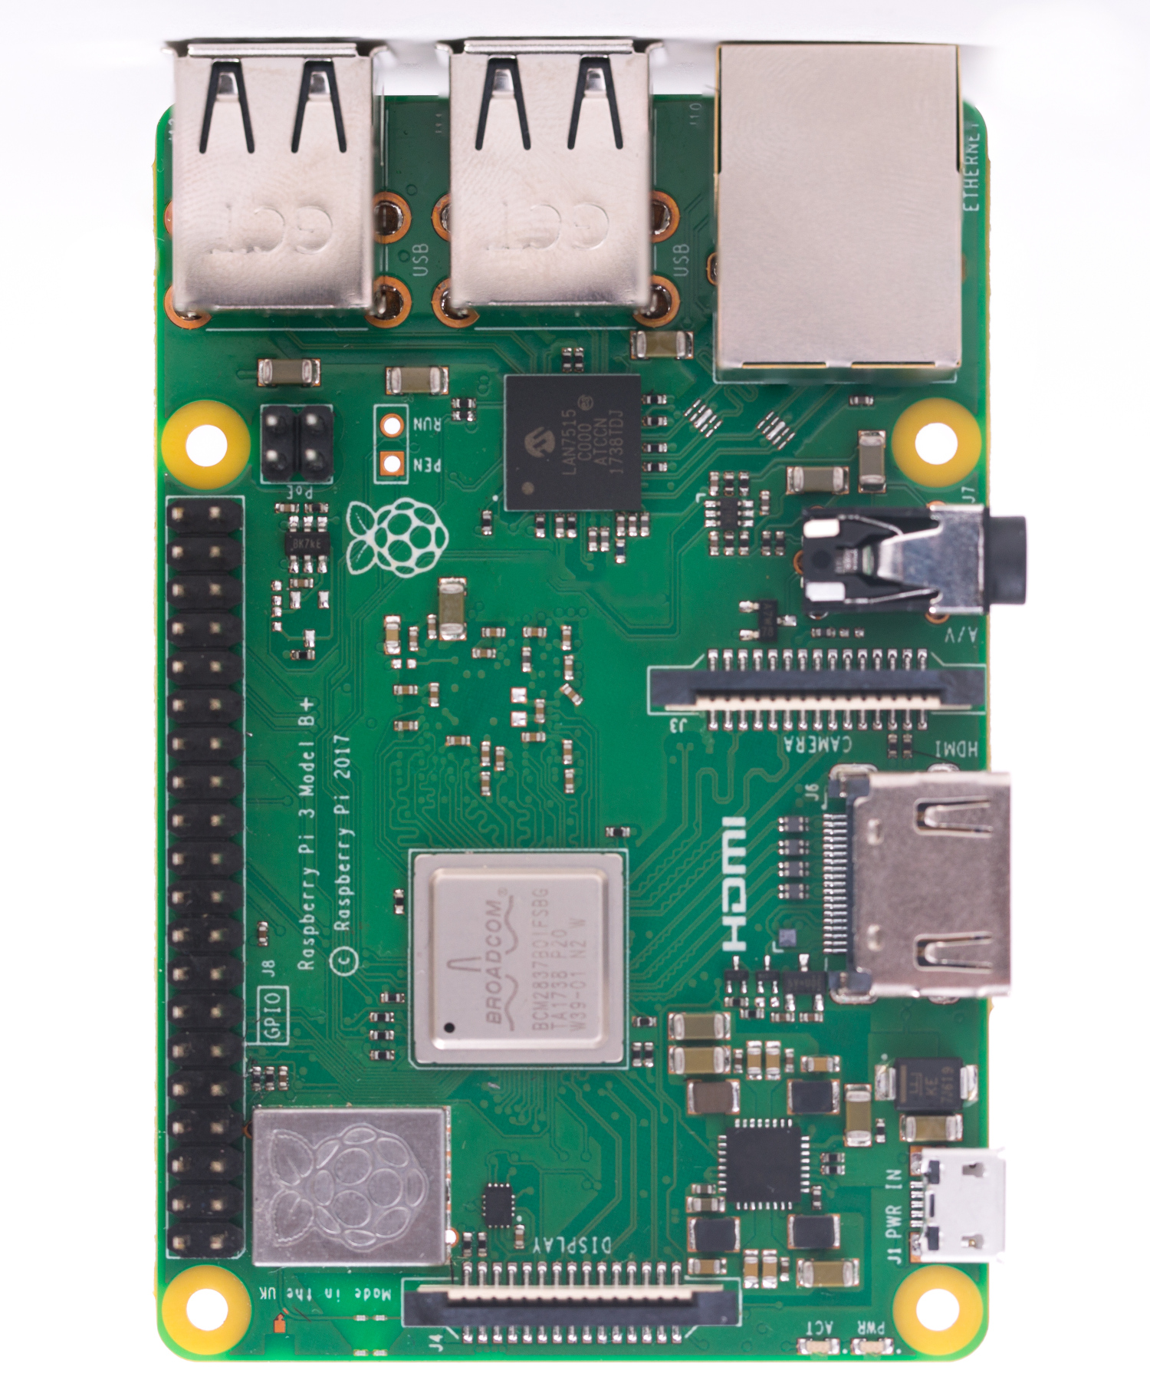
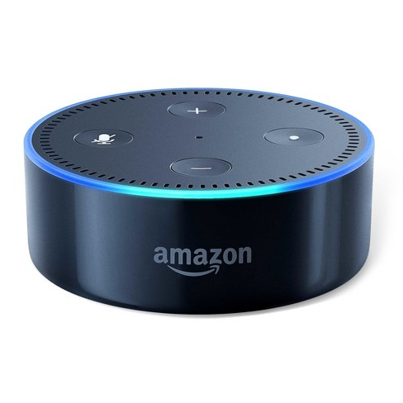
iHome Design
iHome Server
(Alexa Skill)
Internet
iHome Android App
Google Pubsub
Alexa
Voice Service
Raspberry Pi
“Alexa, open iHome
“Turn on DVD Player”

Slide 4
Alexa Skill Supported commands
“Alexa, Open iHome”(This is for opening the Alexa Skill)
“Turn on the DVD Player”(For turning on DVD Player)
“Play”,”Pause”,”Stop”,”Eject”(for DVD Player Controls)
“Turn on the bedroom Fan”(For turning on bedroom fan)
“Turn on the living room light”(For turning on living room light)
“Turn on the living room fan”(For turning on living room Fan)
“Turn off the DVD Player”(For turning off DVD Player)
“Turn off the bedroom Fan”(For turning off bedroom fan)
“Turn off the living room light”(For turning off living room light)
“Turn off the living room fan”(For turning off living room Fan)

Slide 5
Alexa Skill
An Amazon Alexa Skill has been created so that you can control iHome through your Voice
On Receiving the Voice Command, Alexa Server interprets and submits the corresponding ‘intent’ to Alexa Skill
The Voice command to intent mapping has been defined in Alexa Server
On Receiving the Intent, the Alexa Skill publishes the corresponding message in PubSub Service
The Alexa skill has been implemented using Python and hosted in pythonanywhere.com

Slide 6
iHome Client
iHome Client App runs in Raspberry pi
It polls the Google’s Pubsub Service for messages
When a message comes, the app controls the devices using the GPIO Pins.
This iHome Client app has been implemented using Python

Slide 7
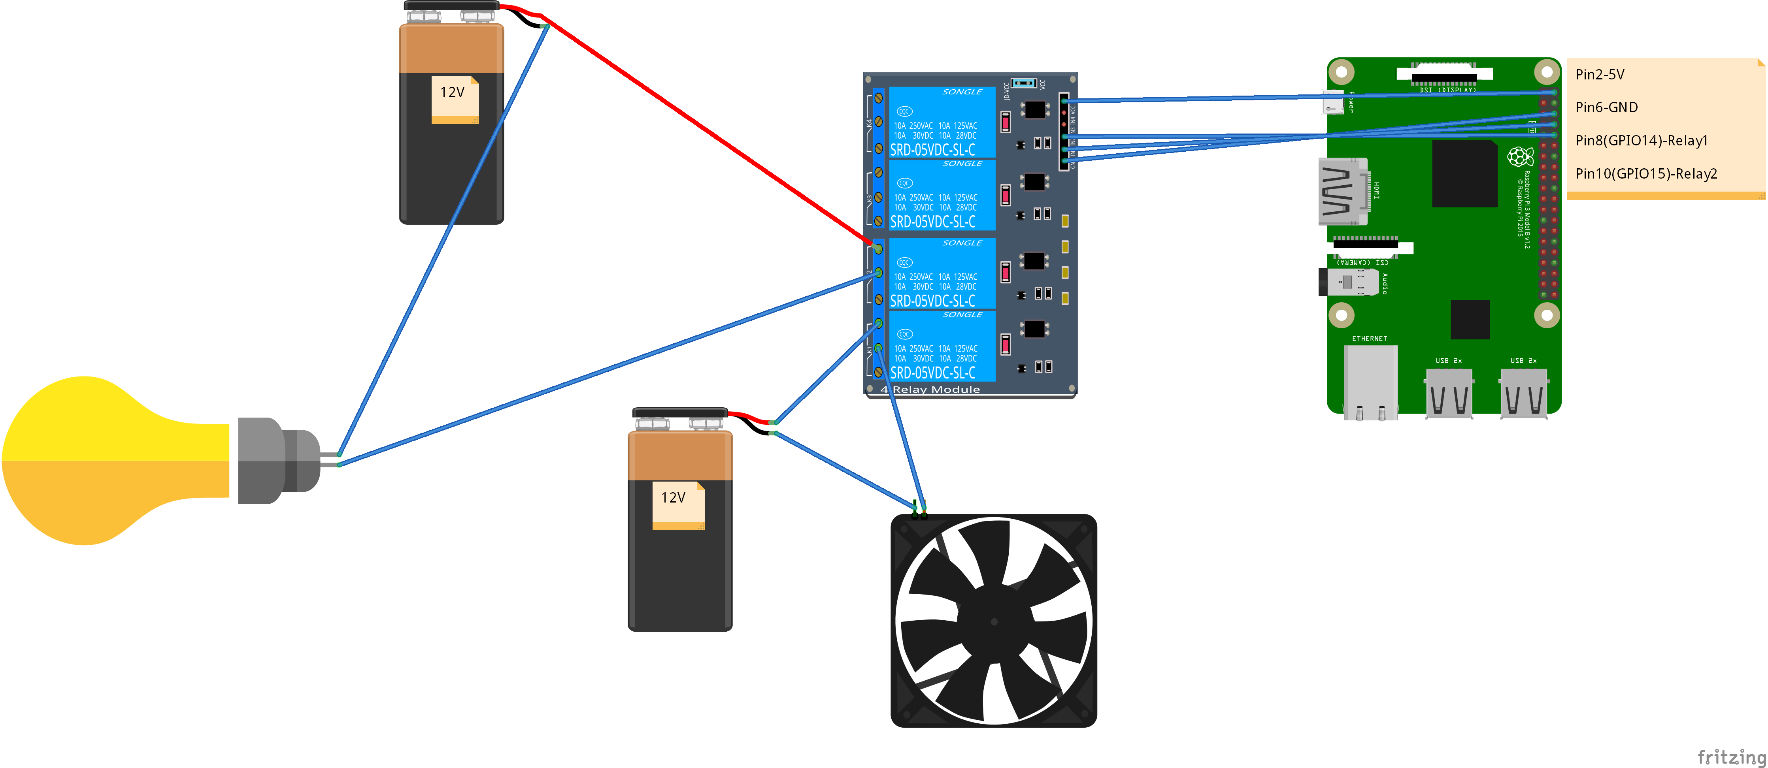
iHome Relay Circuit

Slide 8
iHome Relay Control
The unsmart devices are connected through Relay
Relays are controlled by GPIO Pins of Raspberry Pi
iHome Client sets the GPIO Pins(which are connected to relays) high or Low based on the message received from Pubsub Service

Slide 9
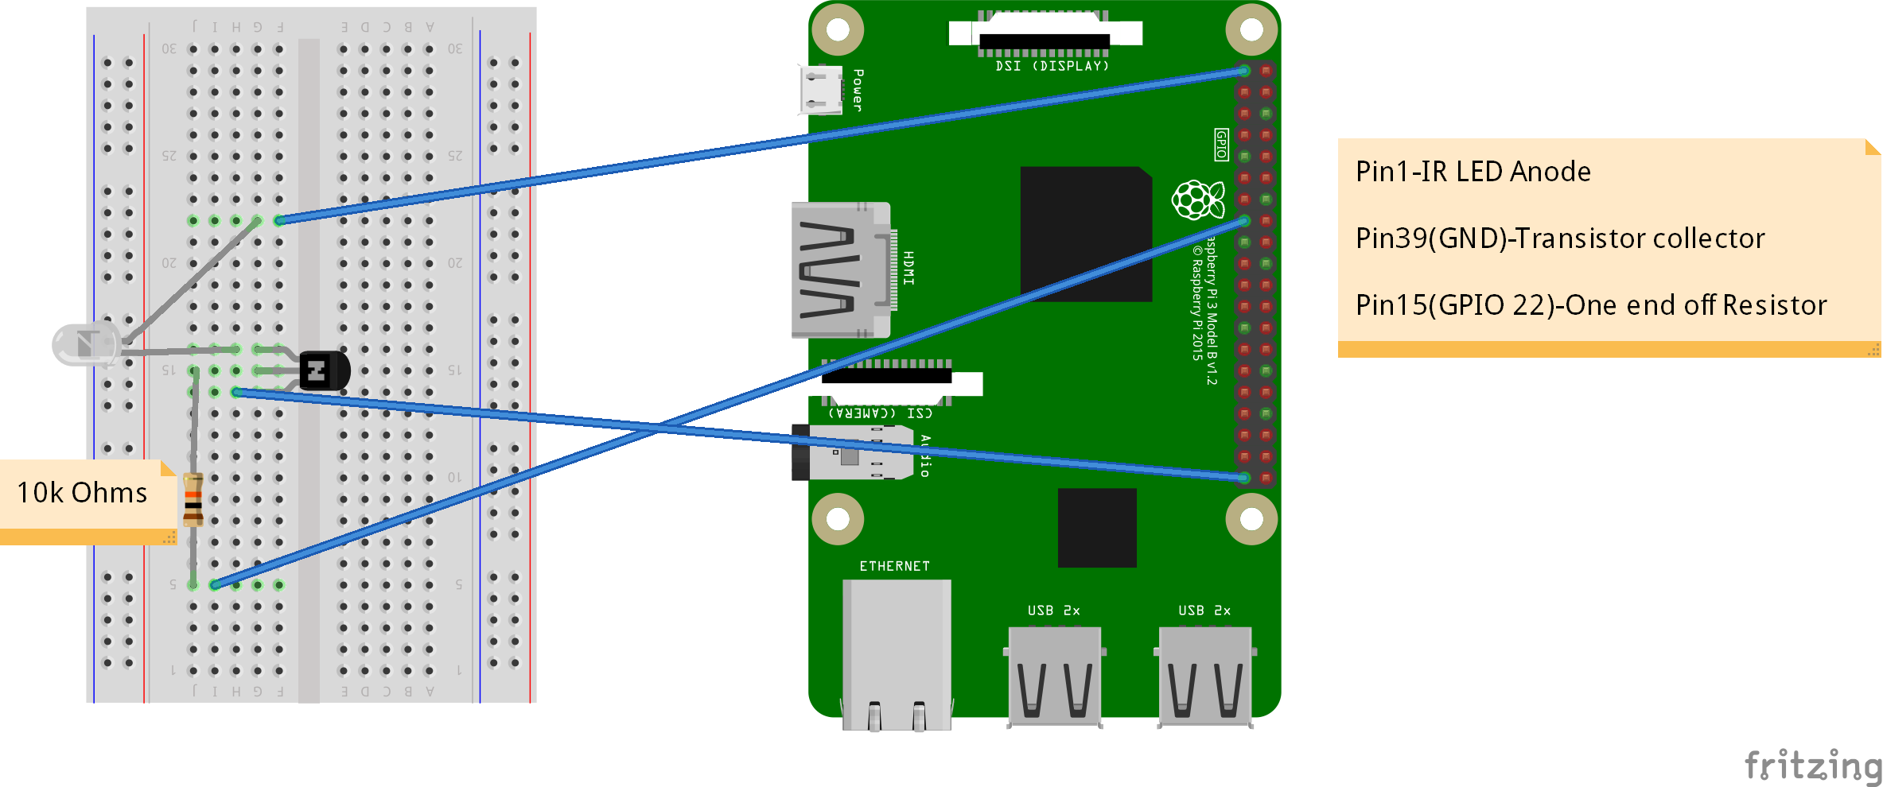
iHome IR Circuit
An NPN Transistor is used to extend IR Signals. Without it, the IR signal would be too weak
The IR LED is connected to GPIO 22

Slide 10
How does IR LED Work
There is a software called LIRC which is mainly used for sending IR Signals through an IR Circuit. The ‘IR Remote control’ commands are executed using Linux Command
When iHome Client receives an ‘IR control’ message from Pubsub Service, the Linux command gets executed

Slide 11
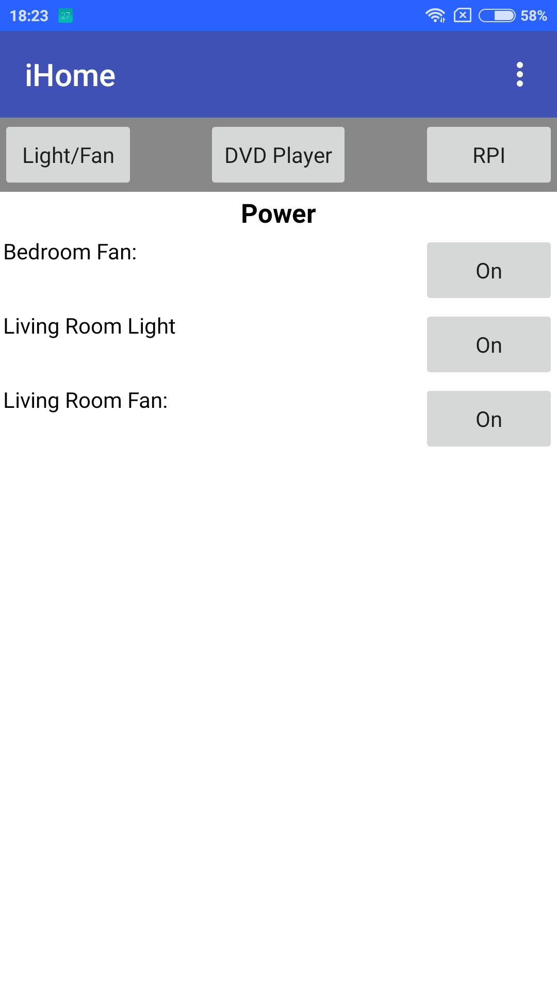
iHome App
Sometimes, It may be convenient to control devices by using an app instead of Voice. Due to this reason, I have built an iHome App which will help you to communicate and control connected devices
This app is built by using MIT Appinventor
The app sends the request to iHome Server(hosted at PythonAnywhere) and rest of the flow is same

Slide 12
Future Enhancements
These days, Manufacturers use RF Signal remotes for better Range. iHome can be extended for RF Signal Remotes
Any IR remote devices(TV,AC,Set top Boxes etc) can be controlled and iHome can be extended for the same
IR circuit can be extended for better range
At present, iHome is a prototype and can be used by one user. This can be extended for multiple users

Slide 13
Thank You!!!
Have a nice Day!!!

