Slide 1
Ioffe Magnet
Design Criteria
Risa Hocking
Research Engineer
Notes:
Maximum character recommendations:
Contact info: 145
Main title: 38
Secondary title: 100
Update all text fields with your relevant information.

Slide 2
Ioffe Overview
PURPOSE
Generate a magnetic field perpendicular to the walls of the cavity to prevent tritium recombination
Order of 10 mT magnitude
Decay as quickly as possible
Provide the cavity for CRES (consequence)
PROTOTYPE DIFFERENCES
Maximum length of 2.5 m

Slide 3
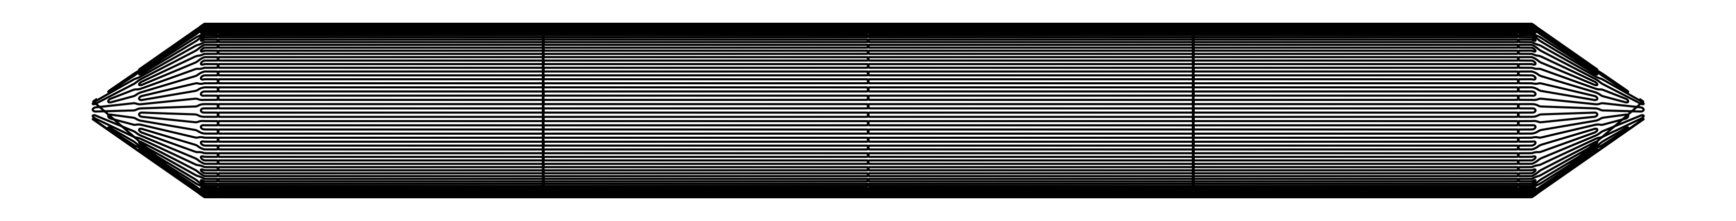
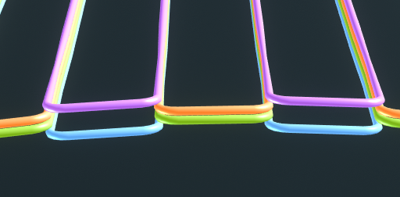
Spatial envelope (full scale)
5.0 m
1.25 m
0.48 m
35°
XZ View
0.14 m
R_{cavity, inner} = 327.0 mm
R_{cond, inner} = 334.35 mm
R_{cond, outer} = 338.70 mm
XY View

Slide 4
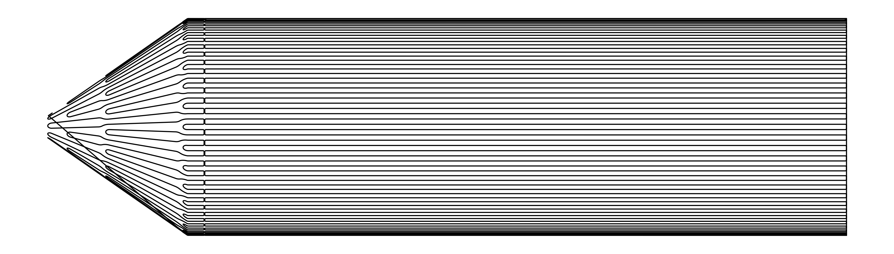
Spatial envelope (prototype)
2.0 m
0.48 m
Do you need both cones?
Can we do a 1.25 m section instead so that we can use it to scale up to the full ~5 m size?
35°
0.14 m
XZ View
R_{cavity, inner} = 327.0 mm
R_{cond, inner} = 334.35 mm
R_{cond, outer} = 338.70 mm
XY View

Slide 5
Former material
What is the impact of the alloying constituents on magnetic susceptibility?
Are they available in a form factor that we need?
Plating needed on inside for cavity?
Cost of material (considering cost of machining)?
Initially Al 6061
Very different CTE than Cu/NbTi cable
Copper-based alloys have similar CTE
Material | Composition | Young’s modulus (GPa) | Yield strength (MPa) | Tensile strength (MPa)
Al 6061 | Mg (0.8-1.2%), Si (0.4-0.8%), Fe (0.7%), Cu (0.15-0.4%), Cr (0.04-0.35%), Zn (0.25%), Ti (0.15%), Mn (0.15%) | 68 | 240 | 290
Copper-silicon (C87500) | Pb (0.09%), Zn (12.0-16.0%), Al (0.5%), Si (3.0-5.0%) | 106 | 165 | 414
Silicon bronze (C87300) | Pb (0.09%), Zn (0.25%), Fe (0.2%), Mn (0.8-1.5%), Si (3.5-4.5%) | 112 | 124 | 310
C18160 | Fe (0.10%), Cr (0.2-1.2%), Si (0.1%), Zr (0.05-0.25%) | 137 | 448-496 | 483-621

Slide 6
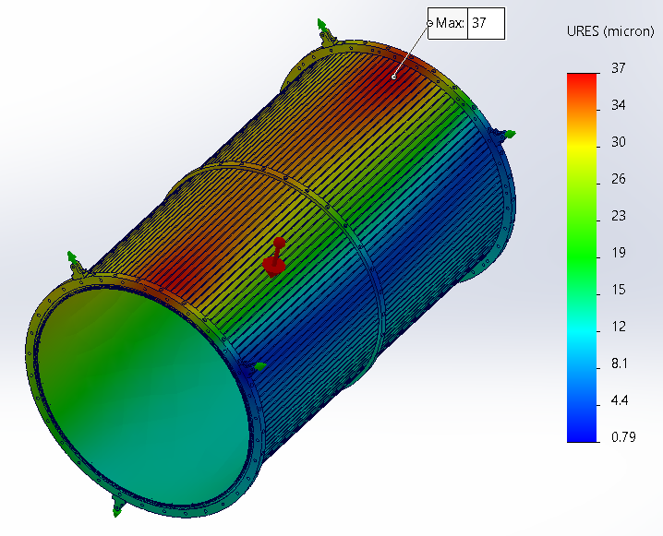
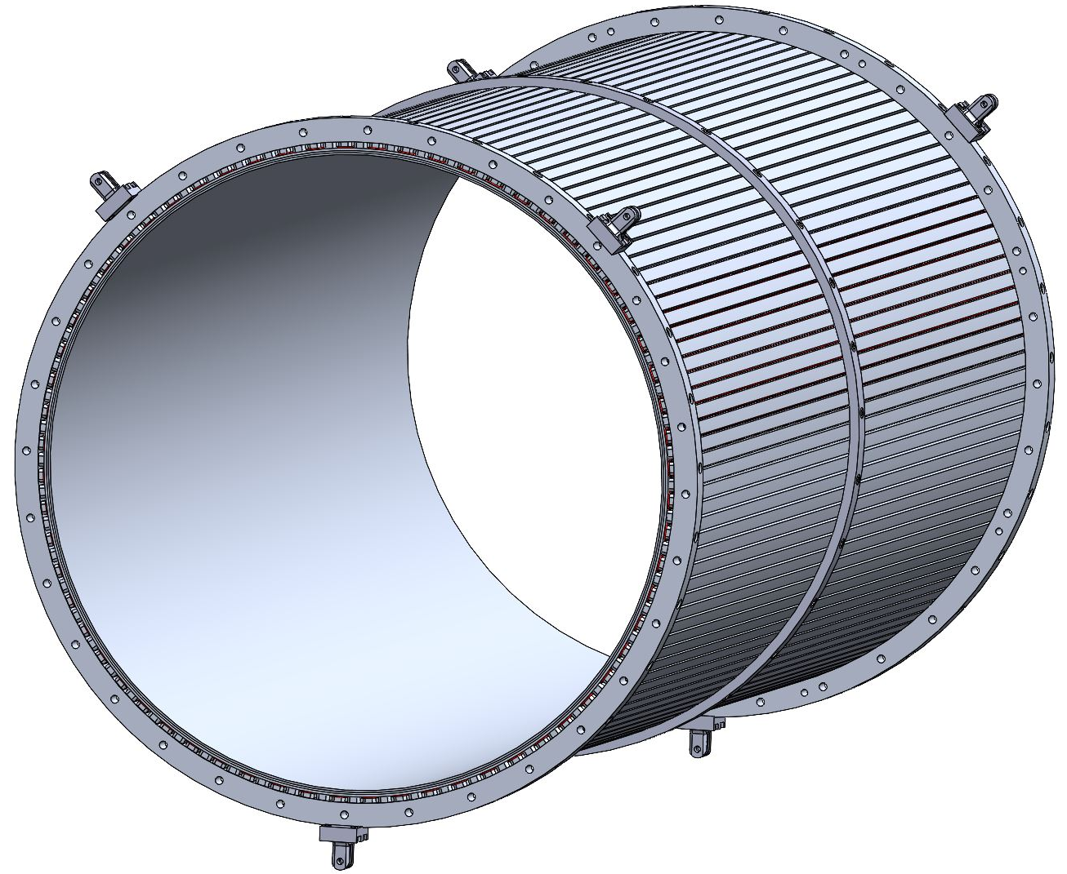
Stiffening of cylindrical segments
Maximum deflection = 37 µm under gravity
13 mm
6.65 mm
Stiffening ring thickness = 10 mm
ID = 654 mm
OD = 680 mm
Note: calculations performed with Al 6061. Need to redo with new alloy.
Suspension ring thickness = 25 mm
Notes:
Oakridge had success with >6’ diameter indium seals

Slide 7
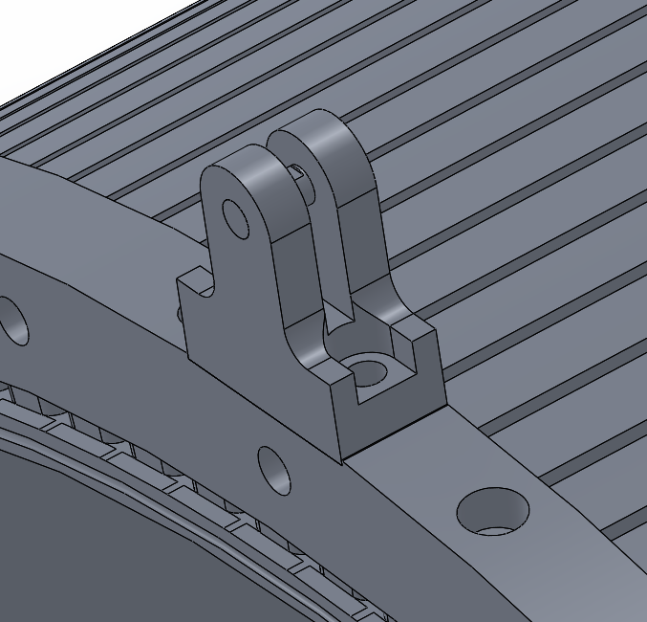
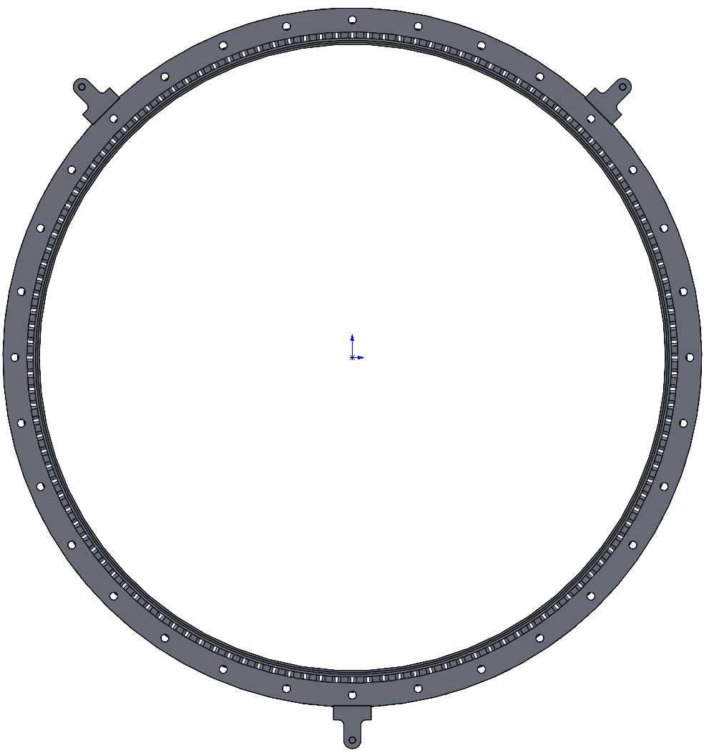
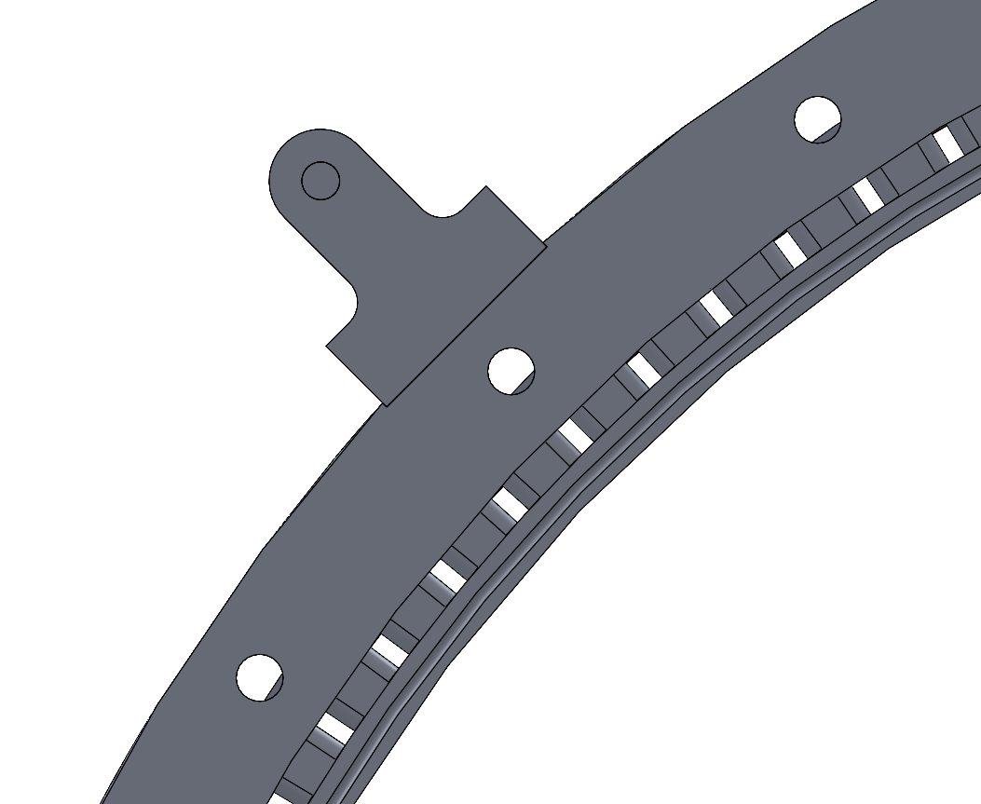
Suspension of cylindrical segments
R_{support tabs} = 410 mm
R_{former} = 340 mm
90°
135°°
R_{suspension ring} = 365 mm
What is threading through the holes for suspension? Rods? Ropes?
Notes:
Oakridge had success with >6’ diameter indium seals

Slide 8
Stiffening and suspension of cones
Suspension point
Stiffening ring?
Is the stiffening ring needed?
Do we need suspension on the cone outside of the cylinder/cone join?
Another suspension point?
Suspension point

Slide 9
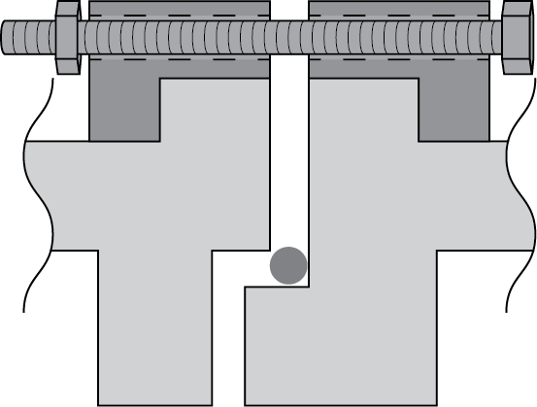
Joining segments together
Thermal stability?
Compatibility with copper-based alloys?
Alignment? (rotational + for seal)
Indium seal
Stability under thermal cycling
Anticipate 3*8 = 24 full thermal cycles from cryo to room temp over lifetime
ORNL has not had issues with cycling indium seals (testing limited to <20 cycles)
Diffusion of indium in copper-based alloy
May need vacuum grease
Ensuring alignment for indium
Indium type I superconductor -> Tc ~ 3.4 K, Bc ~ 30 mT
Not a concern
Reworked suspension/joining rings
Ioffe former
Indium wire
(pre-deformation)

Slide 10
Misc. Fabrication
Roundness of cavity?
Centrifugal casting? Seam welding sheet and hot rolling?
Cost?

Slide 11
Conductor choice
NbTi/Cu
Standard 1.3 mm OD MRI cable, 3.2:1 Cu:SC ratio
Cost estimate?

Slide 12
Field requirements
background field = (0, 0, 20) mT
Azimuthal variation: < 0.1 ppm of background field
Defining as: (range of |B(φ, fixed r) – B_{background}|) / |B_{background}|
Radial variation: < 1 ppm of background field
Defining as: |B(fixed φ, r) – B_{background}| / |B_{background}|
If we change these requirements to some resolution and efficiency for CRES, how do we quickly verify that our design meets requirements?

Slide 13
Benchmarking field calculation accuracy
Concern: need ppm level field accuracy
1ppm of 20mT: ~1e-8T
Most codes: ~ earth magnetic field (~50uT)
Approaches: FEA and Biot-Savart
RAT (Biot-Savart)
COMSOL (FEA)
Opera (Biot-Savart/FEA)
FEA: very small numerical error budget
Need very dense mesh
Need large model space (air boundary)
Biot-Savart
Easy for straight lines, hard for curvature

Slide 14
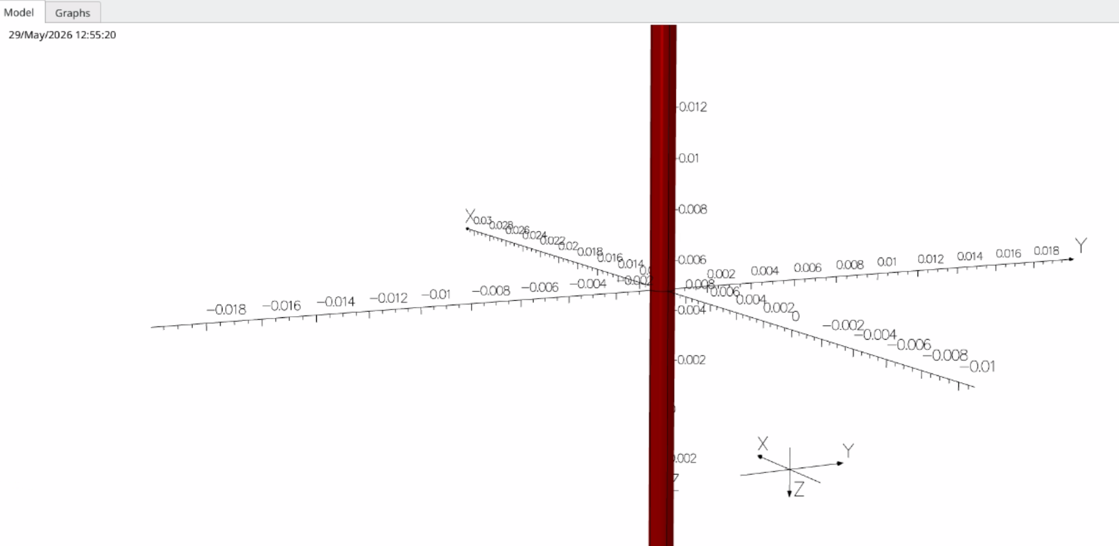
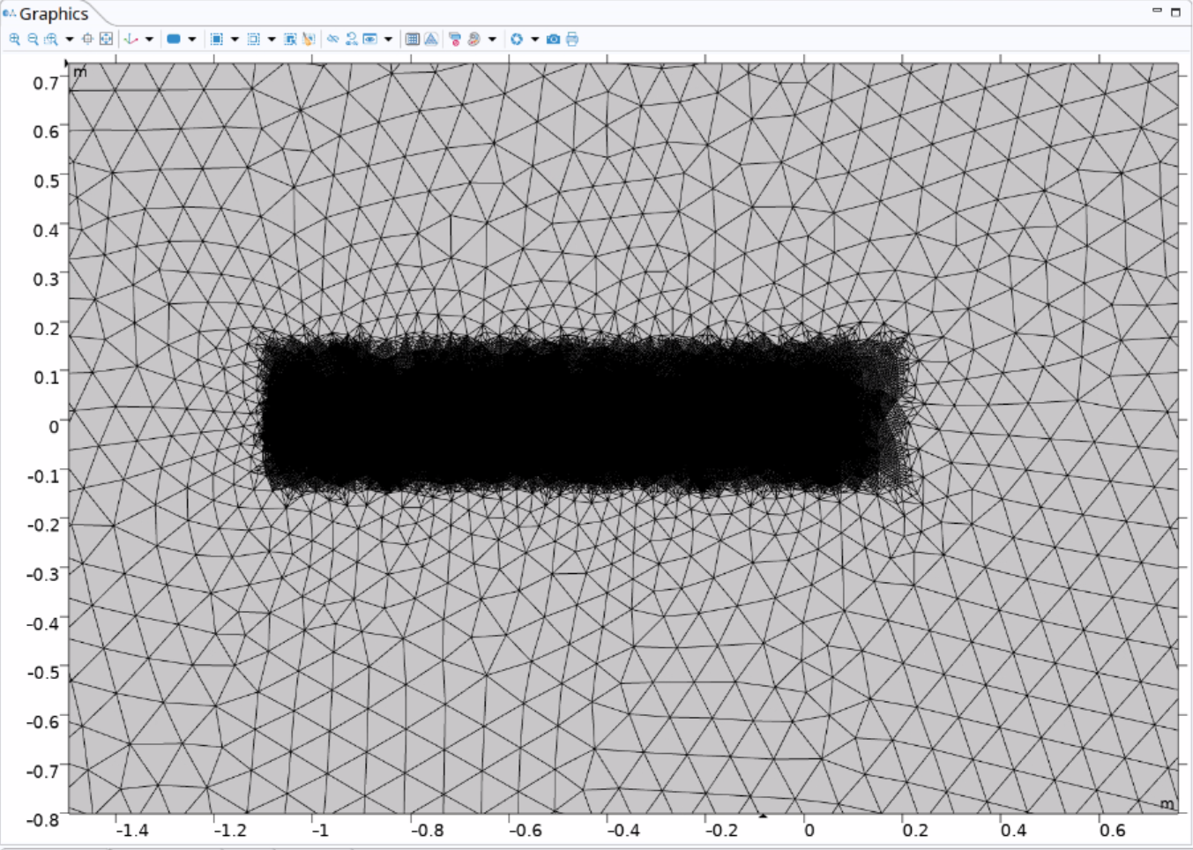
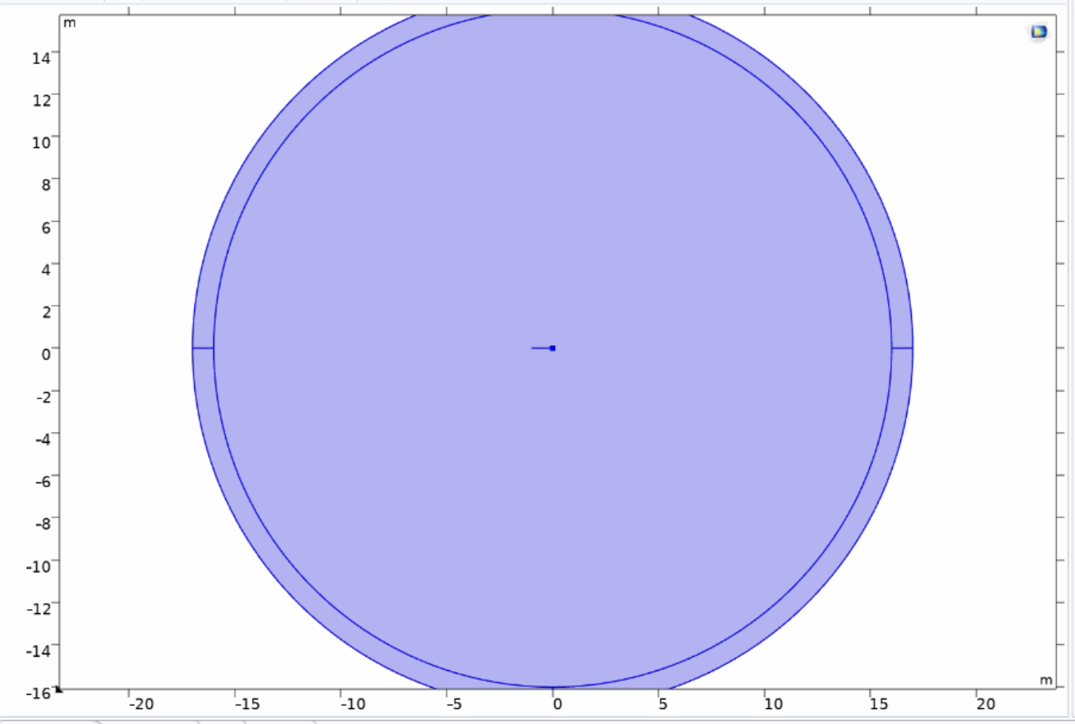
Test case
Simple benchmark: infinitely long straight conductor
Can calculate this analytically (B=µ₀I/(2πr))
COMSOL 2D FEA (solves for A_{z})
Opera: Biot-Savart/FEA
Opera: different FEA implementation (solves for scalar potential)
RAT: MLFMM/CUDA
COMSOL:
R = 15 m background
~2M DOF, 20 min to solve
Opera: issues
Adaptive integral for conductors
Issues with tolerance setting
Opera 3D: 400m long

Slide 15
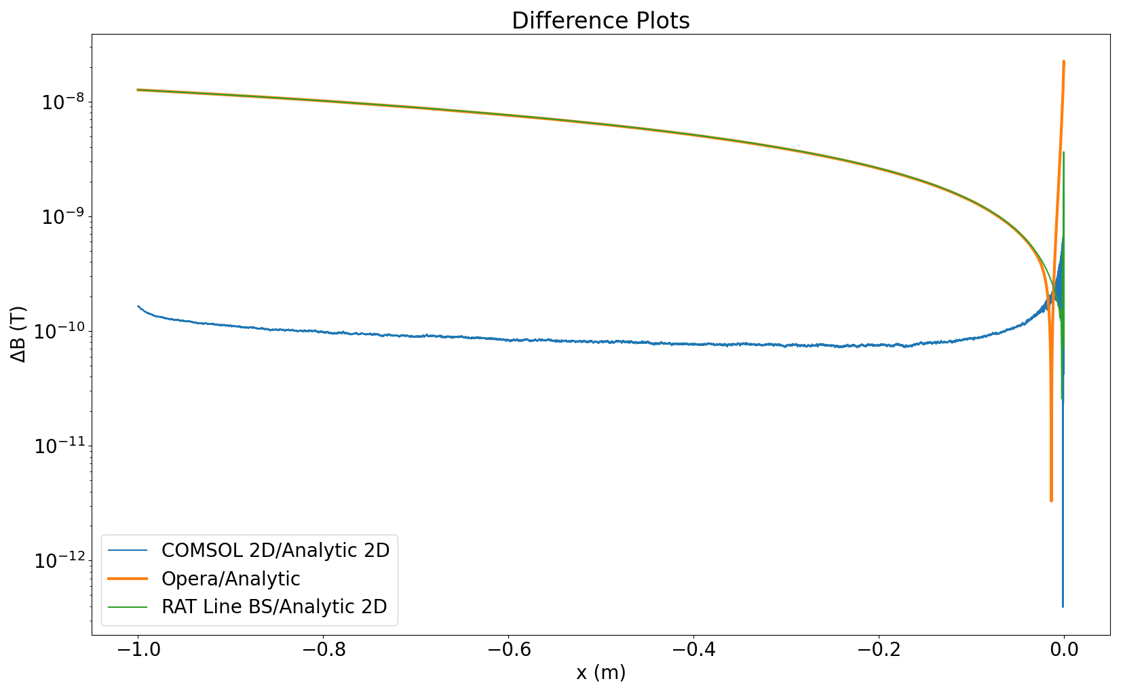
Test case
Extrapolating to COMSOL 3D?
Good agreement COMSOL 2D and analytic
Opera/RAT: good agreement with some/major tweaks

Slide 16
Basic uniformity estimates
Additional correction coils? Slightly different transition geometry?
Adjusting current within individual layers? Unwieldy number of power sources?
σ_{B} (ppm)
Note: asymmetry around φ ~ 0° comes from starting coil near a turn; can be alleviated/become more realistic with adding in leads
<1

Slide 17
Misc. Magnetic Topics
Can we run this in persistent mode?
Full development of quench protection?
Power source requirements?
Allowed geometric tolerances on conductor placement?

