Slide 1

Achieving Extreme B-field Uniformity by an Analysis of Corrective Coil Geometries
Jonah Seguine
Advisors: Dr. Chris Crawford and Dr. Ryan MacLellan

Slide 2
Collaboration Overview

Slide 3
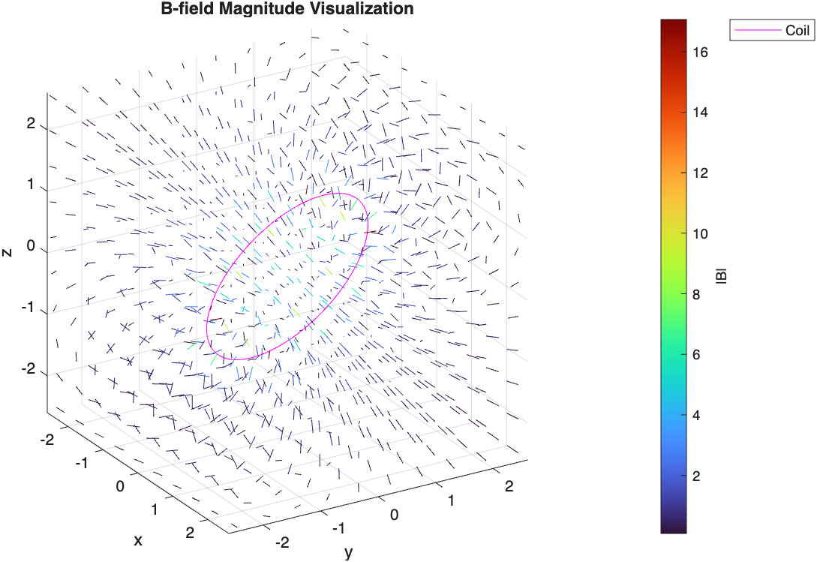
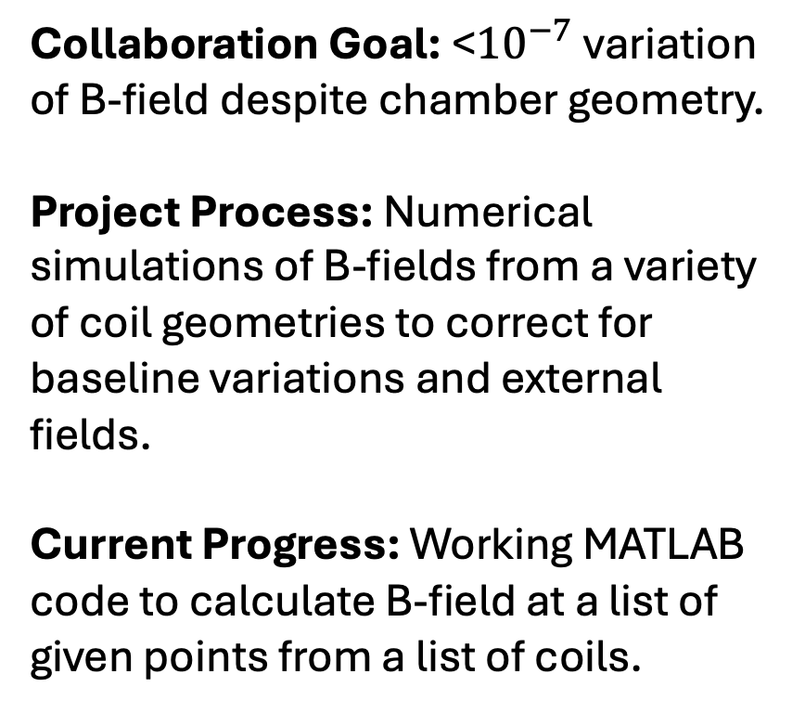
B-Field Visualization
Collaboration Goal: <${10}^{−7}$variation of B-field despite chamber geometry.
Project Process: Numerical simulations of B-fields from a variety of coil geometries to correct for baseline variations and external fields.
Current Progress: Working MATLAB code to calculate B-field at a list of given points from a list of coils.
Fig. 1: A visualization of the simulated, generated magnetic field from a skewed circular coil.

Slide 4
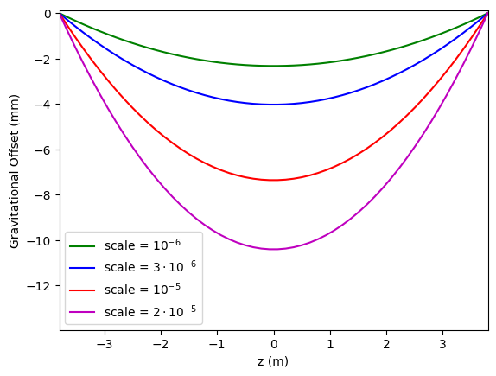

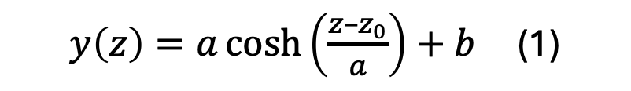
First-Order Gravitational Corrections
Catenary Curve: The curve describing the shape of a hanging chain, or general objects anchored at two ends under the influence of gravity.
Application: I compute the magnetic field accounting for vertical offsets according to the catenary equation (1) with boundary conditions and a length constraint.
$y\left(z\right)=a\cosh\left(\frac{z–z_{0}}{a}\right)+b$ (1)
Fig. 1: Multiple catenary curves are shown with different lengths = scale*separation and common boundaries of 0.

Slide 5
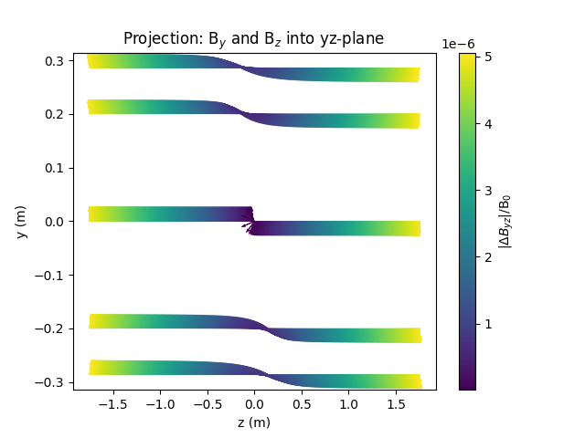
Catenaries
Computed: 3-dimensional magnetic field difference between base case and first gravitational correction.
Generated: A variety of visualizations for the field.
Next Steps: Working on configuring cos(θ) coil to match the difference.
Fig. 2: A visualization of the magnetic field differences at multiple positions projected into the yz-plane.

