Slide 2
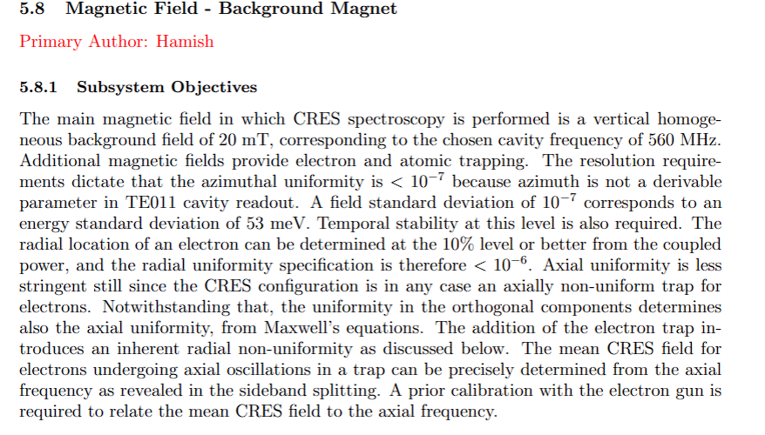

Slide 3
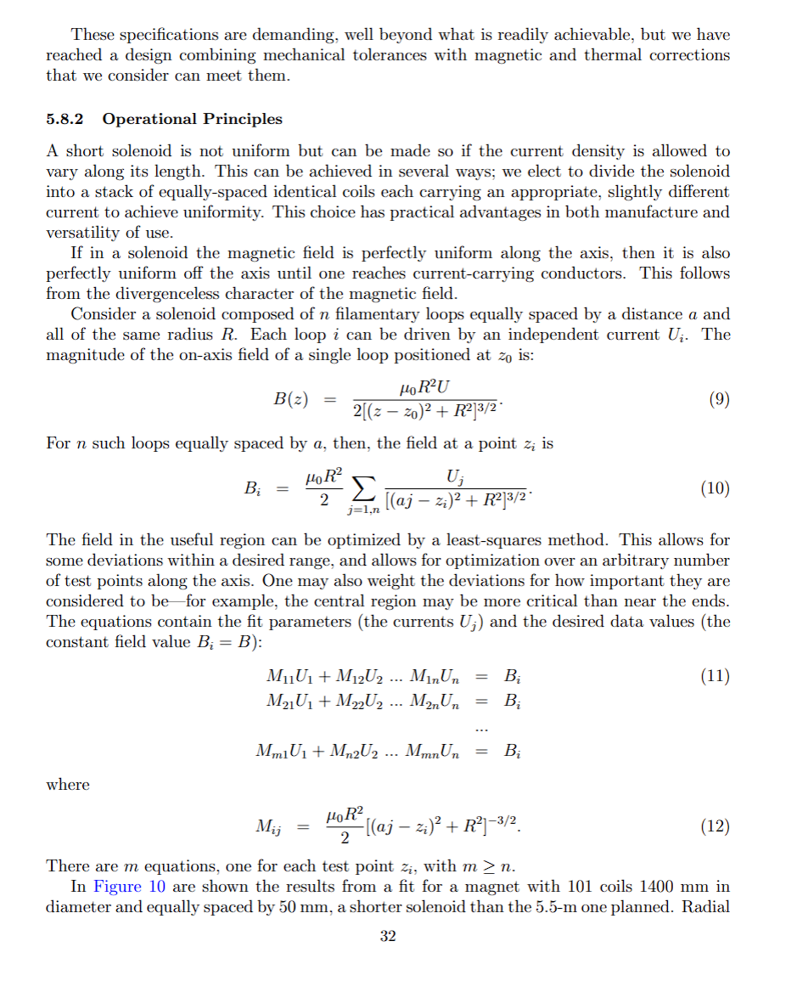
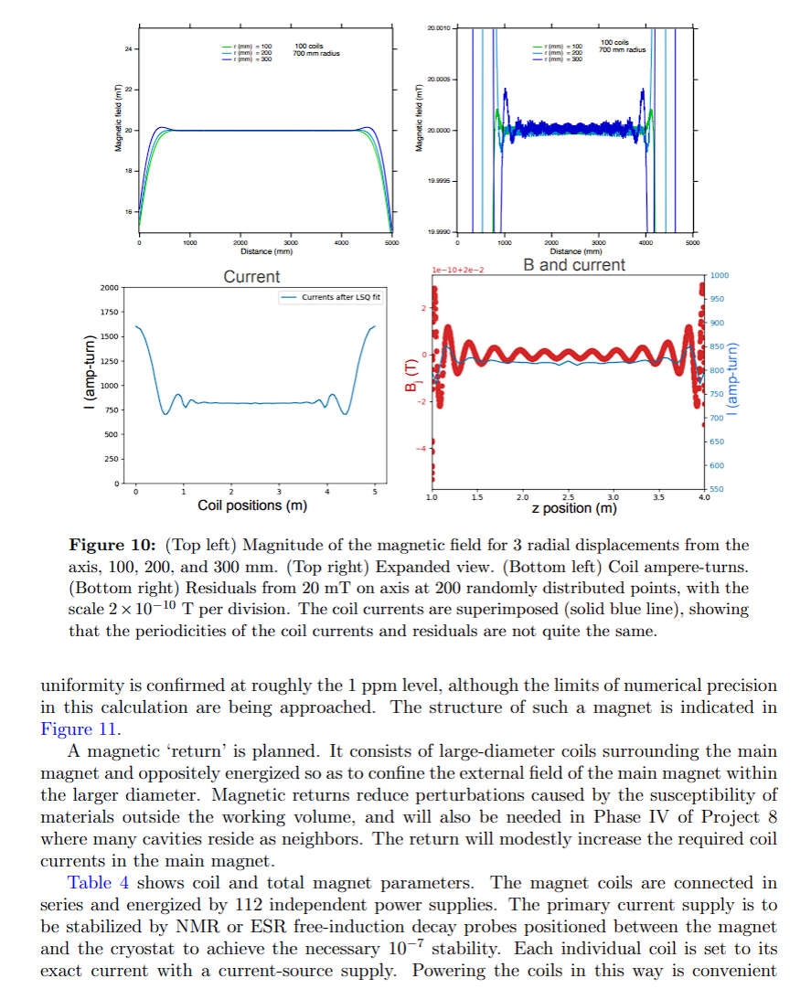

Slide 4
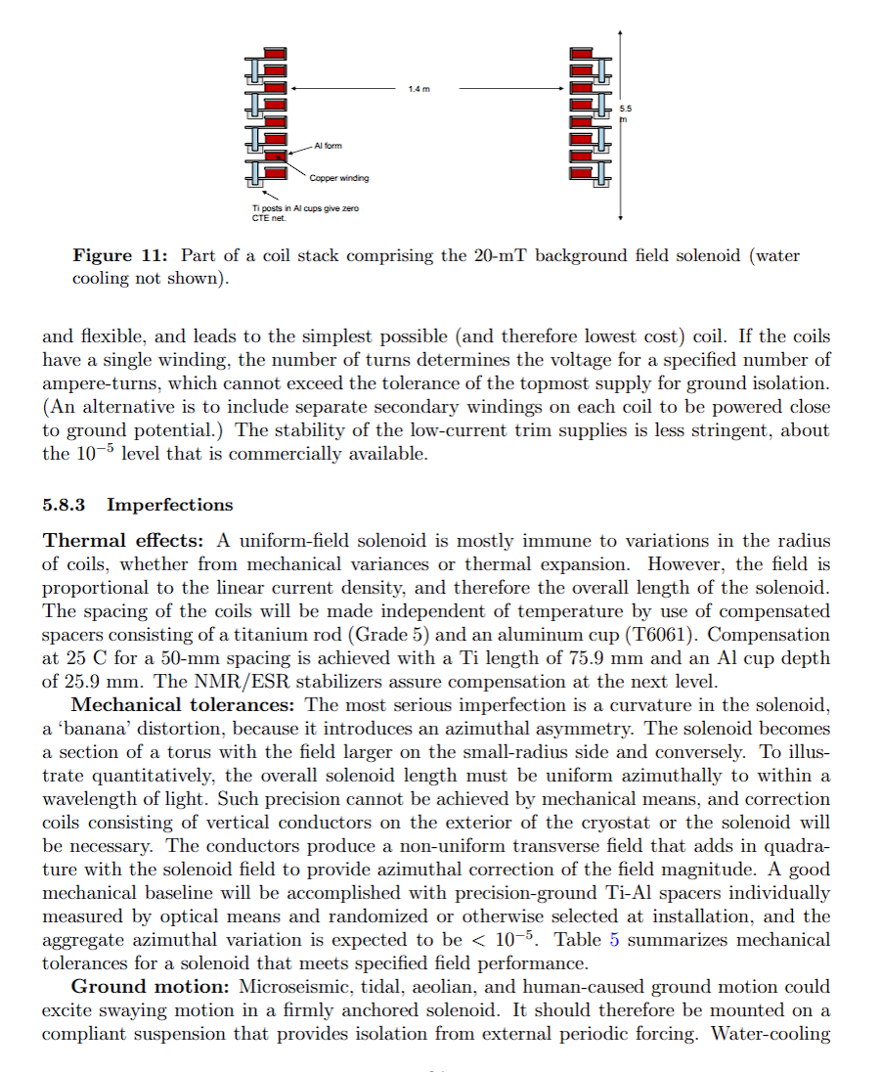

Slide 5
Problem: highly uniform axial magnetic field B about 20 mT over a finite axial region
Key constraints:
2. Axial uniformity target ~ 10 e-7
3. Radial uniformity relaxed ~ 10 e-6
Model:
n circular loops
All with radius R
They are equally spaced by a
Each loop j carries a current U_j
This gives control of the field by controlling the n currents

Slide 6










Magnetic field at point i on the axis from the n loops
This is an overdetermined system (no exact solution exists) and there are more points (m) than coils (n).
The desired field values are constant:

Slide 7





Least Squares Formulation
Singular Value Decomposition

Slide 8














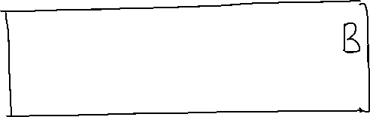



Tikhonov Regularization
Two competing goals:
Flatter the mag field
Keep coil currents reasonable
SVD + Tikhonov

Slide 9
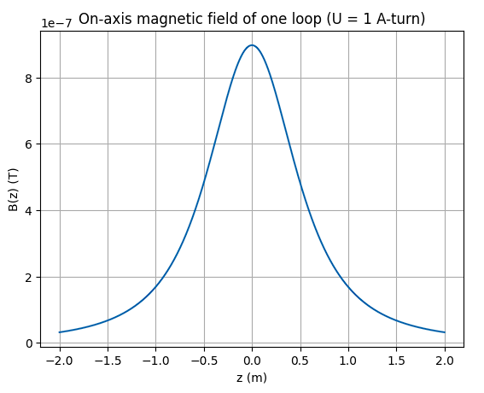
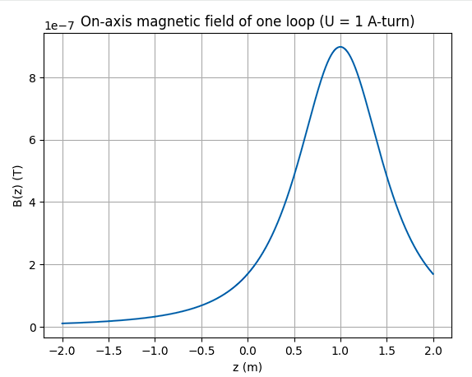
Computing B(z) for one coil at 0 and 1 with 1 A current

Slide 10
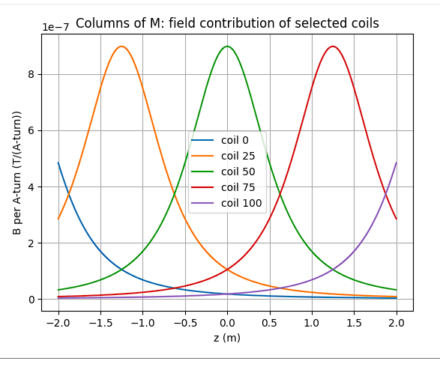
Placing the m points symmetrically about 0 and matrix M_ij building
n = 101 coils, a = 50 mm, coil from -2.5 m to 2.5 m
Region for uniformity from – 2 to 2 m
Each curve is 1 column of matrix M
Coil 50 is near zero, so it peaks there
Coils 0, 25, 50, 75, 100 are plotted here
Coils 0 and 100s curves peak outside of the region hence they contribute weakly

Slide 11
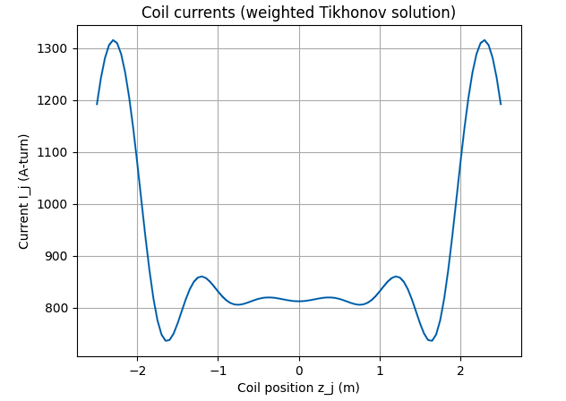
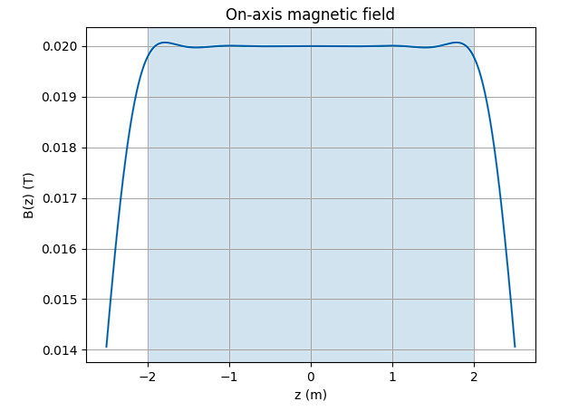




Solving the least squares problem (weighted)
target field is 20 mT

Slide 12
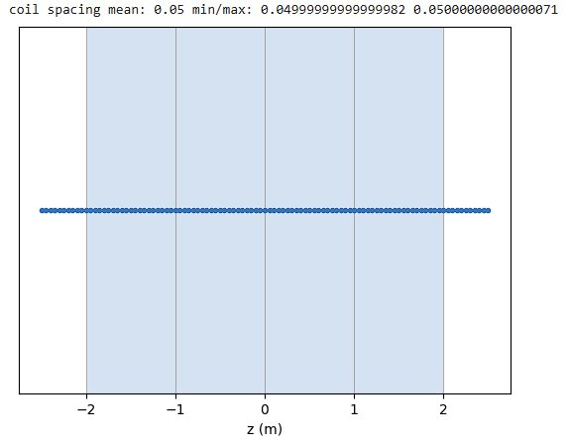
The last segment is not useful if you want to analyze anywhere offset to the axis. I will be generalizing this now
2001 points on the axis with coil spacing of 0.05 mm

Slide 13
Reproducing the results from pre-CDR
Mubi Khan

Slide 14
2001 points on the axis with coil spacing of 0.05 mm

Slide 15
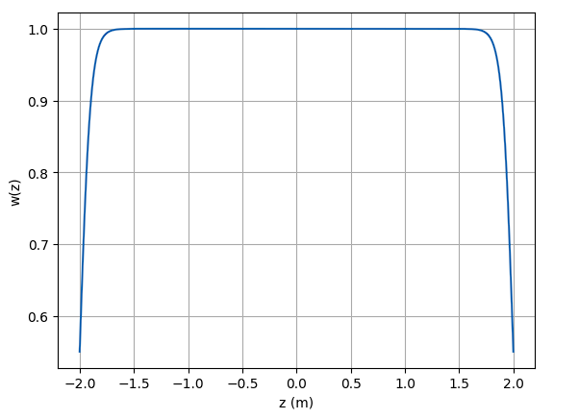
Weight matrix profile: constant where required and roll off on the sides

Slide 16
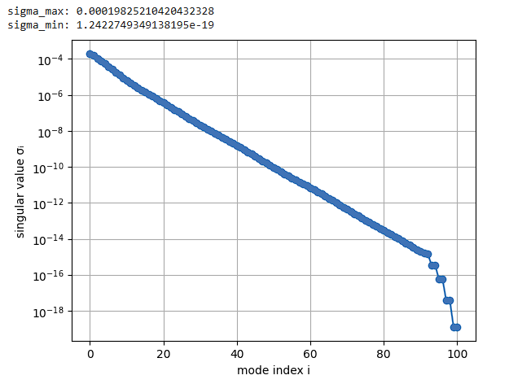
Singular Values from SVD and variation with mode index

Slide 17
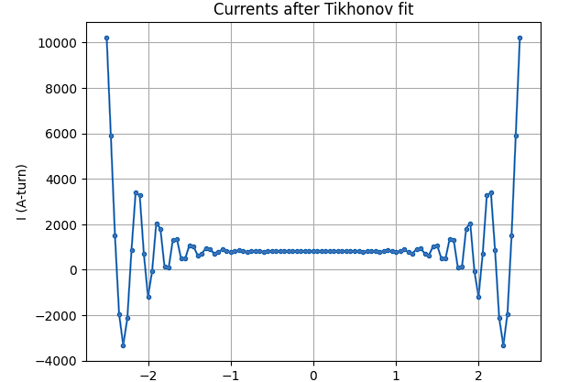
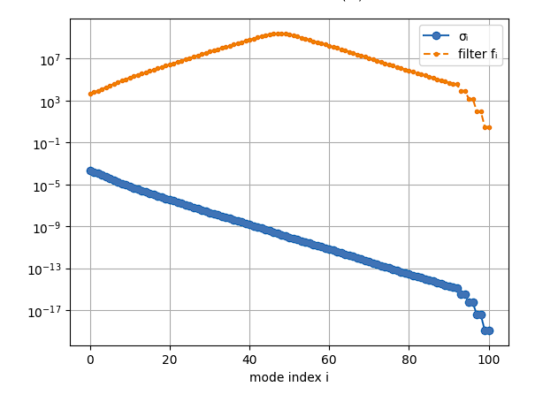

Slide 18
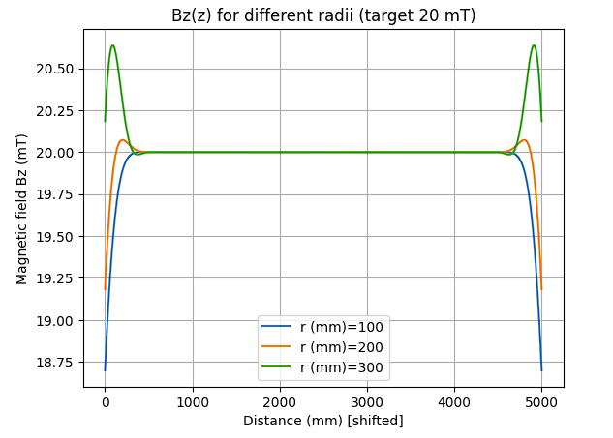
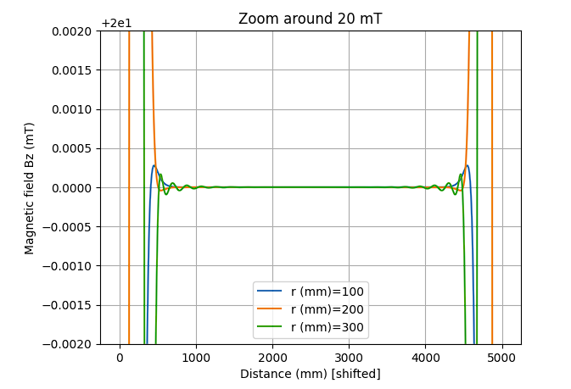

Slide 19
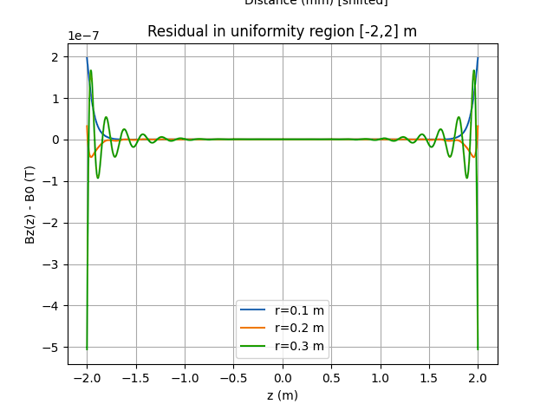

Slide 20
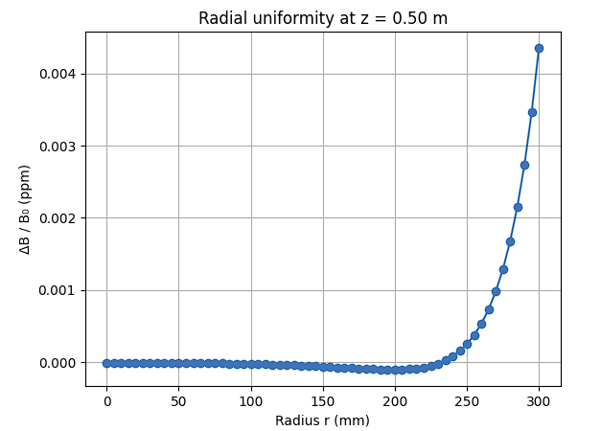
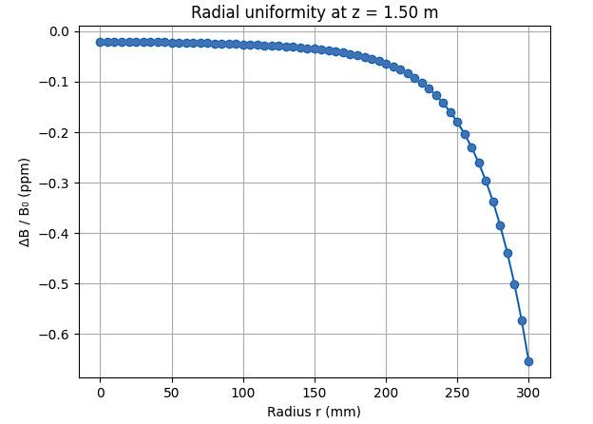
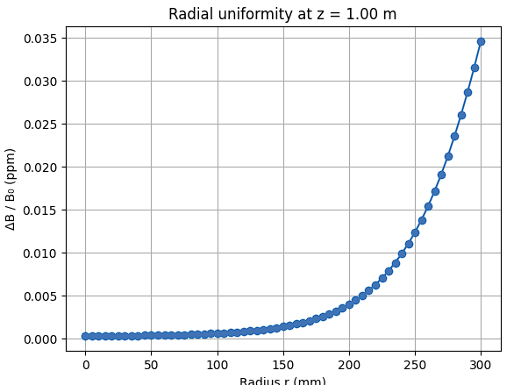
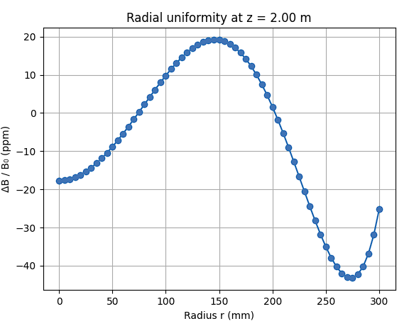

Slide 21
Notes made on SVD code
Peeny’s code checked
* inunuit was used in the code
* using this makes everything simpler because all you do it defined the parameters to fit and it does it for you
*

Slide 22
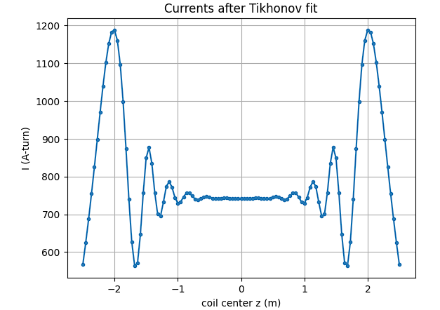
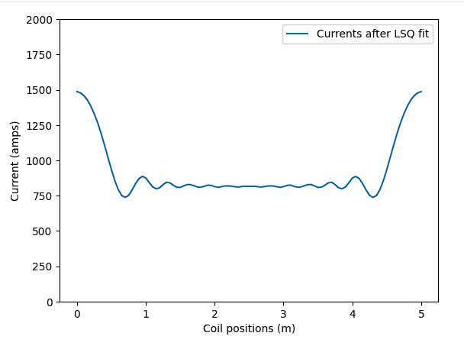
Now trying to match Penny’s results with mine
At 0.45 ppm with 111 coils

Slide 23
Now trying to match Penny’s results with mine
Likely withing 1 ppm; distance from the center unknown. 101 coils
0.45 ppm uniformity with 111 coils at 300 mm from the center

Slide 24
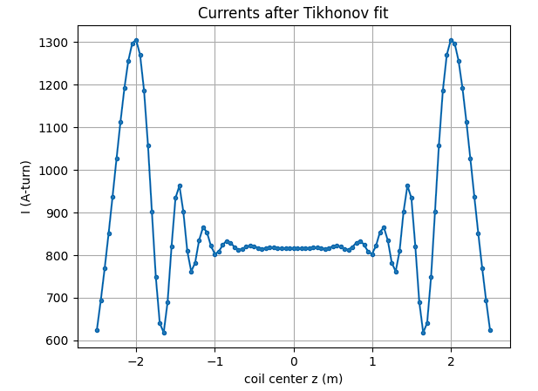
Now trying to match Penny’s results with mine
Likely withing 1 ppm; distance from the center unknown. 101 coils, and 3 m region of uniformity
0.47 ppm uniformity with 101 coils at 300 mm from the center, and 3 m region of uniformity

Slide 25
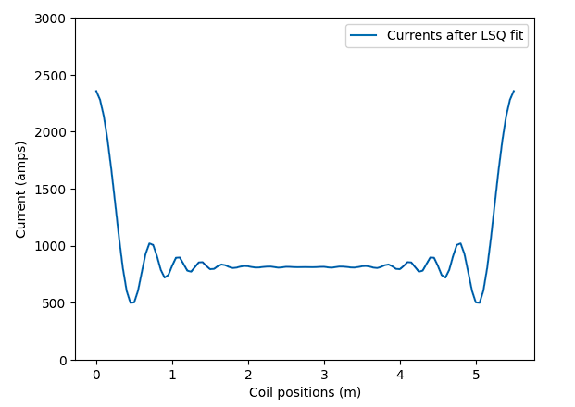
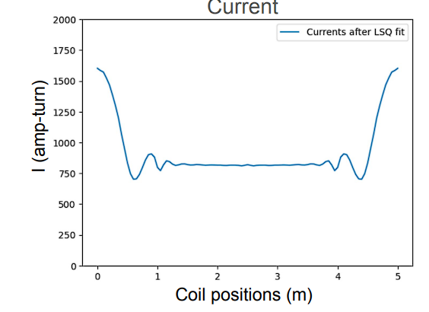

Now comparing both the codes with pre-CDR
preCDR
Penny: Likely withing 1 ppm; distance from the center unknown. 111 coils
~0.47 ppm uniformity with 101 coils at 300 mm from the center. 111 coils

Slide 26
Mubi Khan
University of Kentucky

Slide 27
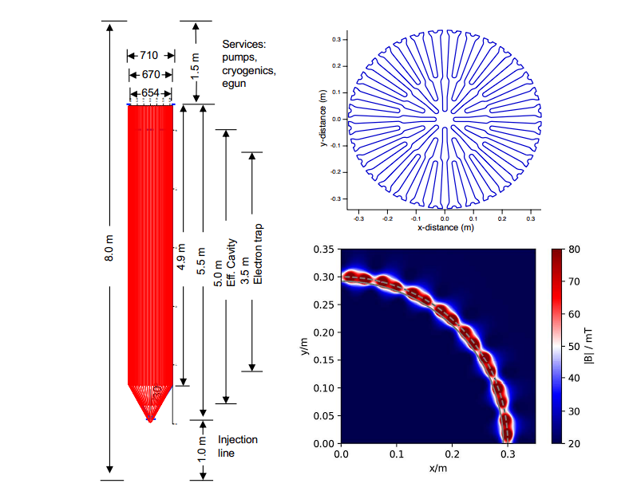
Constraints to be fulfilled in the cylindrical volume of radius 330 cm and length 3.5 meters
Constraint: uniformity <1e-6 in the volume

Slide 28
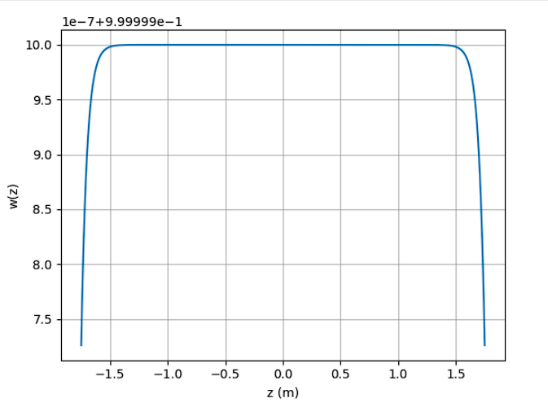
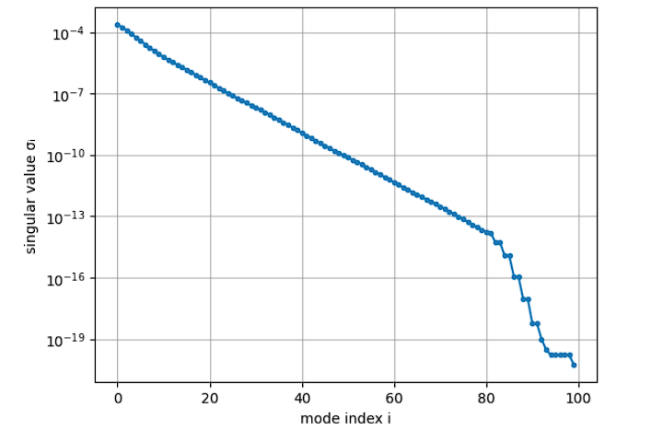
100 coils with 50 mm spacing: weight profile and singular values wrt mode index

Slide 29
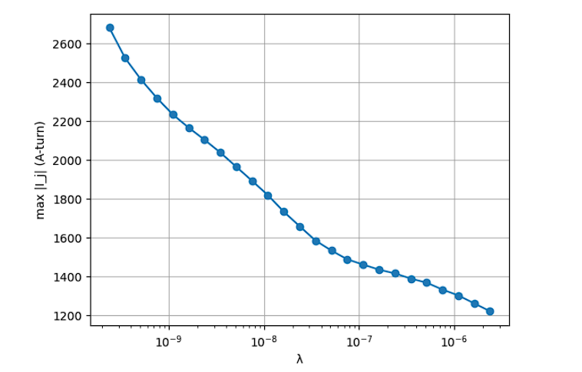
100 coils with 50 mm spacing: max current with respect to lambda value

Slide 30
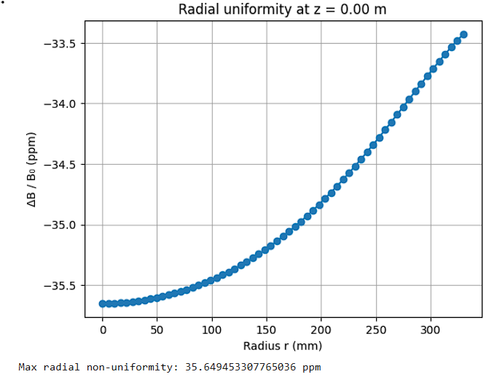
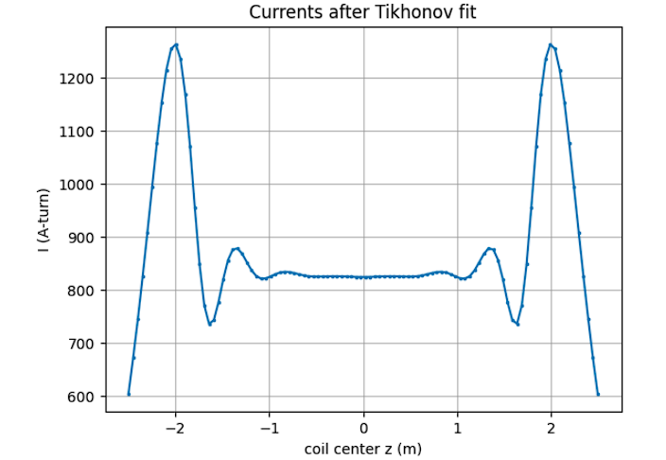
100 coils with 50 mm spacing: 35.64 ppm at the edge of the “uniformity volume”
For lambda = 1.61e-6
Not acceptable

Slide 31
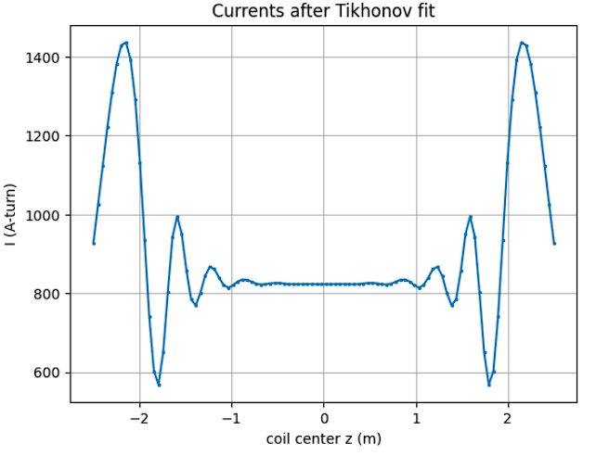
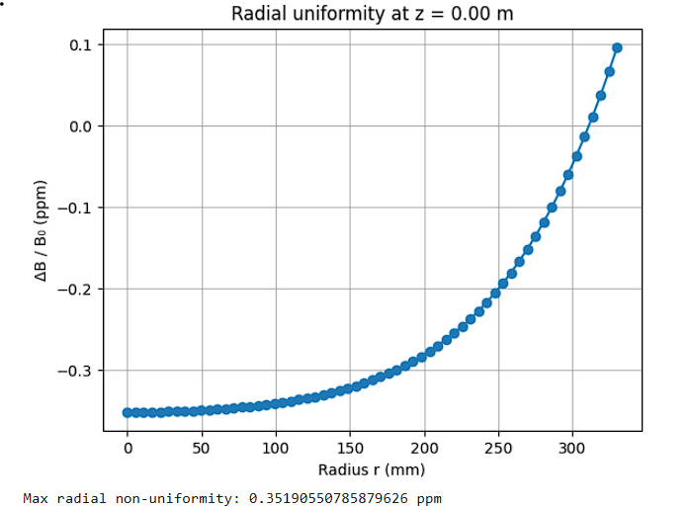
100 coils with 50 mm spacing: 0.35 ppm at the edge of the “uniformity volume”
For lambda = 1.61e-7
acceptable

Slide 32
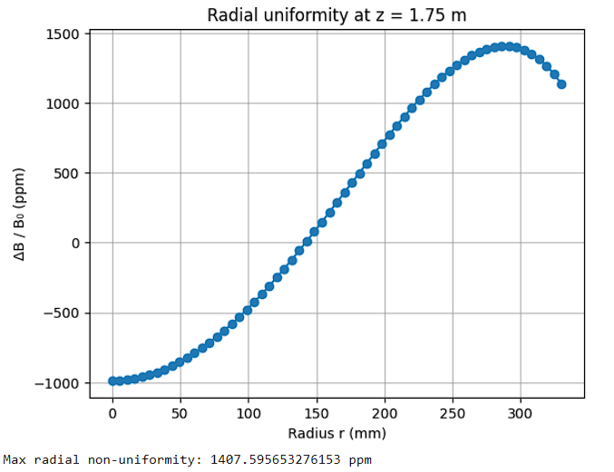
100 coils with 50 mm spacing: extreme slice and the middle one
For lambda = 1.61e-7
This is the case when the radial uniformity requirement is met but the longitudinal uniformity requirement is not met

Slide 33
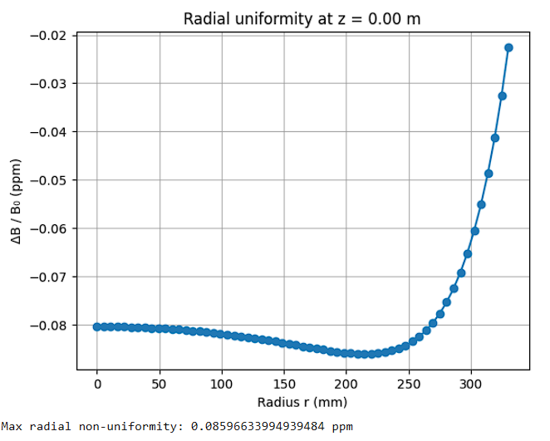
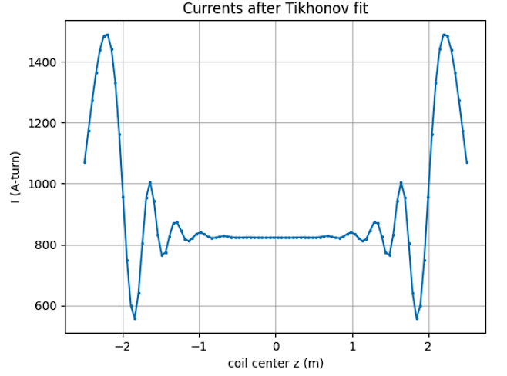
100 coils with 50 mm spacing: .085 ppm at the edge of the “uniformity volume”
For lambda = 7.5e-8
acceptable

Slide 34
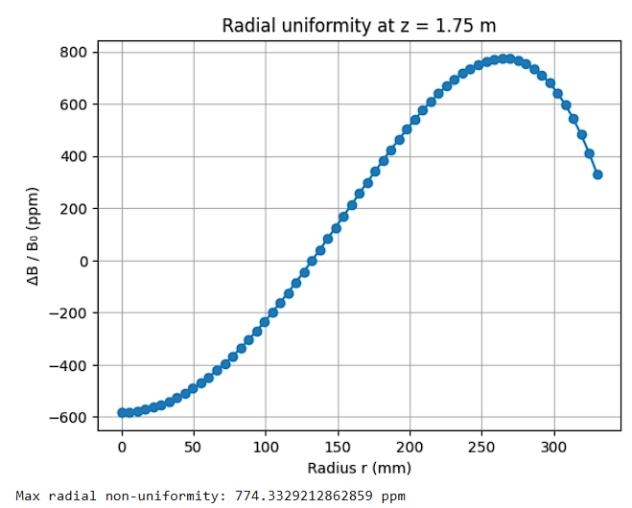
100 coils with 50 mm spacing: extreme slice and the middle one
unacceptable
For lambda = 7.5e-8

Slide 35
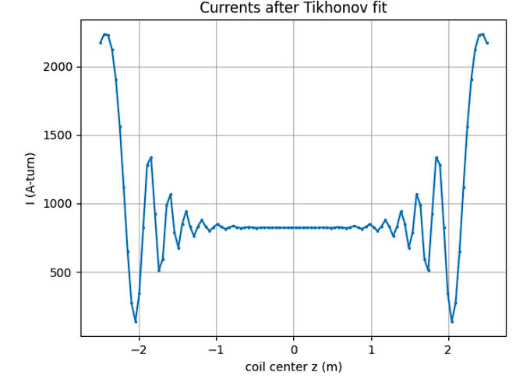
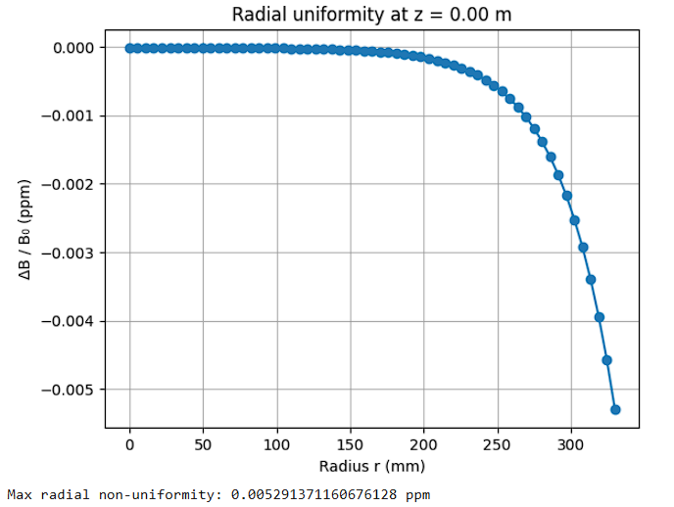
100 coils with 50 mm spacing: -.00052 ppm at the edge of the “uniformity volume”
For lambda = 1.10e-9
acceptable

Slide 36
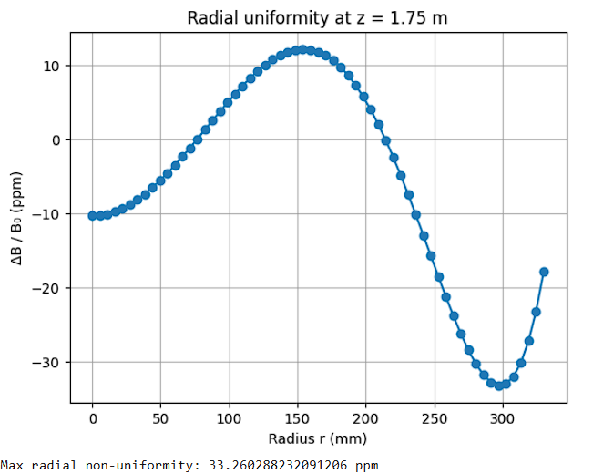
100 coils with 50 mm spacing: -.00052 ppm at the edge of the “uniformity volume”
unacceptable
For lambda = 1.10e-9

Slide 37
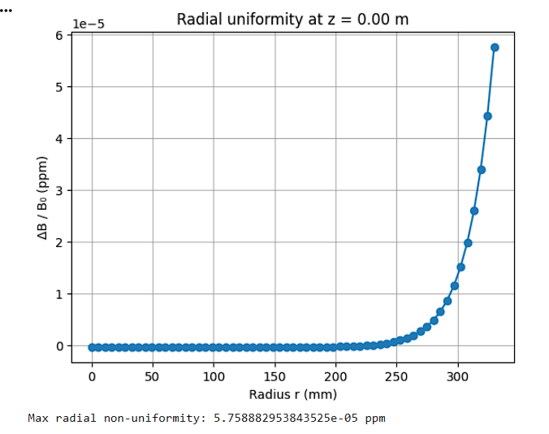
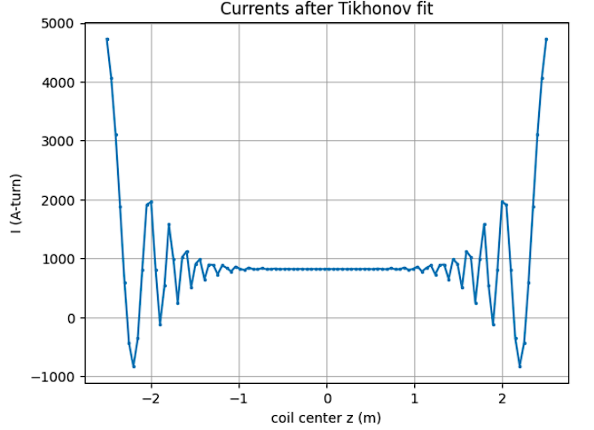
100 coils with 50 mm spacing: -.00052 ppm at the edge of the “uniformity volume”
For lambda = 1.0e-11
Acceptable

Slide 38
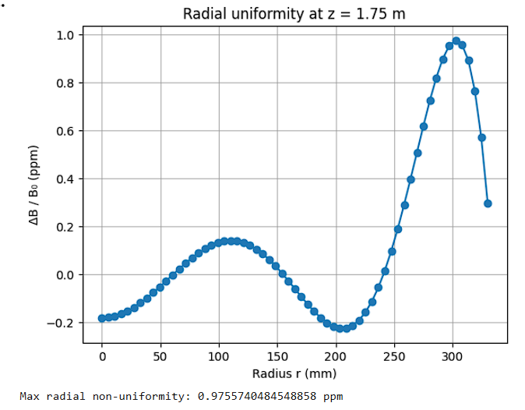
100 coils with 50 mm spacing: -.00052 ppm at the edge of the “uniformity volume”
For lambda = 1.0e-11
Acceptable

Slide 39
As things stand for the last case: lambda = 1e-11 the uniformity requirements are met on the whole volume
This however makes the currents on the sides higher and fluctuating. This means we need to now tune the spacing and number of coils keeping the lambda the same

Slide 40
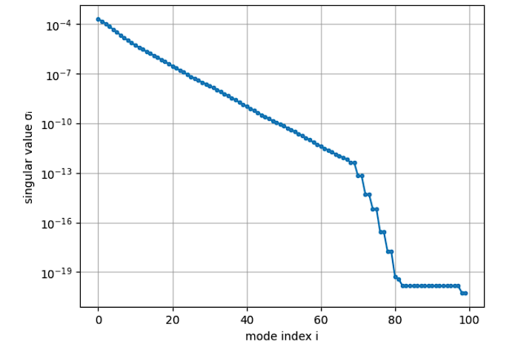
100 coils with 60 mm spacing: weight profile and singular values wrt mode index
Less significant modes than before
Same weight as before

Slide 41
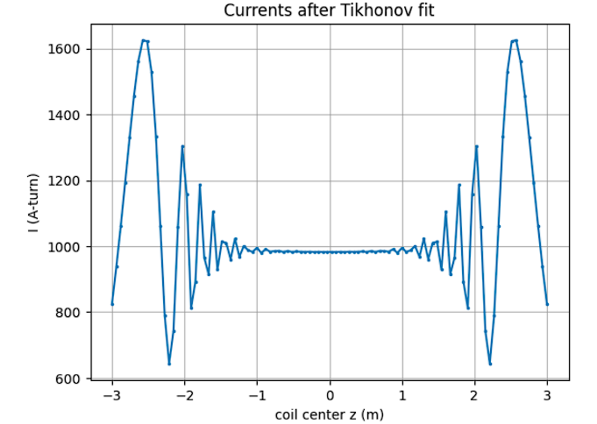
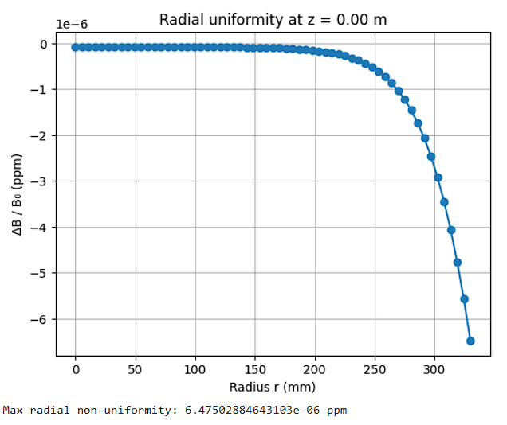
100 coils with 60 mm spacing: 6.47e-6 ppm at the edge of the “uniformity volume”
For lambda = 1e-12
acceptable

Slide 42
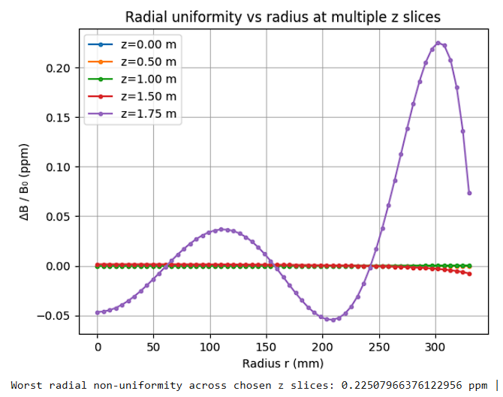
100 coils with 60 mm spacing: 6.47e-6 ppm at the edge of the “uniformity volume”
For lambda = 1e-12
acceptable

Slide 43
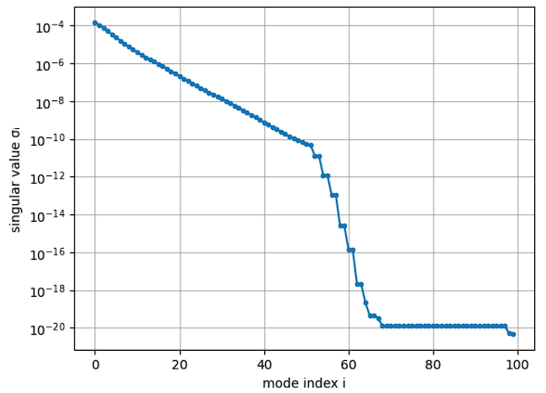
100 coils with 80 mm spacing: weight profile and singular values wrt mode index
Less significant modes than before
Same weight as before

Slide 44


100 coils with 80 mm spacing: 6.47e-6 ppm at the edge of the “uniformity volume”
For lambda = 1e-10
acceptable

Slide 45

100 coils with 80 mm spacing: 6.47e-6 ppm at the edge of the “uniformity volume”
For lambda = 1e-10
Not acceptable

Slide 46


100 coils with 80 mm spacing: 6.47e-6 ppm at the edge of the “uniformity volume”
For lambda = 5e-10
Not acceptable

Slide 47

100 coils with 80 mm spacing 800 mm radius: weight profile and singular values wrt mode index
Less significant modes than before
Same weight as before

Slide 48


100 coils with 80 mm spacing, 800 mm radius: 6.47e-6 ppm at the edge of the “uniformity volume”
For lambda = 5e-10
acceptable

Slide 49

100 coils with 80 mm spacing, 800 mm radius: 6.47e-6 ppm at the edge of the “uniformity volume”
For lambda = 1e-10
Not acceptable

Slide 50

80coils with 63 mm spacing: weight profile and singular values wrt mode index
Less significant modes than before
Same weight as before

Slide 51


80 coils with 63 mm spacing: 6.47e-6 ppm at the edge of the “uniformity volume”
For lambda = 1e-12
acceptable

Slide 52

80 coils with 63 mm spacing: 6.47e-6 ppm at the edge of the “uniformity volume”
For lambda = 1e-10
Not acceptable

Slide 53

80 coils with 63 mm spacing (penalizing the oscillations): weight profile and singular values wrt mode index
Less significant modes than before
Same weight as before

Slide 54


80 coils with 63 mm spacing (penalizing the oscillations):
Less significant modes than before
Lambda = 1e-12, eta = 3

Slide 55

80 coils with 63 mm spacing (penalizing the oscillations):
Less significant modes than before
Lambda = 1e-12, eta = 3

Slide 56

60 coils with 84 mm spacing (penalizing the oscillations): weight profile and singular values wrt mode index
Less significant modes than before
Same weight as before

Slide 57


80 coils with 63 mm spacing (penalizing the oscillations):
Less significant modes than before
Lambda = 1e-12, eta = 3

Slide 58

80 coils with 63 mm spacing (penalizing the oscillations):
Less significant modes than before
Lambda = 1e-12, eta = 3

Slide 59

50 coils with 100 mm spacing (penalizing the oscillations): weight profile and singular values wrt mode index
Less significant modes than before
Same weight as before

Slide 60


60 coils with 63 mm spacing (penalizing the oscillations):
Lambda = 1e-12, eta = 3

Slide 61

50 coils with 100 mm spacing (penalizing the oscillations):
Lambda = 1e-12, eta = 3

Slide 62
Initial Optimization Results of the Stacked Coils Currents
Chris Crawford, Mubi Khan
University of Kentucky
Jan 26, 2026

Slide 63


Target Volume:
A cylinder of radius = 330 mm and length 3.5 m
This was chosen by taking off the Ioffe bite distance of 41 mm from the ID of the Ioffe coil and rounding up, to be safe
length of the electron trap = 3.5 m
Uniformity requirements pertaining to the Target Volume
Radial uniformity of <1e-6
Azimuthal uniformity of <1e-7
# Azimuthal uniformity is met in this analysis by design (rotational symmetry)
$$+z$$
$$r$$
PreCDR

Slide 64







General fitting procedure ($n$ coils, $m$ constraint points)
Define coil geometry ($n$ unknowns currents)
place n circular coils with fixed radii $R_{j}$ and axial positions $z_{j}$ and unknown currents
$I=[I_{1},I_{2 …}$ $I_{n}]^{T}$
2. Choose $m$ constraints points on the axes
build a list of points ${\left\{\left(r_{i}, z_{i}\right)\right\}}_{i=1}^{m}$
* $z$-axis: r = 0, sample
* $r$-axis: z = 0, sample
$$r ε [0, r_{max}]$$
$$r_{max}=330 mm$$
$z ε [−\frac{L}{2},\frac{L}{2}]$, $L=3.5 m$
3. Compute the forward model (design matrix)
For each point $i$ and coil $j$, compute the coil’s contribution to the axial field
* field at any point per 1 A-turn in coil $j$
* stack these into
* the predicted field is linear in currents: $b=M I$, $b=\left[B_{0}, B_{0}, …B_{0}\right] ε ℝ^{m}$
$M_{ij} ≡B_{z}^{}(r_{i}, z_{i};r_{j}^{′},z_{j}^{′})$, where $r_{i}, z_{i}$are the field points and $r_{j}^{′},z_{j}^{′}$ are the positions of the coils
$$M ε ℝ^{m ×n}$$

Slide 65





Pose the regularized least-squares problem
* optional weights can be used:
* solve: $I_{λ}=\min{({\left(M∗I −b\right)}^{T}(M∗I −b)+λ^{2}I^{T}I)}$)
* $λ$ trades off field accuracy vs. current size and suppresses unstable modes
* In a variation of this you could also have another term that suppresses derivatives to counter
oscillating currents (iminuit; Dr Slocum’s code)
$$W=diag \left(w_{i}\right)$$
5. Solve Singular Value Decomposition (SVD)
* This is not required but it helps to see modes and suppress the ones which cause oscillations
currents
* Form the weighted system:
* compute SVD:
* Tikhonov solution is obtained by solving:
* high frequency modes with $σ≪λ$are suppressed; these are ones causing oscillations
Without SVD:
$$I_{λ}={\left(M^{T}M+λ^{2}I\right)}^{−1}M^{T}b$$

Slide 66




Pick $λ$
* Do a 1D sweep over lambda (log-spaced)
* For each lambda compute:
* choose $λ$ as a compromise to produce acceptable current oscillations and field uniformity
7. Validate (report ppm uniformity on the axes)
* After choosing lambda, evaluate the final error in ppm
* Report max/RMS ppm on the two axes you constrained: $r=0$(z-scan) and $z=0$ (r –scan to 3.30 m)

Slide 67



For n = 101 coils, d = 50 mm – mode filtering and currents
$$λ=1e−10$$

Slide 68


# As can be seen on the axis at z = 0 the ppm requirement is met but not around z ~1.75 m

Slide 69


For n = 101 coils, d = 50 mm

Slide 70



For n = 50 coils, d ~ 100 mm – mode filtering and currents
$$λ=1e−7$$

Slide 71



Slide 72



Slide 73




For n = 80 coils, d ~ 63 mm – currents and ppm levels (penalizing fluctuation in currents)
$$λ=1e−12$$
$$η=5$$
the penalization factor

Slide 74



For n = 80 coils, d ~ 63 mm – currents and ppm levels (penalizing fluctuation in currents)
$$λ=1e−12$$
$$η=10$$
the penalization factor

Slide 75



For n = 80 coils, d ~ 63 mm – currents and ppm levels (penalizing fluctuation in currents)
$$λ=1e−12$$
$$η=20$$
the penalization factor

Slide 76



For n = 80 coils, d ~ 63 mm – currents and ppm levels (penalizing fluctuation in currents)
$$λ=1e−12$$
$$η=30$$
the penalization factor

Slide 77



For n = 90 coils (including 5 side coils ID 50 cm each side), d ~ 55 mm – currents and ppm levels (penalizing fluctuation in currents)
$$λ=2e−12$$
$$η=30$$
the penalization factor
Worst ppm = 8.9 for z = 1.75

Slide 78



For n = 66 coils (including 5 side coils ID 50 cm each side), d ~ 100 mm – currents and ppm levels (penalizing fluctuation in currents)
$$λ=1.7e−10$$
$$η=30$$
the penalization factor
Worst ppm = 9.2 for z = 1.75

Slide 79


For n = 66 coils (including 5 side coils ID 50 cm each side), d ~ 100 mm – currents and ppm levels (penalizing fluctuation in currents)
$$λ=1.7e−10$$
$$η=5$$
the penalization factor
Worst ppm = 3.5 for z = 1.75

Slide 80




For n = 66 coils (including 5 side coils ID 50 cm each side), d ~ 100 mm – currents and ppm levels (penalizing fluctuation in currents)
$$λ=1.7e−10$$
$$η=2.5$$
the penalization factor
Worst ppm = 1.077 for z = 1.75, and 0.095 for z = 1.50

Slide 81


For n = 54 coils (including 6 side coils ID 50 cm each side), d ~ 92 mm – currents and ppm levels (penalizing fluctuation in currents)
$$λ=1.7e−10$$
$$η=2.5$$
the penalization factor
Worst ppm = 1.027 for z = 1.75, and 0.019 for z = 1.56

Slide 82
Observations
Decreasing number of coils seem to improve the results
Significant improvement is seen when endcaps coils are added
Oscillations in the currents can be suppressed by penalizing slope of the currents, but it has a tradeoff with uniformity

Slide 83



For n = 52 coils ( 4 side coils ID 50 cm each side), currents and ppm levels (penalizing fluctuation in currents + Chebyshev distribution)
$$λ=1.4e−10$$
$$η=2.5$$
the penalization factor

Slide 84



For n = 52 coils (including 4 side coils ID 50 cm each side), currents and ppm levels (penalizing fluctuation in currents + Chebyshev distribution)
$$λ=1.4e−10$$
$$η=2$$
the penalization factor

Slide 85


For n = 44 coils (including 0 side coils ID 50 cm each side), currents and ppm levels (penalizing fluctuation in currents + Chebyshev distribution)
$$λ=1.4e−10$$
$$η=2$$
the penalization factor

Slide 86



For n = 44 coils – 3 to 3 m (including 0 side coils), currents and ppm levels (penalizing fluctuation in currents + Chebyshev distribution)
$$λ=1.2e−10$$
$$η=2$$
the penalization factor

Slide 87



For n = 44 coils – 2.5 to 2.5 m (including 4 side coils), currents and ppm levels (penalizing fluctuation in currents + Chebyshev distribution + D2 penalty)
$$λ=1.2e−10$$
$$λ∗η(η=0.01)$$
the curvature penalty factor

Slide 88



For n = 44 coils – 2.5 to 2.5 m (NO side coils), currents and ppm levels (penalizing fluctuation in currents + Chebyshev distribution + D2 penalty)
$$λ=1.2e−10$$
$$λ∗η(η=0.021)$$
the curvature penalty factor
Notes:
With both z and r weighting, larger radius larger weights, so that the solver cares more about ppm levels at larger radii, both r weighing and z weighting are diagonals

Slide 89



For n = 44 coils –3 to 3 m (NO side coils), currents and ppm levels (penalizing fluctuation in currents + Chebyshev distribution + D2 penalty)
$$λ=5.2e−12$$
$$λ∗η(η=0.021)$$
the curvature penalty factor
Notes:
With both z and r weighting, larger radius larger weights, so that the solver cares more about ppm levels at larger radii, both r weighing and z weighting are diagonals

Slide 90


For n = 44 coils – 2.5 to 2.5 m (NO side coils), currents and ppm levels (penalizing fluctuation in currents + Chebyshev distribution + D2 penalty)
$$λ=1.2e−10$$
$$λ∗η(η=0.021)$$
the curvature penalty factor

Slide 92



Slide 93





maximum
minimum
average

Slide 94
For n = 44 coils –3 to 3 m (NO side coils), currents and ppm levels (penalizing fluctuation in currents + Chebyshev distribution + D2 penalty)
$$λ=5.2e−12$$
$$λ∗η(η=0.021)$$
the curvature penalty factor
Notes:
With both z and r weighting, larger radius larger weights, so that the solver cares more about ppm levels at larger radii, both r weighing and z weighting are diagonals

Slide 95



For n = 64 coils –3 to 3 m (NO side coils), currents and ppm levels (penalizing fluctuation in currents + Chebyshev distribution + D2 penalty)
$$λ=7.2e−12$$
$$λ∗η(η=0.021)$$
the curvature penalty factor
Notes:
With both z and r weighting, larger radius larger weights, so that the solver cares more about ppm levels at larger radii, both r weighing and z weighting are diagonals

Slide 96



For n = 64 coils – 3 to 3 m (including 0 side coils), currents and ppm levels (penalizing fluctuation in currents)
$$λ=1.2e−10$$
$$η=2,5$$
the penalization factor

Slide 97



For n = 64 coils – 3.5 to 3.5 m (including 0 side coils), currents and ppm levels (penalizing fluctuation in currents)
$$λ=1.35e−10$$
$$η=2,5$$
the penalization factor

Slide 98


For n = 64 coils – 4 to 4 m (including 0 side coils), currents and ppm levels (penalizing fluctuation in currents)
$$λ=1.18e−10$$
$$η=2,5$$
the penalization factor

Slide 99
Notes:
From “penalizing_fluctuation.ipynb”

Slide 101
For n = 44 coils –3 to 3 m (NO side coils), currents and ppm levels (penalizing fluctuation in currents + Chebyshev distribution + D2 penalty)
$$λ=5.2e−12$$
$$λ∗η(η=0.021)$$
the curvature penalty factor
Notes:
With both z and r weighting, larger radius larger weights, so that the solver cares more about ppm levels at larger radii, both r weighing and z weighting are diagonals

Slide 102
For n = 44 coils –3 to 3 m (NO side coils), currents and ppm levels (penalizing fluctuation in currents + Chebyshev distribution + D2 penalty)
$$λ=5.2e−12$$
$$λ∗η(η=0.021)$$
the curvature penalty factor
Notes:
With both z and r weighting, larger radius larger weights, so that the solver cares more about ppm levels at larger radii, both r weighing and z weighting are diagonals

Slide 103

For n = 44 coils – 2.5 to 2.5 m with 5 cm width of coils (NO side coils

Slide 104
For n = 44 coils – 2.5 to 2.5 m with 10 cm width of coils (NO side coils

Slide 105
Initial Optimization Results of the Stacked Coils Currents
Chris Crawford, Mubi Khan
University of Kentucky
Feb 9, 2026

Slide 106
Target Volume:
A cylinder of radius = 330 mm and length 3.5 m
This was chosen by taking off the Ioffe bite distance of 41 mm from the ID of the Ioffe coil and rounding up, to be safe
length of the electron trap = 3.5 m
Uniformity requirements pertaining to the Target Volume
Radial uniformity of <1e-6
Azimuthal uniformity of <1e-7
# Azimuthal uniformity is met in this analysis by design (rotational symmetry)
$$+z$$
$$r$$
PreCDR

Slide 107
General fitting procedure ($n$ coils, $m$ constraint points)
Define coil geometry ($n$ unknowns currents)
place n circular coils with fixed radii $R_{j}$ and axial positions $z_{j}$ and unknown currents
$I=[I_{1},I_{2 …}$ $I_{n}]^{T}$
2. Choose $m$ constraints points on the axes
build a list of points ${\left\{\left(r_{i}, z_{i}\right)\right\}}_{i=1}^{m}$
* $z$-axis: r = 0, sample
* $r$-axis: z = 0, sample
$$r ε [0, r_{max}]$$
$$r_{max}=330 mm$$
$z ε [−\frac{L}{2},\frac{L}{2}]$, $L=3.5 m$
3. Compute the forward model (design matrix)
For each point $i$ and coil $j$, compute the coil’s contribution to the axial field
* field at any point per 1 A-turn in coil $j$
* stack these into
* the predicted field is linear in currents: $b=M I$, $b=\left[B_{0}, B_{0}, …B_{0}\right] ε ℝ^{m}$
$M_{ij} ≡B_{z}^{}(r_{i}, z_{i};r_{j}^{′},z_{j}^{′})$, where $r_{i}, z_{i}$are the field points and $r_{j}^{′},z_{j}^{′}$ are the positions of the coils
$$M ε ℝ^{m ×n}$$

Slide 108
Pose the regularized least-squares problem
* optional weights can be used:
* solve: $I_{λ}=\min{({\left(M∗I −b\right)}^{T}(M∗I −b)+λ^{2}I^{T}I)}$)
* $λ$ trades off field accuracy vs. current size and suppresses unstable modes
* In a variation of this you could also have another term that suppresses derivatives to counter
oscillating currents (iminuit; Dr Slocum’s code)
$$W=diag \left(w_{i}\right)$$
5. Solve Singular Value Decomposition (SVD)
* This is not required but it helps to see modes and suppress the ones which cause oscillations
currents
* Form the weighted system:
* compute SVD:
* Tikhonov solution is obtained by solving:
* high frequency modes with $σ≪λ$are suppressed; these are ones causing oscillations
Without SVD:
$$I_{λ}={\left(M^{T}M+λ^{2}I\right)}^{−1}M^{T}b$$

Slide 109
Pick $λ$
* Do a 1D sweep over lambda (log-spaced)
* For each lambda compute:
* choose $λ$ as a compromise to produce acceptable current oscillations and field uniformity
7. Validate (report ppm uniformity on the axes)
* After choosing lambda, evaluate the final error in ppm
* Report max/RMS ppm on the two axes you constrained: $r=0$(z-scan) and $z=0$ (r –scan to 3.30 m)

Slide 110
The effects of value of $η on the current oscillations$

Slide 111
Mubi Khan
University of Kentucky
Feb 6, 2026

Slide 112
For n = 66 coils (including 5 side coils ID 50 cm each side), d ~ 100 mm – currents and ppm levels (penalizing fluctuation in currents)
$$λ=1.7e−10$$
$$η=30$$
the penalization factor
Worst ppm = 9.2 for z = 1.75
Notes:
File: penalizing_fluctuation_-with sidecoils

Slide 113



For n = 66 coils (including 5 side coils ID 50 cm each side), d ~ 100 mm – currents fluctuation (penalizing fluctuation in currents)
$$λ=1.7e−10$$
$$η=30$$
the penalization factor
The average neighbor-to-neighbor jump is $≈$ 41 A with a spread of $≈66$ Amps
On average, neighboring coils differ by $≈$ $1.6 \%$ of the maximum current

Slide 114
For n = 66 coils (including 5 side coils ID 50 cm each side), d ~ 100 mm – currents and ppm levels (penalizing fluctuation in currents)
$$λ=1.7e−10$$
$$η=5$$
the penalization factor
Worst ppm = 3.5 for z = 1.75

Slide 115



For n = 66 coils (including 5 side coils ID 50 cm each side), d ~ 100 mm – currents fluctuation (penalizing fluctuation in currents)
$$λ=1.7e−10$$
$$η=5$$
the penalization factor
The average neighbor-to-neighbor jump is $≈$ 57 A with a spread of $≈86$ Amps
On average, neighboring coils differ by $≈$ $2.2 \%$ of the maximum current

Slide 116
For n = 66 coils (including 5 side coils ID 50 cm each side), d ~ 100 mm – currents and ppm levels (penalizing fluctuation in currents)
$$λ=1.7e−10$$
$$η=2.5$$
the penalization factor
Worst ppm = 1.077 for z = 1.75, and 0.095 for z = 1.50

Slide 117



For n = 66 coils (including 5 side coils ID 50 cm each side), d ~ 100 mm – currents fluctuation (penalizing fluctuation in currents)
$$λ=1.7e−10$$
$$η=2.5$$
the penalization factor
The average neighbor-to-neighbor jump is $≈$ 100 A with a spread of $≈135$ Amps
On average, neighboring coils differ by $≈$ $3.6 \%$ of the maximum current

Slide 118



We see that the spread in nearest neighbor currents increases with decreasing $η$
$$η=30$$
$$η=5$$
$$η=2.5$$

Slide 119


New: Chebyshev points, and curvature penalty/ second difference penalty
Example: Chebyshev points distribution for 25 points
Second difference penalty (D2 penalty)
Where $D_{2} I$ is the second difference in currents

Slide 120


For n = 44 coils – 2.5 to 2.5 m (NO side coils), currents and ppm levels (penalizing fluctuation in currents + Chebyshev distribution + D2 penalty)
$$λ=1.2e−10$$
$$λ∗η(η=0.021)$$
the curvature penalty factor
Notes:
With both z and r weighting, larger radius larger weights, so that the solver cares more about ppm levels at larger radii, both r weighing and z weighting are diagonals

Slide 121


For n = 44 coils – 2.5 to 2.5 m (NO side coils), currents and ppm levels (penalizing fluctuation in currents + Chebyshev distribution + D2 penalty)
$$λ=1.2e−10$$
$$λ∗η(η=0.021)$$
the curvature penalty factor

Slide 122

For n = 111 coils, from – 2.5 to 2.5 m with zero side coils; a comparison of random and Chebyshev points using Dr Slocum’s code
Notes:
With both z and r weighting, larger radius larger weights, so that the solver cares more about ppm levels at larger radii, both r weighing and z weighting are diagonals

Slide 123
For n = 44 coils – 2.5 to 2.5 m (NO side coils), currents and ppm levels (penalizing fluctuation in currents + uniform distribution + D2 penalty + weight function)
$$λ=1.2e−10$$
$$λ∗η(η=0.021)$$
the curvature penalty factor
Notes:
With both z and r weighting, larger radius larger weights, so that the solver cares more about ppm levels at larger radii, both r weighing and z weighting are diagonals

Slide 124
For n = 44 coils – 2.5 to 2.5 m (NO side coils), currents and ppm levels (penalizing fluctuation in currents + uniform distribution + D2 penalty + NO weight function)
$$λ=1.2e−10$$
$$λ∗η(η=0.021)$$
the curvature penalty factor
Notes:
With both z and r weighting, larger radius larger weights, so that the solver cares more about ppm levels at larger radii, both r weighing and z weighting are diagonals

Slide 125
For n = 44 coils – 2.5 to 2.5 m (NO side coils), currents and ppm levels (penalizing fluctuation in currents + random distribution + D2 penalty + NO weight function)
$$λ=1.2e−10$$
$$λ∗η(η=0.021)$$
the curvature penalty factor
Notes:
With both z and r weighting, larger radius larger weights, so that the solver cares more about ppm levels at larger radii, both r weighing and z weighting are diagonals

Slide 126
For n = 44 coils – 2.5 to 2.5 m (NO side coils), currents and ppm levels (penalizing fluctuation in currents + random distribution + D2 penalty + weight function)
$$λ=1.2e−10$$
$$λ∗η(η=0.021)$$
the curvature penalty factor
Notes:
With both z and r weighting, larger radius larger weights, so that the solver cares more about ppm levels at larger radii, both r weighing and z weighting are diagonals

Slide 127
For n = 44 coils – 2.5 to 2.5 m (NO side coils), currents and ppm levels (penalizing fluctuation in currents + Chebyshev distribution + D2 penalty + NO weight)
$$λ=1.2e−10$$
$$λ∗η(η=0.021)$$
the curvature penalty factor
Notes:
With both z and r weighting, larger radius larger weights, so that the solver cares more about ppm levels at larger radii, both r weighing and z weighting are diagonals

Slide 128
For n = 44 coils – 2.5 to 2.5 m (NO side coils), currents and ppm levels (penalizing fluctuation in currents + Chebyshev distribution + D2 penalty + weight)
$$λ=1.2e−10$$
$$λ∗η(η=0.021)$$
the curvature penalty factor
Notes:
With both z and r weighting, larger radius larger weights, so that the solver cares more about ppm levels at larger radii, both r weighing and z weighting are diagonals

Slide 129
Mubi Khan
University of Kentucky
Feb 9, 2026

Slide 130
LAST TIME:
For n = 54 coils (including 6 side coils ID 50 cm each side), d ~ 92 mm – currents and ppm levels (penalizing fluctuation in currents)
$$λ=1.7e−10$$
$$η=2.5$$
the penalization factor
Worst ppm = 1.027 for z = 1.75, and 0.019 for z = 1.56

Slide 131


For n = 68 coils – 5 to 5 m (NO side coils), currents and ppm levels (penalizing fluctuation in currents; $η=30$)
Notes:
From “penalizing_fluctuation.ipynb”

Slide 132


For n = 68 coils – 4.5 to 4.5 m (NO side coils), currents and ppm levels (penalizing fluctuation in currents; $η=30$)
Notes:
From “penalizing_fluctuation.ipynb”

Slide 133


For n = 68 coils – 4 to 4 m (NO side coils), currents and ppm levels (penalizing fluctuation in currents; $η=30$)
Notes:
From “penalizing_fluctuation.ipynb”

Slide 134


For n = 68 coils – 3.5 to 3.5 m (NO side coils), currents and ppm levels (penalizing fluctuation in currents; $η=30$)
Notes:
From “penalizing_fluctuation.ipynb”

Slide 135


For n = 68 coils – 3 to 3 m (NO side coils), currents and ppm levels (penalizing fluctuation in currents; $η=30$)
Notes:
From “penalizing_fluctuation.ipynb”

Slide 136


For n = 68 coils – 2.5 to 2.5 m (NO side coils), currents and ppm levels (penalizing fluctuation in currents; $η=30$)
Notes:
From “penalizing_fluctuation.ipynb”

Slide 137


For n = 68 coils – 2.75 to 2.75 m (NO side coils), currents and ppm levels (penalizing fluctuation in currents; $η=30$)
Notes:
From “penalizing_fluctuation.ipynb”

Slide 138


For n = 68 coils – 2.65 to 2.65 m (NO side coils), currents and ppm levels (penalizing fluctuation in currents; $η=30$)
Notes:
From “penalizing_fluctuation.ipynb”

Slide 139


For n = 68 coils – 2.55 to 2.55 m (NO side coils), currents and ppm levels (penalizing fluctuation in currents; $η=30$)
Notes:
From “penalizing_fluctuation.ipynb”

Slide 140


For n = 68 coils – 2.5 to 2.5 m (NO side coils), currents and ppm levels (penalizing fluctuation in currents; $η=30$)
Notes:
From “penalizing_fluctuation.ipynb”

Slide 141
Mubi Khan
University of Kentucky
Feb 9, 2026

Slide 142
Best result from last time:
For n = 54 coils (including 6 side coils ID 50 cm each side), d ~ 92 mm – currents and ppm levels (penalizing fluctuation in currents)
$$λ=1.7e−10$$
$$η=2.5$$
the penalization factor
Worst ppm = 1.027 for z = 1.75, and 0.019 for z = 1.56

Slide 143
For n = 68 coils – 3.5 to 3.5 m (NO side coils), currents and ppm levels (penalizing fluctuation in currents; $η=30$)
Notes:
From “penalizing_fluctuation.ipynb”

Slide 144
For n = 68 coils – 3 to 3 m (NO side coils), currents and ppm levels (penalizing fluctuation in currents; $η=30$)
Notes:
From “penalizing_fluctuation.ipynb”

Slide 145


For n = 68 coils – 3 to 3 m (NO side coils), currents and ppm levels (penalizing fluctuation in currents; $η=60$)
Notes:
From “penalizing_fluctuation.ipynb”

Slide 146




For n = 68 coils – 3 to 3 m (NO side coils), comparison (penalizing fluctuation in currents)
$η=30,$ Worst ppm = 0.0286
$η=60,$ Worst ppm = 0.222

Slide 147

New: Chebyshev points, and curvature penalty/ second difference penalty
The roots of the Chebyshev polynomial of the first kind: $T_{n}\left(x\right)=cos⁡(n\arccos{x)}$
Example: Chebyshev points distribution for 25 points
Second difference penalty (D2 penalty)
Where $D_{2} I$ is the second difference in currents

Slide 148
For n = 44 coils – 2.5 to 2.5 m (NO side coils), currents and ppm levels (penalizing fluctuation in currents + Chebyshev distribution + D2 penalty)
$$λ=1.2e−10$$
$$λ∗η(η=0.021)$$
the curvature penalty factor

Slide 149



For n = 68 coils – 2.5 to 2.5 m (NO side coils), currents and ppm levels (penalizing fluctuation in currents + Chebyshev distribution + D2 penalty)
$$λ=1.2e−10$$
$$λ∗η(η=1)$$
the curvature penalty factor
Notes:
File: cheby_noside_goodfit

Slide 150




For n = 44 (left), 64 (right) coils – 2.5 to 2.5 m (NO side coils), comparison
$η=0.021,$ Worst ppm = 0.347
$η=1,$ Worst ppm = 0.364
Notes:
From “cheby_noside_goodfit”

Slide 151

Conclusions: 1. Increasing the overall half-length from 2.5 m to even 2.55 m helps with the ppm
2. In a sweep of 5m to 2.55 m half-length, 3.5 m gave the best ppm = 0.0286
3. If a second difference penalty is introduced with Chebyshev distribution we can get away with 44 coils and 2.5 m half-length (ppm = 0.347)
4. For 2.5 m half length, increasing the coils to 64 with $η=1$suppresses oscillations more with about the same ppm uniformity (ppm = 0.364)

Slide 152


For n = 68 coils – 3.5 to 3.5 m (NO side coils), currents and ppm levels (penalizing fluctuation in currents + Chebyshev distribution + D2 penalty)
Notes:
From: chby_noside_goodfit eta = 30

Slide 153

For n = 68 coils – 3.5 to 3.5 m (NO side coils), (penalizing fluctuation in currents + Chebyshev distribution + D2 penalty)
Notes:
From: chby_noside_goodfit

Slide 154






For 44 coils from -2.5 m to 2.5 m:
Using the solution of the fit $I$ to solve for the field and ppm levels in the volume using Biot-Savart
Notes:
Solve cheby_noside_goodfit in colab then export the current cv to Lcc code fieldsfromBS.ipynb

Slide 155




68 coils from -3.5 to 3.5
Using the solution of the fit $I$ to solve for the field and ppm levels in the volume using Biot-Savart
Worse: 0.150
Notes:
Solve cheby_noside_goodfit (eta = 30) in colab then export the current cv to Lcc code fieldsfromBS.ipynb

Slide 156
Notes:
Do current dispersion plot here

Slide 157

Now that we have a solution that works numerically, we need to think about how to make it work for a more realistic case
We need to do non-filamentary analysis. For this we need to consider how each coil is wound, more specifically what is the effect on the magnetic field and hence the ppm levels when each coil has $n$ turns per layer and $m$ layers
The following analysis tries to do that

Slide 158







Q: For a center point $O$ for what filament radius and current can I replace the following setup?
$n$ turns per layer
Thickness $t$
$m$layers
$$R+m∗t$$
$$r_{mn}$$
$$r_{m(n+\frac{1}{2})}$$
R
$$O$$

Slide 160


Flux Return Design for the coils first attempt: soft iron block neat the coils
Improvement in flux return seen

Slide 161

Flux Return Design for the coils first attempt: soft iron block neat the coils with disturbance

Slide 162
Flux Return Design for the coils first attempt: soft iron block near the coils with disturbance
Improvement in flux return seen

