Slide 1

First Results: Field-Correcting Coils
Presented by: Jonah Seguine
Dr. Chris Crawford, Dr. Ryan MacLellan, and Mubi Khan

Slide 2
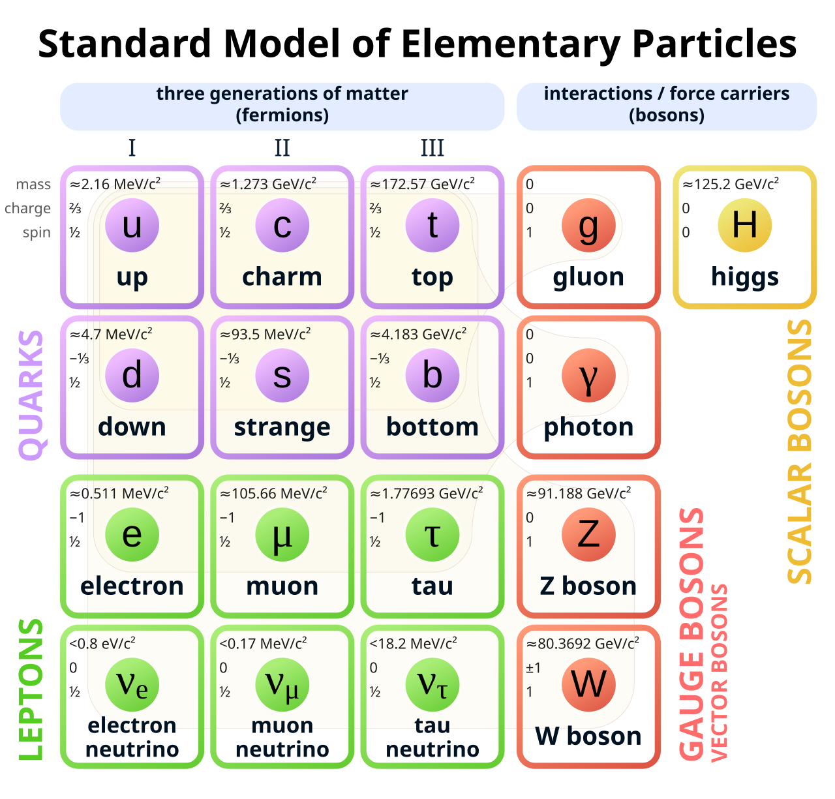


High-Level Overview
The Project 8 Collaboration seeks to measure $m_{ν,e}$, the mass of the electron neutrino through tritium (³H) β-decay.
Fig. 1: The decay channel resulting in a neutrino
d
u
W⁻
e⁻
$$\overline{ν_{e}}$$
[1]
Fig. 2: Table of elementary particles and properties

Slide 3
High-Level Overview
The Project 8 Collaboration seeks to measure $m_{ν,e}$, the mass of the electron neutrino through tritium (³H) β-decay.
By measuring the spectrum of output electron energies, we can solve for the mass of the neutrino.
We measure electron energies by their frequencies along uniform B-field lines.
Fig. 1: The decay channel resulting in a neutrino
d
u
W⁻
e⁻
$$\overline{ν_{e}}$$

Slide 4
Baseline Coils

Slide 5
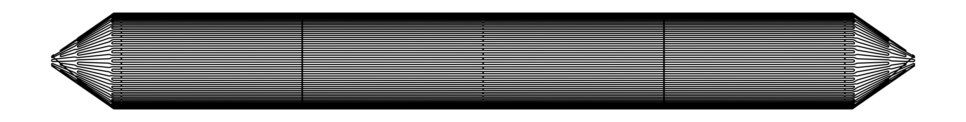
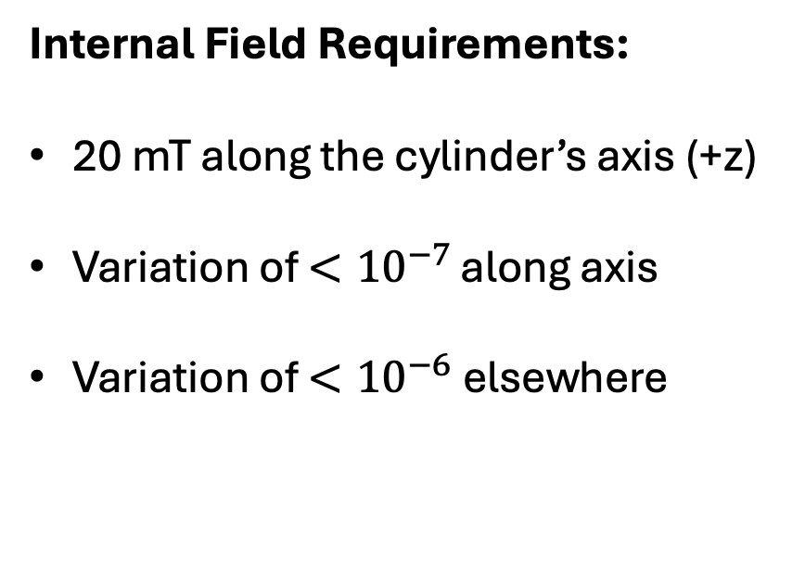
Baseline Coils
Internal Field Requirements:
20 mT along the cylinder’s axis (+z)
Variation of $<{10}^{−7}$ along axis
Variation of $<{10}^{−6}$ elsewhere
Values used for later figures
7.6 m
+x/y
1.62 m
+z
Baseline Coils
Rough area of uniformity

Slide 6
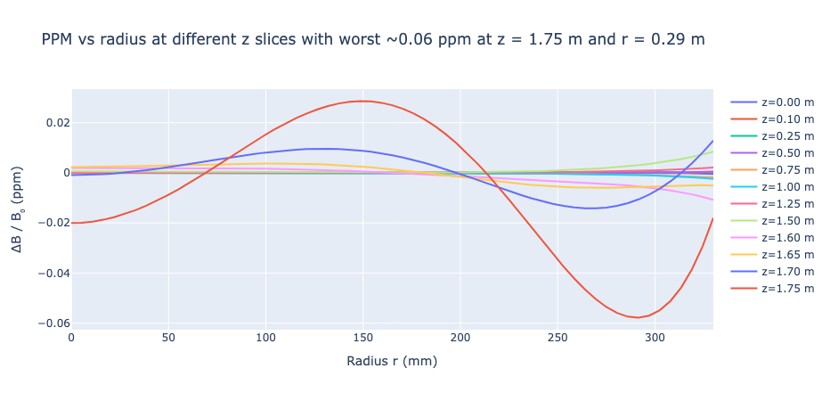
Baseline Field: Generation
Primary coils’ currents are optimized to generate uniform field at specified points
Field uniformity is confirmed by measuring at additional points

Slide 7

Baseline Field: Limitations
xxx
Only computes $B_{z}$
Assumes azimuthal symmetry

Slide 8
Correcting Coils

Slide 9
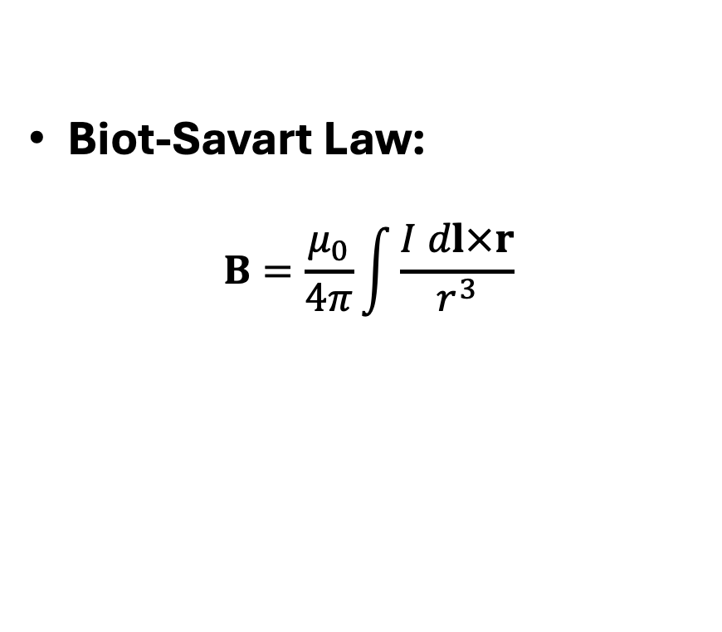
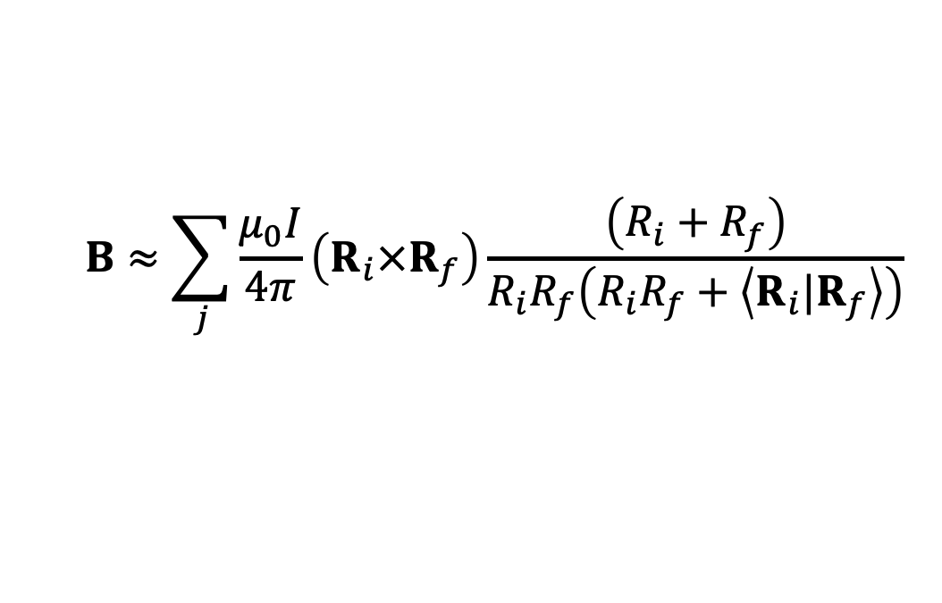
Discrete Biot-Savart Law
Biot-Savart Law:
$$B=\frac{μ_{0}}{4π}\int{\frac{I dl×r}{r^{3}}}$$
Discretize by breaking a current loop into j straight small line segments.
(1)
$$B≈\sum_{j}{\frac{μ_{0}I}{4π}\left(R_{i}×R_{f}\right)\frac{\left(R_{i}+R_{f}\right)}{R_{i}R_{f}\left(R_{i}R_{f}+\left\langle R_{i}|R_{f}\right\rangle \right)}}$$
(2)

Slide 10
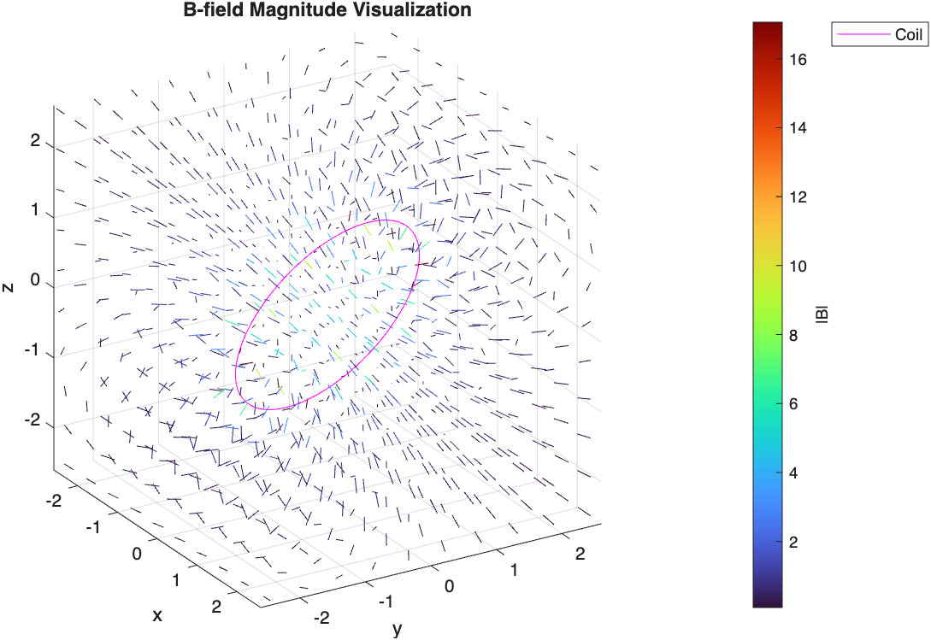
Preliminary B-Field Computation
Initially applied discretization and visualization to simple geometries in MATLAB
Supports multiple coils and arbitrary currents
Results were later ported into Python
Fig. 4: A visualization of the simulated, generated magnetic field from a skewed circular coil.

Slide 11
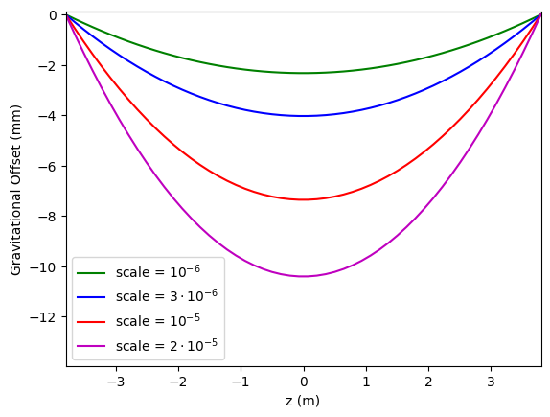
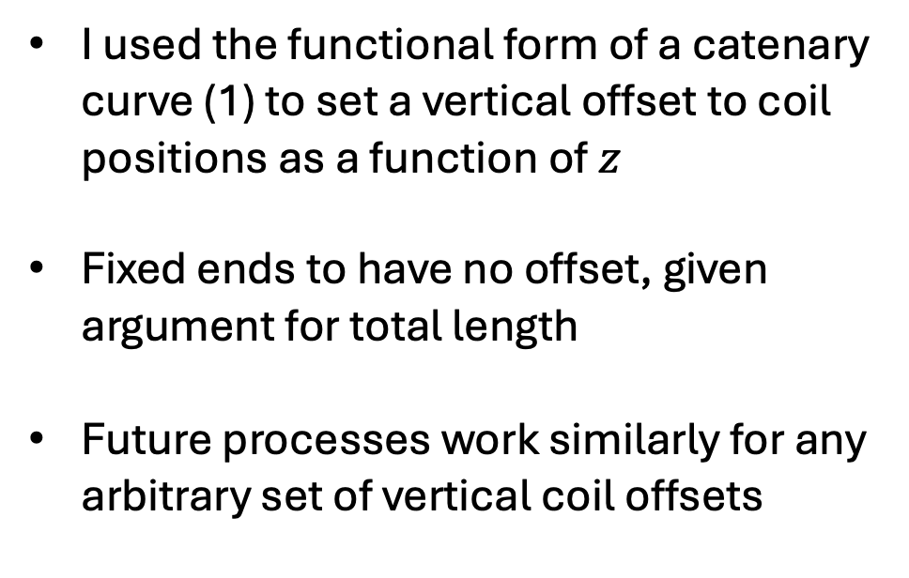
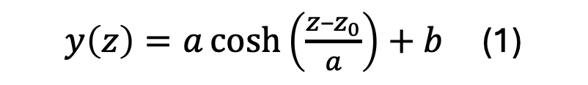
First-Order Gravitational Corrections
I used the functional form of a catenary curve (1) to set a vertical offset to coil positions as a function of $z$
Fixed ends to have no offset, given argument for total length
Future processes work similarly for any arbitrary set of vertical coil offsets
$y\left(z\right)=a\cosh\left(\frac{z–z_{0}}{a}\right)+b$ (1)
Multiple catenary curves are shown with different lengths = scale*separation and common boundaries of 0.

Slide 12
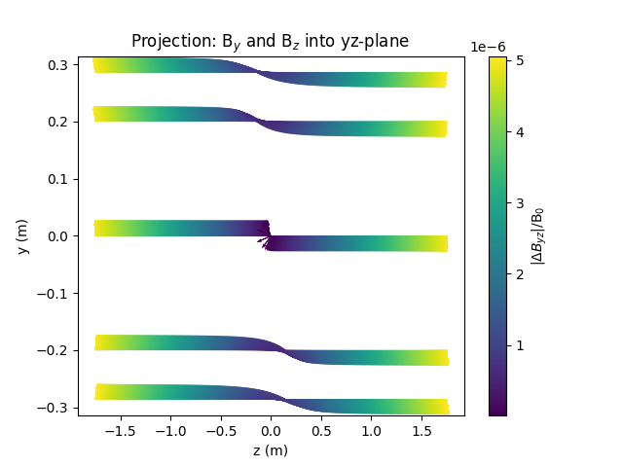
Field Differences
The 3-D magnetic field was then computed for the baseline and first-order cases.
These were subtracted to obtain a field difference, which I then try to mimic using coil and current configurations.
A visualization of the magnetic field differences at multiple positions projected into the yz-plane.

Slide 13
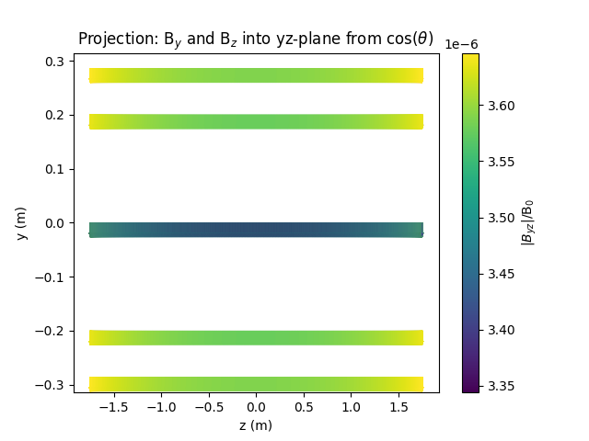
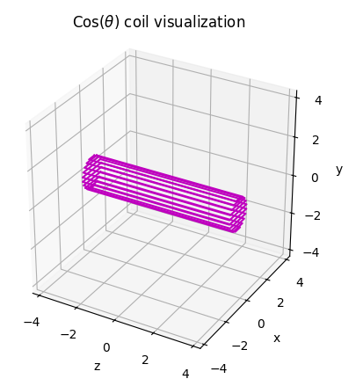
Cos(θ) Coil
Generated a cos(θ) coil
Showed that the field can’t give the desired offset pattern
An example cos(θ) coil geometry.
A typical field produced by a cos(θ) coil.

Slide 14
Solving in COMSOL
Magnetic Fields, No Currents

Slide 15
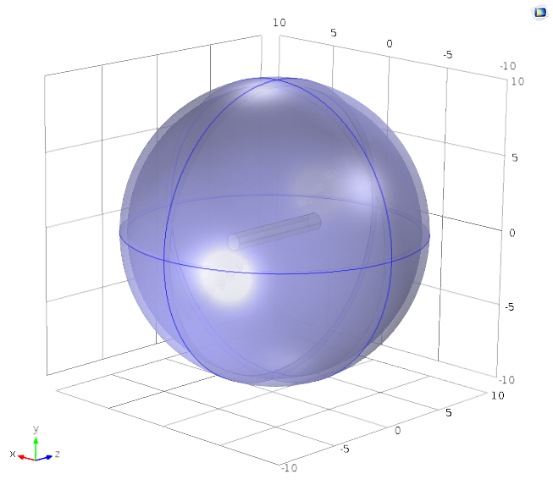
Problem Geometry
Created a cylindrical object and measured the surface normal magnetic flux
Created an infinite element domain sphere surrounding the cylinder

Slide 16
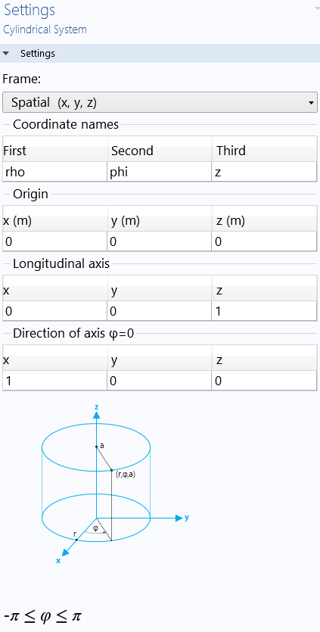
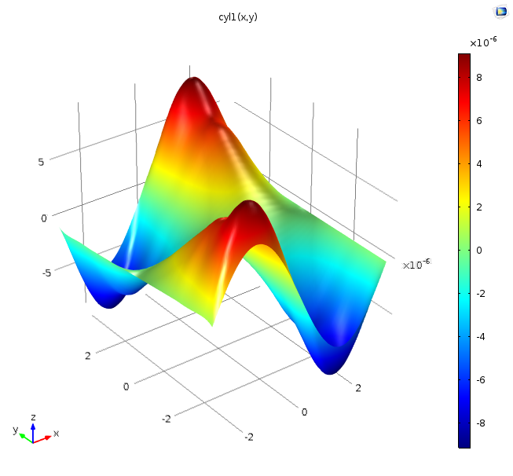
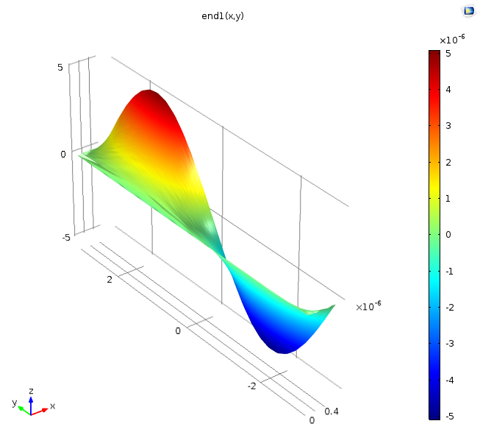
Magnetic Flux Boundary Conditions
Normal Flux on edges
Normal flux on ends
z
φ
φ
ρ
Definition of coordinates

Slide 17
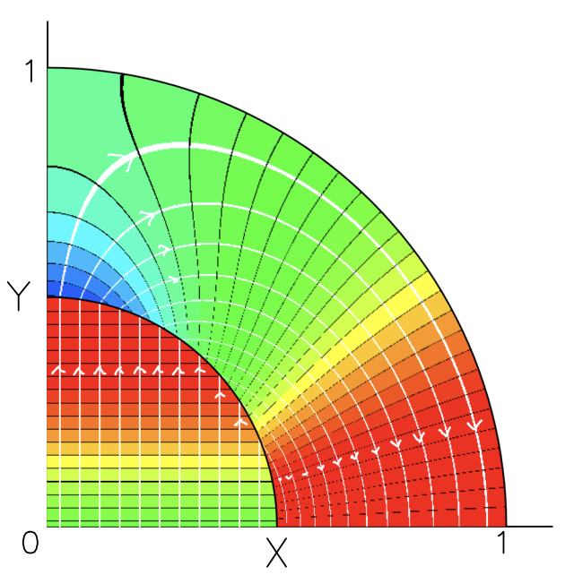
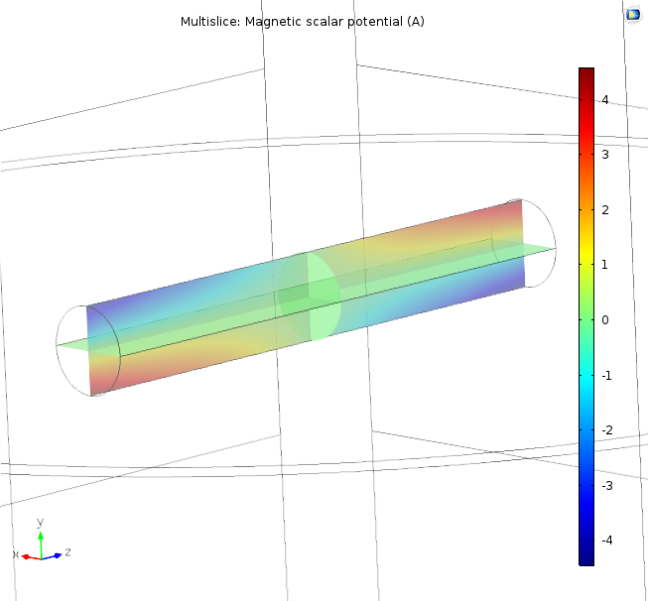

Magnetic Scalar Potential
With no free currents, the surface follows
$$\vec{H}=−\vec{∇}U$$
and
$∇^{2}U=0$
giving
$$−ΔU = I$$
$$\vec{n} × −\vec{∇}\left(U_{\text{out}}–U_{\text{in}}\right)=\vec{K}$$

Slide 18
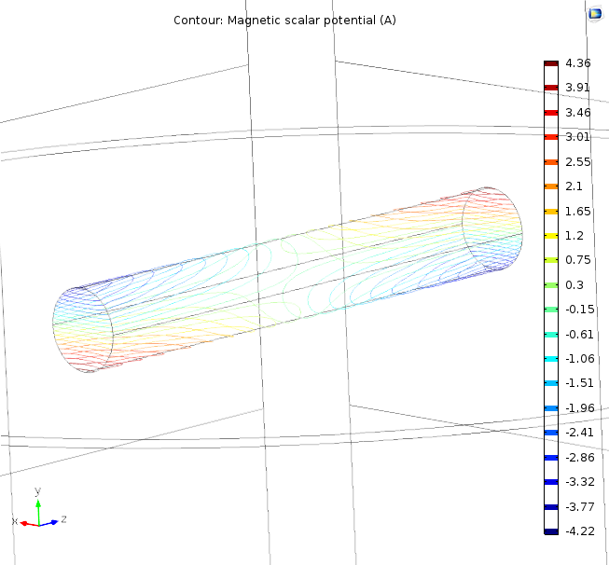
Correcting Coils
Equipotential surface contours demonstrate where to place correcting coils
Currents are given by the change in magnetic scalar potential between equipotentials

Slide 19
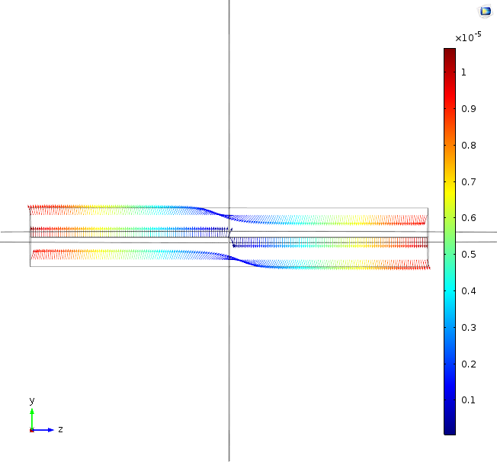
Field Comparisons
ρ < 0.559 m, -3.8 < z < 3.8 m
ρ < 0.330 m, -1.75 < z < 1.75 m

Slide 20
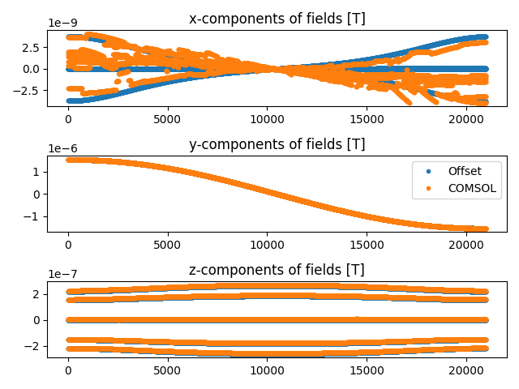
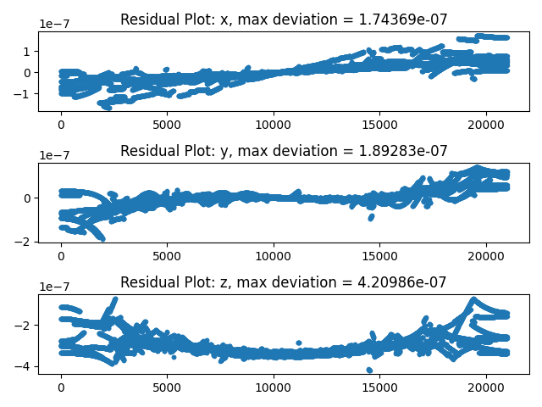

Field Comparisons
108 Primary Coils, Flux sampled 25cm inside
$$\left({\left(ΔB_{i}\right)}_{\text{offset}}–{\left(B_{i}\right)}_{\text{COMSOL}}\right)/20 \text{mT}$$

Slide 21
Further Work
Making accurate correcting coils at more realistic positions through multipole expansions
Tune corrections to final primary coil geometry

Slide 22
Summary
Used Mubi’s script to determine coil currents
Discretized Biot-Savart Law to compute vector B-field
Included first-order gravitational offset
Subtracted resultant field
Showed that basic cos(θ) coil is unable to correct
Working on using COMSOL to determine new correcting coil configuration

Slide 23
Citations
[1] Wikipedia article The Standard Model
[2] Ioffe Magnet Design Criteria, presentation to Project 8 Collaboration

