Slide 1
Fitting Procedure
Mubi Khan

Slide 2




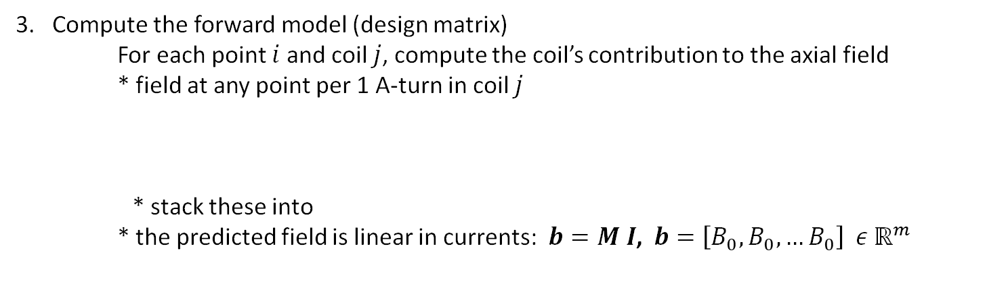
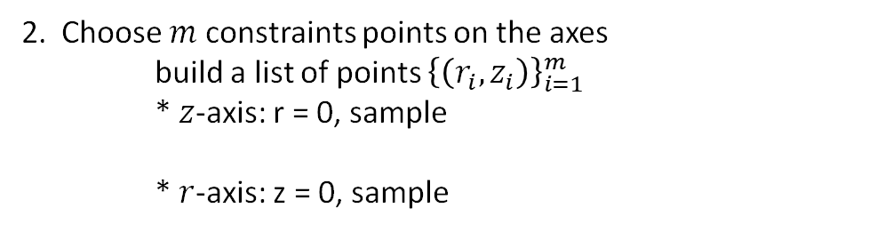

General fitting procedure ($n$ coils, $m$ constraint points)
Define coil geometry ($n$ unknowns currents)
place n circular coils with fixed radii $R_{j}$ and axial positions $z_{j}$ and unknown currents
$I=[I_{1},I_{2 …}$ $I_{n}]^{T}$
2. Choose $m$ constraints points on the axes
build a list of points ${\left\{\left(r_{i}, z_{i}\right)\right\}}_{i=1}^{m}$
* $z$-axis: r = 0, sample
* $r$-axis: z = 0, sample
$$r ε [0, r_{max}]$$
$$r_{max}=330 mm$$
$z ε [−\frac{L}{2},\frac{L}{2}]$, $L=3.5 m$
3. Compute the forward model (design matrix)
For each point $i$ and coil $j$, compute the coil’s contribution to the axial field
* field at any point per 1 A-turn in coil $j$
* stack these into
* the predicted field is linear in currents: $b=M I$, $b=\left[B_{0}, B_{0}, …B_{0}\right] ε ℝ^{m}$
$M_{ij} ≡B_{z}^{}(r_{i}, z_{i};r_{j}^{′},z_{j}^{′})$, where $r_{i}, z_{i}$are the field points and $r_{j}^{′},z_{j}^{′}$ are the positions of the coils
$$M ε ℝ^{m ×n}$$

Slide 3
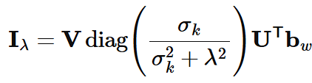

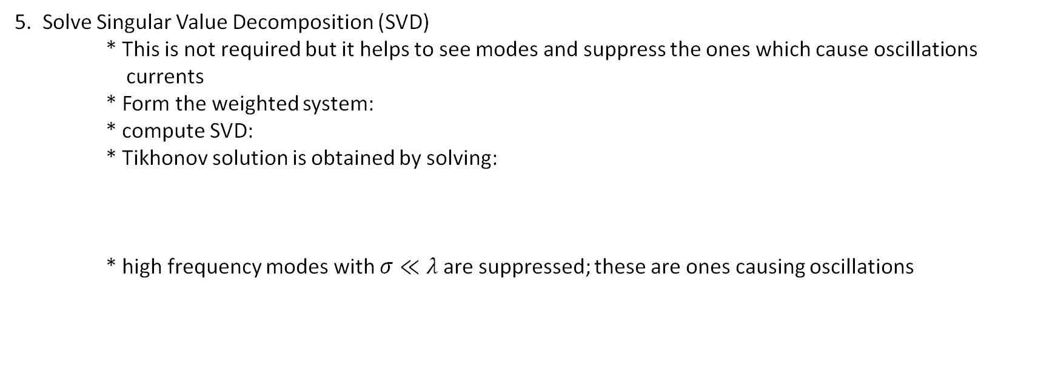

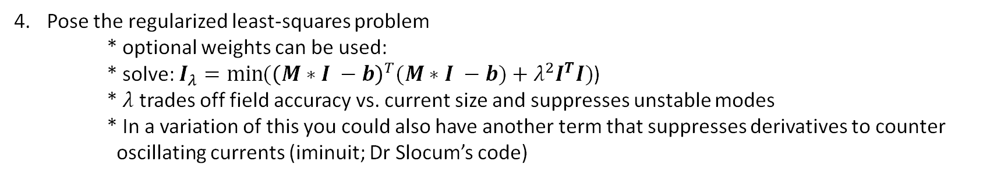
Pose the regularized least-squares problem
* optional weights can be used:
* solve: $I_{λ}=\min{({\left(M∗I −b\right)}^{T}(M∗I −b)+λ^{2}I^{T}I)}$)
* $λ$ trades off field accuracy vs. current size and suppresses unstable modes
* In a variation of this you could also have another term that suppresses derivatives to counter
oscillating currents (iminuit; Dr Slocum’s code)
$$W=diag \left(w_{i}\right)$$
5. Solve Singular Value Decomposition (SVD)
* This is not required but it helps to see modes and suppress the ones which cause oscillations
currents
* Form the weighted system:
* compute SVD:
* Tikhonov solution is obtained by solving:
* high frequency modes with $σ≪λ$are suppressed; these are ones causing oscillations
Without SVD:
$$I_{λ}={\left(M^{T}M+λ^{2}I\right)}^{−1}M^{T}b$$

Slide 4
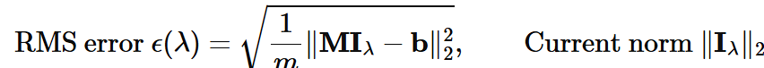
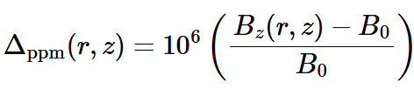
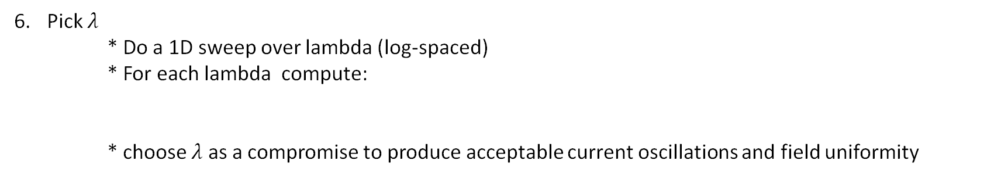
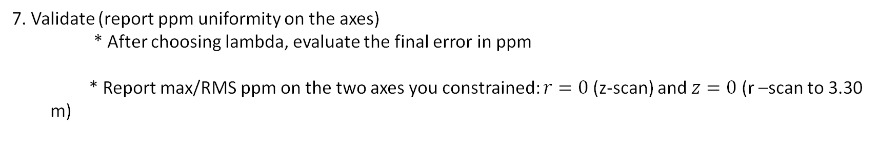
Pick $λ$
* Do a 1D sweep over lambda (log-spaced)
* For each lambda compute:
* choose $λ$ as a compromise to produce acceptable current oscillations and field uniformity
7. Validate (report ppm uniformity on the axes)
* After choosing lambda, evaluate the final error in ppm
* Report max/RMS ppm on the two axes you constrained: $r=0$(z-scan) and $z=0$ (r –scan to 3.30 m)

