Slide 1
Detecting Particles on the Residual
Turning a needle-in-clutter search into finding bright peaks in noise
A micro-CT scan of a cell is dominated by the cell's own structure. We don't search it directly — we search the residual.
−
=
1
2
3
The clutter
Subtract the model
Anomalies isolated
Windings and walls dominate every slice. Genuine high-Z particles are tiny and rare — easily lost in that structure.
Form the residual: reconstructed volume minus a model of the expected structure. Predictable structure cancels out.
What survives are the departures — particles standing out as positive signal-to-noise peaks over near-zero background.
Why it matters: the residual is zero-mean noise, so a true particle is an unambiguous positive peak — the foundation everything downstream relies on.
Notes:
The key idea: rather than detecting particles in the raw reconstructed volume — where the cell's winding and wall structure dominates — we subtract a model of that expected structure to form a residual. In the residual, predictable structure cancels and only anomalies survive, appearing as positive signal-to-noise peaks over a near-zero-mean background. This reframes a hard needle-in-clutter problem as a much simpler 'find bright peaks in noise' problem.

Slide 2
Extracting Candidate Particles
How the volume analysis turns the residual into a list of candidates
1
Calibrate the noise
2
Threshold on SNR
Per-voxel noise (σ) is estimated on a pre-cell basis — independent of cell content — giving a trustworthy baseline that turns the residual into a signal-to-noise ratio.
Flag a strict high-confidence core where the SNR is unambiguous, plus a more generous surrounding skirt of plausible signal.
3
Grow the blob
4
Extract features
Grow each confident core outward into its connected skirt, so the full extent of the particle is captured — not just its brightest center.
Measure each grown particle — size, shape, intensity and related descriptors — producing the feature set used to score and classify candidates downstream.
Governing principle: detect strict, measure generous — decisions rest on the confident core; measurement uses the full grown particle.
Notes:
The candidate-extraction pipeline, at a high level, operating on a single residual volume: per-voxel noise (sigma) is estimated on a pre-cell basis, independent of cell content, and normalizes the residual into a signal-to-noise ratio; a strict core threshold and a generous skirt threshold are applied; each confident core is grown into its skirt to capture the full particle; and features — size, shape, intensity and related descriptors — are extracted from each grown particle for downstream scoring and classification. The governing principle throughout is 'detect strict, measure generous.'

Slide 3
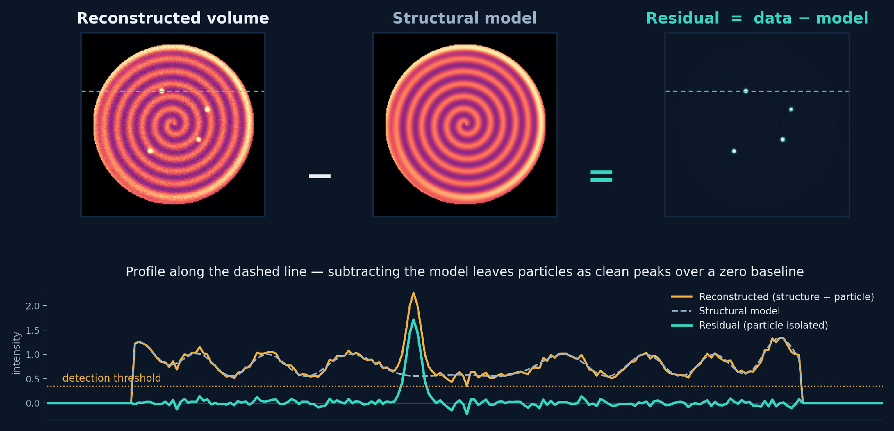
How the Residual Isolates Particles
Subtract the expected structure — anomalies remain as clean peaks
Illustrative schematic — a synthetic winding cross-section, not measured data.
Notes:
Optional supporting visual. Left: a reconstructed slice dominated by the jelly-roll winding structure, with a few faint high-Z particles. Middle: a smooth model of that expected structure. Right: the residual — data minus model — where the structure has cancelled and the particles stand out as bright, isolated peaks. The profile beneath, taken along the dashed line, shows the reconstructed signal tracking the structural model everywhere except at the particle, while the residual stays flat near zero and rises into a clean peak above the detection threshold. This is a synthetic illustration of the concept, not measured data.

Slide 4
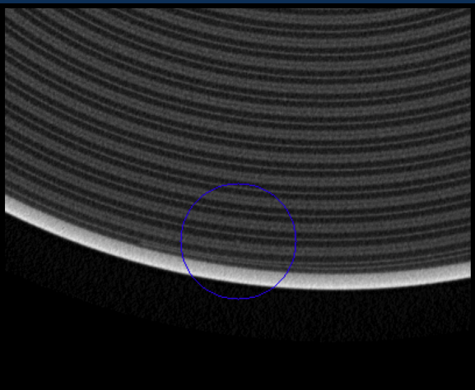
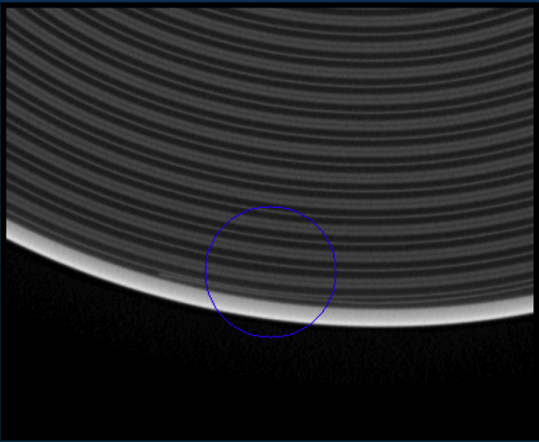
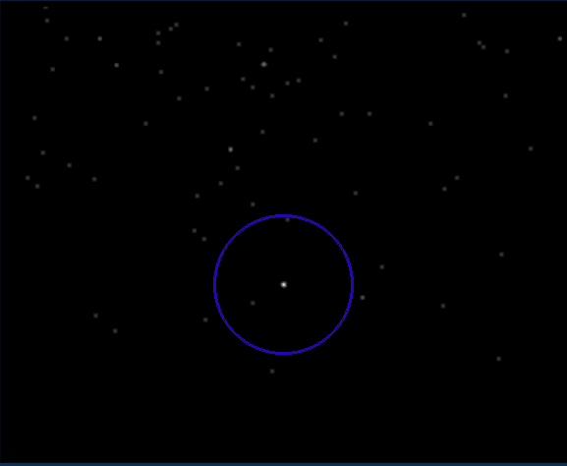
The Same Process on a Real Slice
A genuine particle — hidden in the raw data, isolated in the residual
1 Original radial slice
2 Structural model
3 Residual = data − model
−
=
Circled: a genuine particle — barely distinguishable against the winding structure in the raw slice, but an unmistakable bright point once the model is subtracted.
Notes:
A real radial slice through the cell, shown as original, modeled structure, and residual. In the original slice the winding rings dominate and a genuine particle (circled) sits right against the bright electrode edge, hard to distinguish. The structural model captures the smooth rings and edge. Subtracting it leaves the residual, where the winding structure is gone and the particle stands out as a clear bright point at the same location; the other faint specks are additional candidates and noise. This is the same detect-on-the-residual principle from the schematic, now on measured data.

