Slide 1


Flowbot Starter Kit

Slide 2



What is flowbot?
A Bot Framework
Developed in Node
Based on Microsoft Bot Framework

Slide 3
What do I need
to start developing?
Install Node:
https://nodejs.org/
Get a Microsoft Bot Account
https://dev.botframework.com/
You’ll need an IDE:
https://code.visualstudio.com/
Microsoft Bot Emulator
https://docs.botframework.com/en-us/tools/bot-framework-emulator/

Slide 4
While I’m coding,
how I can debug?
Good question! You can use a secure
tunnel to localhost.
Get ngrok for free!
https://ngrok.com/

Slide 5
I need to start
developing right now
Let’s open the terminal!

Slide 6
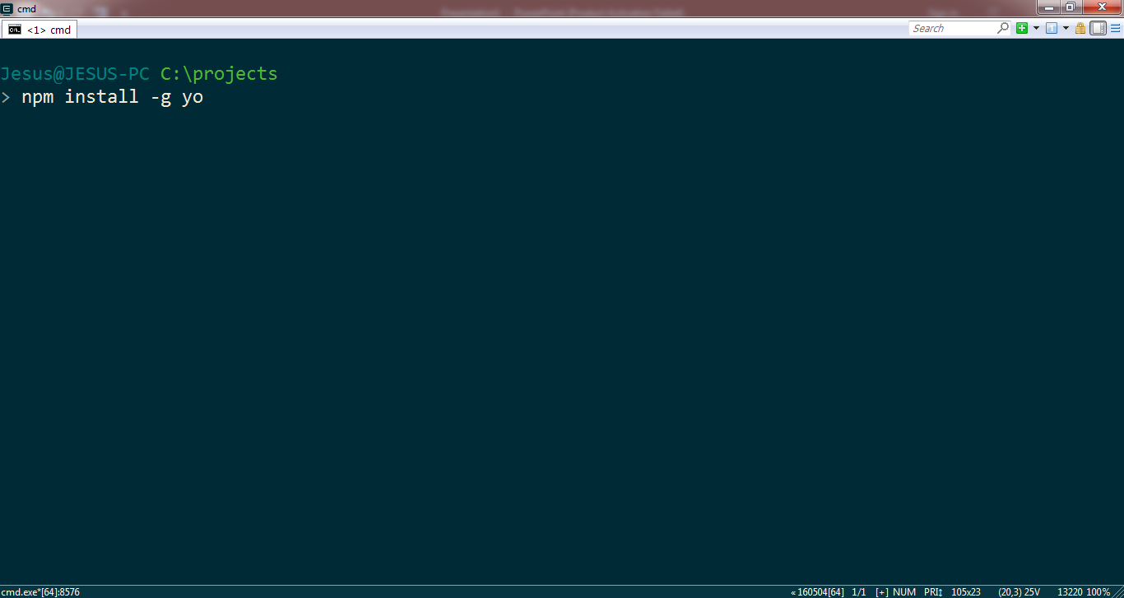
First at all install yeoman.

Slide 7
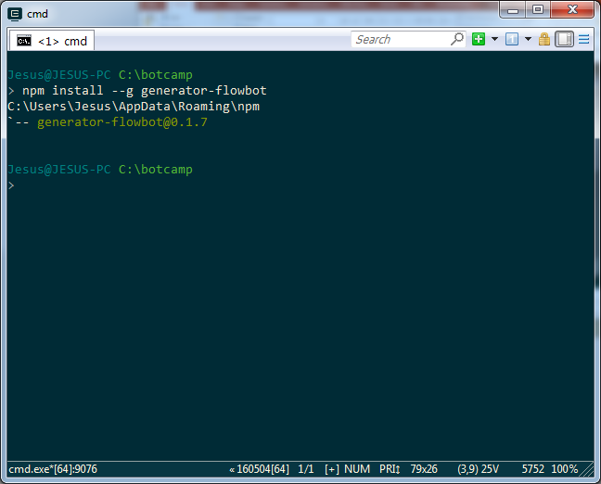
Now install the generator-flowbot

Slide 8
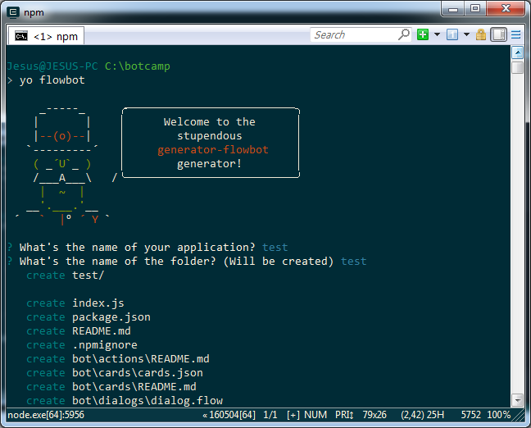
Create your bot with yo flowbot

Slide 9
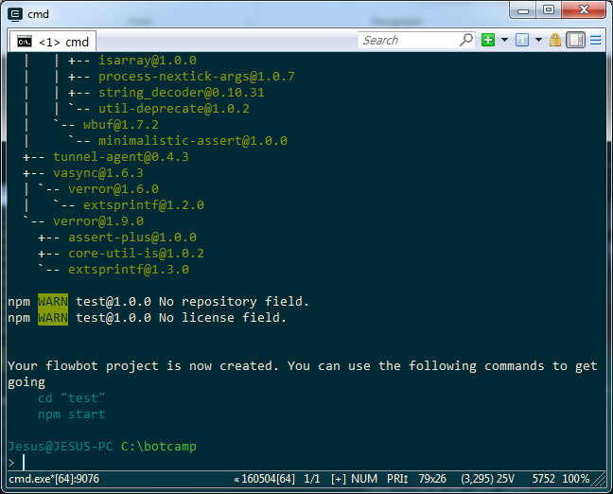
When it finish, you’ll see instructions.

Slide 10
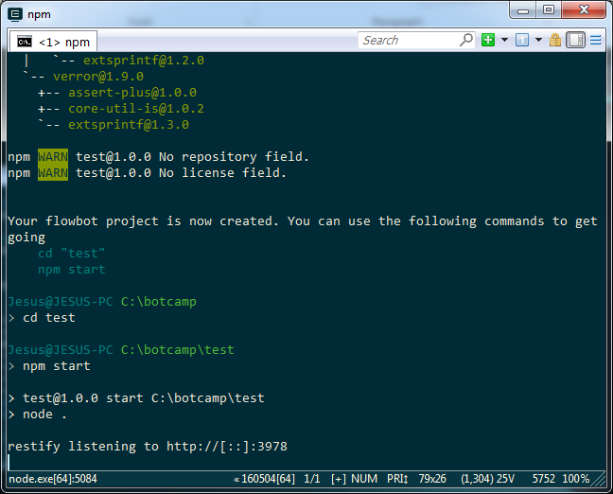
This makes your bot running!

Slide 11
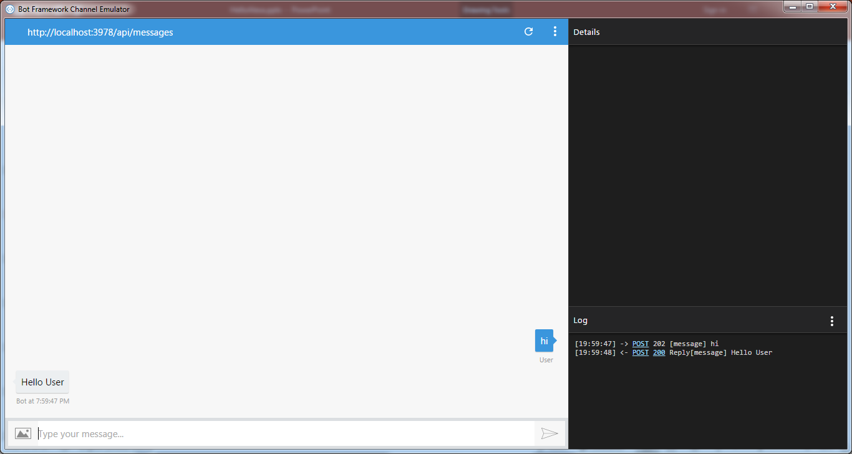
Open the emulator and configure the endpoint:
http://localhost:3978/api/messages

Slide 12
So right now you have a bot working!
But let’s explain what’s happening…

Slide 13
If you open the generated code you’ll see
a folder called bot. Inside there are three folders
The folder cards contains a JSON with cards.
Each card is an interaction with the user.
The folder actions contains the javascript code.
Each action has a name that is the name of the
file. Here we put the complex things.
The folder dialogs contains the flow of the dialogs
You can do the dialogs as complex as you want.
Think on dialogs like an state machine, where each
State execute a pipeline of tasks.

Slide 14
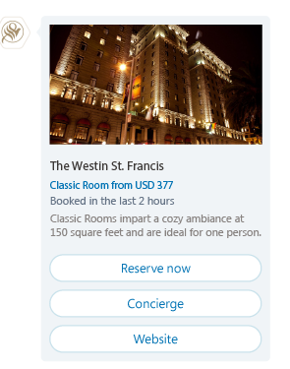
Let’s understand cards!
There are several types of cards:
Text, Picture, Hero, Carousel and Prompt
A Hero Card is a media card that contains an
Image, a title, a subtitle, a text and buttons.
A Carousel is a set of Hero Cards.
A Prompt is an input to the user: you can input
Text, Number, Time, Attachment or Choice.
One special type of promp is the menu: is a choice
where each option is the call to another dialog.
This is used to control the flow.

Slide 15
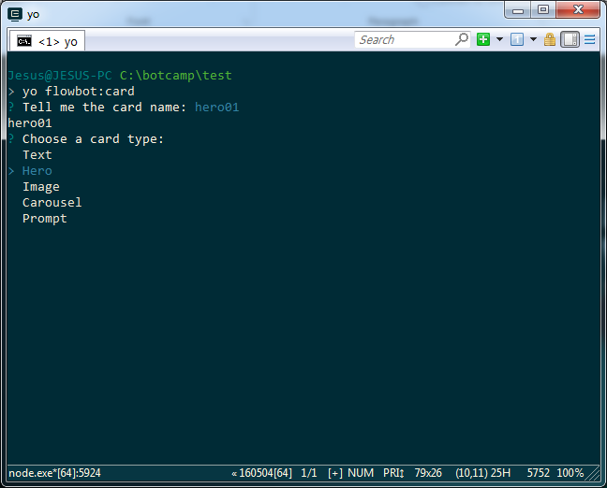
You can create cards with yo flowbot:card

Slide 16
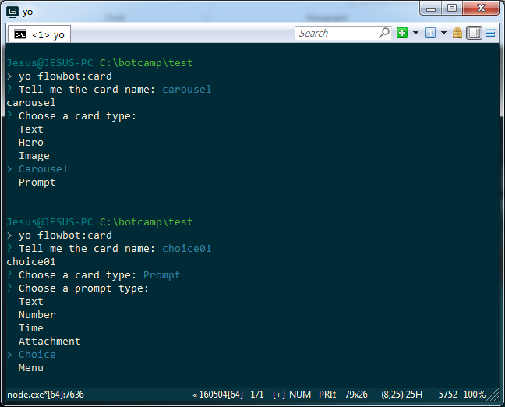
You can choose the subtype for Prompts

Slide 17
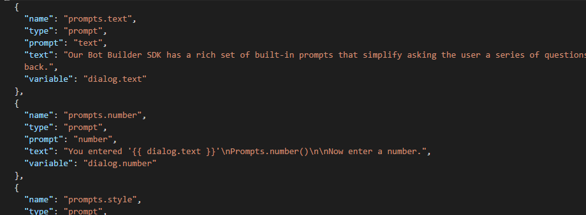
When you choose Prompt you’ll be asked for
a variable name. You can set variables for the
user, example, user.age, or for the current
Dialog, example, dialog.choice.
These variables can be used in the cards
and will be automatically replaced

Slide 18
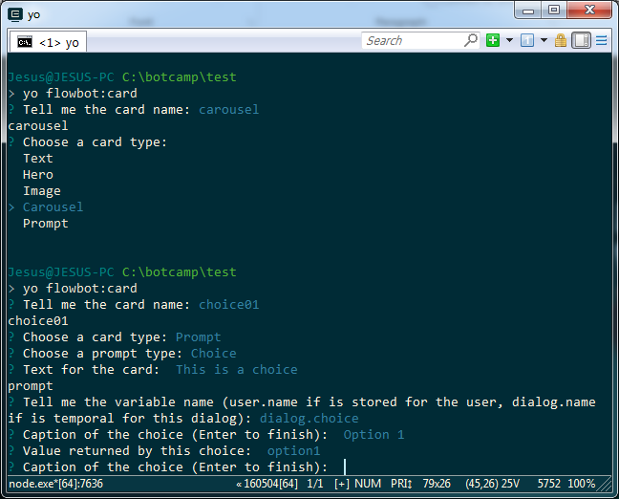
When the prompt is a choice you’ll be asked
for captions and values: the caption is the label
of the button that the user will see, the value
is the value that will be stored in the variable
When the user choose this option.

Slide 19
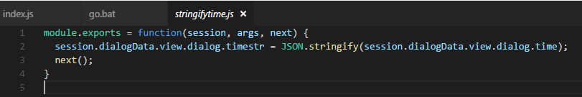
Let’s understand actions!
You can see the Microsoft core concepts:
https://docs.botframework.com/en-us/node/builder/guides/core-concepts/#navtitle

Slide 20
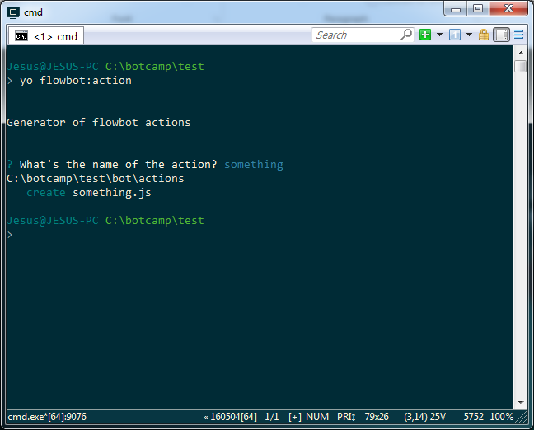
You can create actions with yo flowbot:action
But is not magic… you’ll have to code

Slide 21
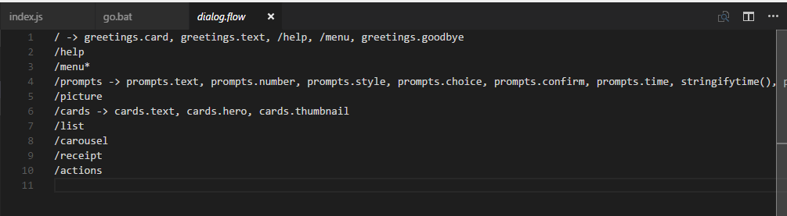
Let’s understand dialogs! Here you have an example of a dialog.flow file. Each line start with the name of the dialog, an arrow, and the pipeline of tasks.
A task that starts with / means call another dialog
A task that ends with () means call an action
If not, then is the name of a card
When a dialog has not pipeline, it means that the card with
The same name as the dialog is called.
A dialog with * means that is repetitive (until endDialog selected)

Slide 22
You have a complete example here:
https://github.com/jseijas/flow-bot-example

Slide 23
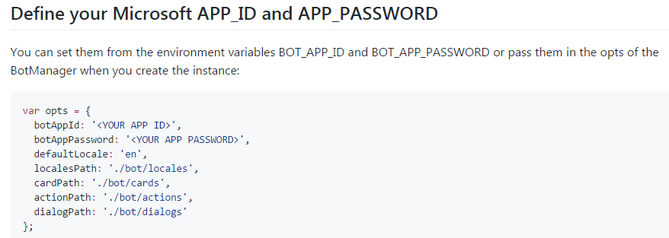
Once you define a bot at Microsoft Bot Framework,
You’ll have an APPID and APPPassword.
You can set them in the code in the index.js

Slide 24
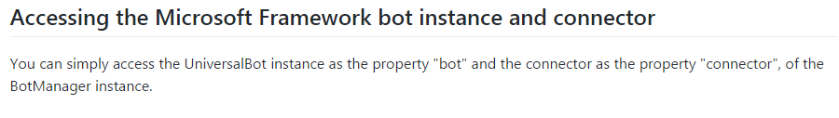
If you need to do more complex things, you can
use the Microsoft Bot Framework documentation.
The bot and the connector are exposed!

Slide 25
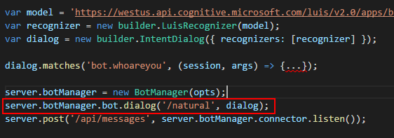
If you need to use NLP, then well… you’ll have
to learn more about Microsoft Bot Framework
https://docs.botframework.com/en-us/node/builder/guides/understanding-natural-language/#navtitle
Create all following the instructions of Microsoft.
Then you can insert a dialog like this in your bot
You can call this dialog in your flow as always.
Remember that in your custom dialogs you can call other with
session.beginDialog(‘/name’) or end current with session.endDialog()

Slide 26
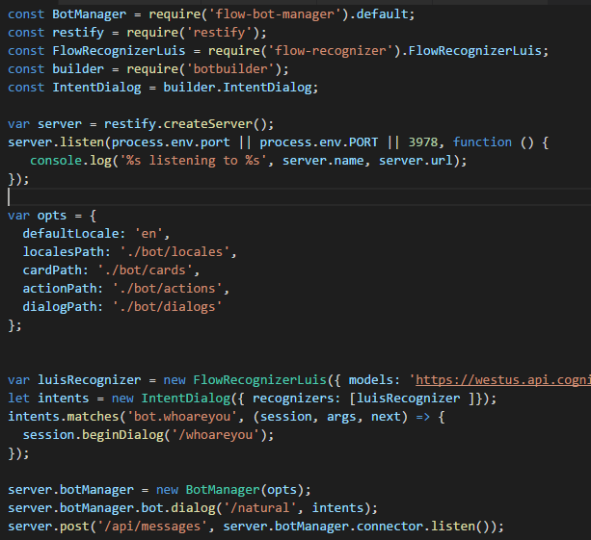
Or you can install flow-recognizer!
It’s able to use API.ai, Wit.ai or LUIS.ai
https://github.com/jseijas/flow-recognizer

Slide 27
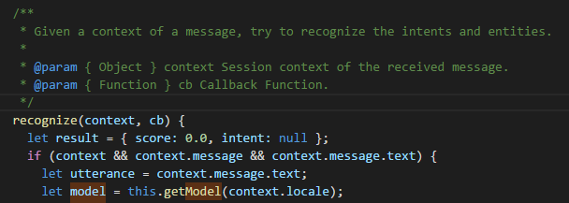
There is another way to use it! When you have a text, example
at a Prompt, you can call directly to recognize method of
your recognizer. You pass a context :
{ message: { text: “this is the utterance” }, locale: “en” }

