Slide 1



CHATBOTS
Workshop
Jesus Seijas
@jseijasdev

Slide 2
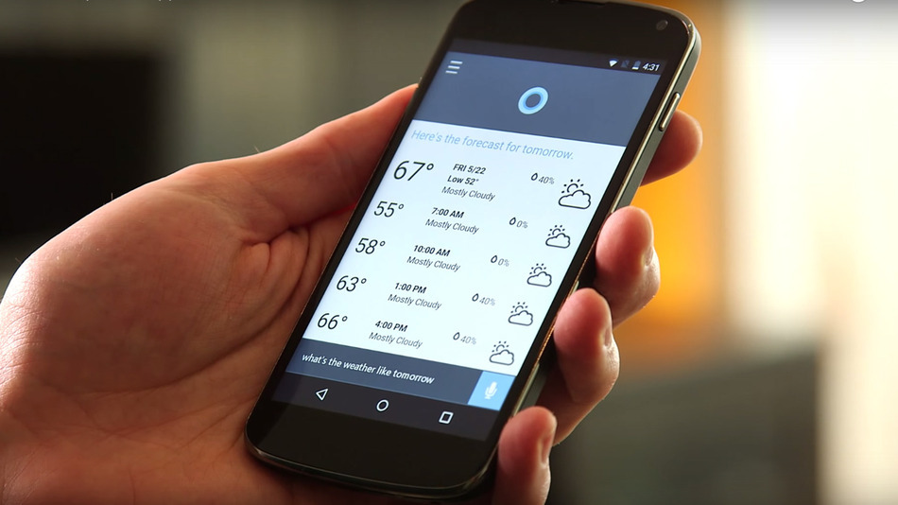
Conversational Agents

Slide 3


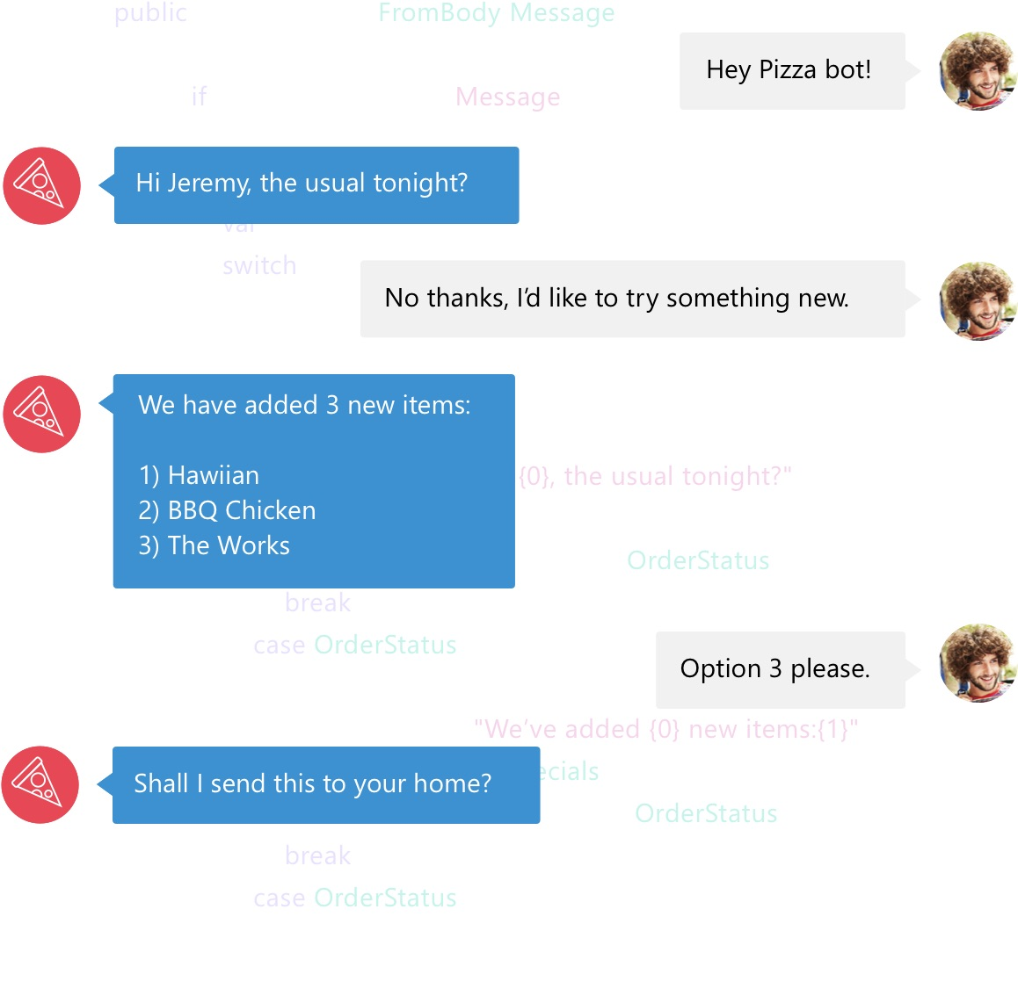

Slide 4
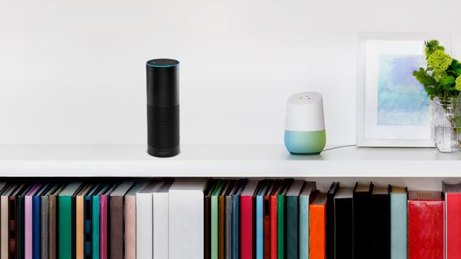


Slide 5
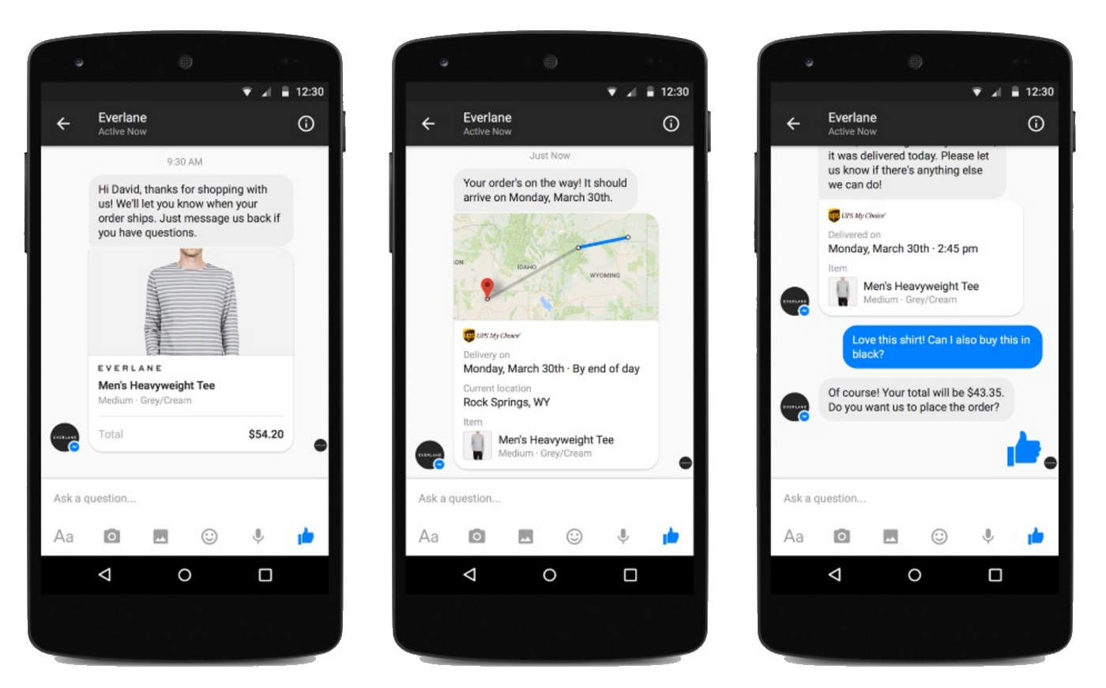


Slide 6

Why so hype now?

Slide 7
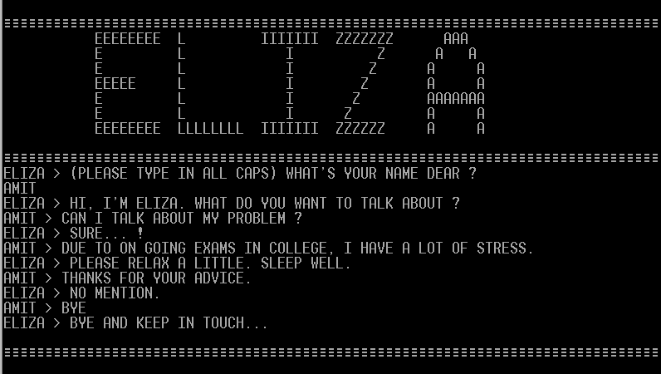

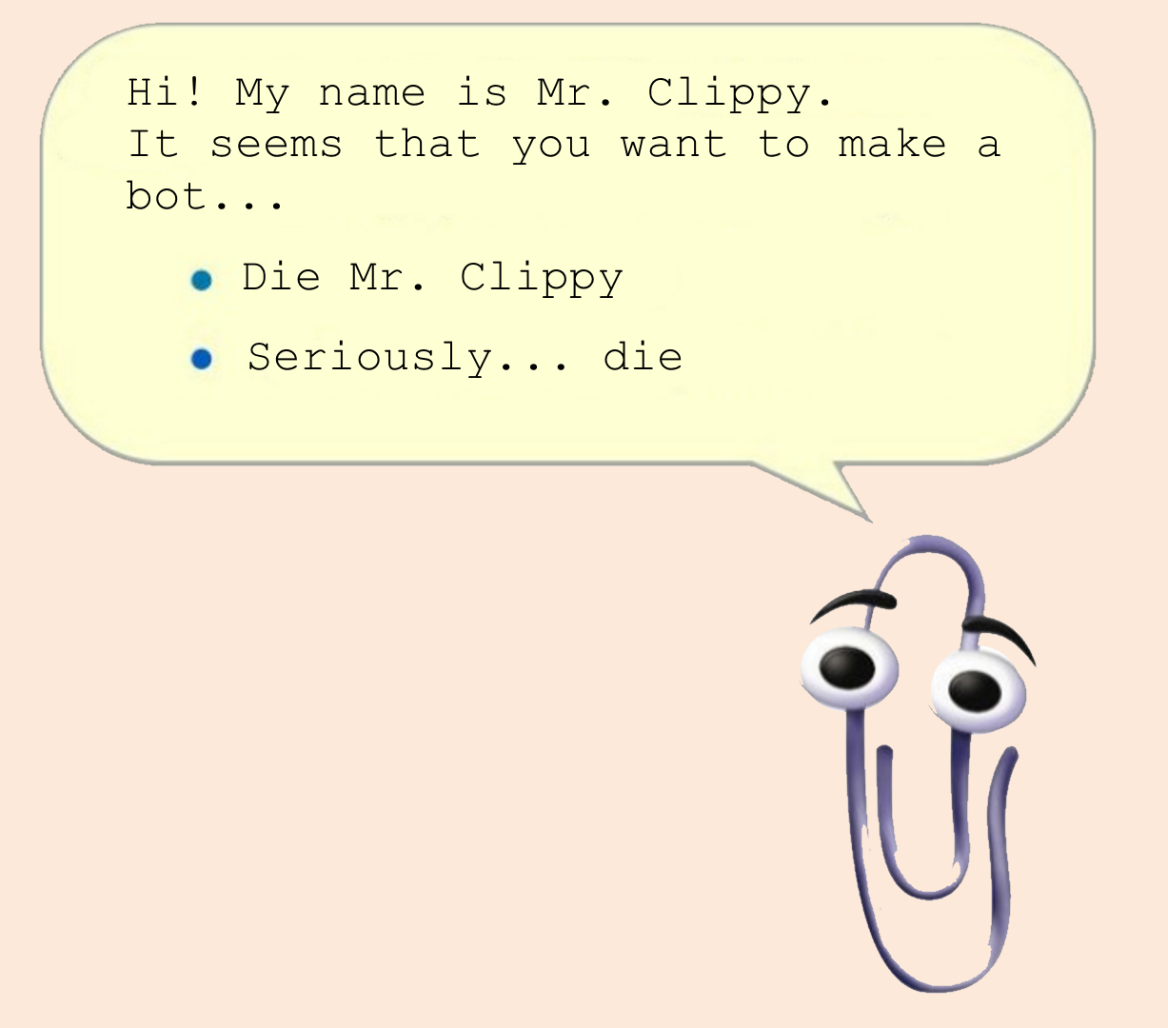
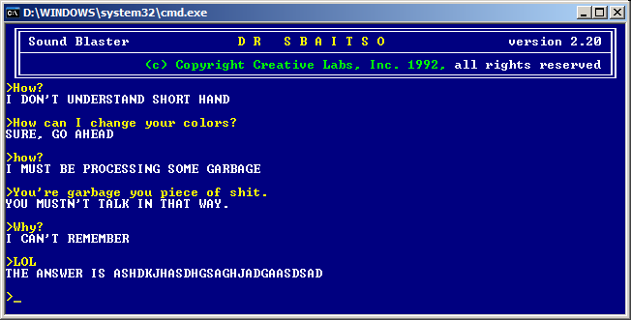

Slide 8
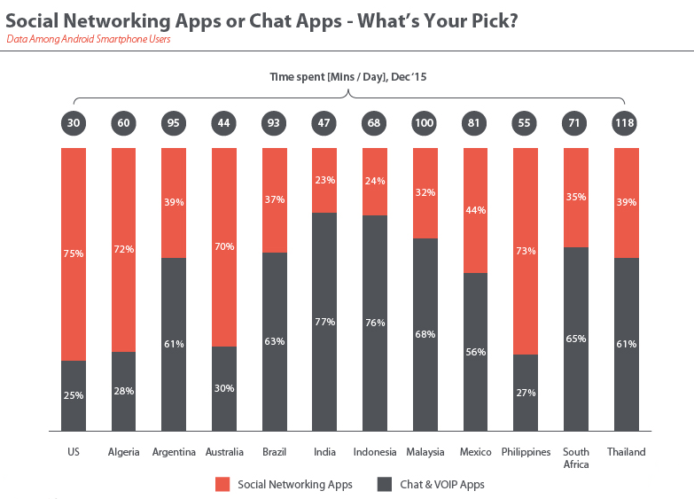


Slide 9
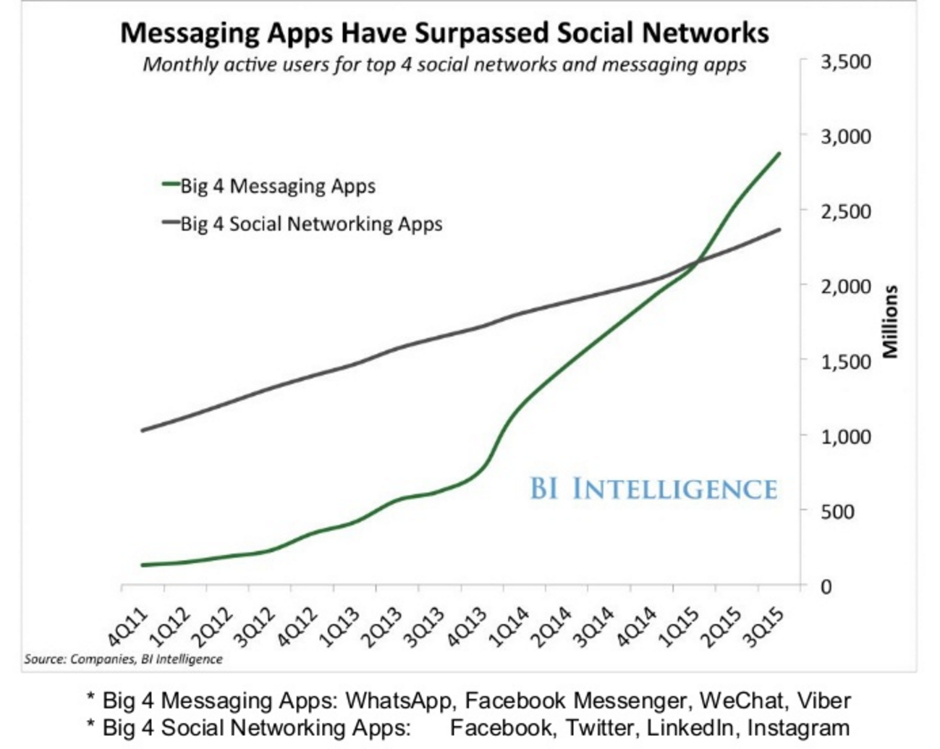


Slide 10
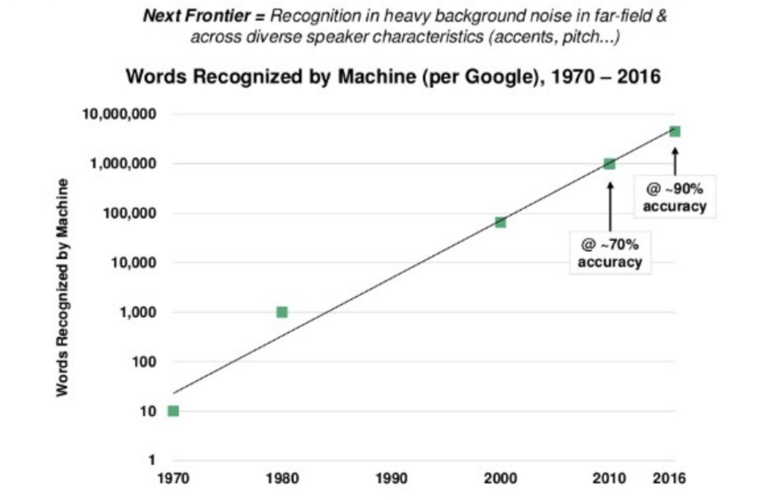


Slide 11
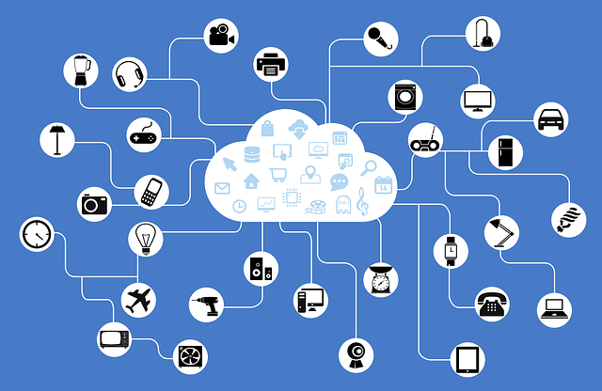
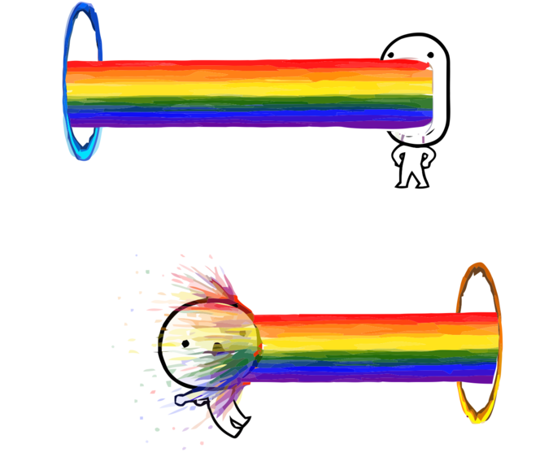

Slide 12
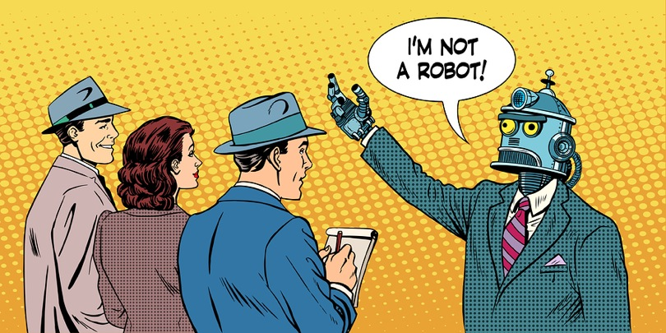

Slide 13












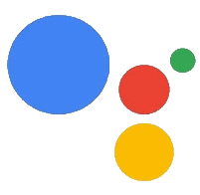






Facebook
Messenger
Slack
Telegram
Skype
LINE
Wechat
KIK
GroupMe
Microsoft
Teams
Alexa
Cortana
Google Actions
Twilio
Mail
API
Web
Android SDK
iOS SDK

Slide 14

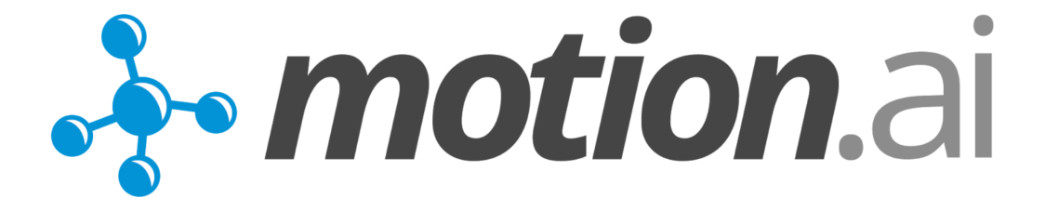






























Slide 15






Botkit
Hubot
Microsoft
Bot Framework
Claudia.js
Botpress

Slide 16


Slide 17
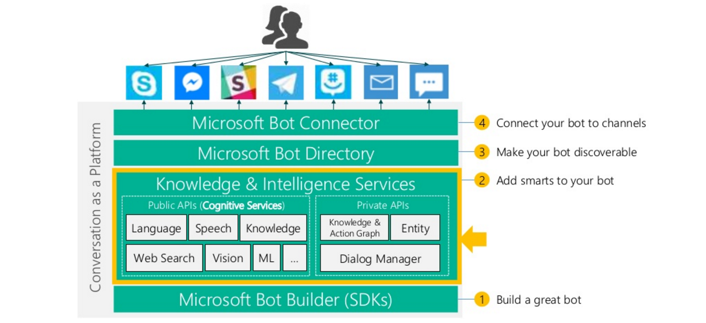


Slide 18



