Slide 1
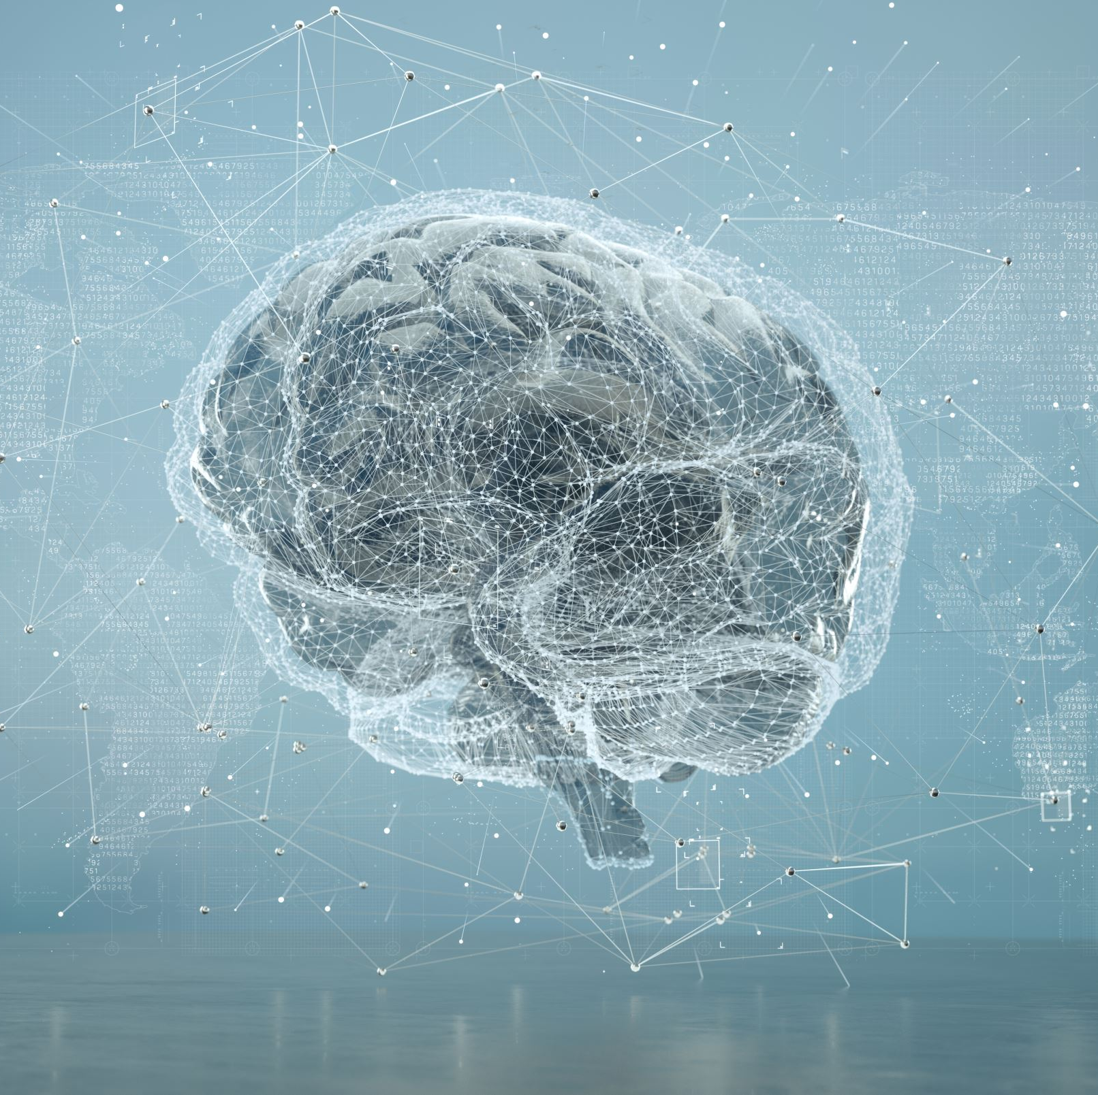
Application of DFQ in Machine Learning: Neural Ordinary Differential Equations
Presentation by Jasmine Sellers
University of Washington Tacoma
TMATH 207 Fall 2023
Instructor: Duong Than

Slide 2
Outline
Topic Overview
Development and Use of Differential Equations
Application
Goal: Learn about differential equations in machine learning, specifically neural ODEs.

Slide 3
TOPIC OVERVIEW
Learning Target:
What is artificial intelligence, machine learning, and deep learning?
How are neural networks connected?
What is neural ODEs?

Slide 4
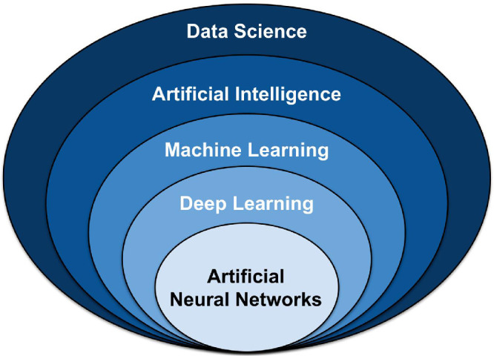
Background
Why did I choose this topic?
I wanted to know …
How can algorithms be used to make predictions and decisions?
What role do differential equations play in machine learning tools?
Why is it important to study this topic?
Implementation of AI is applicable in a vast majority of fields such as biology, business, and engineering.
Differential equations allow for flexible and adaptive frameworks for modeling data that change continuously
Key Concepts
Artificial Intelligence: intelligence of machines/software
Machine Learning: uses data and algorithms to learn
Neural Networks: interconnected, layered processing units
Deep Learning: uses neural networks to learn
Notes:
Oke, S. A. (2008). A literature review on artificial intelligence. International journal of information and management sciences, 19(4), 535-570.
Jain, A. K., Mao, J., & Mohiuddin, K. M. (1996). Artificial neural networks: A tutorial. Computer, 29(3), 31-44.

Slide 5
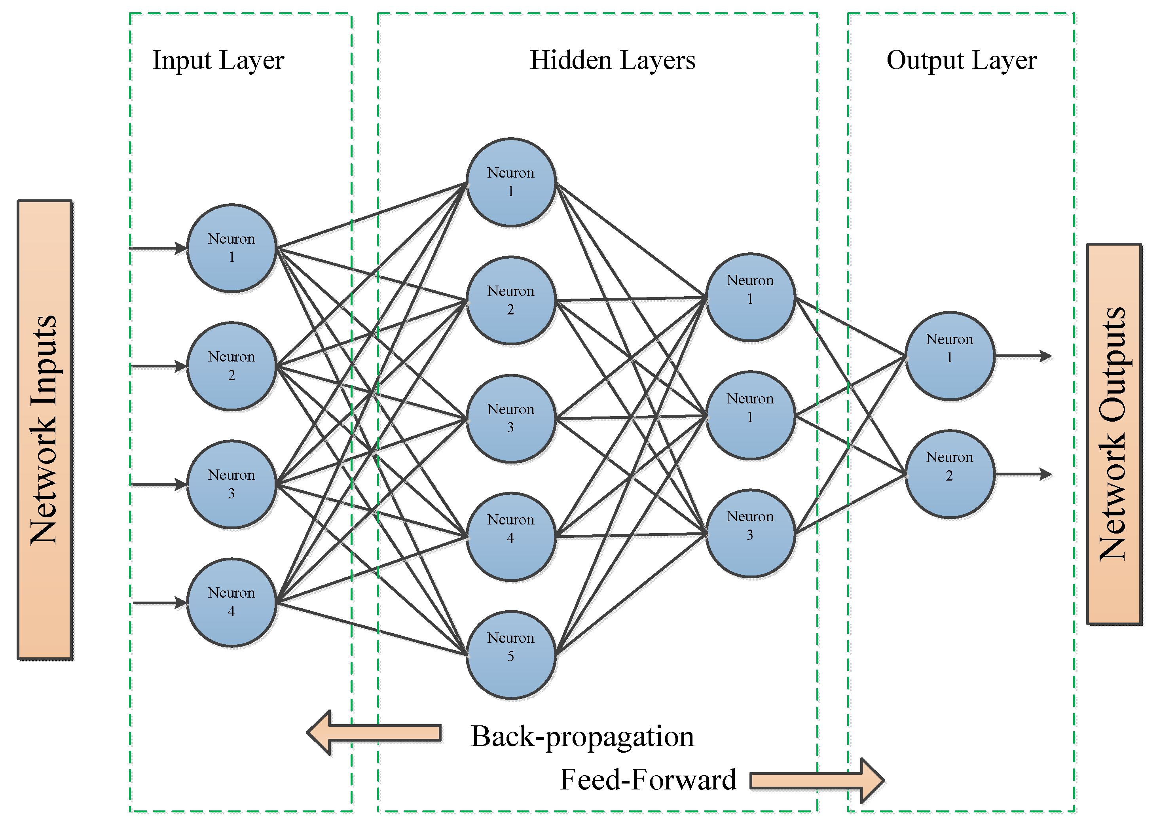
Aspects of Networks
Neuron/Nodes: receive input, perform calculations, and produce output
Layers: contain nodes that process and transform data
Weights and Biases: determine the strength of connections between neurons
Feedforward Propagation: flow data from the input layer to the output layer
Backpropagation: trains algorithm to adjust network weights and biases in accordance with error in the output; uses gradients and updates parameters to minimize the loss function.
Loss Function: quantifies the error between the network’s prediction and actual values
Gradients: rate of change of the loss with respect to the model’s parameters
Notes:
Abdolrasol, M. G., Hussain, S. M., Ustun, T. S., Sarker, M. R., Hannan, M. A., Mohamed, R., Ali, J. A., Mekhilef, S., & Milad, A. (2021). Artificial Neural Networks Based Optimization Techniques: A Review. Electronics, 10(21), 2689. https://doi.org/10.3390/electronics10212689
Chen, R. T., Rubanova, Y., Bettencourt, J., & Duvenaud, D. K. (2018). Neural ordinary differential equations. Advances in neural information processing systems, 31.
Choi, R. Y., Coyner, A. S., Kalpathy-Cramer, J., Chiang, M. F., & Campbell, J. P. (2020). Introduction to machine learning, neural networks, and deep learning. Translational vision science & technology, 9(2), 14-14.
Jain, A. K., Mao, J., & Mohiuddin, K. M. (1996). Artificial neural networks: A tutorial. Computer, 29(3), 31-44.

Slide 6

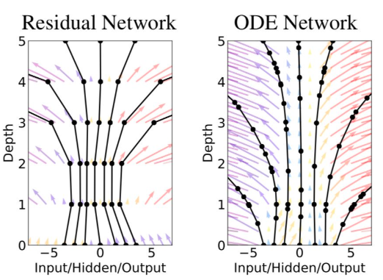

Neural Ordinary Differential Equations (ODEs) Networks
Parametrize the derivative of the hidden state
$\frac{dh\left(t\right)}{dt} = f(h(t),t,θ)$
h(t) = hidden layer function
t = time
$θ$ = learnable parameters
$f(h(t),t,θ)$ = neural network function
 | Neural ODEs
Processing | Continuous data
Architecture | Dynamic/adaptive
Application | Physics-based modeling, physiology

Slide 7
DEVELOPMENT
Learning Target:
What differential equations are involved in neural ODE?

Slide 8
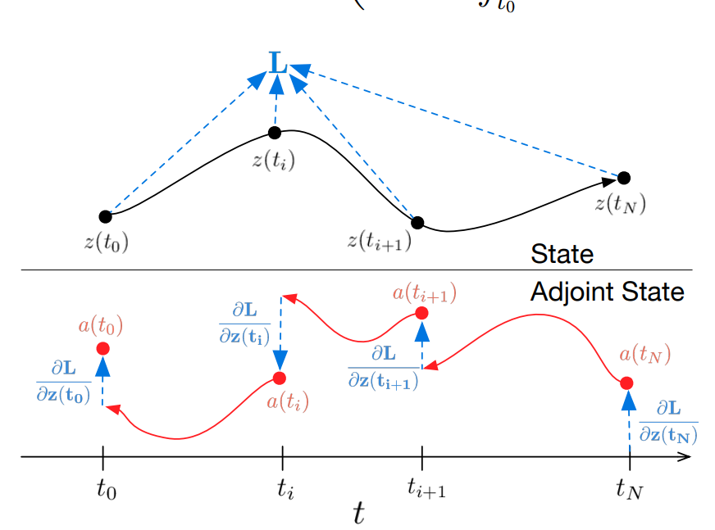
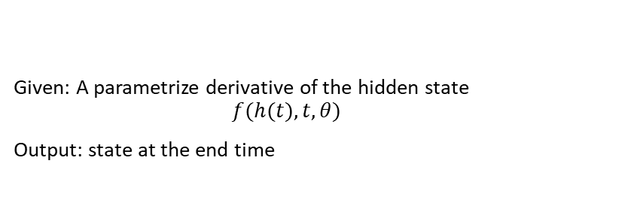
Overview
Given: A parametrize derivative of the hidden state
$$f(h(t),t,θ)$$
Output: state at the end time
Back Propagation
Forward Propagation
Notes:
Chen, R. T., Rubanova, Y., Bettencourt, J., & Duvenaud, D. K. (2018). Neural ordinary differential equations. Advances in neural information processing systems, 31.

Slide 9
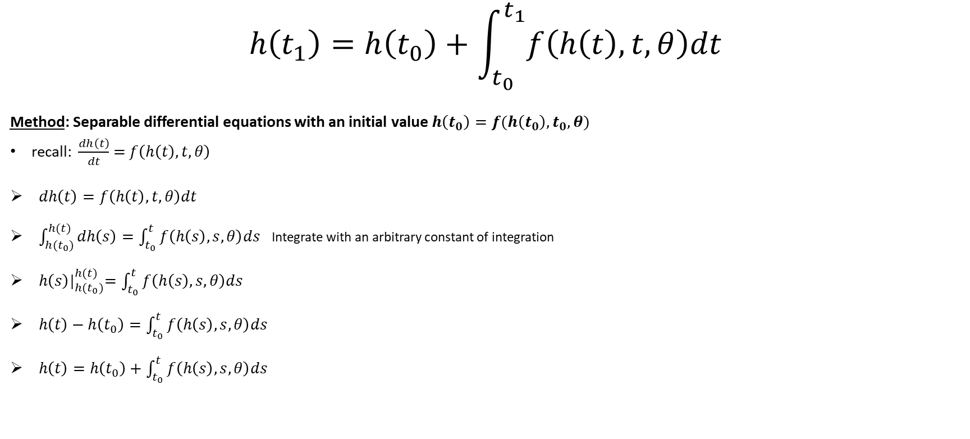

Forward Propagation
$$h\left(t_{1}\right)=h\left(t_{0}\right)+\int_{t_{0}}^{t_{1}}{f\left(h\left(t\right),t,θ\right)dt}$$
Method: Separable differential equations with an initial value $h\left(t_{0}\right)=f(h\left(t_{0}\right), t_{0},θ)$
recall: $\frac{dh\left(t\right)}{dt}$ $=$ $f\left(h\left(t\right),t,θ\right)$
$dh\left(t\right)=f\left(h\left(t\right),t,θ\right)dt$
$\int_{{h(t}_{0})}^{h(t)}{dh\left(s\right)=\int_{t_{0}}^{t}{f\left(h\left(s\right),s,θ\right)ds}}$ Integrate with an arbitrary constant of integration
${ h\left(s\right)|}_{h(t_{0})}^{h(t)}=\int_{t_{0}}^{t}{f\left(h\left(s\right),s,θ\right)ds}$
$h\left(t\right)−h\left(t_{0}\right)=\int_{t_{0}}^{t}{f\left(h\left(s\right),s,θ\right)ds}$
$h\left(t\right)=h\left(t_{0}\right)+\int_{t_{0}}^{t}{f\left(h\left(s\right),s,θ\right)ds}$
Variables:
h(t) = hidden layer function
t = time, $t_{0}=$ initial time, $t_{1}=$ final time of interest
$θ$ = learnable parameters
$f(h(t),t,θ)$ = neural network function
Notes:
Chen, R. T., Rubanova, Y., Bettencourt, J., & Duvenaud, D. K. (2018). Neural ordinary differential equations. Advances in neural information processing systems, 31.
Lebl, J. (2019). Separable equations. In Notes on diffy QS: Differential Equations for Engineers (6.5, pp. 33–37). essay, CreateSpace Independent Publishing Platform.

Slide 10


Backpropagation: Adjoint sensitivity method
Adjoint sensitivity method:
Captures the sensitivity of the function with respect to the parameters of the model
What is involved:
Adjoint, a(t), a gradient of the loss function (L) depends on the hidden state h(t)
Gradient of the loss function (L) with respect to the systems parameters $(θ)$
$\frac{∂L}{∂h\left(t_{0}\right)}=$ $\frac{∂L}{∂h\left(t_{1}\right)}$ $−$ $\int_{t_{1}}^{t_{0}}{a{\left(t\right)}^{T}\frac{∂f(h\left(t\right),t,θ)}{∂h}dt}$
Used to adjust hidden states based on loss
$\frac{∂L}{∂θ}=−$ $\int_{t_{1}}^{t_{0}}{a{\left(t\right)}^{T}\frac{∂f(h\left(t\right),t,θ)}{∂θ}dt}$
Used to adjust the model’s parameters based on loss
Variables:
h(t) = hidden layer function
t = time, $t_{0}=$ initial time, $t_{1}=$ final time of interest
$θ$ = learnable parameters
$f(h(t),t,θ)$ = neural network function
$a{\left(t\right)}^{T}=transpose of the adjoint (\frac{dL}{dh\left(t\right)})$
Notes:
Chen, R. T., Rubanova, Y., Bettencourt, J., & Duvenaud, D. K. (2018). Neural ordinary differential equations. Advances in neural information processing systems, 31.

Slide 11

Big Question: What is the loss function?
Loss function: quantifies the error between the network’s prediction and actual values
The loss function (L) used depends on the purpose of the neural ODE
A few methods:
Quadratic Mean Square Error (MSE): penalizes large errors more
Log-Cosh Loss: used for data containing many outliers and noise
Poisson Loss: used if interested in the number of times an event occurred
Note we won’t go deep into this topic since this is a statistics-focused topic
Notes:
Terven, J., Cordova-Esparza, D. M., Ramirez-Pedraza, A., & Chavez-Urbiola, E. A. (2023). Loss Functions and Metrics in Deep Learning. A Review. arXiv preprint arXiv:2307.02694.

Slide 12

Big Question: How do we optimize the model?
The gradients are used to adjust the model’s parameters (i.e., train the model)
$\frac{∂L}{∂h\left(t_{0}\right)}$, $\frac{∂L}{∂θ}$
One method: Gradient Descent
Note we won’t go deep into this topic since there is no direct application of differential equations

Slide 13
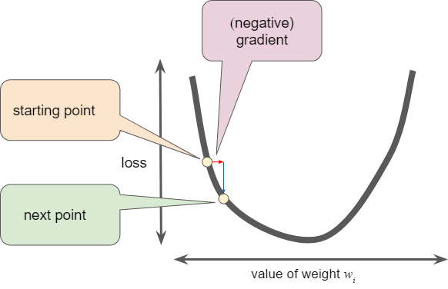
Gradient Descent
Uses the direction (+/-) to determine which direction will reduce loss
Some fraction of the gradient’s magnitude is added to the ‘starting point’
Notes:
Google. (n.d.). Reducing loss: Gradient descent&nbsp; |&nbsp; machine learning&nbsp; |&nbsp; google for developers. Google. https://developers.google.com/machine-learning/crash-course/reducing-loss/gradient-descent

Slide 14
APPLICATION
Learning Target:
Walk through setting up problems using neural ODEs.

Slide 15
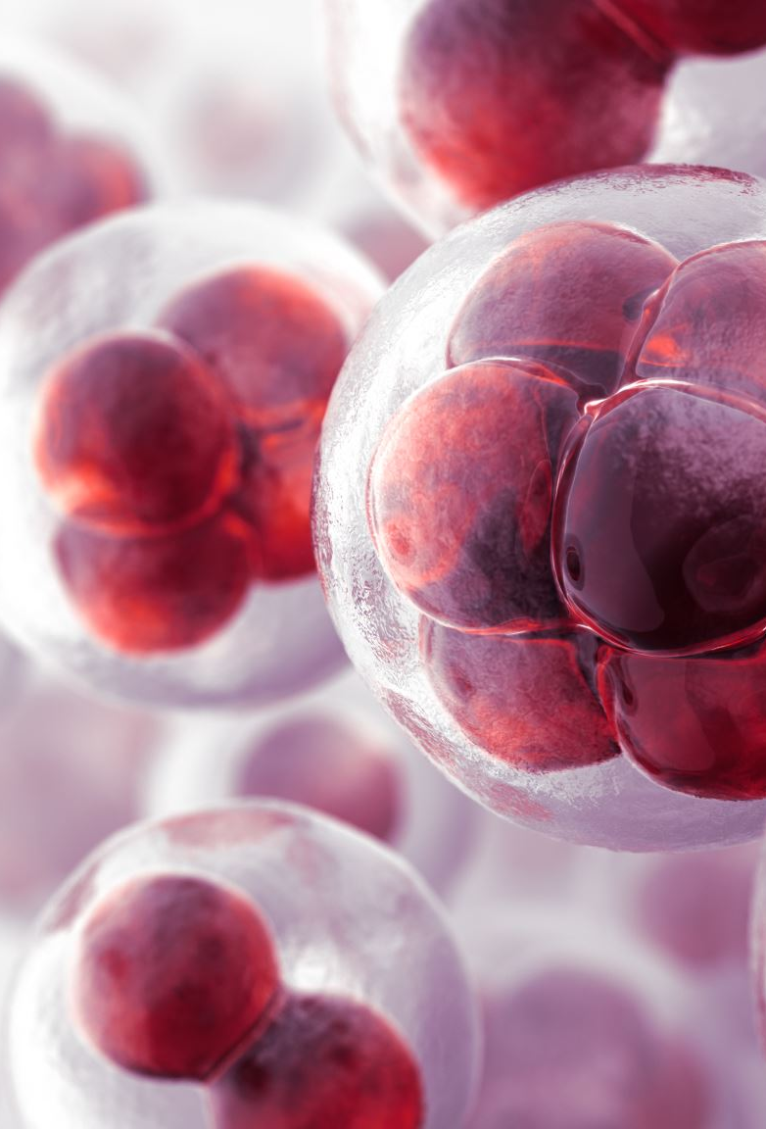

Example 1: Tumor Dynamic Modeling
$\frac{dh\left(t\right)}{dt} = f(h(t),t, θ)$ $t∈\left[0, T\right]$
t represents time
T is the final simulation time of interest
$θ$ patient-specific kinetic parameters (e.g., chemical reactions and biological processes)
h(t) is the time-continuous solution representing the state of the tumor
h(0) patient-specific initial state
h(T) patient’s predicted state at time T
These metrics can be used to predict a patient's overall survival.
Notes:
Laurie, M., & Lu, J. (2023). Explainable Deep Learning for Tumor Dynamic Modeling and Overall Survival Prediction using Neural-ODE. arXiv preprint arXiv:2308.01362.

Slide 16
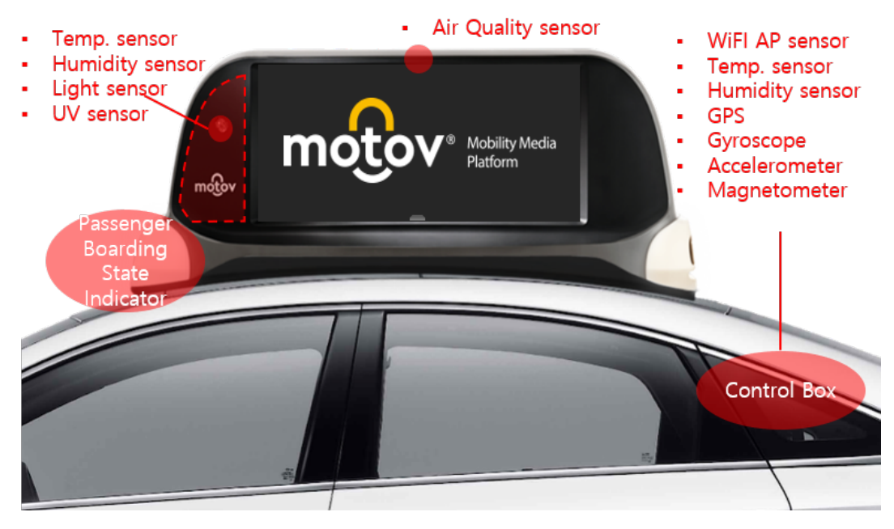

Example 2: Taxicab Rooftop Advertising
$\frac{dh\left(t\right)}{dt} = f(h(t),t,θ)$ $t∈\left[0, T\right]$
t represents time
T is the final simulation time of interest
$θ$ parameters in the system (e.g., start location, drop-out rate of passengers, distance traveled)
h(t) taxi location
h(0) initial taxi location
H(T) taxi location at time T
The taxi’s location can be used to target advertisement.
Notes:
Jeon, J., Kang, S., Jo, M., Cho, S., Park, N., Kim, S., & Song, C. (2021, October). Lightmove: A lightweight next-poi recommendation fortaxicab rooftop advertising. In Proceedings of the 30th ACM International Conference on Information & Knowledge Management (pp. 3857-3866).

Slide 17


Example 3: Pharmacokinetics
$\frac{dh\left(t\right)}{dt} = f(h(t),t, θ)$ $t∈\left[0, T\right]$
t represents time
T is the final simulation time of interest
$θ$ measurable parameters in the system (e.g., absorption rate, distribution volume, clearance, and half-life)
h(0) initial drug concentration
h(t) drug concentration at time t
Understanding the dynamics of drug concentration can allow for the optimization of drug therapy
Notes:
Bräm, D. S., Nahum, U., Schropp, J., Pfister, M., & Koch, G. (2023). Low-dimensional neural ODEs and their application in pharmacokinetics. Journal of Pharmacokinetics and Pharmacodynamics, 1-18.
Ota, R., & Yamashita, F. (2022). Application of machine learning techniques to the analysis and prediction of drug pharmacokinetics. Journal of Controlled Release, 352, 961-969.
Grogan S, Preuss CV. Pharmacokinetics. [Updated 2023 Jul 30]. In: StatPearls [Internet]. Treasure Island (FL): StatPearls Publishing; 2023 Jan-. Available from: https://www.ncbi.nlm.nih.gov/books/NBK557744/

Slide 18


Questions?

Slide 19
Very Briefly
If you are interested, these are the proofs of the gradients

Slide 20
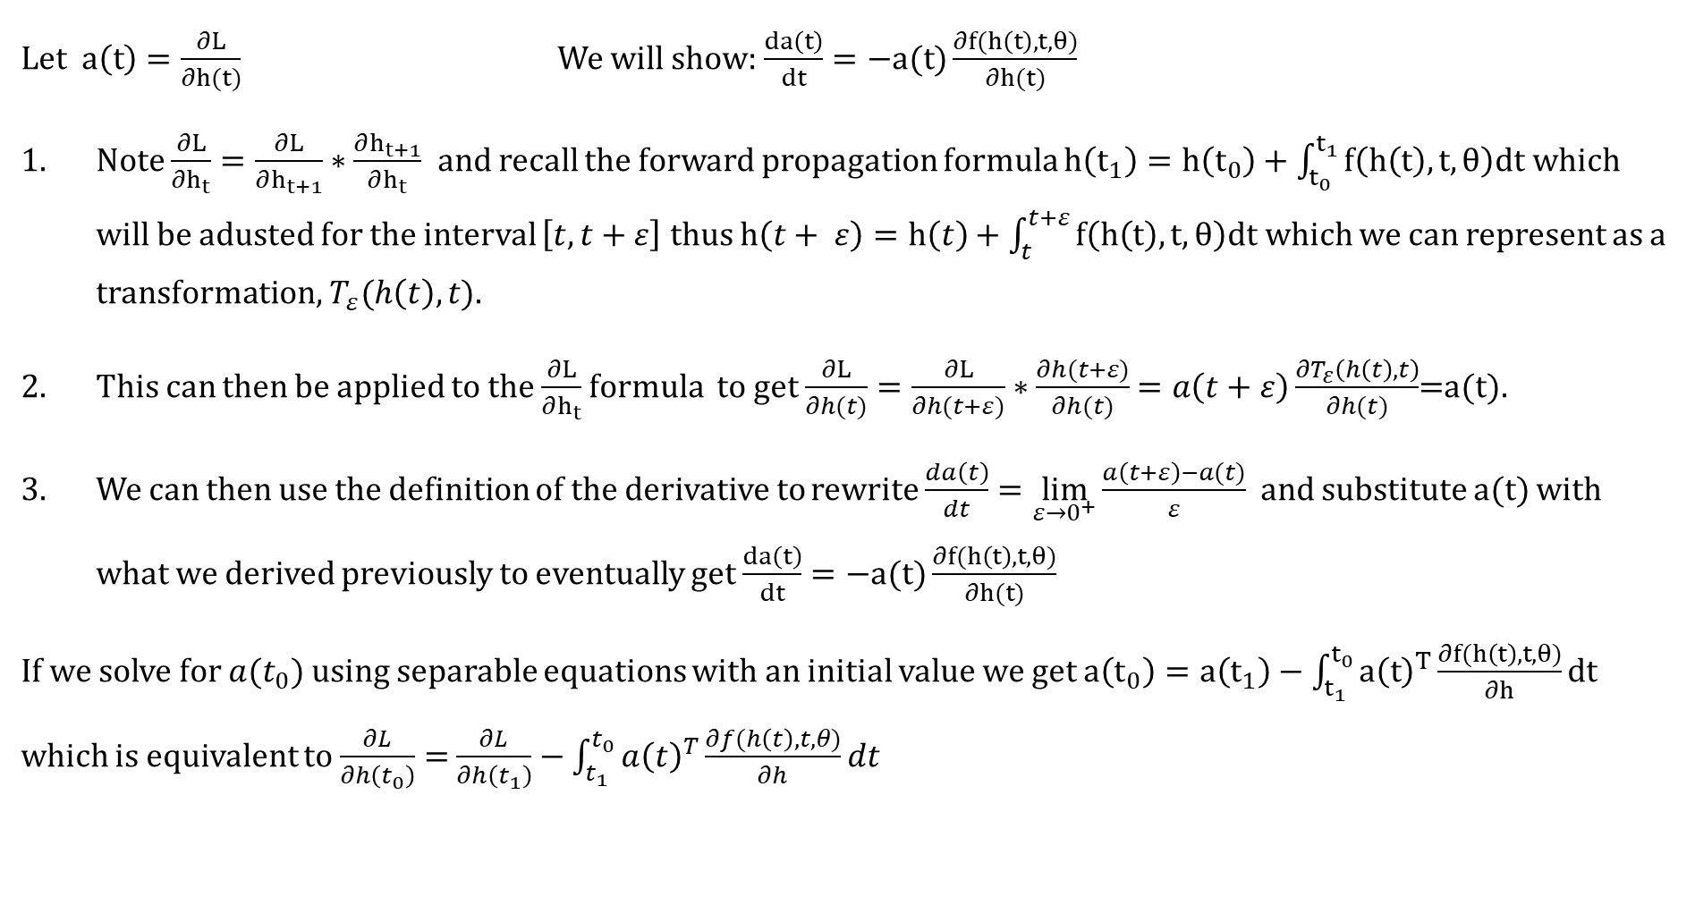
Proving Gradient (1)
Let $a\left(t\right)=\frac{∂L}{∂h(t)}$ We will show: $\frac{da\left(t\right)}{dt}=−a(t)\frac{∂f(h\left(t\right), t,θ)}{∂h(t)}$
Note $\frac{∂L}{∂h_{t}}=\frac{∂L}{∂h_{t+1}}∗\frac{∂h_{t+1}}{∂h_{t}}$ and recall the forward propagation formula $h\left(t_{1}\right)=h\left(t_{0}\right)+\int_{t_{0}}^{t_{1}}{f\left(h\left(t\right),t,θ\right)dt}$ which will be adusted for the interval $\left[t, t+ε\right]$ thus $h\left(t+ ε\right)=h\left(t\right)+\int_{t}^{t+ε}{f\left(h\left(t\right),t,θ\right)dt}$ which we can represent as a transformation, $T_{ε}(h\left(t\right), t)$.
This can then be applied to the $\frac{∂L}{∂h_{t}}$ formula to get $\frac{∂L}{∂h(t)}=\frac{∂L}{∂h(t+ε)}∗\frac{∂h(t+ε)}{∂h(t)}$ $=a\left(t+ε\right)\frac{∂T_{ε}\left(h\left(t\right), t\right)}{∂h(t)}$=a(t).
We can then use the definition of the derivative to rewrite $\frac{da\left(t\right)}{dt}=\lim_{ε→0^{+}}{\frac{a\left(t+ε\right)−a(t)}{ε}}$ and substitute a(t) with what we derived previously to eventually get $\frac{da\left(t\right)}{dt}=−a(t)\frac{∂f(h\left(t\right), t,θ)}{∂h(t)}$
If we solve for $a(t_{0})$using separable equations with an initial value we get $a\left(t_{0}\right)=a\left(t_{1}\right)−\int_{t_{1}}^{t_{0}}{a{\left(t\right)}^{T}\frac{∂f(h\left(t\right),t,θ)}{∂h}dt}$ which is equivalent to $\frac{∂L}{∂h\left(t_{0}\right)}=$ $\frac{∂L}{∂h\left(t_{1}\right)}$ $−$ $\int_{t_{1}}^{t_{0}}{a{\left(t\right)}^{T}\frac{∂f(h\left(t\right),t,θ)}{∂h}dt}$
Notes:
Chen, R. T., Rubanova, Y., Bettencourt, J., & Duvenaud, D. K. (2018). Neural ordinary differential equations. Advances in neural information processing systems, 31.

Slide 21
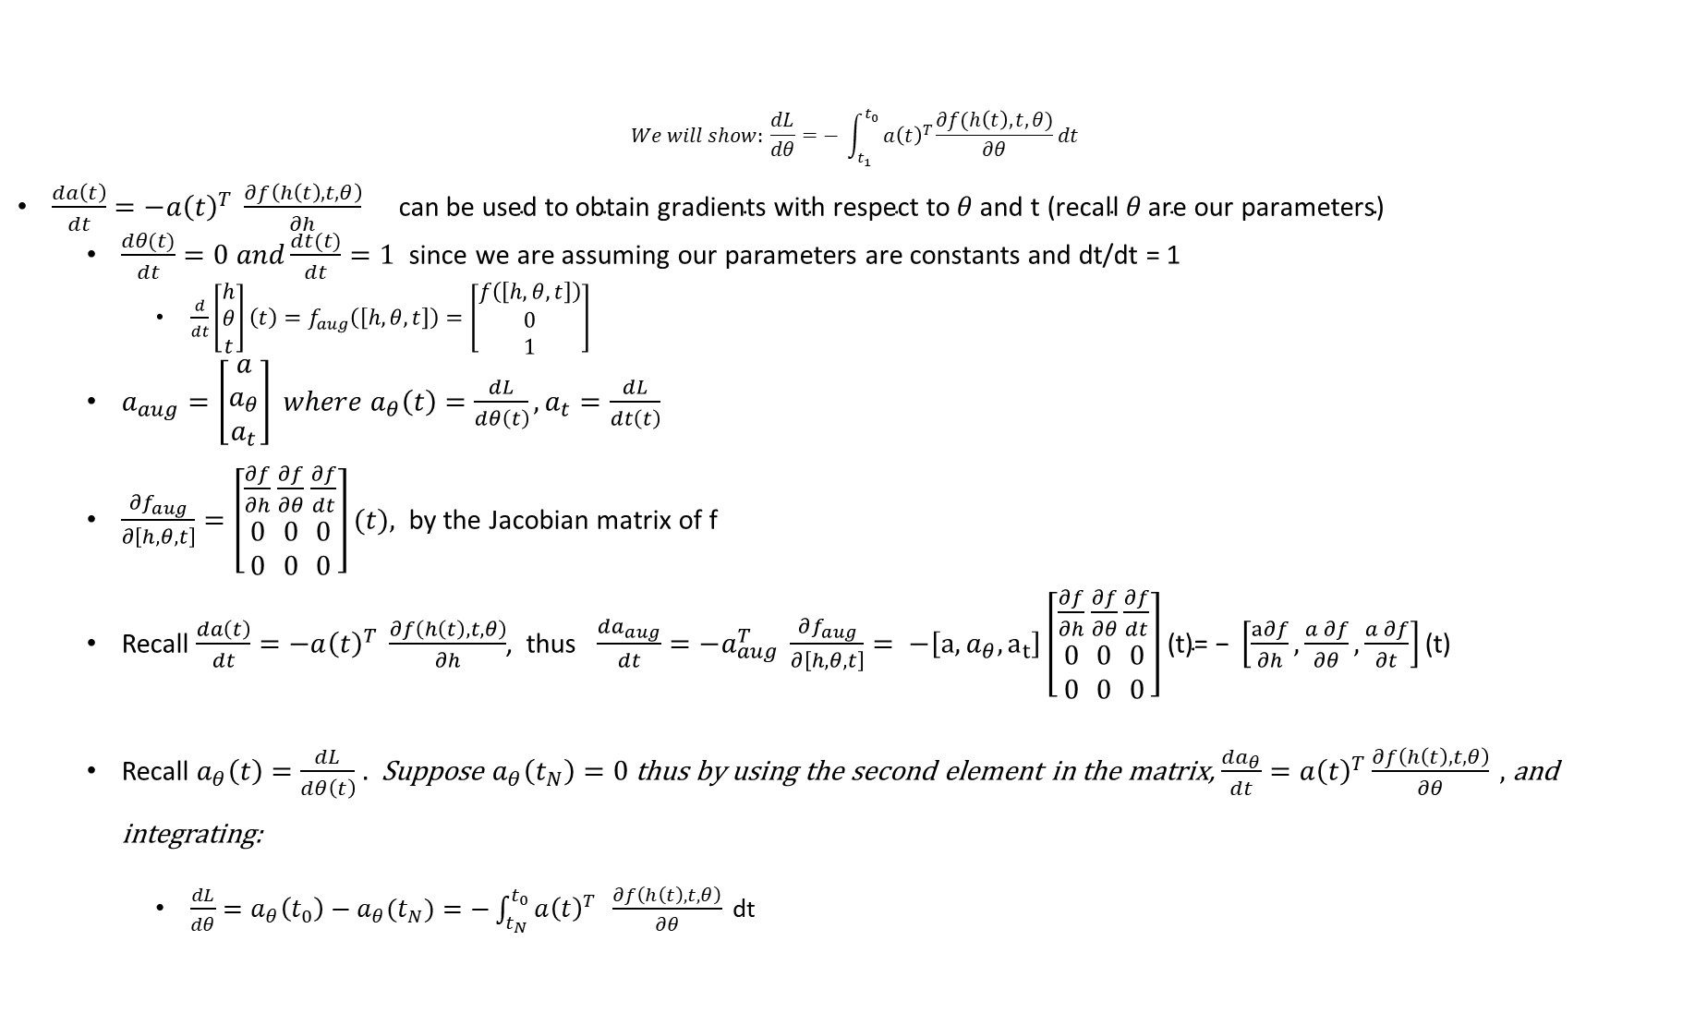
Proving Gradient (2)
$$We will show: \frac{dL}{dθ}=− \int_{t_{1}}^{t_{0}}{a{\left(t\right)}^{T}\frac{∂f(h\left(t\right),t,θ)}{∂θ}dt}$$
$\frac{da\left(t\right)}{dt}=−a{\left(t\right)}^{T} \frac{∂f\left(h\left(t\right),t,θ\right)}{∂h} \text{can} \text{be} \text{used} \text{to} \text{obtain} \text{gradients} \text{with} \text{respect} \text{to} θ \text{and} \text{t}\text{ (}\text{recall} θ \text{are} \text{our} \text{parameters}\text{)}$
$\frac{dθ(t)}{dt}=0 and\frac{dt(t)}{dt}=1$ since we are assuming our parameters are constants and dt/dt = 1
$\frac{d}{dt}\left[\begin{matrix}h \\ θ \\ t\end{matrix}\right]\left(t\right)=f_{aug}\left(\left[h,θ,t\right]\right)=\left[\begin{matrix}f\left(\left[h,θ,t\right]\right) \\ 0 \\ 1\end{matrix}\right]$
$a_{aug}=\left[\begin{matrix}a \\ a_{θ} \\ a_{t}\end{matrix}\right] where a_{θ}\left(t\right)=\frac{dL}{dθ\left(t\right)}, a_{t}=\frac{dL}{dt\left(t\right)}$
$\frac{∂f_{aug}}{∂\left[h,θ,t\right]}=\left[\begin{matrix}\frac{∂f}{∂h} \\ 0 \\ 0\end{matrix} \begin{matrix}\frac{∂f}{∂θ} \\ 0 \\ 0\end{matrix} \begin{matrix}\frac{∂f}{dt} \\ 0 \\ 0\end{matrix}\right](t)\text{,}$ by the Jacobian matrix of f
Recall $\frac{da\left(t\right)}{dt}=−a{\left(t\right)}^{T} \frac{∂f\left(h\left(t\right),t,θ\right)}{∂h}$, thus $\frac{da_{aug}}{dt}=−a_{aug}^{T} \frac{∂f_{aug}}{∂\left[h, θ,t\right]}= −\left[a,a_{θ},a_{t}\right]\left[\begin{matrix}\frac{∂f}{∂h} \\ 0 \\ 0\end{matrix} \begin{matrix}\frac{∂f}{∂θ} \\ 0 \\ 0\end{matrix} \begin{matrix}\frac{∂f}{dt} \\ 0 \\ 0\end{matrix}\right]\text{(}\text{t}\text{)= −} \left[\frac{a∂f}{∂h},\frac{a ∂f}{∂θ},\frac{a ∂f}{∂t}\right]\text{(}\text{t}\text{)}$
Recall $a_{θ}\left(t\right)=\frac{dL}{dθ\left(t\right)}$ $.$ Suppose $a_{θ}\left(t_{N}\right)=0$ thus by using the second element in the matrix, $\frac{da_{θ}}{dt}=a{\left(t\right)}^{T}\frac{∂f\left(h\left(t\right),t,θ\right)}{∂θ} ,$and integrating:
$\frac{dL}{dθ}=a_{θ}\left(t_{0}\right)−a_{θ}(t_{N})=−\int_{t_{N}}^{t_{0}}{a{\left(t\right)}^{T}} \frac{∂f\left(h\left(t\right),t,θ\right)}{∂θ} \text{dt}$
Notes:
Chen, R. T., Rubanova, Y., Bettencourt, J., & Duvenaud, D. K. (2018). Neural ordinary differential equations. Advances in neural information processing systems, 31.

Slide 22
References
Abdolrasol, M. G., Hussain, S. M., Ustun, T. S., Sarker, M. R., Hannan, M. A., Mohamed, R., Ali, J. A., Mekhilef, S., & Milad, A. (2021). Artificial Neural Networks Based Optimization Techniques: A Review. Electronics, 10(21), 2689. https://doi.org/10.3390/electronics10212689
Bräm, D. S., Nahum, U., Schropp, J., Pfister, M., & Koch, G. (2023). Low-dimensional neural ODEs and their application in pharmacokinetics. Journal of Pharmacokinetics and Pharmacodynamics, 1-18.
Chen, R. T., Rubanova, Y., Bettencourt, J., & Duvenaud, D. K. (2018). Neural ordinary differential equations. Advances in neural information processing systems, 31.
Choi, R. Y., Coyner, A. S., Kalpathy-Cramer, J., Chiang, M. F., & Campbell, J. P. (2020). Introduction to machine learning, neural networks, and deep learning. Translational vision science & technology, 9(2), 14-14.
Finlay, C., Jacobsen, J. H., Nurbekyan, L., & Oberman, A. M. (2020). How to train your neural ode. arXiv preprint arXiv:2002.02798, 2.
Google. (n.d.). Reducing loss: Gradient descent&nbsp; |&nbsp; machine learning&nbsp; |&nbsp; google for developers. Google. https://developers.google.com/machine-learning/crash-course/reducing-loss/gradient-descent
Grogan S, Preuss CV. Pharmacokinetics. [Updated 2023 Jul 30]. In: StatPearls [Internet]. Treasure Island (FL): StatPearls Publishing; 2023 Jan-. Available from: https://www.ncbi.nlm.nih.gov/books/NBK557744/
Jain, A. K., Mao, J., & Mohiuddin, K. M. (1996). Artificial neural networks: A tutorial. Computer, 29(3), 31-44.
Jeon, J., Kang, S., Jo, M., Cho, S., Park, N., Kim, S., & Song, C. (2021, October). Lightmove: A lightweight next-poi recommendation fortaxicab rooftop advertising. In Proceedings of the 30th ACM International Conference on Information & Knowledge Management (pp. 3857-3866).
Laurie, M., & Lu, J. (2023). Explainable Deep Learning for Tumor Dynamic Modeling and Overall Survival Prediction using Neural-ODE. arXiv preprint arXiv:2308.01362.
Lebl, J. (2019). Separable equations. In Notes on diffy QS: Differential Equations for Engineers (6.5, pp. 33–37). essay, CreateSpace Independent Publishing Platform.
Oke, S. A. (2008). A literature review on artificial intelligence. International journal of information and management sciences, 19(4), 535-570.
Ota, R., & Yamashita, F. (2022). Application of machine learning techniques to the analysis and prediction of drug pharmacokinetics. Journal of Controlled Release, 352, 961-969.
Terven, J., Cordova-Esparza, D. M., Ramirez-Pedraza, A., & Chavez-Urbiola, E. A. (2023). Loss Functions and Metrics in Deep Learning. A Review. arXiv preprint arXiv:2307.02694.

