Slide 1
MATLAB Accelerator Physics
MATLAB and Symbolic Math should be installed on an accessible computer to run the Apps and scripts
There is a textbook available
  The book is supplied by UPAS
  There is an accessible folder for scripts and Apps used in the course
Lecture/class notes – email list for communications of the class
Homework and work sessions, the focus is on Python
USPAS - MATLAB Physics

Slide 2
MATLAB Physics
Main 8 Topics using Apps:
1. Uniform electric and magnetic fields – dipole, solenoid, cyclotron, ExB
2. Quadrupole – doublet, beams – sextupole and dispersion
3. Accelerator parameters – Twiss and rays, complementary descriptions
4. FODO and dispersion – unit cell
5. Magnet errors – Steering, Quad misalign and gradient error, bumps corrections, space charge
6. Induced charge and BPM – measuring emittance and dp/p
7. Cables and strip-lines, simple Collins straight section
8. Acceleration and phase stability
USPAS - MATLAB Physics

Slide 3
MATLAB
MATLAB is a vector language widely used in academia and business. Many other languages exist, so the idea is not to favor MATLAB but to explore the physics of beams and accelerators using the MATLAB tools which exist.
There are many tutorials on the MATLAB site. Initially, the “onramp” is a good place to start. You need not use MATLAB for the homework.
PYTHON is also used extensively, especially for homework. Conversion is possible with MATLAB tools.
USPAS - MATLAB Physics

Slide 4
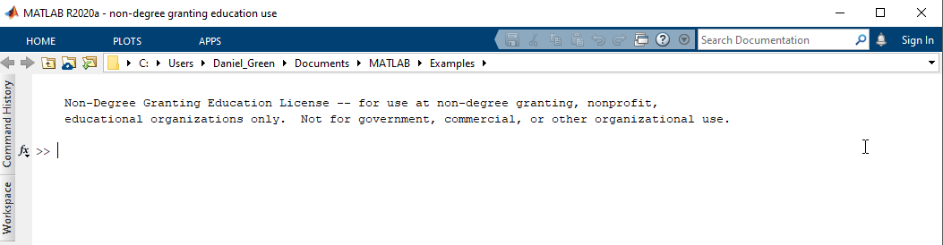
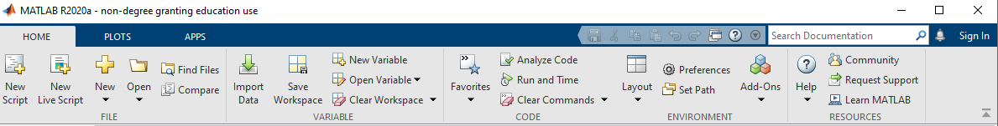
MATLAB – First Steps
Start MATLAB – define windows as desired. Here are the command, history and workspace windows.
Go to HOME tab – set path, open scripts/Apps, use documentation as desired
USPAS - MATLAB Physics

Slide 5
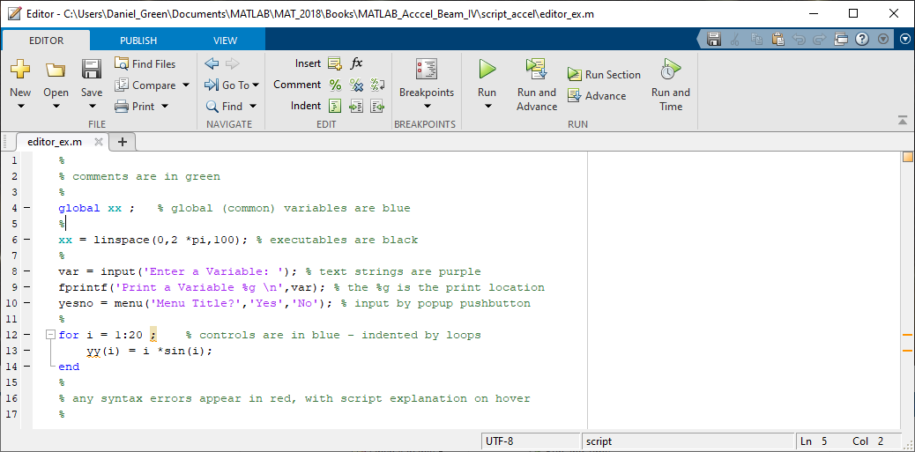
MATLAB - Editor
The editor is used to write, save, edit, and run scripts. Apps are opened and
edited using a distinct “open” or “new’ command. Start with “editor.m”
USPAS - MATLAB Physics

Slide 6

MATLAB “Onramp”
Many tools are included with MATLAB:
To avoid tedium, many
problems are solved
using the symbolic math
tools. The Live script
“Symbolic_ex” may be invoked for some details.
Also the “search documentation” in the command window is useful. with MATLAB.
USPAS - MATLAB Physics

Slide 7
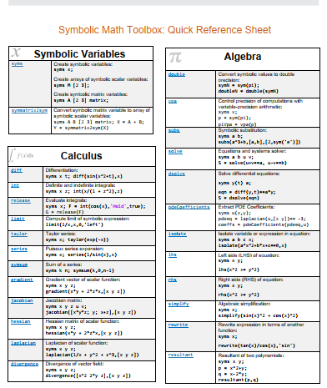
MATLAB - Summary
MATLB and PYTHON both use the Maple Kernel for symbolic math. A .pdf summary is in the files for the course.
USPAS - MATLAB Physics

Slide 8
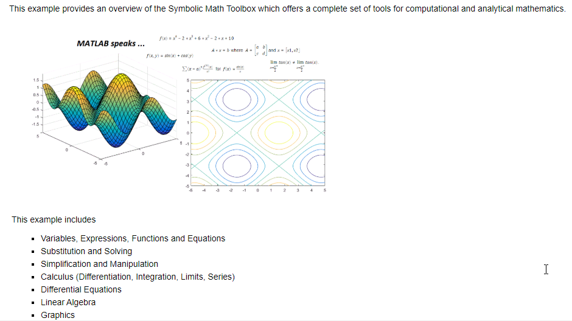
“Symbolic_ex” Introduction
Much beam and accelerator math is 19th century -> use MATLAB tools to avoid unnecessary tedium.
USPAS - MATLAB Physics

Slide 9
Special Relativity (SR)
Special Relativity (SR) – energy, momentum, velocity. Accelerators and beams are normally operated in the relativistic regime, so some familiarity is needed. A summary follows.
In classical physics energy and momentum are separately conserved. In special relativity, SR, energy and momentum are components of a four - dimensional vector. We take classical kinetic energy to be T = p2/2m, p = mv. In SR the energy for a material particle is ε with ε2 = (mc2)2 + (cp)2, so that at low momenta ε ~ mc2 + p2/2m, the rest energy plus the NR kinetic energy T. In general, ε = γmc2 with γ = 1/√1-β2. One can approximately think of the effective mass gaining a factor of γ due to motion. For momentum p = γmβc and again m -> γm is a useful way to think of momentum in SR.
USPAS - MATLAB Physics

Slide 10
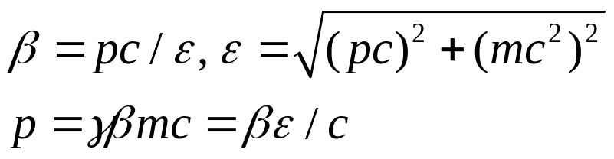
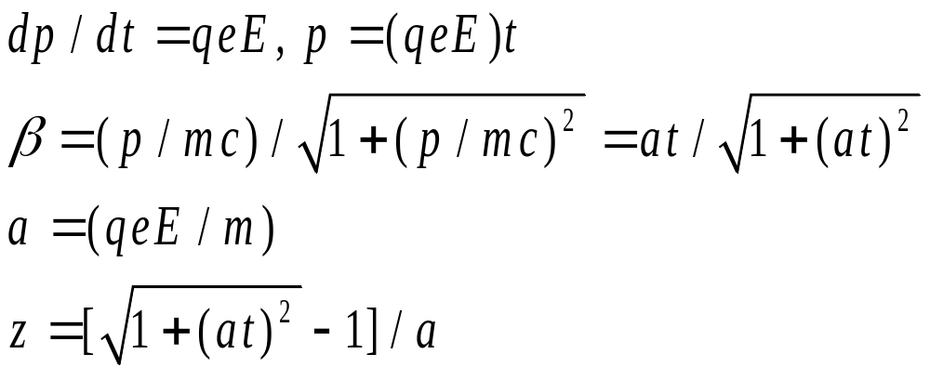
Uniform E Field
Special Relativity (SR)
Electric and magnetic fields act of charged particles. These fields are used to form beams of particles and to accelerate them to high energies. The simplest fields are uniform – over all space. Start with a constant electric field. Use a MATLAB App to play with the parameters of the situation. MKS units are Coulomb for charge qe and Volt/m for field E.
“UniformE_App_USPAS”.
USPAS - MATLAB Physics

Slide 11
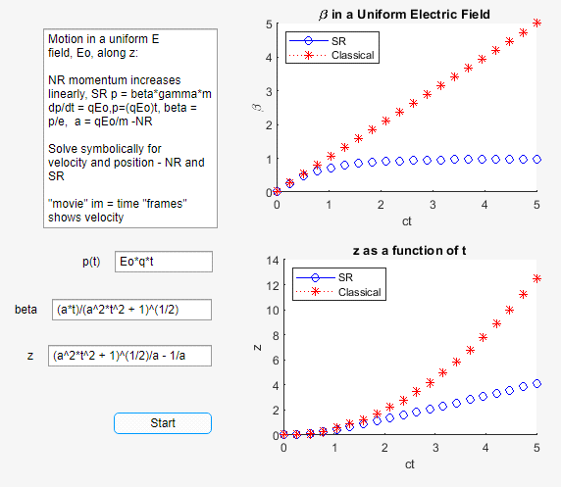
Uniform E App
Uniform Electric Field App
Typical App
Text box
Start button
Symbolic solutions
“Sliders” to set values
“movies” and plots
Numerical or
symbolic results
in “Edit Fields”
USPAS - MATLAB Physics

Slide 12
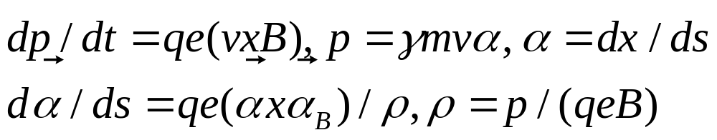
Uniform B Field
Uniform Magnetic Field
The MKS/SI units for the magnetic field are Tesla (T) or Weber/m2, where a Weber is a measure of the flux of the magnetic field B. A Tesla is 1 N/(Am). The permeability of the vacuum is μo= 4π x 10-7 (Tm)/A. The Lorentz force is here perpendicular to the velocity, so the momentum magnitude is constant. The direction cosines are α, and they change as the particle bends in the field. The total arc length is the parameter ds = vdt, while the radius of curvature is ρ. The Lorentz force equation is used and the constancy of the momentum p is assumed (no work done by a B field).
USPAS - MATLAB Physics

Slide 13
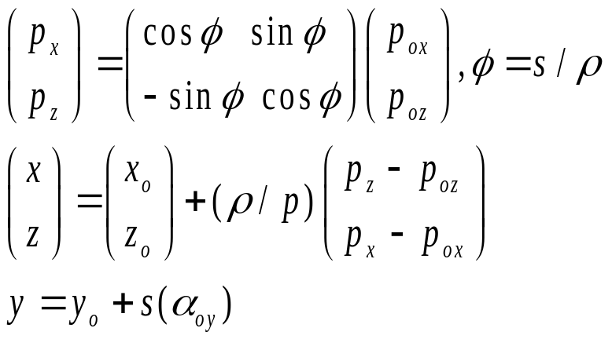
Uniform B Field -2
Uniform Magnetic Field - 2
In MKS units, e = 0.3 with p in GeV (c=1), B in T and ρ in m which makes the radius of curvature ρ(m) = 3.33 p(GeV)/B(T). For example, if p = 100 GeV and B = 1 T, the radius is 333 m. A useful approximation for small bend angles, ϕ, and magnet length L is that after ds ~ dz = L, ϕ ~ L/ρ, y ~ yo +αyoL, x ~ xo +αxoL + ϕ(L/2). In terms of a transverse momentum impulse ΔpT, imparted to the particle, ϕ ~ ΔpT/p, ΔpT ~ eLB = 0.3B(T)L(m) independent of the particle, if q = 1. For a 1T field with a L = 1 m extent, the transverse impulse is 0.3 GeV.
USPAS - MATLAB Physics

Slide 14
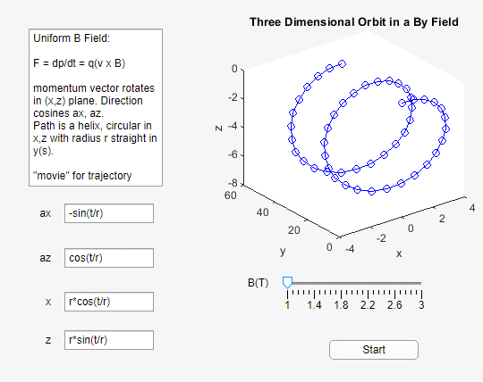
Uniform B Field - 3
Uniform B Field App
“Uniform_B_App_USPAS”. - “Slider” for B, “movie”
Symbolic solutions
Special initial case
α_{x}(0)= 0
Helical trajectory
USPAS - MATLAB Physics

Slide 15
Making a B Field
Making a Magnetic Field
How might one make a uniform magnetic field?
A solenoid carrying a current I with N total turns of length L and radius a has a magnetic field on the center line of B = μo(N/L)I[(L/2)/√a2+(L /2)2. A long solenoid has approximately a purely axial field of magnitude B ~ μoIn, n = N/L. The dimension of μo is (Tm/A) and μo is 1.26 x 10-6 in those units.
For example, with n in turns/cm and I in A, for I = 20,000 A and 1.6 turns/cm the field is 4T. The Compact Muon Solenoid (CMS) experiment at the CERN Large Hadron Collider (LHC) is a large 4T solenoid with ~ those parameters.
USPAS - MATLAB Physics

Slide 16
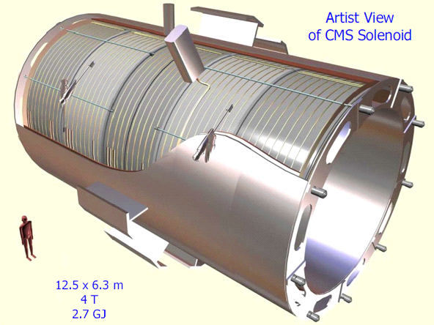
CMS – LHC Solenoid
CMS – LHC Solenoid
USPAS - MATLAB Physics

Slide 17
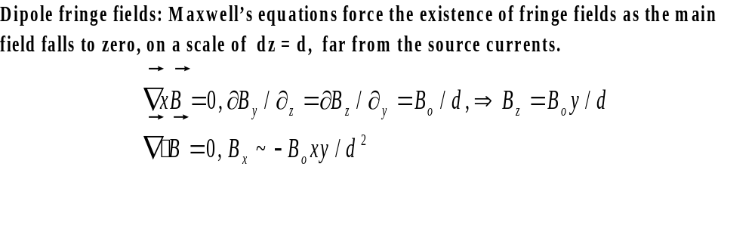
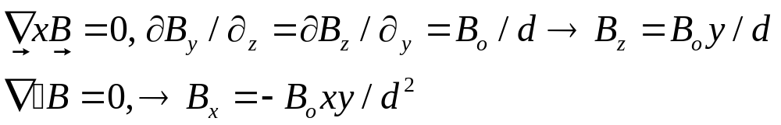
Solenoid App
Solenoid App
An App to get some feeling for a solenoid is “Solenoid6_fringe_USPAS”. It uses the Biot-Savert law to construct a “solenoid” of from 1 to 6 current loops with variable spacing. The App “Sliders” for number of turns and turn spacing are there to be explored.
Note that the fringe field is unavoidable
USPAS - MATLAB Physics

Slide 18
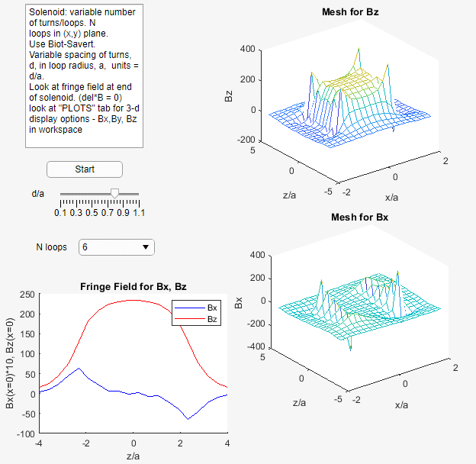
Solenoid App - 2
Solenoid App - 2
Solenoid and fringe:
Up to 6 loops and a
Variable radius
Using “sliders”
USPAS - MATLAB Physics

Slide 19
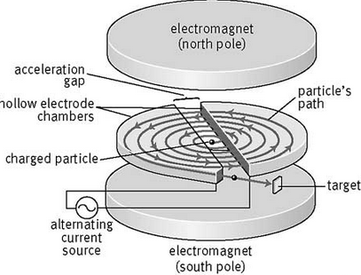
Cyclotron
Cyclotron
An example of NR motion in a constant magnetic field is the cyclotron. The field is taken to be a dipole extending over a fixed radius and pointing in the y direction. For NR motion, a charged particle has a rotation frequency in a magnetic field which is independent of particle velocity. The radio frequency, r.f., accelerating voltage can then be at a constant frequency. In general, the rotation frequency is ωo = v/ρ = qeBv/p which, for NR motion, is just qeB/m. For SR operation the accelerating frequency must change.
USPAS - MATLAB Physics

Slide 20
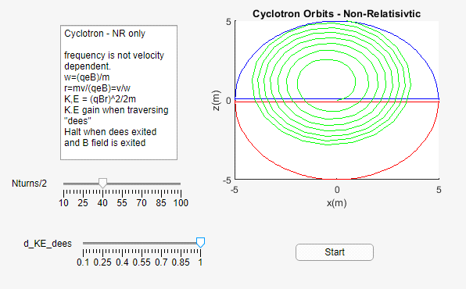
Cyclotron- 2
Cyclotron - 2
For a 10 MeV proton with kinetic energy, T = mpv2/2, cyclotron, pc = 141 MeV and in a 1 T field, the radius is 0.47 m. The rotation circular frequency ωo is 9.6 x 107 rad/s or a frequency, fo, of 15.3 MHz. One can play with the # of turns and the energy gain per turn to “extract” an external beam. (“Cyclotron_USPAS”)
USPAS - MATLAB Physics

Slide 21
Notations - Frequency
Frequencies - Notation
A short digression on circular frequencies: There are many different frequencies that will be discussed in these notes.
ω = betatron oscillation frequency
ωo = circular rotation frequency
ωs = synchrotron oscillation frequency
ωh = r.f. power frequency
These different quantities will be defined and made distinct in what follows.
USPAS - MATLAB Physics

Slide 22
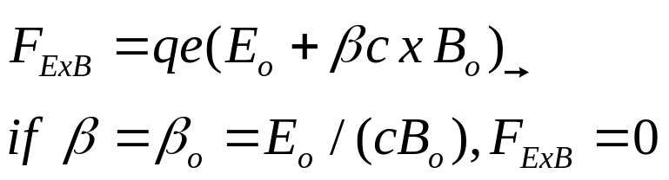
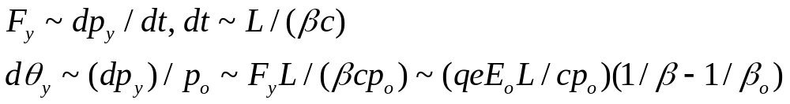
Uniform E and B - “Crossed”
Uniform E and B – “Crossed”
In accelerator produced secondary beams, the momentum is chosen by dipoles magnets and collimators to be within a limited range. There are particles of charge qe which have different masses and therefore different velocities. The crossed fields can select the undeflected velocity and therefore, the mass. Muons have mass (times c²) 0.113 GeV, pions 0.140 GeV. The kaon mass is 0.494 GeV and proton mass is 0.938 GeV.
USPAS - MATLAB Physics

Slide 23
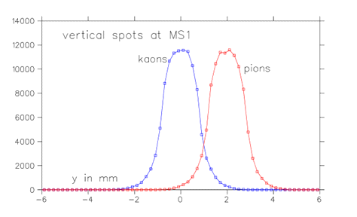
“Separated” Beam at KEK
Separated Beam at KEK
At the KEK, a particle physics laboratory in Japan, electrostatically separated kaon beam, sextupoles are needed to correct for the chromaticity due to the finite momentum spread in the acceptance of the beam (later). For the KEK beam: Eo ~ 5.5 MV/m, Bo ~ 0.02 T so that βo ~ 0.916. For a beam with central momentum of po = 1.1 GeV/c, pions have a β of 0.992, while kaons have a value of 0.912, and are undeflected. Over a length L of 0.4 m, the pions get a vertical angle kick of 0.18 mrad. At a momentum collimator (mass slit) 15 m downstream of the fields, the pions are deflected by 2.7 mm.
USPAS - MATLAB Physics

Slide 24
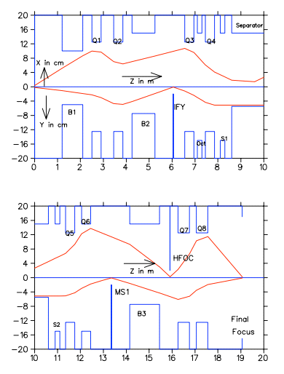
KEK - 2
KEK -2
Discussion of the beam optics done later – just for reference here.
The particles emanating from the target are captured by magnetic lenses (quadrupoles). Dipole magnets bend the beams and define a central beam momentum. The beam passes “parallel” through the ExB separator after which it is focused in y at the “mass slit”. Quadrupoles then focus in both x and y at the experimental apparatus.
USPAS - MATLAB Physics

