Slide 1
MATLAB Physics - 2
In 1 uniform magnetic fields were explored
In 2 the basic magnetic lens – the quadrupole will be explored.
The basic “unit cell” which focuses in both x and y is the quadrupole doublet.
The focal length of the lens depends on momentum and that can be corrected by sextupole elements (recall KEK kaon beam).
USPAS - MATLAB Physics

Slide 2
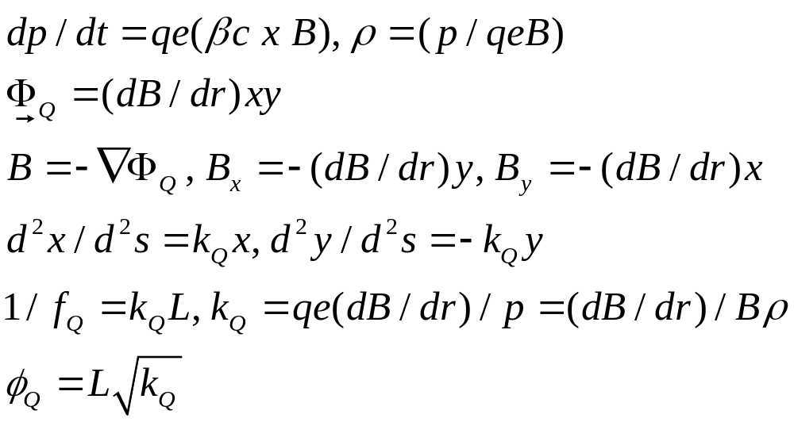
Quadrupole Field
Quadrupole Fields:
The quadrupole is the analogue of the optical lens. However, Maxwell’s equations mean that if the quadrupole focuses in one transverse dimension it must defocus in the other. In turn, that means that the simplest system with overall focusing is a “doublet” of 2 quadrupoles (e.g. KEK).
The quadrupole fields are derived from the magnetic potential Φ_{Q} .
USPAS - MATLAB Physics

Slide 3
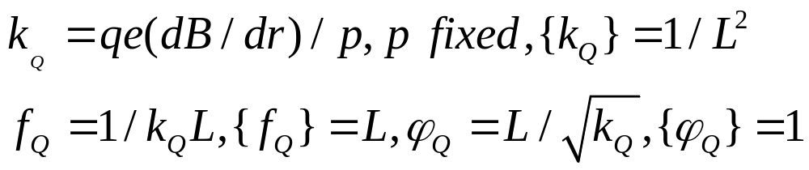
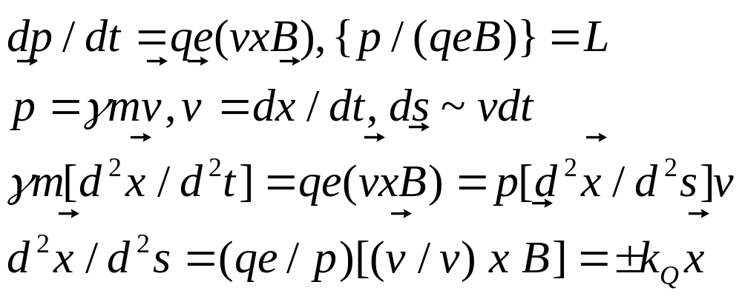
Quadrupole Field - Algebra
Lorentz force approximations. Use { } to indicate the dimensions of a quantity
The equations of motion are approximated for beams and accelerators:
USPAS - MATLAB Physics

Slide 4
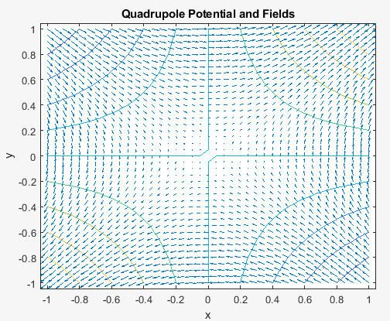
Potential and Fields
Potential and Fields
Script “Quad_pot_field” – uses “gradient” and “quiver”
Forces grow (F or D) as distance from (0,0) grows which makes the element
act like a lens.
USPAS - MATLAB Physics

Slide 5
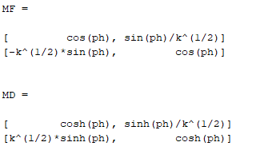
Quadrupole Transfer Matrices
Quadrupole Transfer Matrices
Maxwell’s equations for the quadrupole yield transverse fields By = (dB/dr)x and Bx = (dB/dr)y. The Lorentz force equations assuming motion with path length ds ~ dz ~ vdt are then: d2x/d2s = kx, d2y/d2s = -ky, with harmonic motion (F) or divergence (D)
Fermilab Main Ring (MR) quadrupoles are an example. The length is L = 2.1 m. The field gradient is 24.5 T/m. At 400 GeV the focal length fQ is ~ 25 m. In what follows, the MR will be adopted for most discussions of an “accelerator”. In this way the numerical examples are made coherent which should tie together several distinct topics using the same accelerator parameters. The “thick lens” transfer matrices for (x, x’=dx/ds) for a focusing quad and a defocusing quad are:
Thin lens – small angle φ
MF = [1 0, -1/f 1]
MD = [1 0, 1/f 1]
USPAS - MATLAB Physics

Slide 6
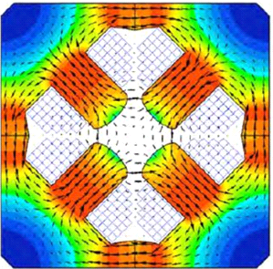
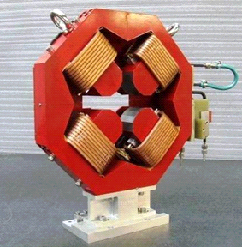
Actual Quadrupoles
Actual Quadrupoles
Field shaping with iron, 4 pole windings, water cooled
USPAS - MATLAB Physics

Slide 7
Quadrupole Doublet
Quadrupole Doublet
Numerically, for example, assuming a quadrupole of length L = 3m with gradient dB/d r = 10 T/m, √ k_{Q} is 0.17 m⁻¹, the quadrupole angle is ϕ_{Q} = 0.51 rad and the focal length, f, for a particle with p = 0.1 TeV is 11.2 m.
A doublet consisting of a Q_{F} quadrupole followed by a field - free, or drift space, followed by a Q_{D} quadrupole is the next step – making a doublet. A quadrupole is assigned F or D in regards to the x direction. Initial conditions are specified at a point upstream of the Q_{F} quadrupole, either a point, [0 ; 1] ,(x_{o} = 0), or a parallel beam, [1 ; 0] (dx_{o}/ds = 0). Symbolic solutions for constraints are obtained by multiplying the matrices for the drift spaces and the quadrupoles together and applying constraints on the “focal condition” location downstream of the doublet.
The focal conditions applied to the overall transfer matrix, M_{T} , can be a parallel to point focus, M_{T}(1,1) = 0, or a point to point beam, M_{T}(1,2) = 0 or a point to parallel, M_{T}(2,2) = 0. A parallel to parallel solution cannot be obtained with a simple doublet. However, later that condition will be approximated by our “accelerator” unit cell, the “FODO”
USPAS - MATLAB Physics

Slide 8
Symbolic Math and Thin Lens Doublet
Symbolic Thin Lens Doublet
The App is “Doublet_Symbolic_USPAS”
The script allows the user to choose the 3 distances; target to first quad, distance between quads and distance from second quad to focal condition. Symbolic solutions are displayed for the focal lengths and the focal location as well as numerical values.
It is useful to play with the “Sliders” and look at the numerical results and the plots.
A beam-line can be made by a doublet point (target) to parallel followed by a doublet parallel to point to focus at an experiment. The parallel section might be useful for Cherenkov measurements or ExB separation (KEK). Collimators and dipoles can define the momentum acceptance of the beam.
USPAS - MATLAB Physics

Slide 9
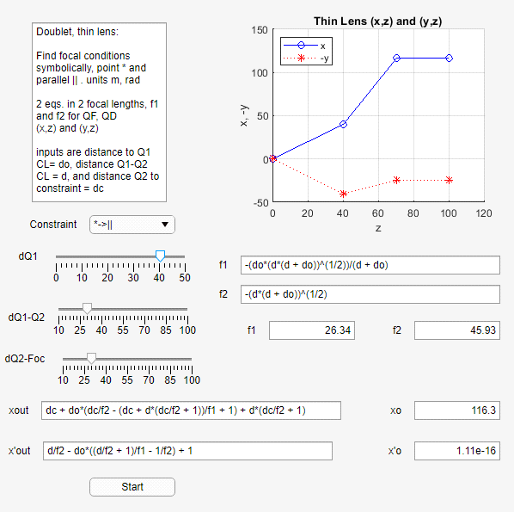
Thin Lens Doublet App
Thin Lens Doublet App
Choose focus
constraint and
the doublet geometry.
The symbolic and
numerical 2 focal
lengths and the
position and angle
at the constraint
are displayed. The quads
Are taken to have 0
Length (impulse approx)
USPAS - MATLAB Physics

Slide 10
Beam Thick and Thin
Beam- Thick Lens
In the special case where Q_{F} and Q_{D} have the same focal lengths, there is a net focusing effect, and M(2,1) < 0, for both x and y motion with M(2,1) ~ -d/f² giving an effective doublet focal length of ~f²/d. This special case is a precursor to the FODO unit cell for an accelerator.
This is a much more complex coding (several “functions” needed). The quadrupoles are “thick” and the nonlinear constraints are imposed numerically using “fminsearch”. The starting values for the solutions are the thin lens approximate results. The differences between thin lens approximate and thick les results are usually not large. It is important to get starting values for fitters that are close to the local minimum.
A selection of the momentum of the beam can be made using dipole, or bending, magnets and collimating the resulting chromatic spectrum of angles induced by the dipoles. The beam has a finite acceptance in momentum, δ = dp/p, and in transverse coordinates and velocities, x, dx/ds, y, dy/ds. The beam may also contain a mix of particles of different masses (KEK).
USPAS - MATLAB Physics

Slide 11
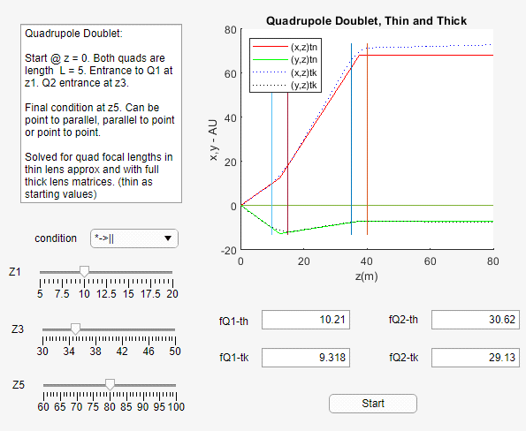
Quad_Doublet_Thick_USPAS
“Quad_Doublet_Thick_USPAS”
Thick/thin
comparison:
Focal lengths are
computed for the 2
cases and ray trace
plots are compared.
USPAS - MATLAB Physics

Slide 12
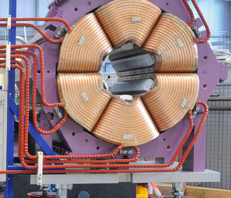
Sextupole
Sextupole
The next most complex field is created by sextupole magnets. The fields depend on the second derivative of B w.r.t. r. Quadrupole fields depend on dB/dr and the forces are then linear in the displacement. For sextupoles the forces are quadratic in the displacements, and sextupoles are non-linear beam elements.
USPAS - MATLAB Physics

Slide 13
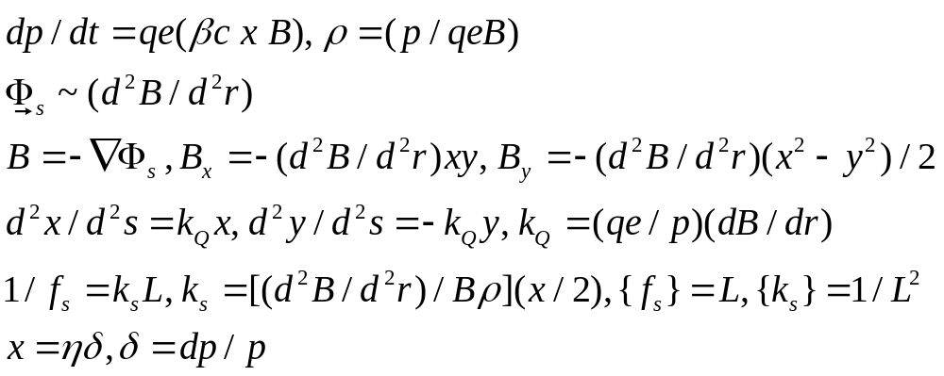
Sextupole 2
Sextupole - 2
The sextupole fields are no longer linear in the coordinates as are the quadrupole fields. The focal length then depends on the displacement, which can be exploited to correct for the chromaticity of quadrupoles (f depends on momentum) and the use of sextupoles to correct for it (as in KEK kaon beam or in accelerator FODO). The sextupole inverse focal length (thin lens) is proportional to the displacement x which can be due to the momentum spread dp/p contained in the beam. Discussed later for accelerators
USPAS - MATLAB Physics

