Slide 1
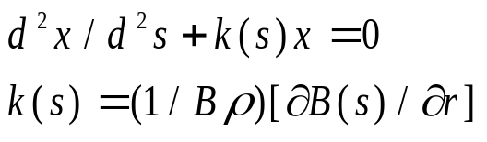

MATLAB Physics - 3
Circular Accelerator Parameters – Twiss/Beam
Lots of algebra: Use MATLAB symbolic Math to avoid most of it. This is 19th century math, as in Hill’s Equation, and there is no need to reproduce it yet again. It is better to “play” with examples and Apps.
For a periodic system with a reference trajectory defined by an arc length s (~ z), a transverse coordinate x(s) is assumed to have a quasi-harmonic behavior defined by a scale factor A = √ε, an amplitude function, β(s), an oscillation phase ψ(s) with an initial phase at s = 0, ψ_{o}. This ansatz, when substituted into Hill’s equation for a periodic system subject to focusing, k(s), which changes with s, d²x/ds²+k(s)x = 0, k = (1/Bρ)(∂B(s)/∂r), is indeed found to be a solution. The variable k(s) is a generalization of the constant quadrupole factor k_{Q}.
USPAS - MATLAB Physics

Slide 2
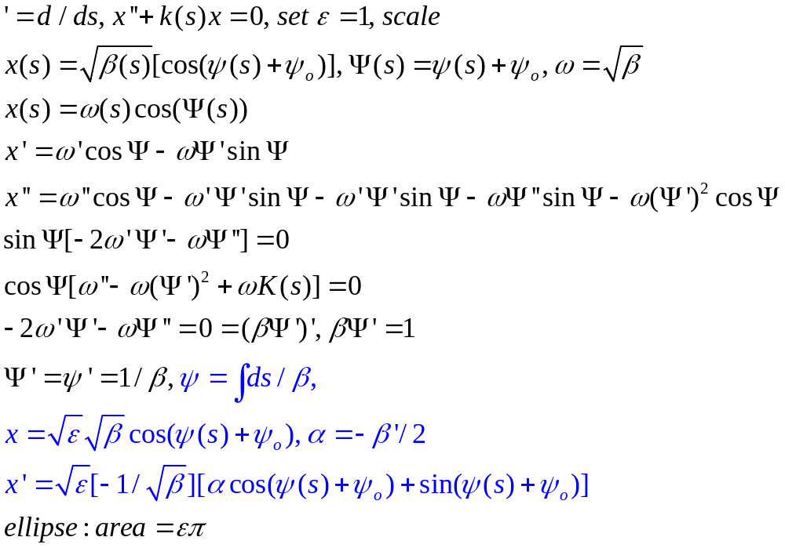
Hill’s Equation - Details
Hill’s Equation - Details
The algebra is here – x(s) and dx(s)/ds
Just notation to simplify the algebra.
Differentiate twice.
Take the Ansatz and show it is a solution if the phase rate of change with s is 1/β. Then x and dx/ds map the boundary of a phase space ellipse.
USPAS - MATLAB Physics

Slide 3
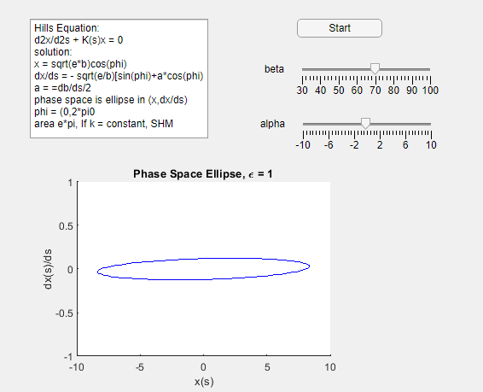
App for Ellipse
App for Ellipse
The Hills results for x and x’ map out a phase space ellipse as the phase goes from 0 to 2π. The phase space for the second order differential equation has 2 parameters, α andβ, and a scale factor, the emittance ε
“Hill_Ellipse_USPAS”
Use the Sliders to look at
the ellipse as a function
of α and β
USPAS - MATLAB Physics

Slide 4
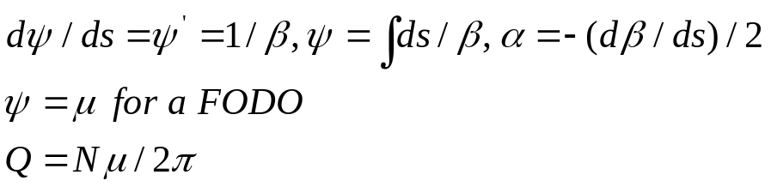
The “tune” Q and the Emittance ε
Q Value, Emittance
The system is conservative so, as in mechanics, a unitary matrix M, defined by 3 variables (Twiss variables), a phase advance μ and variables with dimensions, β and α, transforms the system to other locations, s, given the initial conditions x_{o} and x’_{o} at s = 0 as with any differential equation initial value problem.
The Q is defined to be the total phase advance around the accelerator with N unit cells (FODO), ω = 2πQ ~ Nμ. The parameter ω is the betatron oscillation frequency which is caused by the periodic quadrupole focusing.
The accelerator, invoking the Liouville theorem, has a conserved “emittance”, ε, which defines the phase space boundary in (x,x’) space within which particles may orbit stably, or within some limiting aperture. The origin of the coordinates is the reference closed orbit at (0,0) for the reference particle with the reference momentum. The phase space boundary is elliptical, which we will also “derive” later using rays. It is defined by the α, β, and γ parameters with an emittance, ε. Emittance defines the phase space boundary, with constant area, πε.
USPAS - MATLAB Physics

Slide 5
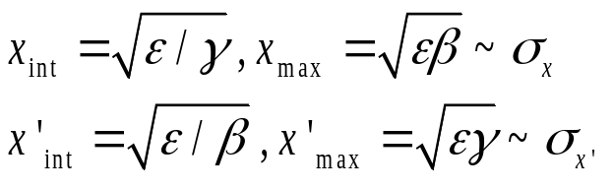
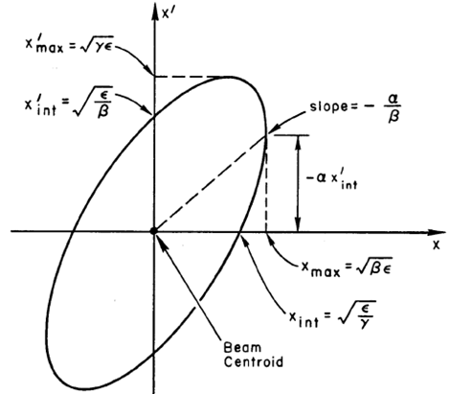
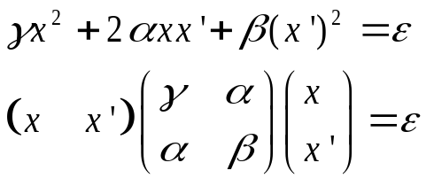

Phase Space Ellipse - Twiss
Phase Space Ellipse - Twiss
γ not independent = (1+α²)/β
“Emittance_Beam_Matrix”
USPAS - MATLAB Physics

Slide 6
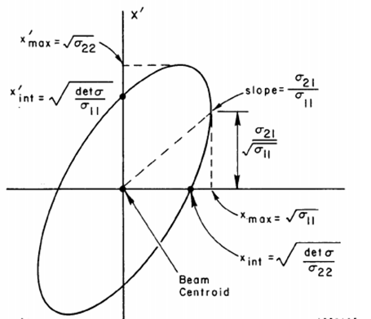
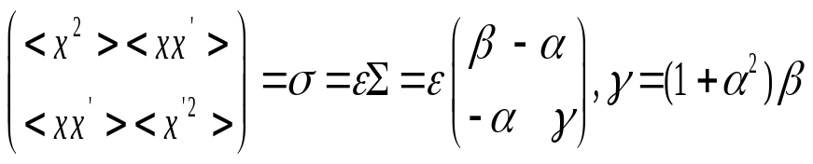
Phase Space Ellipse - Beam
An alternative to lattice Twiss parameters is a beam based definition of the phase space. The < > denotes the r.m.s of a distribution. The Σ matrix factors out the emittance from the beam matrix, σ. The three parameters are now beam position and divergence based and their correlation.
The Σ shape is as with the Twiss, defined by α and β. The σ matrix is beam defined with emittance ε.
USPAS - MATLAB Physics

Slide 7
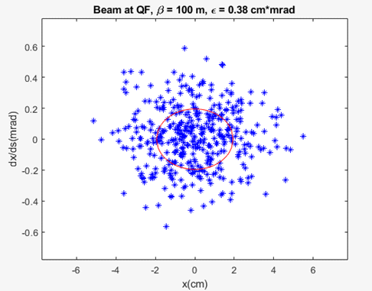
Beam r.m.s. - Gaussian
Beam r.m.s. Gaussian
As an example, the values of the beam matrix are the r.m.s values of the beam, so that only 68% of the beam particles are contained within 1 standard deviation. A FNAL MR FODO is plotted. The 1 σ boundaries, shown in red, are 2 cm and 0.2 mrad, as will be derived later. (“Ellipse_Gaus_USPAS”)
USPAS - MATLAB Physics

Slide 8
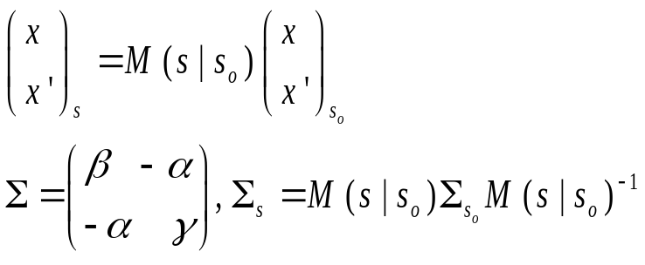
Transforming the Beam
Transforming the Beam with M
Transformation of the Σ matrix for general M from s_{o} to s transforms the Twiss parameters. The matrix M has an inverse which is the transpose as is the case in classical mechanics.
There are two complementary ways to treat the properties of a beam, either using the α, β, μ lattice parameters or the beam parameters, <x²>, <x’²> and <xx’>. The transformed α, β, and γ are found symbolically using the script “a_b_g_M_trans”. The transfer matrix M is used to propagate the beam ellipse from location s_{o} to location s. The matrix M defines how the x and x’ of the beam transform from s_{o} to s.
USPAS - MATLAB Physics

Slide 9
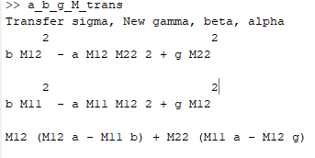
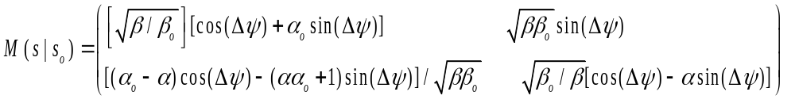
Twiss and Beam Formulation
Transfer Matrix or Twiss α, β, ψ
Alternatively, the initial values of the position and divergence can be transformed from an initial location to a final location where the location is defined by the Twiss parameters and not the transfer matrix itself. The general form is quite unwieldy. Algebra is given on the next slide – using symbolic math to make the algebra tolerable…...
USPAS - MATLAB Physics

Slide 10
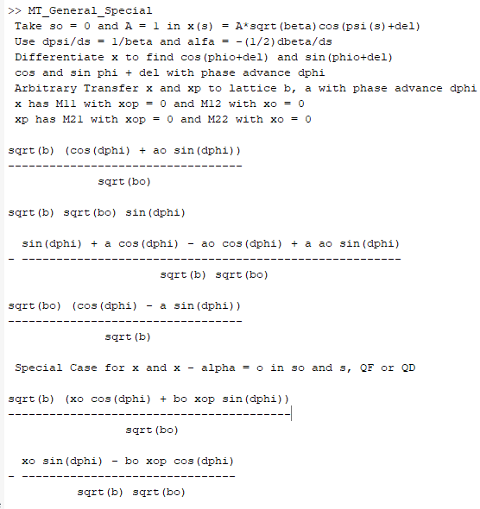
Proof for General Case
Transfer Matrix Using Twiss
Symbolic output
“MT_General_Special”
Proof of general M(s|so) using MATLAB
symbolic math -
starting with x and dx/ds as derived
previously.
USPAS - MATLAB Physics

Slide 11
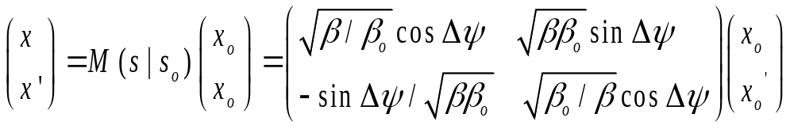
Transformation when α = 0
Transfer Matrix When α = 0, Quads
This condition occurs at the quadrupoles since beam turns over then.
In any case there is no need to yet again derive these expressions. Taking the assumed form of the solutions, the differential Hill equation can be solved and the initial conditions are applied. The solution can then cast in the form of a matrix transformation. All the work is done using MATLAB symbolic math, which saves the reader from a lot of unnecessary algebra.
The proof is reasonably easy using Matlab symbolic math and trig identities. Symbolic math often does not apply identities – use “subs” to substitute by hand in the script.
USPAS - MATLAB Physics

Slide 12
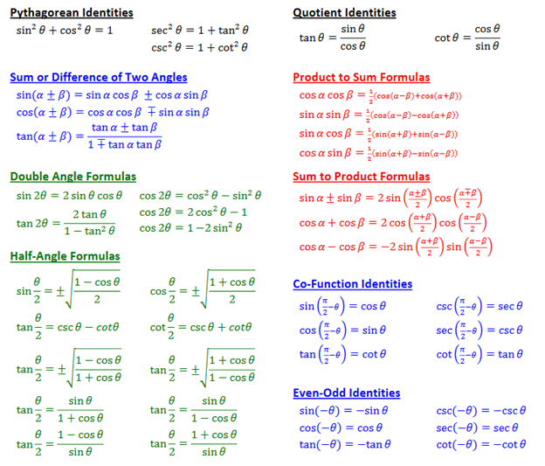
Caveats – Use “subs”
Caveat – Use “subs” to Clean Up
_{The symbolic math package}
_{does not}
_{always simplify optimally.}
_{Use “simplify” or “pretty”,}
_{but most useful is “subs”}
_{where one can replace}
_{say sin^2+ cos^2 by 1.}
_{Trig identities can often be}
_{used ( examples below) to}
_{simplify. BUT you need not}
_{do this unless you wish to.}
USPAS - MATLAB Physics

Slide 13
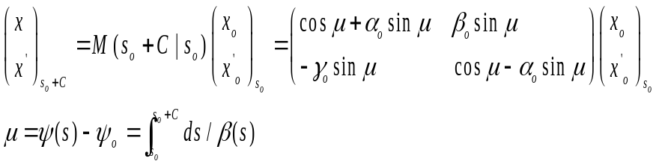
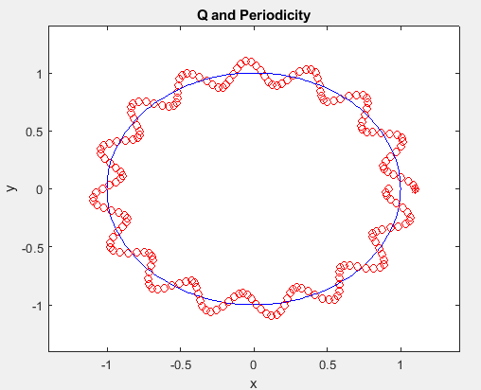
Closed Orbit and Circumference
Closed Orbit and Circumference
A particular special case of the general transformation is when the system repeats in a circumference C, for a circular accelerator, such that α = α_{o}, β = β_{o}, γ = γ_{o}.
It is important to notice that, although the C repeats the magnet elements, the solution need not, and we will see should not, return to the initial state after traversing the circumference C. μ = 2πQ. Use “Q_Tune_USPAS, “movie”.
USPAS - MATLAB Physics

