Slide 1
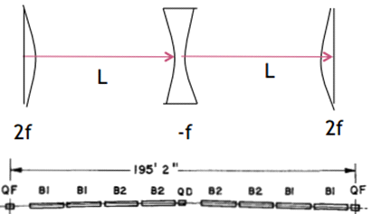
MATLAB Physics - 4
FODO - “Accelerator”
Use FNAL MR as a “standard” example for numerical exercises in order to have coherent set of parameters. The FODO consists of 2 quadrupoles, D and F. Most of the space is taken up by dipoles needed to bend into a circular path (done later, drift space for now).
The FODO is the basic unit
cell. It is basically the Quad
doublet explored previously
but not with a hard focus. The
FODO captures a beam for many revolutions, while a beam doublet sees only a single particle passage. The FODO is ~ || to || with f ~ d
d
d
USPAS - MATLAB Physics

Slide 2
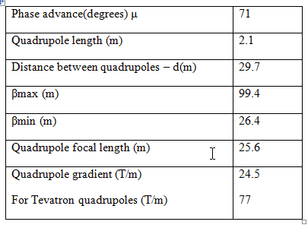
MR FODO Parameters
FODO Parameters
Mostly dipoles, 2 strings of 0.033 rad each. Total 66 mrad. For 96 unit cells end to end the total bend is ~ 2π. The quadrupoles do not focus strongly. They simply contain the beam with small betatron oscillations, which is not like an experimental external beam which may strongly focus on a target. The simple FODO has only 3 parameters, f, d, and bend angle ϕ_{B}.
USPAS - MATLAB Physics

Slide 3
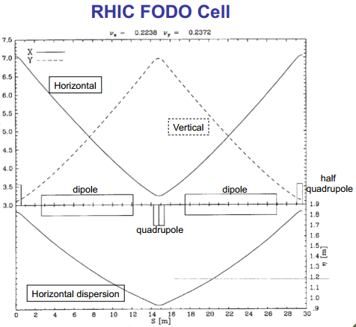
FODO - 2
FODO - 2
The MR emittance is ~ 12π mm*mrad. For a 1 cm beam pipe aperture, angles of ~ 3.8 mad are captured. The values of x derived from the ε and β ellipse are that a maximum (Q_{F}) x is ~ 2 cm, with a minimum (Q_{D}) of ~ 1.0 cm, both with α = 0.
USPAS - MATLAB Physics

Slide 4
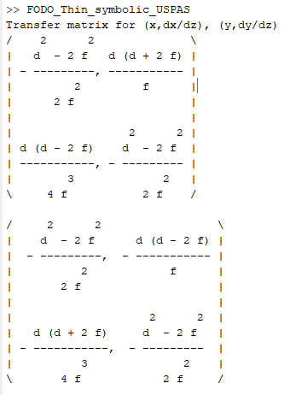
Thin Lens FODO - M
Thin Lens FODO - Matrix
The quadrupoles have the same focal length, powered from the same buss. From the previous discussion of a beam-line doublet, precursor to the FODO unit cell, where Q_{F} and Q_{D} have the same focal lengths, there is a net focusing effect, M(2,1) < 0, for both x and y motion with M(2,1) = -d(d-2f)/4f³, giving an effective doublet focal length of f_{eff} = -2f²/[d(1-d/2f)]. Stable, M(2,1) < 0, if 2f > d which is a “soft” focus.
“FODO_Thin_symbolic_USPAS”
Transfer matrix for (x,x’) and (y,y’)
x’ → M(2,1)x + M(2,2)x’
Reduced if M(2,1) < 0
USPAS - MATLAB Physics

Slide 5
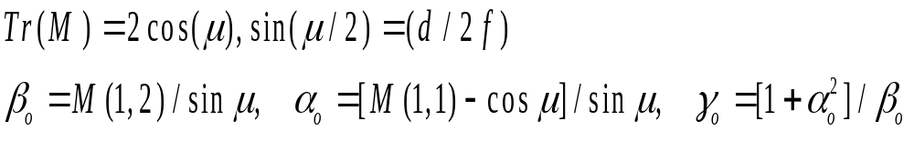
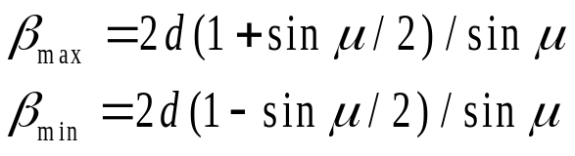
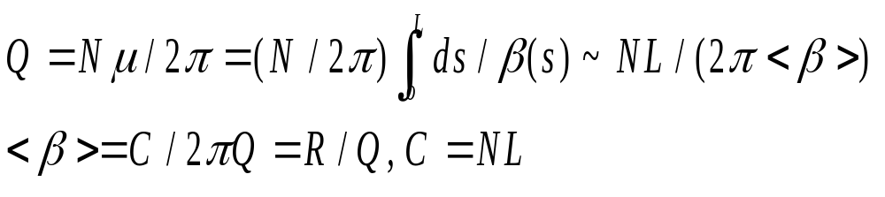
Thin Lens FODO - Twiss
FODO - Twiss
The MR repeat structure is approximated to be only the FODO. Ignore insertions, extraction, injection, etc. From the FODO transfer matrix the Twiss parameters can be extracted, as this is the basic repeat unit. Note the sin stability condition, sin < 1,, 2f > d. Use trig identities and M.
The scale for <β> is ~ 2d ~ 60 m. The Q is after N = 96 FODO, each ~ 71º, Q ~ 18.9. The FNAL MR radius is ~ 1 km. Another estimate for <β> ~ 53 m.
USPAS - MATLAB Physics

Slide 6
Twiss - Matrix
Twiss - Matrix
As a way to visualize how a FODO aperture can sculpt the acceptance to yield an emittance ellipse, the App ”Ray_Ellipse_FODO” can be used. Rays are traced through some “Slider” chosen number of FODO to see the ellipse develop. This shows the connection of ray tracing (matrices) and Twiss parameters. Compare to the tracing of the emittance ellipse through a single FODO in 13 steps using the transfer matrix to extract α, β, μ, γ at several points traversing the FODO.
Slider for the # of FODO. One FODO gives a linear acceptance boundary. The ellipse is a limit for large N.
Compare ray trace with the Twiss formulation of the ellipse evolution through a FODO.
USPAS - MATLAB Physics

Slide 7
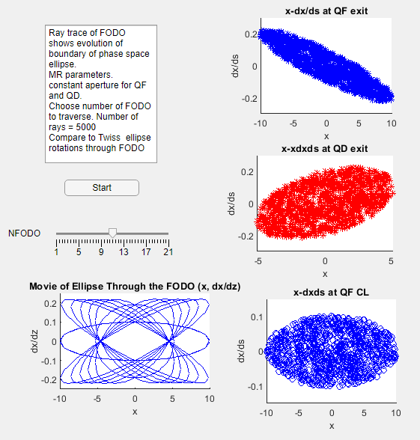
Twiss Matrix - 2
Twiss-Matrix - 2
Watch the ellipse
evolve as more FODO
are traversed.
The ellipse is upright
at the QF and QD
centers (α = 0)
USPAS - MATLAB Physics

Slide 8
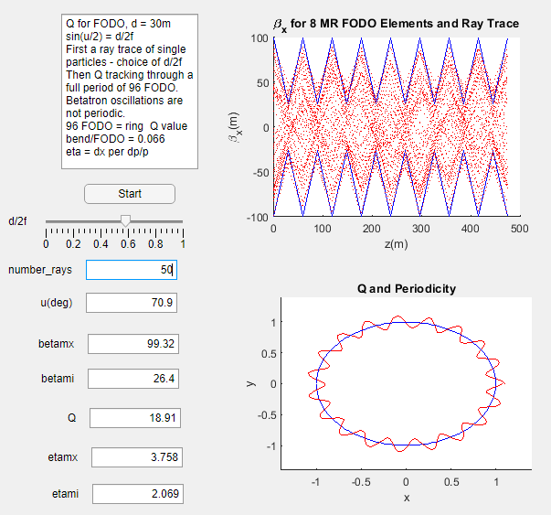
Ray Trace and Twiss
Rays and Twiss
Generate rays.
see how Twiss
parameters change
with d/2f -
β, η, and Q
(dipoles in FODO)
“Rays_FODO_Q”
(η – dispersion later)
“movie” of Q
USPAS - MATLAB Physics

Slide 9
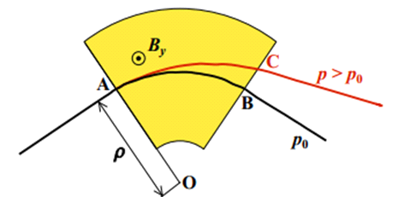
Dipoles and Dispersion - η
Dipoles and Dispersion
The MR FODO dipoles are two strings of 4 dipoles, each bending by 33 mrad, for a total bend angle in 96 FODO of 6.34 rad ~ 2π. This is our standard “accelerator” model.
A dipole bends a particle by an angle that scales as 1/p. Larger p go farther and bend less. Shown below is a sector dipole. Reference is p_{o}.
USPAS - MATLAB Physics

Slide 10
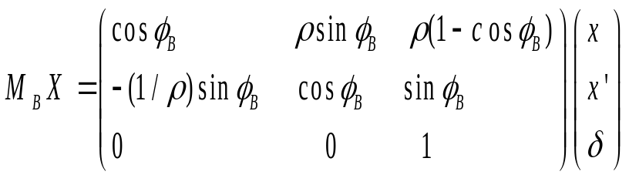
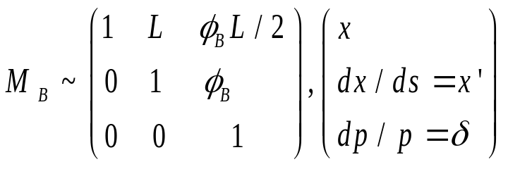
Sector Dipole
Sector Bending Magnet
A sector dipole has a transfer matrix that must therefore be extended to a third dimension since beams capture a finite range of momenta. The fractional momentum spread, δ = dp/p is chosen typically as the third variable. The small bend approximation was already seen in the discussion of uniform B field motion (lecture 1). For on momentum particles, the dipole acts like a drift space and defines the reference trajectory.
As seen already, a dipole bends by ~ ϕ_{B} with x at the exit ~ϕ_{B}L/2
USPAS - MATLAB Physics

Slide 11
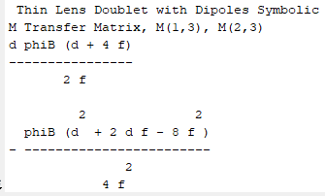
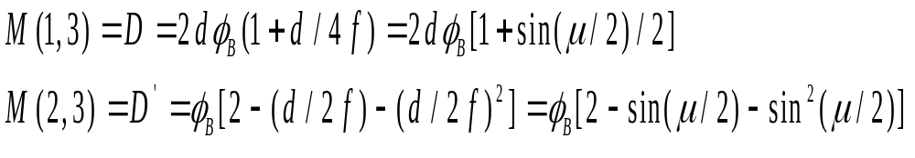
“FODO_dispersion_USPAS”
“FODO_dispersion_USPAS”
The FODO in thin lens approximation and small bend approximation has transfer matrix elements M(1,3) and M(2,3). The drift matrices with length d are extended to 3x3 with L ~ d. The (2 x 2) is a drift space.
In terms of the Twiss FODO phase advance μ instead of the matrix elements:
.
USPAS - MATLAB Physics

Slide 12
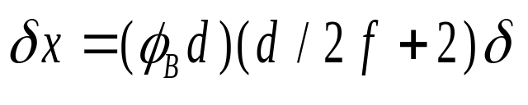
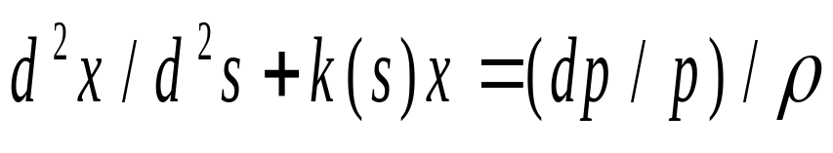
FODO Dispersion - 2
FODO Dispersion - 2
The scale for D is 2dϕ_{B}. The bend angle refers to each string, with 33 mrad bend, for which D is ~ 2 m. If δx is to be 2 cm which is the assumed FODO aperture for on momentum particles then 2 cm = δx means δ = dp/p ~ 0.8% is ~ the momentum range.
The differential equation is no longer homogeneous. There is a driving term for the closed reference orbit of an off momentum particle which is no longer (0,0).
USPAS - MATLAB Physics

Slide 13
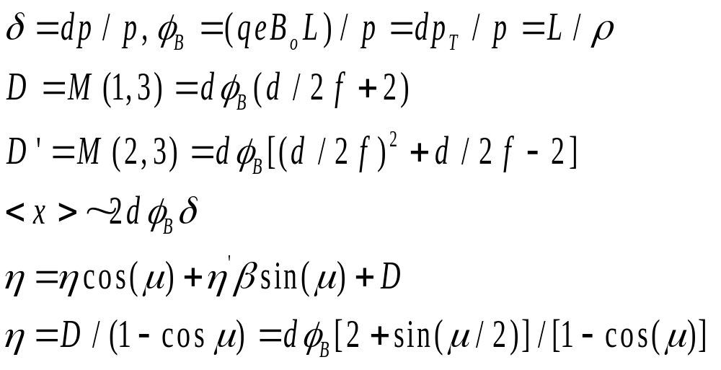
FODO Dispersion - 3
FODO – Dispersion - 3
The closed orbit for the off momentum particle differs from that for the reference trajectory by an amount defined to be the dispersion η. The closed orbit is derived by requiring that it repeats after one unit cell. Assuming α = 0 for simplicity, requiring the off momentum closed orbit, η = x_{co}, η’ = x’_{co} and taking η’ = 0 at the Q_{F}/2 center, reduces η from D by a factor (1 - cosμ).
<x> ~ Dδ
Evaluate η at Q_{F} or Q_{D} ((max, min) where η’ = 0,
Impose periodicityx> ~
USPAS - MATLAB Physics

Slide 14
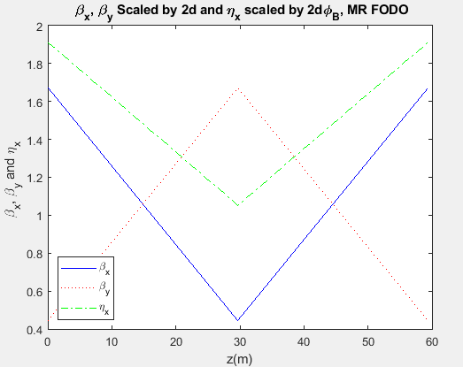
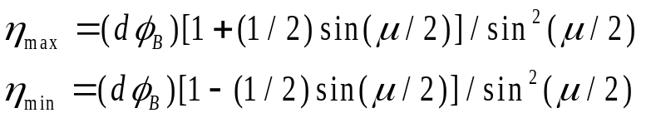
FODO Dispersion - 4
FODO Dispersion -4
The value of η is a maximum at the Q_{F} location and a minimum at the Q_{D} location, as can be seen in the RHIC FODO plot. For the MR FODO, the dispersion max is 3.75 m, min is 2.06 m (see “Rays_FODO_Q”). The MR plot is shown below, as created by the script “FODO_Dispersion_USPAS”.
Note that the scaled variables
Are all of O(1)
USPAS - MATLAB Physics

Slide 15
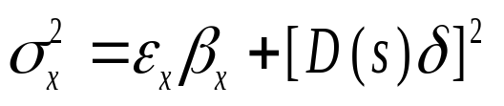
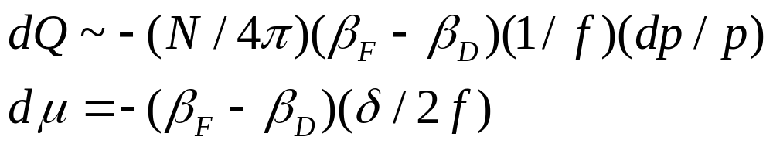
dp/p Beam Size and Tune Shift
dp/p Beam Size and Tune Shift
The effective beam size has a part due to on momentum betatron oscillations about the (0,0) closed orbit and a contribution, folded in quadrature due to off momentum particles centered on the off momentum closed orbit.
The quadrupoles have a focal length that is momentum dependent, f ~ p. That leads to a betatron phase shift for off momentum particles. This broadening of the Q value with momentum spread can be dangerous, as will be seen later (resonances).
For the MR, Q = 18.9 and dQ ~ - 43.5(dp/p) and Q+dQ = 19 (resonance) if dp/p = 0.23 %. The momentum spread accepted is limited by the quadrupole chromaticity if it remains uncorrected.
USPAS - MATLAB Physics

Slide 16
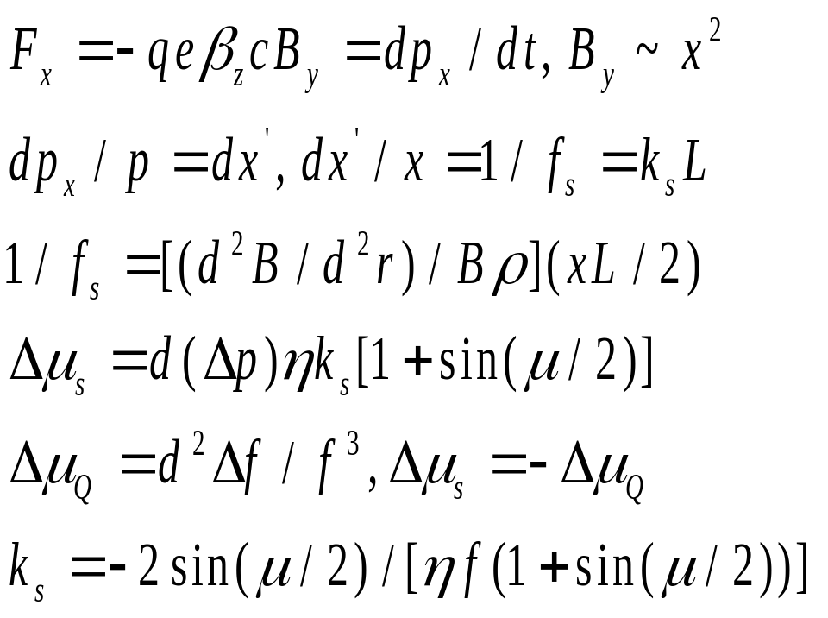
Sextupole Correction
Sextupole Correction
There is a sextupole correction of the tune shift that can be employed. Sextupoles can be added to the FODO. The sextupole 1/f_{s} value depends on the orbit excursion, x. Therefore, the sextupole can be used to cancel the phase change due to the quadrupole chromaticity.
Lorentz force is quadratic In x. Sextupole focal length ~ 1/x. Sextupole phase shift matches quad
chromatic phase shift.
Match is easiest if
Sextupole is in the QF location.
USPAS - MATLAB Physics

Slide 17
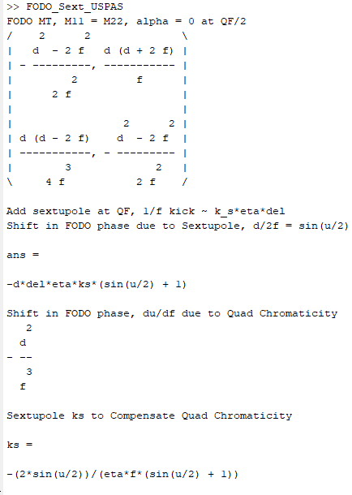
Sextupole - 2
Sextupole - 2
The cancellation condition is derived
symbolically in the script “FODO
_Sext_USPAS” using the utility
“solve” assuming the sextupole is
located at the maximum excursion
– at Q_{F}. The sextupole k factor
needed is inversely proportional to the
quadrupole focal length , f ,
and the dispersion, η, ks ~ 1/fη.
USPAS - MATLAB Physics

Slide 18
Sextupole KEK Beam
Sextupole – KEK Beam
A nice example is the KEK electrostatically separated beam used to make an enriched kaon beam . First there is a dipole to do initial momentum selection, followed by a quadrupole doublet going approximately point to point in y. There is a vertical focus followed by a second doublet which goes point to parallel. Just before the ExB separator there is a sextupole to make as parallel a y beam as possible by correcting for vertical chromaticity.
After the separator there is another doublet to focus at a mass slit (parallel to point) which passes kaons and largely removes the pions in the beam. A final doublet focuses the beam (point to point) onto the experimental target. This example also shows that many experimental beam lines can be decomposed and understood as imposing the 3 focus conditions which were previously explored for the quadrupole doublet.
USPAS - MATLAB Physics

Slide 19
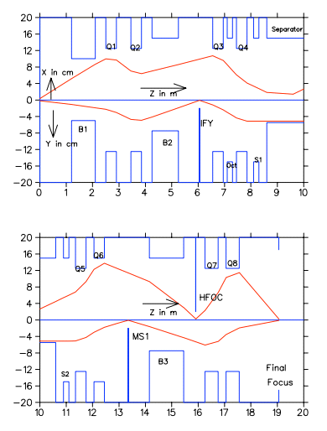
KEK Beam - 2
KEK Beam - 2
Build a beam
quad doublets
point to parallel
parallel to point
dipole collimation
sextupole correction
ExB fields
mass selection
electrostatically
separated K beam
USPAS - MATLAB Physics

