Slide 1
MATLAB Physics - 5
FODO elements: errors – quad alignment and dipole error.
Steering:
An accelerator must be assembled from manufactured parts. Limitations on optical survey mean the quadrupoles may be off center and thus give a kick to the reference trajectory. Optical alignment has a limit ~ 100 μm. To do better need to use the beams themselves and Beam Position Monitors (BPM) iteratively. Large β – near an F quad will amplify “kicks” as we will see.
Quad misalignment adds angles dθ ~ Δx_{Q}/f and Δx_{Q} excites β oscillations. A linear and small error approximation is to add (0, Δx_{Q}/f) to the x and dx/ds at the quad error location. This is “steering” – all particles in the phase space get the same kick.
USPAS - MATLAB Physics

Slide 2
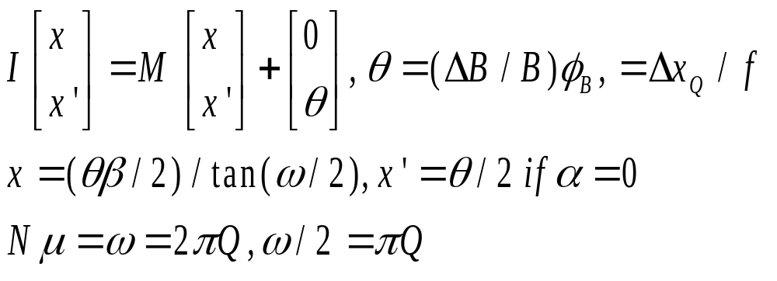
Field Errors – Steering 1
Field Errors - 1
Besides magnet misalignment there are manufacturing errors in the quad gradient or the dipole central field. For a B field error, the central momentum particle is no longer on the reference trajectory closed orbit.
For a full 1 turn transfer matrix M, the angular errors cause a new closed orbit indicated by the identity matrix I. The linear shift in closed orbit at the error location for dipole field error or quad misalignment is, solved using symbolic “solve” in “First_Order_Res_USPAS2” for x and x’ with general α, and β. Results for α = 0 are simpler, x’ = θ/2.
USPAS - MATLAB Physics

Slide 3
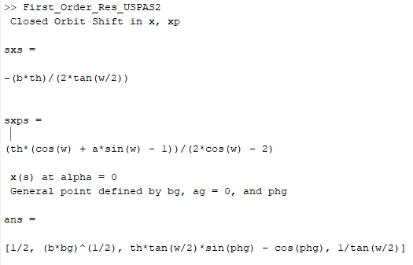
Field Errors – Steering 2
Details of printout made by “First_Order_Res_USPAS2” assume α = 0, sampled at F or D quad. Limit check for co result.
xs and x’s. x’s = θ/2 for F,D.
For point s factors are shown. Use cos(a+b) trig
Identities to find final result. x/xo from b to bg
USPAS - MATLAB Physics

Slide 4
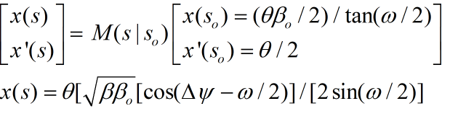
Field Errors – Steering 3
Field Errors - 2
The solution for the 2 equations in 2 unknowns, x and x’, is found using the “solve” utility in a symbolic calculation in an App used later
For the shift in x at a general lattice point the symbolic solution can be easily generalized to find the displacement for point s as quoted below and which collapses to the previous solution if the phase difference is zero. Note the resonant blow up. The shifts are linear in the errors, θ.
This result applies to a location s with β caused by an error at s_{o}, β_{o} , α_{o} = 0 with a phase difference between them of Δψ = ψ - ψ_{o}. There is resonant behavior due to the denominator. Lattice points near F quads see the largest effects.
USPAS - MATLAB Physics

Slide 5
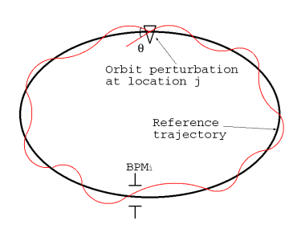
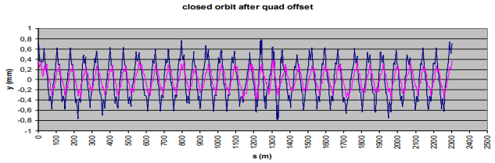
Field Errors – Steering 4
Field Errors - 3
The effect of the B field or quad position error can then be measured in a BPM anywhere in the orbit. Knowing the Twiss parameters at the locations of the kick and the BPM, the error can be determined and corrected for. Points with α= 0 at Q_{F} (or Q_{D}) typically give maximum displacements. New closed orbit exists.
BPM are the tools needed to sample the beams , detect errors and indicate how to correct for them
USPAS - MATLAB Physics

Slide 6
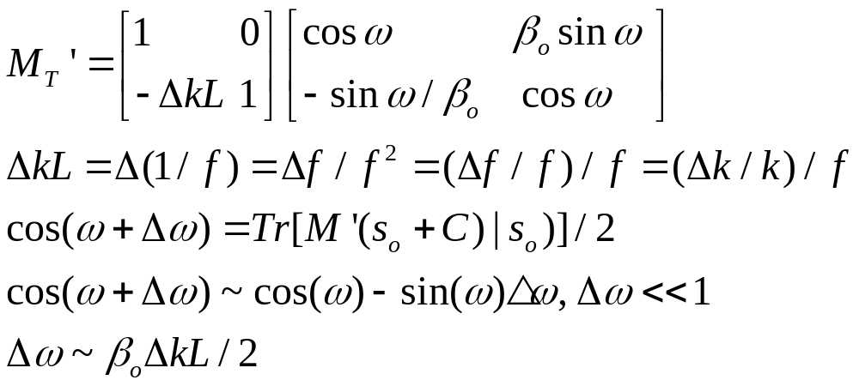
Quad Gradient Error – Phase Shift
Quad Gradient Error
Turning from the quad alignment steering error to the quadrupole gradient error at s_{o} there is a tune shift found using the full 1 turn matrix. The error is represented not by a displacement but an additional error “kick” in this case. One result is a tune shift, Δω. ( note α = 0 is assumed for the quadrupole)
Proceed to a general location as in the case of the steering error. The result seems not very illuminating - however (see “Quad_Grad_Err_General_USPAS” script. The scale is Δx(s) ~ΔkLββ_{o} ~ (df/f)(β β_{o} /f) which is ~ 4% for a 1% gradient error. The errors are again largest when the β factors are largest, The displacement depends on both the error and observation locations .
USPAS - MATLAB Physics

Slide 7
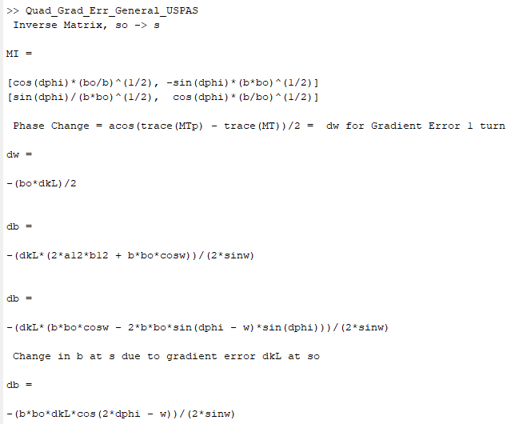
Quad Gradient Error - script
Use “Quad_Grad_Err_General_USPAS” script to see the effect of a quad gradient error at α = 0 transformed to a general point.
Lots of algebra. Script
Identifies the steps. The phase change for 1 turn comes from the changed trace. The change in b comes from tracking the grad error from so to s and finding an altered M12 =
(b+db)sin(w+dw) and using the phase change fond already to solve for db.
USPAS - MATLAB Physics

Slide 8
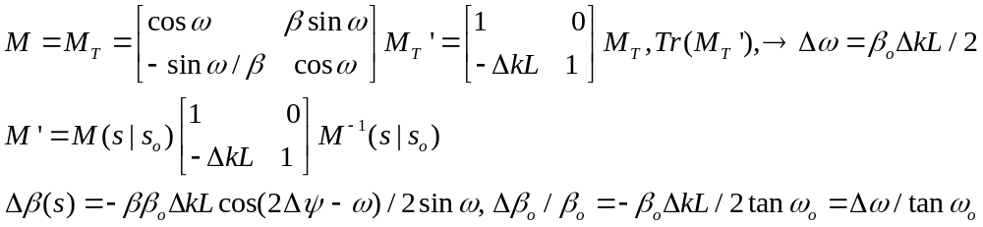
Quad Gradient Error - Δβ
Gradient Error -2
The value of β also changes as found by using the M12 element at a general location, s, with α = 0 as was done for x(s) with the steering displacement.
After a lot of algebra, explore the results. The App which is provided plots both the steering and the gradient error for typical values. Gradient error typically increases the value of β. The symbolic results are displayed in the App. The periodicity of the 2 errors differs, w/2 and w resonances.
Note the periodicity of the perturbation, which differs for misalignment and gradient error. Note also that the gradient error changes β
USPAS - MATLAB Physics

Slide 9
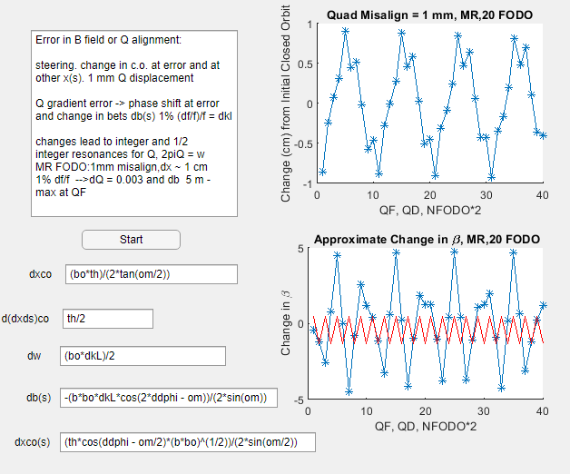
Quad Misalignment and Gradient Error
First the Twiss
Parameter
formulation:
“Steer_Align_Q_B_Err”
Generalize the co
distortion from 1 turn
with final α = 0 and β_{o} to location at β – with a phase shift and a change in β
USPAS - MATLAB Physics

Slide 10
Ray Trace and Misalign, Gradient
Quad Errors – Ray Trace
Ray Tracing:
Appealing again to the complementary view of lattice parameters and ray traces, the effects of errors can also be explored using ray tracing. Both alignment errors and gradient errors are implemented at an initial point and a set of rays is tracked through a set of FODO. The use of “Sliders” enables the viewing of the response of the beam sizes for different quad displacements and gradient errors. For the MR FODO with a phase shift of 71 degrees, one betatron oscillation happens every ~ 5.1 FODO and the plots are for 9 FODO. Crudely speaking the alignment response is at ω, while the gradient response is at ω/2.
“Quad_align_grad_Err” -” play” with the parameters
First ray traces for no quad errors. Then more rays, say 100 to fill the phase space. Then add a quad alignment error. Finally apply a gradient error. There are different periodicities for the 2 error types.
USPAS - MATLAB Physics

Slide 11
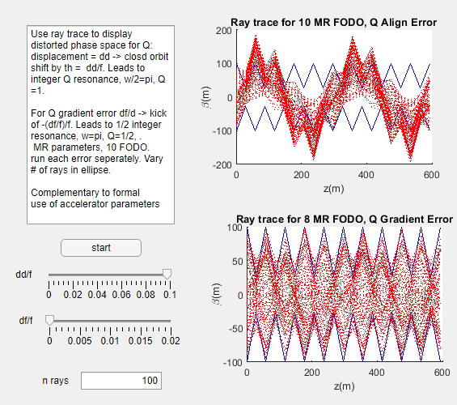
Ray Trace
Ray Trace - 2
Misalign quad and
Gradient error
With alignment
error alone the β
value does not change. The gradient change
alters the phase and the β value at the source point and observation point. There is also resonant behavior.
USPAS - MATLAB Physics

Slide 12
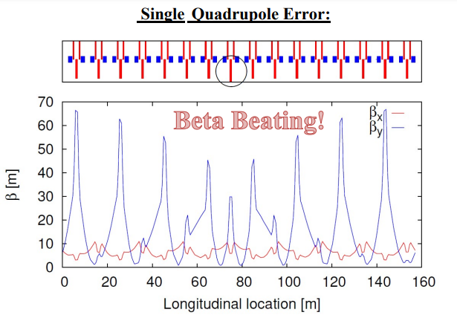
“Beta Beat”
Beta “beat”
A similar plot with 16 FODO of “beta beating” is shown from another accelerator which displays comparable structure in β function
beta beat scales with Δk and β at
both the error and the observation
points. As with the
steering, there is
resonance behavior but w not w/2.
USPAS - MATLAB Physics

Slide 13
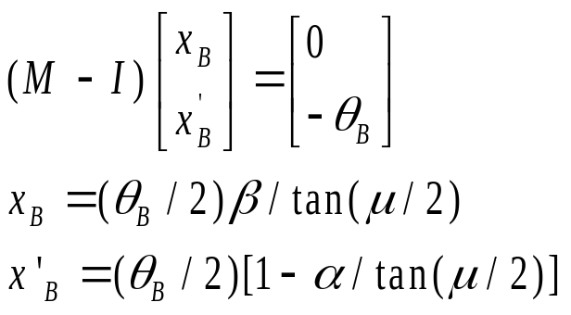
BPM + Bump = Correction
BPM + Bump = Correction
Alignment Correction:
Use BPM or screens or strip lines to determine beam properties at different locations. Need to align elements with errors to the co.
Use a dipole “bump” , θ_{B}, correcting element to steer a beam at ~ the bump location and change the closed orbit to x_{B} , x’_{B}. For example correct for misaligned quadrupoles. As before but now choose the bump that gives the desired change in the beam at the ~ BPM location parameterized by the local Twiss parameters. The identity matrix is I, M is 1 turn.
USPAS - MATLAB Physics

Slide 14
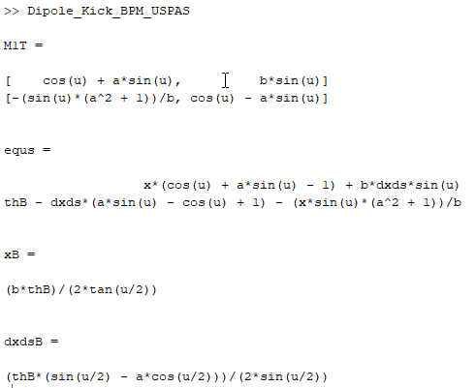
co Correction - 2
Run the script – “Dipole_Kick_BPM_USPAS” - general location with non-zero α. Solve for θ_{B} to yield x_{B} and (dx/ds)_{B} .
USPAS - MATLAB Physics

Slide 15
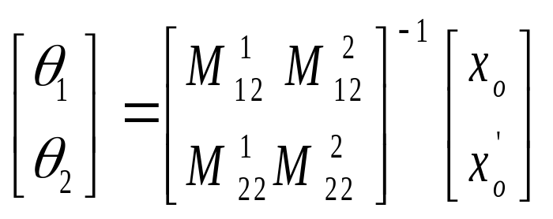
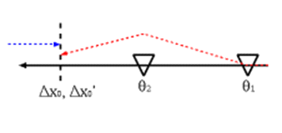
co Correction - 3
Correction - 3
More generally, a simple case is to use 2 dipole correctors with angle kick θ₁ and θ₂. Add the vectors (0 θ) at the bump locations. Suppose the final beam at s_{o} is to have the condition x_{o} and (x’)_{o} . Using the transfer matrices, M¹, M² from the correctors to the final location one can solve for the θ₁ and θ₂ needed to impose the required condition on x_{o} and (dx/ds)_{o} .
Using bump magnet correctors and BPM, the errors can be corrected for – cancelling the closed orbit distortions. These techniques can be generalized to the use of many BPM and many bump correctors. With the expanded instrumentation of modern accelerators and more online compute power, much can be accomplished quickly.
USPAS - MATLAB Physics

Slide 16
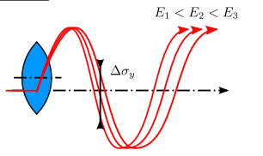
Quad Chromaticity
Quad Chromaticity
In addition the quad focusing depends of p, so there is a focal length spread due to dp/p - chromaticity. The momentum spread in the beam then leads to a tune “spread” which may extend into resonant values of 1= full or ½ integer values. Measure by observingt he x change by changing r.f. (beam energy) or dipole buss (reference trajectory).
Kick varies – change downstream in both position and in phase. That means there is an additional tune spread due to the momentum spread in the beam.
USPAS - MATLAB Physics

Slide 17
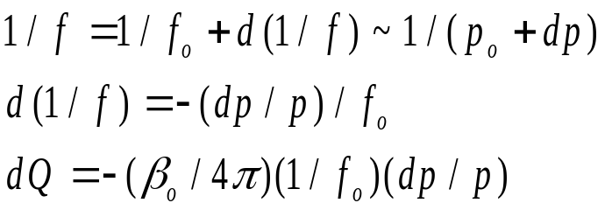

Tune Shift and dp/p
Tune Shift and dp/p
The dipole bend is ~ 1/p so the dipoles in the FODO have a dispersion – as do the quads, since they have a focal length ~ p. Quad effects dominate . 1/f_{o} =e(dB/dr)L/p_{o} so that Δ(1/f) ~ δ/f_{o} . The shift in position is Δx = D(s)(dp/p) = D(s)δ.
The tune shift for off momentum particles is called the chromaticity , ξ, ΔQ = ξδ. For dp > 0 focusing is decreased -> tune is decreased, ΔQ < 0.
A quad acts on both x and y so there is both an x and a y tune shift.
The value of the tune shift is similar to the tune shift arising from a gradient error, ΔQ = β_{o}(df/f)/[4πf] by assigning (df/f) = -(dp/p). The chromaticity for a single quadrupole is then, ξ = -β/(4πf). For a MR FODO a 1% dp/p causes a tune shift, dQ ~ 0.003.
USPAS - MATLAB Physics

Slide 18
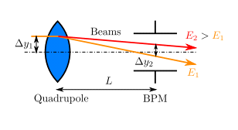
1 BPM and dp/p
BPM and dp/p
Using BPM ( discussed later), the shift in the BPM position allows a measurement of the momentum spread in a beam. A BPM operation and a stripline will be discussed later. For now it is simply assumed that the beam centroid and r.m.s can be measured with detectors sampling the beam positions at a point in the accelerator.
USPAS - MATLAB Physics

Slide 19
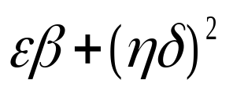
2 BPM → ε and dp/p
2 BPM → ε and dp/p
“BPM_dpp_QF_QD_USPAS”
The MR FODO parameters are assumed. The dp/p value is selected by “Slider”. The values of the emittance, the β values and D values at Q_{F} and Q_{D} are assumed to be known and to be the design values.
A “beam” of 5000 particles is generated Gaussian distributed to create a beam ellipse. BPM are assumed to exist at Q_{F} and Q_{D}. The 2 measured r.m.s . values are assumed to be described by
The solutions for ε and δ using the 2 measurements of r.m.s. are statistically limited, but changing the input dp/p is still instructive.
USPAS - MATLAB Physics

Slide 20
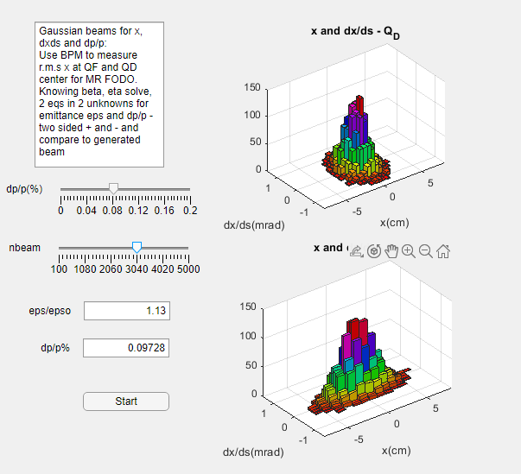
MR FODO ε and dp/p
MR FODO: ε and dp/p
BPM at QF/2
and QD in
MR FODO
Sliders for dp/p and the
number of measured
beam particles – statistical
errors are ~ 1/√n .
Fractionally, e.g. n = 100
expect 10 % error
USPAS - MATLAB Physics

Slide 21
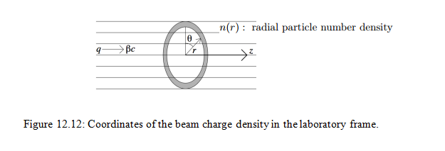
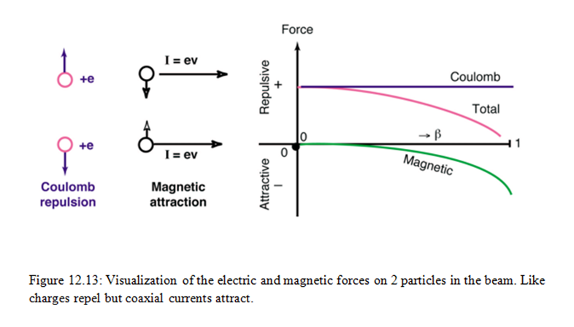
Beam Self Repulsion
Added Topic -1, “space charge”
A possible bunch density limitation due to particle repulsion. (also interactions with wall image charges).The Lorentz force is purely radial in this approximation. There is a Coulomb repulsion and a magnetic attraction.
USPAS - MATLAB Physics

Slide 22
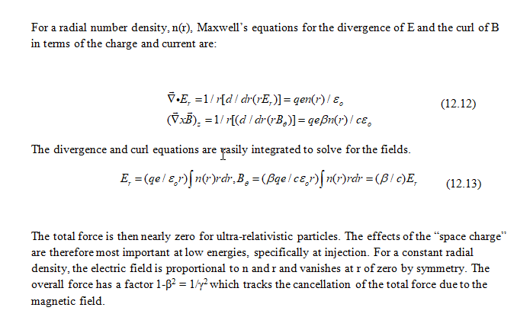
Repulsion 2
Added Topic - 2
USPAS - MATLAB Physics

Slide 23
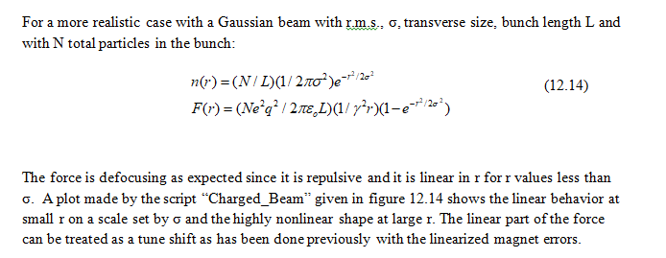
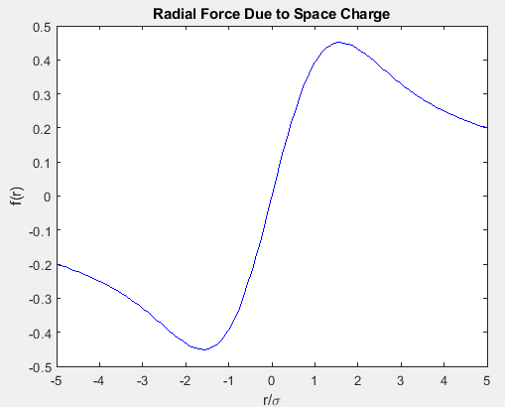
Repulsion 3
Added Topic - 3
Use “Charged_Beam_USPAS.m”
to explore the repulsive force
USPAS - MATLAB Physics

Slide 24
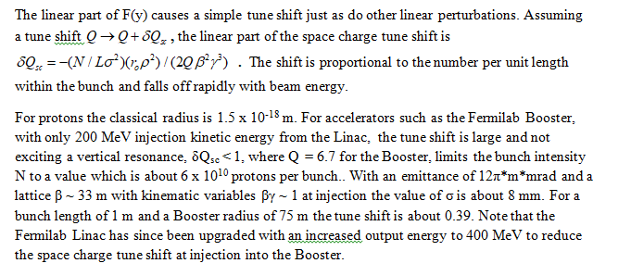
Repulsion 4 – Tune Shift
Added Topic – 4
Space charge tune shift – FNAL Booster at injection. Note Booster energy raised to 400 MeV in Upgrade.
USPAS - MATLAB Physics

