Slide 1
MATLAB Physics - 6
BPM ,FFT and Measuring α, β, ε, δ and Q:
The beam in an accelerator is an ensemble in space and time of moving charged particles, a current. The electric field of this current is then detected by instruments used to measure and monitor the properties of the beam. BPM are used to correct errors in the accelerator elements – alignment, B fields and gradients.
The NR electric force is (qe)E_{o} = (qe)²/(4πε_{o}b²) and acts over a time ~ b/v, so that the momentum impulse seen by the observer is Δp_{x} = (qe)E_{o}Δt. The effect of SR is to increase the field by a factor γ, but the relevant time shrinks by a factor γ, leaving the momentum impulse constant. In the UR regime, the E_{x}(t) pulse is almost a “delta function” acting strongly but only over a very short time (impulse).
USPAS - MATLAB Physics

Slide 2
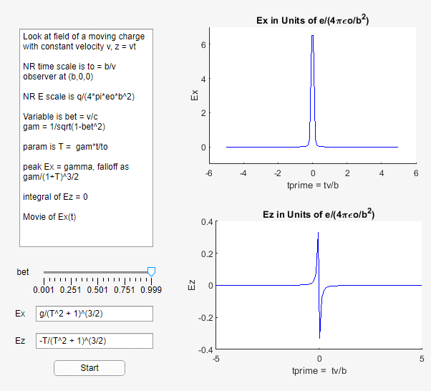
SR and Electric Fields
SR and Electric Fields
“E_Moving_q_USPAS”
makes a “movie” of
E_{x}(t) for values of β
chosen by “Slider”.
Plots of electric field vs.
time. The integral of E_{x}
is 0. “movie” of E first.
USPAS - MATLAB Physics

Slide 3
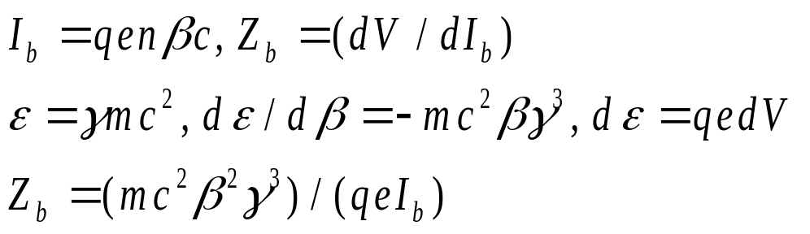
Beam Induced Wall Current
Beam Current, Impedance
Using the charge induced by the beam on the beam pipe is a nondestructive method to determine the properties of the beam.
The beam current and impedance are found using symbolic “diff” to find dε/dβ. [ see the script “Zb_Impedance.m” ]. The number of charges in the beam is n. The UR impedance Z is very large because it is very hard to change the beam velocity when a voltage is applied.
USPAS - MATLAB Physics

Slide 4
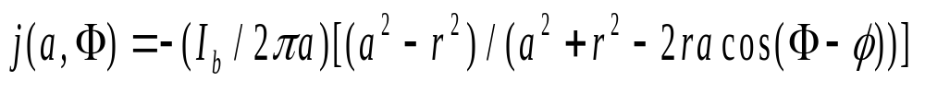
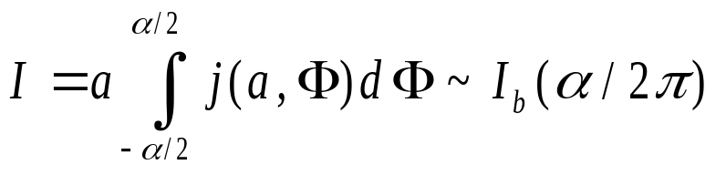
Induced Current - Image
Induced Current, Images
To find the induced current, I, use the method of image charges for a cylindrical geometry, taken to be only 2 dimensional since the z range of a UR beam is small and has 0 time integral in x.
The solution can be obtained as a function of the (x,y) location inside the beam pipe. For a charge qe with a radius r inside the pipe of radius a the image charge is along the radius to the charge with image charge q_{i} = -qe(a/r) and location r_{i} = a²/r. The image charge induces a linear current density j on the wall at (a, Φ) due to the beam charge at (r, ϕ).
Integrating j over a range of azimuth α, the induced current is approximately the beam current reduced by the azimuthal fraction of the BPM.
USPAS - MATLAB Physics

Slide 5
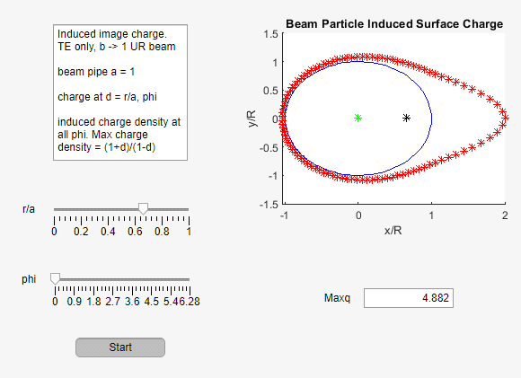
Beam Position and j
Beam Position and j
“Induced_Charge_USPAS”
The “Sliders” change
the location of the point
charge inside the beam
pipe. The contours of the
image charge are plotted.
An off axis beam has a
phi asymmetric induced
charge density.
USPAS - MATLAB Physics

Slide 6
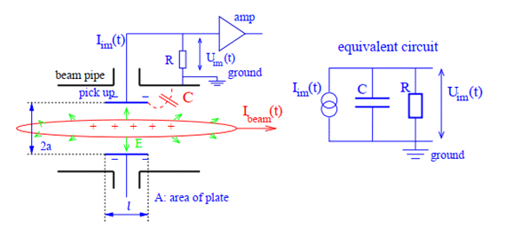

BPM Readout
BPM Readout
The image current impulse I is detected as an induced current proportional to I_{b}. It is a current source which is amplified after a high pass RC filter.
The filter time constant is τ_{C} = RC. The signal voltage in the frequency domain follows, where j is now √-1 (sorry). The difference signal XAB is approximately proportional to the beam position for small values of x_{b}.
USPAS - MATLAB Physics

Slide 7
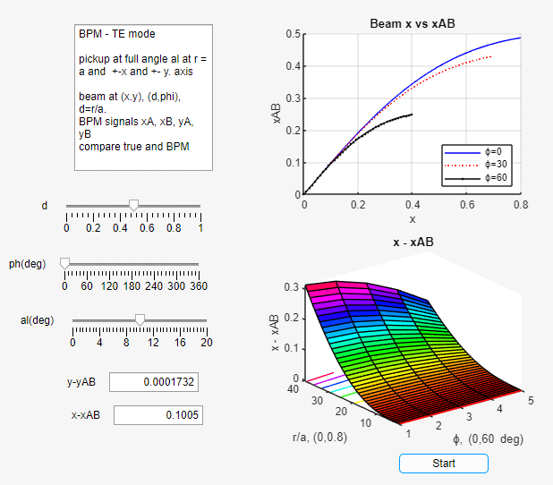
BPM Position Error
BPM Position Error
BPM_X_Y_USPAS”.
The errors in
measuring the
position of the beam
using a BPM are
explored in the App.
The dependence of the
error on d, ϕ, and α
can be explored using
the “Sliders”.
USPAS - MATLAB Physics

Slide 8
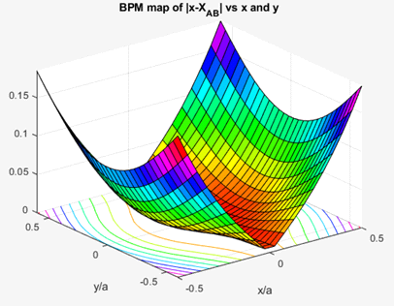
BPM Error - 2
BPM Error - 2
The error in x of the BPM for a point-like beam as a function of (x,y) of the beam is generated using the script “BPM_x_y_err_USPAS”. The errors increase as x/a and or y/a increase as is expected. The x error depends largely on x/a and not y/a as expected.
The errors can be corrected by changing the BPM pickup structure or it can be mapped offline. If the beam is a few pipe radii away the error is small.
USPAS - MATLAB Physics

Slide 9
Use 2 BPM to Measure ε and δ
2 BPM to Find Emittance and dp/p
As was already shown, for the Fermilab MR FODO the maximum η(s) and β(s) are at Q_{F}, while the minima are at Q_{D}. If the x standard deviation of a beam is measured at these two points, the emittance and the momentum spread of the beam can be determined assuming the lattice parameters η(s) and β(s) are known.
Gaussian beams are generated in the App. “BPM_dpp_QF_QD_FODO” with typical results for 5000 beam particles shown again below. The emittance was fixed at 3.8 mm*mrad. The full 3 x 3 FODO matrices are used. The Matlab utility “histogram2” is used to produce the plots, sometimes called “LEGO plots” for obvious reasons. The solutions are accurate within the statistics, estimated to be ~ 1/√5000 = 1.4%. The BPM are assumed to be without error since the beam is assumed to be far from the beam pipe.
Corrections for the BPM errors can be made either offline or by tweaking the shape of the pickup electrodes. Those detailed considerations are not explored further here.
USPAS - MATLAB Physics

Slide 10
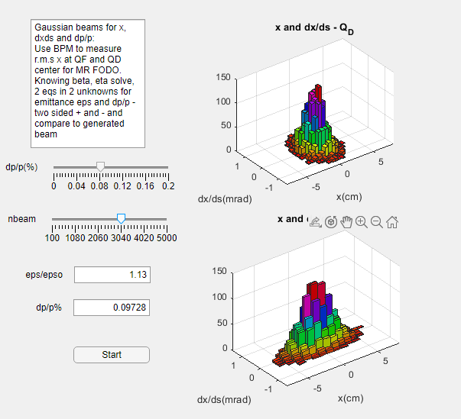
BPM at FODO QF and QD
BPM at Q_{F} and Q_{D}
Use of 2 BPM
measuring beam r.m.s.
at Q_{F} and Q_{D}
No BPM distortion
of x is assumed. Errors
would need to be
corrected for depending
on the size of the beams.
USPAS - MATLAB Physics

Slide 11
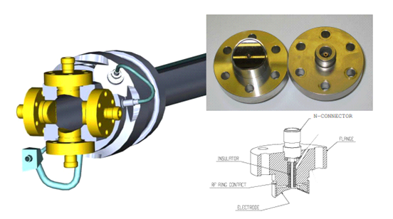
A Button BPM
A “button”BPM
Schematic of an LHC “button” BPM
USPAS - MATLAB Physics

Slide 12
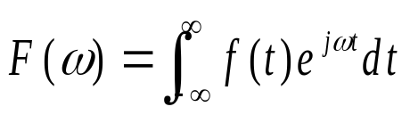
Fourier Transforms
Fourier Transforms
The time domain and the frequency domain are complementary and equivalent descriptions of a system. For an accelerator with harmonic betatron oscillations it is natural to explore the frequency domain of operation. The Fourier transform, F(ω) of a function of time f(t) is defined to be:
There are only a few closed form solutions. A notable one is that the FT of a delta function is a constant function (familiar from QM?). Another is the FT of a Gaussian with an r.m.s. σ is a Gaussian with r.m.s. proportional to 1/σ.
The Matlab utility “fourier” can be used to search for other examples of closed form solutions using the App “Fourier_Transform_USPAS”. There is a drop down menu with 5 examples or the user can input their own favorite function and see if a closed form transform exists.
USPAS - MATLAB Physics

Slide 13
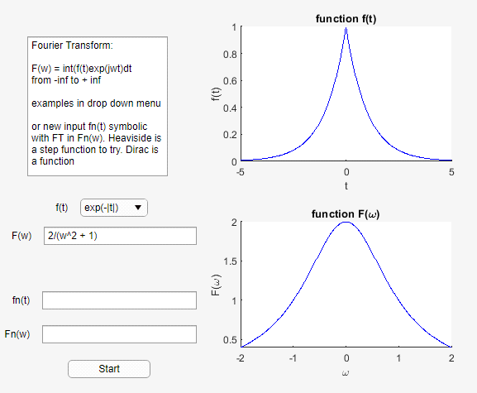
FT Exercise
FT Exercise
FT are not
of much direct
use for
accelerators.
User can input
any function of t
that might have
a closed form
solution.
USPAS - MATLAB Physics

Slide 14
Fast Fourier Transform - FFT
FFT
A tool of more practical use is the Discrete Fourier Transform or the Fast Fourier Transform (FFT). It is applied to a sequence of N time samples. These operations are available in Matlab using the utilities “fft”, “ifft” to find the FFT and the inverse FFT of a series of data points, and the utility “abs” which is used to find the power as a function of frequency ω. Only the power is explored here and not the phase information that is also available using the MATLAB “fft” utility.
A script “Sunspots_USPAS” is supplied to introduce the Matlab FFT utilities. Matlab supplies 288 years of data on sunspot activity. The sunspot cycle has a period of 11.08 years. The plots of sunspot activity in both time and frequency are displayed by the script.
USPAS - MATLAB Physics

Slide 15
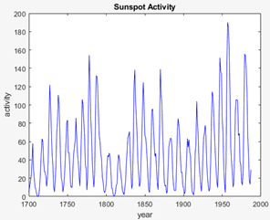
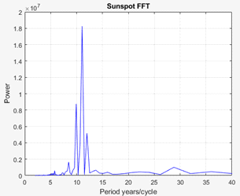
Sunspot Example
Sunspot Example
FFT finds the power as a function of frequency for a series of time measurements.
USPAS - MATLAB Physics

Slide 16
Example – a BPM per FODO
Set of contiguous BPM
“Accel_Q_BPM_USPAS”
What do a set of BPM tell us about the Q of the MR betatron oscillations? An initial, quite unrealistic example, tracks a single particle generated Gaussian randomly in the beam ellipse. Position is sampled by n < 96 sequential BPM.
Use FFT on x to measure Q. Use “Slider” to change quad focal length to see tune shift. Watch the quality of the Q determination degrade with a reduced number of BPM.
In modern accelerators, there are, in fact, many BPM instrumented around the ring. This gives the operators a wealth of information.
USPAS - MATLAB Physics

Slide 17
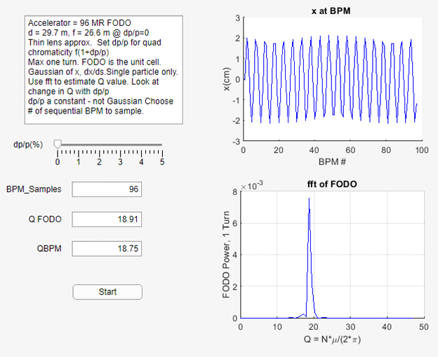
A Set of BPM – Single Particle
Set of BPM
Full turn shown:
Vary dp/p
and the number
of sequential
BPM. The betatron
oscillation is
visible in the
plot of x(s). Twiss
α β inferred from x
USPAS - MATLAB Physics

Slide 18
1 BPM with multi-turn data
Multi Turn Data from BPM
“Accel_Multi_Turn_USPAS” instead of 96 BPM with a single particle and 1 turn as done just previously using FFT.
Movie for first 5 particles. Frequency the same but phase differs within the ellipse. Track “beam” of 2000 particles within the ellipse.
For the MR FODO the phase advance is μ = 1.2376 rad = 70.707o. For one turn or 96 FODO, μ1 = 0.5662 since 96μ = 118.8096 or Q = 18.909. Using Matlab “acos” for the one turn matrix trace, the Q1 angle is 0.5662 rad or 32.44o. This wrap around phase increments each turn until 360/32.44 ~ 11.097. Note x(s) and σ(s) have different periodicity since σ is single valued.
USPAS - MATLAB Physics

Slide 19
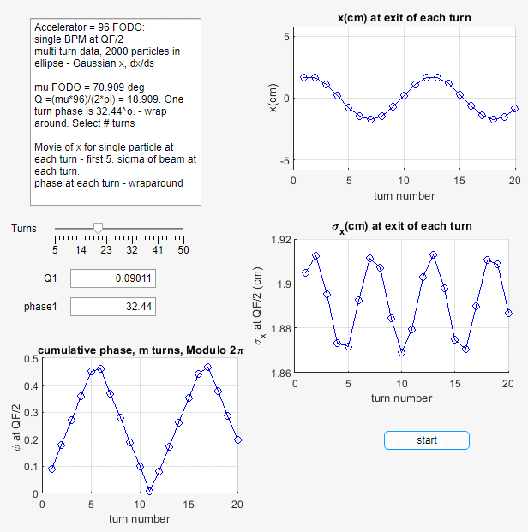
Q and “wraparound”
Q and “wraparound”
Position and
r.m.s appear
different in
Periodicity (abs)
USPAS - MATLAB Physics

Slide 20
BPM and bunch r.m.s
BPM and Bunch r.m.s.
“FFT_Multiturn_MR”
An FFT analysis with ~200 particles in a bunch, tracked over ~100 MR turns, is available in the App. A single particle can be used, or the r.m.s. of the bunch. For the single particle the power maximum is at 11.22 turns, while for the r.m.s. the power is a maximum at 5.611 turns which is half the single particle result because the r.m.s. is always positive while x for a single particle can be both positive and negative. Using the “Sliders” for the number of turns of 1 particle or the number of particles in a bunch can be varied to explore the stability of the results.
To repeat:
For the MR FODO the phase advance is μ = 1.2376 rad = 70.707º. For one turn or 96 FODO, μ₁ = 0.5662 since 96μ = 118.8096 or Q = 18.909. Using Matlab “acos” for the one turn matrix trace, the Q₁ angle is 0.5662 rad or 32.44º. This wrap around phase increments each turn until 360/32.44 ~ 11.097 turns
USPAS - MATLAB Physics

Slide 21
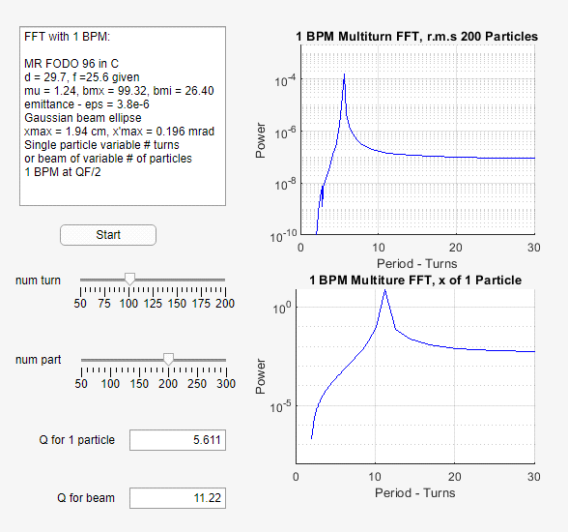
FFT of 1 particle or the r.m.s of a Bunch for Q measurement
FFT of “bunch” with 1 BPM
FFT
determination
of Q is limited
here by the
“bunch” statistics
USPAS - MATLAB Physics

