Slide 1
MATLAB Physics - 7
Cables, Fibers and Strip-lines:
All the elements of a detector/accelerator need to communicate. In the past coaxial cables were the most used objects.
Lately, spurred by the telecom industry, optical fibers have taken a lead because of their superior performance.
Strip lines are used as BPM with large z extent (not a “button”) and are related to cables.
Insertions – Collins straight section and LHC low β
USPAS - MATLAB Physics

Slide 2
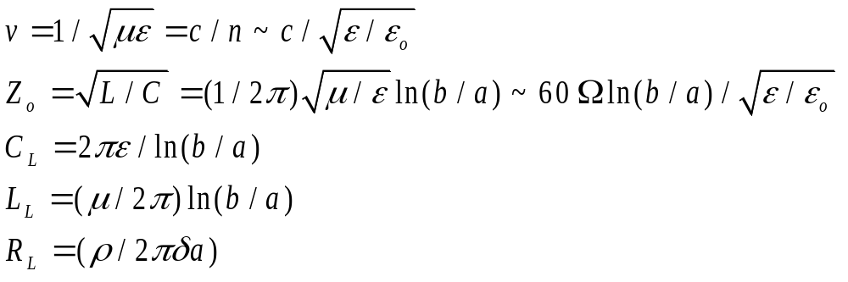

Coaxial Cable
Coaxial Cable
A typical coaxial cable has an inner conductor surrounded by a dielectric with permittivity ε and permeability μ, usually assumed to be μ_{o}, and then a metallic mesh, usually at ground.
These devices are waveguides. They have an index of refraction, n > 1 with a velocity < c. They have a characteristic impedance, Z_{o}. The characteristic capacitance, inductance and resistance per unit length C_{L},L_{L}, R_{L} are:
The impedance of the vacuum is 377 Ω. The impedance of a cable depends on the dielectric material and the axial geometry.
USPAS - MATLAB Physics

Slide 3
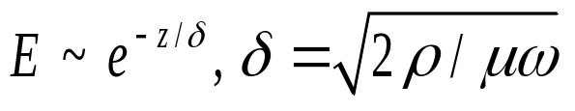
Cable - 2
Coaxial Cable - 2
The electric field, unlike the case for electrostatics , can penetrate into a conductor by a frequency dependent distance called the skin depth, δ, where ρ is the conductivity of the central conductor of the coax.
A standard cable is called RG58 which has 50 Ω impedance. The bandwidth of the cable is limited due to resistance caused by finite skin depth δ. For RG58 the rise time of a step function pulse is ~ 0.2 ns, or a bandwidth ~ 5 GHz for 10 m of cable. The capacitance for 10 m is 300 pF and resistance 3 Ω. The time constant τ ~ RC = 0.9 ns for 10m of RG58.
USPAS - MATLAB Physics

Slide 4
Cable - 3
Coaxial Cable - 3
For example, in copper, ρ = 1.7 x 10-8 Ωm, taking μ = μ_{o}, the skin depth is 6.6 cm divided by √f in Hz. At 60 Hz (house power) the depth is 8.5 mm. That allows one to simply twist wires together at home to make a sufficiently good contact. At 100 MHz the skin depth is 6.5μm or 0.65 μm at 10 GHz and the fields do not penetrate any reasonable thickness of copper. Clearly, efficient power transmission is easier at high frequencies.
Note that in the discussion of BPM it was tacitly assumed that the fields induced by the beam charge did not penetrate into the vacuum pipe for this reason.
Numerically, for a cable with copper conductor the skin depth is δ = 16.5 cm/√(ω(Hz)), for an inner radius a = 0.1 cm and R_{L} ~ 10⁻⁷ Ω/(cm√(ω(Hz)). The finite resistance of the coaxial cable causes the limitation in bandwidth.
USPAS - MATLAB Physics

Slide 5
Fiber Optical Cable
Fiber Optic Cable
The advantages of fiber optics to transmit over long distances with high bandwidth and immunity from electromagnetic noise are clear. Such fibers are also used to transmit signals in sensitive detectors since they present less mass to particles which transverse them and therefore less scattering and energy loss.
In fact, the 2009 Nobel Prize in Physics was awarded for research in fiber optical communication.
The modulated signals are often created using LEDs which emit light in the IR range where the attenuation length is very large. The received light is converted back to an electrical signal using a photodiode, which uses the photoelectric effect. The light is captured in the cable by the use of total internal reflection which is ~ lossless.
USPAS - MATLAB Physics

Slide 6
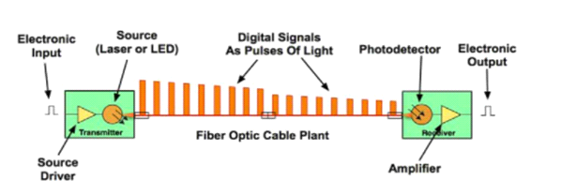
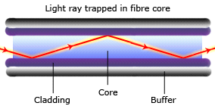
Fiber - 2
Fiber Optic Cable - 2
At present a figure of merit for a typical high - quality fiber is ~ 3.5 GHzkm at 850 nm wavelength. It is clear why fiber optics has revolutionized the way telecommunication signals are sent over long distances. On the other hand there is a niche for coaxial cables because of their ease of use for short runs that require only modest bandwidth performance.
USPAS - MATLAB Physics

Slide 7
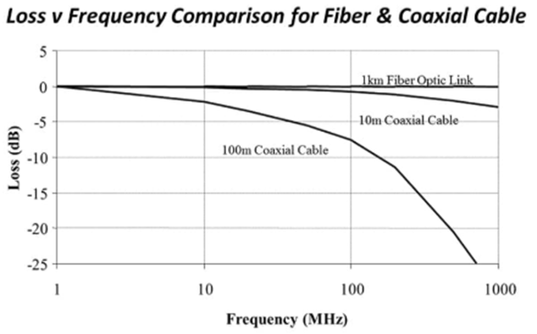
Fiber - 3
Fiber Optic Cable - 3
The bandwidth advantages of fiber are clear. For shorter cable runs coaxial may work well depending on the specific bandwidth requirements of the installation
USPAS - MATLAB Physics

Slide 8
Strip Line
Strip Line
In the earlier discussion of BPM the focus was on the transverse dimensions of the beam. However, beams also have longitudinal structure (bunches) imposed by the acceleration process which requires a monitoring technique. More detailed exposition of stable bunch structure will appear in the section on acceleration.
For very short bunch lengths other techniques may are needed in order to obtain accurate longitudinal measurements. Strip lines are an example. They are related to coaxial cables. Strip lines may be thought of as a coaxial cable cut longitudinally and unfolded.
The E and B fields in a coaxial cable are between the inner and outer conductors in the dielectric. For strip lines the fields are more spread out. Strip lines are also often printed on large circuit boards as copper traces on G-10 over the ground plane, in order to insure matched impedance reflection-less signal transmission.
USPAS - MATLAB Physics

Slide 9
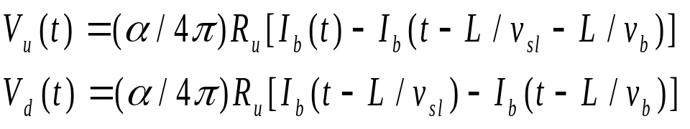
Strip Line - 2
Strip Line - 2
Unlike BPM “buttons” strip lines are also extended in azimuth with angle α but also extended along a length L of the accelerator z axis, with impedance Z_{o}. With readout at both ends of the stripline, upper and lower termination R_{u} , beam current I_{b}, beam velocity v_{b}, and strip velocity v_{sl}, the signal voltages at the upstream and downstream ends are in the general case (consult picture that follows if unclear).
If the stripline velocity is equal to the beam velocity, the downstream signal is zero when both ends are matched terminated to Z_{sl} with no reflections. The signal is therefore directional (useful for storage rings with2 counter rotating beams like the LHC) in that only the upstream electrode gives a signal.
USPAS - MATLAB Physics

Slide 10
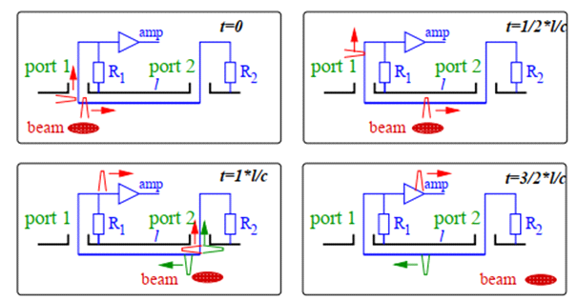
Strip Line - 3
Strip Line - 3
The pulses are shown schematically and V_{u}(t) ~ I_{b}(t)-I_{b}(t-2L/v_{sl}) while V_{d}(t) = 0. As a special case, if the r.f bunch length is 2L in time there is no upstream signal either because the reflected signal cancels it since the beam bunch is in synch with the stripline.
First, consider the simplest case. The time development of the pulses in a single stripline if v_{b} = v_{sl} = c means the downstream pulse is zero. Delta function pulses in time are assumed. The two pulses are spaced in time by 2L/c.
USPAS - MATLAB Physics

Slide 11
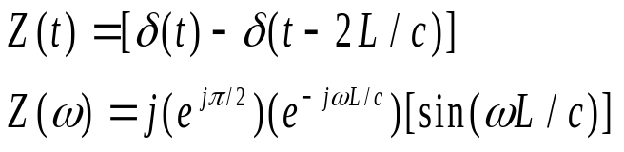
Strip Line - 4
Strip Line - 4
The impedance of the strip line in both the time domain and the frequency domain is simple. The FT of a single delta function is a constant function. In Matlab, the command line input, fd = fourier(dirac(t) - dirac(t-(2*L)/c)) leads to the result 1 - exp(-(L*w*2i)/c) where i = √-1 for this symbolic utility. Trig identities establish the equivalence of this result with that shown below. In these notes j is consistently √-1.
The deployment of strip - lines in azimuth is similar to that for BPM. A picture of four strip - lines is shown below, two vertical and two horizontal, deployed to yield information on both x and y of a short beam - bunch. These devices are easiest to use and interpret if the bunch length is less than the strip length so that the direct and reflected signals do not overlap.
USPAS - MATLAB Physics

Slide 12
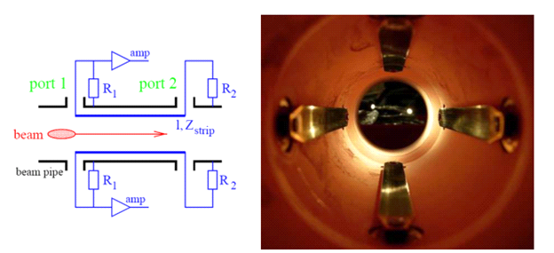
Strip Line - 5
Strip Line - 5
Installed in the vacuum – access is limited which may make servicing the stripline an issue.
USPAS - MATLAB Physics

Slide 13
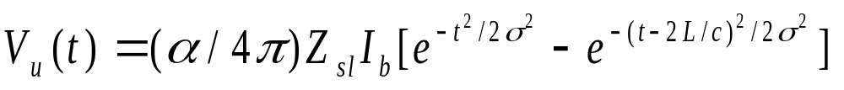
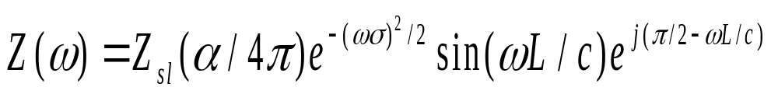
Strip Line - 6
Strip Line - 6
For a longer, more realistic, pulses the response is more complex. The FT of a Gaussian in time is a Gaussian in frequency as mentioned previously, exp(-t²/(2s²) -> exp(-ω²s²/2). For a beam which is Gaussian distributed in time, with beam velocity c and strip - line velocity c, the upstream voltage time behavior and the impedance frequency behavior appear below. The impedance Z(ω) is proportional to the FFT of V_{u}(t) with matched termination R_{u} = Z_{sl}.
Using the utility “fourier” one can easily confirm with a short code snippet that the FT of exp[-(t-b)²/2s²] is exp[(-ω²s²/2-jωb] so that a shift in time creates an additional phase factor in frequency in the FFT, exp[-jωb].
USPAS - MATLAB Physics

Slide 14
Strip Line 7
Strip Line - 7
An App called “Stripline_USPAS” is available to explore some more aspects of a single stripline. The bunch length is a Gaussian in time with r.m.s. chosen by “Slider” with a range available from very short, to the case of overlapping direct and reflected signals. The stripline output in both the time domain and the frequency domain is plotted. The stripline length is 30 cm or 1 ns. The frequencies extend up to tens of GHz. A “movie” is shown schematically which indicates a delta function in time for the beam and the reflected pulses. A sample output of the App appears below. The FT plot displays the modulus of the impedance rather than the real part. A 10 ps pulse has frequency components > 30 GHz, while a 1 nsec pulse is just resolvable into a bipolar pulse with frequencies ~ 2 GHz as seen in the Figure.
Longer bunches require longer strip-lines or normal BPM with a wide bandwidth.
USPAS - MATLAB Physics

Slide 15
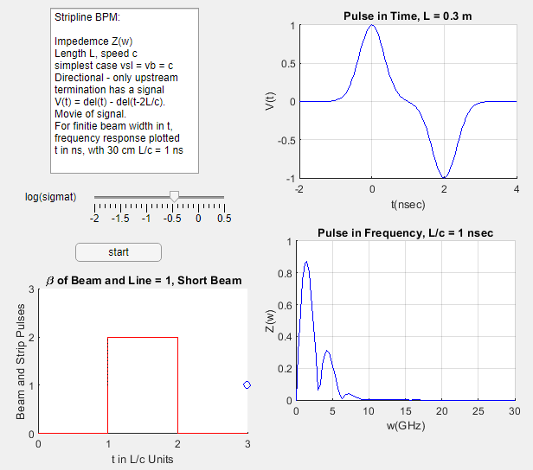
Strip Line App
Strip Line – 8, App
“Slider” for beam
width. “Movie” of
pulses. Plots of V(t)
and Z(ω). Pulses
not resolved for
larger σ.
USPAS - MATLAB Physics

Slide 16
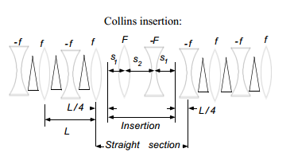
Simple Insertion – Collins Straight
The accelerator is not just a series of FODOs. There is acceleration (rf), extraction/injection , collisions (low β) and many other needs for free space.
To accomplish these operations, magnet free space is needed. However, the “insertion” must not disturb the main lattice (beam loss)
For a “Collins” insertion the FODO length is L = 2d. The Collins starts at d/2, with free space s₂ The insertion point has α_{x} = -α_{y} where matching works in both x and y.
USPAS - MATLAB Physics

Slide 17
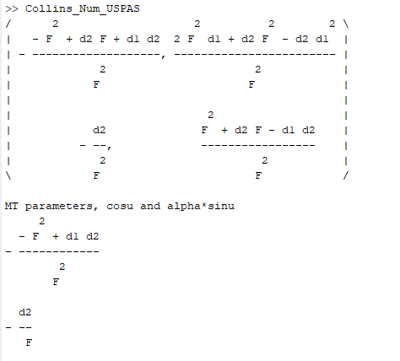
Collins - 2
Collins Straight - 2
Use “Collins_Num_USPAS” which uses “Ellipse_Prop_USPAS”. Notation; d, f are for FODO and d1 and d2 are for Collins. The lattice parameters to match are αm and βm.
The symbolic transfer matrix for the Collins elements in terms of F, d₁ and d₂, (s1 and s2 on last page) with Twiss parameters cosμ and αsinμ
USPAS - MATLAB Physics

Slide 18
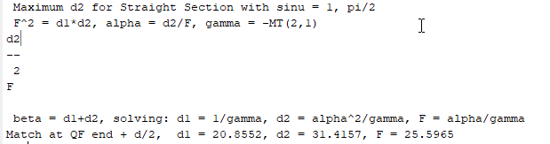
Collins - 3
Collins Straight - 3
The numerical results for creating a Collins insertion for a MR FODO unit cell are shown below. Start from the QF FODO centerline where α = 0, β is the maximum value and γ is 1/β, propagate the lattice parameters to the matching point and then further through the Collins section and finally into the remainder of the MR FODO into which the Collins straight section was inserted. Examining the overall insertion transfer matrix and using the fact that the transfer matrix defines the Collins lattice parameters, M(1,1) + M(2,2) = 2cosμ, M(1,1) – M(2,2) = 2α, M(1,2) = βsinμ, and M(2,1) = -γsinμ.The largest value of the free space d₂ clearly then occurs sinμ=1, which is the reason why it called a “π/2 insertion”. In this specific case, the parameters of the Collins insertion can be simply related to the unit cell parameters at the point of insertion where the subscript m indicates the matching betatron parameters. the conditions to match the basic FODO lattice parameters, α_{m}, β_{m}, and γ_{m} are d₁ = 1/γ_{m}, d₂ = α²_{m}/γ_{m}, F = α_{m}γ_{m} .
USPAS - MATLAB Physics

Slide 19
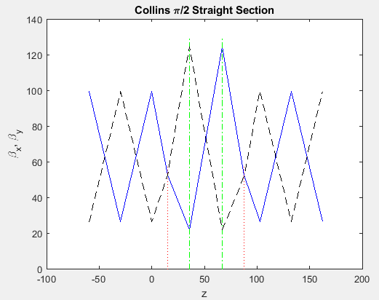
Collins Straight - 4
A plot of the βx and βy For the MR and the Collins is provided by the script. Note that the x and y functions are mirror images. That symmetry, which occurs midway between the MR Q_{F} and Q_{D}, makes the matching possible in both x and y simultaneously. In the MR case, a free space of 31 m is achieved
The green vertical lines
indicate the Collins quads. The dotted verticals indicate the
matching locations The solid blue and dotted
black indicate the matched β functions. Note the increase in β at the insertion. Much greater in “low β” at LHC
USPAS - MATLAB Physics

Slide 20
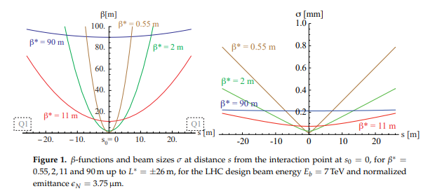
Low β Insertion at the LHC
The LHC wants to maximize luminosity → minimum size at the interaction point.
That requirement is like a “point” beam focus, much different than the accelerator gentle focus with small beta functions.
USPAS - MATLAB Physics

Slide 21
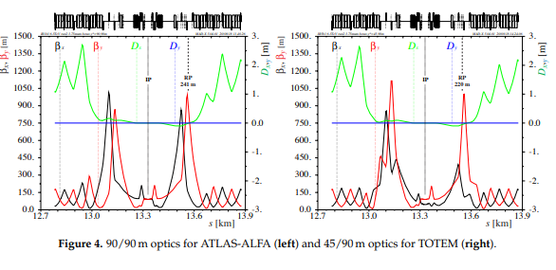
Low β Lattice Match
In turn, the quadrupoles must be strong and of large aperture w.r.t. the accelerator quads. The “low beta” insertion must also match the LHC lattice as in the Collins insertion case.
The max β are ~ 6x the accelerator values. The x dispersion is reduced to achieve the smallest possible intersection region (luminosity)
USPAS - MATLAB Physics

