Slide 1
MATLAB Physics - 8
Acceleration: This is USPAS after all ….
Constant V_{o} Acceleration First:
How does one make a high energy beam? Drop a charged particle through a static electric field.
First a source of beam particles is needed to serve as input to an accelerator. For an electron beam many sources as possible. For example, the electron “gun” in old cathode ray TV sets.
For protons, the simplest method is simply to ionize hydrogen gas in a strong electric field which disassociates the gas. At Fermilab there was a series of accelerating steps. First in the Cockcroft-Walton, a voltage multiplier device, the ions gained a kinetic energy T of 0.75 MeV in an electric field, T = qeV_{o}.
USPAS - MATLAB Physics

Slide 2
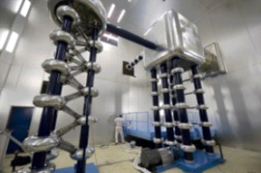
Cockcroft-Walton → Linac
Cockcroft – Walton → Linac
The protons are then accelerated in a drift tube linear accelerator which at FNAL was about 150 m long where they were acted on by harmonic electric fields which raised the kinetic energy, T, to 200 MeV. The Linac final energy was subsequently upgraded to 400 MeV. The maximum emittance is 6π -mm-mrad, and the maximum possible accepted momentum spread was 0.3 %
USPAS - MATLAB Physics

Slide 3

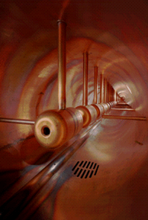
Linac - 2
Linac - 2
Note that the electric driving field is a sine wave and that only the particles riding along the positive half of the wave are accelerated. If the voltage were constant, a length L of field would give an energy gain of qeVo, Vo = EoL. Taking the r.f. phase ψ_{h} into account the constant field energy gain is reduced by a factor
E&M is transverse. A longitudinal field is
created in a cylindrical cavity – a waveguide
-> Bessel Eq. E(z) ~ J_{o}(ω_{h}r/c) zero at
argument = 2.405. Note all the pipe radius
is useful.
USPAS - MATLAB Physics

Slide 4
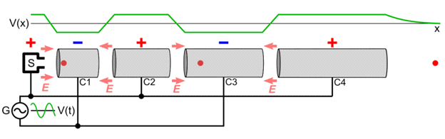
Linac - 3
Linac - 3
The Linac consists of a series of variable length “drift tubes” The time to transit a tube is phased to be ½ the r.f. period, τ_{h}. Since the proton velocity increases, the tube length must therefore increase. The Linac can be thought of as a series of time dependent Cockroft-Waltons in series or as a cyclotron with the accelerating “dees” opened up. The maximum final kinetic energy, T_{f}, is n times the qeV_{o} value. It becomes impractical to extend the linac and therefore magnetic fields are then employed to bend the protons into a circular ring, in this case called the Booster.
USPAS - MATLAB Physics

Slide 5
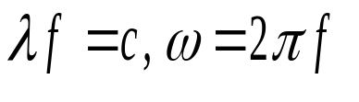
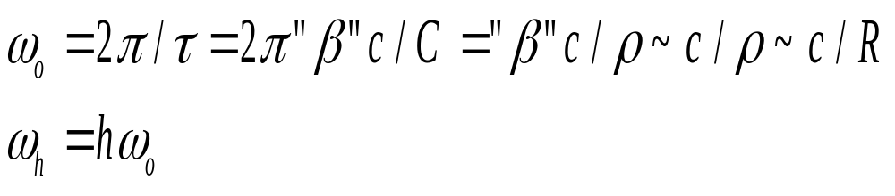

FNAL MR - 1
FNAL MR - 1
Skip directly to the MR. Ignore the Booster injection from the Linac and the extraction and subsequent injection into the MR. For the Booster, the r.f. frequency f_{h} goes from 37 to 53 MHz as the energy goes from 0.4 GeV to 8 GeV.
For simplicity, assume a single accelerating gap per revolution in a circular ring. As the energy increases the r.f. frequency must increase so that as the beam speeds up it continues to see a stable phase of the accelerating voltage on each turn. [Note: physicists cannot “count” above δ, so in SR β and γ are used as well as in Twiss lattice parameter definitions in accelerator conventions α, β, and γ]. Here quotes are used for SR quantities in an attempt to avoid ambiguities but SR is needed.
USPAS - MATLAB Physics

Slide 6


FNAL MR - 2
MR - 2
The rotation frequency is ω_{o}, period τ. The particle velocity is βc. The ring circumference is C, with radius R. The ring is filled with ramping dipoles, with magnetic fields increasing to keep the radius of curvature ρ = R. The r.f. voltage has a frequency ω_{h} which is h times the revolution frequency ω_{o} where h is called the harmonic number. Integer h insures synchronous acceleration at each turn. The MR harmonic number is 1113, R ~ 1 km, τ ~ 21 μs, ω_{o} = 0.3 MHz, ω_{h} = 333 MHz, f_{h} = 53 MHz.
For Vo = 2 MV, Vo/τ ~ 96 GeV/s → a several second ramp up to full energy.
The accelerating voltage is and time = 0 is defined to be when a synchronous particle passes the accelerating gap. The energy gain per turn for the synchronous particle is . There are phases, with associated z positions, near the synchronous phase which experience a restoring force and which form a “bunch” with “phase stability”. However the phase of particles in the “bunch” changes with time as the beam particles execute “synchrotron oscillations”. These oscillations are very slow w.r.t. betatron oscillations.
USPAS - MATLAB Physics

Slide 7
Digression on “Transition”
Digression on “Transition”
The phase range of a stable bunch depends on whether the beam is UR or not. This is not an issue for e beams nor for UR p beams such as the LHC.
The issue will be explored here, but one need not dwell on the details.
After this, the assumption will be that operation is at well above transition.
USPAS - MATLAB Physics

Slide 8
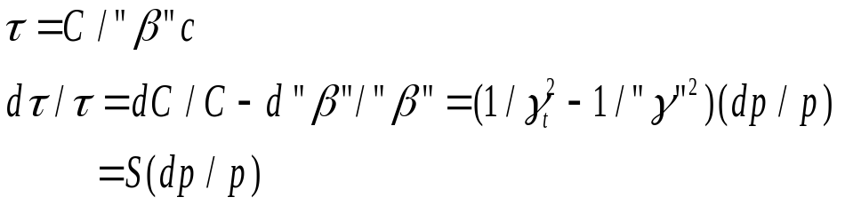
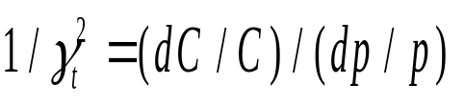
Transition - 2
Transition - 2
As particles are accelerated there are 2 competing effects w.r.t. the r.f. timing. Higher p particles go faster and arrive at the gap earlier, but they also have a longer path because their ρ is larger. That is similar to the dispersion caused by the bending magnets discussed previously.
Far above transition S ~ 1/γ_{t}² and is positive while it is negative below transition. For the FNAL MR, γ_{t} ~ Q_{x}, and is ~ 18.7 at 150 GeV. Since the “slip factor”, S, is the integral around C of η(s)/ρ over ds/C another useful estimate is that S ~ <η>/R which for the MR, with R ~ 1 km and <η> ~ 2.9 m, is ~ 0.0029 ~ 1/(18.7)². The change in period with p is:
USPAS - MATLAB Physics

Slide 9
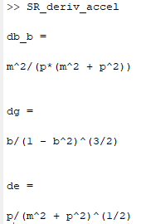
Transition - 3
Transition - 3
The kinematic relationships that are used are easily derived using Matlab symbolic logic and “diff” as in the script “SR_deriv_accel”. Results are shown below, that dβ/β = (1/γ²)(dp/p), dγ/dβ = βγ³, and dε/dp = p/ε.
As the beam is accelerated it can go through “transition” where the 2 competing effects are equal. In what follows the assumption is that the beam is well above transition and that the fractional change in period is proportional to dp/p with a constant proportionality S. These issues are not important in electron machines as they are almost always UR.
USPAS - MATLAB Physics

Slide 10
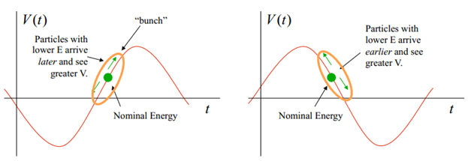
Transition - 4
Transition - 4
Phase Stability above and below transition: Subsequently it will be assumed that operation is well above transition, oscillating about the synchronous phase. In the “bunch” there is a “restoring force” which adds energy to those particles with lower energy and vice-versa.
USPAS - MATLAB Physics

Slide 11
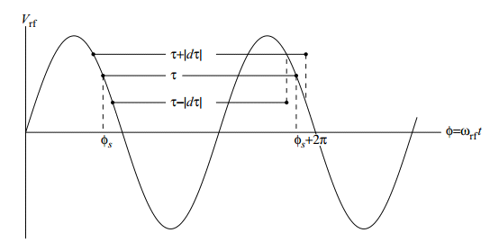
Acceleration of a UR beam
Acceleration of UR Beam
The synchronous particle during acceleration gains an energy ( coasting, ϕ_{s}= 0)
dε_{s} = qeV_{o}sinφ_{s} . Only a fraction of the phase is stable → “buches”
For the MR there are at most h ~ 1100 bunches, spacing ~ 2π m, ~ 21 ns.
Late arrivals get more energy while early get less w.r.t. The synchronous particle –> a 'restoring force” → harmonic motion. The following is just a lot of algebra.
Above transition here
particle in bunch oscillates about synchronous position
USPAS - MATLAB Physics

Slide 12
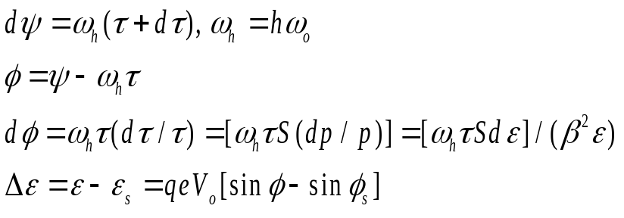
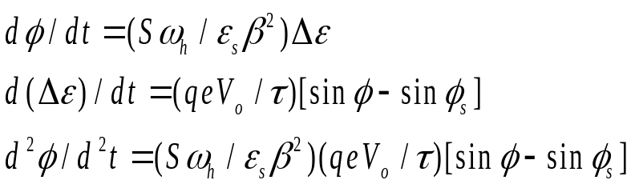
Phase Stable Oscillations
Phase Stable Oscillations
Synchrotron Oscillations:
The r.f. phase change as the period changes is dψ and ϕ subtracts the synchronous phase. The energy gain w.r.t. the synchronous phase is Δε. The phase (early or late) depends on (dp/p). The energy gain is 0 (purely harmonic coasting beam) unless there is a nonzero driving term ϕ_{s ,} dp/p = (dε/ε)/β² .
For the Tevatron at 150 GeV the ratio of synchrotron oscillation frequency to betatron oscillation frequency is about 0.002 which takes many MR turns, so approximate, dt ~ τ.
USPAS - MATLAB Physics

Slide 13
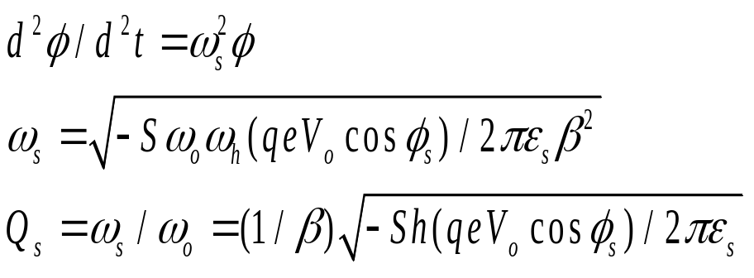
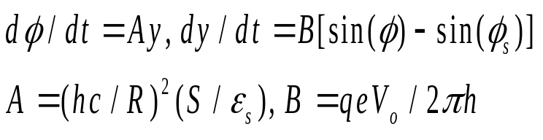
Synchrotron Oscillations
Synchrotron Oscillations
The fact that the oscillation period is >> the rotation period allows us to use t or τ as the variable.
For small angles w.r.t. the synchronous angle there is simple harmonic motion with a synchrotron frequency ω_{s}. The Q_{s} value is normally defined w.r.t. the rotation frequency.
In order to adopt Fermilab conventions, the variables use units eV and sec, B in eV and A in (eVs² )⁻¹ will be used. y = Δε/ω_{h} = [R(cp)/hc](dp/p)
d²ϕ/d²t ~ (AB)ϕ
USPAS - MATLAB Physics

Slide 14
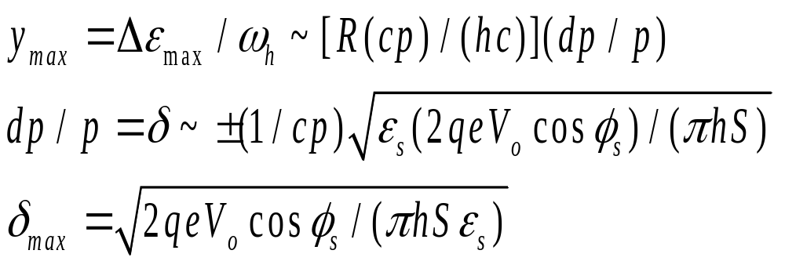
Max dp/p and Acceleration
Max dp/p and Acceleration
A beam can be “coasting” without acceleration.
Under acceleration, there is a maximum value of dp/p which is phase stable.
For small values of φ_{s} the maximum value is :
USPAS - MATLAB Physics

Slide 15
Analogous non-linear System
Another Non-Linear System
Use the App “Phase_Stable_Pend_MRrf”
After all that algebra, take a simple example of a pendulum that can make large angular deviations. The differential equation is non-linear. Explore when the nonlinear deviation sets in. These tend to be very abrupt in general.
For reference, look at the stable phase range, with MR parameters, as a function of the accelerating phase. If there is no acceleration, coasting beam, the phase range approaches π. With acceleration, the stable phase range decreases. Details of this behavior will be explored in a subsequent App.
USPAS - MATLAB Physics

Slide 16
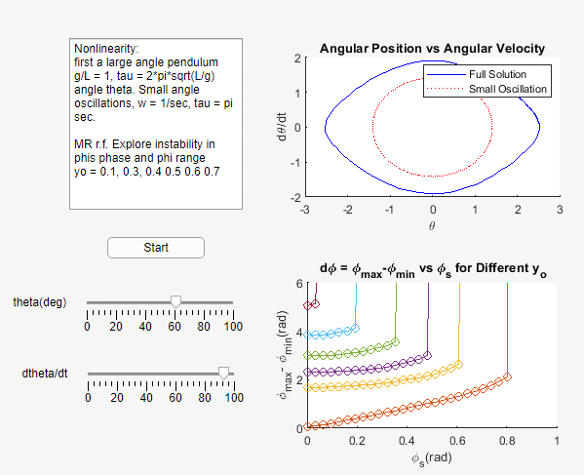
Non Linear Divergence
Non-Linear Divergence
“Phase_Stable_Pend_MRrf”
A mix of a simple pendulum
and MR stability
plots. Under MR
acceleration a reduced
phase range for
stable operation
exists.
USPAS - MATLAB Physics

Slide 17
MR Bucket - 1
MR Bucket
“Bucket_MR_rf”
As in mechanics (pendulum) the system can be described as evolving in time, for example a ballistic trajectory. Or the system can be described as occupying a region of “phase space”, for example position and momentum. Planetary orbits can be described both by radii and energy for example. For acceleration the time evolution of the phase and energy can be explored. An alternative is the phase space of particle phase and energy
An App, “Bucket_MR_rf”, is available to vary the parameters for the FNAL MR as a numerical example after all the mathematical formulae. The constants for the differential equations are, dϕ/dt = Ay, dy/dt = B[sinϕ - sinϕ_{s}], A = (hc/R)²(S/ε_{s}) = 2125/eVs² and B = qeV_{o}/2πh = 286 eV assuming UR operation. In those terms, ω_{syn} = √AB = 780 Hz and y_{max} = π√B/A = 0.734 eVs. The maximum fractional momentum which is stably captured with no net acceleration is 0.26 %.
USPAS - MATLAB Physics

Slide 18
MR Bucket - 2
MR Bucket - 2
The initial value of y and the synchronous phase are chosen by “Slider”. The full non-linear equations of motion are solved using the MATLAB utility “ode45”. The maximum and minimum values of y and ϕ and the momentum acceptance are displayed using “EditFields”. Plots of y and ϕ as a function of time are displayed as well as the contour of allowable values.
The user can also explore the regions of instability where particles would be lost from the r.f. bunch as a function of both synchronous phase and momentum acceptance. The physical bunch length corresponds to an r.f. phase acceptance of at most π. An output of the App appears in a case where the solution is stable and harmonic. In this specific case the phase range is 0.74π. The contours of the stability region were already shown in the previous App ( “Phase_Stable_Pend_MRrf”). As the accelerating phase ϕ_{s} increases, the stable phase range, the y range ( the dp/p acceptance) both decrease.
USPAS - MATLAB Physics

Slide 19
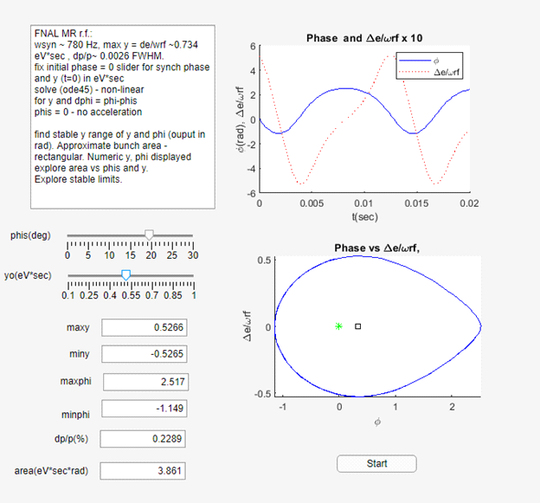
MR Bucket - 3
MR Bucket - 3
App for MR stable
operation use “sliders”
to choose accelerating
phase and y, (dp/p).
Display max/min y and
max/min phase ϕ range
USPAS - MATLAB Physics

Slide 20
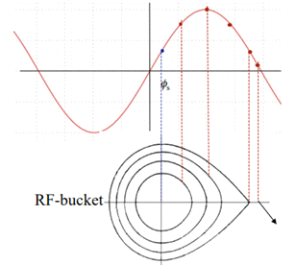
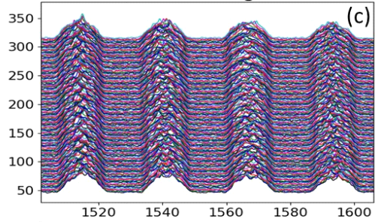
MR Bucket - 4
MR Bucket - 4
For the MR the r.f. frequency is f_{h} = 53 MHz with a wavelength of 5.66 m and a period of 18.9 ns. The maximum bunch with dϕ ~ π. may be at most 9.4 ns long or 2.8 m. The bunch length in general is proportional to the momentum acceptance of the bunch. Bunches with smaller momentum spread will have smaller bunch sizes. These bunch lengths are a bit long for a stripline. For electron machines or linear accelerators, shorter bunch lengths may be encountered. The Booster, shown here has f_{h} = 37 MHz, 27 ns period.
USPAS - MATLAB Physics

