Slide 1
Lecture 4: Symbolic Algebra, Dispersion Matching, Coupled Oscillators,
J. Eldred
MATLAB/Python for Accelerators
February 7-18 2020

Slide 2
2
2
Dispersion-Matching
2
Jeffrey Eldred | MATLAB/Python for Accelerators
Notes:
2
2
2
2
2
2

Slide 3
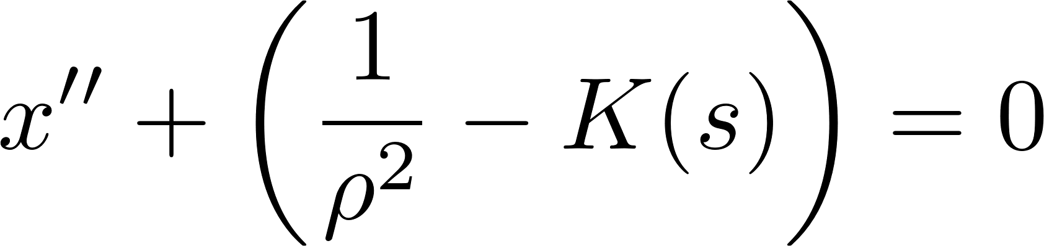
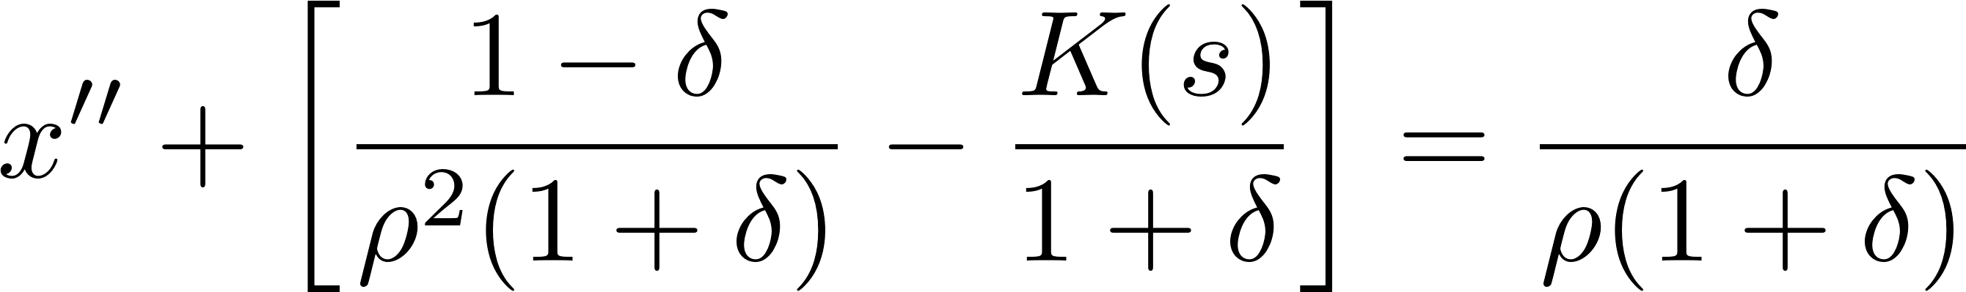
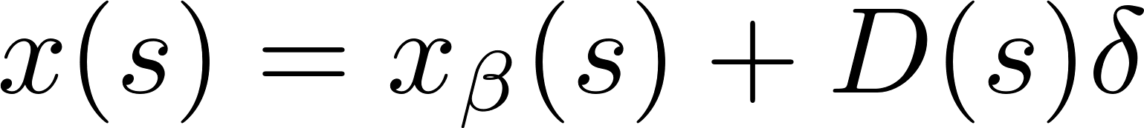
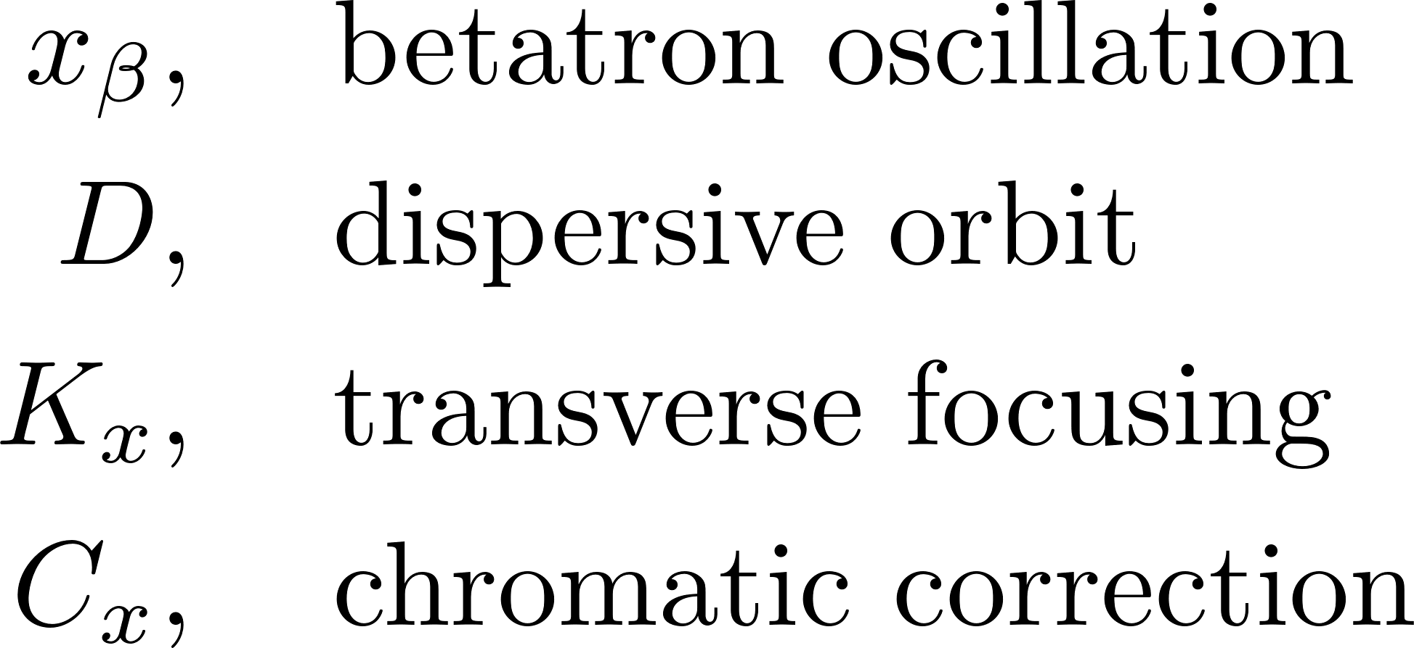
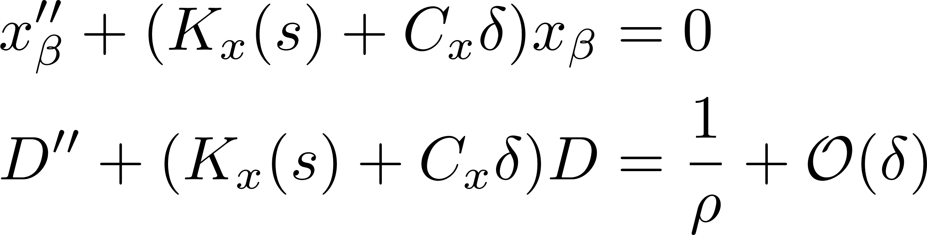
3
Transverse Focusing with Off-Momentum Terms
Hill’s equation can be derived from the Hamilitonian for relativistic co-moving electromagnetic particles in Frenet-Serret coordinates under linear transverse magnetic fields:
With the lowest order perturbation in δ (the fractional deviation from momentum p₀)
Hill’s equation instead becomes:
The solution to this equation can be expressed:
3
Classical Mechanics and Electromagnetism | January 2021 USPAS
Notes:
3
3
3

Slide 4
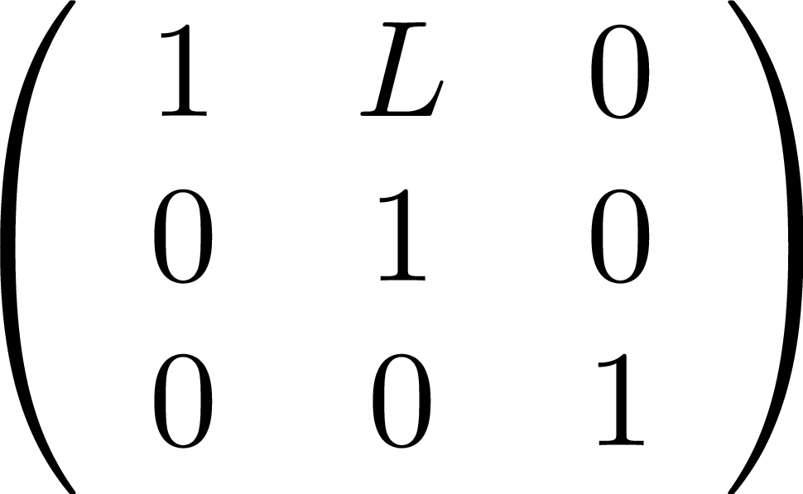
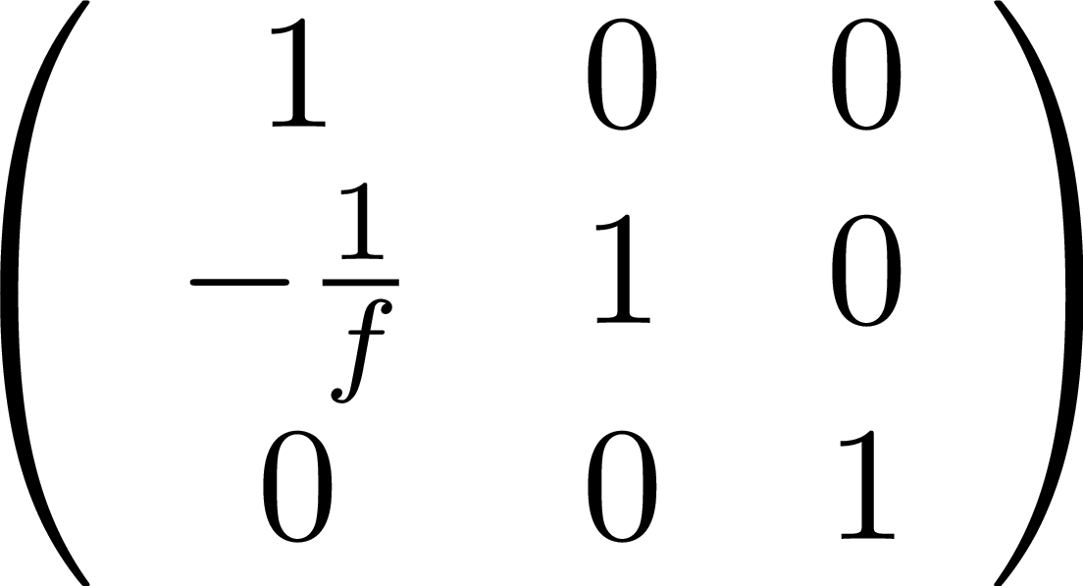
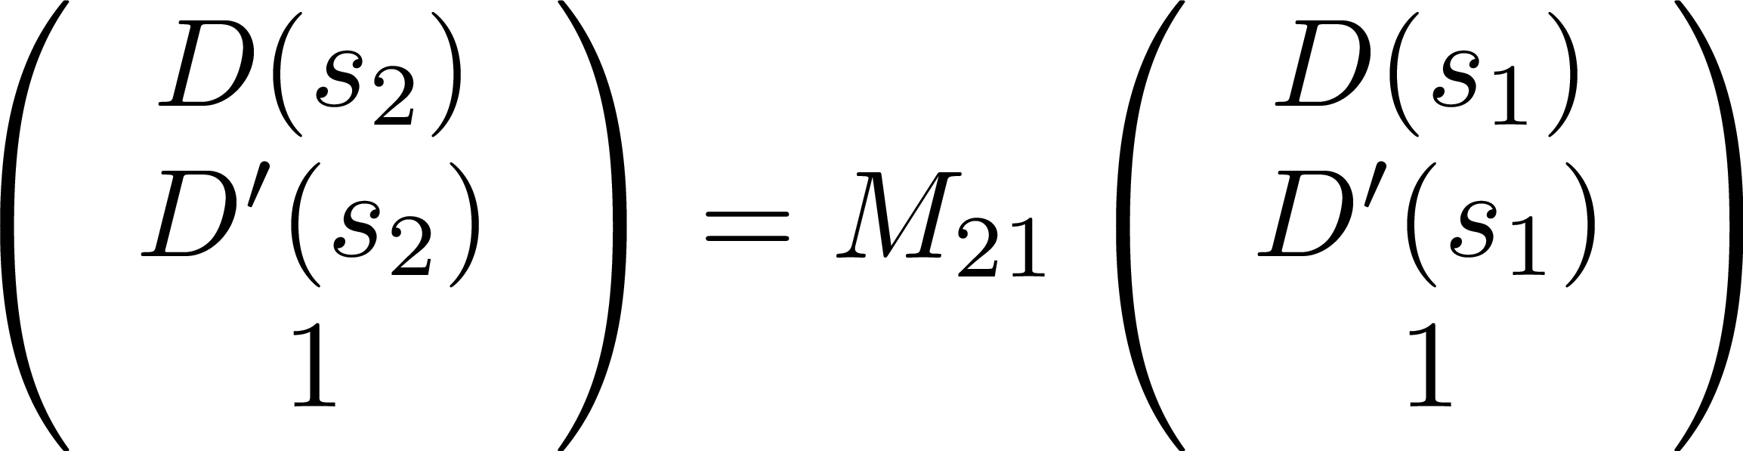
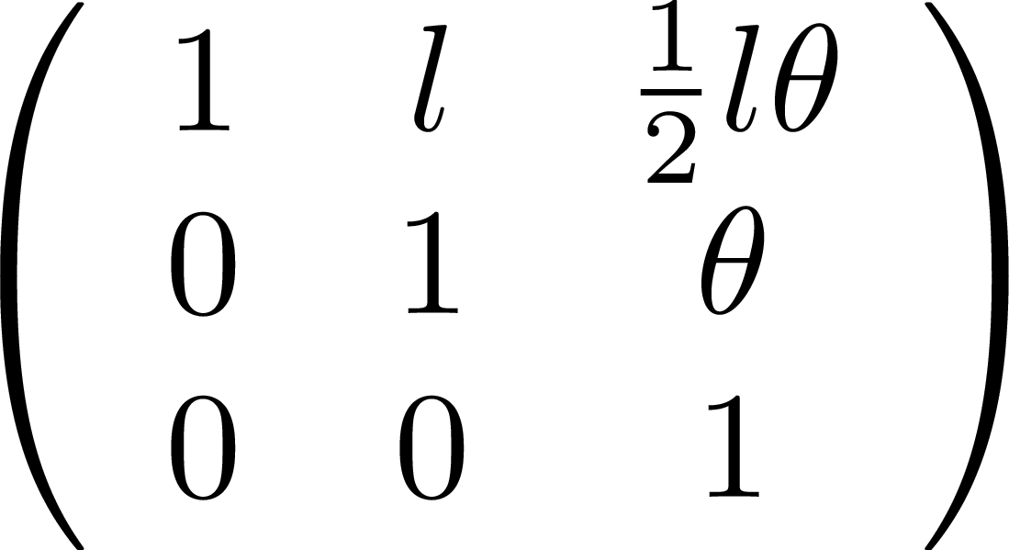
4
Dispersive Transfer Matrices
Dispersive Transfer matrices are 3x3 and propagate the 3x1 Dispersion vector:
Drift:
Thin quad:
Weak dipole:
4
Classical Mechanics and Electromagnetism | January 2021 USPAS
Notes:
4
4
4

Slide 5
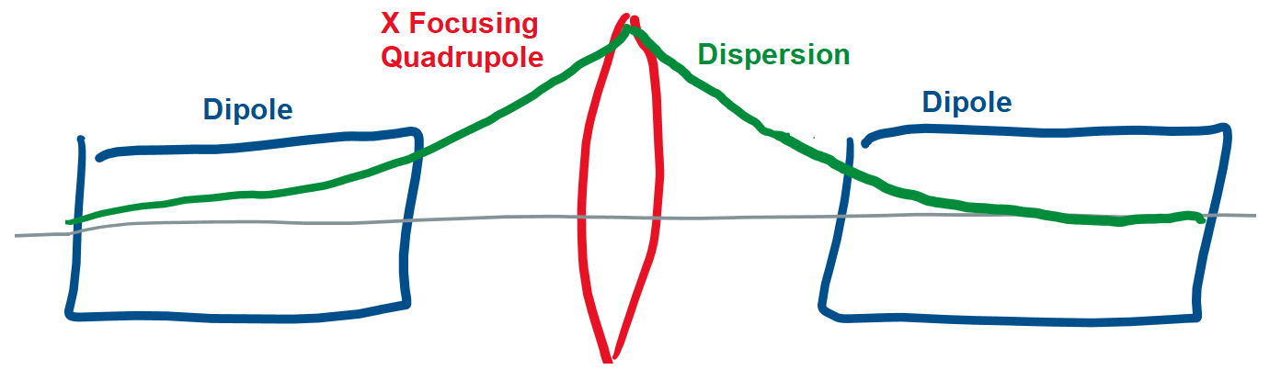
5
Chasman–Green Double-Bend Achromat
Only dipoles generate dispersion, so assume dispersion in the lattice outside of achromatic cell is zero (D=0, D’=0).
Once dispersion exists a horizontally focusing quadrupole can kick it, just as it would restore any other particle with a deviating horizontal orbit.
If the quad kick is perfect, the exit dipole will cancel out the dispersion in a mirror image of the entry dipole which generated the dispersion.
To find the necessary quad kick, multiply a zero dispersion vector by the dispersive transfer matrices for these five elements and find what value f1 and L1 need to be in order for the exit dispersion vector to also be zero.
5
Classical Mechanics and Electromagnetism | January 2021 USPAS
Notes:
5
5
5

Slide 6
6
6
Coupled Oscillators
6
Jeffrey Eldred | MATLAB/Python for Accelerators
Notes:
6
6
6
6
6
6

Slide 7

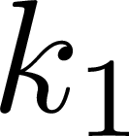
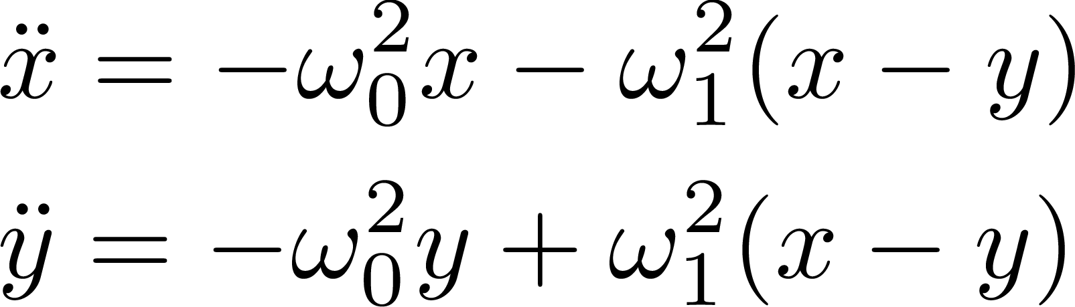
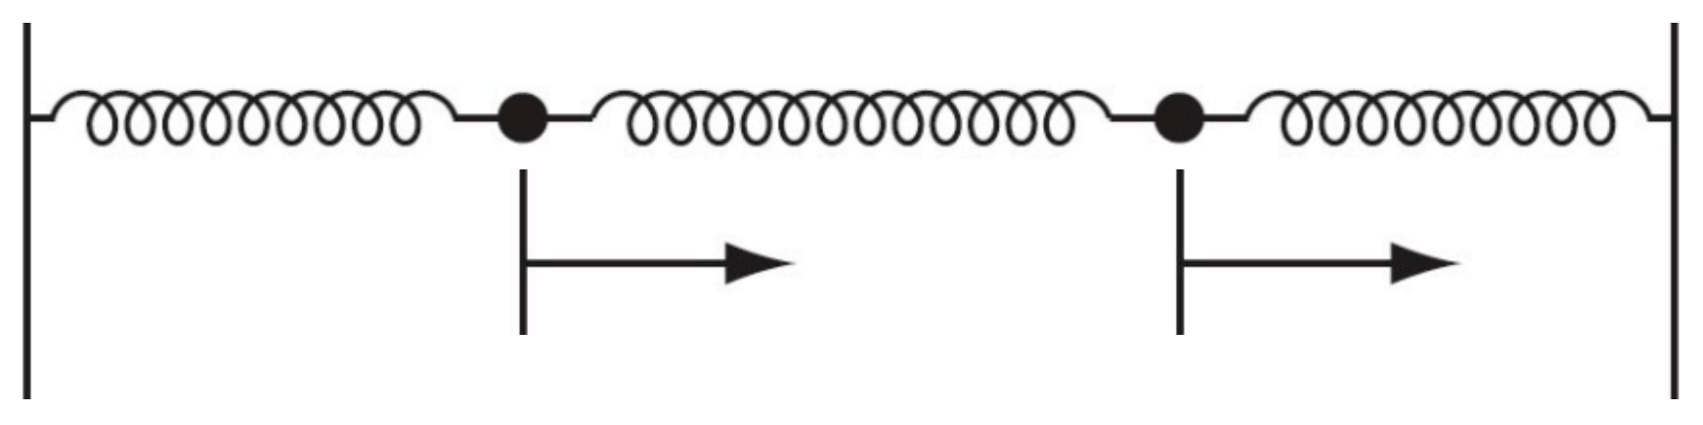


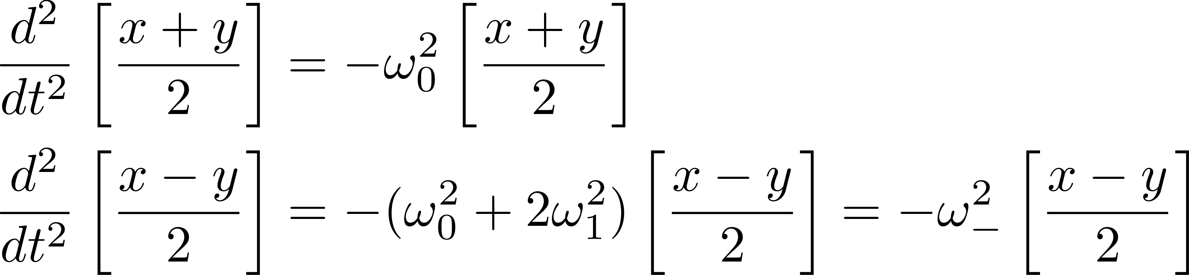
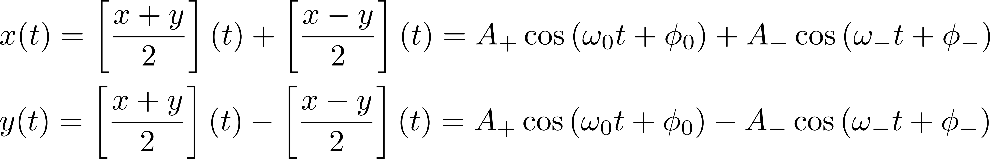
7
Coupled Oscillators
Two oscillators, with some coupling force between them.
By taking linear combinations, we can find independent modes:
Once we solve the mode, we can then transform back to the original:
7
Jeffrey Eldred | MATLAB/Python for Accelerators
Notes:
7
7
7

Slide 8

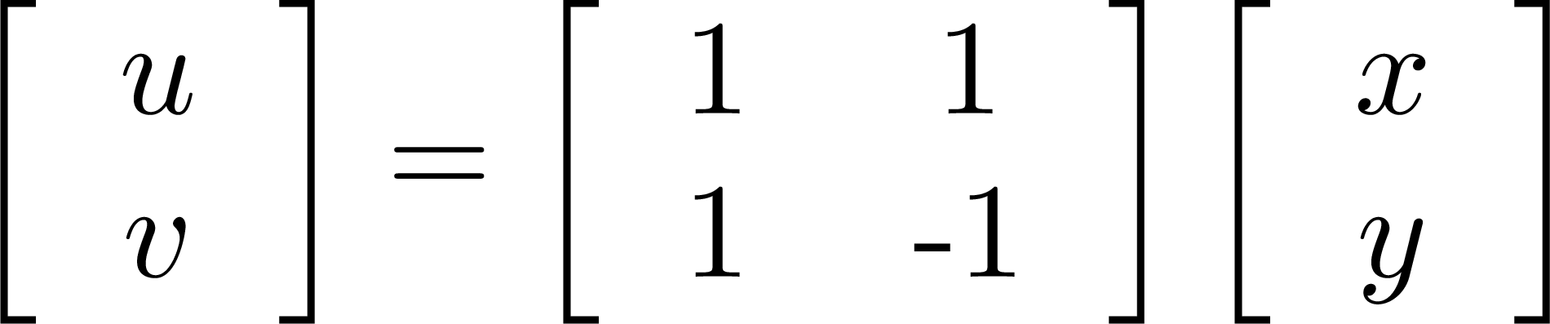
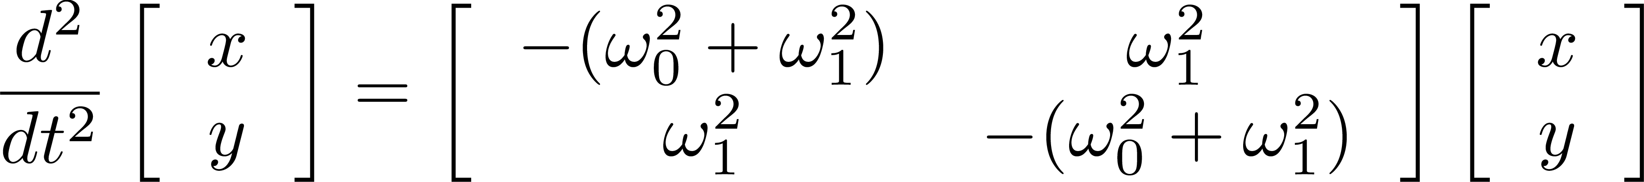
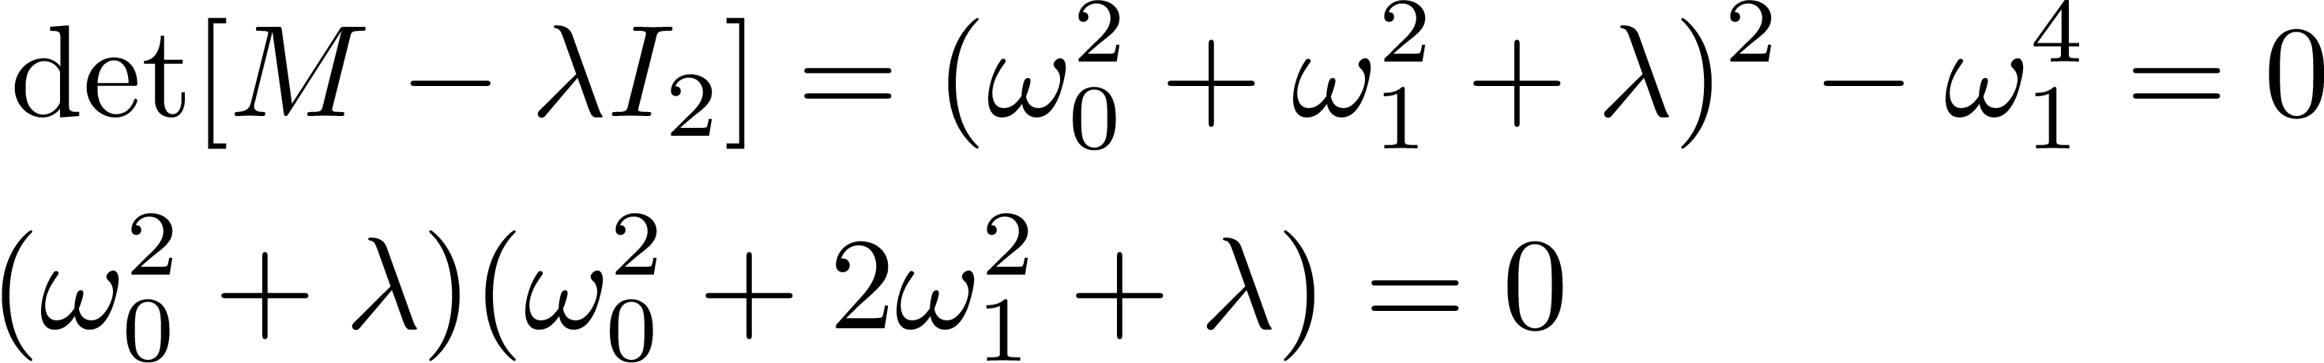
8
Coupled Oscillators (cont.)
How to obtain these modes? Diagonalization of a matrix representation.
Matrix Representation
Eigenvalues
Eigenvectors
8
Jeffrey Eldred | MATLAB/Python for Accelerators
Notes:
8
8
8

Slide 9
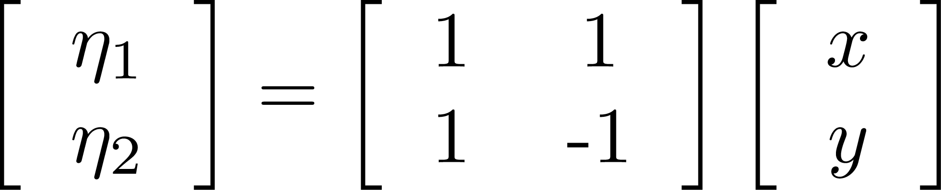
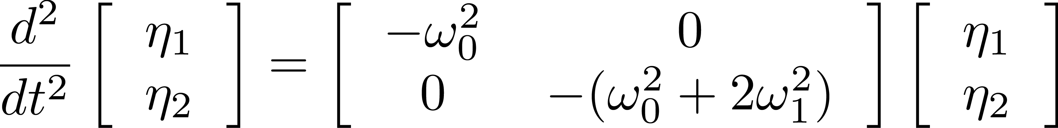
9
Coupled Oscillators (cont.)
How to obtain these modes? Diagonalization of a matrix representation.
Matrix Representation
Eigenvectors
Diagonalization
9
Jeffrey Eldred | MATLAB/Python for Accelerators
Notes:
9
9
9

Slide 10
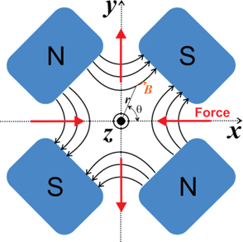
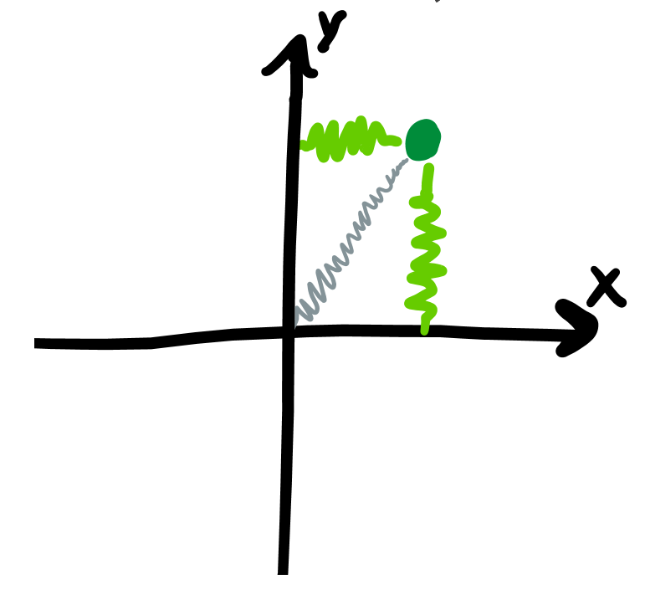
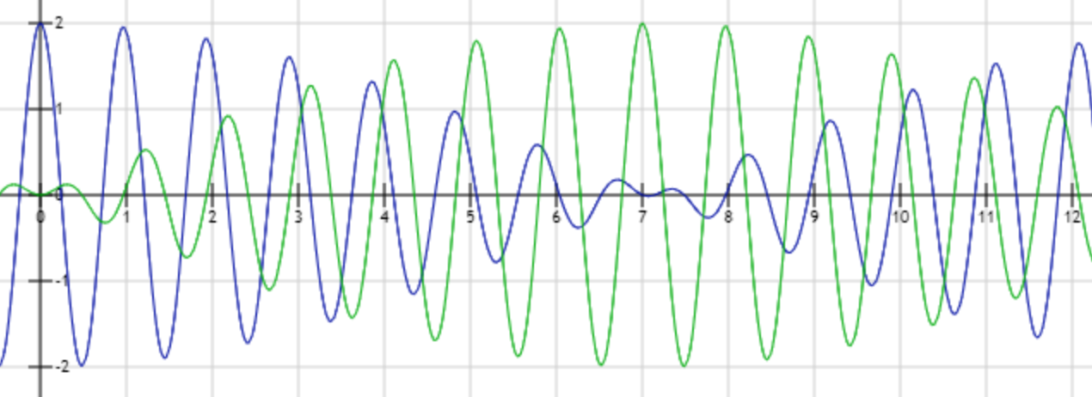
10
Coupled Oscillators in Accelerators
Most accelerators are formally designed with independent focusing in the horizontal and vertical plane. In practice, there is usually coupling.
10
Jeffrey Eldred | MATLAB/Python for Accelerators
Notes:
10
10
10

