Slide 1
Final Projects
J. Eldred
MATLAB/Python for Accelerators
February 7-18 2020

Slide 2
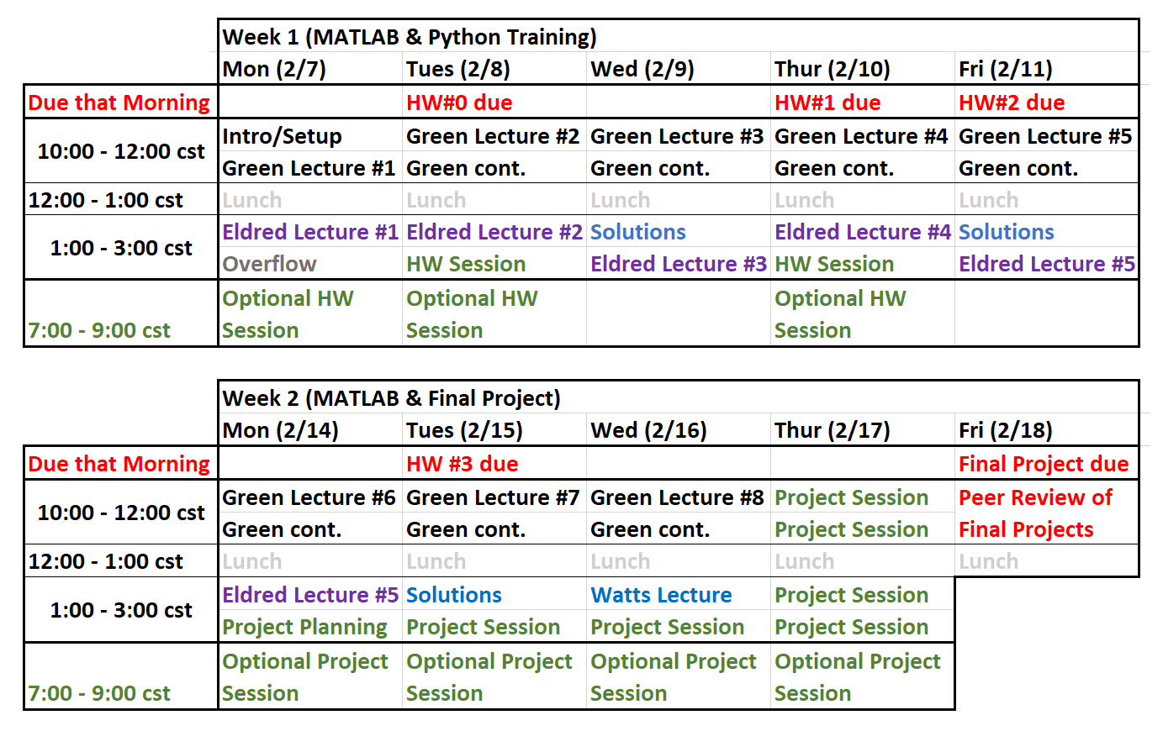
2
Current Schedule
2
Classical Mechanics and Electromagnetism | January 2021 USPAS
Notes:
2
2
2

Slide 3
3
Final Projects
Final Project
By Friday 10am cst you should commit to your individual folder:
- Well-commented ready-to-execute code
- Any plots or outputs you would like to include.
10-noon cst, 5 minute Presentations
So when am I done?
- Last class lecture is Wednesday afternoon
- Turn in your final project by 10cst.
- On Friday morning 5min Presentations
3
Classical Mechanics and Electromagnetism | January 2021 USPAS
Notes:
3
3
3

Slide 4
4
5 min Video Presentation
With your final project, you will present 5 minute video.
The video doesn’t have to be perfectly polished and you don’t have to provide any more insight than what is already there in your code/output. But this is your opportunity to explain what you worked on and how it works.
4
Classical Mechanics and Electromagnetism | January 2021 USPAS
Notes:
4
4
4

Slide 5
5
Final Project Grading Criteria
Completeness
- Does the script run? Does the project make sense to me?
Outputs
- Do you produce good plots and/or outputs? Can I see the result of your work?
Clarity
- Is the code well-commented and organized? Can I understand it by reading it?
Programming
- Did you use what we learned past day 2? How advanced is the project?
Analysis
- Did you vary the parameters/technique? Did you seek to understand?
Bonus:
- Did you go beyond the class? Do something I found impressive?
Presentation
5
Classical Mechanics and Electromagnetism | January 2021 USPAS
Notes:
5
5
5

Slide 6
6
Some Past “A+” Projects
Ensemble of Particles in a Synchrotron Oscillation
- Generate a 2D Truncated Gaussian distribution of particles, 2D histrogram.
- Symplectic tracking for each particle undergoing synchrotron oscillation.
- Provide an example with a mismatched injection and one with changing V.
- Produce 2D animations and 1D plots of the results.
Channeling Electrons in a Crystal Lattice
- Make a 2D grid of circular atoms and a track the 2D trajectory of an electron.
- When the electron comes close enough to an atom, give it a random impact parameter and a new trajectory corresponding to Rutherford scattering.
- Simulate an initial distribution of electron trajectories and the outgoing trajectories.
6
Classical Mechanics and Electromagnetism | January 2021 USPAS
Notes:
6
6
6

Slide 7
7
Some Past “A+” Projects
Optimizing a Bunch-Compressor Chicane
- Take elements from a proposed upgrade to a real electron beamline.
- Vary and optimize those elements to achieve desired optics objectives.
- Take into account some reasonable limits in length, component strength.
- Compare to that performance to original beamline.
Design of a Simple Wire Octupole
- Take the four-wire dipole example and instead make an eight-wire octupole.
- Consider the effect of errors, such as misaligned orbit or misplaced wire.
- Show the effect of errors on dipole, quadrupole, sextupole, octupole fields.
7
Classical Mechanics and Electromagnetism | January 2021 USPAS
Notes:
7
7
7

Slide 8
8
Some Past “B” Projects
Random Walk Stock Market
- Simulate a stocks each with a series of random Gaussian kicks.
- Create a GUI to track a wallet, specify which stock buy or sell, advance time.
- Limitation: Not very STEM-oriented, all stocks are the same, no analysis.
- Advice: If you are done early, ask how you can push it further.
Proton Dose Delivery
- Simulate a radiation therapy schedule by starting with a target delivery area, then a series of proton beams of different energies to cover that area, and calculate the integrate dose to the target delivery area.
- Limitation: Great idea for a project, but not executed. Drew a 3D box and a 3D trajectory, but no Bragg peak or dose integrating in there. Too ambitious.
- Advice: Start small, focus on delivering the core of the project.
Synchrotron Form Factors
- Make 1D plots of formula for a synchrotron form factors.
- Limitation: Not enough depth there, no analysis or advanced technique.
8
Classical Mechanics and Electromagnetism | January 2021 USPAS
Notes:
8
8
8

Slide 9
9
Where to get project ideas?
1. MATLAB, Python, and Homework scripts
- Is there a particular example or homework that speaks to you and that you’d like to do a more advanced version of?
- Can you combine what you know from two different examples/homeworks?
2. Catching up on Work
- Is there something you’d like to do for work/study/research anyway?
- If not, what is basic physics taking place where you work and can you make an oversimplified model of it?
3. Learn something new
- Did you want to use something you learned in another class?
- Something you want to learn about, such as loess smoothing or ICA algorithms.
4. Adam, Dan, and I can help
9
Classical Mechanics and Electromagnetism | January 2021 USPAS
Notes:
9
9
9

