Slide 1
Final Projects
J. Eldred
MATLAB/Python for Accelerators
February 7-18 2020

Slide 2
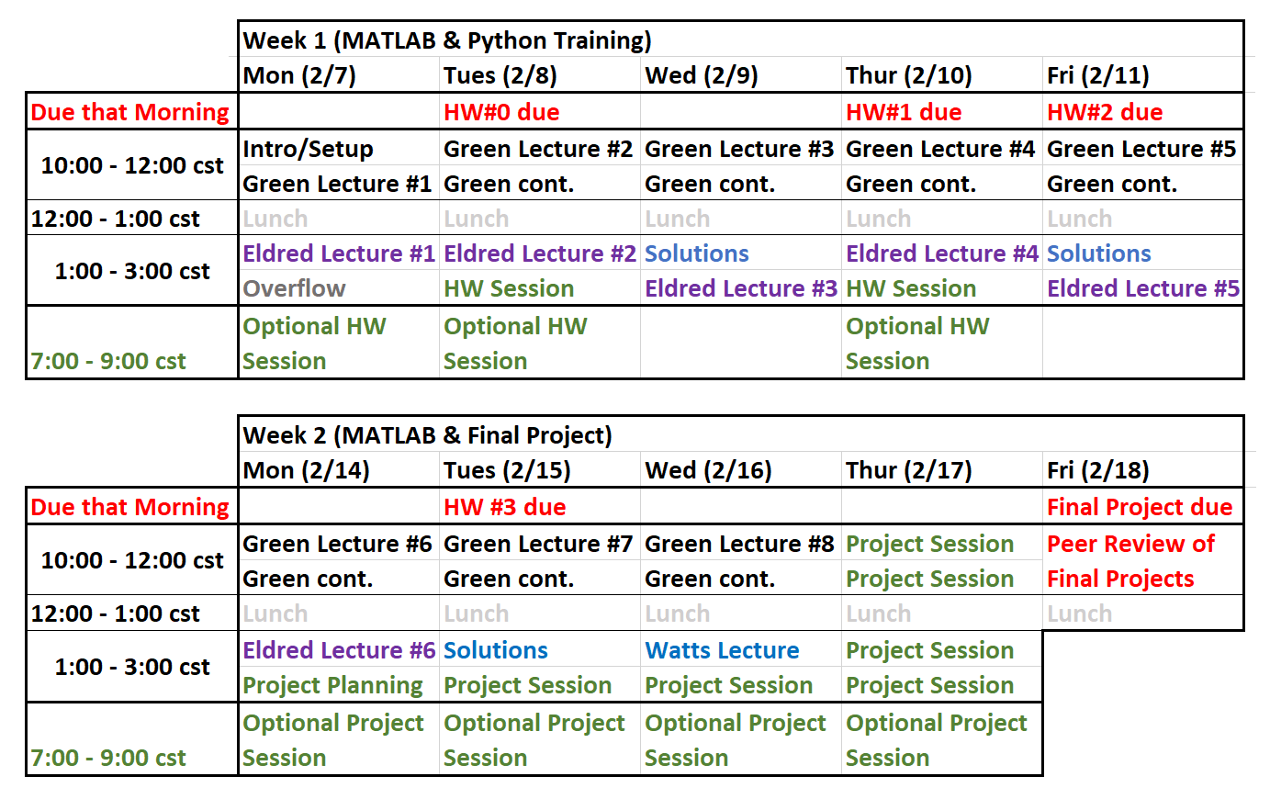
2
Current Schedule
2
Classical Mechanics and Electromagnetism | January 2021 USPAS
Notes:
2
2
2

Slide 3
3
Final Projects
Final Project
By Friday 10am cst you should commit to your individual folder:
- Well-commented ready-to-execute code
- Any plots or outputs you would like to include.
- A video up to 5 minutes explaining your project.
Peer-Review Sessison
- Between 10am and noon cst, take a moment to look at others student’s projects.
- Turn in a bulletpoint list of 10-20 comments, showing evidence of having seen at least five different presentation (think book report).
- Your comments will not be used in grading other student’s work.
So when am I done?
- Last class lecture is Wednesday afternoon
- Turn in your final project by 10cst.
- On Friday morning Peer-Review Session.
3
Classical Mechanics and Electromagnetism | January 2021 USPAS
Notes:
3
3
3

Slide 4
4
5 minute Video Presentation
With your final project, you will record a 5 minute video.
The easiest way to do that will be to go into an empty Zoom room by yourself, hit the record button at the bottom, and do a screen share while you walk through your code and its output explaining what you did.
The video doesn’t have to be perfectly polished and you don’t have to provide any more insight than what is already there in your code/output. But this is your opportunity to explain what you worked on and how it works.
My advice is not to do any more than two “takes” and not to worry about it too.
4
Classical Mechanics and Electromagnetism | January 2021 USPAS
Notes:
4
4
4

Slide 5
5
Peer Review Session
Everyone is supposed to turn in their final projects at 10am cst.
At that time I will move a copy of everyone’s final projects to a public repository folder. Which you can then download. I estimate that will take about 15 minutes.
Then from 10am to noon cst will be a virtual poster session. You should look through, read some other people’s codes, watch some of their videos. You can comment on the Discord chat and give them immediate feedback, but you don’t have to. Do take the opportunity to learn from each other!
I do want you to make a short report on what you saw and learned, and commit it to the repository. It can be a bulletpoint list or it can a few short paragraphs no more than a page. Provide comments – things you liked, state the project in your own words, ways the project could be expanded, whether it reminded you of something from class or work, something you didn’t understand about it etc.
There should be somewhere between 10-20 comments and they should provide commentary on at least five different presentations. You don’t have to be particularly insightful and you don’t have to worry about your comments affecting their grade.
5
Classical Mechanics and Electromagnetism | January 2021 USPAS
Notes:
5
5
5

Slide 6
6
Final Project Grading Criteria
Completeness
- Does the script run? Does the project make sense to me?
Outputs
- Do you produce good plots and/or outputs? Can I see the result of your work?
Clarity
- Is the code well-commented and organized? Can I understand it by reading it?
Programming
- Did you use what we learned past day 2? How advanced is the project?
Analysis
- Did you vary the parameters/technique? Did you seek to understand?
Bonus:
- Did you go beyond the class? Do something I found impressive?
Participation in Peer-Review Session
Completion of a Video Presentation
6
Classical Mechanics and Electromagnetism | January 2021 USPAS
Notes:
6
6
6

Slide 7
7
Some Past “A+” Projects
Ensemble of Particles in a Synchrotron Oscillation
- Generate a 2D Truncated Gaussian distribution of particles, 2D histrogram.
- Symplectic tracking for each particle undergoing synchrotron oscillation.
- Provide an example with a mismatched injection and one with changing V.
- Produce 2D animations and 1D plots of the results.
Channeling Electrons in a Crystal Lattice
- Make a 2D grid of circular atoms and a track the 2D trajectory of an electron.
- When the electron comes close enough to an atom, give it a random impact parameter and a new trajectory corresponding to Rutherford scattering.
- Simulate an initial distribution of electron trajectories and the outgoing trajectories.
7
Classical Mechanics and Electromagnetism | January 2021 USPAS
Notes:
7
7
7

Slide 8
8
Some Past “A+” Projects
Optimizing a Bunch-Compressor Chicane
- Take elements from a proposed upgrade to a real electron beamline.
- Vary and optimize those elements to achieve desired optics objectives.
- Take into account some reasonable limits in length, component strength.
- Compare to that performance to original beamline.
Design of a Simple Wire Octupole
- Take the four-wire dipole example and instead make an eight-wire octupole.
- Consider the effect of errors, such as misaligned orbit or misplaced wire.
- Show the effect of errors on dipole, quadrupole, sextupole, octupole fields.
8
Classical Mechanics and Electromagnetism | January 2021 USPAS
Notes:
8
8
8

Slide 9
9
Some Past “B” Projects
Random Walk Stock Market
- Simulate a stocks each with a series of random Gaussian kicks.
- Create a GUI to track a wallet, specify which stock buy or sell, advance time.
- Limitation: Not very STEM-oriented, all stocks are the same, no analysis.
- Advice: If you are done early, ask how you can push it further.
Proton Dose Delivery
- Simulate a radiation therapy schedule by starting with a target delivery area, then a series of proton beams of different energies to cover that area, and calculate the integrate dose to the target delivery area.
- Limitation: Great idea for a project, but not executed. Drew a 3D box and a 3D trajectory, but no Bragg peak or dose integrating in there. Too ambitious.
- Advice: Start small, focus on delivering the core of the project.
Synchrotron Form Factors
- Make 1D plots of formula for a synchrotron form factors.
- Limitation: Not enough depth there, no analysis or advanced technique.
9
Classical Mechanics and Electromagnetism | January 2021 USPAS
Notes:
9
9
9

Slide 10
10
Where to get project ideas?
1. MATLAB, Python, and Homework scripts
- Is there a particular example or homework that speaks to you and that you’d like to do a more advanced version of?
- Can you combine what you know from two different examples/homeworks?
2. Catching up on Work
- Is there something you’d like to do for work/study/research anyway?
- If not, what is basic physics taking place where you work and can you make an oversimplified model of it?
3. Learn something new
- Did you want to use something you learned in another class?
- Something you want to learn about, such as loess smoothing or ICA algorithms.
4. Adam, Dan, and I can help
10
Classical Mechanics and Electromagnetism | January 2021 USPAS
Notes:
10
10
10

