Slide 1
Lecture 5: Nonlinear Optimization
J. Eldred
MATLAB/Python for Accelerators
February 7-18 2020

Slide 2
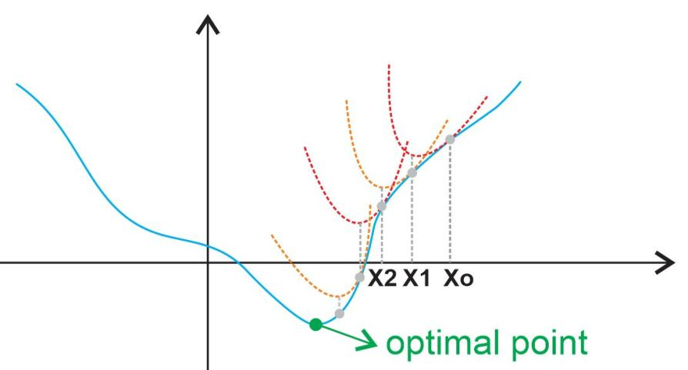
2
“Newton” or “Gradient” Methods
1. Estimate the local first and second-order gradients by sampling nearby points.
2. Proceed towards the local minimum of that parabola.
3. Repeat
2
Jeffrey Eldred | MATLAB/Python for Accelerators
Notes:
2
2
2

Slide 3
3
“Simplex” or “Nelder-Mead” Methods
1. Create a nD polygon.
2. Lose the weakest point in the polygon.
3. Gain a point directly opposite.
4. Without a clear direction, shrink the size of the polygon.
3
Jeffrey Eldred | MATLAB/Python for Accelerators
Notes:
3
3
3

Slide 4
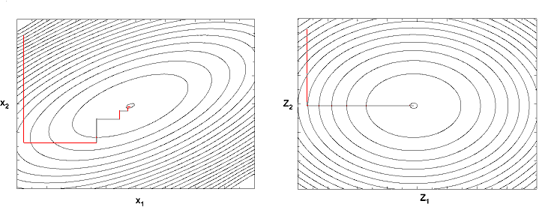
4
“Powell” or “Conjugate Direction” Methods
1. Sample a point or along a line in each direction.
2. Move to the best point sampled.
3. Shrink if the center point is the best.
4
Jeffrey Eldred | MATLAB/Python for Accelerators
Notes:
4
4
4

Slide 5
5
A Brief List of Other Methods
Particle Swarm Methods.
Simulated Annealing
Multi-objective Genetic Algorithms.
Gaussian-process or Bayesian Models.
Neural-network enhancements.
Some of these methods are appropriate for multi-objective problems, especially complex optimization spaces, when global maximum has a high value relative to computing power, when each optimization step is computationally intensive.
This is an active field of research!
5
Jeffrey Eldred | MATLAB/Python for Accelerators
Notes:
5
5
5

Slide 6
6
Dimensionality Reduction
Sampling ten points along each of four variables is one thing, but what about sampling ten points along each of twenty variables. That’s 10^16 as many points!
If two variables have exactly or essentially the same effect, you are losing a factor of 10 efficiency for essentially no benefit!
If you know one variable needs to take a precise value in relation to other variables, don’t let it vary randomly, just calculate it.
If there is a fundamental symmetry to the problem, find a way to incorporate that into your solver so it doesn’t spend time redundantly.
If you are interested in many different parameters, consider ways to break up the problem into several small problems or apply your constraints in the right order.
Bottom line: Any insight you have can be incorporated to achieve a more computationally efficient result.
6
Jeffrey Eldred | MATLAB/Python for Accelerators
Notes:
6
6
6

