Slide 1
Modern Statistics for Modern Biology
Susand Holmes & Wolfgang Huber
Chapter 2 background material

Slide 2
Conditional probability
Bayes theorem
Residuals
Hat
MLE
Log rules
Differentiation rules
Regression
Residuals
phat We put a hat over the letter to remind us that this is not (necessarily) the underlying true value, but an estimate we make from the data
overline
Matrix multiplication

Slide 3
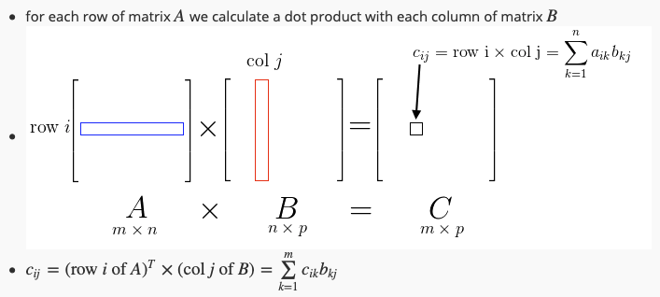
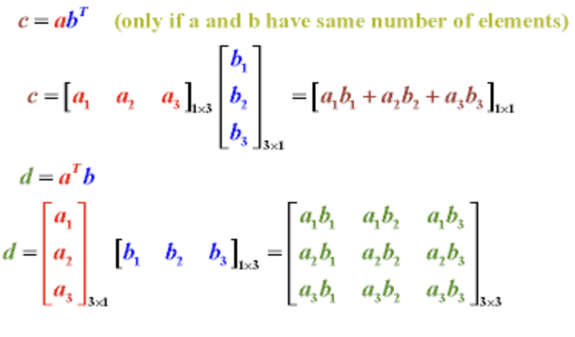
Inner product
Dot product
Dot product of two matrices
c=a^{T}b
Outer product
d=ab^{T}

Slide 4
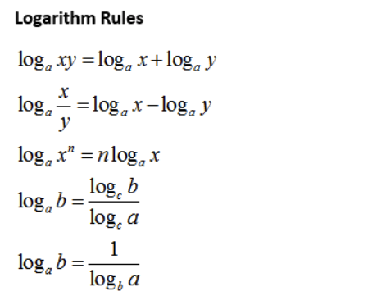
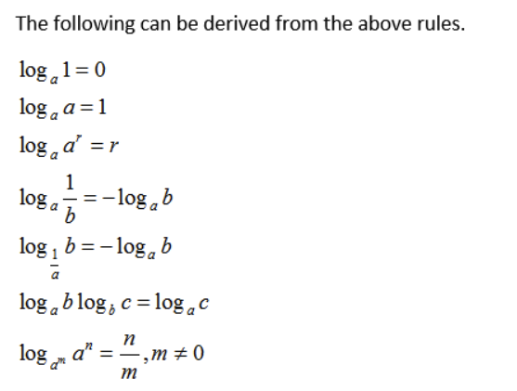

Slide 5
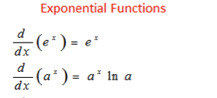

https://www.onlinemathlearning.com/derivative-rules.html

Slide 6
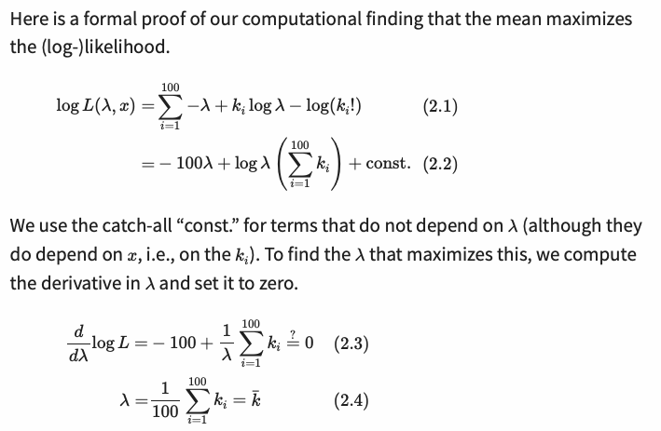
Proof that the mean of the Poisson distribution maximises the likelihood:
…. A more detailed working out is on the next slide….

Slide 7
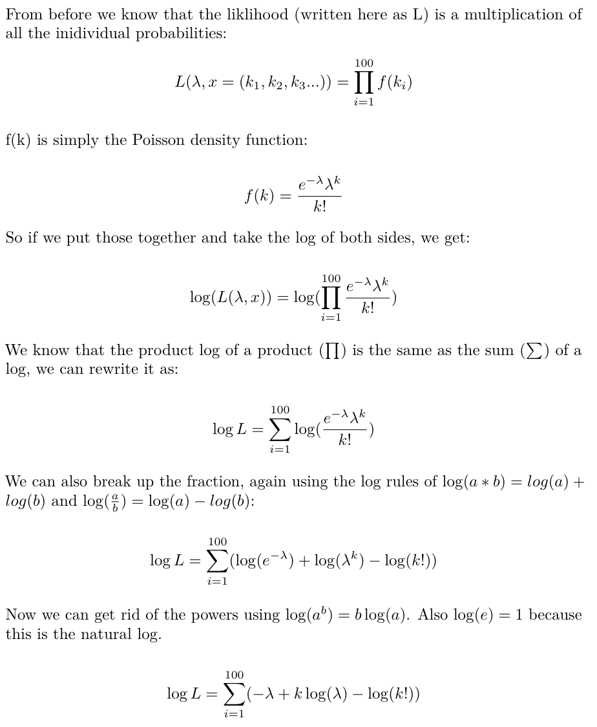
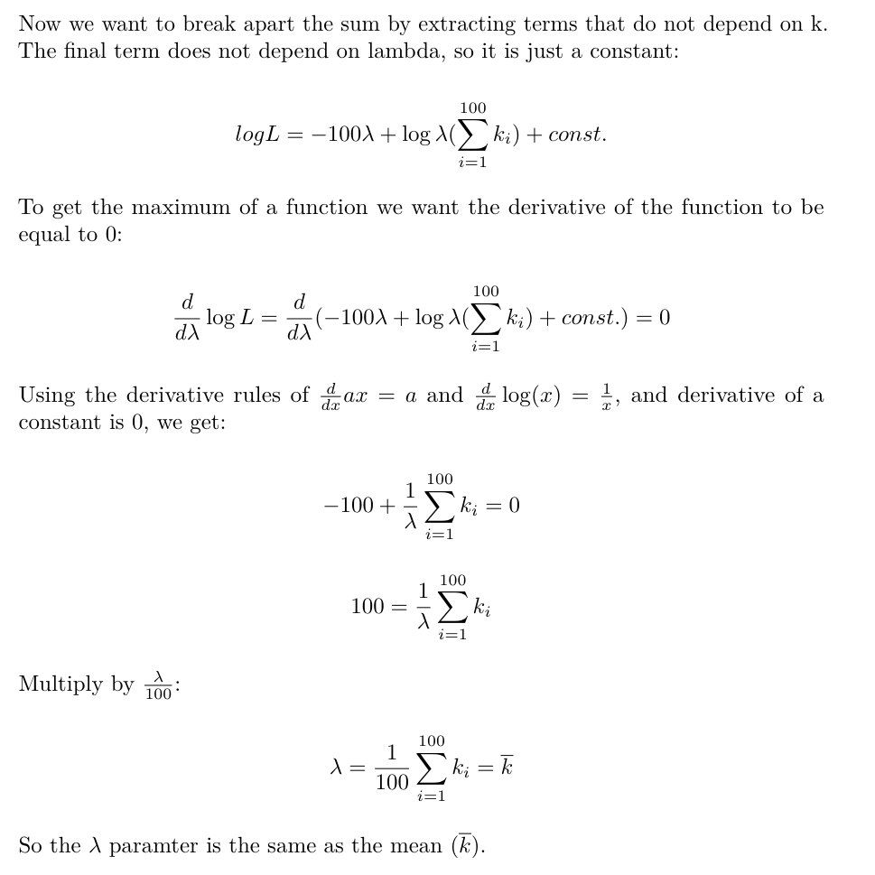
Proof that the mean of the Poisson distribution maximises the likelihood:

Slide 8
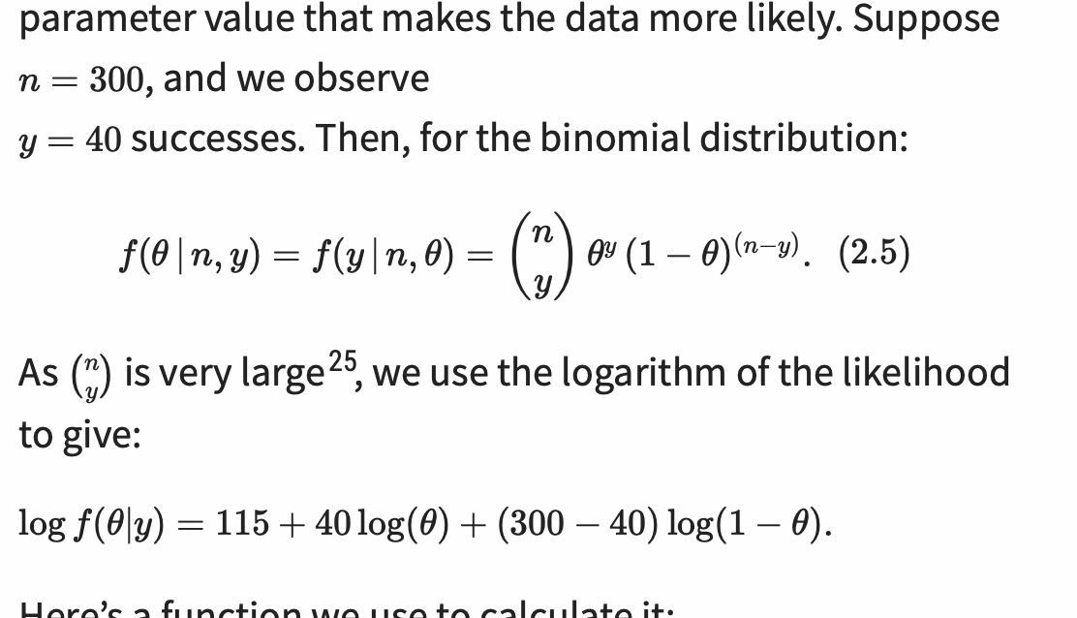
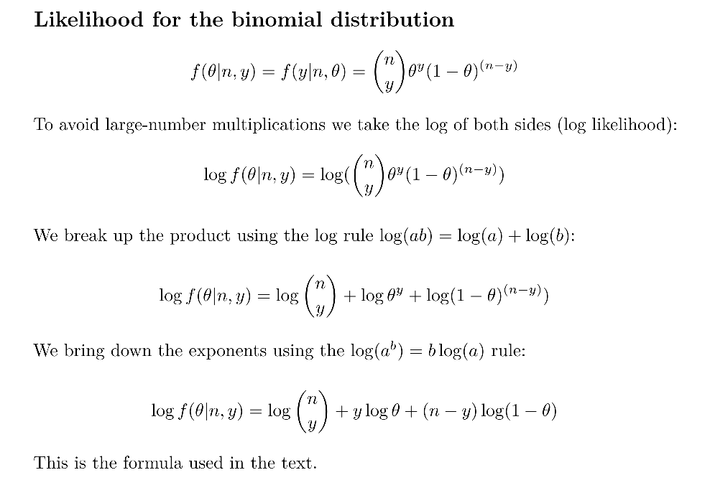
Likelihood for the binomial distribution

Slide 9
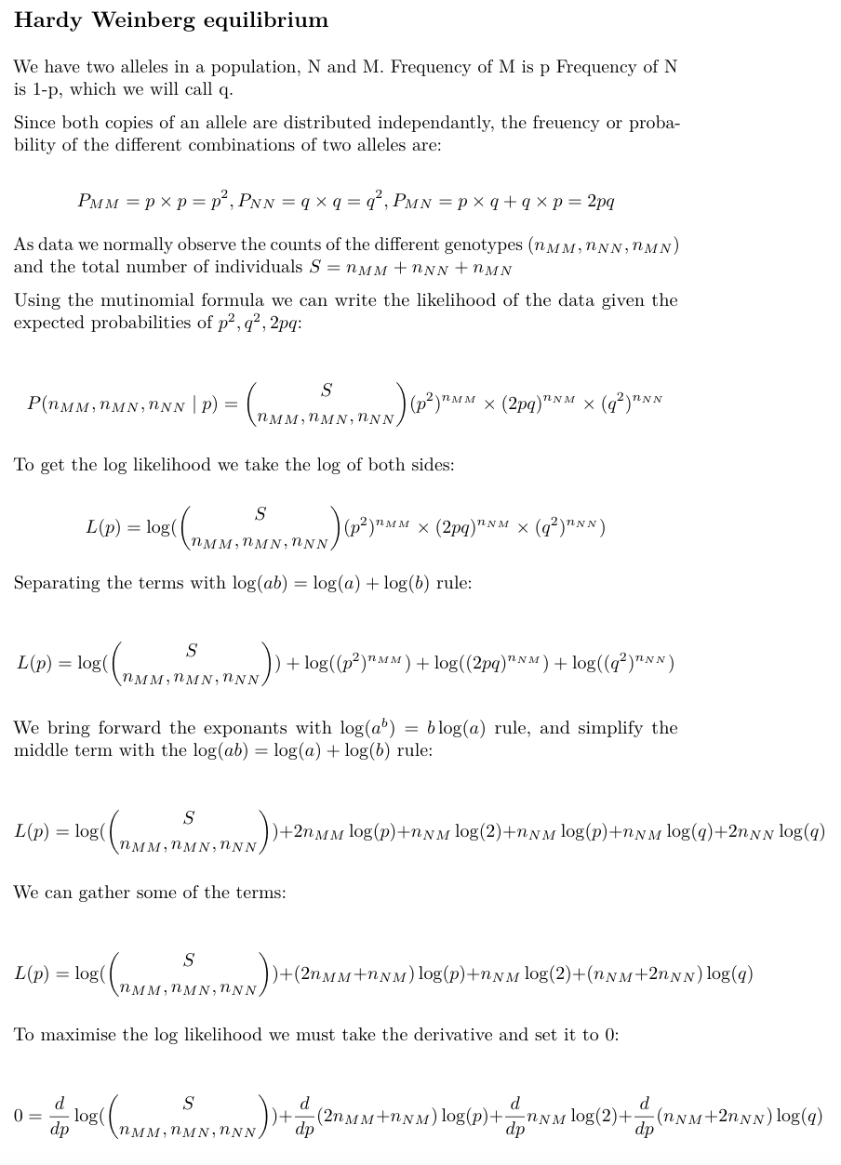
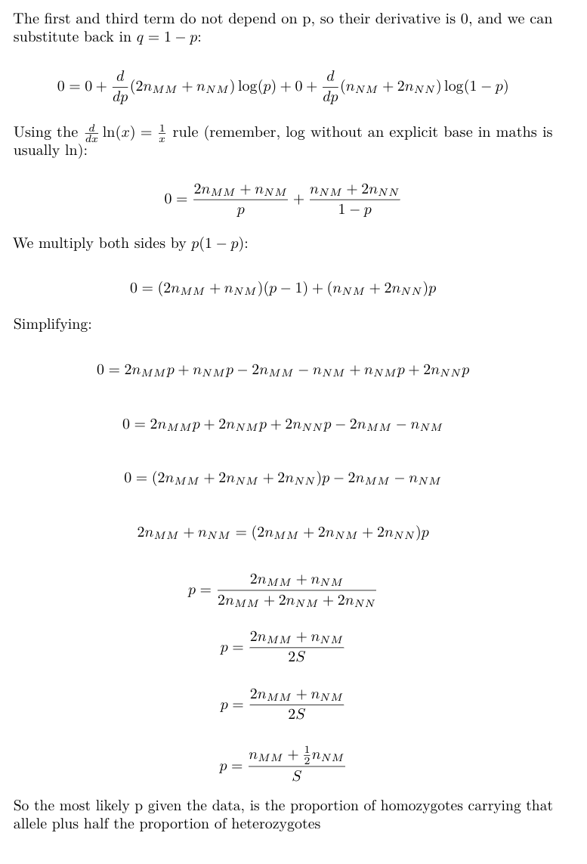

Slide 10
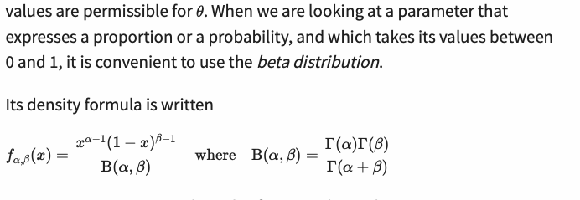
The beta distribution

Slide 11
In Bayesian statistics, a maximum a posterior probability (MAP) estimate is an estimate of an unknown quantity, that equals the mode of the posterior distribution. The MAP can be used to obtain a point estimate of an unobserved quantity on the basis of empirical data. It is closely related to the method of maximum likelihood (ML) estimation, but employs an augmented optimization objective which incorporates a prior distribution (that quantifies the additional information available through prior knowledge of a related event) over the quantity one wants to estimate. MAP estimation can therefore be seen as a regularization of ML estimation. (Wikipedia)
In Bayesian statistics, a credible interval is an interval within which an unobserved parameter value falls with a particular probability. It is an interval in the domain of a posterior probability distribution or a predictive distribution.^{[1]} The generalisation to multivariate problems is the credible region. Credible intervals are analogous to confidence intervals in frequentist statisticsß

