Slide 1
Modern Statistics for Modern Biology
Susand Holmes & Wolfgang Huber
Chapter 2 background material

Slide 2
Conditional probability
Bayes theorem
Residuals
Hat
MLE
Log rules
Differentiation rules

Slide 3
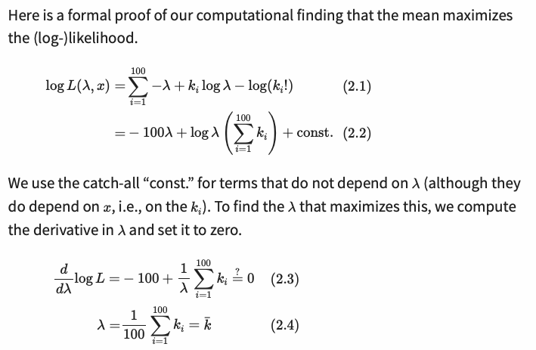
Proof that the mean of the Poisson distribution maximises the likelihood:
…. A more detailed working out is on the next slide….

Slide 4
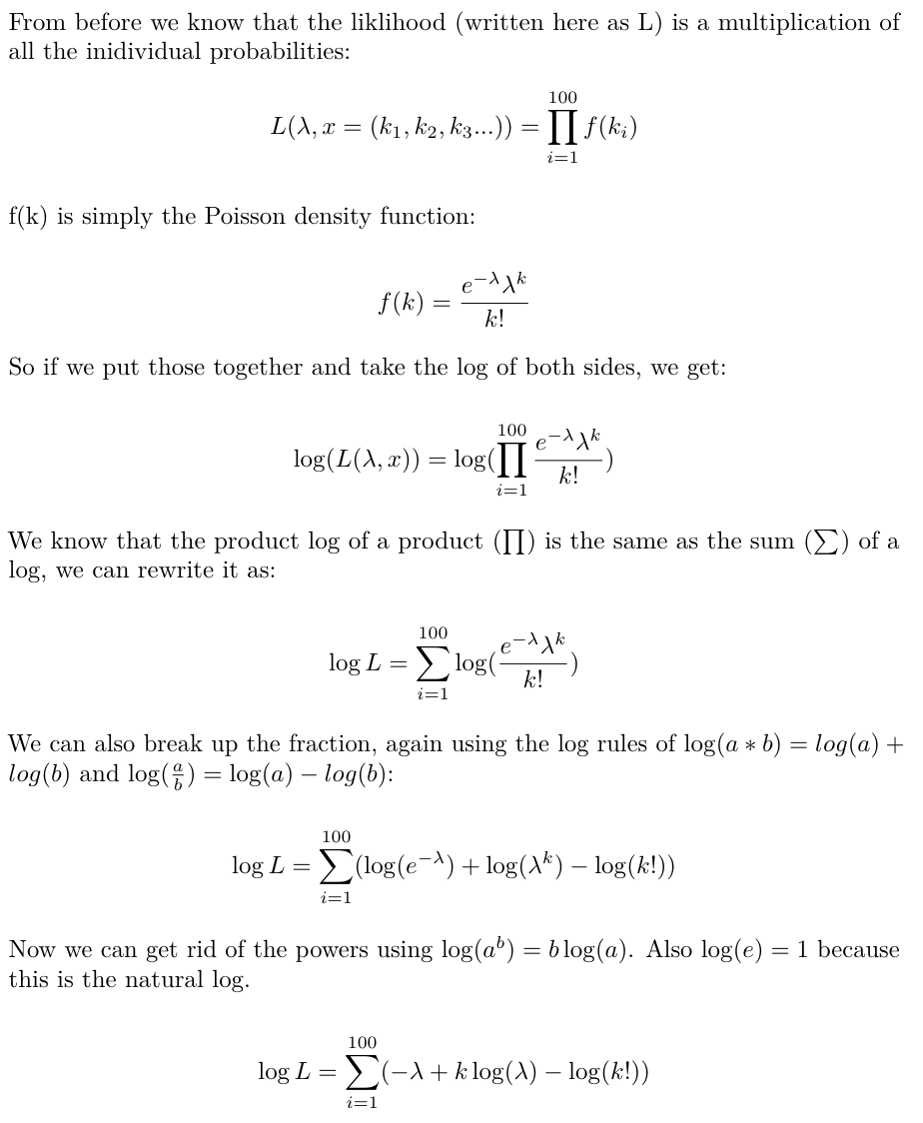
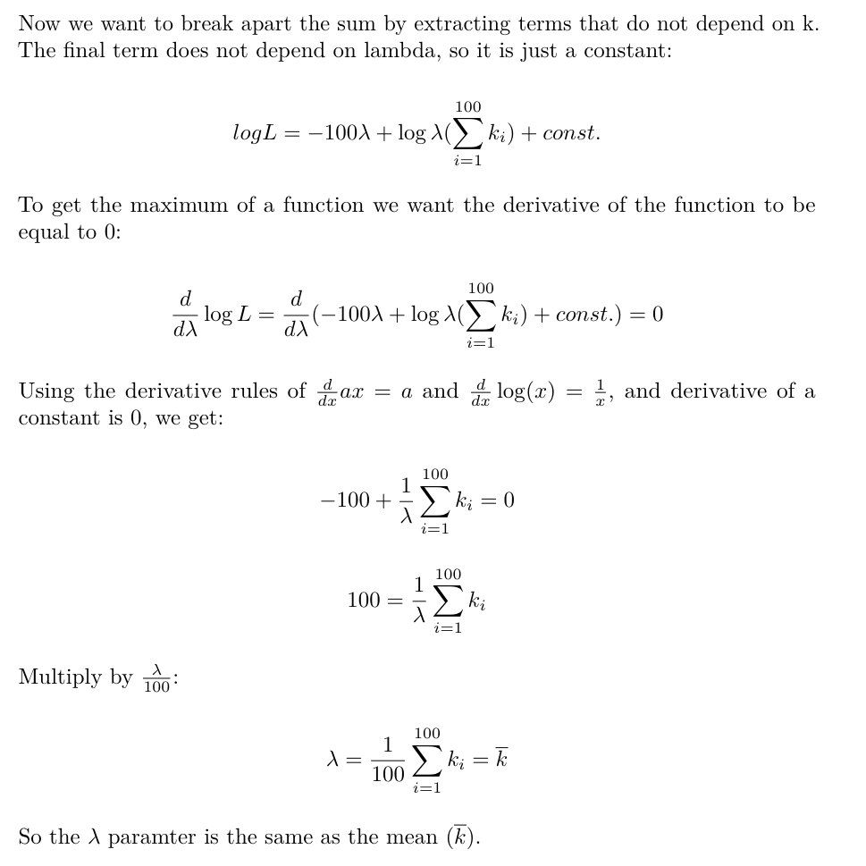
Proof that the mean of the Poisson distribution maximises the likelihood:

