Slide 1
Modern Statistics for Modern Biology
Susand Holmes & Wolfgang Huber
Chapter 2 background material

Slide 2
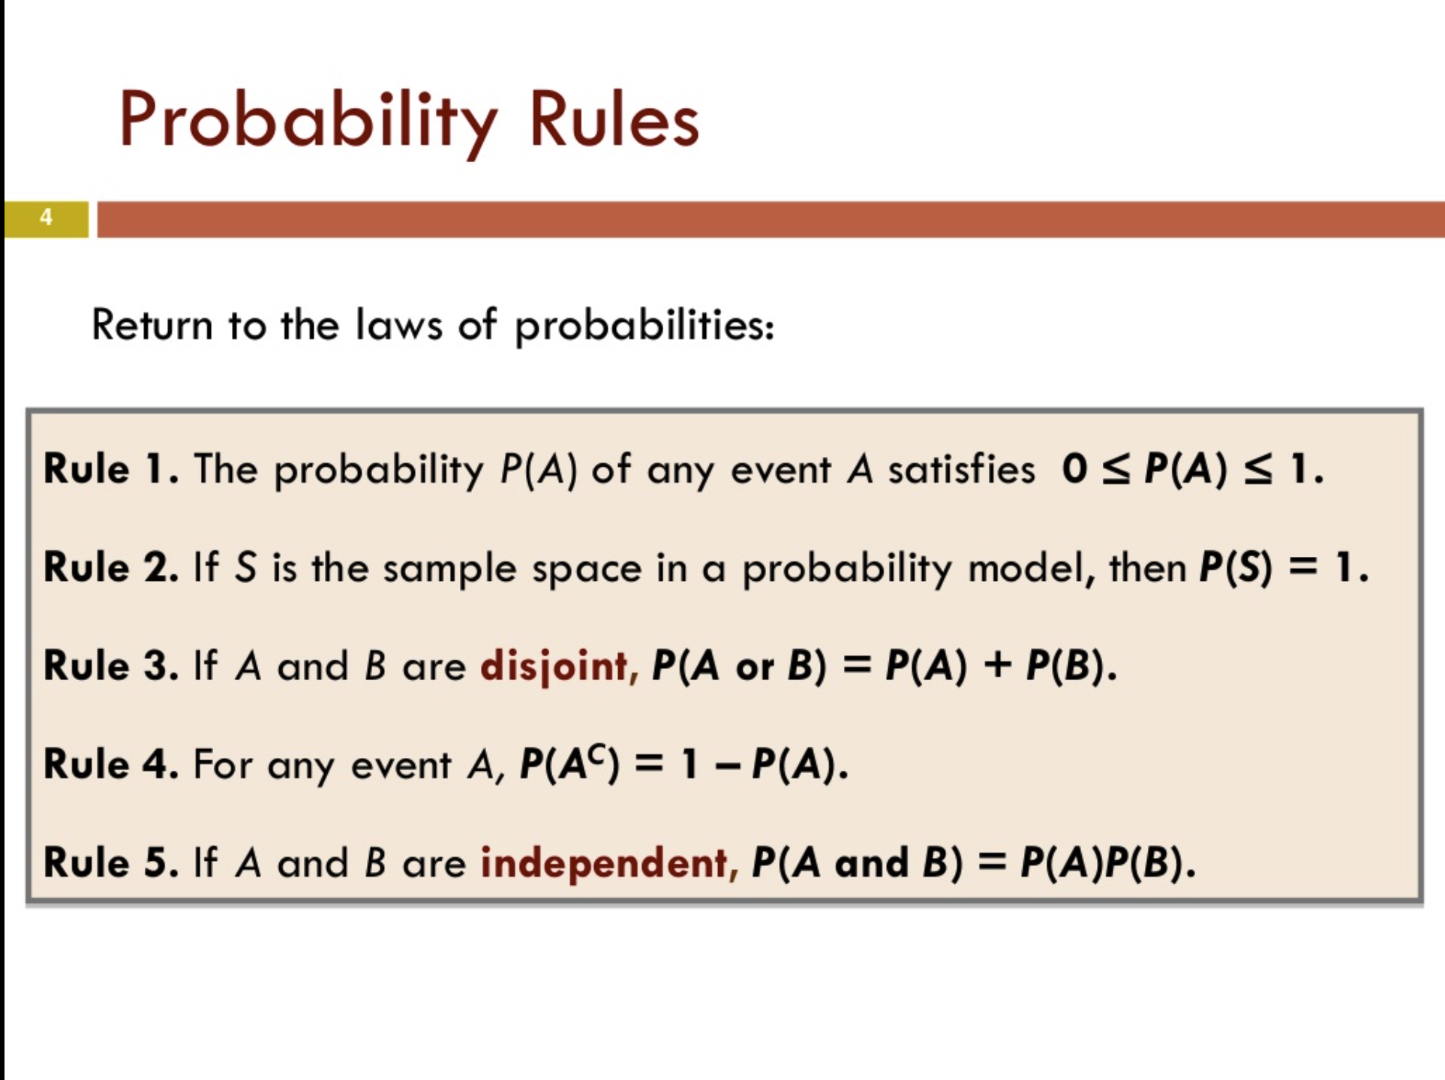
Dr. Nahid Sultana https://www.slideshare.net/nszakir/chapter-4-part4-general-probability-rules

Slide 3
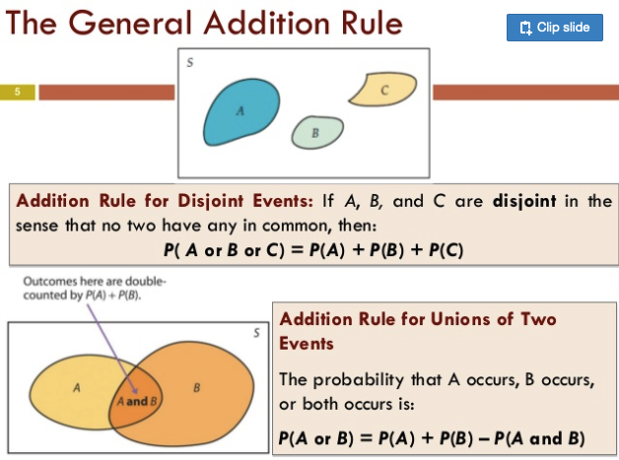
Dr. Nahid Sultana https://www.slideshare.net/nszakir/chapter-4-part4-general-probability-rules

Slide 4
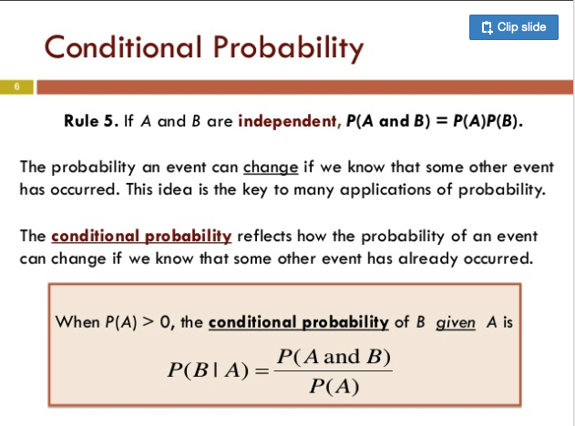
Dr. Nahid Sultana https://www.slideshare.net/nszakir/chapter-4-part4-general-probability-rules

Slide 5

Conditional probability
Probability than an event (a) occurs, given that another event (b) has already occurred. It is written as: P(a|b)
0.7
rain
P(rain|cloudy)=0.2*0.7=0.14
conditional probabilities
cloudy
0.2
0.3
dry
P(dry|cloudy)=0.2*0.3=0.06
weather
rain
P(rain|sun)=0.8*0.1=0.08
0.8
0.1
sunshine
0.9
Marginal probabilities
dry
P(dry|sun)=0.8*0.9=0.72

Slide 6
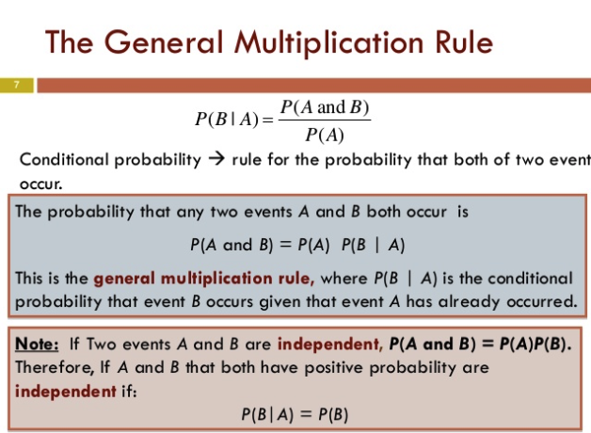
Dr. Nahid Sultana https://www.slideshare.net/nszakir/chapter-4-part4-general-probability-rules

Slide 7
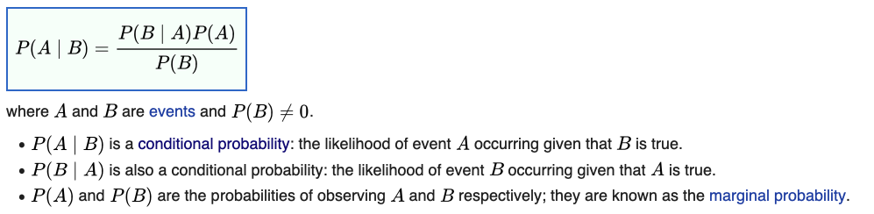
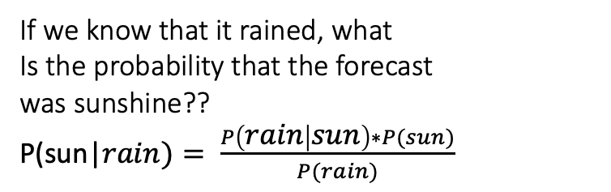
Bayes rule
rain
P(rain|cloudy)=0.2*0.7=0.14
If we know that it rained, what
Is the probability that the forecast
was sunshine??
P(sun|$rain)= \frac{P\left(rain | sun\right)∗P(sun)}{P(rain)}$
0.7
cloudy
0.2
0.3
dry
P(dry|cloudy)=0.2*0.3=0.06
weather
rain
P(rain|sun)=0.8*0.1=0.08
= 0.08*0.8/(0.14+0.08)= 0.29
0.8
0.1
sunshine
0.9
dry
P(dry|sun)=0.8*0.9=0.72

Slide 8
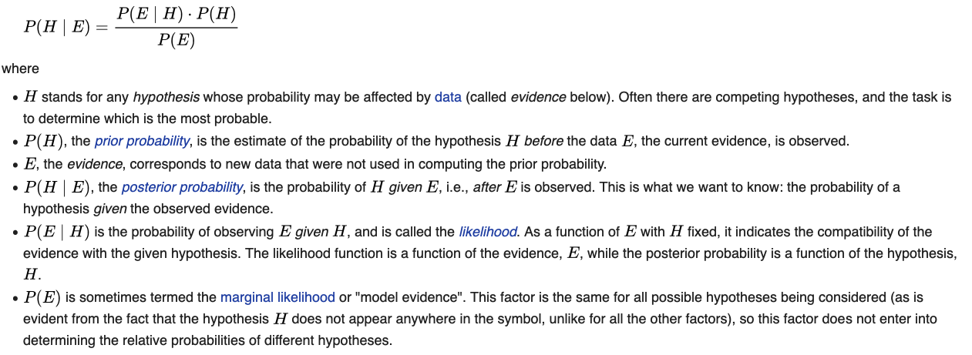
Bayesian inference
is a method of statistical inference in which Bayes' theorem is used to update the probability for a hypothesis as more evidence or informationbecomes available
E=evidence
H=hypothesis
What is the probability of our hypothesis given the evidence?
e.g. what is the probability our data comes from a Poisson distribution
given the distribution of our data?
Posterior
prob.
likelihood
Prior prob.
Marginal likelihood

Slide 9
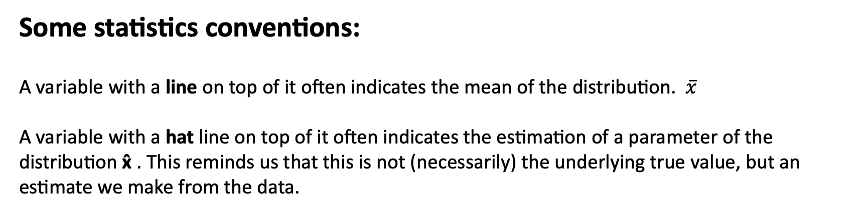
Some statistics conventions:
A variable with a line on top of it often indicates the mean of the distribution. $\overline{x}$
A variable with a hat line on top of it often indicates the estimation of a parameter of the distribution x̂ . This reminds us that this is not (necessarily) the underlying true value, but an estimate we make from the data.

Slide 10
In Bayesian statistics, a maximum a posterior probability (MAP) estimate is an estimate of an unknown quantity, that equals the mode of the posterior distribution. The MAP can be used to obtain a point estimate of an unobserved quantity on the basis of empirical data. It is closely related to the method of maximum likelihood (ML) estimation, but employs an augmented optimization objective which incorporates a prior distribution (that quantifies the additional information available through prior knowledge of a related event) over the quantity one wants to estimate. MAP estimation can therefore be seen as a regularization of ML estimation. (Wikipedia)
In Bayesian statistics, a credible interval is an interval within which an unobserved parameter value falls with a particular probability. It is an interval in the domain of a posterior probability distribution or a predictive distribution.^{[1]} The generalisation to multivariate problems is the credible region. Credible intervals are analogous to confidence intervals in frequentist statisticsß

Slide 11
Some linear algebra

Slide 12
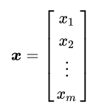

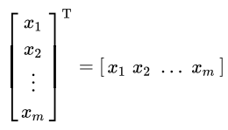

Vectors and matrices
A vector is essentially a list of numbers.
Column vector
row vector
To go from one to the other you transpose the vector.
In R the default vector is a row vector, so x=c(1,2,3) is a row vector and to get a column vector you need to transpose:
t(c(1,2,3))
A matrix of size 2x3 (always say row number first)
Matrices are simply a collection of row or column vectors of the same size:

Slide 13
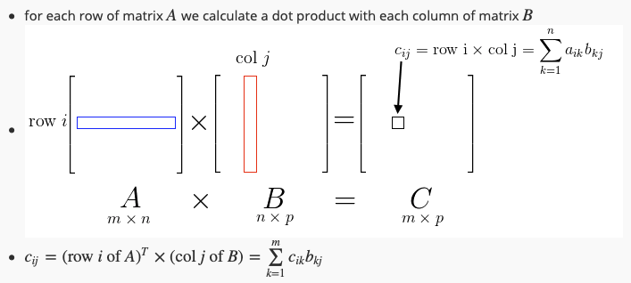
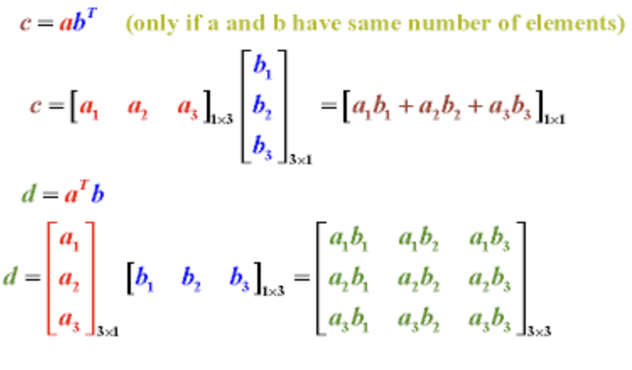
Inner product
Dot product
Dot product of two matrices
c=a^{T}b
Outer product
d=ab^{T}

Slide 14
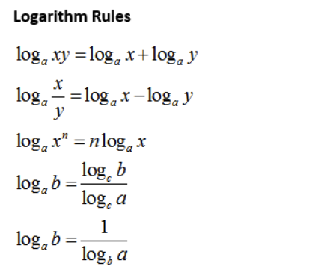
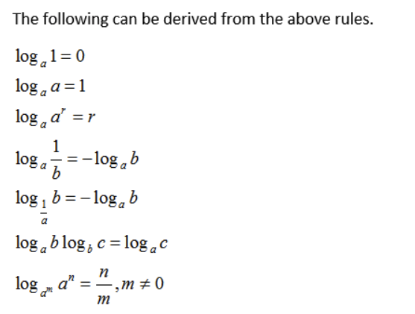

Slide 15
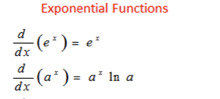

https://www.onlinemathlearning.com/derivative-rules.html

Slide 16
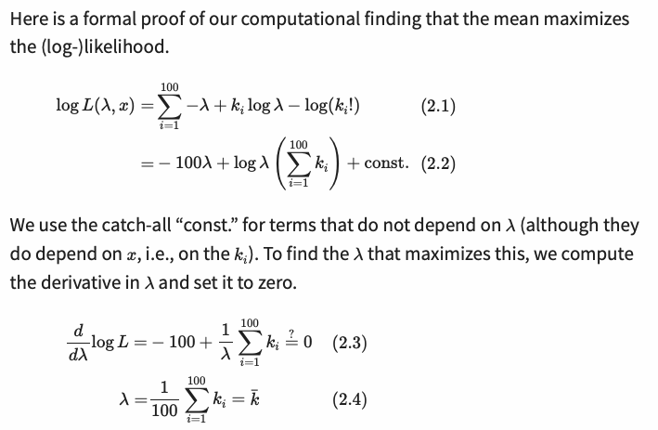
Proof that the mean of the Poisson distribution maximises the likelihood:
…. A more detailed working out is on the next slide….

Slide 17
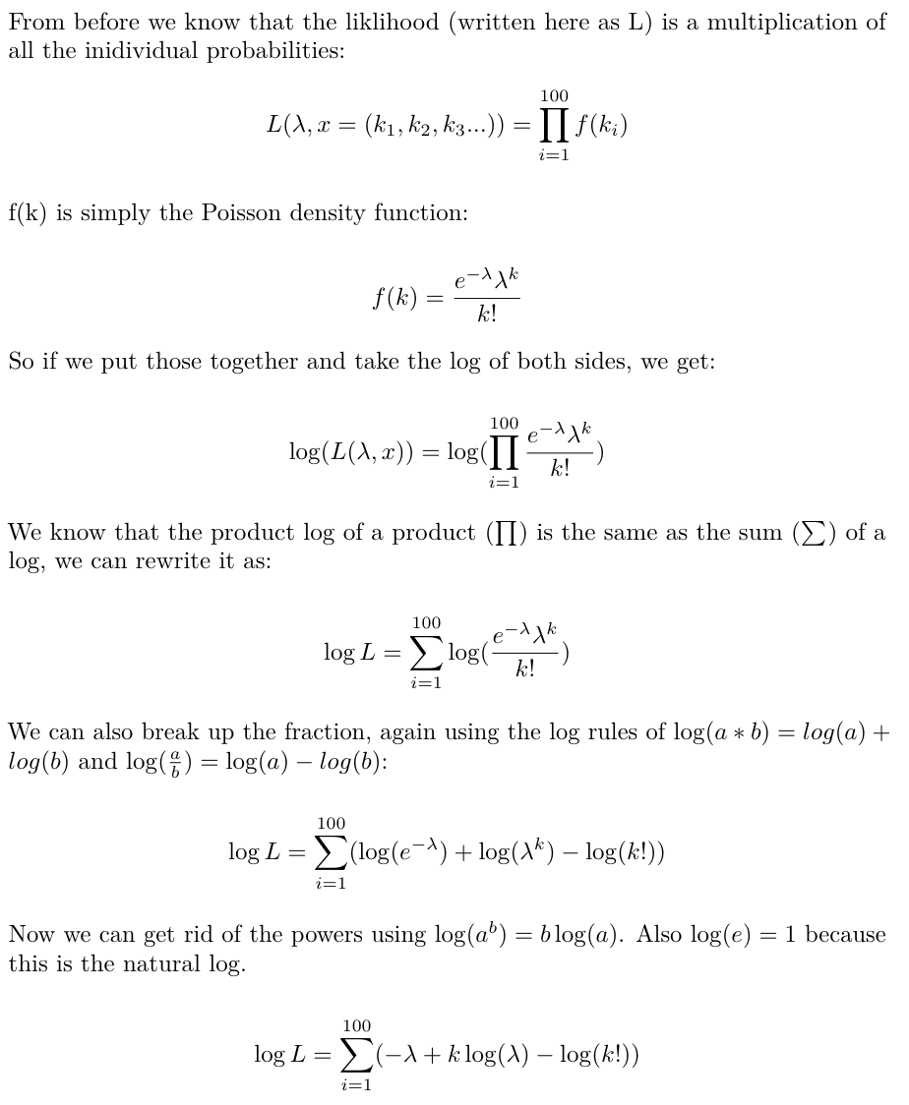
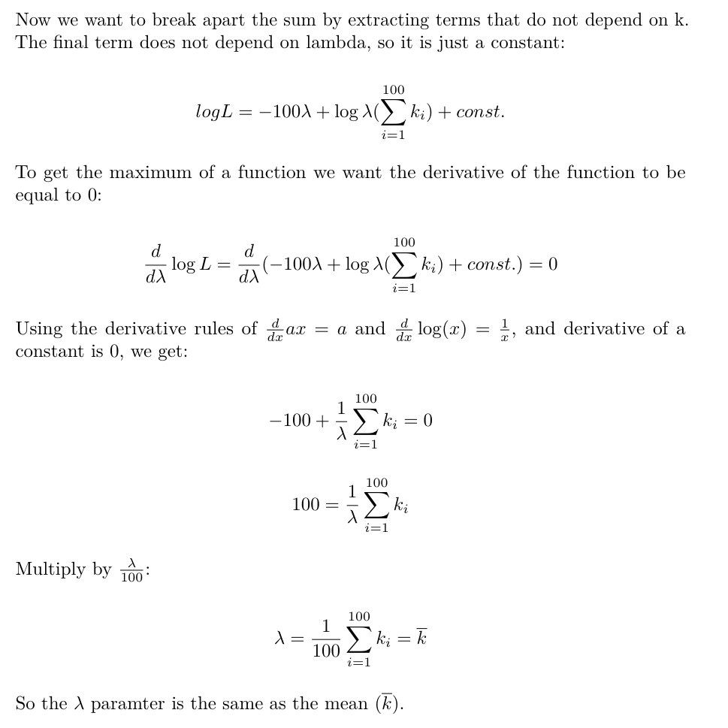
Proof that the mean of the Poisson distribution maximises the likelihood:

Slide 18
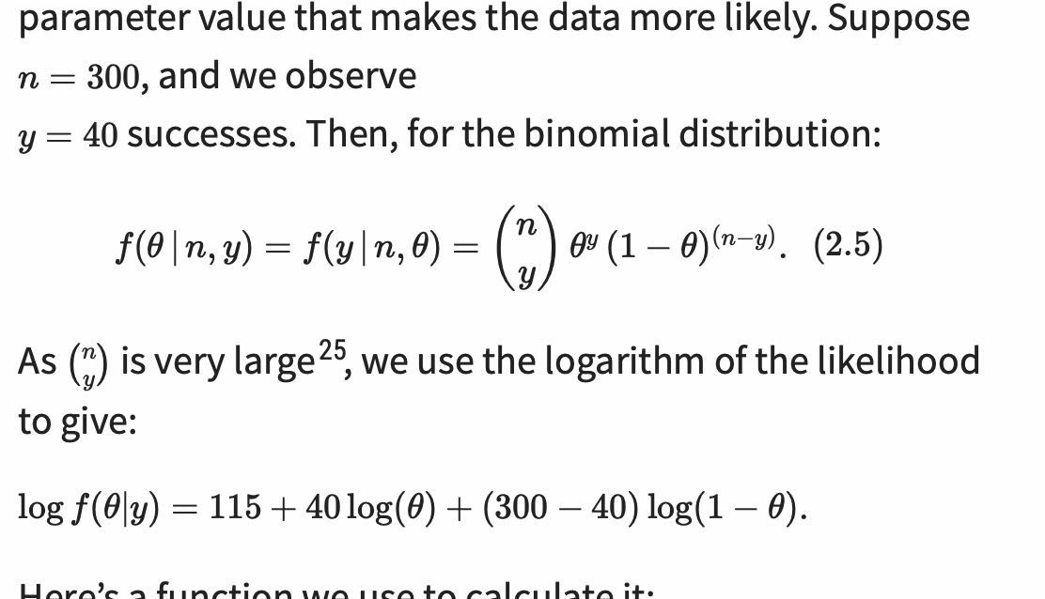
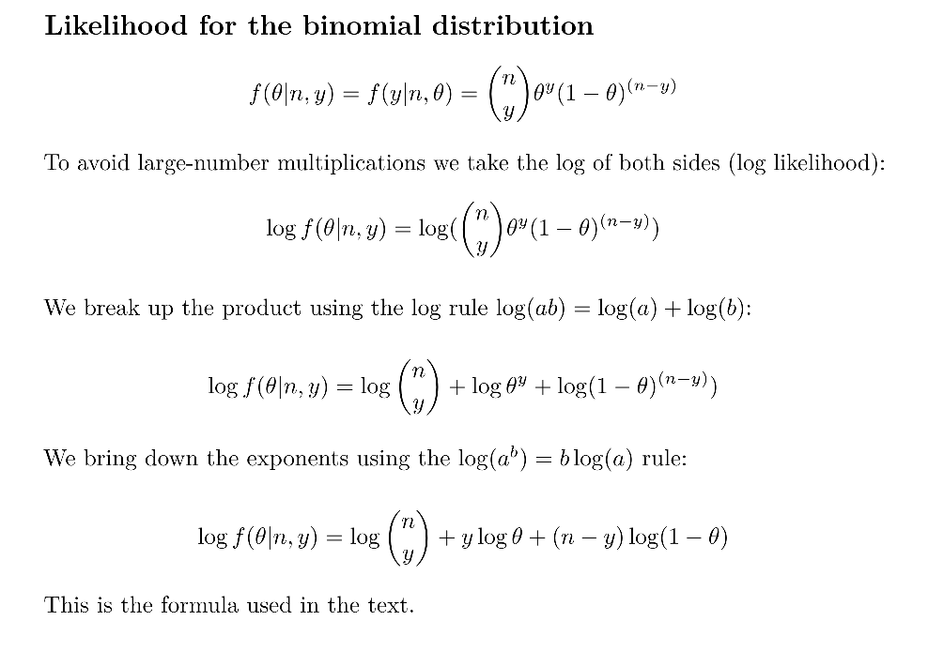
Likelihood for the binomial distribution

Slide 19
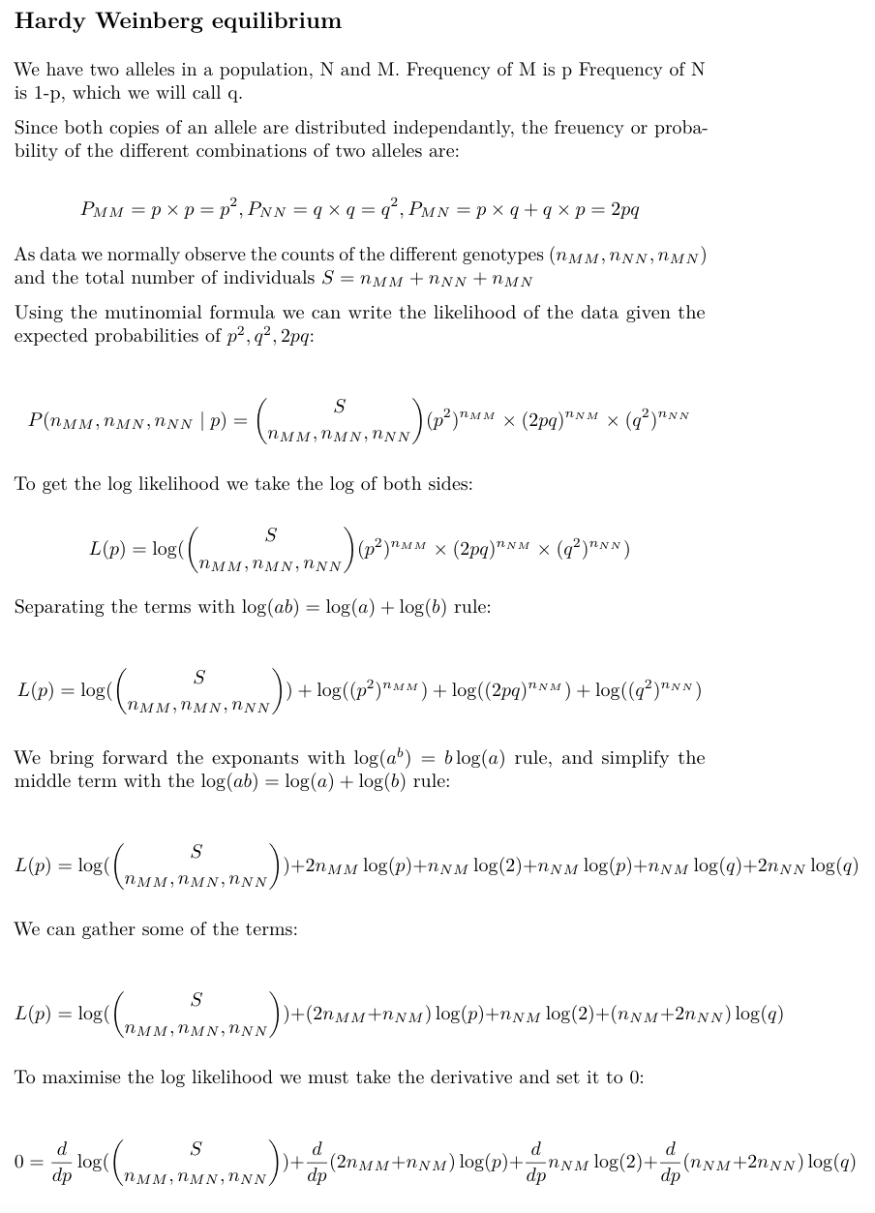
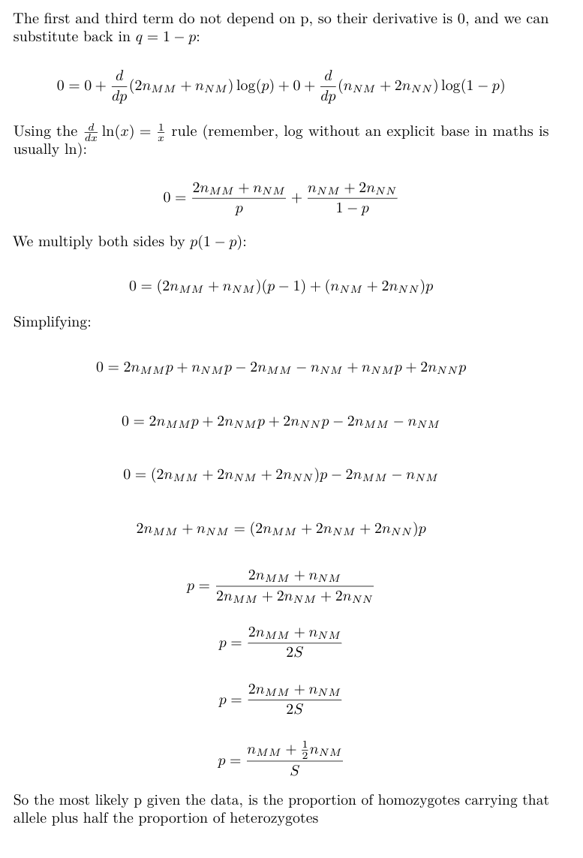

Slide 20
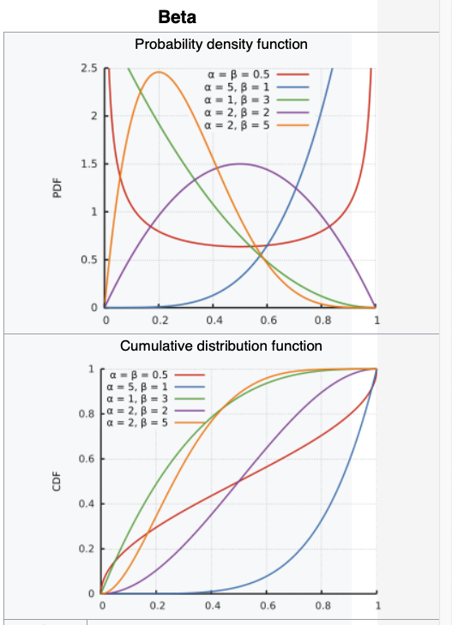
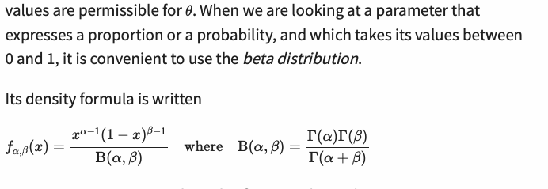
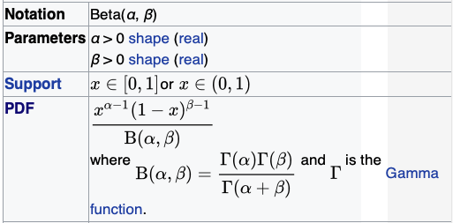


The beta distribution
Good for modelling probabilities, because it takes values between 0 and 1
It has two parameters: alpha and beta

Slide 21
Residuals
MLE
Regression
Residuals

