Slide 1
Modern Statistics for Modern Biology
Susand Holmes & Wolfgang Huber
Chapter 2 background material

Slide 2
Conditional probability
Bayes theorem
Residuals
Hat
MLE
Log rules
Differentiation rules
Regression
Residuals
phat We put a hat over the letter to remind us that this is not (necessarily) the underlying true value, but an estimate we make from the data
poverline

Slide 3
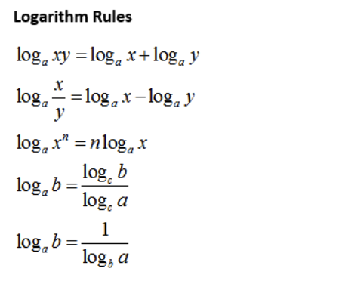
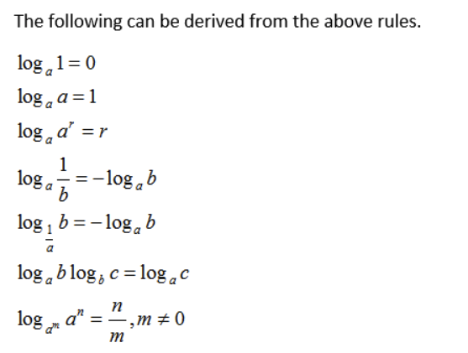

Slide 4
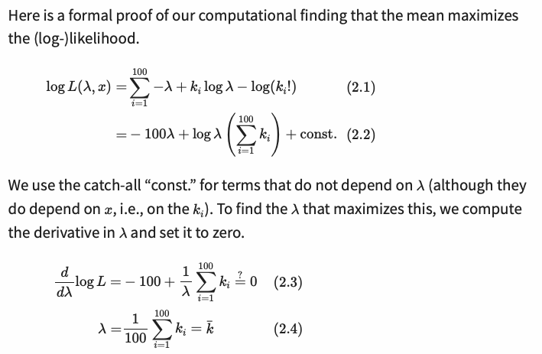
Proof that the mean of the Poisson distribution maximises the likelihood:
…. A more detailed working out is on the next slide….

Slide 5
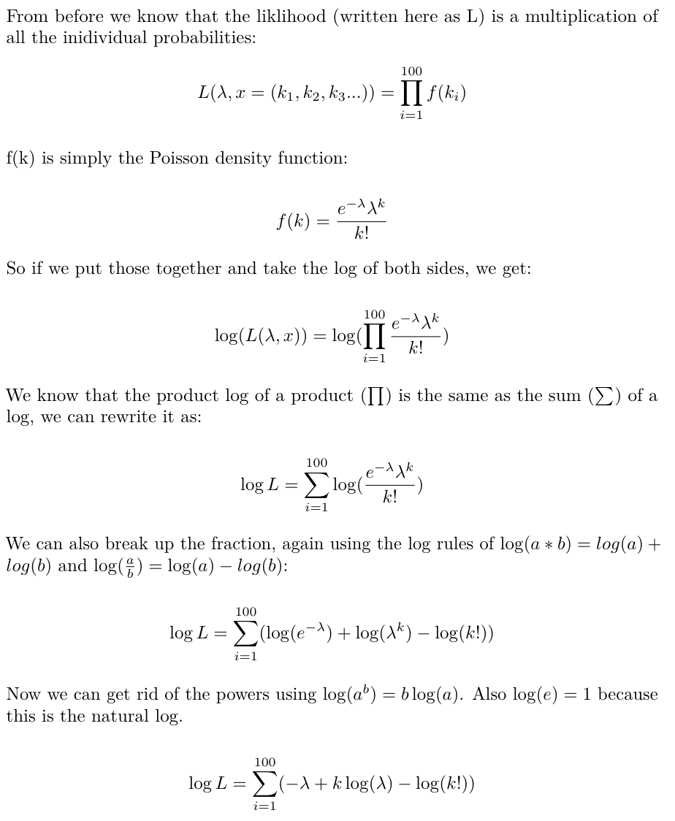
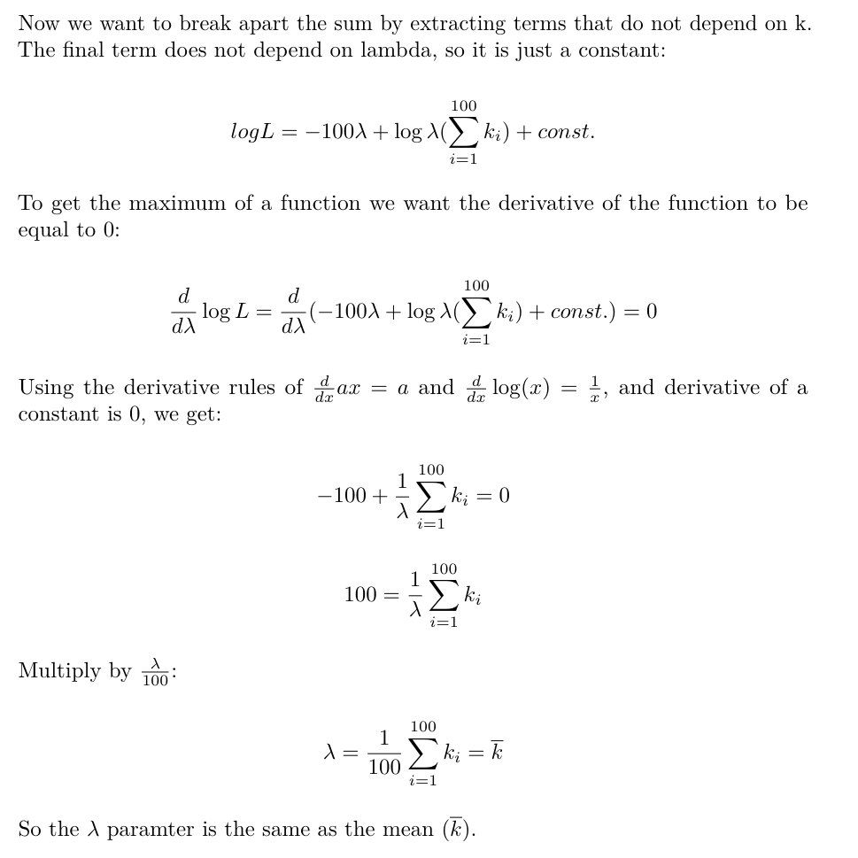
Proof that the mean of the Poisson distribution maximises the likelihood:

Slide 6
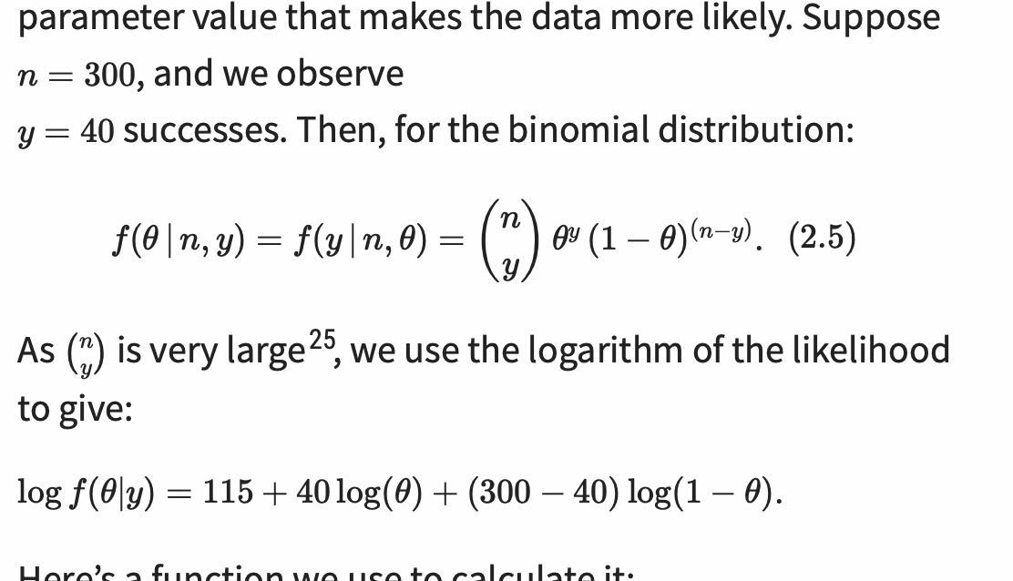
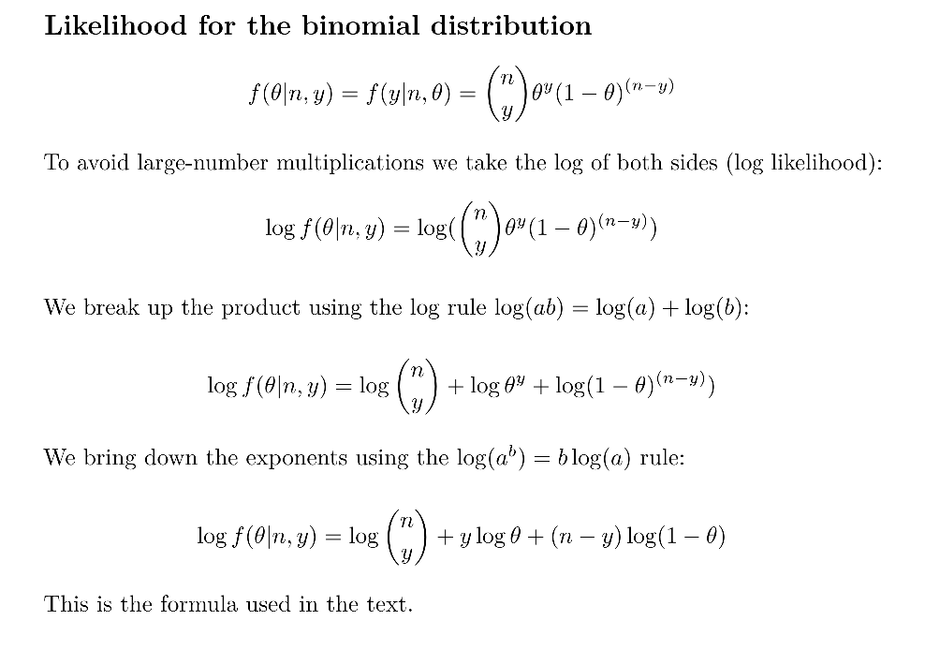
Likelihood for the binomial distribution

