Slide 1
Modern Statistics for Modern Biology
Susand Holmes & Wolfgang Huber
Chapter 2 background material

Slide 2
Conditional probability
Bayes theorem
Residuals
Hat
MLE
Log rules
Differentiation rules
Regression
Residuals
phat We put a hat over the letter to remind us that this is not (necessarily) the underlying true value, but an estimate we make from the data
overline
Matrix multiplication

Slide 3
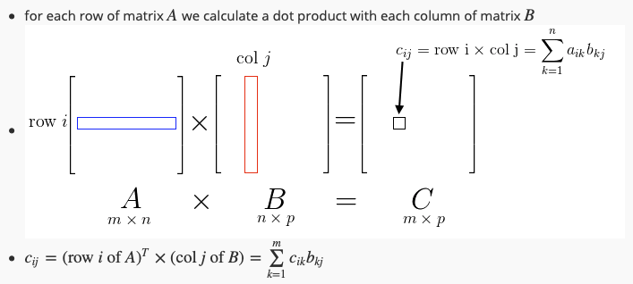
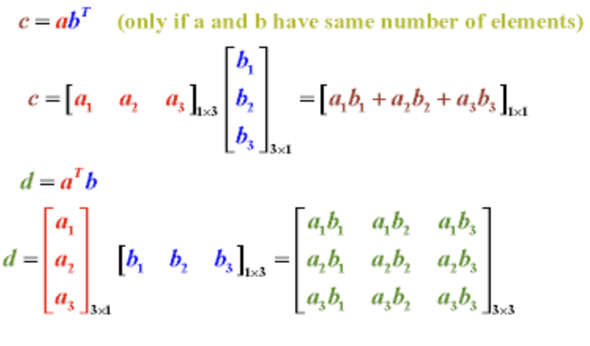
Inner product
Dot product
Dot product of two matrices
c=a^{T}b
Outer product
d=ab^{T}

Slide 4
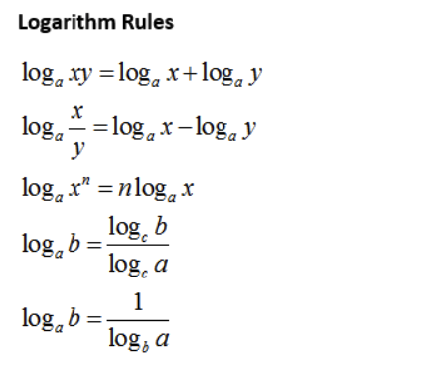
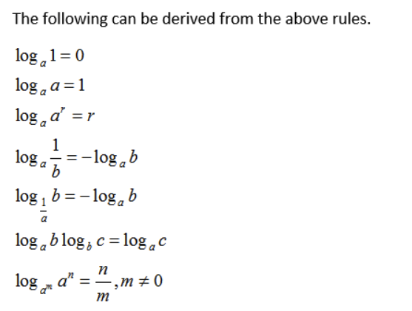

Slide 5
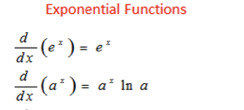

https://www.onlinemathlearning.com/derivative-rules.html

Slide 6
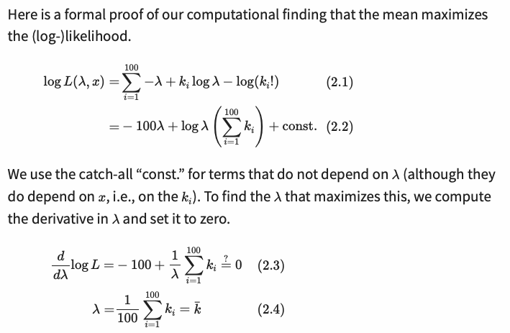
Proof that the mean of the Poisson distribution maximises the likelihood:
…. A more detailed working out is on the next slide….

Slide 7
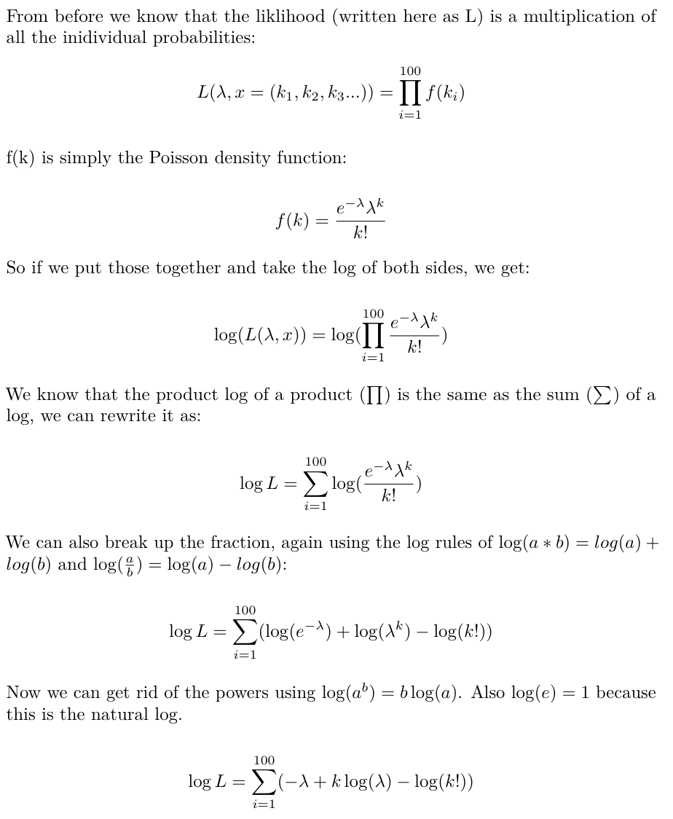
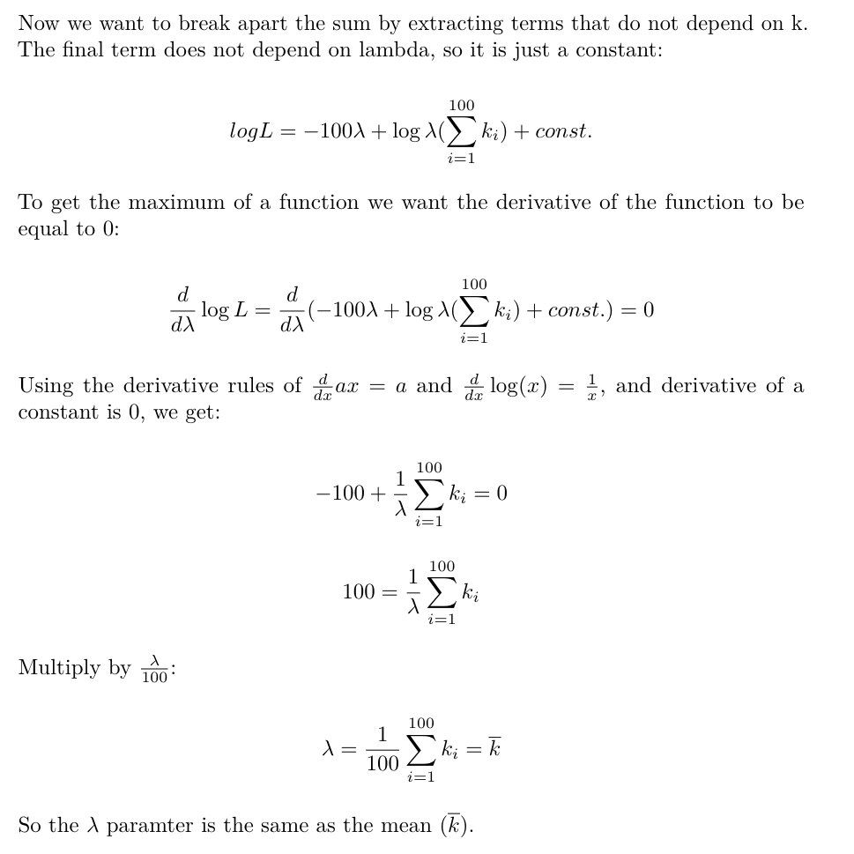
Proof that the mean of the Poisson distribution maximises the likelihood:

Slide 8
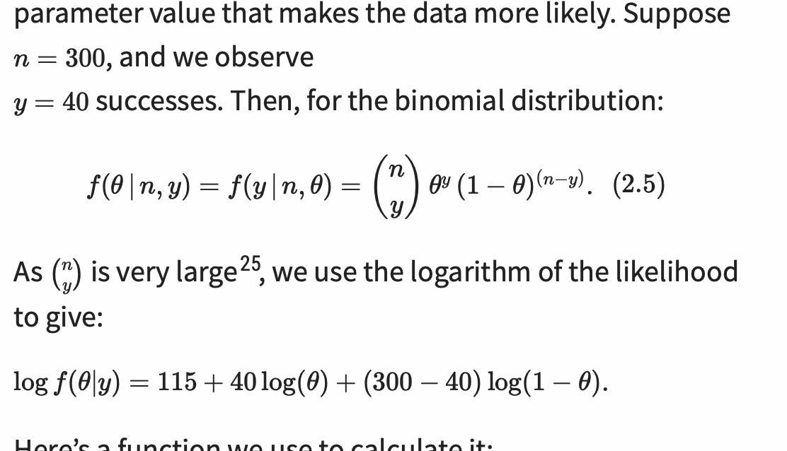
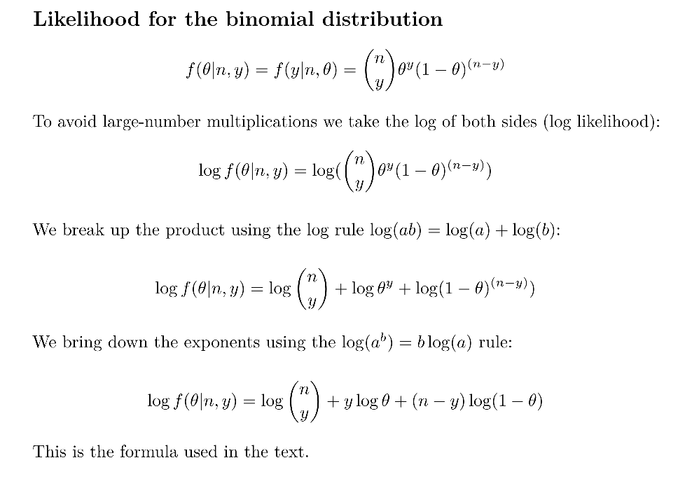
Likelihood for the binomial distribution

Slide 9
