Slide 1
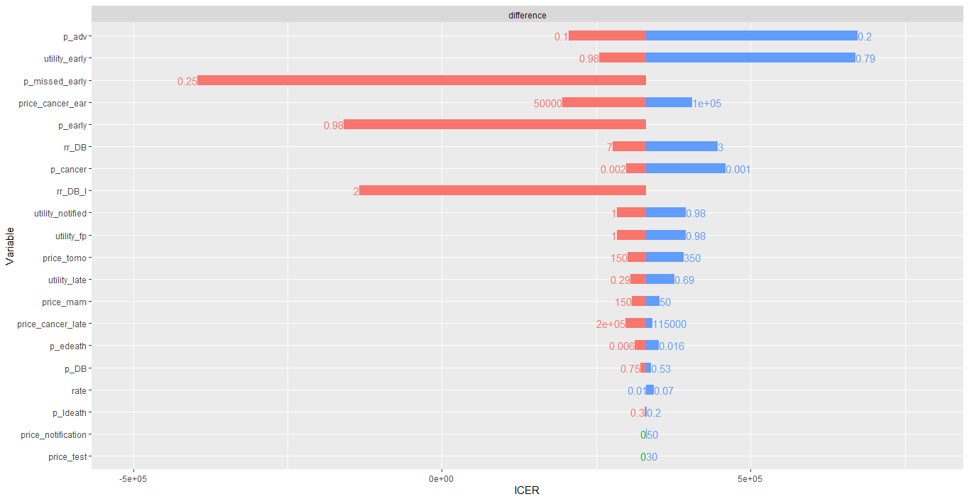
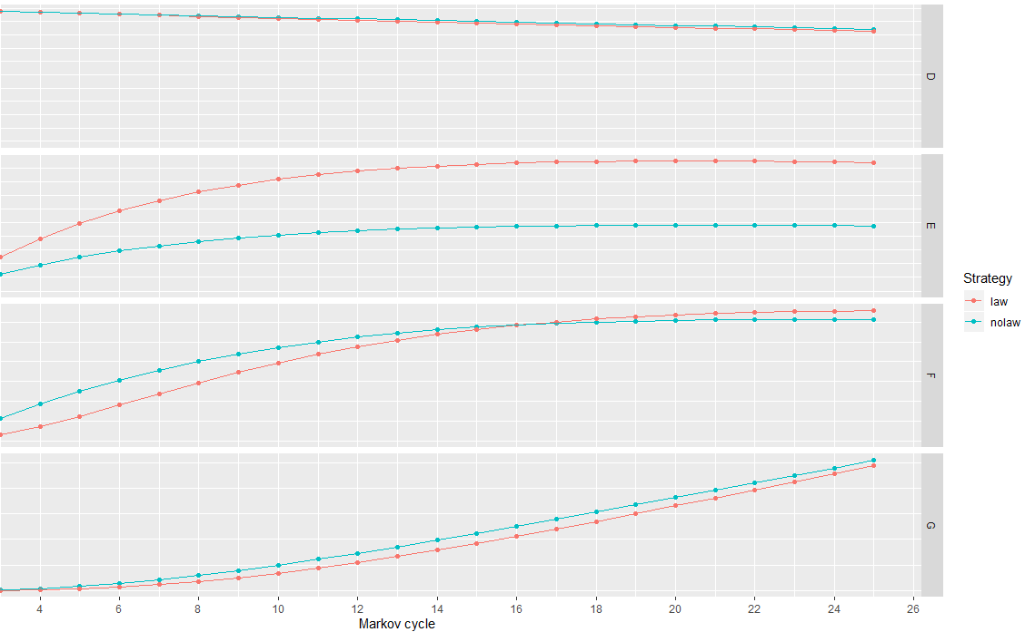
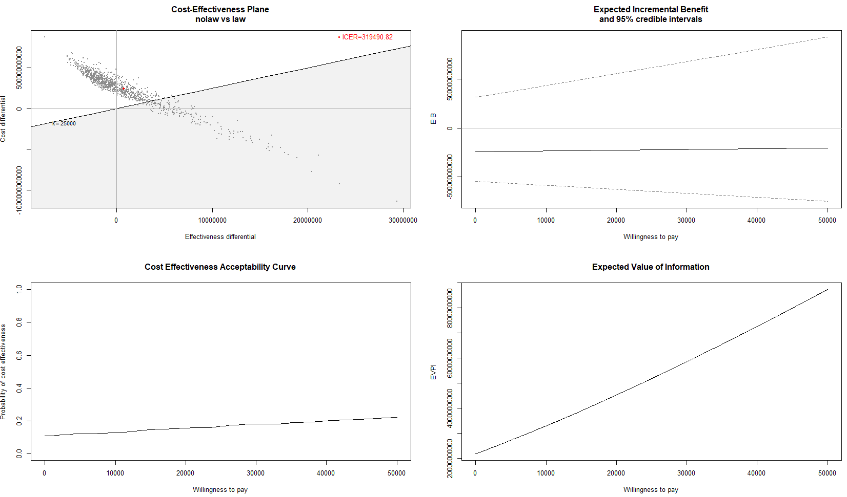
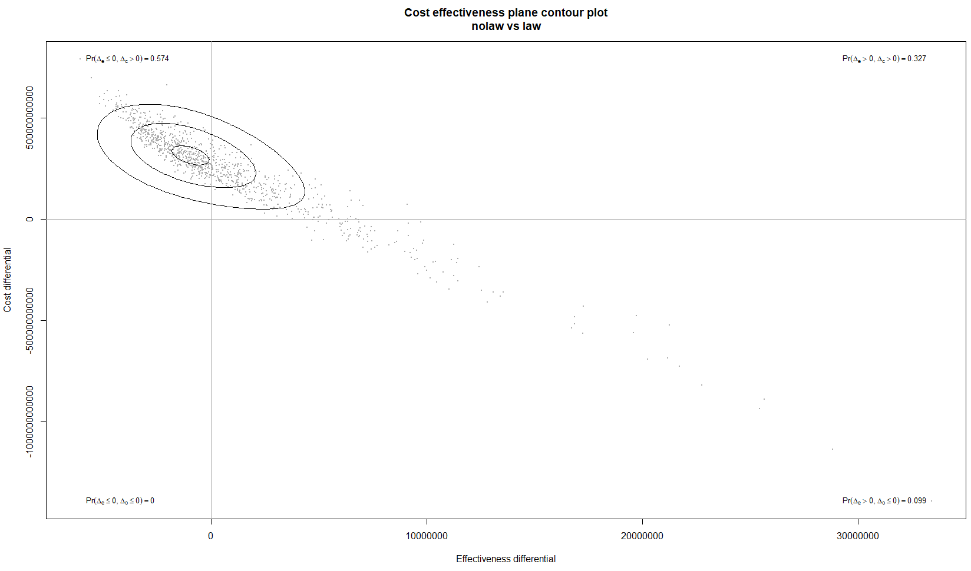

Breast Density Notification with Adjunctive Digital Breast Tomosynthesis (DBT) - A Cost-Effectiveness Analysis
Semprini, Jason MPP’; Mary S. Vaughan-Sarrazin, PhD
University of Iowa College of Public Health; Department of Health Management and Policy
Carver College of Medicine, Department of Internal Medicine
Purpose
Results
To estimate the cost-effectiveness of a breast density notification law, with DBT insurance coverage, for breast cancer screening in young women.
Table 1: Incremental Cost-Effectiveness Ratios
Background
Model | Cost Dif. | Effect Dif. | ICER
Homogeneous | 12,112 | 0.0367 | 330,401
Probabilistic | 12,203 | 0.0382 | 319,491
Time-Variant | 10,450 | 0.0599 | 174,218
Time-Variant w/ Age Heterogeneity | 11,292 | 0.0719 | 157,146
Time-Variant w/ Age + Family History Heterogeneity | 11,540 | 0.0752 | 153,388
Not only do dense breasts increase a woman's risk of developing cancer, but greater breast density also raises the likelihood of a missed diagnosis from traditional mammography screening. Many states have responded to these risks by implementing legislation which mandates medical providers notify women who have dense breasts, but only few states have required additional, adjunctive screening coverage. Evidence is mixed, but preliminary studies suggest notification laws increase early-stage cancer diagnoses relative to late-stage cancer diagnoses. However, no study has estimated the cost-effectiveness of breast density notification laws with DBT, which has been shown to more accurately identify positive breast cancer than traditional mammography.
Figure 1: Sensitivity Analysis
Figure 2: Outcome States for Women with Dense Breasts
No Cancer
Cost-Effectiveness Analysis Design
Early-Stage Cancer
Taking the perspective of a healthcare system, this analysis estimates the incremental cost-effectiveness ratio (ICER) of breast density notification laws against the current standard of care (mammography for all women, with no notification or adjunctive DBT screening). The R Statistical software package, Heemod, was used to construct 1) homogenous, 2) probabilistic, 3) time-variant, and 4) heterogenous Markov Models. In addition to reporting the ICER, the results of a one-way sensitivity analysis at willingness to pay threshold of 50,000 and the outcomes states for women in the simulation were reported. All input data were obtained from recent meta analyses, CEA registry, and Medicare Fee Schedules.
Late-Stage Cancer
Death
Effect | Utility
Never Diagnosed with Breast Cancer | 1
Diagnosed with Breast Cancer (Early)1 | 0.91
Diagnosed with Breast Cancer (Late)1 | 0.45
Death | 0
Notification2 | 0.99
False Positive3 | 0.9899
Cost | $
Test | 0
Notification | 0
Mammogram1 | 100
Digital Breast Tomosynthesis (DBT)1 | 215
Annual BC treatment, early stage2 | 82,121
Annual BC treatment, late stage | 134,682
Parameter | Risk (%)
P(Dense Breasts) | (61.7)
P(Cancer | Age) | (0.1616)
P(Early Stage | Cancer) | (94)
P(Death | Early Stage Cancer) | (1.1)
P(Death | Late Stage Cancer) | (22.82)
P(Advance from Early to Late Stage | Cancer) | (15)
*Cancer Probability Multiplier for Women with Dense Breasts | 4.7x
*Late Stage Probability Multiplier after year 1 for women with dense breasts | 7x
Figure 3: Results of
Probabilistic
Markov Model
Conclusion
Breast density notification laws would result in fewer deaths and increase QALYs.
However, the effect is minimal and carries a high-cost.
Breast density notification laws which provide additional screening via Digital Breast Tomosynthesis is not cost-effective (ICER > 330,000)
Combining these notification laws with greater risk stratification protocols may prove highly cost-effective.
(Nelson 2012; Tufts 2019; CMS 2019; Blumen 2016; Boyd 2011; Freer 2015; McCormack 2006; Kerlikowske 2005; Sprague 2014; Brewer 2017; Lee 2017; Chastek 2012)

