Slide 1
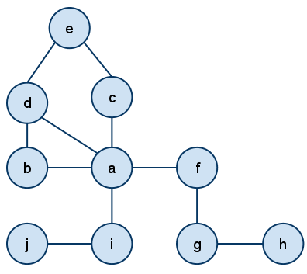
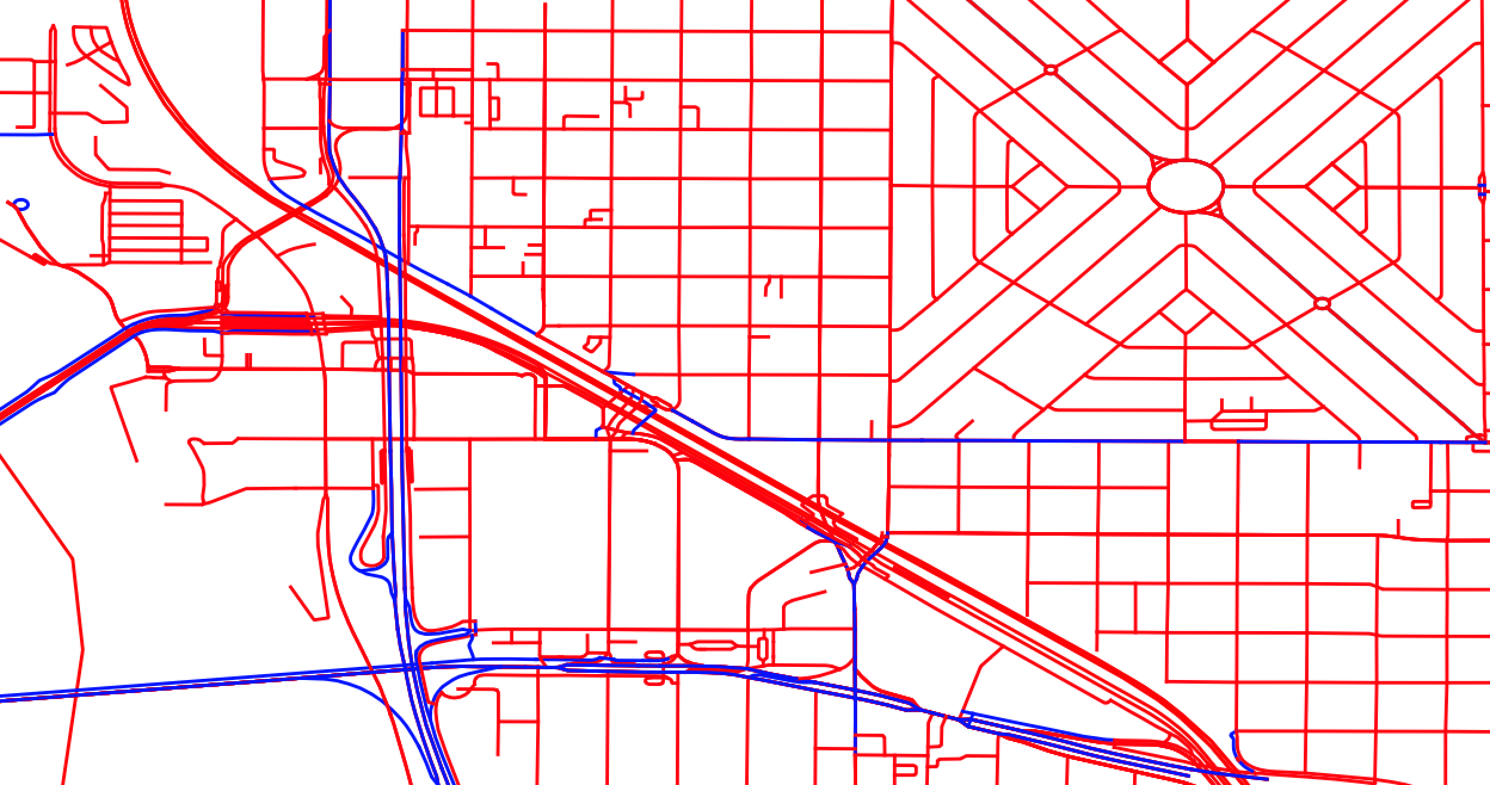
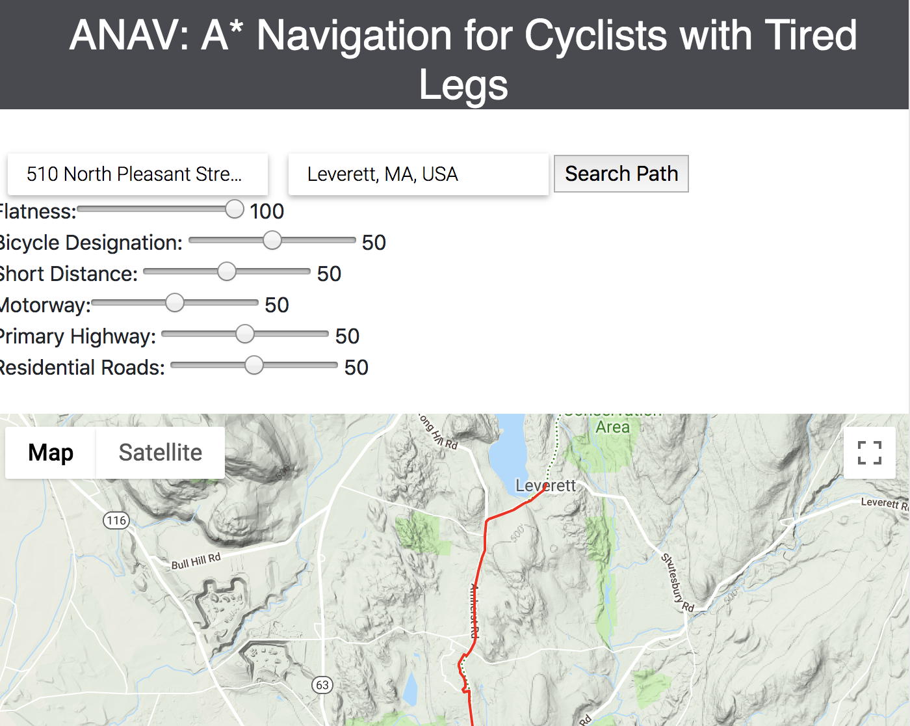
PostgreSQL
Open Street Map
Cloud-hosted
database
Route optimization
API
Google Elevation API
Frontend
UI

Slide 2
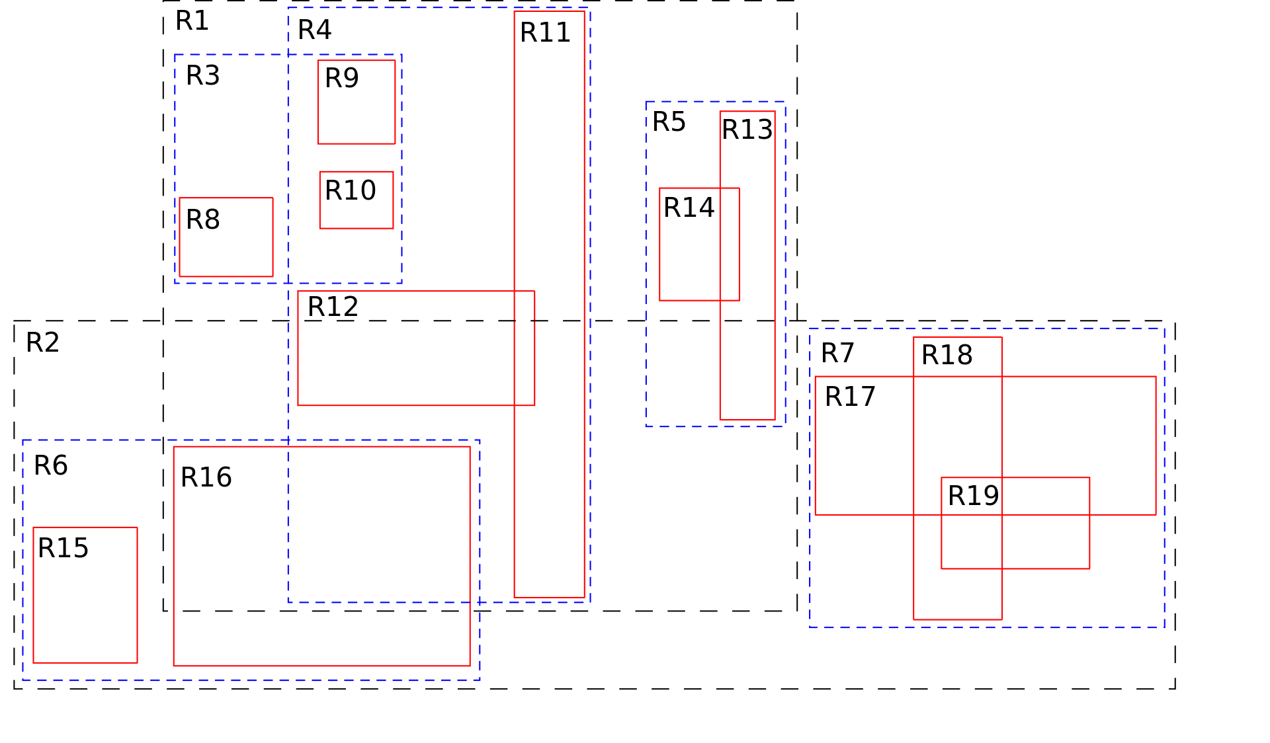
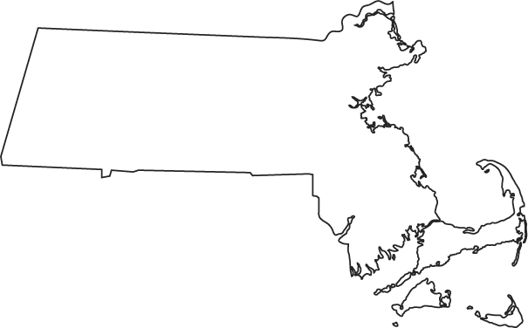


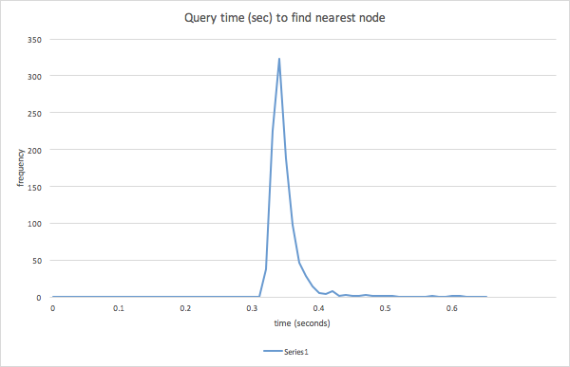
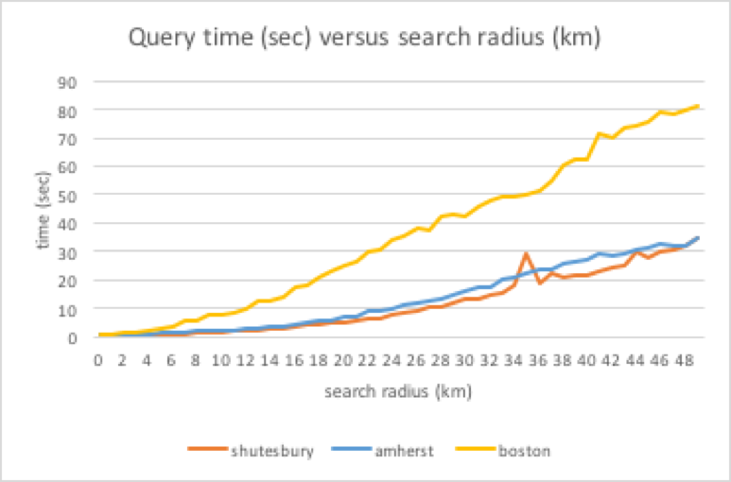
How do we limit the size of our graph?
How do we quickly get data from PostgreSQL?
Solution: R-Tree Spatial Indexes
Results
Solution
Limit the graph to a search radius depending on the user’s start and end coordinates
0.3 seconds to find nearest node
Find nearby nodes in ~seconds

