Slide 1

ADC
Josue serrano

Slide 2
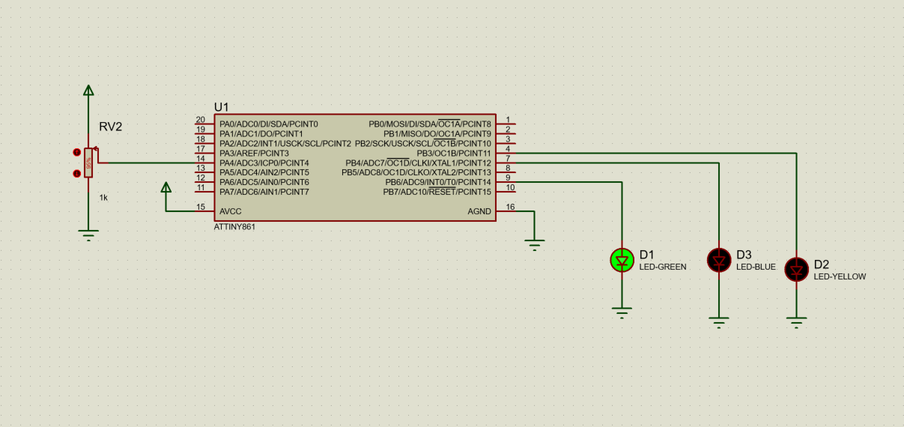

Slide 3
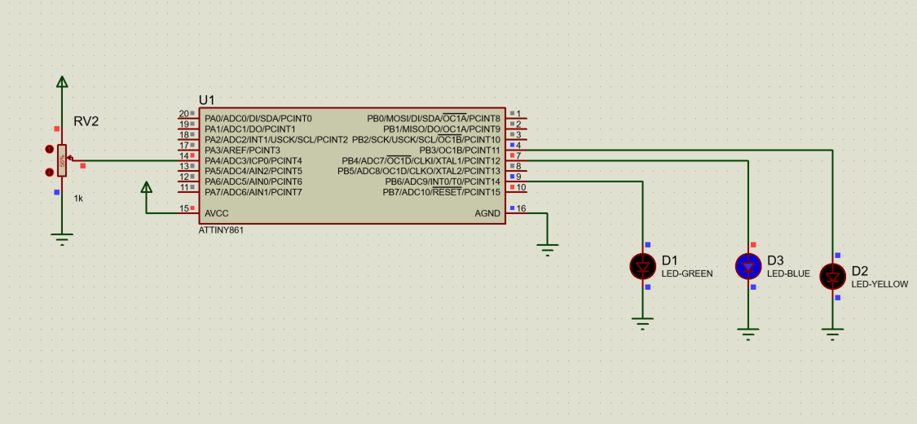

Slide 4
