Slide 1
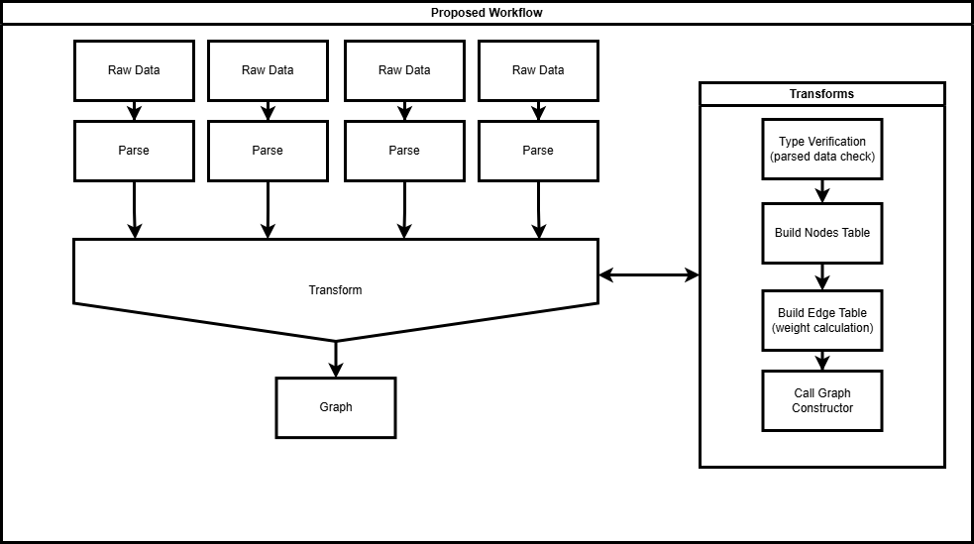
About
Standardization
Related Vignettes
Iteration 1
Project Config
Diagram
Weight Integration Example
Kaiaulu Functionality
Engagement metrics
Notes:
The table under “weight integration example” would be the data table obtained from the engagement metrics with a blurb explaining it.

Slide 2
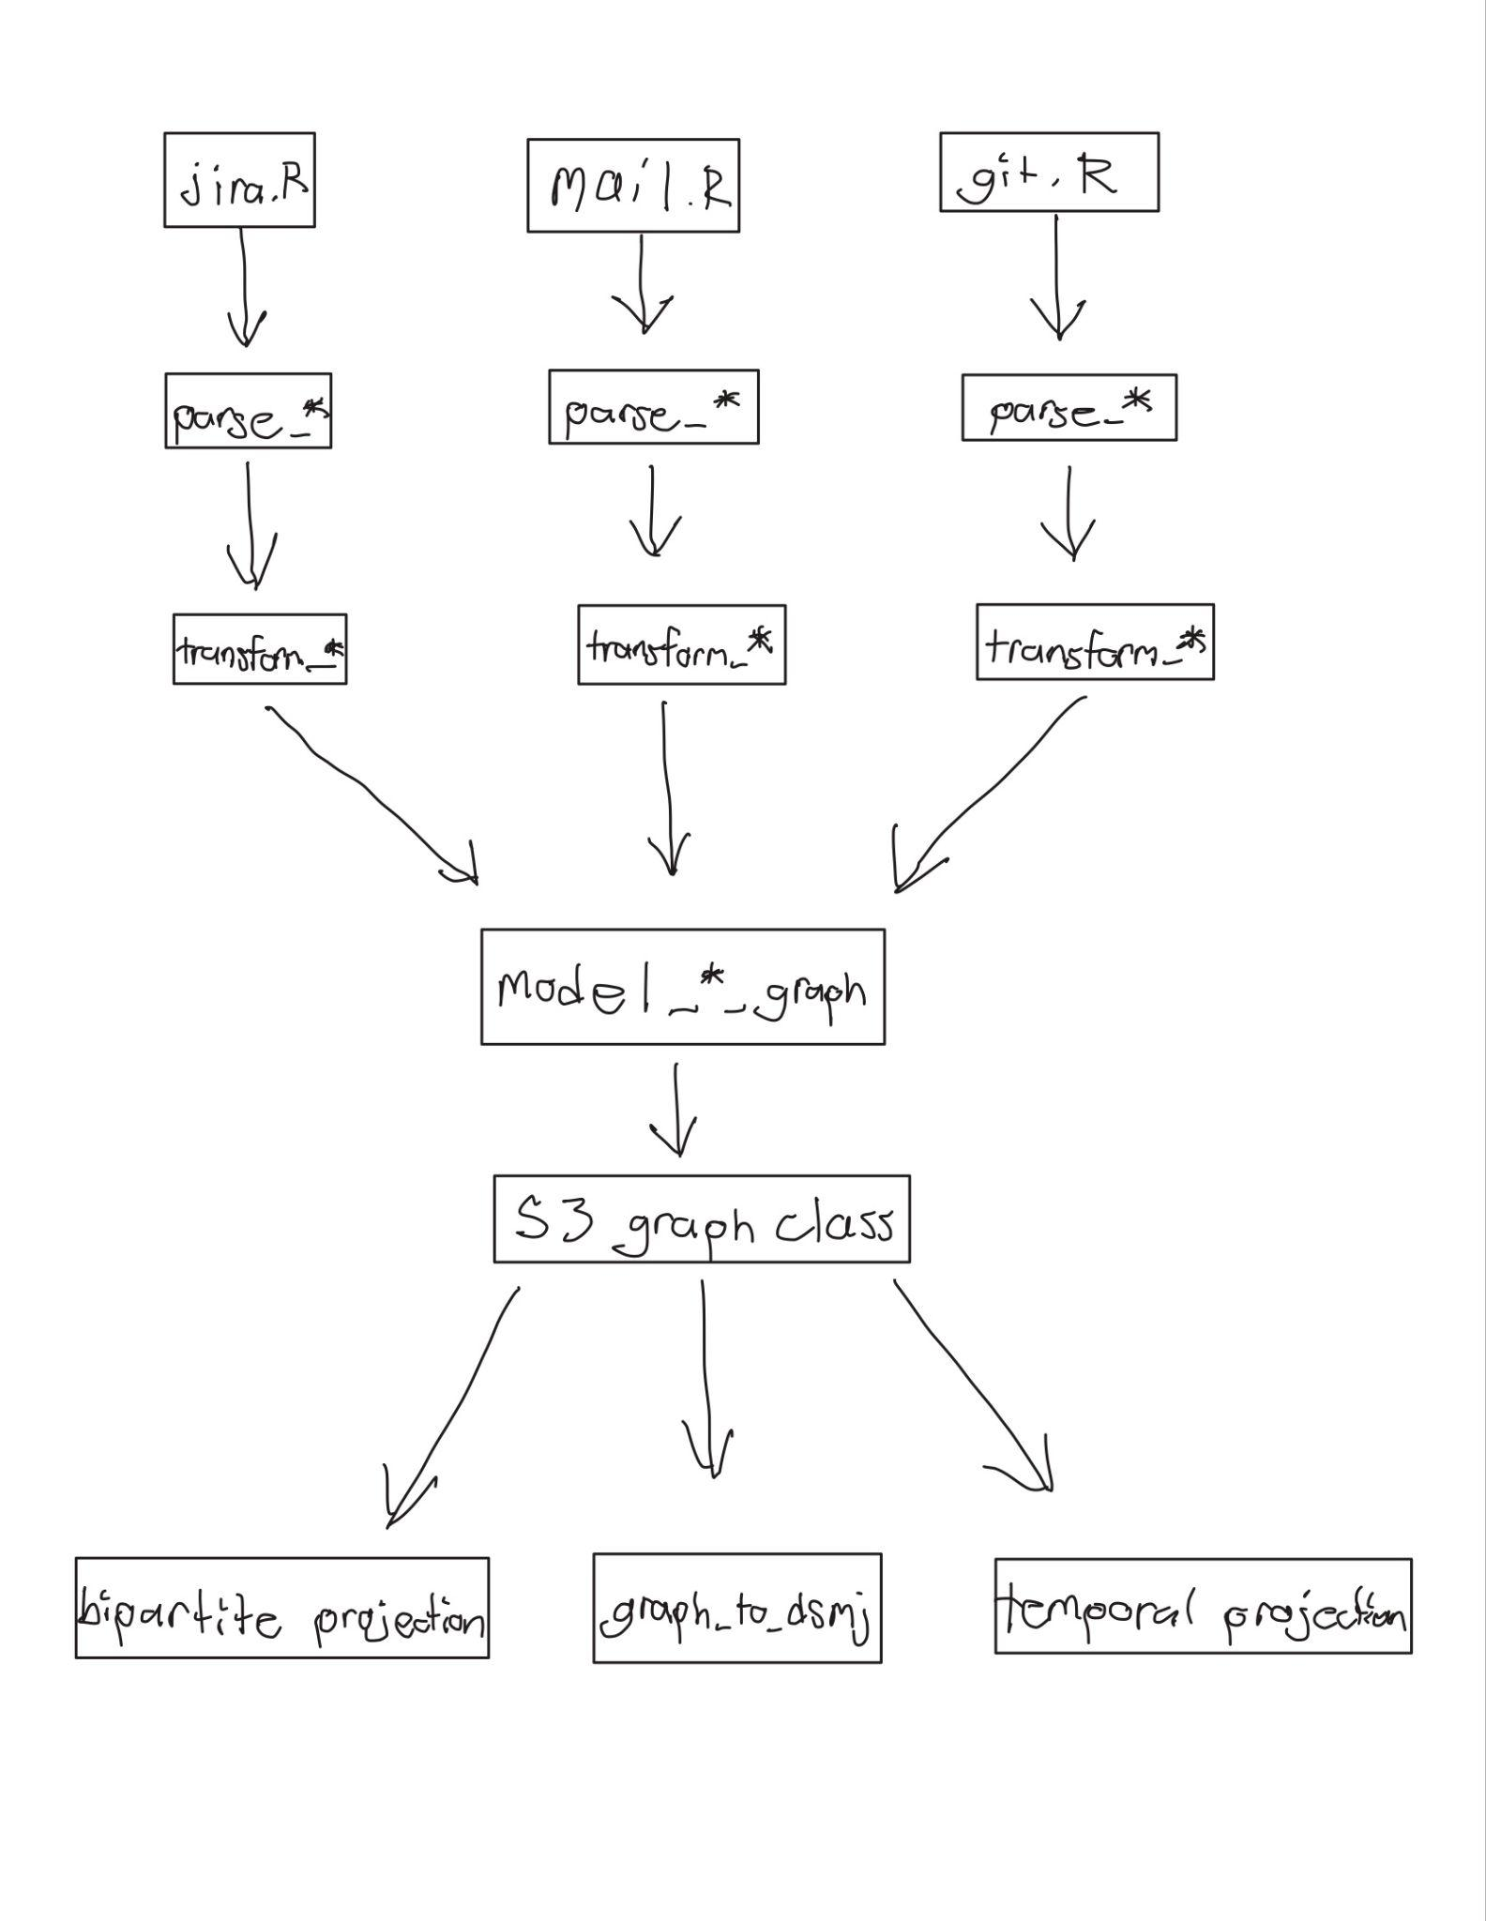
About
Diagram
Related Vignettes
Iteration 2
Project Config
Weight Integration Example
Kaiaulu Functionality
Engagement metrics data.table output
Sentiment Values
0.8
-0.5
1
S3 Generic Functions
Notes:
The table under “weight integration example” would be the data table obtained from the engagement metrics with a blurb explaining it.

Slide 3


Network Transform: : CHEAT SHEET
About
Network Transform Pipeline
Related Vignettes
Kaiaulu's analysis pipelines convert raw data sources including git logs, mailing lists, and issue trackers into graphs for downstream analysis. This work introduces a standardized S3 class system for Kaiaulu's graph model, replacing inconsistent graph construction with two well-defined constructors that encode graph properties such as directionality, weight, and bipartiteness directly in the object's class. Consumer functions dispatch on these classes, meaning new analyses can be implemented as S3 methods that automatically work with any graph produced by the existing transform functions without requiring changes to those transforms.
See the following notebooks for related analyses:
.git
.json
.mbox
gitlog_showcase.Rmd
gitlog_entity_showcase.Rmd
motif_analysis.Rmd
community_detection_showcase.Rmd
blamed_line_types_showcase.Rmd
line_metrics_showcase.Rmd
depends_showcase.Rmd
social_smell_showcase.Rmd
reply_communication_showcase.Rmd
issue_social_smell_showcase.Rmd
gitlog_vulnerabilities_showcase.Rmd
bug_count.Rmd
causal_flaws.Rmd
dv8_showcase.Rmd
git.R
jira.R
mail.R
parse_*()
Project Config Setup
The first part of running any vignette is setting up your project configuration file (examples in kaiaulu/conf).
transform_*_to_network()
Required Fields
model_*_graph()
graph.R
External Weight Integration
The standardized S3 class system makes it straightforward to extend Kaiaulu's analysis capabilities by adding new functions that operate on the graph model without touching the transform layer. For example, sentiment metrics can be introduced as a new weight scheme function that receives a typed graph object and is automatically compatible with any network produced by the existing transforms.
S3 Graph Class
Sentiment Metrics
………….
…………
*_projection()
The file ”tools.yml” must also be configured. See README.md for more information on 3rd party software dependencies.
Required Fields:
Kaiāulu

Slide 4
Network Transform: : CHEAT SHEET
About
Network Transform Pipeline
Network Transform
Kaiaulu converts raw data sources into graphs for downstream analysis. This work introduces a standardized S3 class system for Kaiaulu's graph model, replacing inconsistent graph construction with two well-defined constructors that encode properties such as directionality, weight, and bipartiteness in the object's class. Consumer functions dispatch on these classes, so new analyses can be implemented as S3 methods that automatically work with any graph the existing transforms produce.
parse_*()
.git
.json
.mbox
Parse functions take raw data sources, such as git logs, mailing lists, issue trackers, and normalize them into structured tables that transform functions can consume. This separation allows the same parsed data to be reused across multiple transforms without re-parsing the source.
transform_*_to_network()
Transform functions take parsed data tables and construct graph representations by defining the nodes, edges, and relationships relevant to a specific analysis, such as author-file modifications or temporal developer connections. Each transform returns a standardized S3 graph object ready for downstream analysis.
Project Config Setup
The first part of running any vignette is setting up your project configuration file (examples in kaiaulu/conf).
S3 Graph Class
Required Fields
model_*_graph()
1. model_unimodal_graph()
Builds S3 class vector for graphs where all nodes are the same type
2. model_multimodal_graph()
Builds S3 class vector for graphs with multiple node types such as authors and files.
S3 Functions
.dsmj
Examples of S3 Generic functions:
1. bipartite_graph_projection()
Performs a bipartite projection on a multimodal graph
2. temporal_graph_projection()
Performs a temporal projection on a multimodal graph
3. graph_to_dsmj()
Exports graph to .dsmj file
Examples of S3 Auxiliary Functions:
4. subset_bipartite_from_multimodal()
Slices a bipartite graph from a multimodal graph to do projection analyses
Sentiment Metrics
………….
…………
The file ”tools.yml” must also be configured. See README.md for more information on 3rd party software dependencies.
Required Fields:
External Weight Integration
The S3 class system allows new analyses like sentiment metric weight schemes to be added without modifying any existing transforms.
Kaiāulu

Slide 5
Network Transform: : CHEAT SHEET
About
Network Transform Pipeline
Network Transform
Data transformations produce standardized S3 graph objects encoding directionality, weight, and bipartiteness. New analyses can be added as S3 methods that automatically work with any graph the existing transforms produce, without rewriting upstream code.
Downloaders
Raw Data
Download raw data: cheatsheets/refresher-cheatsheet.pdf
.git
.json
.mbox
Parsers
Tabular Data
Parse functions normalize raw data into structured tables reusable across multiple transforms.
Project Config Setup
Transformers
The first part of running any vignette is setting up your project configuration file (examples in kaiaulu/conf).
Transform functions construct S3 graph objects from parsed tables by defining nodes, edges, and relationships.
Node/
Edgelist
Graph Constructors
Required Fields
A graph structure generalizes different types of graphs, regardless of their data source.
1. model_unimodal_graph()
Represents a unimodal graph.
2. model_multimodal_graph()
Represents a multimodal graph.
S3 Graph Class
S3 Functions
S3 methods execute the correct behavior based on the graph's class, regardless of the data's origin.
Examples of S3 Generic Functions:
1. bipartite_graph_projection()
Performs bipartite projection on multimodal graphs.
2. temporal_graph_projection()
Performs temporal projection on multimodal graphs.
3. graph_to_dsmj()
Exports graph to a .dsmj file.
Example of S3 Auxiliary Functions:
4. subset_bipartite_from_multimodal()
Slices a bipartite graph from a multimodal graph.
Sentiment Metrics
…………
S3 Graph API
Graph Export
.dsmj
The file ”tools.yml” must also be configured. See README.md for more information on 3rd party software dependencies.
External Weight Integration
Required Fields:
The S3 class system allows new analyses like sentiment metric weight schemes to be added without modifying any existing transforms.
1. transform_reply_to_bipartite_network(weight,…)
Kaiāulu

Slide 6
Network Transform: : CHEAT SHEET
About
Network Transform Pipeline
Graph Constructors
Data transformations produce standardized S3 graph objects encoding directionality, weight, and bipartiteness. New analyses can be added as S3 methods that automatically work with any graph the existing transforms produce, without rewriting upstream code.
A graph structure generalizes different types of graphs, regardless of their data source.
1. model_unimodal_graph()
Represents a unimodal graph.
2. model_multimodal_graph()
Represents a multimodal graph.
Raw Data
.git
.json
.mbox
Downloaders
Tabular Data
Download raw data: cheatsheets/refresher-cheatsheet.pdf
S3 Functions
Node/
Edgelist
S3 methods execute the correct behavior based on the graph's class, regardless of the data's origin.
Examples of S3 Generic Functions:
1. bipartite_graph_projection()
Performs bipartite projection on multimodal graphs.
2. temporal_graph_projection()
Performs temporal projection on multimodal graphs.
3. community_oslom()
Runs OSLOM community detection on a graph.
4. graph_to_dsmj()
Exports graph to a .dsmj file.
Example of S3 Auxiliary Functions:
5. subset_bipartite_from_multimodal()
Slices a bipartite graph from a multimodal graph.
5. get_bidirected_edges()
Returns all mutual edge pairs from a graph.
Parsers
Parse functions normalize raw data into structured tables reusable across multiple transforms.
1. parse_gitlog()
Parses a git repository into a commit table.
2. parse_jira_replies()
Parses Jira issue comments into a reply table.
3. parse_mbox()
Parses mbox files into a reply table.
S3 Graph Class
S3 Graph API
Transformers
Transform functions construct S3 graph objects from parsed tables by defining nodes, edges, and relationships.
1. transform_gitlog_to_bipartite_network()
Git Log commit table → bipartite graph.
2. transform_gitlog_to_multimodal_network()
Git Log commit table → multimodal graph.
3. transform_gitlog_to_temporal_network()
Git Log commit table → temporal projection graph.
4. transform_reply_to_bipartite_network()
Reply table → person-issue bipartite graph.
Graph Export
External Weight Integration
.dsmj
The S3 class system allows new analyses like sentiment metric weight schemes to be added without modifying any existing transforms.
1. transform_reply_to_bipartite_network(weight, …)
2. transform_gitlog_to_bipartite_network(weight, …)
Kaiāulu
CC BY SA Jared Seto, Carlos Paradis • Kaiāulu package version 0.0.0.9700 (in development) • Updated: 2026-04

Slide 7
Network Transform: : CHEAT SHEET
About
Network Transform Pipeline
Graph Constructors
Raw project data (git logs, mailing lists, issue trackers) is parsed and transformed into S3 (R's object-oriented system) graph objects encoding directionality and weight. Functions like projections, exports, and community detection automatically dispatch the correct behavior regardless of the data origin.
A graph structure generalizes different types of graphs, regardless of their data source.
1. model_unimodal_graph()
Represents a unimodal graph.
2. model_multimodal_graph()
Represents a multimodal graph.
Raw Data
.git
.json
.mbox
Tabular Data
Downloaders
Kaiaulu downloaders allow different raw data to be obtained. For reference, see refreshers cheatsheet.: cheatsheets/refresher-cheatsheet.pdf
1. download_jira_issues()
Downloads JIRA data to a locally as JSON files
Node/
Edgelist
S3 Functions
S3 methods execute the correct behavior based on the graph's class, allowing for analyses functions to work regardless of the data’s origin.
Examples of S3 Generic Functions:
1. bipartite_graph_projection()
Performs bipartite projection on multimodal graphs.
2. temporal_graph_projection()
Performs temporal projection on multimodal graphs.
3. community_oslom()
Runs OSLOM community detection on a graph.
4. graph_to_dsmj()
Exports graph to a .dsmj file.
Example of S3 Auxiliary Functions:
5. subset_bipartite_from_multimodal()
Slices a bipartite graph from a multimodal graph.
5. get_bidirected_edges()
Returns all mutual edge pairs from a graph.
Parsers
S3 Graph Class
Parse functions normalize raw data into structured tables reusable across multiple transforms.
1. parse_gitlog()
Parses a git repository into a commit table.
2. parse_jira_replies()
Parses Jira issue comments into a reply table.
3. parse_mbox()
Parses mbox files into a reply table.
S3 Graph API
Transformers
Transform functions construct S3 graph objects from parsed tables by defining nodes, edges, and relationships.
1. transform_gitlog_to_bipartite_network()
Git Log commit table → bipartite graph.
2. transform_gitlog_to_multimodal_network()
Git Log commit table → multimodal graph.
3. transform_gitlog_to_temporal_network()
Git Log commit table → temporal projection graph.
4. transform_reply_to_bipartite_network()
Reply table → person-issue bipartite graph.
Graph Export
External Weight Integration
.dsmj
Any numeric value — such as sentiment scores or custom weight schemes — can be assigned as edge weights without modifying any existing transforms.
1. transform_reply_to_bipartite_network(weight, …)
2. transform_gitlog_to_bipartite_network(weight, …)
Kaiāulu
CC BY SA Jared Seto, Carlos Paradis • Kaiāulu package version 0.0.0.9700 (in development) • Updated: 2026-04

Slide 8
Network Transform: : CHEAT SHEET
About
Network Transform Pipeline
Graph Constructors
Kaiaulu unifies a variety of data sources (e.g. git logs, mailing lists) in a consistent object-oriented graph structure using S3 (R's object-oriented system). This abstraction allows future graph functions to be de-coupled from the data source. Graph functions will also apply the correct transformations depending on the graph object being passed as parameter (similarly to a print() function).
Transformers utilize a graph structure which generalizes different types of graphs, regardless of their data source.
1. model_unimodal_graph()
Represents a unimodal graph.
2. model_multimodal_graph()
Represents a multimodal graph.
Raw Data
.git
.json
.mbox
Tabular Data
Downloaders
S3 Functions
Kaiaulu downloaders allow different raw data to be obtained. For reference, see refreshers cheatsheet: cheatsheets/refresher-cheatsheet.pdf
1. download_jira_issues()
Downloads JIRA data locally as JSON files.
2. …
Node/
Edgelist
S3 methods execute the correct behavior based on the graph's class, allowing for analyses functions to work regardless of the data’s origin.
Examples of S3 Generic Functions:
1. bipartite_graph_projection()
Performs bipartite projection on multimodal graphs.
2. temporal_graph_projection()
Performs temporal projection on multimodal graphs.
3. community_oslom()
Runs OSLOM community detection on a graph.
4. graph_to_dsmj()
Exports graph to a .dsmj file.
Example of S3 Auxiliary Functions:
5. subset_bipartite_from_multimodal()
Slices a bipartite graph from a multimodal graph.
6. get_bidirected_edges()
Returns all mutual edge pairs from a graph.
S3 Graph Class
Parsers
Parse functions format raw data into structured tables that are reusable across multiple transforms.
1. parse_gitlog()
Parses a git repository into a commit table.
2. parse_jira_replies()
Parses Jira issue comments into a reply table.
3. …
S3 Graph API
Transformers
Transform functions construct S3 graph objects from parsed tables by defining nodes, edges, and relationships.
1. transform_gitlog_to_bipartite_network()
Git Log commit table → bipartite graph.
2. transform_gitlog_to_multimodal_network()
Git Log commit table → multimodal graph.
3. transform_reply_to_bipartite_network()
Reply table → person-issue bipartite graph.
4. …
Graph Export
Custom Graph Weights
.dsmj
Any numeric value — such as sentiment scores or custom weight schemes — can be assigned as edge weights without modifying any existing transforms.
1. transform_reply_to_bipartite_network(weight, …)
2. transform_gitlog_to_bipartite_network(weight, …)
3. …
Kaiāulu
CC BY SA Jared Seto, Carlos Paradis • Kaiāulu package version 0.0.0.9700 (in development) • Updated: 2026-04

Slide 9
Network Transform: : CHEAT SHEET
About
Network Transform Pipeline
Graph Constructors
Kaiaulu’s graph module unifies a variety of data sources (e.g. git logs, mailing lists) in a consistent object-oriented structure using S3 (R's object-oriented system). This abstraction allows future graph functions to be de-coupled from the data source. Graph functions will also apply the correct transformations depending on the graph object being passed as parameter (similarly to a print() function).
Transformers utilize a graph structure which generalizes different types of graphs, regardless of their data source.
1. model_unimodal_graph()
Represents a unimodal graph.
2. model_multimodal_graph()
Represents a multimodal graph.
Raw Data
.git
.json
.mbox
Tabular Data
Downloaders
S3 Functions
Kaiaulu downloaders allow different raw data to be obtained. For reference, see refreshers cheatsheet: cheatsheets/refresher-cheatsheet.pdf
1. download_jira_issues()
Downloads JIRA data locally as JSON files.
2. …
Node/
Edgelist
S3 methods execute the correct behavior based on the graph's class, allowing for analyses functions to work regardless of the data’s origin.
Examples of S3 Generic Functions:
1. bipartite_graph_projection()
Performs bipartite projection on multimodal graphs.
2. temporal_graph_projection()
Performs temporal projection on multimodal graphs.
3. community_oslom()
Runs OSLOM community detection on a graph.
4. graph_to_dsmj()
Exports graph to a .dsmj file.
Example of S3 Auxiliary Functions:
5. subset_bipartite_from_multimodal()
Slices a bipartite graph from a multimodal graph.
6. get_bidirected_edges()
Returns all mutual edge pairs from a graph.
S3 Graph Class
Parsers
Parse functions format raw data into structured tables that are reusable across multiple transforms.
1. parse_gitlog()
Parses a git repository into a commit table.
2. parse_jira_replies()
Parses Jira issue comments into a reply table.
3. …
S3 Graph API
Transformers
Transform functions construct S3 graph objects from parsed tables by defining nodes, edges, and relationships.
1. transform_gitlog_to_bipartite_network()
Git Log commit table → bipartite graph.
2. transform_gitlog_to_multimodal_network()
Git Log commit table → multimodal graph.
3. transform_reply_to_bipartite_network()
Reply table → person-issue bipartite graph.
4. …
Graph Export
Custom Graph Weights
.dsmj
Any numeric value — such as sentiment scores or custom weight schemes — can be assigned as edge weights without modifying any existing transforms.
1. transform_reply_to_bipartite_network(weight, …)
2. transform_gitlog_to_bipartite_network(weight, …)
3. …
Kaiāulu
CC BY SA Jared Seto, Carlos Paradis • Kaiāulu package version 0.0.0.9700 (in development) • Updated: 2026-04

Slide 10
Network Transform: : CHEAT SHEET
About
Network Transform Pipeline
Graph Constructors
Kaiaulu’s graph module unifies a variety of data sources (e.g. git logs, mailing lists) in a consistent object-oriented structure using S3 (R's object-oriented system). This abstraction allows future graph functions to be de-coupled from the data source. Graph functions will also apply the correct transformations depending on the graph object being passed as parameter (similarly to a print() function).
Transformers utilize a graph structure which generalizes different types of graphs, regardless of their data source.
1. model_unimodal_graph()
Represents a unimodal graph.
2. model_multimodal_graph()
Represents a multimodal graph.
Raw Data
.git
.json
.mbox
Tabular Data
Downloaders
S3 Functions
Kaiaulu downloaders allow different raw data to be obtained. For reference, see refreshers cheatsheet: cheatsheets/refresher-cheatsheet.pdf
1. download_jira_issues()
Downloads JIRA data locally as JSON files.
2. …
Node/
Edgelist
S3 methods execute the correct behavior based on the graph's class, allowing for analyses functions to work regardless of the data’s origin.
Examples of S3 Generic Functions:
1. bipartite_graph_projection()
Performs bipartite projection on multimodal graphs.
2. temporal_graph_projection()
Performs temporal projection on multimodal graphs.
3. community_oslom()
Runs OSLOM community detection on a graph.
4. graph_to_dsmj()
Exports graph to a .dsmj file.
Example of S3 Auxiliary Functions:
5. subset_bipartite_from_multimodal()
Slices a bipartite graph from a multimodal graph.
6. get_bidirected_edges()
Returns all mutual edge pairs from a graph.
S3 Graph Class
Parsers
Parse functions format raw data into structured tables that are reusable across multiple transforms.
1. parse_gitlog()
Parses a git repository into a commit table.
2. parse_jira_replies()
Parses Jira issue comments into a reply table.
3. …
S3 Graph API
Transformers
Transform functions construct S3 graph objects from parsed tables by defining nodes, edges, and relationships.
1. transform_gitlog_to_bipartite_network()
Git Log commit table → bipartite graph.
2. transform_gitlog_to_multimodal_network()
Git Log commit table → multimodal graph.
3. transform_reply_to_bipartite_network()
Reply table → person-issue bipartite graph.
4. …
Graph Export
Custom Graph Weights
.dsmj
Any numeric value — such as sentiment scores or custom weight schemes — can be assigned as edge weights without modifying any existing transforms.
1. transform_reply_to_bipartite_network(weight, …)
2. transform_gitlog_to_bipartite_network(weight, …)
3. …
Kaiāulu
CC BY SA Jared Seto, Carlos Paradis • Kaiāulu package version 0.0.0.9700 (in development) • Updated: 2026-04

Slide 11
Network Transform: : CHEAT SHEET
About
Network Transform Pipeline
Graph Constructors
Kaiaulu's graph module unifies data sources such as git logs and mailing lists into a consistent structure using R's S3 object-oriented system. This decouples graph functions from their data source, allowing each function to apply the correct transformation based on the graph object it receives, like how a `print()` function behaves.
Raw Data
Transformers utilize a graph structure which generalizes different types of graphs, regardless of their data source.
1. model_unimodal_graph()
Represents a unimodal graph.
2. model_multimodal_graph()
Represents a multimodal graph.
.git
.json
.mbox
Tabular Data
Downloaders
Kaiaulu downloaders allow different raw data to be obtained. For reference, see refreshers cheatsheet: cheatsheets/refresher-cheatsheet.pdf
1. download_jira_issues()
Downloads JIRA data locally as JSON files.
2. …
Node/
Edgelist
S3 Functions
S3 methods execute the correct behavior based on the graph's class, allowing for analyses functions to work regardless of the data’s origin.
Examples of S3 Generic Functions:
1. bipartite_graph_projection()
Performs bipartite projection on multimodal graphs.
2. temporal_graph_projection()
Performs temporal projection on multimodal graphs.
3. community_oslom()
Runs OSLOM community detection on a graph.
4. graph_to_dsmj()
Exports graph to a .dsmj file.
Example of S3 Auxiliary Functions:
5. subset_bipartite_from_multimodal()
Slices a bipartite graph from a multimodal graph.
6. get_bidirected_edges()
Returns all mutual edge pairs from a graph.
S3 Graph Class
Parsers
Parse functions format raw data into structured tables that are reusable across multiple transforms.
1. parse_gitlog()
Parses a git repository into a commit table.
2. parse_jira_replies()
Parses Jira issue comments into a reply table.
3. …
S3 Graph API
Transformers
Transform functions construct S3 graph objects from parsed tables by defining nodes, edges, and relationships.
1. transform_gitlog_to_bipartite_network()
Git Log commit table → bipartite graph.
2. transform_gitlog_to_multimodal_network()
Git Log commit table → multimodal graph.
3. …
Graph Export
Custom Graph Weights
.dsmj
Any numeric value — such as sentiment scores or custom weight schemes — can be assigned as edge weights without modifying any existing transforms.
1. transform_reply_to_bipartite_network(weight, …)
2. transform_gitlog_to_bipartite_network(weight, …)
3. …
Kaiāulu
CC BY SA Jared Seto, Carlos Paradis • Kaiāulu package version 0.0.0.9700 (in development) • Updated: 2026-04

