Slide 1
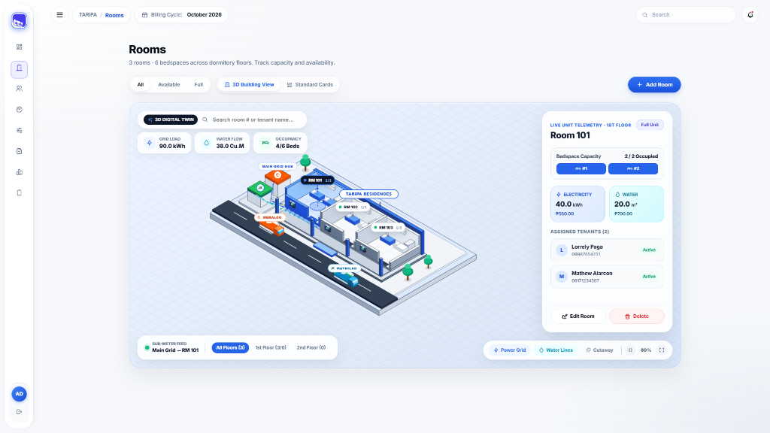
IM 2 FINAL PROJECT DEFENSE
TARIPA
Apartment Electricity & Water
Sub-Meter Billing Management System
A full-stack relational database platform for accurate sub-meter computation, interactive 3D building telemetry, and transparent tenant billing.
PROPONENTS
James Sevilla · Lorrely Paga
COURSE & INSTRUCTOR
Information Management 2 (IM 2) · Prof. Xerxes

Slide 2
01 · PROBLEM STATEMENT
Why Manual Sub-Meter Billing Fails
Addressing the pain points of apartment landlords and dormitory tenants in the Philippines
01
Prone to Manual Computation Errors
02
Lack of Tenant Billing Transparency
Landlords manually subtract Previous from Current meter readings and multiply by changing Meralco and Maynilad rates using paper notebooks or error-prone spreadsheets.
Tenants frequently dispute utility charges because they cannot verify their previous vs. present sub-meter readings or see how their kWh and Cu.M costs were calculated.
03
Fragmented & Unnormalized Records
04
Zero Access Control & Audit Trail
Room capacities, bedspace occupancy, monthly meter logs, and payment statuses (Paid, Pending, Overdue) are scattered without relational foreign-key integrity.
Paper receipts and shared spreadsheets lack Role-Based Access Control (RBAC), brute-force login protection, and verifiable official payment receipts.

Slide 3
02 · PROJECT OBJECTIVES
The TARIPA Solution & Key Innovations
Combining relational database accuracy with modern 3D visualization and self-service transparency
AUTOMATION
Automated Sub-Meter Computation
Automatically fetches previous readings, validates against meter rollback, computes exact kWh & Cu.M usage, and applies active Meralco and Maynilad rates.
3D DIGITAL TWIN
Interactive 3D Building Floor Plan
Visualizes the boarding house in an isometric 3D view with Meralco power & Maynilad water grid lines, 6-room floor capacity tracking, and live room telemetry.
TRANSPARENCY
Self-Service Tenant Portal & Odometer
Auto-provisions tenant accounts with a Digital Sub-Meter Odometer (PREV → PRES verification), 6-month usage trends, and printable Official Receipts.
RELATIONAL DB
3NF MySQL Integrity & SAST Security
Enforces strict foreign-key rules (CASCADE / SET NULL), 100% prepared statements against SQL injection, and HS256 JWT Role-Based Access Control.

Slide 4
03 · SYSTEM ARCHITECTURE
3-Tier Full-Stack Software Architecture
Clean separation of concerns across Presentation, Application API, and Relational Database layers
TIER 01 · PRESENTATION LAYER
React 19 + Vite Single Page Application (Frontend)
Liquid Glass Admin Dashboard, Interactive SVG 3D Isometric Building Digital Twin, collapsible Icon-Rail Sidebar, and Mobile-First Tenant Portal.
TIER 02 · APPLICATION & SECURITY LAYER
Node.js + Express 5 RESTful API (Backend)
Stateless JWT HS256 authentication, separate adminAuth & clientAuth RBAC middlewares, 5-attempt brute-force lockout limiter, and server-side billing validation.
TIER 03 · RELATIONAL DATA LAYER
MySQL 8.0 Relational Database (taripa_db)
5 normalized tables in 3rd Normal Form (3NF) using mysql2/promise connection pooling, foreign-key referential integrity, and 100% prepared statements.

Slide 5
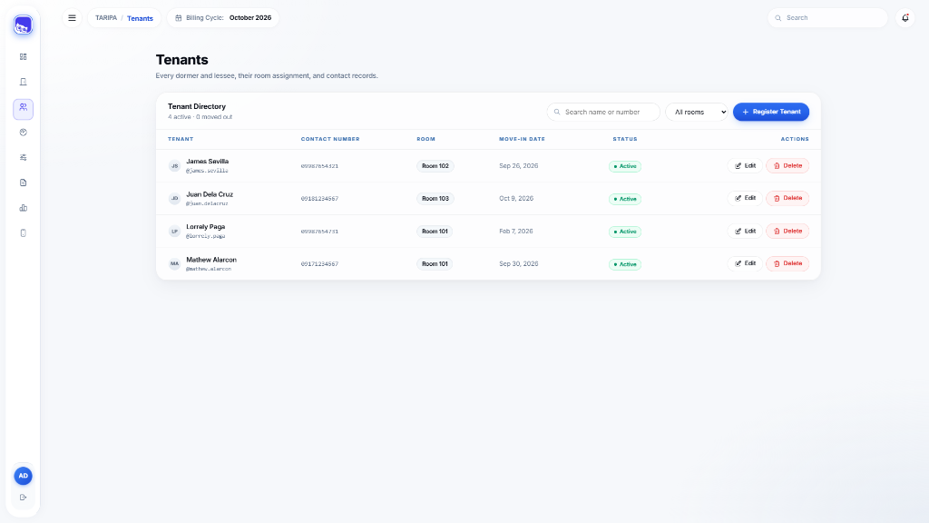
04 · DATABASE DESIGN (IM 2 CORE)
5-Table Normalized Relational Schema (taripa_db)
Designed in Third Normal Form (3NF) with strict Foreign Key constraints and SQL JOIN aggregations
1. rooms
PRIMARY ENTITY
Stores room_number (UNIQUE), capacity (1–30 beds, 6 rooms/floor), and monthly base rent.
2. tenants
FK: room_id → rooms(id) ON DELETE SET NULL
Stores resident full_name, contact_number, move_in_date, and status (Active / Inactive).
3. tenant_accounts
FK: tenant_id → tenants(id) ON DELETE CASCADE
1:1 credentials table storing auto-generated @username and BCrypt password_hash (10 salt rounds).
4. utility_rates
LOOKUP ENTITY
Stores active Meralco Electricity (₱/kWh) and Maynilad Water (₱/Cu.M) tariff rates per unit.
5. meter_readings & billing_records
FK: tenant_id → tenants(id) ON DELETE CASCADE
Logs monthly PREV & PRES sub-meter readings, computed kWh/Cu.M usage, itemized charges, and payment status.

Slide 6
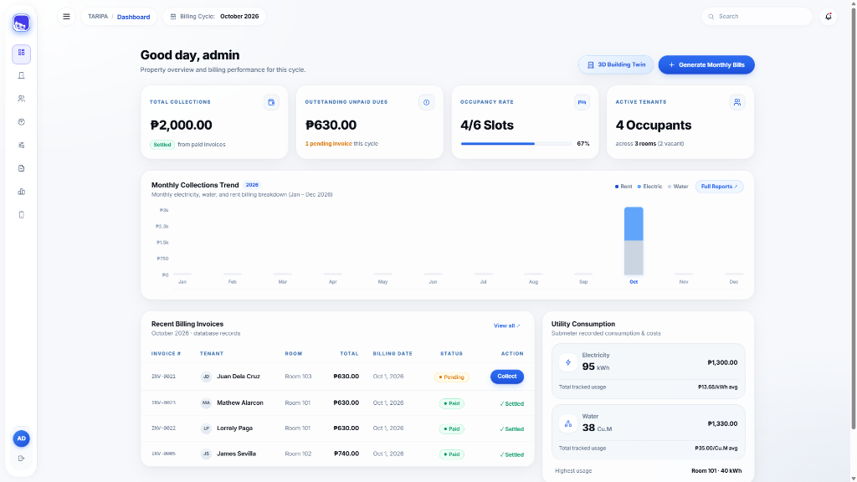
05 · ADMIN OPERATIONS & ANALYTICS
Executive Dashboard & Automated Billing Workflow
Real-time KPI tracking, 12-Month Collections Trend Bar Graph, and one-click monthly invoice generation
1. Room & Capacity Control
Enforces bedspace limits per room and prevents assigning tenants to full units.
2. Zero-Touch Provisioning
Registering a tenant auto-generates their @username and hashed portal password.
3. Smart Meter Validation
Auto-fills previous readings and blocks invalid meter rollbacks (Current < Previous).
4. 12-Month Revenue Analytics
Tracks monthly Rent, Electricity, and Water collections right on the Dashboard bar graph.

Slide 7
06 · FEATURE SPOTLIGHT #1
Interactive 3D Building Digital Twin
Real-time isometric floor plan with Meralco & Maynilad grid lines and per-room sub-meter telemetry
Meralco & Maynilad Grid Simulation
Visualizes animated electricity and water distribution lines flowing from the Main Grid Hub (with Meralco & Maynilad service trucks) into each occupied room.
6-Room Floor Capacity & Cutaway View
Supports 1st Floor (6/6 capacity) and 2nd Floor switching, roof cutaway toggle, and zoom controls.
Live Room Telemetry Inspector
Clicking any 3D room unit displays bedspace occupancy slots (#1, #2), live kWh & Cu.M consumption, and active tenant profiles.

Slide 8
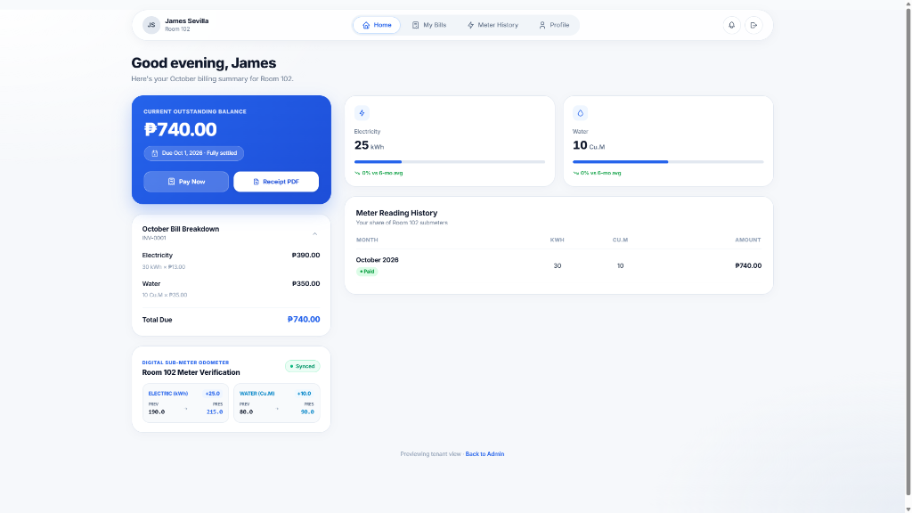
07 · FEATURE SPOTLIGHT #2
Tenant Self-Service Portal & Sub-Meter Odometer
Empowering residents with verifiable meter readings, consumption gauges, and instant digital receipts
Digital Sub-Meter Odometer Card
Displays exact PREV → PRES sub-meter readings for Electricity (kWh) and Water (Cu.M) with a live Synced verification badge so tenants can verify their physical room meters.
Itemized Bill Breakdown & Gauges
Shows exact formula computations (kWh × Rate and Cu.M × Rate) alongside 6-month usage trend comparisons.
Instant Payment & Printable Receipt
Allows tenants to settle bills via GCash, Maya, or Bank Transfer and generate an Official Receipt PDF.

Slide 9
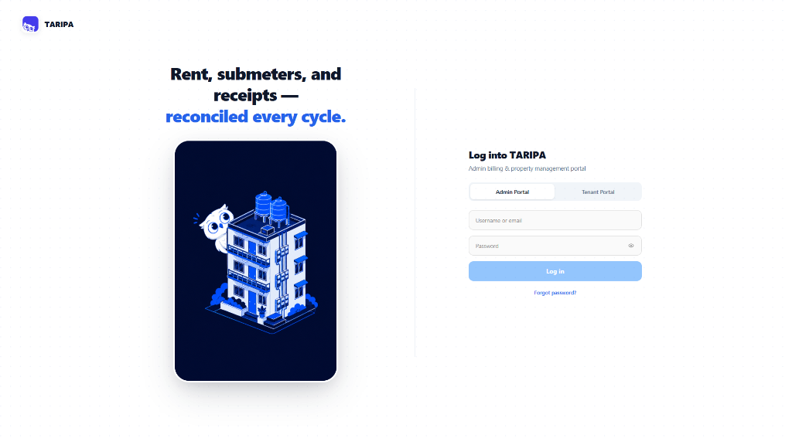
08 · CYBERSECURITY & DATA PRIVACY
SAST Security Audit & Defensive Hardening
Audited and hardened against OWASP Top 10 web and API vulnerabilities
100% SQL Injection Immunity
All SQL queries across all 7 backend route modules use parameterized prepared statements (?) via mysql2/promise.
JWT HS256 Pinning & RBAC / IDOR Guard
Separate adminAuth and clientAuth middlewares pinned to HS256; tenants can only access their own verified req.clientTenantId.
Brute-Force Lockout & DoS Guards
5-attempt login rate limiter with a 30-second lockout (HTTP 429), strict JSON string/length validation, and a 100KB payload limit.
HTTP Security Headers & XSS Escaping
Protected with X-Frame-Options: DENY, X-Content-Type-Options: nosniff, and HTML escaping on printable billing statements.

Slide 10
09 · CONCLUSION & LIVE WALKTHROUGH
Summary & Live System Demonstration Flow
Transitioning from presentation slides to our live full-stack TARIPA demonstration
STEP 01
STEP 02
STEP 03
STEP 04
Admin Dashboard & Analytics
3D Building Digital Twin
Tenant & Sub-Meter Workflow
Tenant Portal & Official Receipt
Showcase real-time KPIs, the 12-Month Collections Trend Bar Graph, and the collapsible Icon-Rail Sidebar.
Demonstrate the interactive isometric building view, Meralco & Maynilad grid lines, and Room 101 telemetry.
Register a tenant, log sub-meter readings with rollback protection, and generate monthly utility invoices.
Log in as a tenant, verify PREV → PRES readings on the Digital Odometer, pay via GCash, and print the Official Receipt.
Thank You! We are now ready for the Live System Demonstration & Panel Q&A.

