Slide 1
MCU-platform for R-DIM
University of Michigan

Slide 2
R-DIM: Relaxation-based DIM
Mid-level
Optimization problem
High-level
Adjacency matrix, $$A$$
Progression program
Binary solution, $$σ$$
R-DIM
Low-level
Rules adjustment
Projection
Random initial state, $$ξ\left(0\right)$$
Progression rules
Evolution
$$\dot{ξ}=F\left(ξ\left(t\right)\right)$$
Final state, $$ξ_{F}$$

Slide 3
Software-hardware co-development
Hardware component
Core architecture
Multi-board architectures
Application-centered architectures
Core instruction set
Extended instruction set
Specialized instruction sets
Heterogeneous kernels
Communication protocols
Optimized nodes layouts
Adaptive control
Fixed and expandable architectures
Hyperparallelization techniques
Software component
User-facing interfaces
C/C++, Python, Julia bindings, …
Pre-processing tools
Mid-level and low-level code generators, …
Behavior simulation platform
Platform emulator, …

Slide 4
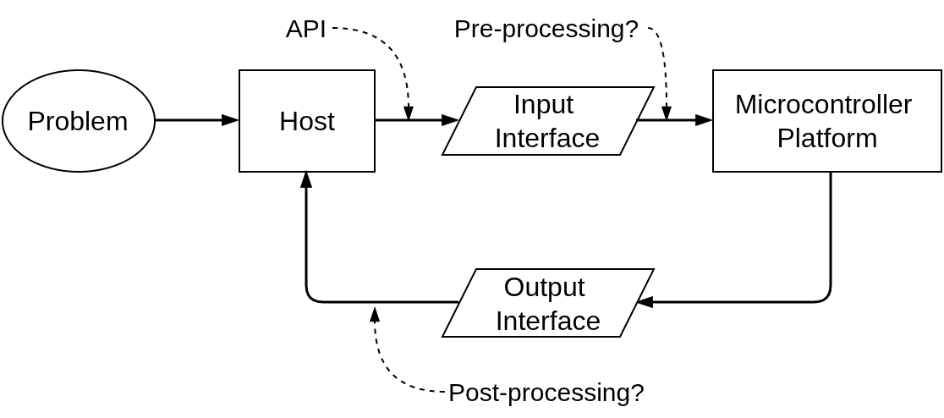
Platform dataflow overview
Modes of Host/Platform communications
Protocols

Slide 5
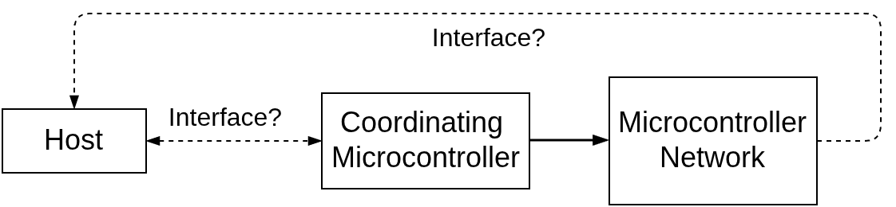
Dedicated control node

Slide 6
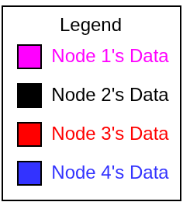
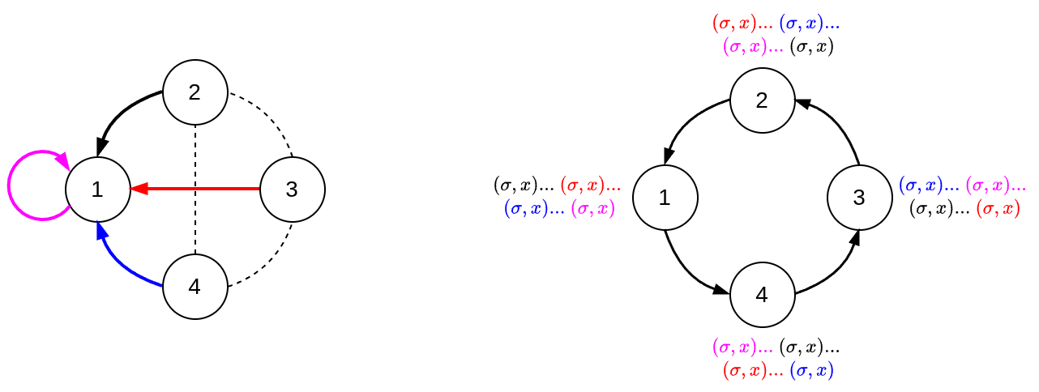
Topologies: network vs platform
Platform topology and data pass-through
Network topology and the order of processing

