Slide 1
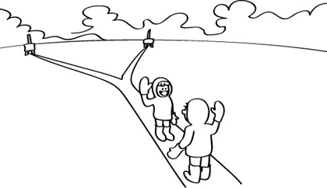
Finding Steiner Minimal Trees in Euclidean d-Space
Source: http://csunplugged.org/steiner-trees

Slide 2
Outline
What will happen in this presentation

Slide 3
Introduction to the problem
What is estp, smt, fst?

Slide 4
2D and why it doesn't generalize

Slide 5
Smith's algorithm

Slide 6
Extensions to Smith's algorithm
Basically about my implementation and the new things made

Slide 7
Experiments
Correctness
Performance (run-time, # of trees, # of iterations)

Slide 8
Correctness

Slide 9
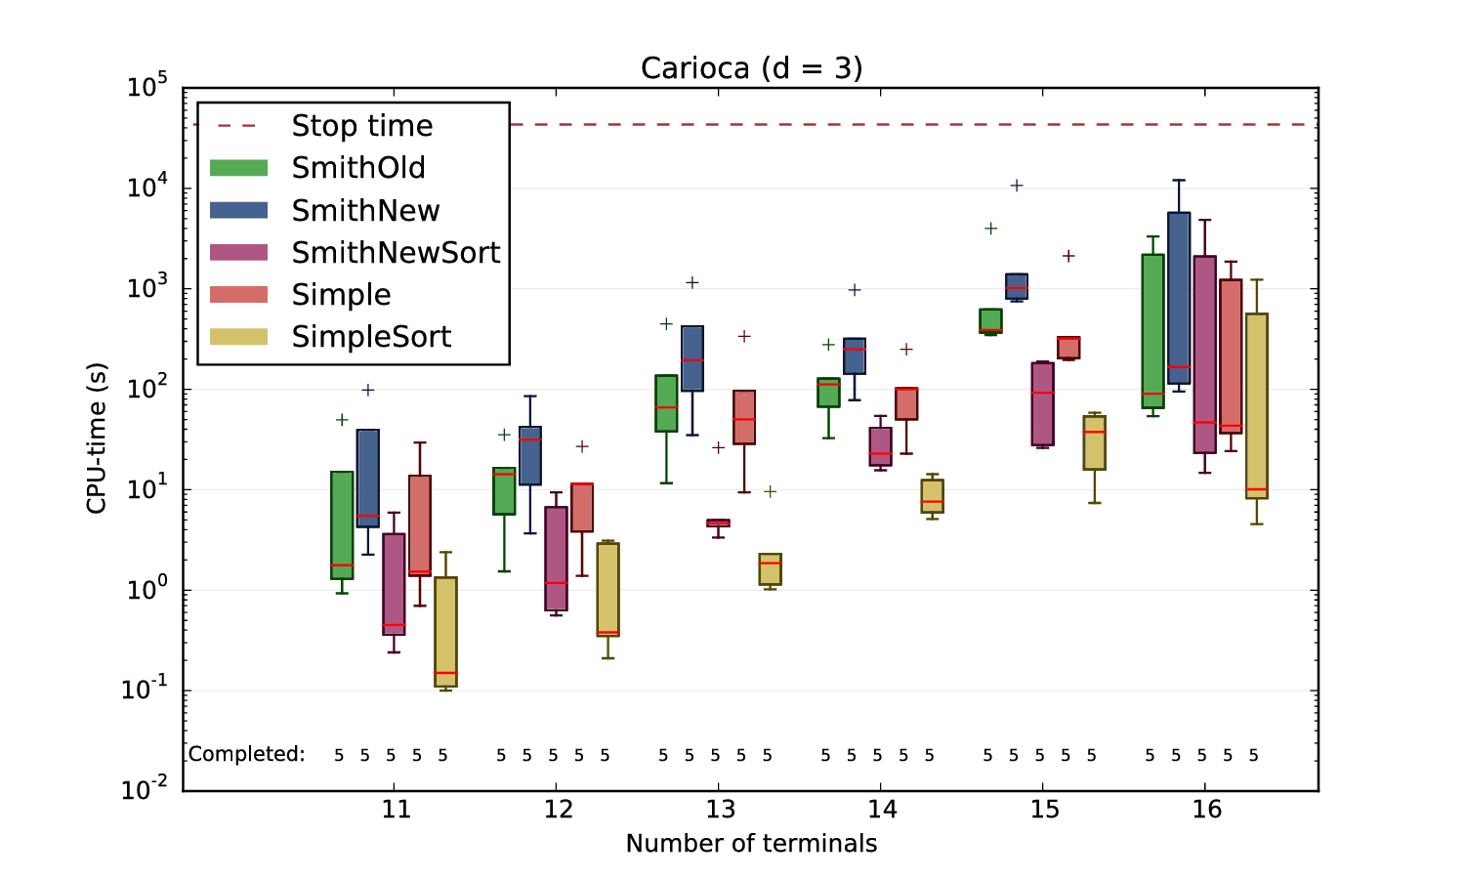
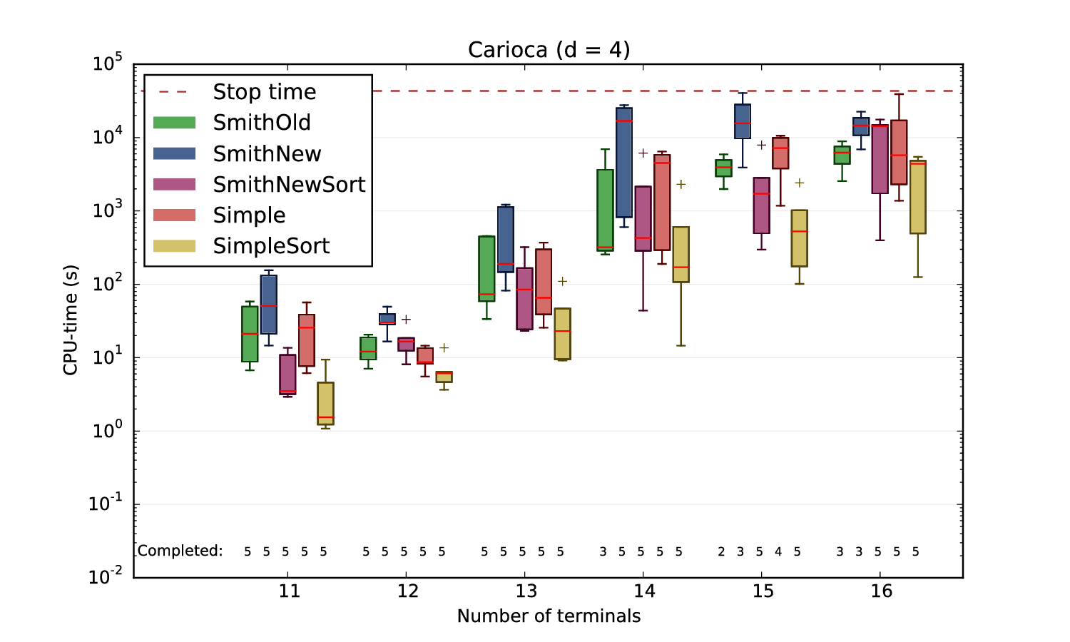
Run-times (1/3)

Slide 10
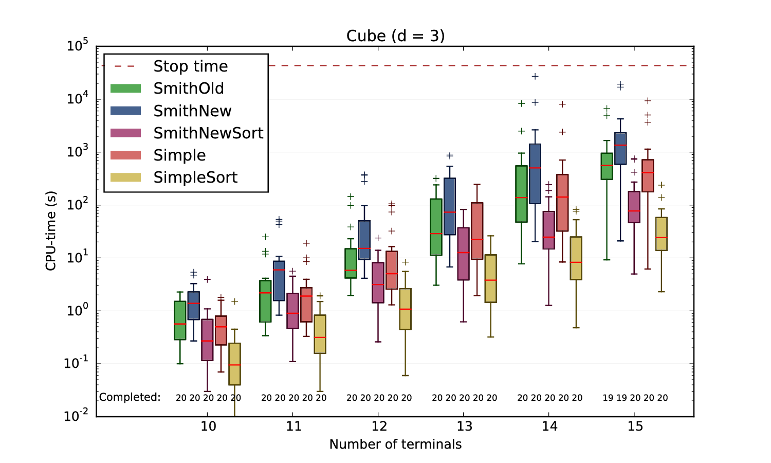
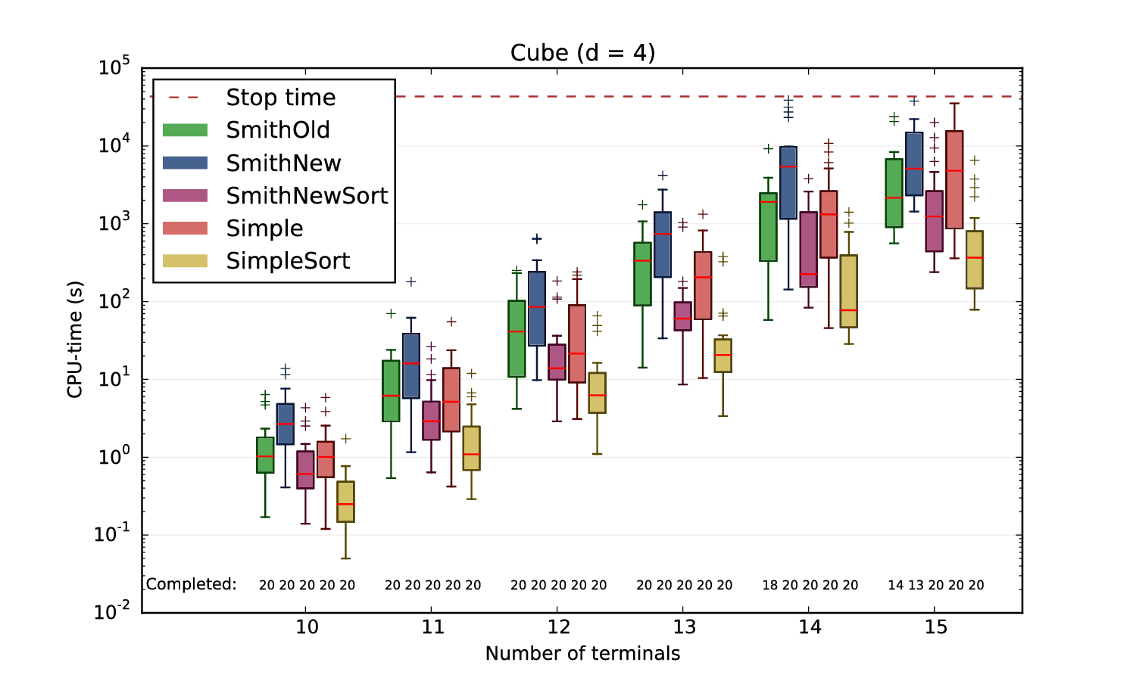
Run-times (2/3)

Slide 11
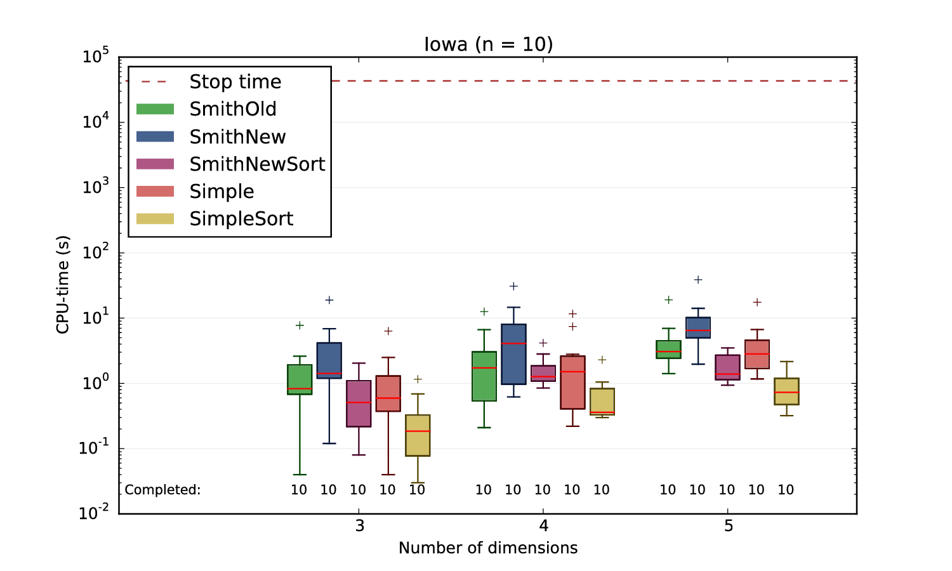
Run-times (3/3)

Slide 12
# of trees/iterations

Slide 13
Possible further improvements
Making the main loop concurrent
Only optimize Steiner points when a change is propageted
Place Steiner points using the analytical solution to Fermat-Torricelli initially (instead of the centroid)
  Quick test showed 20% fewer iterations and 60% fewer trees.
Using the weber point?

Slide 14
Conclusion
Further work needs to be done on the sub-optimality

