Slide 1
Case Study 3
Textual Analysis of Movie Reviews: When Two is Better Than One and Three Is Not a Crowd.
November 15, 2017
Group 1: Claire Danaher, Jonny Friedman, Janvi Kothari, Renee Sweeney, Erin Teeple

Slide 2


v2.0 polarity dataset
2000 movie review text files
pre-labelled as positive or negative

Slide 3
Natural Language Processing
1
Objective: Automated interpretation of natural language text
Methods: Computer Science, Artificial Intelligence, Linguistics

Slide 4
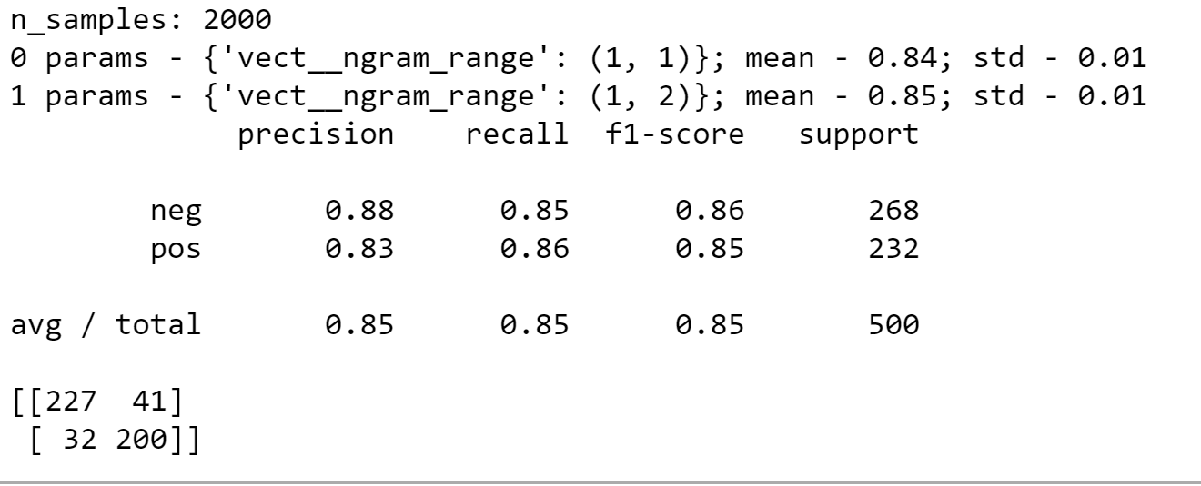
Basic Model - Sentiment Analysis of Movie Reviews
Classification report and confusion matrix show that bigrams provide better classification accuracy than unigrams.

Slide 5
Tuning Parameters
2
Objective: Automated interpretation of natural language text
Methods: Computer Science, Artificial Intelligence, Linguistics

Slide 6
TfidVectorizer - transform text documents into TF-IFD matrix
Important terms:
TF-IDF: term frequency inverse document frequency
Max_df: parameter to exclude high frequency words
Min_df: parameter to exclude very low frequency words
N-gram range: extracts terms as N-length sets of words

Slide 7
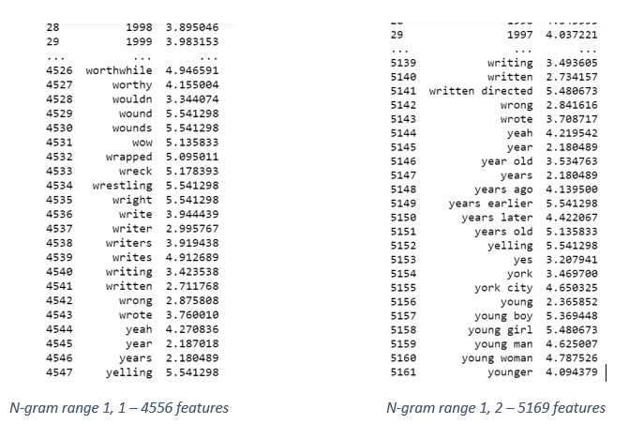
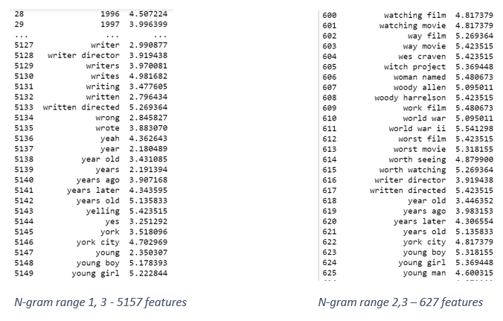
Further parameter tuning.
Comparison of number of features for varying n-gram ranges

Slide 8
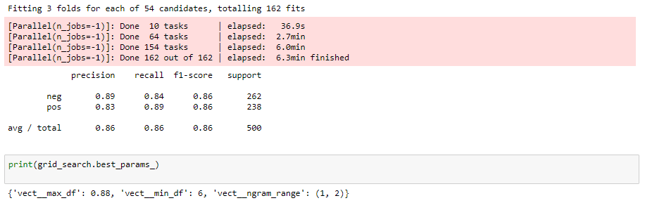
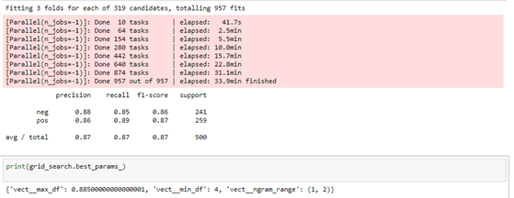
Tuning parameters can be time-intensive.

Slide 9
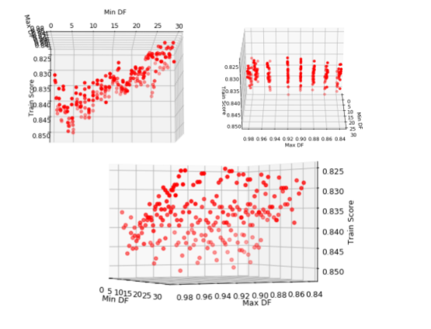
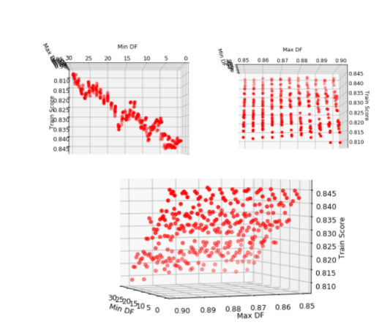
Classification report following further optimization with GridSearchCV

Slide 10
Fitting and Optimizing
3
GridSearchCV used to tune parameters on different models for further comparison:
K-Nearest Neighbors
Linear Support Vector Classifier

Slide 11
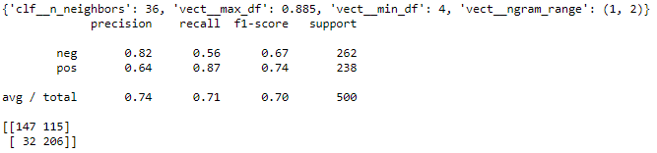
Classification Performance Summary - K-Nearest Neighbors
K-nearest neighbors did not perform as well as SVC.

Slide 12
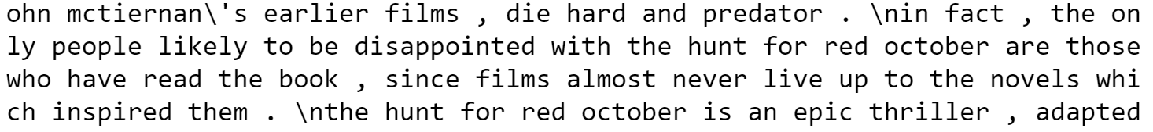
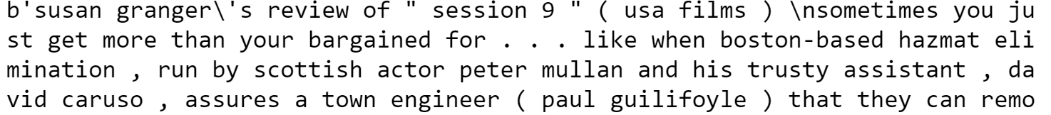
Misclassifications: SVC, bigrams
Y_Predicted[11] - positive review, misclassified as negative
Y_Predicted[484] - negative review, misclassified as positive

Slide 13
Visualizations
4

Slide 14
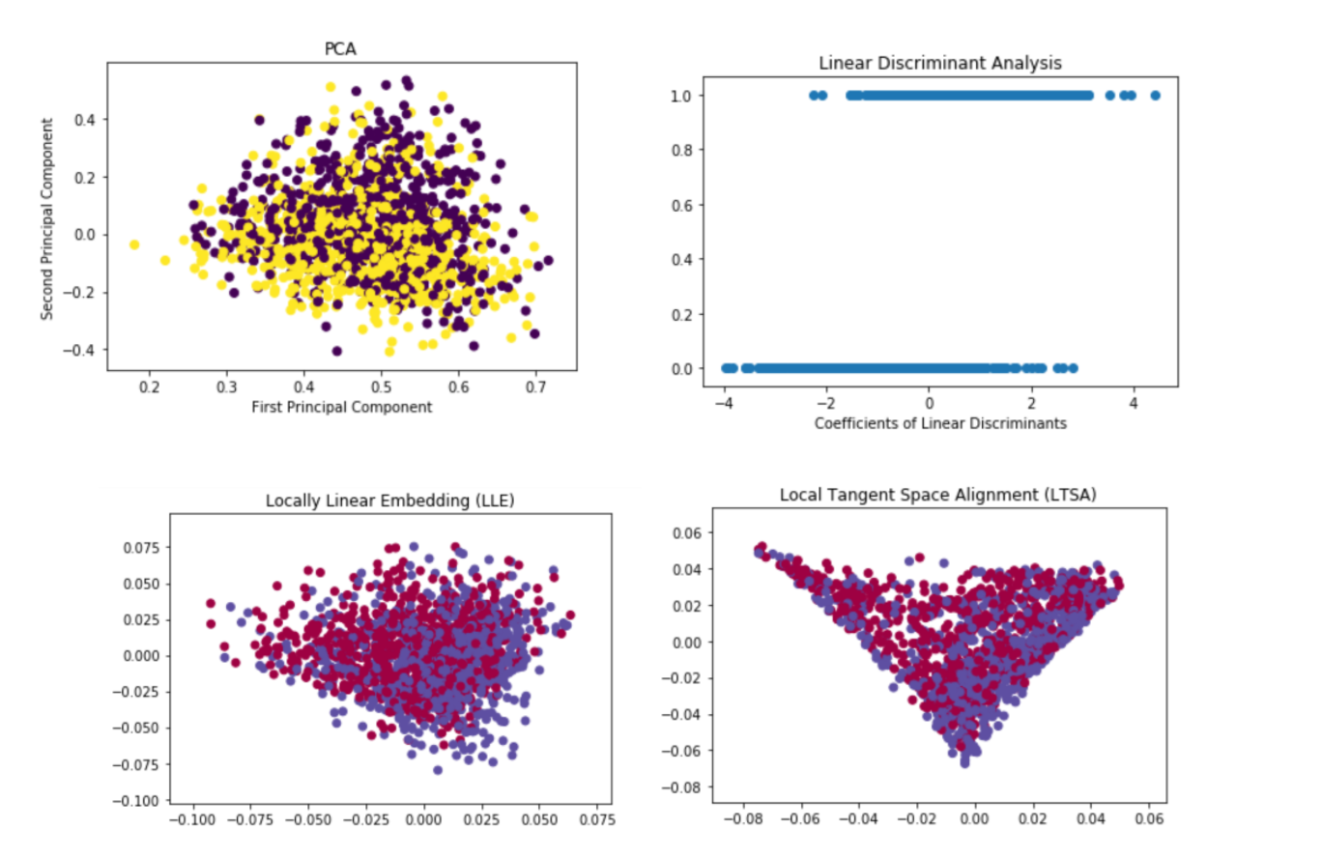
Visualizations

Slide 15
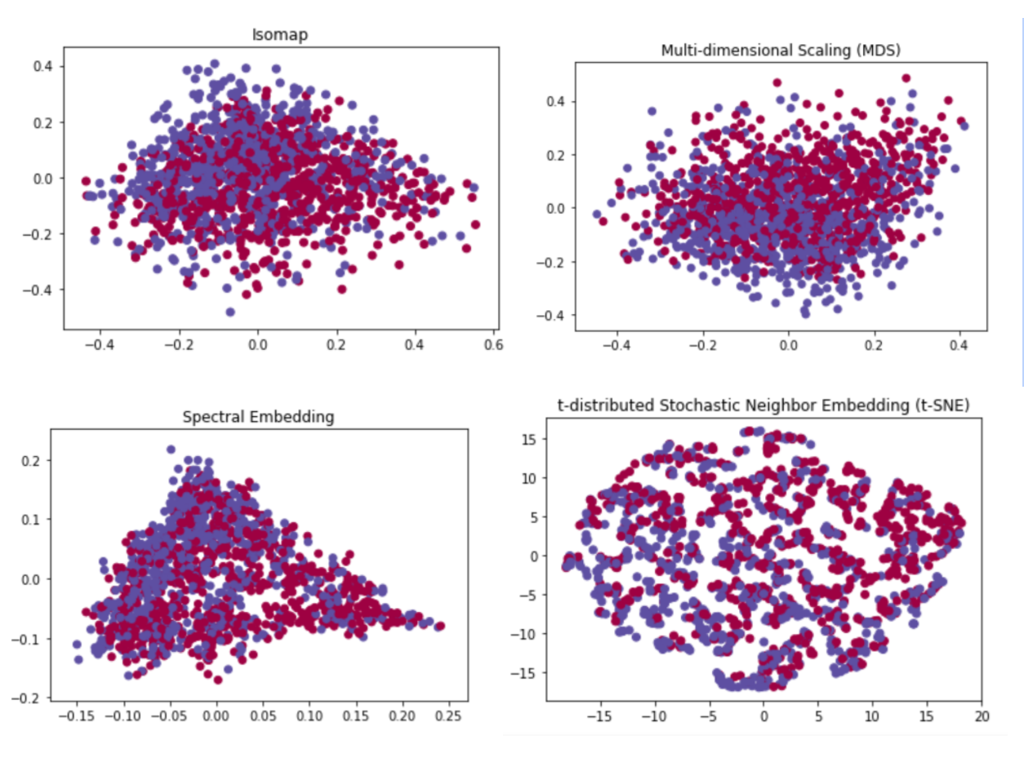
Visualizations

Slide 16
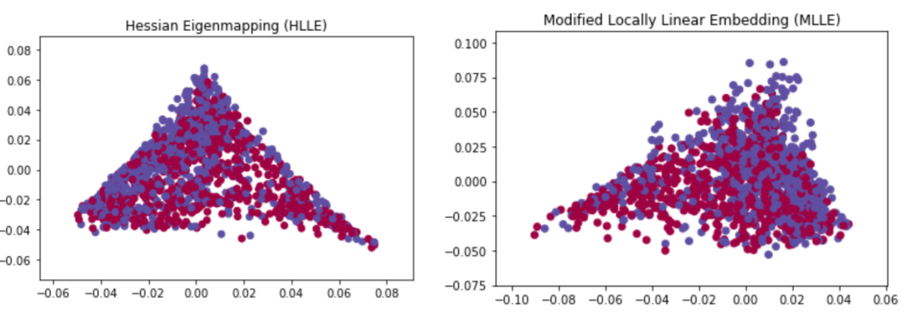
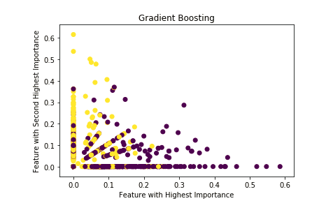
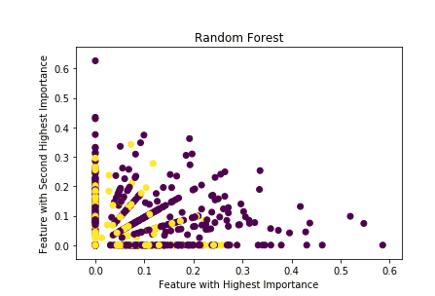
Visualizations

Slide 17
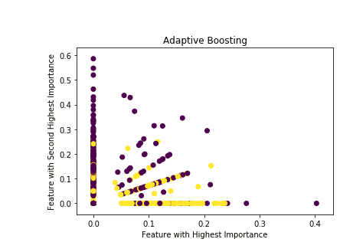

Slide 18
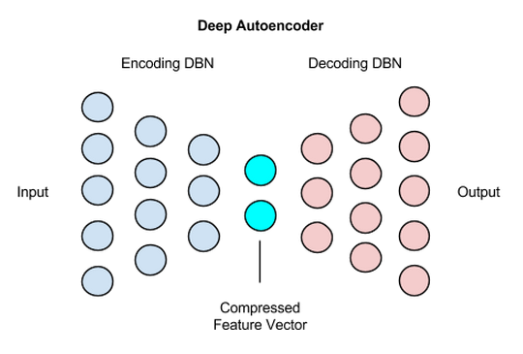
Autoencoders
https://deeplearning4j.org/img/deep_autoencoder.png

Slide 19
Natural Language Processing and Business Intelligence
Natural Language Processing Unstructured text data analyzed to gauge author sentiment
Efficient, reproducible quantitative analysis of critical reception
Movie Industry Insights
Examine reception relative to profitability, genre, talent, other metrics

Slide 20
Conclusions and Future Directions
We were able to achieve relatively high classification accuracy for the task of determining movie review positive or negative sentiment.
Visualization of our insights in a 2-dimensional figure proved challenging, although some separation could be demonstrated with different methods.
Cross-validation is needed to establish method accuracy for different document types

Slide 21
Thank You
QUESTIONS?

