Slide 1
Raven’s Progressive Matrices IQ Test
Number 1 – 60 on a blank sheet of paper. We will do 12 questions a day.
from http://www.clipsite.com.ar/HOME/Salud/Test/Raven/
Another test is at http://www.iqleague.com/iq-scores
Go to Day 2.
Go to Day 3.
Go to Day 4.
Go to Day 5.

Slide 2
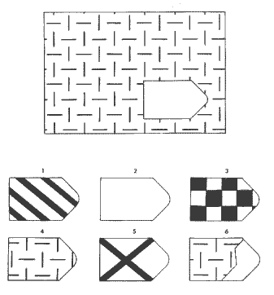
1.
T E S T D E R A V E N

Slide 3
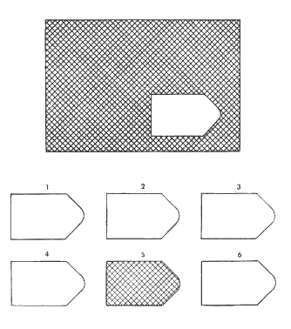
2.

Slide 4
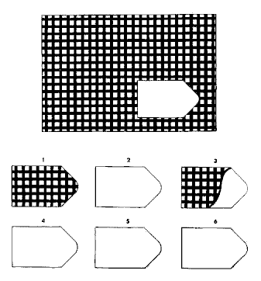
3.

Slide 5
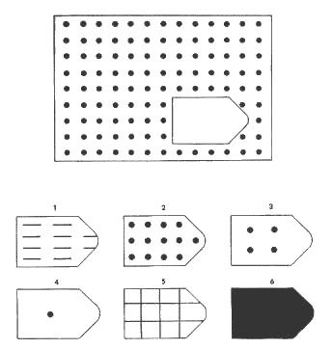
4.

Slide 6
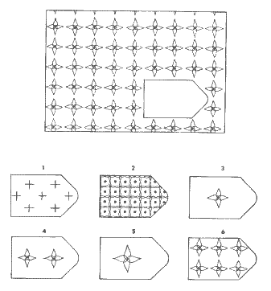
5.

Slide 7
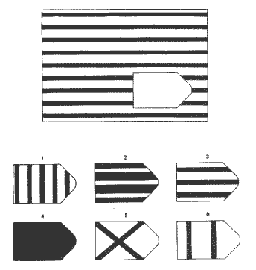
6.

Slide 8
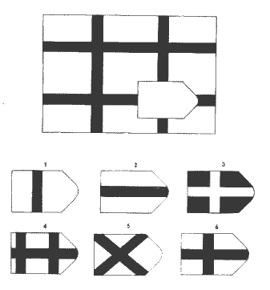
7.

Slide 9
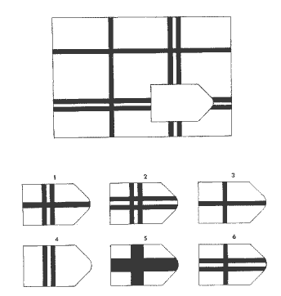
8.

Slide 10
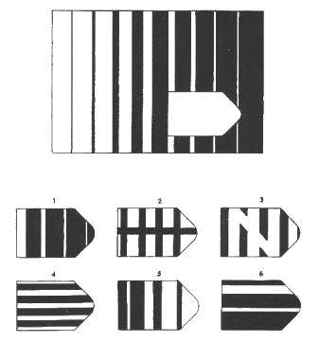
9.

Slide 11
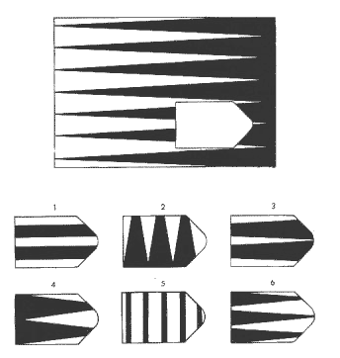
10.

Slide 12
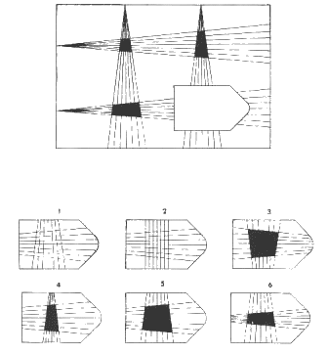
11.

Slide 13
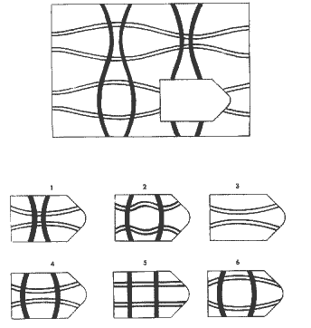
12.

Slide 14
End Day 1 of IQ Test
To be continued…..

Slide 15
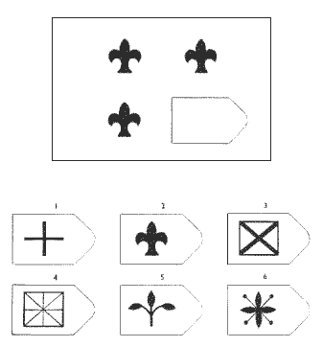
13.

Slide 16
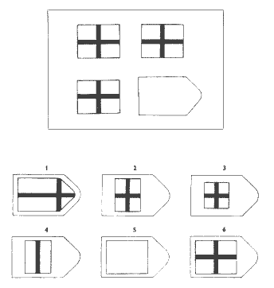
14.

Slide 17
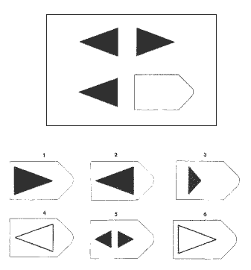
15.

Slide 18
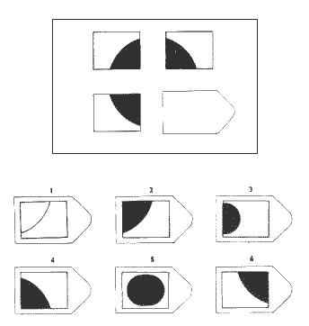
16.

Slide 19
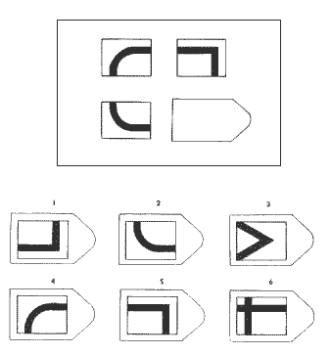
17.

Slide 20
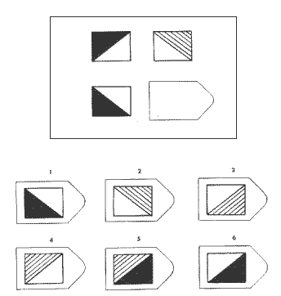
18.

Slide 21
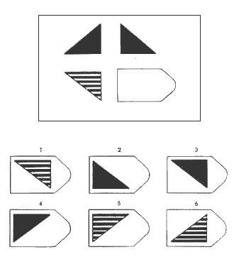
19.

Slide 22
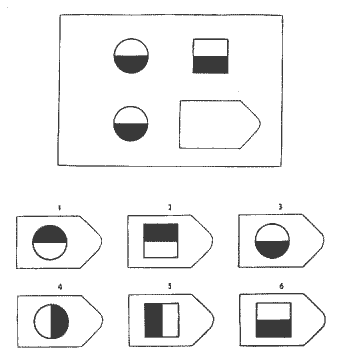
20.

Slide 23
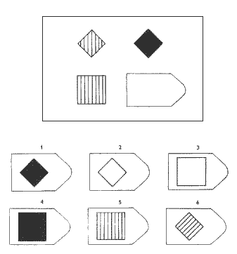
21.

Slide 24
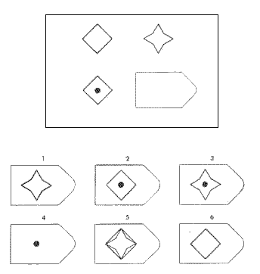
22.

Slide 25
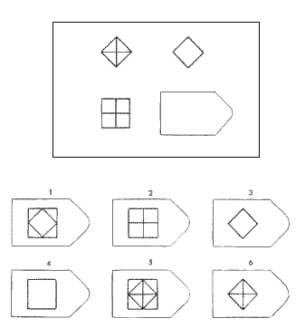
23.

Slide 26
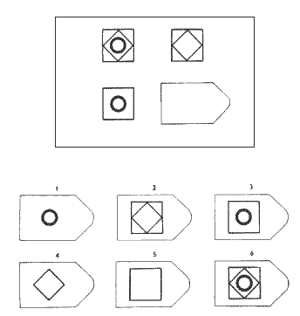
24.

Slide 27
End Day 2 of IQ Test
To be continued…..

Slide 28
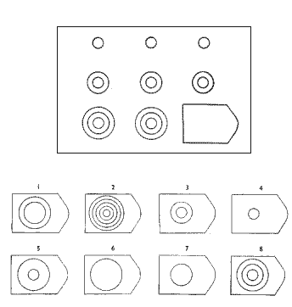
25.

Slide 29
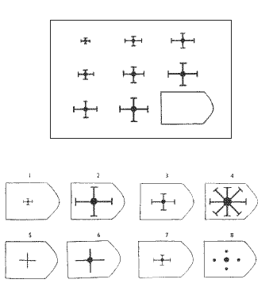
26.

Slide 30
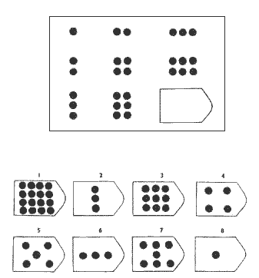
27.

Slide 31
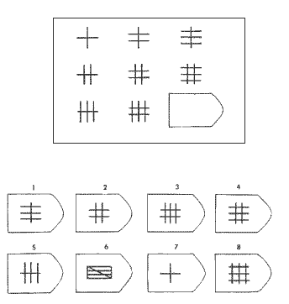
28.

Slide 32
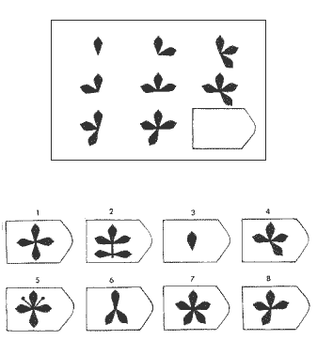
29.

Slide 33
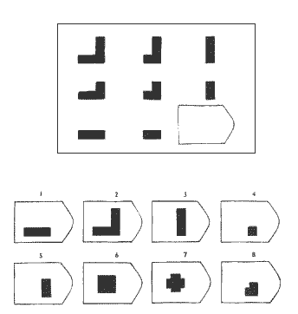
30.

Slide 34
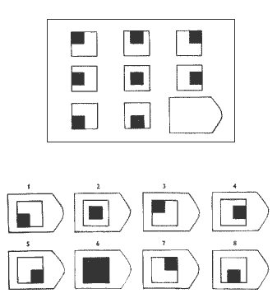
31.

Slide 35
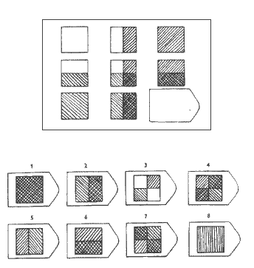
32.

Slide 36
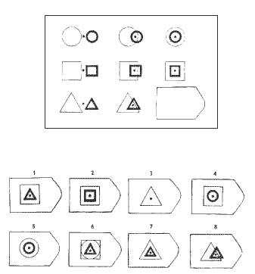
33.

Slide 37
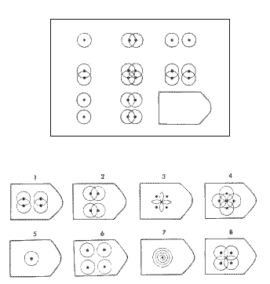
34.

Slide 38
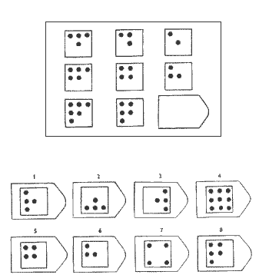
35.

Slide 39
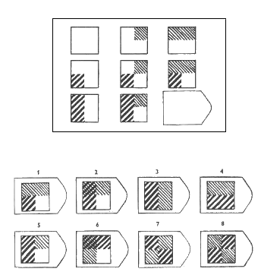
36.

Slide 40
End Day 3 of IQ Test
To be continued…..

Slide 41
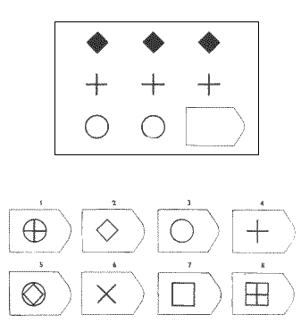
37.

Slide 42
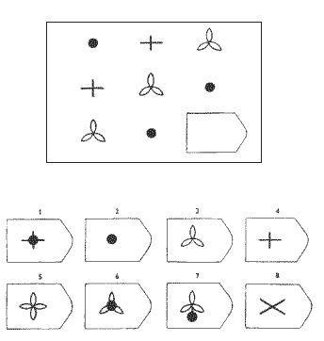
38.

Slide 43
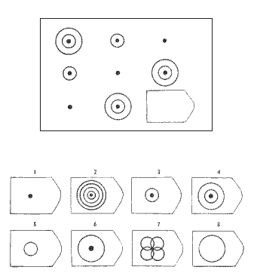
39.

Slide 44
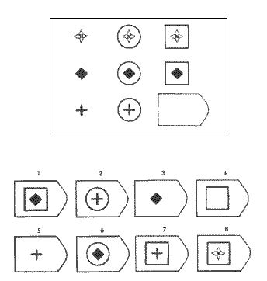
40.

Slide 45
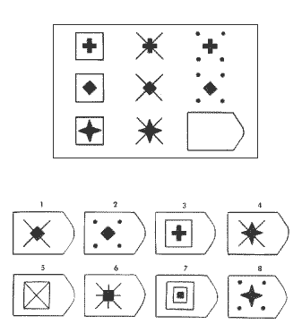
41.

Slide 46
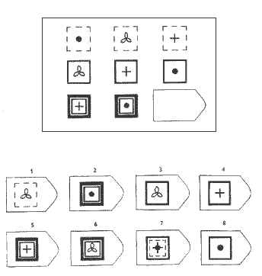
42.

Slide 47
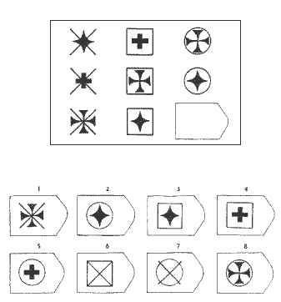
43.

Slide 48
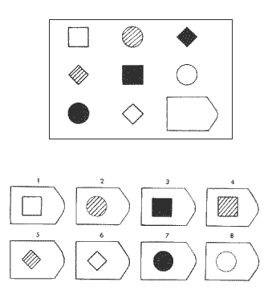
44.

Slide 49
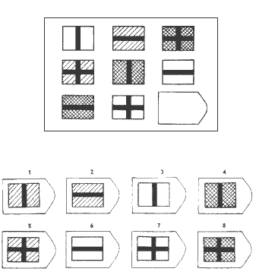
45.

Slide 50
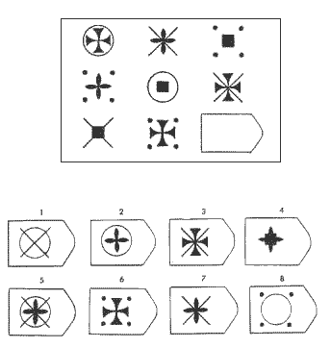
46.

Slide 51
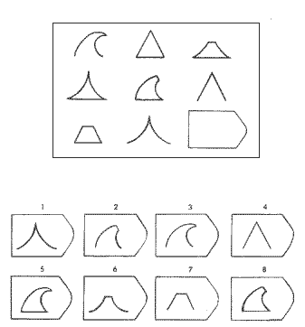
47.

Slide 52
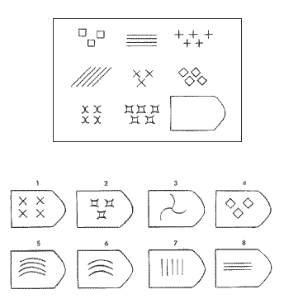
48.

Slide 53
End Day 4 of IQ Test
To be continued…..

Slide 54
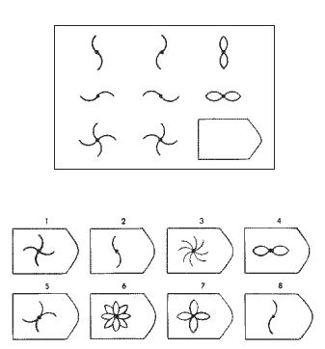
49.

Slide 55
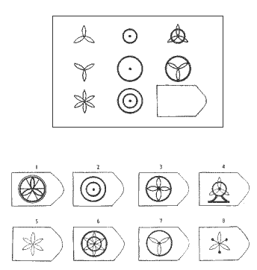
50.

Slide 56

51.

Slide 57

52.

Slide 58

53.

Slide 59

54.

Slide 60

55.

Slide 61

56.

Slide 62

57.

Slide 63

58.

Slide 64

59.

Slide 65

60.

Slide 66
End Day 5 of IQ Test

Slide 67
IQ
#correct 2 11 21 30 39 49 58
70
80
90
100
110
120
130

