Slide 1
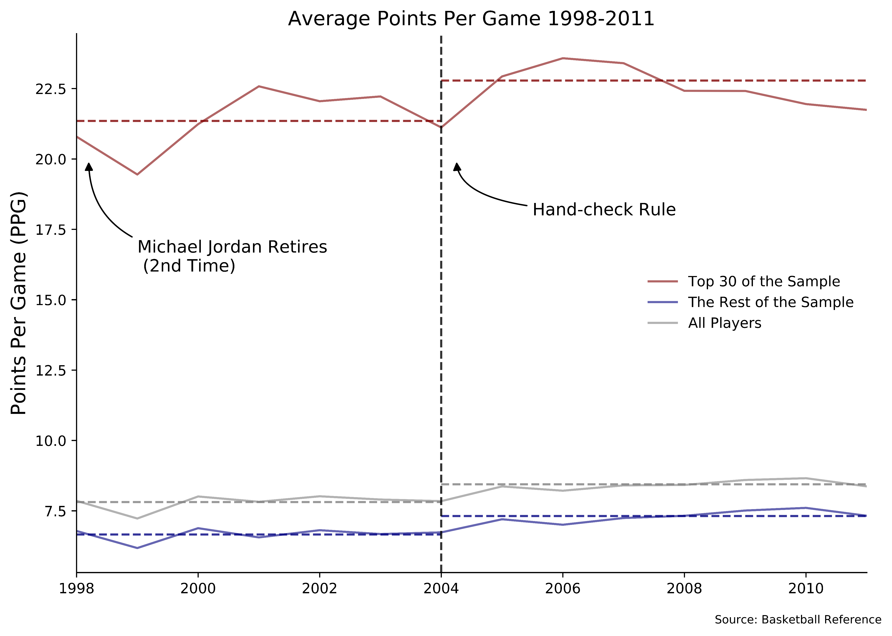

Average Points Per Game
$$PPG=\frac{Total Points Scored}{Games Played}$$

Slide 2
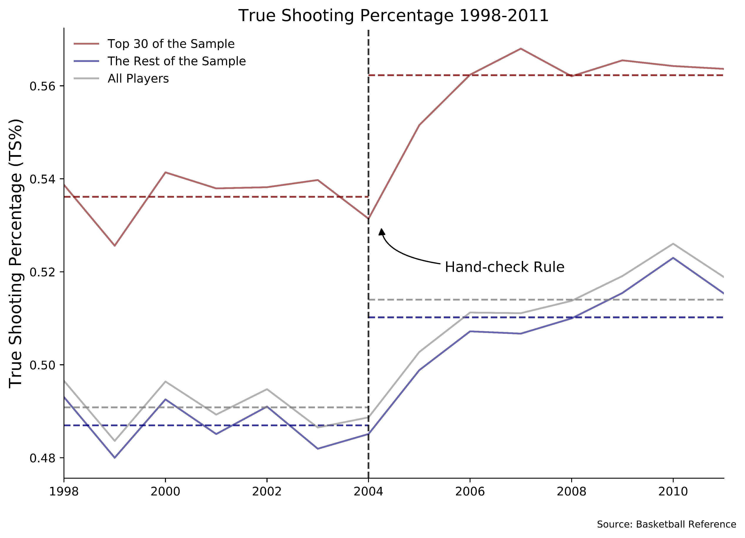

True Shooting Percentage
$$TS\%=\frac{PTS}{2(FGA+\left(0.44×FGA\right))}×100$$

Slide 3
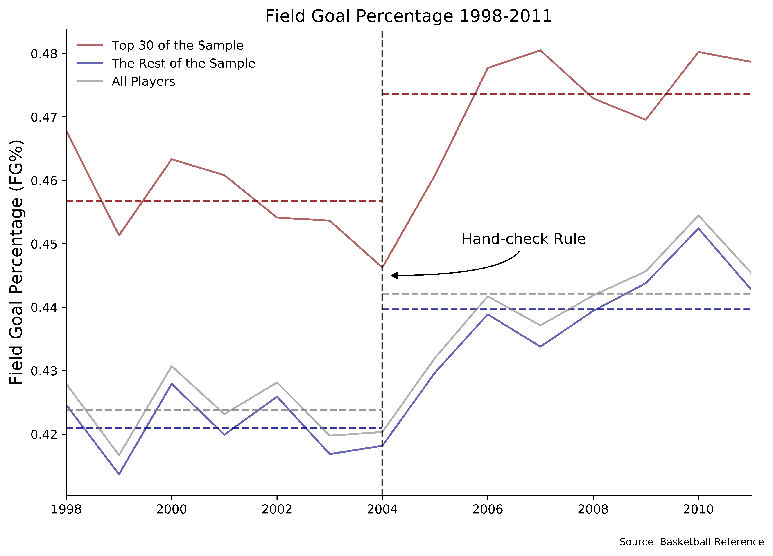

Field Goal Percentage
$$FG\%=\frac{Field Goals Made}{Field Goal Attempts}×100$$

Slide 4
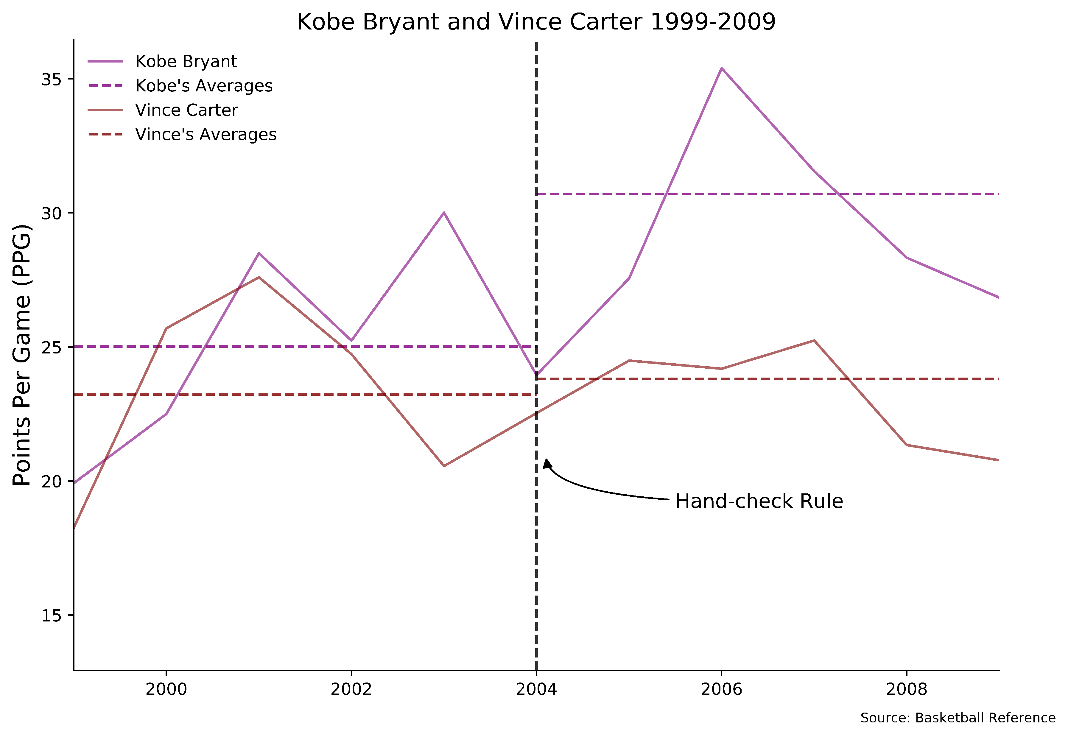
Kobe Bryant and Vince Carter PPG

