Slide 1
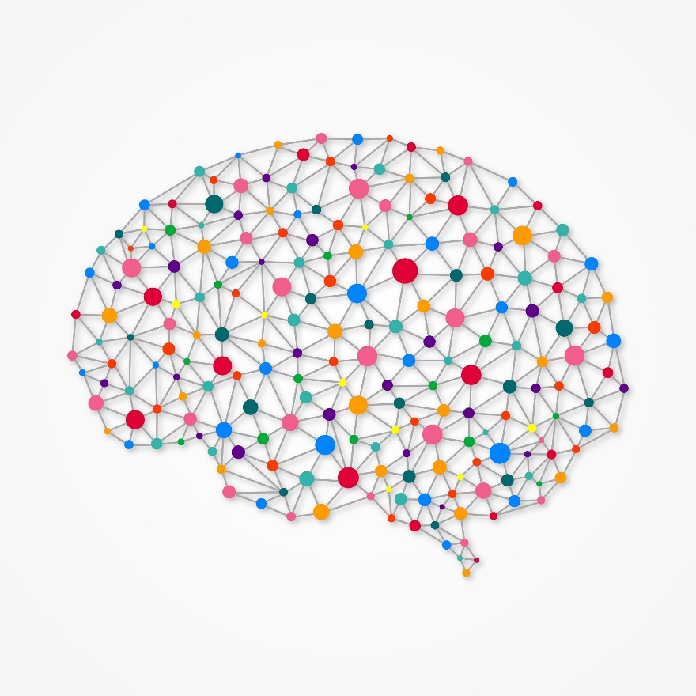

Final Project
Movie genre classification
Deep Learning and Neural Network
Ángela Ordoñez C. - Juan Sebastián Garcés C.

Slide 2
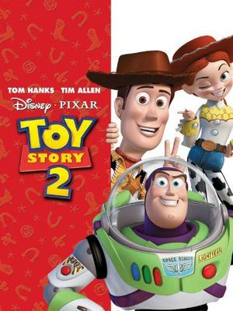


Movie genre classification
Objective
Classify a movie genre based on plots and posters.
Methodology
Machine Learning algorithm using both images and text
Deep Learning algorithm using both images and text
Embed results of the best model found in images and the best model found in text.

Slide 3
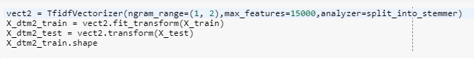
Movie genre classification
Using the movie plots - Text
The function TfidfVectorizer, allows summarize the text to a matrix, using the parameters: ngram, max_features and stemmer:
This transformation will be use to fit a random forest (Machine Learning) and also to a Neuronal Network (Deep Learning).

Slide 4
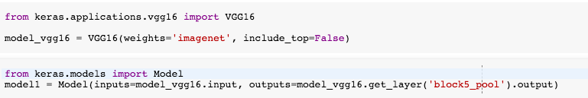
Movie genre classification
Using the movie posters - Image
A PCA with 80 componentes was applied to the flatten grey scale and color images. For the 80 components, fit a random forest as a Machine Learning algorithm.
After split Training color images into train and validation, the pre-trained VGG16 model without de top layer was used as input of a neural network (Deep Learning).

Slide 5
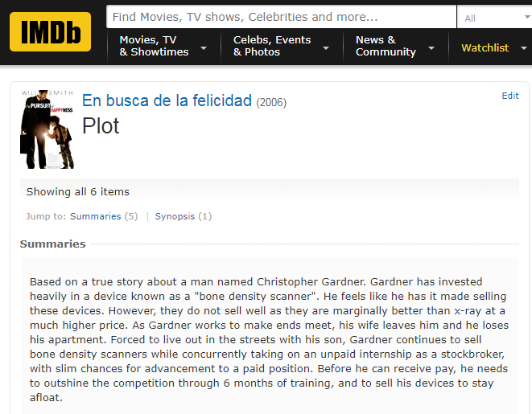

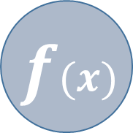

Movie genre classification
Results - AUC
Random Forest
0.84
Average
Text
CNN
$$\tilde{x}$$
0.56
0.88
Random Forest
0.58
Grey
$$f(x)$$
0.74
Image
Transfer Learning
Color
0.5
Stacking

Slide 6
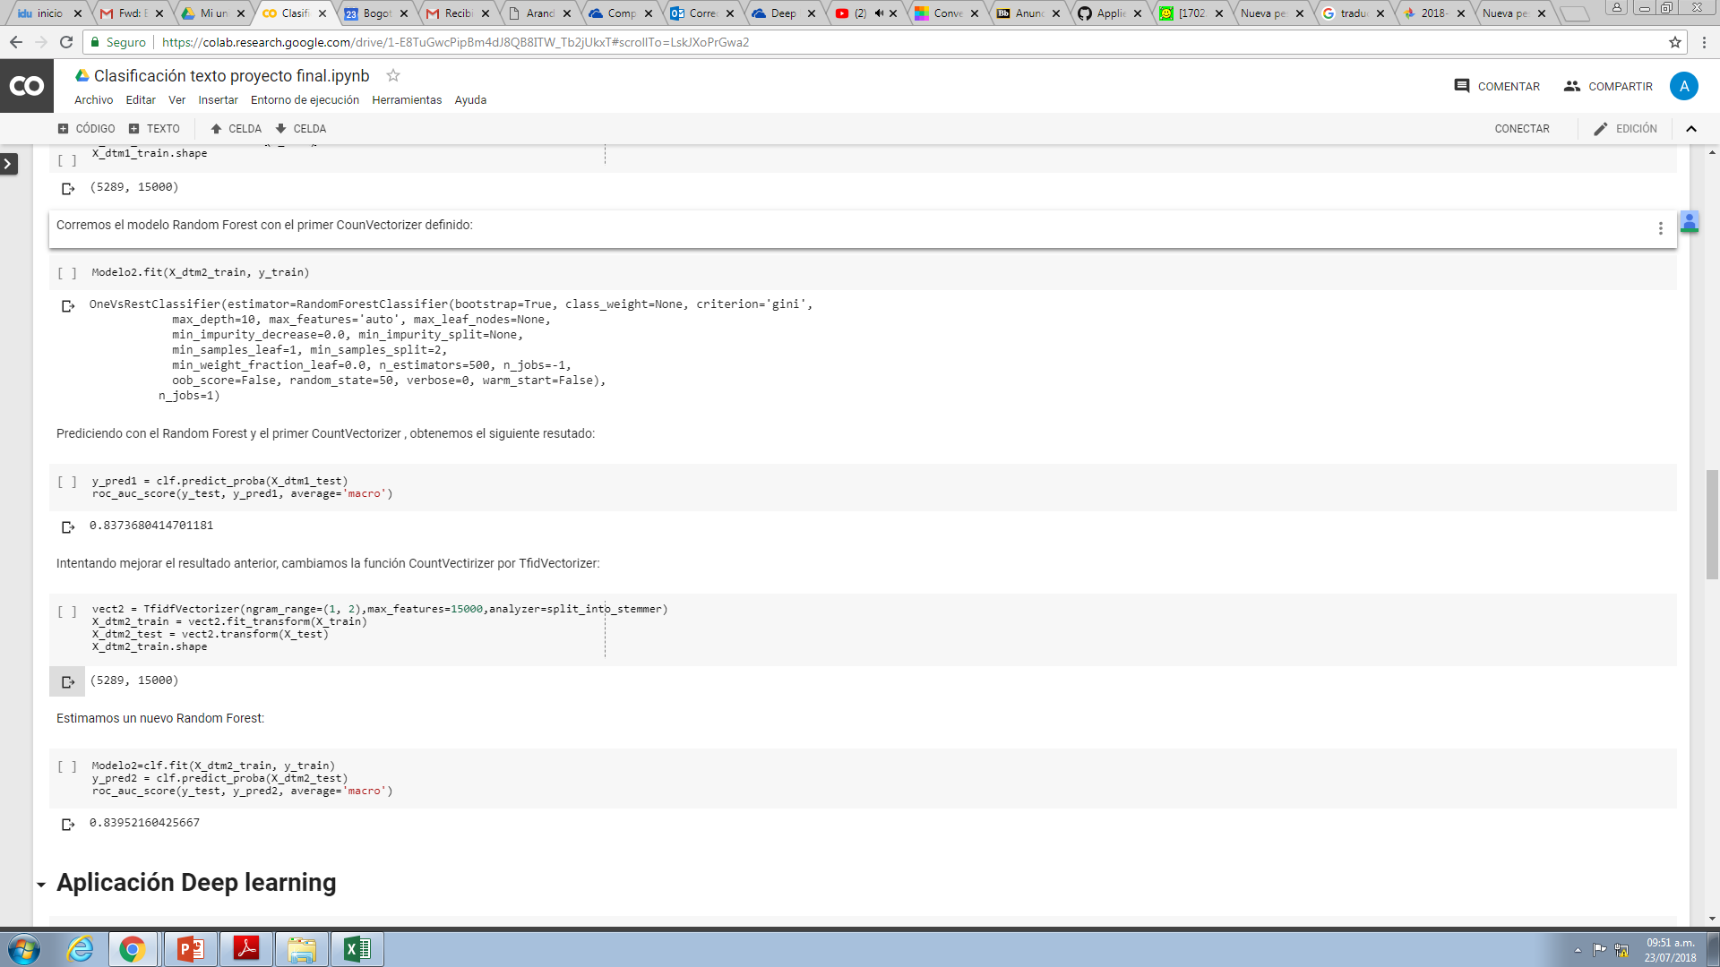
Movie genre classification
Random Forest – Text

Slide 7
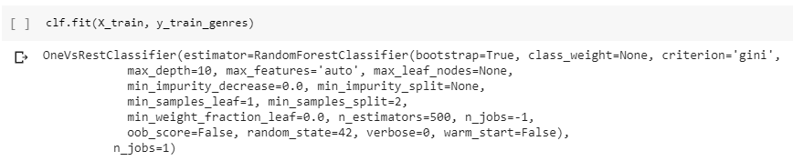
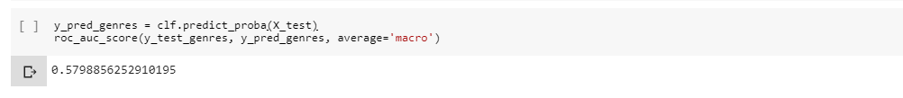
Movie genre classification
Random Forest – Images

Slide 8
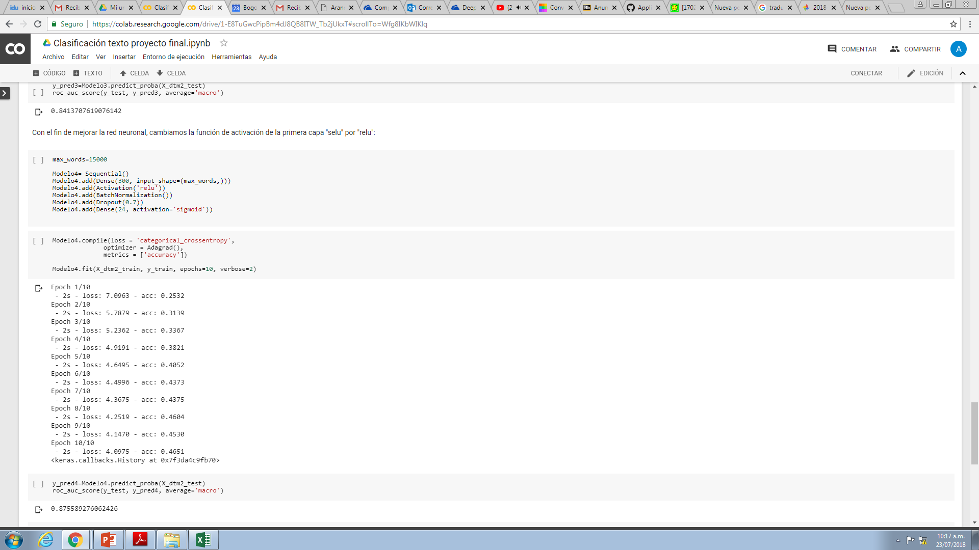
Movie genre classification
CNN – Text

Slide 9
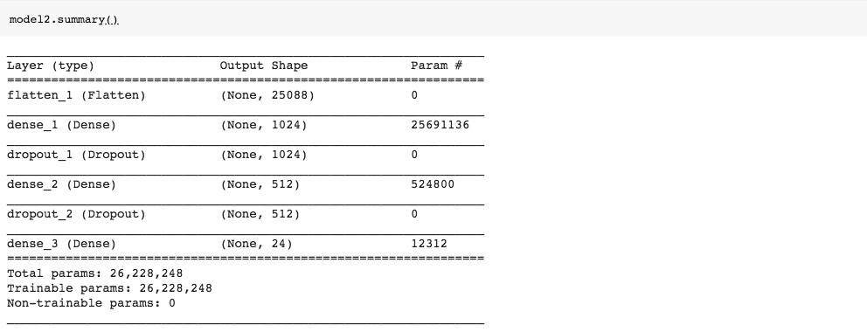
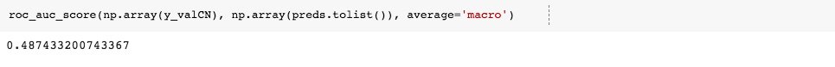
Movie genre classification
Transfer Learning – Images

