Slide 1
FailSafe
2
We’re back
A Jordan Gill, Bre Tucker, and Autumn Jackson production

Slide 2
recap
Basically we’re aiming to help students stay on top of their academic performance by providing an app to let them see what grades are needed to meet their academic goals.
Notes:
Maybe add some animated shapes and stuff saying that our main goals right now are calculating the grades, keeping track of assignments, and extending the calculating grades bit to include the what if feature.

Slide 3
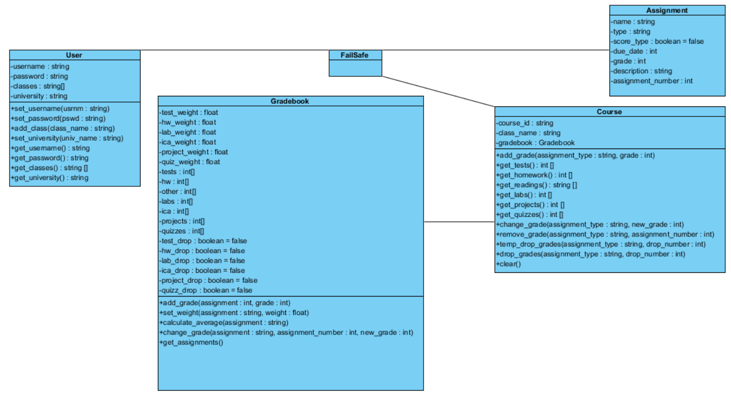
the starting Lineup

Slide 4
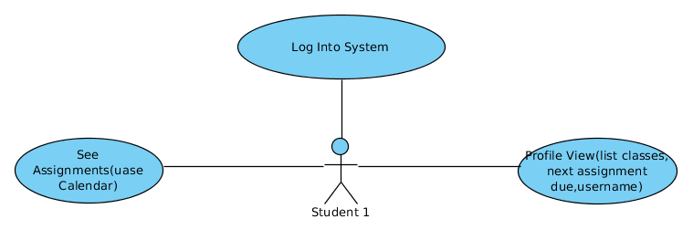
Use Cases

Slide 5
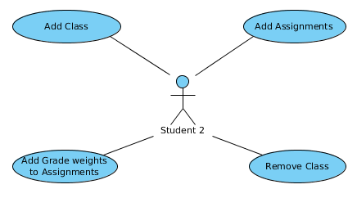
Use Cases

Slide 6
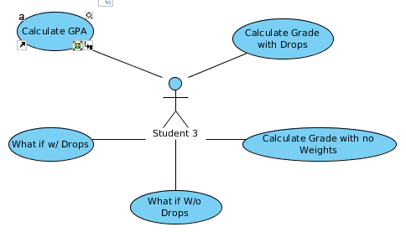
Use Cases

Slide 7
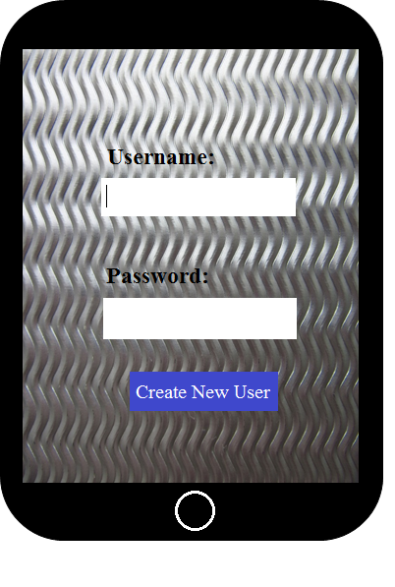
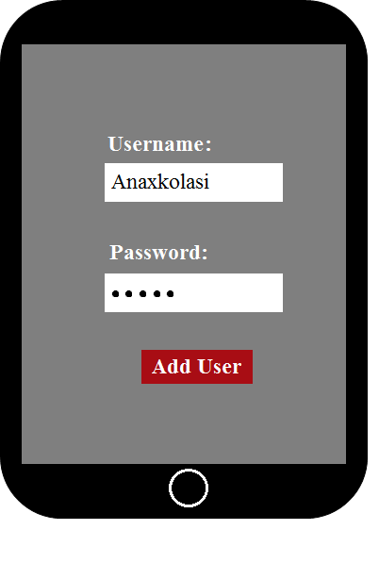
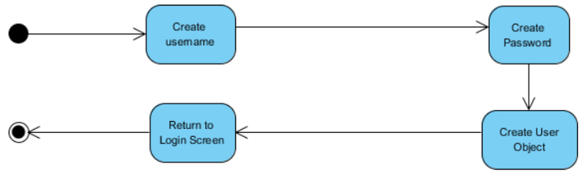
Play-by-play
Create User

Slide 8
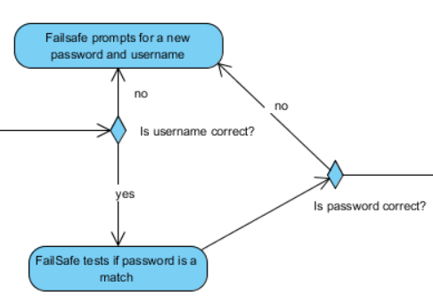
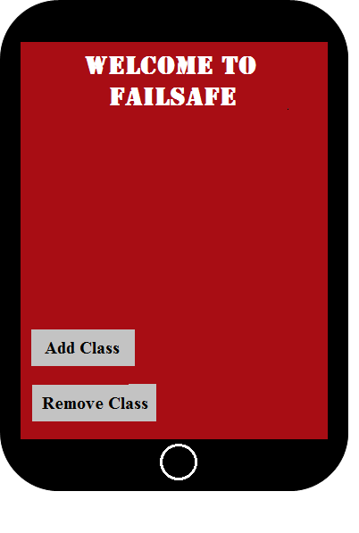
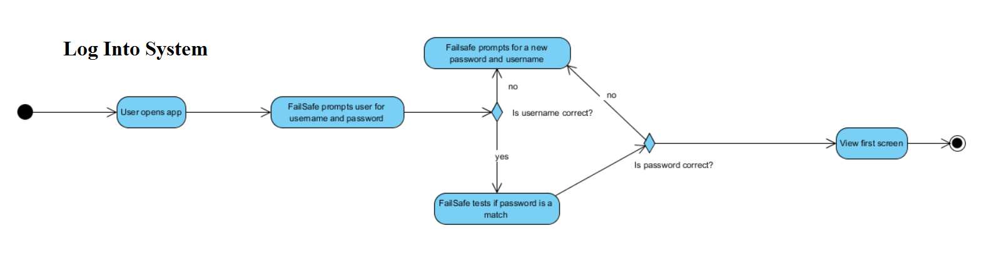
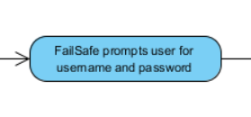
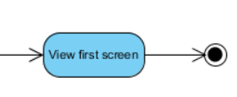
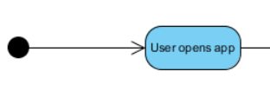
Log into System

Slide 9
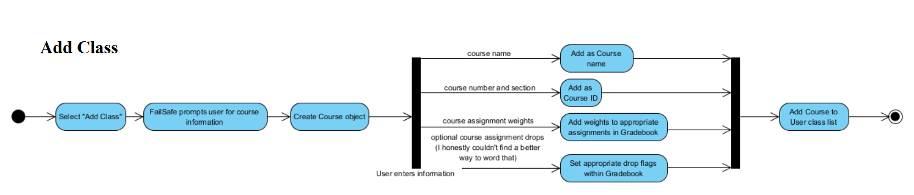
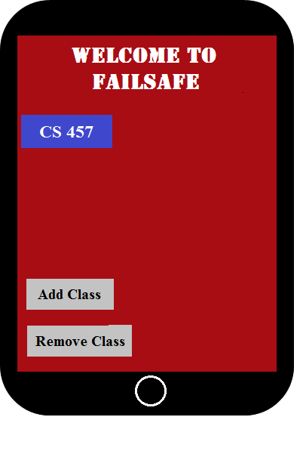
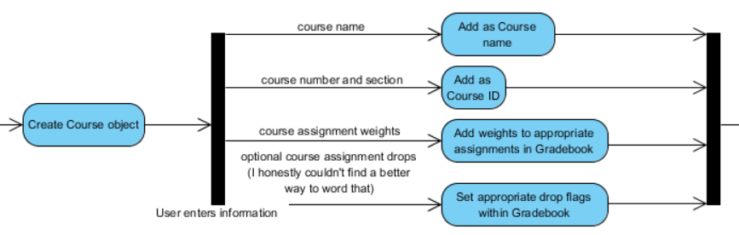
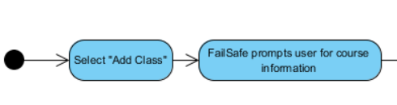
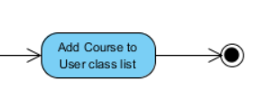
Add Class

Slide 10
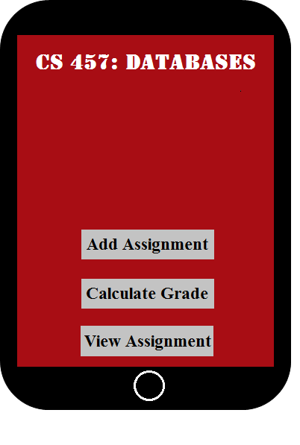
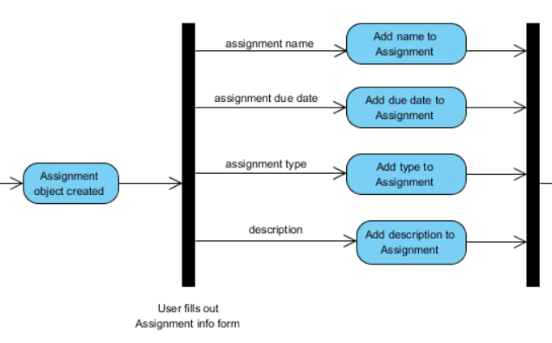
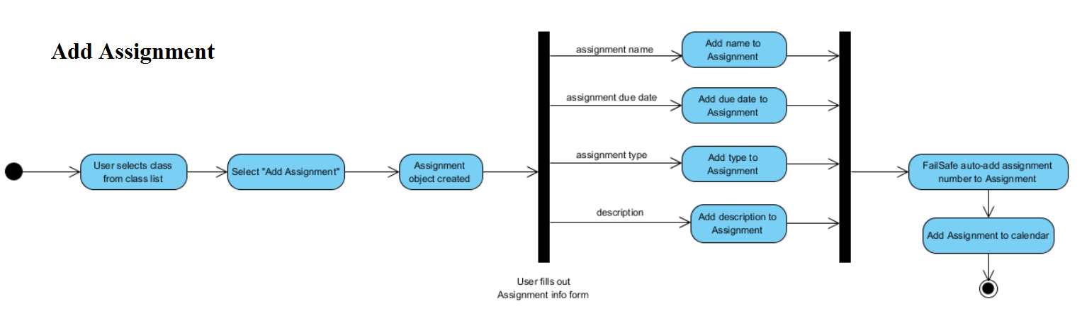
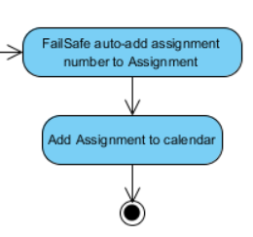
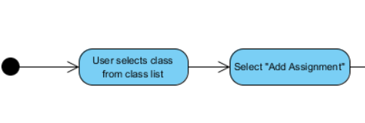
Add Assignment

Slide 11
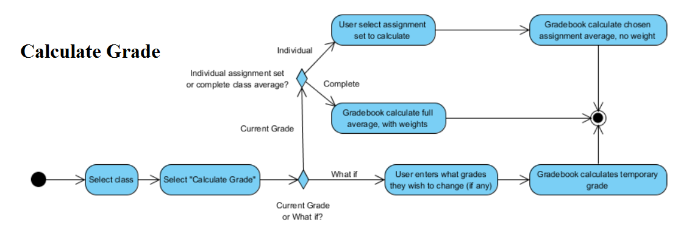
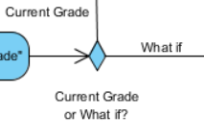
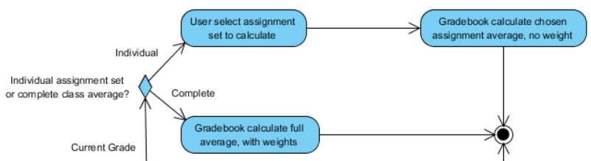
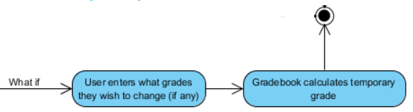

Calculate Grade

Slide 12
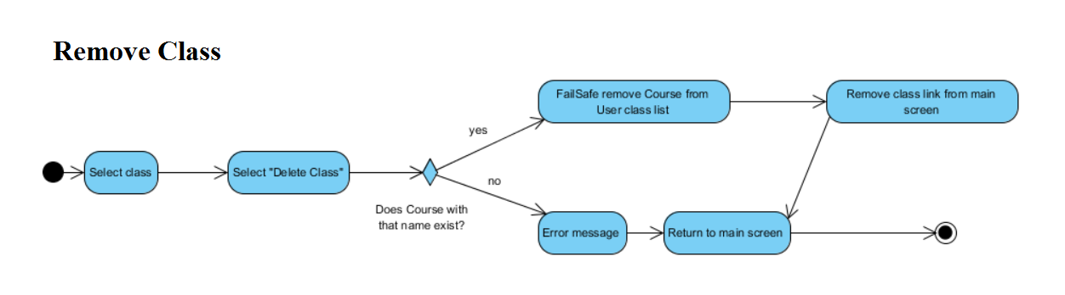
Remove Class

Slide 13
Priorities
User will definitely be able to: | User will hopefully be able to: | User will one day be able to:
Add classes | Add/view assignments to in-app calendar | Interact with other users
Add and track assignments |  | Have access to teacher specific tools, such as adding class-wide assignments
Calculate weighted and unweighted grades |  | Find buildings with interactive map
Calculate possible grades with What If feature

Slide 14
Potential Risks
Application may not be completed to specifications by the requested deadline in the case that all team members contract a deadly disease.
Application may not be able to sync with University of Alabama’s systems to access list of available classes.

Slide 15
Inside Perspective
How do we feel the project is going?
Not too bad all things considered.

Slide 16
¿Preguntas?

