Slide 1

In a school where assignment grades cannot be viewed online, students quake in fear of one day: the Final Drop Date (October 26, btw. Just so you know). They tremble in fear of the unknown. Will they be able to withstand the remainder of their course? Or will they fall in agony from the dreaded unsatisfactory final average? Who can save them from this tragedy? Is there no hope for their GPAs?

Slide 2


Fail afe
Featuring:
Jordan Gill, Autumn Jackson, Bre Tucker

Slide 3
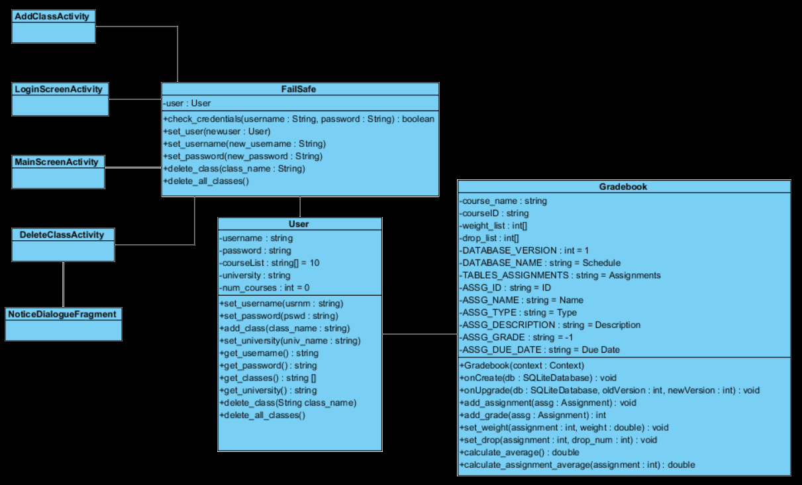
About Our Cast

Slide 4
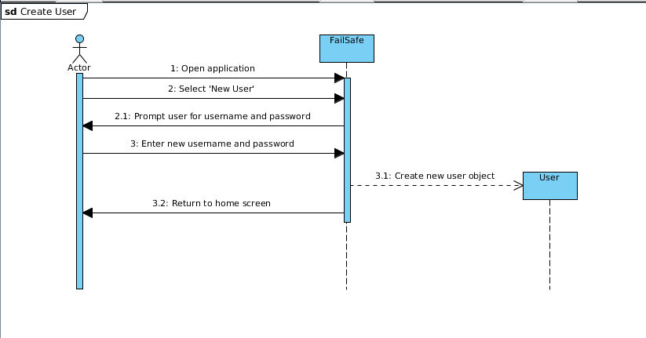
Scene 1 : Create User

Slide 5
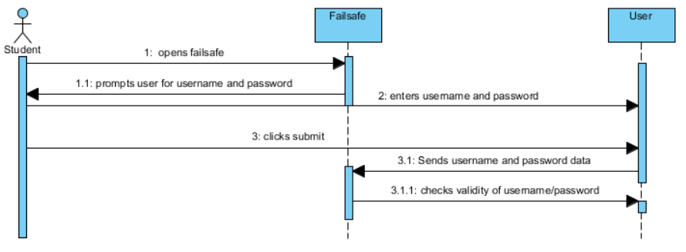
Scene 2 : Log into System

Slide 6
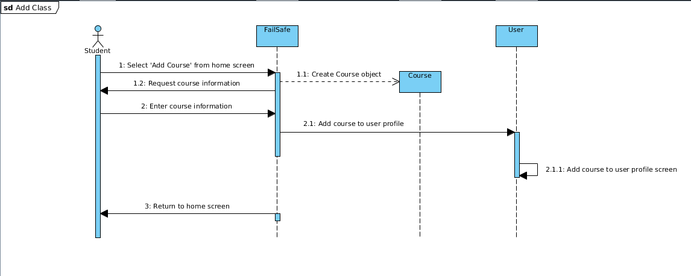
Scene 3 : Add Class

Slide 7
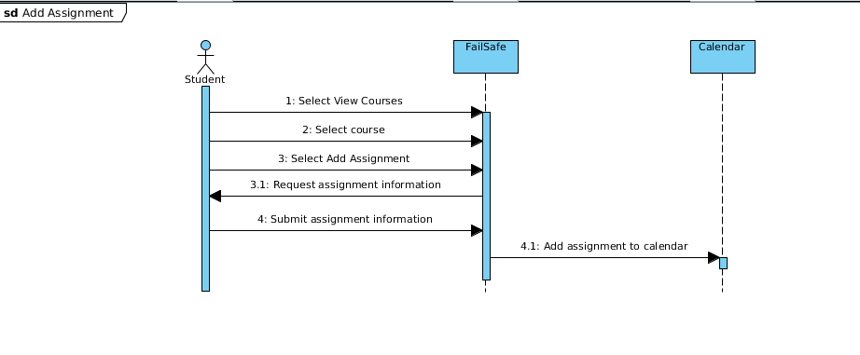
Scene 4 : Add Assignment

Slide 8
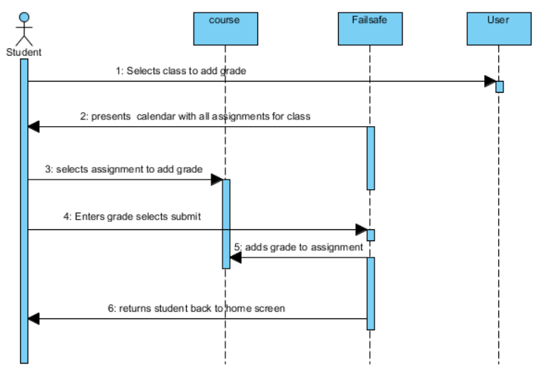
Scene 5 : Add Grade

Slide 9
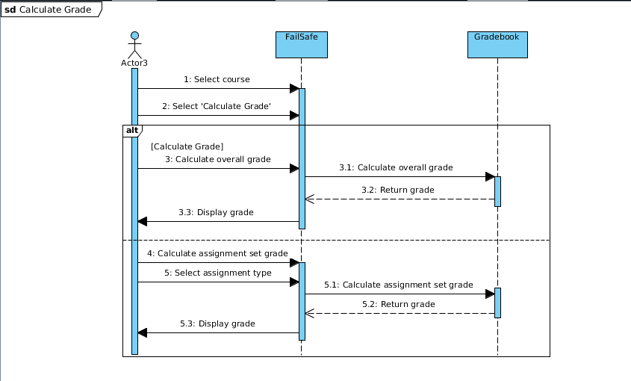
Scene 6 : Calculate Grade

Slide 10
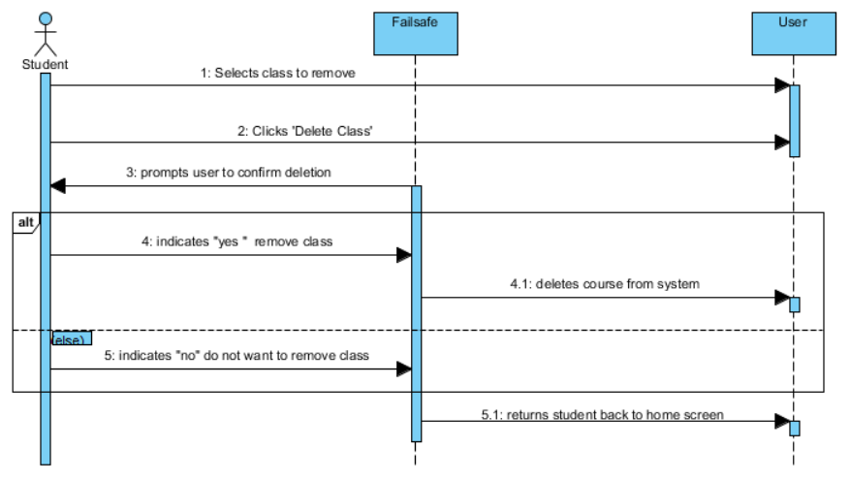
Scene 7 : Delete Class

Slide 11
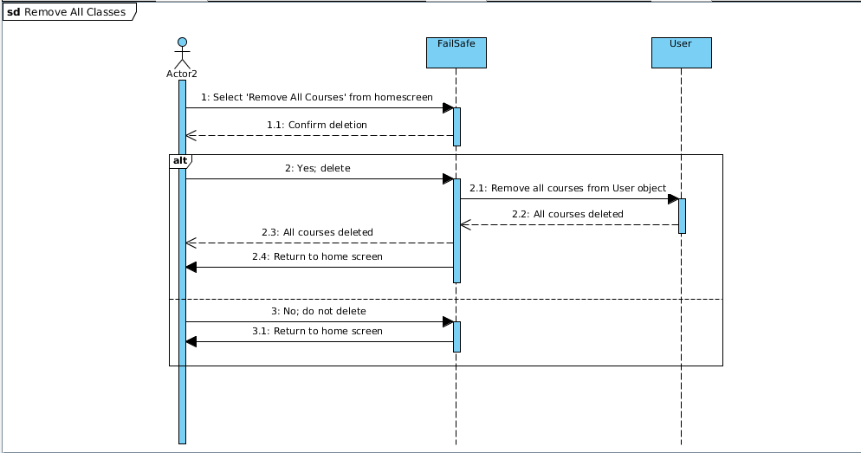
Scene 8 : Delete All Classes

Slide 12
Plot Twists
We went from doing an array based structure to a database for storing the Assignment information and grades
Database is more sophisticated
Database is more efficient because querying
Realising everything has to be done thru various activity classes
Serialised object passing
Upgrade in graphics

Slide 13
Plot Twists: The Sequel
86’d Course and Assignment

Slide 14
Directors’ Commentary

Slide 15

QuEStiOnS???

