Slide 1


A State Management and Persistency Architecture for Peer-to-Peer Massively Multi-user Virtual Environments
John Gilmore
February 2013

Slide 2
Outline
Peer-to-peer Massively Multi-user Virtual Environments (P2P MMVEs)
State consistency
State management and persistency
Pithos design
Pithos implementation
Pithos evaluation

Slide 3
Massively Multi-user Virtual Environments (MMVEs)
Online virtual worlds
Hosting thousands of users
Example: Massively Multiplayer Online Games
$2.6 billion industry in USA alone
21 million active subscribers in 2011
Complex networked application
Real-time requirements

Slide 4

MMVE examples: Eve Online

Slide 5

MMVE examples: World of Warcraft

Slide 6
Issues of Client/Server MMEs
High cost of robustness
High cost of scalability
High operator cost
Low responsiveness
High amount of required server bandwidth
Weak handling of transient loads

Slide 7
P2P MMVE proposal
Increased robustness
Improved scalability
Lower operator costs
Improved handling of transient loads
Improved responsiveness
Abundance and availability of resources
Resistance to faults and attacks

Slide 8
Peer-to-peer (P2P) networks
High degree of decentralisation
Self-organisation
Multiple administrative domains
P2P routing overlay

Slide 9
Challenges of P2P MMVEs
Cheating mitigation
Peer bandwidth
Incentive mechanisms
Distributed computation
State consistency

Slide 10
State consistency: terminology
Virtual Environment
Environment state
Authoritative and non-authoritative objects
Agents and avatars
Events
Environment logic
Updates

Slide 11
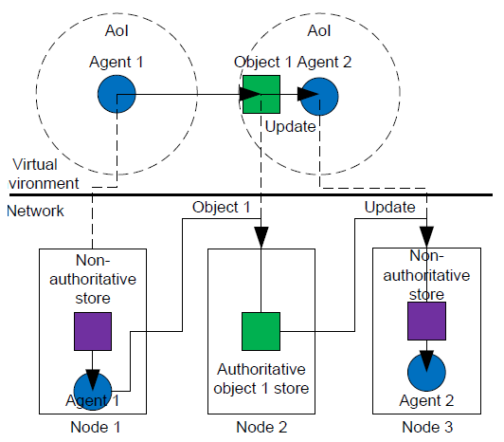
State consistency: Object creation

Slide 12
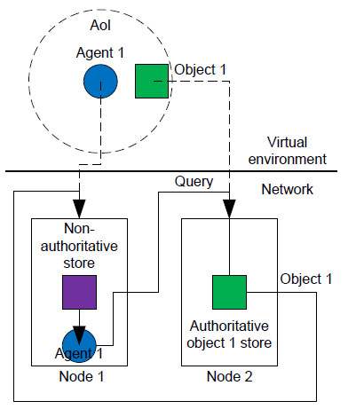
State consistency: Object query

Slide 13
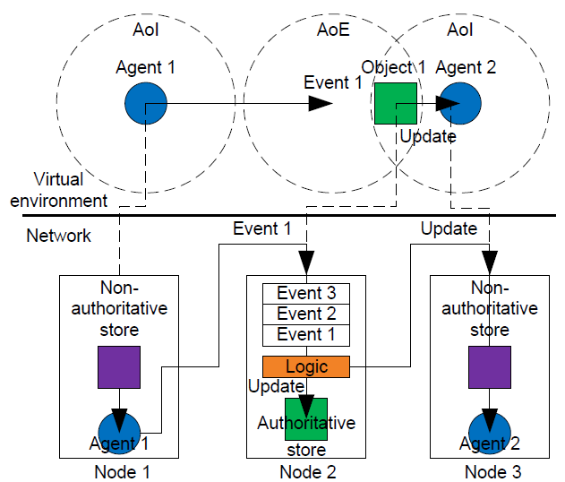
State consistency: Object update

Slide 14
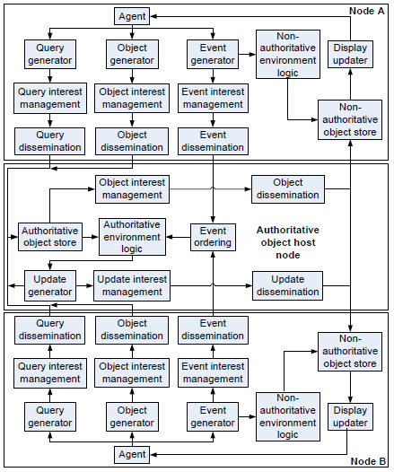
Generic state consistency model

Slide 15
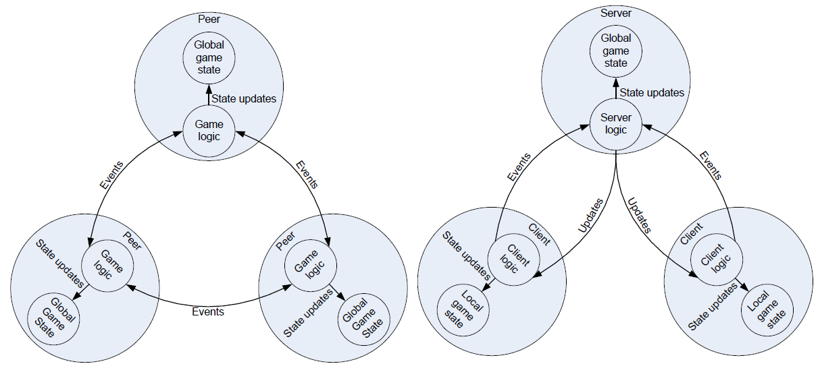
Classic state consistency

Slide 16
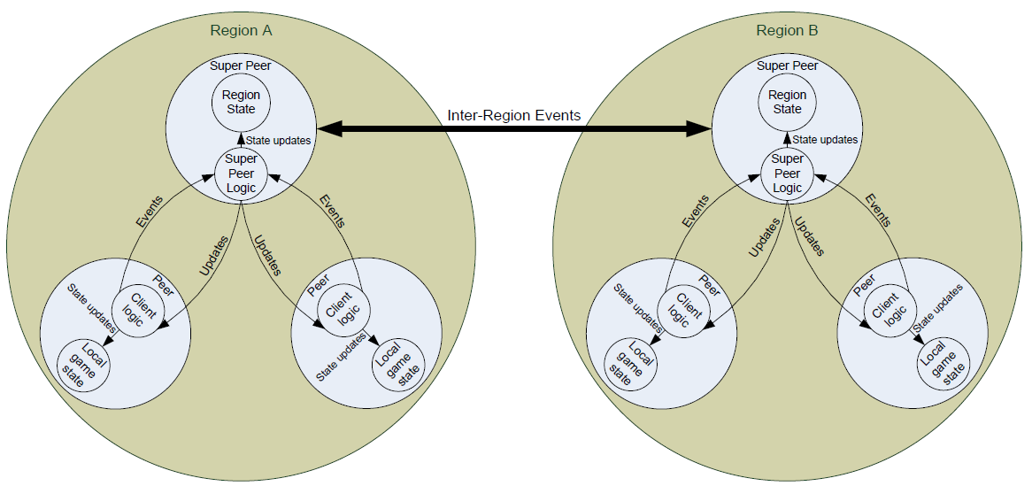
P2P MMVE state consistency

Slide 17
State management and persistency
Storage of short-term and long-term object states.
Apply generated or received object updates to objects housed on a node.
Supply information of object states to the environment logic.

Slide 18
MMVE storage requirements
Scalability
Fairness
Reliability
Responsiveness
Security
Overhead

Slide 19
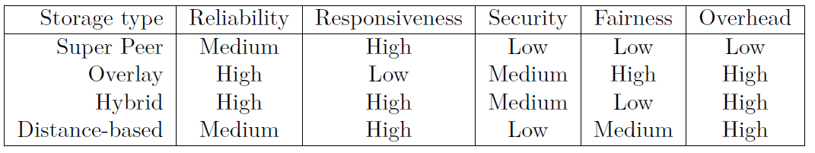
P2P MMVE storage types

Slide 20
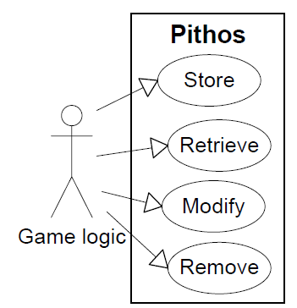
Pithos design
Fulfil P2P MMVE state management and persistency requirements
Combine multiple storage models in such a way that the disadvantages are removed.
Satisfy the use cases

Slide 21
Pithos characteristics
Group storage
Fully connected
Distance-based storage
Replication and repair
Overlay storage
Certification
Quorum

Slide 22
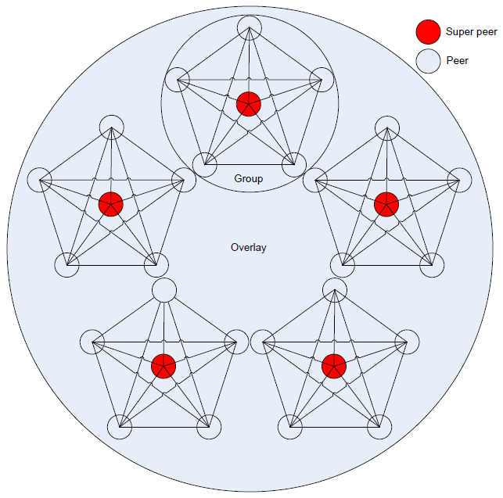
Pithos geometry

Slide 23
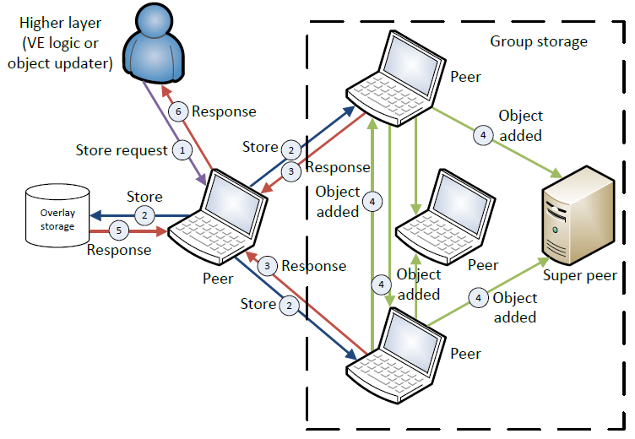
Pithos store request

Slide 24
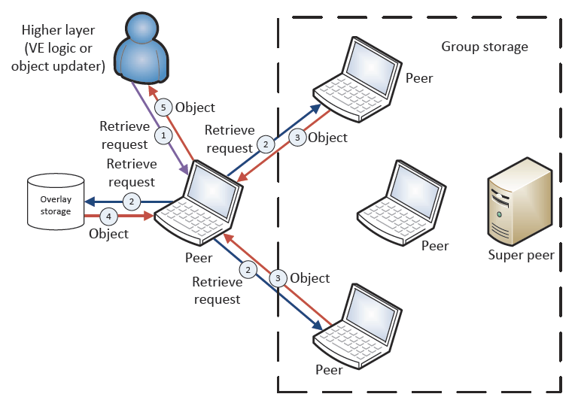
Pithos retrieve request

Slide 25
Pithos Oversim simulation
Implemented in Oversim, based on the Omnet++ network simulator.
Oversim contains multiple underlay models
Oversim implements many P2P routing overlays (Pastry, Chord, Kademlia)
Statistics collection framework of Omnet++
Contains a DHT storage implementation

Slide 26
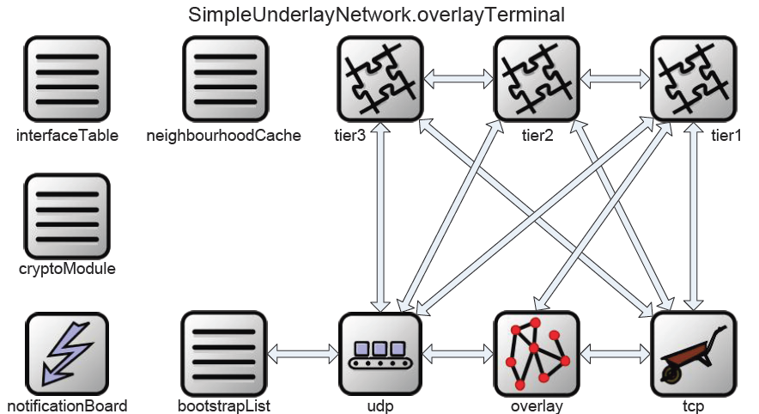
Oversim architecture

Slide 27
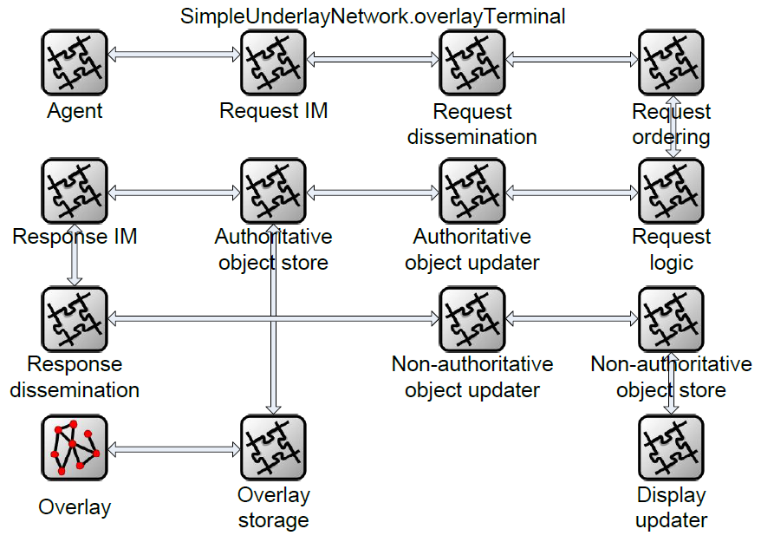
Extended Oversim architecture

Slide 28
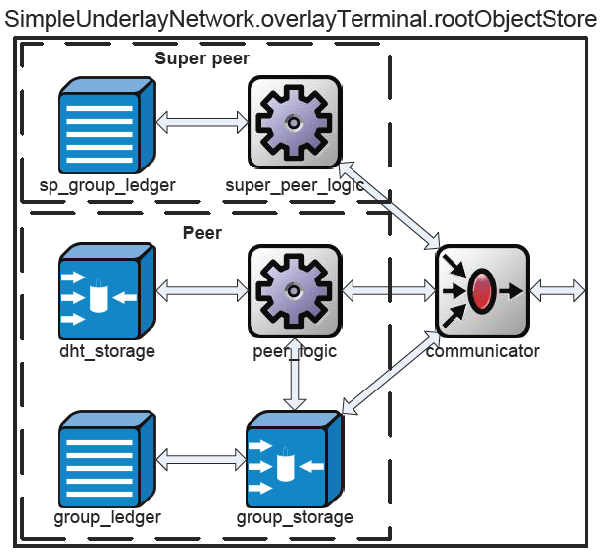
Pithos Oversim architecture

Slide 29
Pithos evaluation
2500 peers, 100 super peers
5 million storage and retrieval requests
600,000 objects stored
5s per request per node
Coordinate-based underlay network
Exponential node lifetimes with 1800s mean
1024 byte objects with 300s TTL
Chord routing overlay

Slide 30
Evaluating storage and retrieval
Fast storage, fast retrieval
100% group probability
No malicious nodes
1800s node lifetime

Slide 31
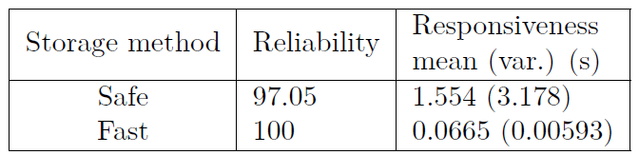
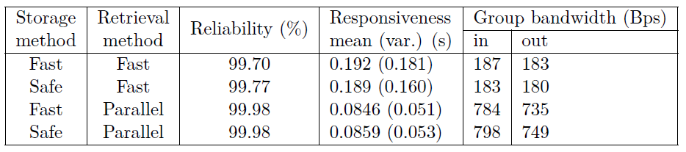
Group storage and retrieval performance

Slide 32
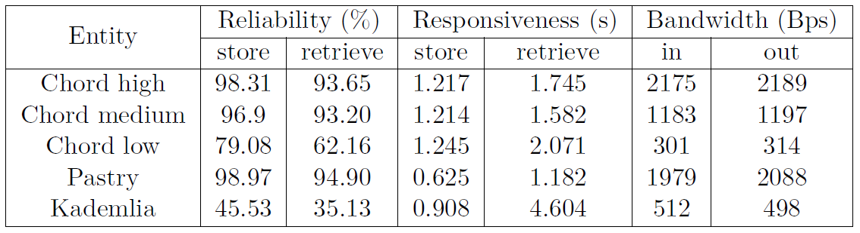
Overlay storage and retrieval performance

Slide 33
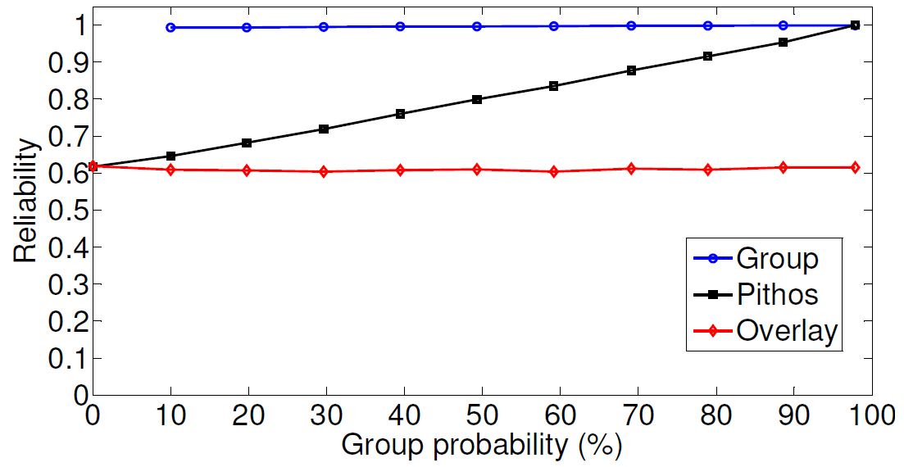
Group probability: Reliability

Slide 34
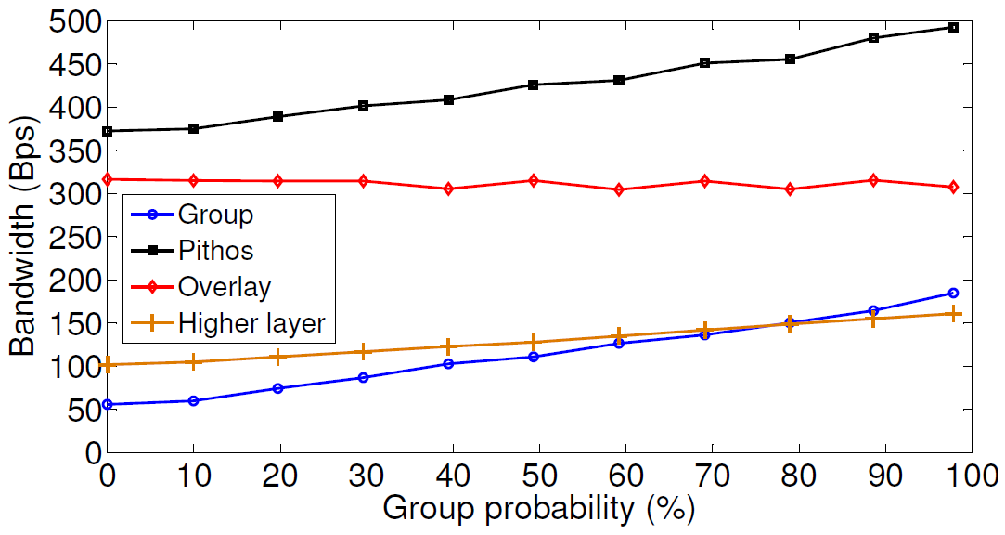
Group probability: Bandwidth

Slide 35
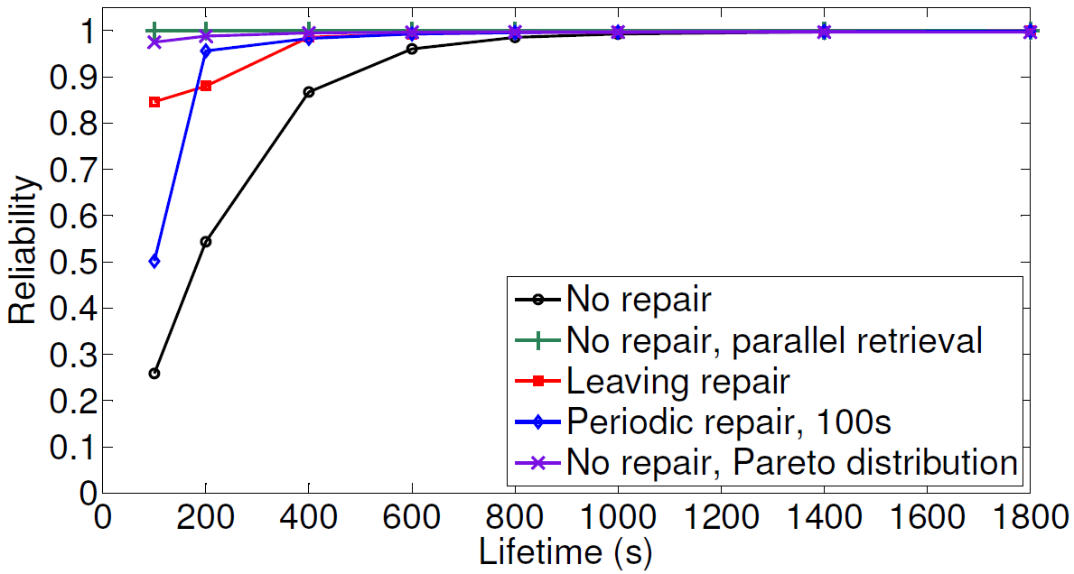
Node lifetime: Reliability

Slide 36
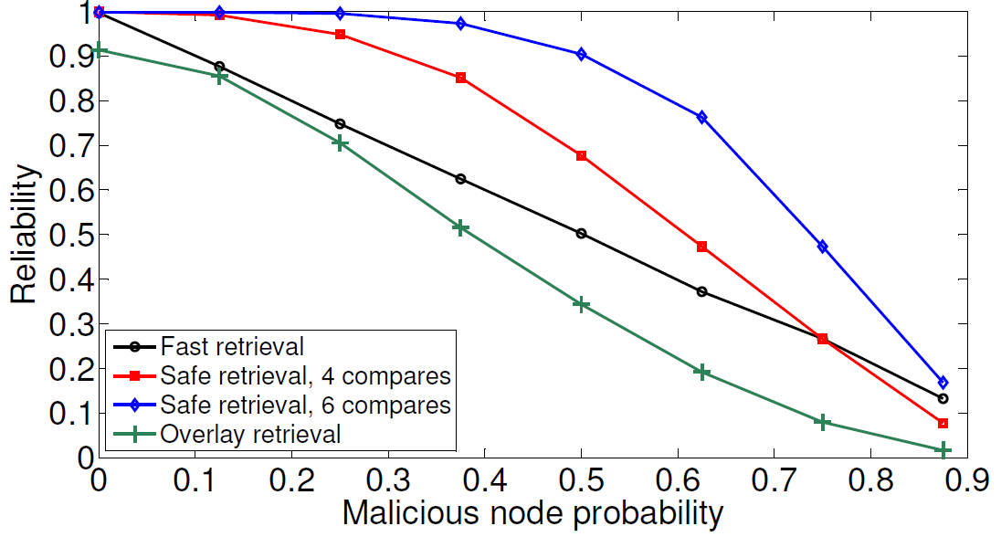
Malicious nodes: Reliability

Slide 37
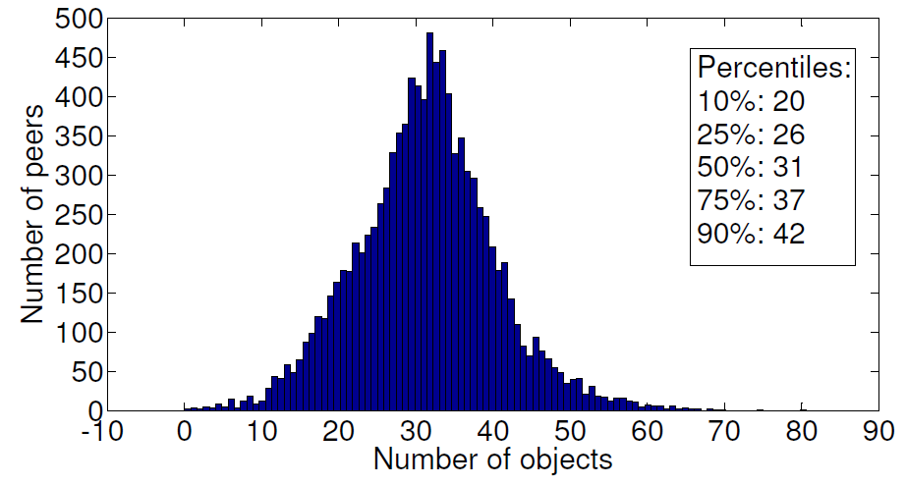
Pithos fairness

Slide 38
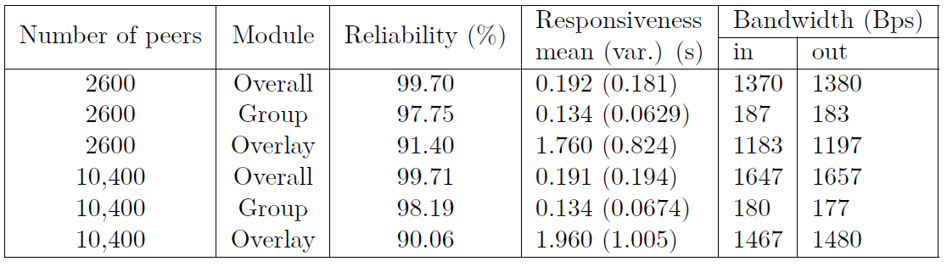
Pithos scalability

Slide 39
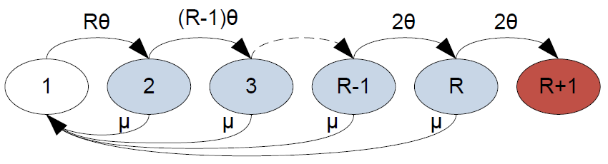
Modelling object lifetimes
It would be helpful to design Pithos (and any distributed storage) with a specific reliability.
Reliability depends on object lifetimes.
Reliability engineering can help with that:

Slide 40
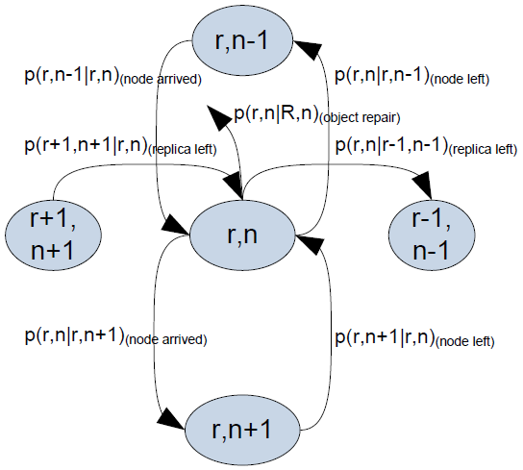
Extending the classic model
But Pithos makes use of groups to store data.
These groups might be limited in size, which might affect object lifetime.
Model object lifetime by extending the classic model:

Slide 41
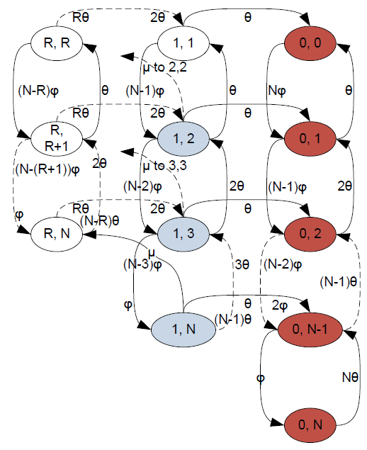
The model
White states are initial states
Red states are absorption states
Blue states are interior states

Slide 42
The model
White states are initial states
Red states are absorption states
Blue states are interior states

Slide 43
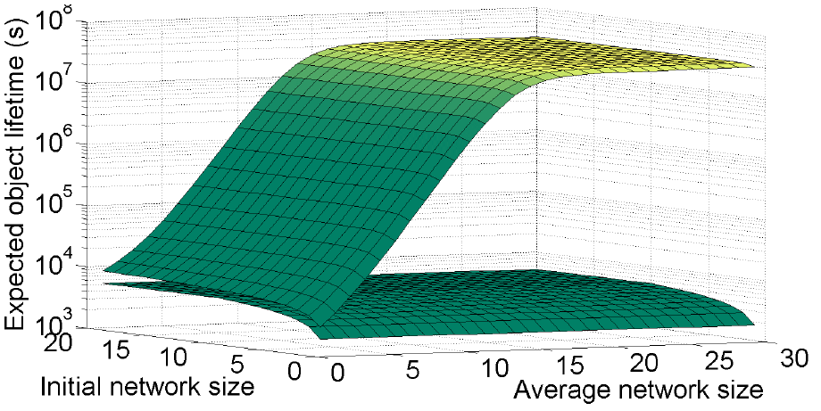
Lifetimes for initial and average network sizes

Slide 44
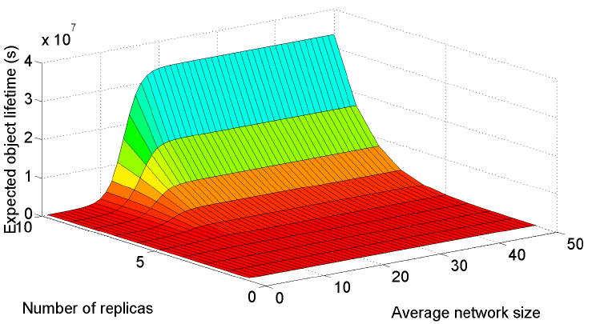
Lifetimes for initial and average network sizes

Slide 45
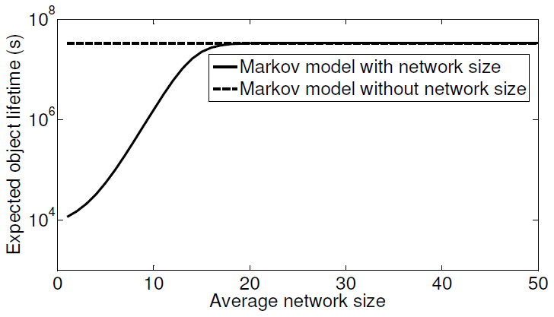
Lifetimes for initial and average network sizes

Slide 46
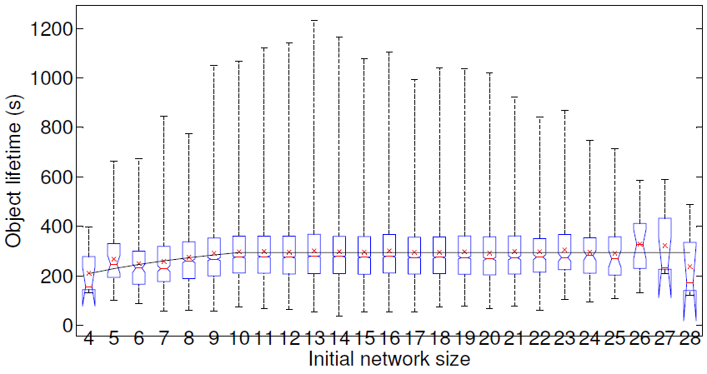
Lifetimes for initial and average network sizes

Slide 47
Conclusion
Developed a generic state consistency model for MMVEs.
Investigated issue of state management and state persistency for P2P MMVEs.
Found that highly scalable, fair and highly responsive storage is still lacking.
Developed Pithos to satisfy identified storage requirements for P2P MMVEs.
Evaluated Pithos as an Oversim simulation

