Slide 1
Pithos: A State Persistency Architecture for Peer-to-Peer Massively Multiuser Virtual Environments
Authors: John S. Gilmore
Herman A. Engelbrecht

Slide 2
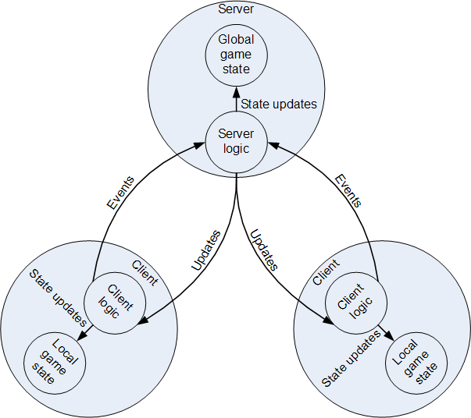
Update-based consistency model

Slide 3
P2P MMVE Challenges
Interest management
Game event dissemination
Non-player character (NPC) hosting
Game state persistency
Cheating mitigation
Incentive mechanisms

Slide 4
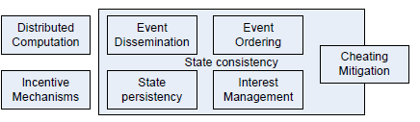
Consistency challenges
Event dissemination
Event ordering
State persistency
Interest management
Cheating mitigation

Slide 5
State persistency
Storage of game objects
Game objects can be stored in primary (state management) or secondary storage
State persistency is treated as a sub-domain of state consistency
State persistency remains relatively unaddressed

Slide 6
State persistency requirements
Scalability
Reliability
Fairness
Responsiveness
Security

Slide 7
State persistency types
Super peer storage
Overlay storage
Super peer-overlay hybrid storage
Distance-based storage

Slide 8
Storage type comparison
Type | Reliability | Fairness | Responsiveness | Security
Super peer | Yes | No | Yes | No
Overlay | Yes | Yes | No | Yes
Super peer-overlay hybrid | Yes | No | Yes | Yes
Distance-based | No | Yes | Yes | No

Slide 9
Observations guiding innovation
Hybridisation can produce storage models with fewer disadvantages than the sum of their parts.
Responsiveness is increased in a fully distributed model.
Fully distributed models are not inherently scalable.

Slide 10
Pithos characteristics
Grouping
Replication
Distance-based storage
Secure storage and node ID assignments

Slide 11
Grouping

Slide 12
Replication

Slide 13
Distance-based storage

Slide 14
Secure storage and node ID assignments

Slide 15
Pithos evaluation
Simulation model description
Responsiveness
Fairness

Slide 16
Conclusion

Slide 17
Future work

