Slide 1
JSgram
design
by Lv-430.NodeJS

Slide 2
Inspiration

Slide 3


Slide 4


Slide 5


Slide 6


Slide 7
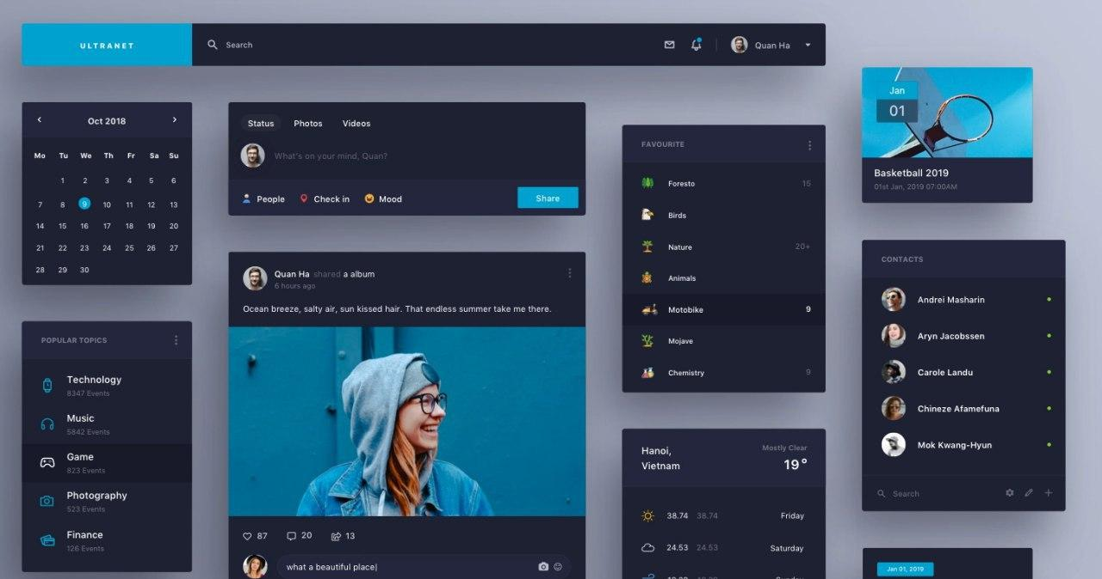

Slide 8
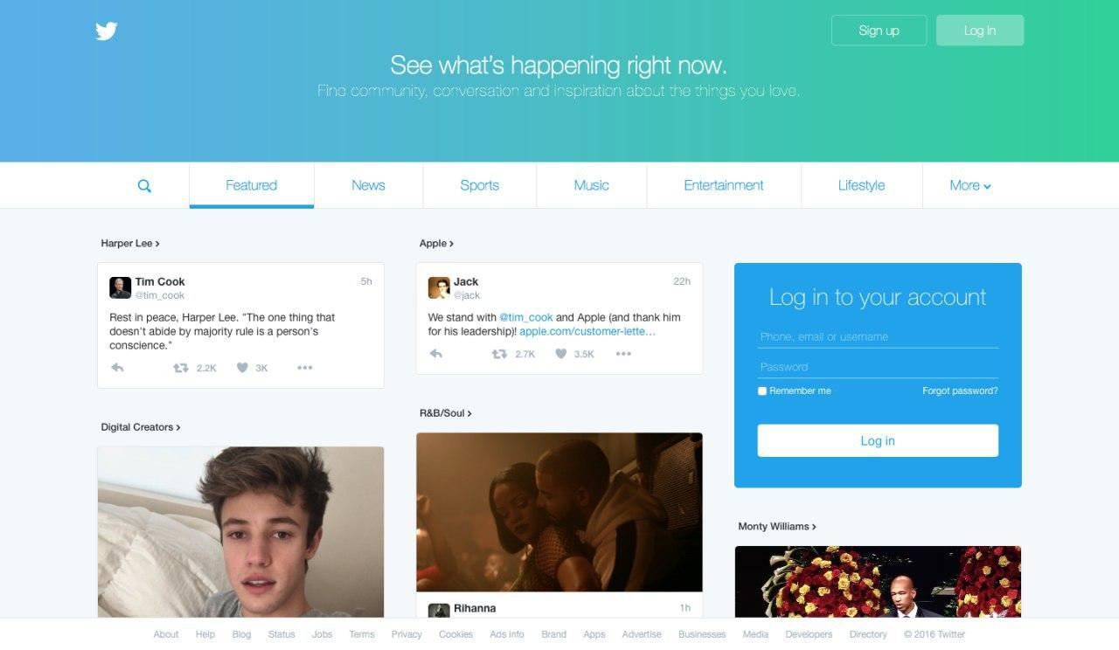

Slide 9
Prototype

Slide 10


Slide 11
Design

Slide 12
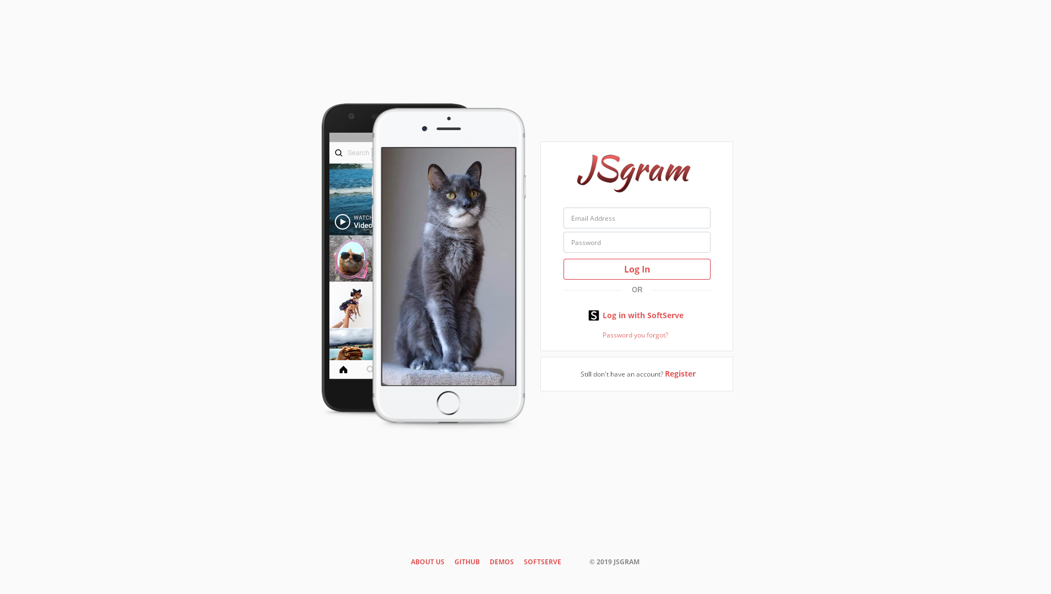

Slide 13
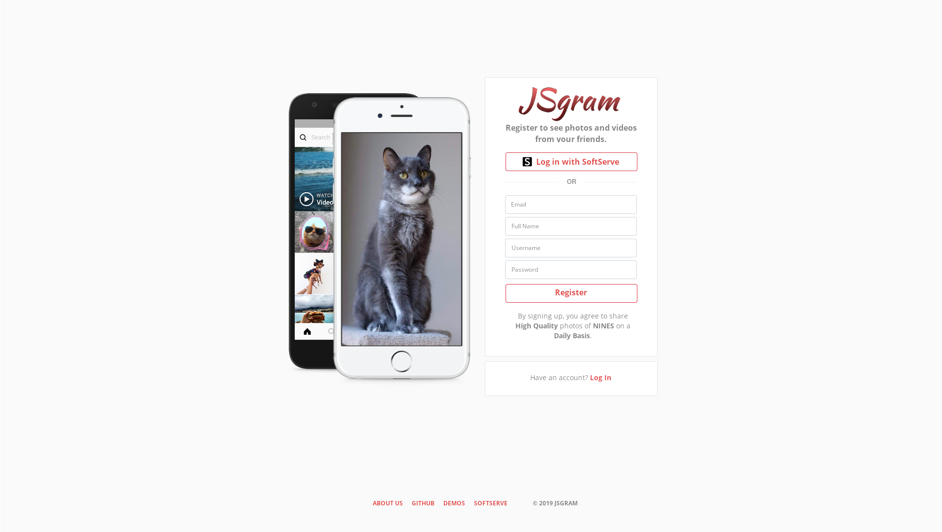

Slide 14
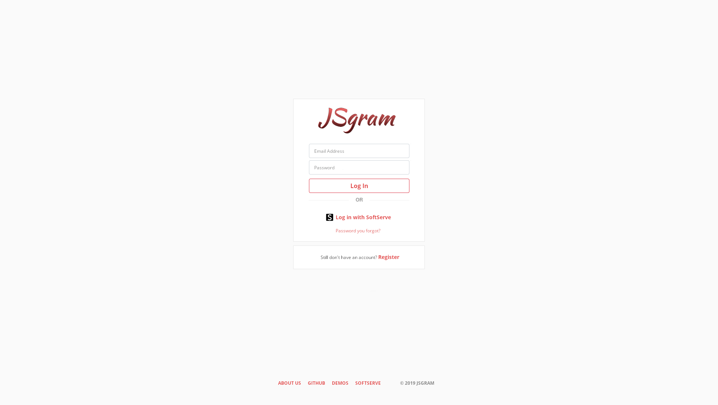

Slide 15


Slide 16
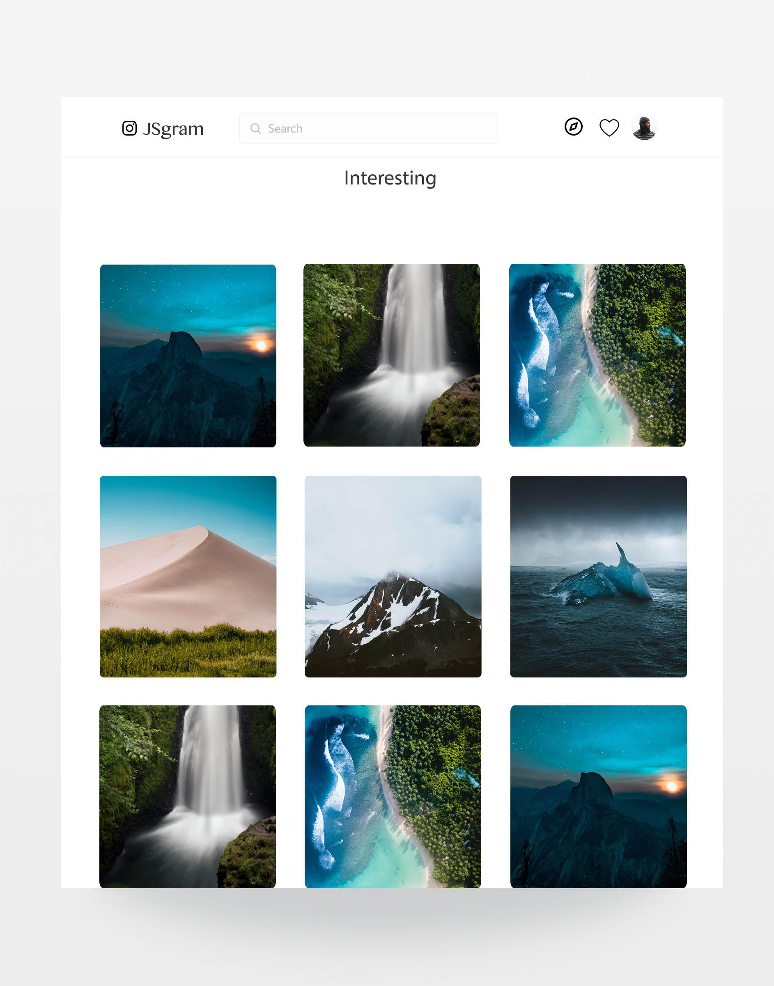

Slide 17
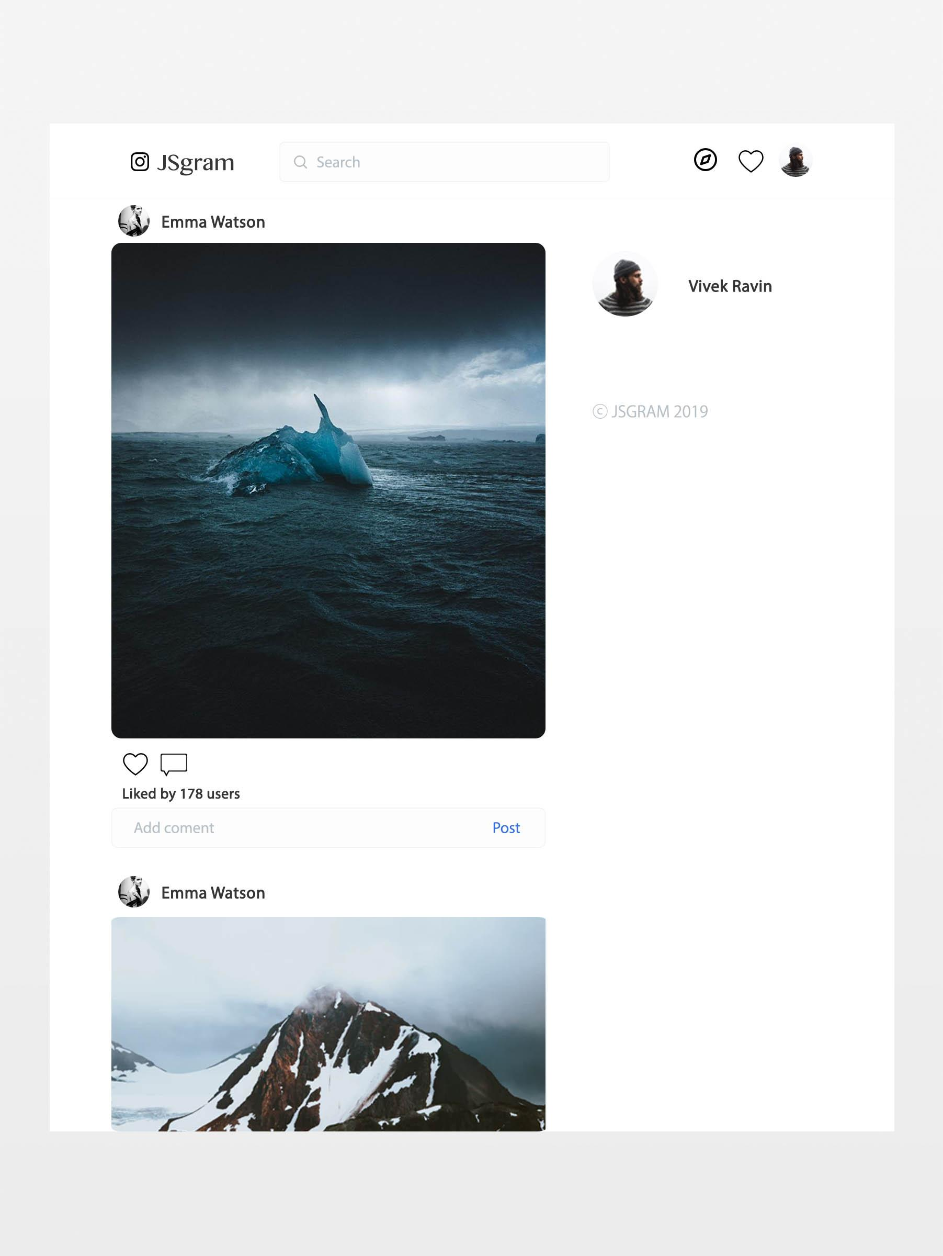

Slide 18
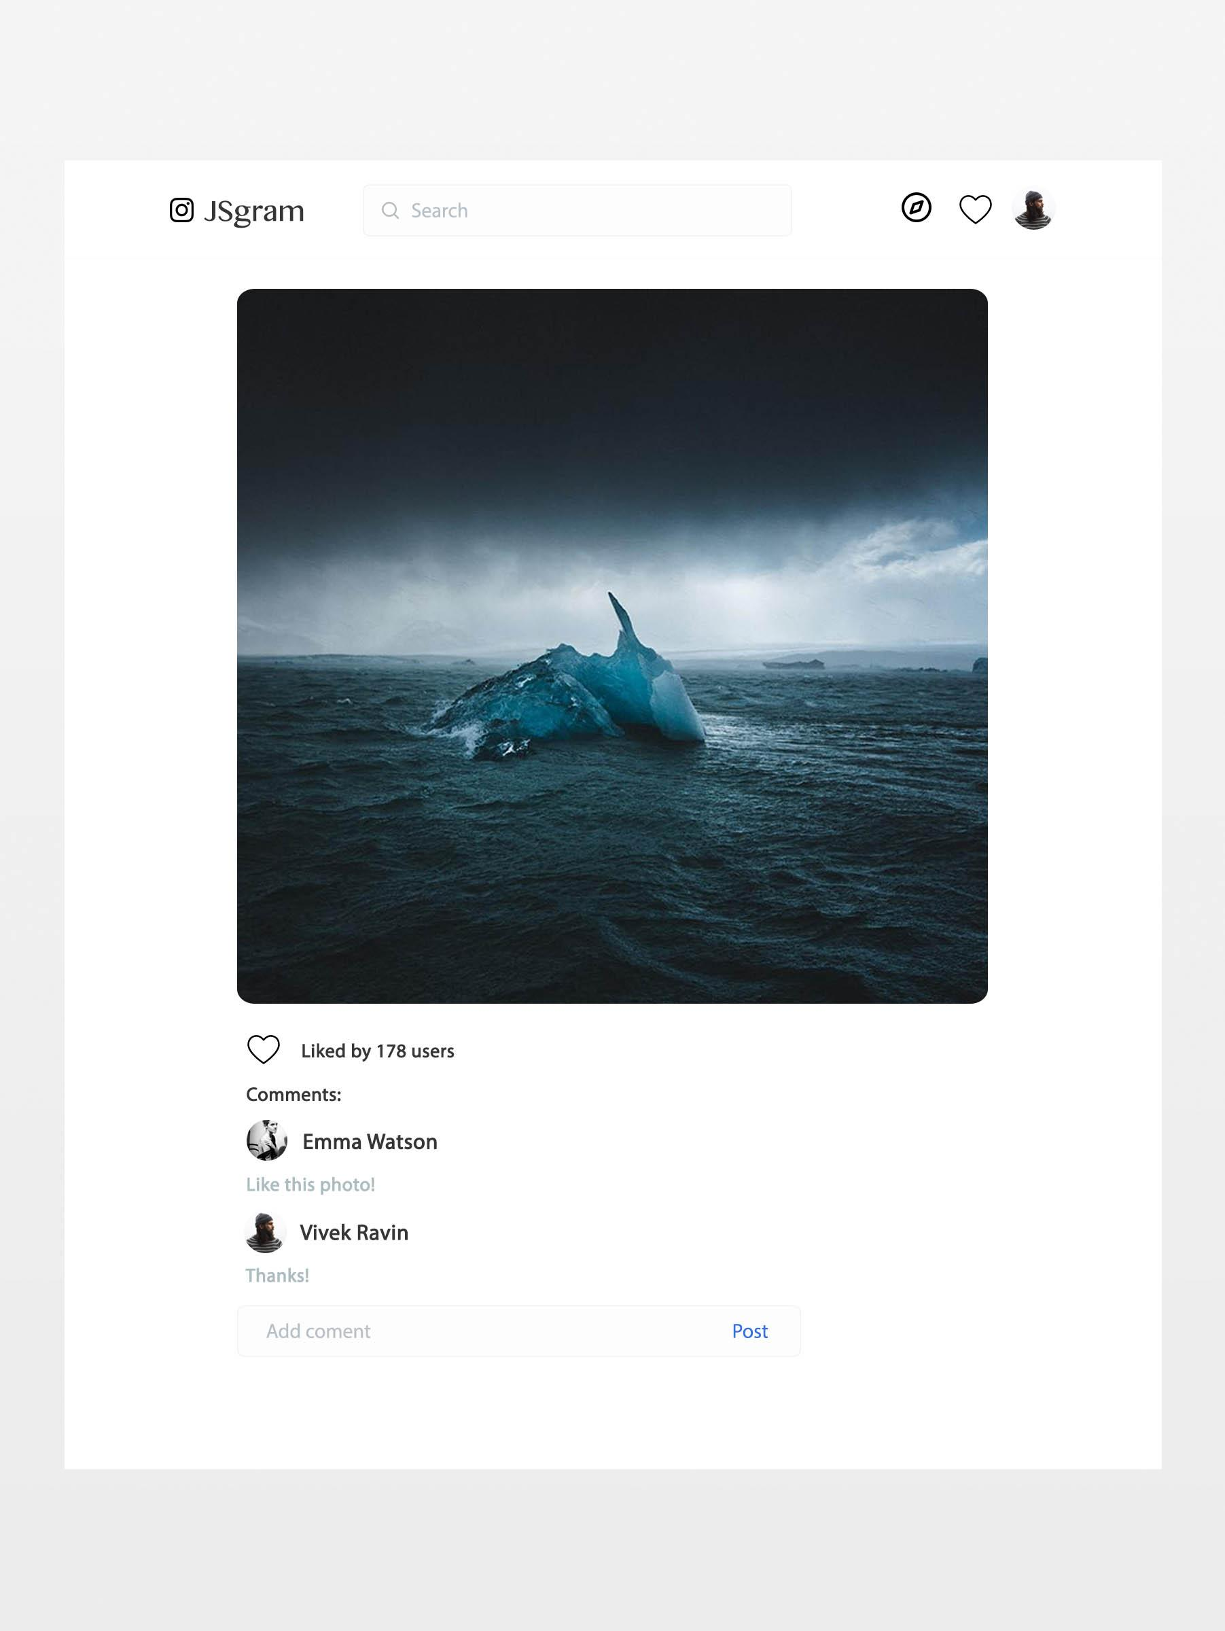

Slide 19
