Slide 1
Exact File Check File-5
Example file for checking if two files are the same exact file or not. This file has different content.
Notes:
This is a notes field for exact file checking.

Slide 2
Slide Two
Header 1 | Header 2
One | Two
Three | Four

Slide 3
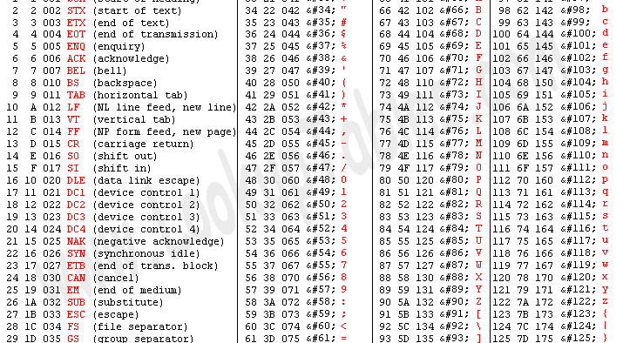
Slide 3.0

